Slide 1
CSCI-1680
Some Alternatives
Rodrigo Fonseca
Based partly on lecture notes by Scott Shenker and John Jannotti

Slide 2
Alternatives
P2P
  Focus on scalable routing on flat names
Erasure Coding
  Alternative to ACK-based reliability
Information-Centric Networking
  Alternative to pair-based communication

Slide 3
Peer-to-Peer Systems
How did it start?
  A killer application: file distribution
  Free music over the Internet! (not exactly legal…)
Key idea: share storage, content, and bandwidth of individual users
  Lots of them
Big challenge: coordinate all of these users
  In a scalable way (not NxN!)
  With changing population (aka churn)
  With no central administration
  With no trust
  With large heterogeneity (content, storage, bandwidth,…)

Slide 4
3 Key Requirements
P2P Systems do three things:
Help users determine what they want
  Some form of search
  P2P version of Google
Locate that content
  Which node(s) hold the content?
  P2P version of DNS (map name to location)
Download the content
  Should be efficient
  P2P form of Akamai

Slide 5

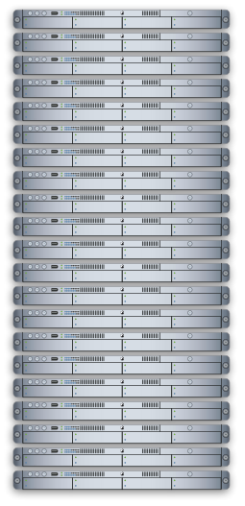

Napster (1999)
xyz.mp3

Slide 6
Napster
xyz.mp3
xyz.mp3 ?

Slide 7
Napster
xyz.mp3
xyz.mp3 ?

Slide 8
Napster
xyz.mp3
xyz.mp3 ?

Slide 9
Napster
Search & Location: central server
Download: contact a peer, transfer directly
Advantages:
  Simple, advanced search possible
Disadvantages:
  Single point of failure (technical and … legal!)
  The latter is what got Napster killed

Slide 10

Gnutella: Flooding on Overlays (2000)
Search & Location: flooding (with TTL)
Download: direct
xyz.mp3
xyz.mp3 ?
An “unstructured” overlay network

Slide 11
Gnutella: Flooding on Overlays
xyz.mp3
xyz.mp3 ?
Flooding

Slide 12
Gnutella: Flooding on Overlays
xyz.mp3
xyz.mp3 ?
Flooding

Slide 13
Gnutella: Flooding on Overlays
xyz.mp3

Slide 14
KaZaA: Flooding w/ Super Peers (2001)
Well connected nodes can be installed (KaZaA) or self-promoted (Gnutella)

Slide 15
Say you want to make calls among peers
You need to find who to call
  Centralized server for authentication, billing
You need to find where they are
  Can use central server, or a decentralized search, such as in KaZaA
You need to call them
  What if both of you are behind NATs? (only allow outgoing connections)
  You could use another peer as a relay…

Slide 16

Skype
Built by the founders of KaZaA!
Uses Superpeers for registering presence, searching for where you are
Uses regular nodes, outside of NATs, as decentralized relays
  This is their killer feature
This morning, from my computer:
  29,565,560 people online

Slide 17
Lessons and Limitations
Client-server performs well
  But not always feasible
Things that flood-based systems do well
  Organic scaling
  Decentralization of visibility and liability
  Finding popular stuff
  Fancy local queries
Things that flood-based systems do poorly
  Finding unpopular stuff
  Fancy distributed queries
  Vulnerabilities: data poisoning, tracking, etc.
  Guarantees about anything (answer quality, privacy, etc.)

Slide 18

BitTorrent (2001)
One big problem with the previous approaches
  Asymmetric bandwidth
BitTorrent (original design)
  Search: independent search engines (e.g. PirateBay, isoHunt)
    Maps keywords -> .torrent file
  Location: centralized tracker node per file
  Download: chunked
    File split into many pieces
    Can download from many peers

Slide 19
BitTorrent
How does it work?
  Split files into large pieces (256KB ~ 1MB)
  Split pieces into subpieces
  Get peers from tracker, exchange info on pieces
Three-phases in download
  Start: get a piece as soon as possible (random)
  Middle: spread pieces fast (rarest piece)
  End: don’t get stuck (parallel downloads of last pieces)

Slide 20
BitTorrent
Self-scaling: incentivize sharing
  If people upload as much as they download, system scales with number of users (no free-loading)
Uses tit-for-tat: only upload to those who give you data
  Choke most of your peers (don’t upload to them)
  Order peers by download rate, choke all but P best
  Occasionally unchoke a random peer (might become a nice uploader)
Optional reading:
[Do Incentives Build Robustness in BitTorrent? Piatek et al, NSDI’07]

Slide 21
Structured Overlays: DHTs
Academia came (a little later)…
Goal: Solve efficient decentralized location
  Remember the second key challenge?
  Given ID, map to host
Remember the challenges?
  Scale to millions of nodes
  Churn
  Heterogeneity
  Trust (or lack thereof)
    Selfish and malicious users

Slide 22
DHTs
IDs from a flat namespace
  Contrast with hierarchical IP, DNS
Metaphor: hash table, but distributed
Interface
  Get(key)
  Put(key, value)
How?
  Every node supports a single operation:
  Given a key, route messages to node holding key

Slide 23

Identifier to Node Mapping Example
Node 8 maps [5,8]
Node 15 maps [9,15]
Node 20 maps [16, 20]
…
Node 4 maps [59, 4]
Each node maintains a pointer to its successor
4
58
8
15
44
20
35
32
Example from Ion Stoica

Slide 24
Consistent Hashing-like
But each node only knows about a small number of other nodes (so far only their successors)
4
58
8
15
44
20
35
32

Slide 25
Lookup
lookup(37)
Each node maintains its successor
Route packet (ID, data) to the node responsible for ID using successor pointers
4
58
8
node=44
15
44
20
35
32

Slide 26
Optional: DHT Maintenance

Slide 27
Stabilization Procedure
Periodic operations performed by each node N to maintain the ring:
STABILIZE() [N.successor = M]
N->M: “What is your predecessor?”
M->N: “x is my predecessor”
if x between (N,M), N.successor = x
N->N.successor: NOTIFY()
NOTIFY()
  N->N.successor: “I think you are my successor”
M: upon receiving NOTIFY from N:
  If (N between (M.predecessor, M))
  M.predecessor = N

Slide 28
Joining Operation
Node with id=50 joins the ring
Node 50 needs to know at least one node already in the system
  Assume known node
  is 15
succ=4
pred=44
4
58
8
succ=nil
pred=nil
15
50
44
succ=58
20
pred=35
35
32

Slide 29
Joining Operation
Node 50: send join(50) to node 15
Node 44: returns node 58
Node 50 updates its successor to 58
succ=4
pred=44
4
58
8
join(50)
succ=58
succ=nil
pred=nil
15
58
50
44
succ=58
20
pred=35
35
32

Slide 30
Joining Operation
Node 50: send stabilize() to node 58
Node 58:
  Replies with 44
  50 determines it is the right predecessor
succ=4
pred=44
4
58
“my predecessor is 44
8
stabilize():
“What is your predecessor?”
succ=58
pred=nil
15
50
44
succ=58
20
pred=35
35
32

Slide 31
Joining Operation
Node 50: send notify() to node 58
Node 58:
  update predecessor to 50
succ=4
pred=50
pred=44
4
58
8
notify():
“I think you are my successor”
succ=58
pred=nil
15
50
44
succ=58
20
pred=35
35
32

Slide 32
Joining Operation
succ=4
Node 44 sends a stabilize message to its successor, node 58
Node 58 replies with 50
Node 44 updates its successor to 50
pred=50
4
58
“my predecessor is 50”
8
stabilize():
“What is your predecessor?”
succ=58
pred=nil
15
50
succ=50
44
succ=58
20
pred=35
35
32

Slide 33
Joining Operation
succ=4
Node 44 sends a notify message to its new successor, node 50
Node 50 sets its predecessor to node 44
pred=50
4
58
8
succ=58
pred=44
pred=nil
15
notify()
50
succ=50
44
20
pred=35
35
32

Slide 34
Joining Operation (cont’d)
This completes the joining operation!
pred=50
4
58
8
succ=58
50
pred=44
15
44
20
succ=50
35
32

Slide 35

Achieving Efficiency: finger tables
Say m=7
Finger Table at 80
0
i ft[i]
0 96
1 96
2 96
3 96
4 96
5 112
6 20
(80 + 2⁶) mod 2⁷ = 16
80 + 2⁵
112
20
96
80 + 2⁴
32
80 + 2³
80 + 2²
80 + 2¹
45
80 + 2⁰
80
ith entry at peer with id n is first peer with id >=

Slide 36
Chord
There is a tradeoff between routing table size and diameter of the network
  You can achieve diameter O(1) with O(n)-entry routing tables
  Max diameter with O(1) routing tables (random walks)
Chord achieves diameter O(log n) with O(log n)-entry routing tables

Slide 37
Many other DHTs
CAN
  Routing in n-dimensional space
Pastry/Tapestry/Bamboo
  (Book describes Pastry)
  Names are fixed bit strings
  Topology: hypercube (plus a ring for fallback)
Kademlia
  Similar to Pastry/Tapestry
  But the ring is ordered by the XOR metric
  Used by BitTorrent for distributed tracker
Viceroy
  Emulated butterfly network
Koorde
  DeBruijn Graph
  Each node connects to 2n, 2n+1
  Degree 2, diameter log(n)
…

Slide 38
Discussion
Query can be implemented
  Iteratively: easier to debug
  Recursively: easier to maintain timeout values
Robustness
  Nodes can maintain (k>1) successors
  Change notify() messages to take that into account
Performance
  Routing in overlay can be worse than in the underlay
  Solution: flexibility in neighbor selection
    Tapestry handles this implicitly (multiple possible next hops)
    Chord can select any peer between [2^{n},2^{n+1}) for finger, choose the closest in latency to route through

Slide 39
Where are they now?
Many P2P networks shut down
  Not for technical reasons!
  Centralized systems work well (or better) sometimes
But…
  Vuze network: Kademlia DHT, millions of users
  Concepts incorporated into many systems (e.g., Amazon’s DynamoDB)
  Skype used to use a P2P network similar to KaZaA
Shown that you can have scalable routing without hierarchy

Slide 40
Where are they now?
DHTs allow coordination of MANY nodes
  Efficient flat namespace for routing and lookup
  Robust, scalable, fault-tolerant
If you can do that
  You can also coordinate co-located peers
  Now dominant design style in datacenters
    E.g., Amazon’s Dynamo storage system
  DHT-style systems everywhere
Similar to Google’s philosophy
  Design with failure as the common case
  Recover from failure only at the highest layer
  Use low cost components
  Scale out, not up

Slide 41
An alternative for reliability
Erasure coding
  Assume you can detect errors
  Code is designed to tolerate entire missing packets
    Collisions, noise, drops because of bit errors
  Forward error correction
Examples: Reed-Solomon codes, LT Codes, Raptor Codes
Property:
  From K source frames, produce B > K encoded frames
  Receiver can reconstruct source with any K’ frames, with K’ slightly larger than K
  Some codes can make B as large as needed, on the fly

Slide 42
Erasure Codes
Motivation: scalability of reliable multicast
  Problem: in large multicast groups, where each receiver misses specific packets, how to coordinate retransmissions?
Erasure codes:
  Any K out of N messages reconstruct original content
Initially:
  Fixed-rate codes (e.g. Reed-Solomon ~ 1960)
    Solve for polynomial of degree K with N linearly independent equations

Slide 43
LT Codes
Luby Transform Codes
  Michael Luby, circa 1998
Encoder: repeat B times
  Pick a degree d (*)
  Randomly select d source blocks. Encoded block t_{n}= XOR or selected blocks
  * The degree is picked from a distribution, robust soliton distribution, that guarantees that the decoding process will succeed with high probability

Slide 44
More on encoding
Picking the degree d of encoded blocks
  Robust Soliton Distribution
  Balances the probability that there is at least one block of degree 1 in each decoding iteration
  While trying to minimize the probability of decoding failing
In practice, you don’t encode the list of source blocks on each block, but the state of a pseudo-random number generator
  From this you can generate the next numbers in the sequence: degree d, and the next ids of the d source blocks in the encoded block

Slide 45
LT Decoder
Find an encoded block t_{n} with d=1
Set s_{n} = t_{n}
For all other blocks t_{n’} that include s_{n} ,
set t_{n’}=t_{n’} XOR s_{n}
Delete s_{n} from all encoding lists
Finish if
  You decode all source blocks, or
  You run out out blocks of degree 1

Slide 46
Decoding Example
1
2
2
1⊕2
3
3⊕4
4
1⊕4
5
3⊕4⊕5

Slide 47
Decoding Example
1
2
2
1⊕2
3
3⊕4
4
1⊕4
5
3⊕4⊕5

Slide 48
Decoding Example
1
2
2
1⊕2
3
3⊕4
4
1⊕4
5
3⊕4⊕5

Slide 49
Decoding Example
1
2
2
1
3
3⊕4
4
1⊕4
5
3⊕4⊕5

Slide 50
Decoding Example
1
2
2
1
3
3⊕4
4
1⊕4
5
3⊕4⊕5

Slide 51
Decoding Example
1
2
2
1
3
3⊕4
4
4
5
3⊕4⊕5

Slide 52
Decoding Example
1
2
2
1
3
3⊕4
4
4
5
3⊕4⊕5

Slide 53
Decoding Example
1
2
2
1
3
3
4
4
5
3⊕5

Slide 54
Decoding Example
1
2
2
1
3
3
4
4
5
3⊕5

Slide 55
Decoding Example
1
2
2
1
3
3
4
4
5
5

Slide 56
Decoding Example
1
2
2
1
3
3
4
4
5
5

Slide 57
Uses
IPTV, defense, postal service, satellite systems
3G/4G/5G Multicast service (Qualcomm)
Storage systems
…
Byers, Luby, Mitzenmacher, CCR 2019. A Digital Fountain Retrospective
https://ccronline.sigcomm.org/wp-content/uploads/2019/10/acmdl19-354.pdf

Slide 58
Information-Centric Networking (ICN)
(a vision)
Named-Data Networking (NDN)
(a specific architecture proposal)
Content-Centric Networking (CCN)
(an earlier project)
Some content from kc klaffy, CAIDA

Slide 59
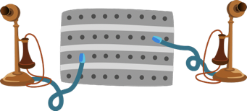
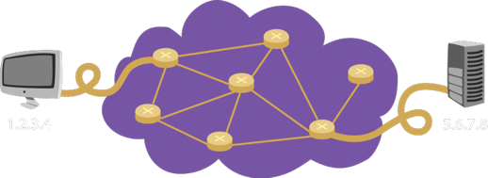
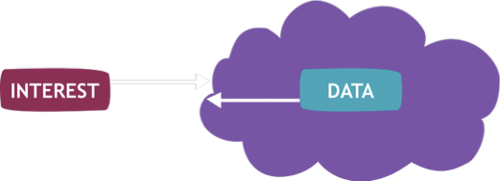
Evolution of Communications
Telegraph, Telephony: pairwise communication
IP Networking: node-to-node communication
Today: most uses retrieve objects, don’t care which server they come from

Slide 60
Named-Data Networking
Focus on data rather than on endpoints
All content is named
In-network storage and multicast arise naturally
Secure the data rather than the process
  Each data packet is immutable and signed

Slide 61
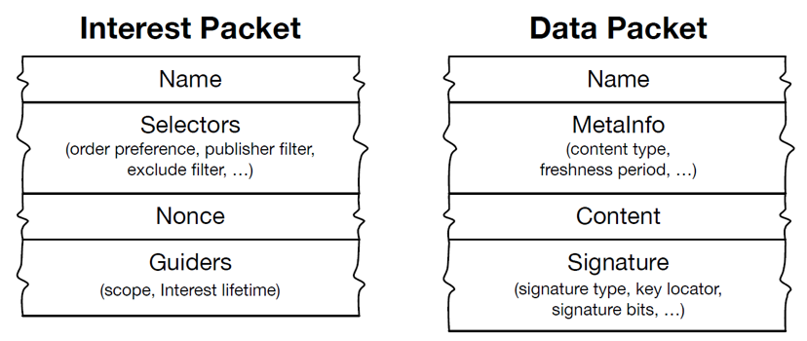
How does this work?

Slide 62
A new architecture
Today’s architecture
NDN architecture

Slide 63
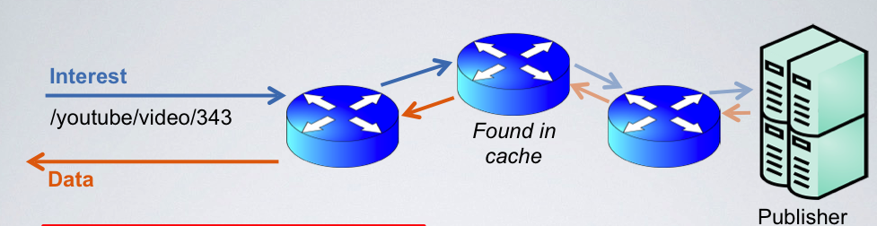

Slide 64
Some details (and questions)
Names are hierarchical
  e.g. /brown.edu/courses/cs168/f19/videos/l25.mpg/5
  Can name anything (including endpoints)
Routing can work similarly to IP prefix-based routing
  Aggregation on prefixes, longest-prefix matching
Signatures enable caching anywhere
  Hierarchical names provide context for trust management
Pull-based model
  Not “always on”, no unsolicited packets
  Eliminates some types of DDoS attackes

Slide 65
Will this work?
Many challenges
  Does the current architecture work “well enough”?
  Can we route efficiently on names of unbounded length?
  How does trust management work? Yet another PKI?
  What is the role of CDNs?
Proponents view this as the underlying architecture in 20 years, with IP-like communications as a special case
  Much like telephony today is a special case of IP communications

