Slide 1
CSCI-1680
Transport Layer I
Rodrigo Fonseca
Based partly on lecture notes by David Mazières, Phil Levis, John Jannotti

Slide 2
Administrivia
Homework 2 out since Sunday
  Due Friday (hours flexible): you get graded before midterm
  No late days until Monday at 4pm (free extension)
  No grade after that! (We release the solutions before the midterm)
Studying for the midterm
  Similar questions to homeworks, end-of-chapter problems in the book

Slide 3
Today
IPv6 (see slides from previous class)
Transport Layer
  UDP
  TCP Intro

Slide 4
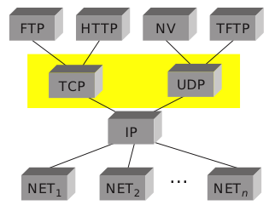
Transport Layer
Transport protocols sit on top of network layer
Problem solved: communication among processes
  Application-level multiplexing (“ports”)
  Error detection, reliability, etc.

Slide 5
UDP – User Datagram Protocol
Unreliable, unordered datagram service
Adds multiplexing, checksum
End points identified by ports
  Scope is an IP address (interface)
Checksum aids in error detection

Slide 6

UDP Header

Slide 7
UDP Checksum
Uses the same algorithm as the IP checksum
  Set Checksum field to 0
  Sum all 16-bit words, adding any carry bits to the LSB
  Flip bits to get checksum (except 0xffff->0xffff)
  To check: sum whole packet, including sum, should get 0xffff
How many errors?
  Catches any 1-bit error
  Not all 2-bit errors
Optional in IPv4: not checked if value is 0

Slide 8
Pseudo Header
0 7 8 15 16 23 24 31
+--------+--------+--------+--------+
| source address |
+--------+--------+--------+--------+
| destination address |
+--------+--------+--------+--------+
| zero |protocol| UDP length |
+--------+--------+--------+--------+
UDP Checksum is computer over pseudo-header prepended to the UDP header
  For IPv4: IP Source, IP Dest, Protocol (=17), plus UDP length
What does this give us?
What is a problem with this?
  Is UDP a layer on top of IP?

Slide 9
Next Problem: Reliability
Review: reliability on the link layer
Problem | Mechanism
Dropped Packets
Acknowledgments + Timeout
Duplicate Packets
Sequence Numbers
Packets out of order
Receiver Window
Keeping the pipe full
Sliding Window (Pipelining)
Single link: things were easy… ☺

Slide 10
Transport Layer Reliability
Extra difficulties
  Multiple hosts
  Multiple hops
  Multiple potential paths
Need for connection establishment, tear down
  Analogy: dialing a number versus a direct line
Varying RTTs
  Both across connections and during a connection
  Why do they vary? What do they influence?
Notes:
RTT influences the potential window size (delay X bandwidth), the values for timeouts.

Slide 11
Extra Difficulties (cont.)
Out of order packets
  Not only because of drops/retransmissions
  Can get very old packets (up to 120s), must not get confused
Unknown resources at other end
  Must be able to discover receiver buffer: flow control
Unknown resources in the network
  Should not overload the network
  But should use as much as safely possible
  Congestion Control (next class)

Slide 12
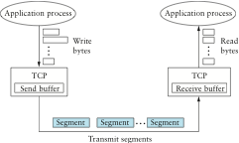
TCP – Transmission Control Protocol
Service model: “reliable, connection oriented, full duplex byte stream”
  Endpoints: <IP Address, Port>
Flow control
  If one end stops reading, writes at other eventually stop/fail
Congestion control
  Keeps sender from overloading the network (next lecture)

Slide 13
TCP
Specification
  RFC 793 (1981), RFC 1222 (1989, some corrections), RFC 5681 (2009, congestion control), …
Was born coupled with IP, later factored out
  We talked about this, don’t always need everything!
End-to-end protocol
  Minimal assumptions on the network
  All mechanisms run on the end points
Alternative idea:
  Provide reliability, flow control, etc, link-by-link
  Does it work?

Slide 14
TCP Header
0 1 2 3
0 1 2 3 4 5 6 7 8 9 0 1 2 3 4 5 6 7 8 9 0 1 2 3 4 5 6 7 8 9 0 1
+-+-+-+-+-+-+-+-+-+-+-+-+-+-+-+-+-+-+-+-+-+-+-+-+-+-+-+-+-+-+-+-+
| Source Port | Destination Port |
+-+-+-+-+-+-+-+-+-+-+-+-+-+-+-+-+-+-+-+-+-+-+-+-+-+-+-+-+-+-+-+-+
| Sequence Number |
+-+-+-+-+-+-+-+-+-+-+-+-+-+-+-+-+-+-+-+-+-+-+-+-+-+-+-+-+-+-+-+-+
| Acknowledgment Number |
+-+-+-+-+-+-+-+-+-+-+-+-+-+-+-+-+-+-+-+-+-+-+-+-+-+-+-+-+-+-+-+-+
| Data | |U|A|P|R|S|F| |
| Offset| Reserved |R|C|S|S|Y|I| Window |
| | |G|K|H|T|N|N| |
+-+-+-+-+-+-+-+-+-+-+-+-+-+-+-+-+-+-+-+-+-+-+-+-+-+-+-+-+-+-+-+-+
| Checksum | Urgent Pointer |
+-+-+-+-+-+-+-+-+-+-+-+-+-+-+-+-+-+-+-+-+-+-+-+-+-+-+-+-+-+-+-+-+
| Options | Padding |
+-+-+-+-+-+-+-+-+-+-+-+-+-+-+-+-+-+-+-+-+-+-+-+-+-+-+-+-+-+-+-+-+
| data |
+-+-+-+-+-+-+-+-+-+-+-+-+-+-+-+-+-+-+-+-+-+-+-+-+-+-+-+-+-+-+-+-+

Slide 15
Header Fields
Ports: multiplexing
Sequence number
  Correspond to bytes, not packets!
Acknowledgment Number
  Next expected sequence number
Window: willing to receive
  Lets receiver limit SWS (even to 0) for flow control
Data Offset: # of 4 byte header + option bytes
Flags, Checksum, Urgent Pointer

Slide 16
Header Flags
URG: whether there is urgent data
ACK: ack no. valid (all but first segment)
PSH: push data to the application immediately
RST: reset connection
SYN: synchronize, establishes connection
FIN: close connection

Slide 17
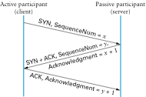
Establishing a Connection
Connect
Listen, Accept…
Accept returns
Three-way handshake
  Two sides agree on respective initial sequence nums
If no one is listening on port: server sends RST
If server is overloaded: ignore SYN
If no SYN-ACK: retry, timeout

Slide 18
Connection Termination
FIN bit says no more data to send
  Caused by close or shutdown
  Both sides must send FIN to close a connection
Typical close
Close
FIN_WAIT_1
FIN
ACK
CLOSE_WAIT
FIN_WAIT_2
…
FIN
Close
LAST_ACK
TIME_WAIT
2MSL
ACK
CLOSED
CLOSED

Slide 19
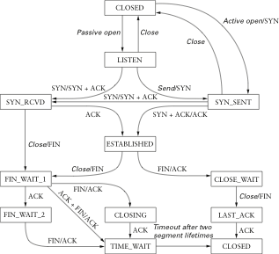
Summary of TCP States
Unsynchronized
Synchronized
Connection Establishment
Passive close:
Can still send!
Active close:
Can still receive

Slide 20
TIME_WAIT
Why do you have to wait for 2MSL in TIME_WAIT?
  What if last ack is severely delayed, AND
  Same port pair is immediately reused for a new connection?
Solution: active closer goes into TIME_WAIT
  Waits for 2MSL (Maximum Segment Lifetime)
Can be problematic for active servers
  OS has too many sockets in TIME_WAIT, can accept less connections
    Hack: send RST and delete socket, SO_LINGER = 0
  OS won’t let you re-start server because port in use
    SO_REUSEADDR lets you rebind

Slide 21
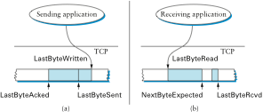
How about some data?
Next Class: sliding window revisited
  Used for reliability and in-order delivery (acks, timeouts, sequence numbers, buffers)
  New: flow control, by means of receiver Window size
  New: congestion control, sender intelligently sets SWS

Slide 22
Coming Up
IP handins: please pay attention to the issues we discussed today, good luck!
Next week: Transport Layer

