Slide 1
CSCI-1680
Physical Layer
Rodrigo Fonseca
Based partly on lecture notes by David Mazières, Phil Levis, John Jannotti

Slide 2
Administrivia
Signup for Snowcast milestone
  Make sure you signed up
Return signed policy sheet
  So we can grade you

Slide 3
Today
Physical Layer
  Modulation and Channel Capacity
  Encoding
Link Layer I
  Framing

Slide 4
Physical Layer (Layer 1)
Responsible for specifying the physical medium
  Type of cable, fiber, wireless frequency
Responsible for specifying the signal (modulation)
  Transmitter varies something (amplitude, frequency, phase)
  Receiver samples, recovers signal
Responsible for specifying the bits (encoding)
  Bits above physical layer -> chips

Slide 5
Modulation
Specifies mapping between digital signal and some variation in analog signal
Why not just a square wave (1v=1; 0v=0)?
  Not square when bandwidth limited
Bandwidth – frequencies that a channel propagates well
  Signals consist of many frequency components
  Attenuation and delay frequency-dependent

Slide 6
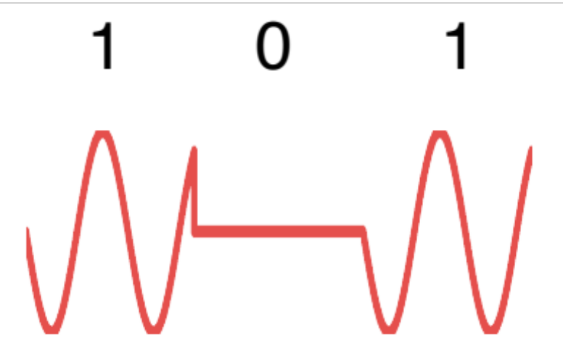
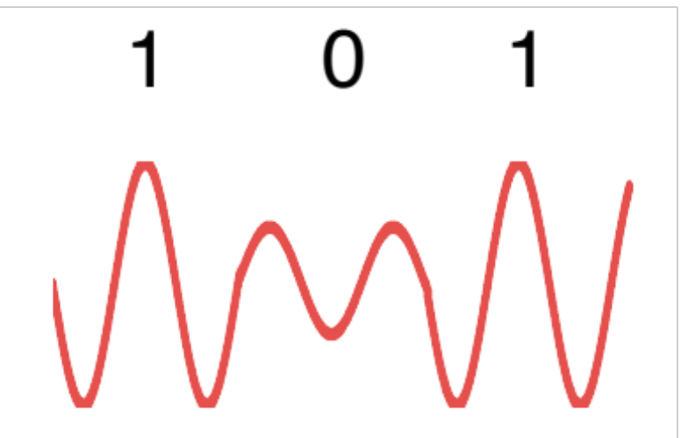
Use Carriers
Idea: only use frequencies that transmit well
Modulate the signal to encode bits
OOK: On-Off Keying
ASK: Amplitude Shift Keying

Slide 7
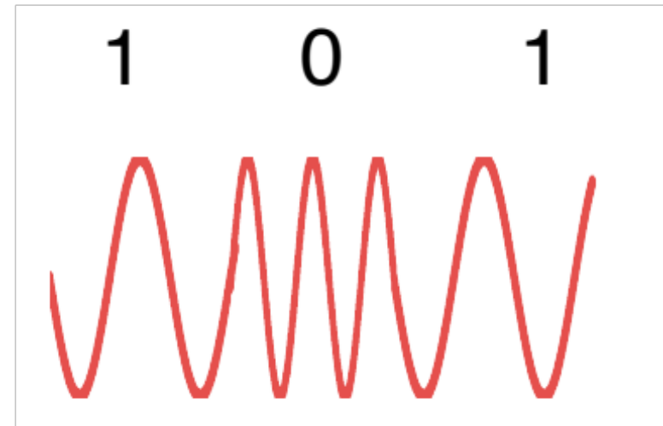
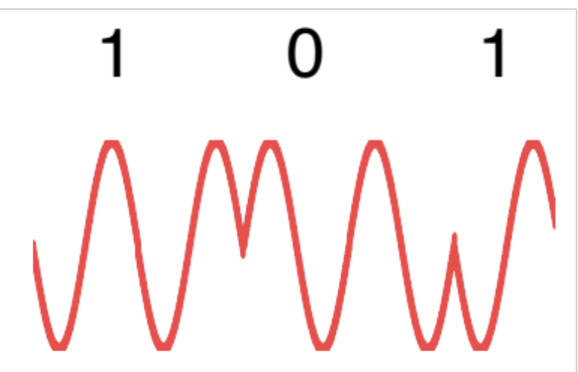
Use Carriers
Idea: only use frequencies that transmit well
Modulate the signal to encode bits
FSK: Frequency Shift Keying
PSK: Phase Shift Keying

Slide 8
How Fast Can You Send?
Encode information in some varying characteristic of the signal.
If B is the maximum frequency of the signal
C = 2B bits/s
(Nyquist, 1928)
Notes:
Intuition: 2B comes from Nyquist’s

Slide 9
Can we do better?
So we can only change 2B/second, what if we encode more bits per sample?
  Baud is the frequency of changes to the physical channel
  Not the same thing as bits!
Suppose channel passes 1KHz to 2KHz
  1 bit per sample: alternate between 1KHz and 2KHz
  2 bits per sample: send one of 1, 1.33, 1.66, or 2KHz
  Or send at different amplitudes: A/4, A/2, 3A/4, A
  n bits: choose among 2^{n} frequencies!
What is the capacity if you can distinguish M levels?

Slide 10
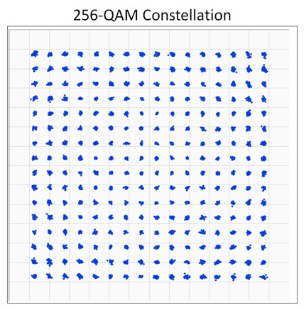
Example
Amplitude
Phase

Slide 11
Hartley’s Law
C = 2B log₂(M) bits/s
Great. By increasing M, we can have as large a capacity as we want!
Or can we?

Slide 12

The channel is noisy!

Slide 13
The channel is noisy!
Noise prevents you from increasing M arbitrarily!
This depends on the signal/noise ratio (S/N)
Shannon: C = B log₂(1 + S/N)
  C is the channel capacity in bits/second
  B is the bandwidth of the channel in Hz
  S and N are average signal and noise power
  Signal-to-noise ratio is measured in dB = 10log₁₀(S/N)

Slide 14
Putting it all together
Noise limits M!
2B log₂(M) ≤ B log₂(1 + S/N)
M ≤ √1+S/N
Example: Telephone Line
  3KHz b/w, 30dB S/N = 10ˆ(30/10) = 1000
  C = 3KHz log₂(1001) ≈ 30Kbps

Slide 15
Encoding
Now assume that we can somehow modulate a signal: receiver can decode our binary stream
How do we encode binary data onto signals?
One approach: 1 as high, 0 as low!
  Called Non-return to Zero (NRZ)
0
0
1
0
1
0
1
1
0
NRZ
(non-return to zero)
Clock

Slide 16
Drawbacks of NRZ
No signal could be interpreted as 0 (or vice-versa)
Consecutive 1s or 0s are problematic
Baseline wander problem
  How do you set the threshold?
  Could compare to average, but average may drift
Clock recovery problem
  For long runs of no change, could miscount periods

Slide 17
Alternative Encodings
Non-return to Zero Inverted (NRZI)
  Encode 1 with transition from current signal
  Encode 0 by staying at the same level
  At least solve problem of consecutive 1s
0
0
1
0
1
0
1
1
0
NRZI
(non-return to zero
intverted)
Clock

Slide 18
Manchester
Map 0 → chips 01; 1 → chips 10
  Transmission rate now 1 bit per two clock cycles
Solves clock recovery, baseline wander
But cuts transmission rate in half
0
0
1
0
1
0
1
1
0
Manchester
Clock

Slide 19
4B/5B
Can we have a more efficient encoding?
Every 4 bits encoded as 5 chips
Need 16 5-bit codes:
  selected to have no more than one leading 0 and no more than two trailing 0s
  Never get more than 3 consecutive 0s
Transmit chips using NRZI
Other codes used for other purposes
  E.g., 11111: line idle; 00100: halt
Achieves 80% efficiency

Slide 20
Encoding Goals
DC Balancing (same number of 0 and 1 chips)
Clock synchronization
Can recover some chip errors
Constrain analog signal patterns to make signal more robust
Want near channel capacity with negligible errors
  Shannon says it’s possible, doesn’t tell us how
  Codes can get computationally expensive
In practice
  More complex encoding: fewer bps, more robust
  Less complex encoding: more bps, less robust

Slide 21
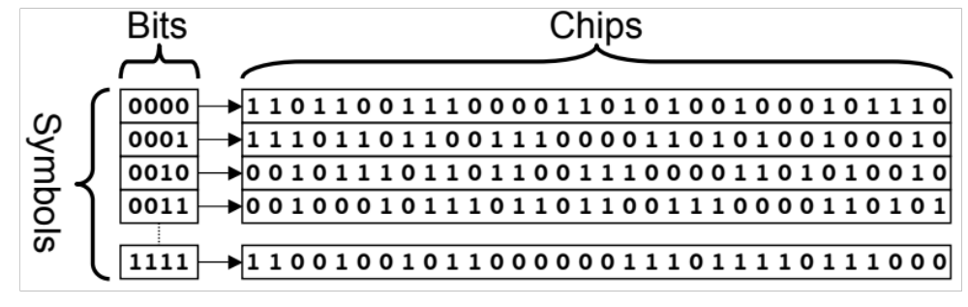
Last Example: 802.15.4
Standard for low-power, low-rate wireless PANs
  Must tolerate high chip error rates
Uses a 4B/32B bit-to-chip encoding

Slide 22
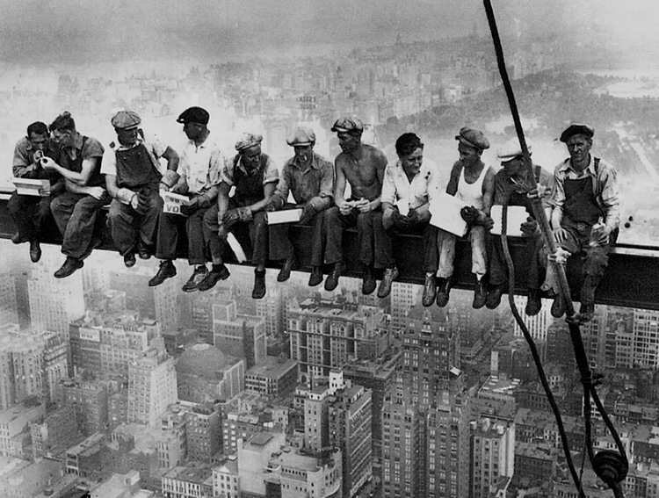
Questions so far?
Photo: Lewis Hine

Slide 23
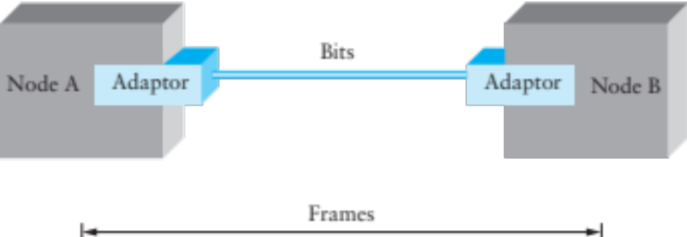
Framing
Given a stream of bits, how can we represent boundaries?
Break sequence of bits into a frame
Typically done by network adaptor

Slide 24
Representing Boundaries
Sentinels
Length counts
Clock-based

Slide 25
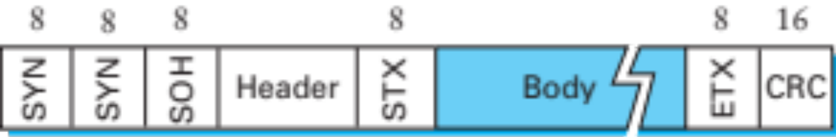
Sentinel-based Framing
Byte-oriented protocols (e.g. BISYNC, PPP)
  Place special bytes (SOH, ETX,…) in the beginning, end of messages
What if ETX appears in the body?
  Escape ETX byte by prefixing DEL byte
  Escape DEL byte by prefixing DEL byte
  Technique known as character stuffing

Slide 26
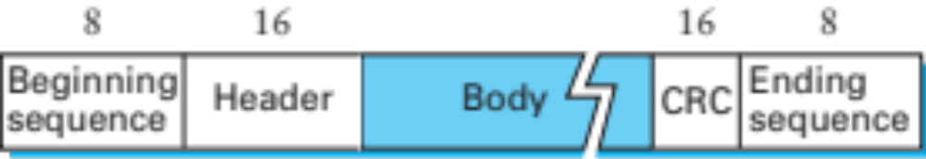
Bit-Oriented Protocols
View message as a stream of bits, not bytes
Can use sentinel approach as well (e.g., HDLC)
  HDLC begin/end sequence 01111110
Use bit stuffing to escape 01111110
  Always append 0 after five consecutive 1s in data
  After five 1s, receiver uses next two bits to decide if stuffed, end of frame, or error.
Notes:
USB uses bit stuffing for a different reason: it uses NRZI with 0:transition, 1:stay => 1’s are a problem. USB stuffs a 0 after every six consecutive 1’s

Slide 27
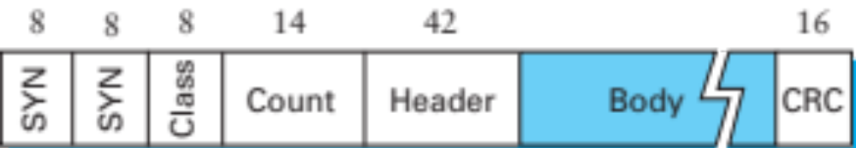
Length-based Framing
Drawback of sentinel techniques
  Length of frame depends on data
Alternative: put length in header (e.g., DDCMP)
Danger: Framing Errors
  What if high bit of counter gets corrupted?
  Adds 8K to length of frame, may lose many frames
  CRC checksum helps detect error

Slide 28
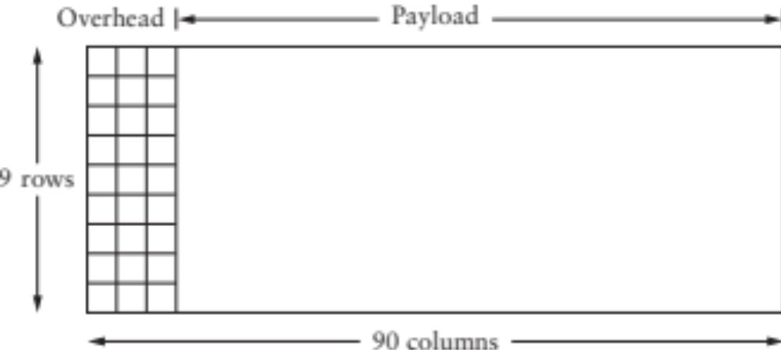
Clock-based Framing
E.g., SONET (Synchronous Optical Network)
  Each frame is 125μs long
  Look for header every 125μs
  Encode with NRZ, but XOR payload with 127-bit string to ensure lots of transitions

Slide 29
Error Detection
Basic idea: use a checksum
  Compute small checksum value, like a hash of packet
Good checksum algorithms
  Want several properties, e.g., detect any single-bit error
  Details in a later lecture

Slide 30
Coming Up
Next week: more link layer
  Flow Control and Reliability
  Ethernet
  Sharing access to a shared medium
  Switching
Friday 10th: Snowcast due

