Slide 1
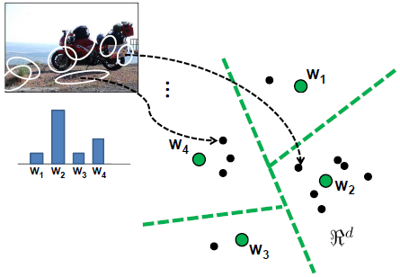

Recap: Advanced Feature Encoding
Bag of Visual Words is only about counting the number of local descriptors assigned to each Voronoi region (0th order statistics)
Why not including other statistics? For instance:
    mean of local descriptors (first order statistics)
http://www.cs.utexas.edu/~grauman/courses/fall2009/papers/bag_of_visual_words.pdf

Slide 2
Recap: Advanced Feature Encoding
Bag of Visual Words is only about counting the number of local descriptors assigned to each Voronoi region (0th order statistics)
Why not including other statistics? For instance:
    mean of local descriptors (first order statistics)
    (co)variance of local descriptors
http://www.cs.utexas.edu/~grauman/courses/fall2009/papers/bag_of_visual_words.pdf

Slide 3
Recap: Advanced Feature Encoding
We’ve looked at methods to better characterize the distribution of visual words in an image:
  Soft assignment (a.k.a. Kernel Codebook)
  VLAD
  Fisher Vector
Mixtures of Gaussians could be thought of as a soft form of kmeans which can better model the data distribution.

Slide 4
Modern Object Detection
Computer Vision
CS 143
Brown
James Hays
Many slides from Derek Hoiem

Slide 5
Recap: Viola-Jones sliding window detector
Fast detection through two mechanisms
Quickly eliminate unlikely windows
Use features that are fast to compute
Viola and Jones. Rapid Object Detection using a Boosted Cascade of Simple Features (2001).

Slide 6
Cascade for Fast Detection
Choose threshold for low false negative rate
Fast classifiers early in cascade
Slow classifiers later, but most examples don’t get there
Stage 1
H₁(x) > t₁?
Yes
Stage 2
H₂(x) > t₂?
Stage N
H_{N}(x) > t_{N}?
Yes
…
Pass
No
No
No
Examples
Reject
Reject
Reject

Slide 7
Features that are fast to compute
“Haar-like features”
  Differences of sums of intensity
  Thousands, computed at various positions and scales within detection window
-1
+1
Two-rectangle features
Three-rectangle features
Etc.

Slide 8
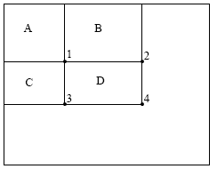
Integral Images
ii = cumsum(cumsum(im, 1), 2)
x, y
ii(x,y) = Sum of the values in the grey region
How to compute B-A?
How to compute A+D-B-C?

Slide 9

Feature selection with Adaboost
Create a large pool of features (180K)
Select features that are discriminative and work well together
  “Weak learner” = feature + threshold + parity
  Choose weak learner that minimizes error on the weighted training set
  Reweight

Slide 10
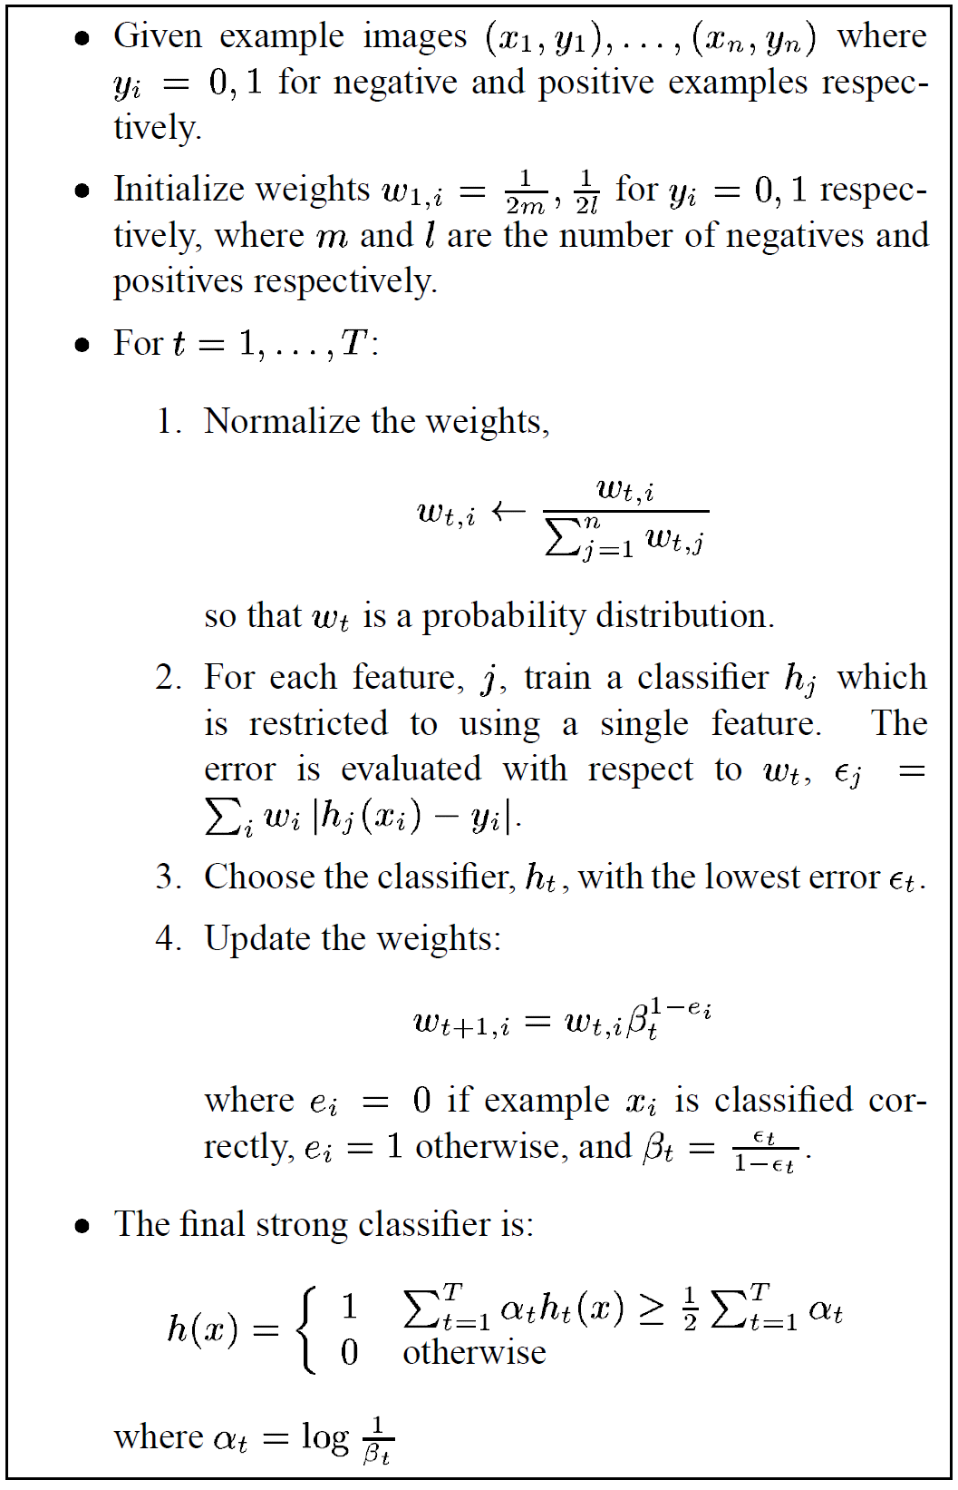
Adaboost

Slide 11
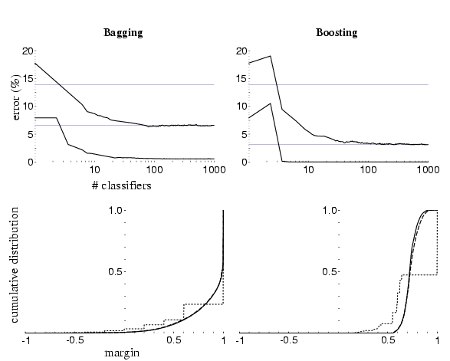
Adaboost: Immune to Overfitting?
Test error
Train error

Slide 12
Adaboost: Margin Maximizer
Test error
Train error
margin

Slide 13
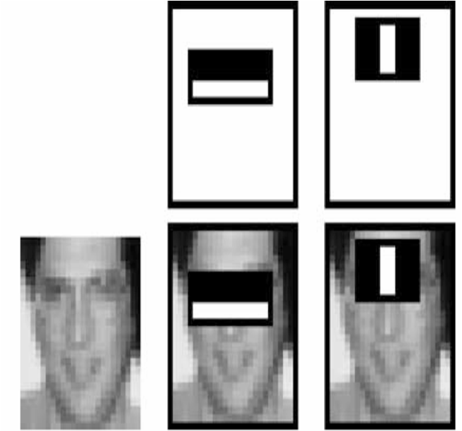
Top 2 selected features

Slide 14
Viola-Jones details
38 stages with 1, 10, 25, 50 … features
  6061 total used out of 180K candidates
  10 features evaluated on average
Training Examples
  4916 positive examples
  10000 negative examples collected after each stage
Scanning
  Scale detector rather than image
  Scale steps = 1.25 (factor between two consecutive scales)
  Translation 1*scale (# pixels between two consecutive windows)
Non-max suppression: average coordinates of overlapping boxes
Train 3 classifiers and take vote

Slide 15
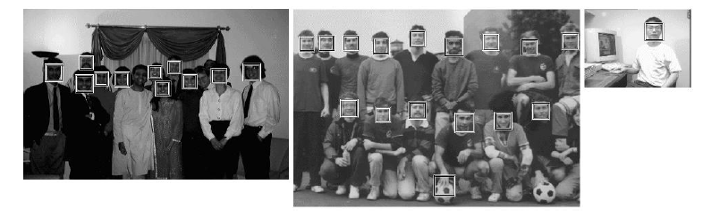
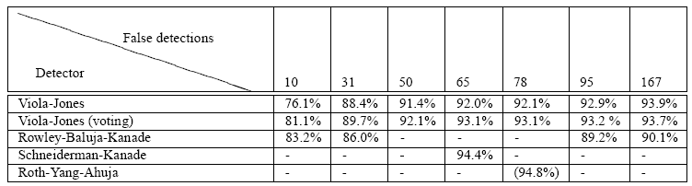
Viola Jones Results
Speed = 15 FPS (in 2001)
MIT + CMU face dataset

Slide 16
Today’s class: Modern Object Category Detection
  Recap of Viola Jones
Overview of object category detection
Statistical template matching with sliding window detector
  Dalal-Triggs pedestrian detector

Slide 17
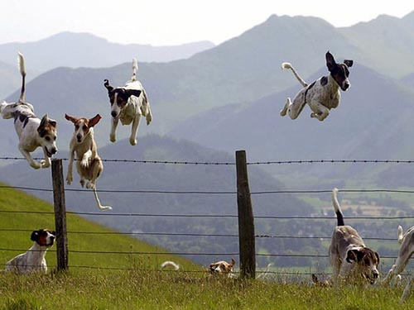
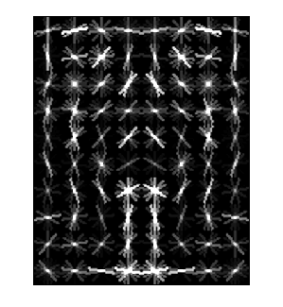
Object Category Detection
Focus on object search: “Where is it?”
Build templates that quickly differentiate object patch from background patch
Dog Model
…
Object or
Non-Object?

Slide 18
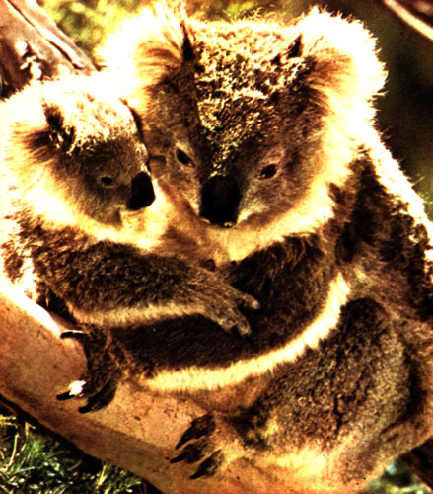
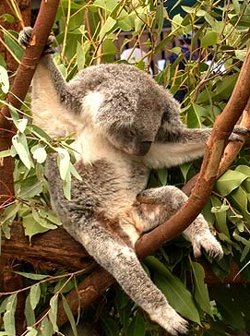
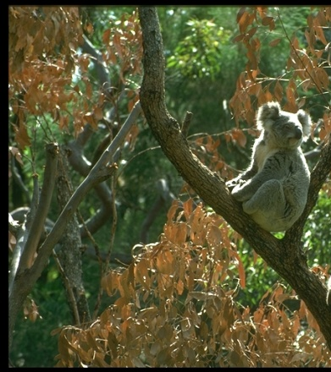

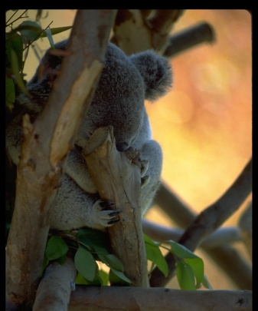
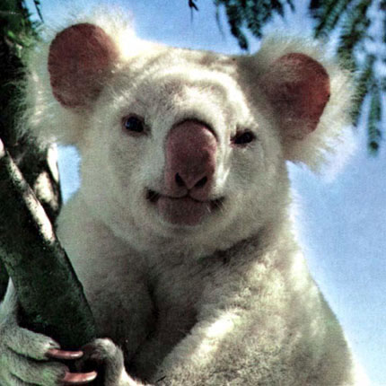
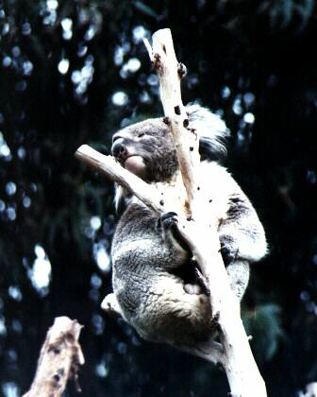
Challenges in modeling the object class
Illumination
Object pose
Clutter
Occlusions
Intra-class appearance
Viewpoint
Slide from K. Grauman, B. Leibe

Slide 19
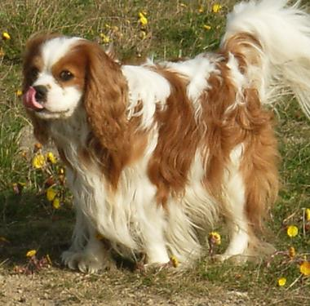
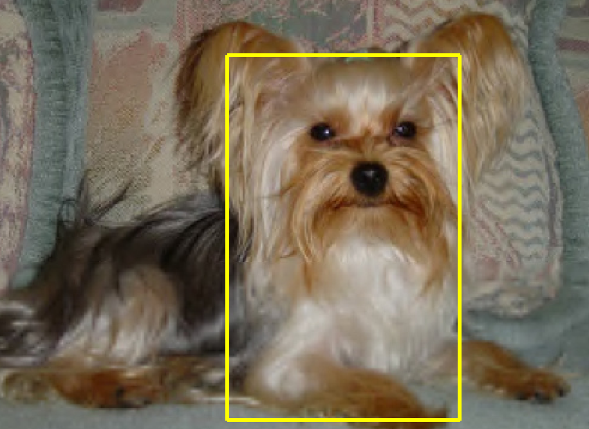
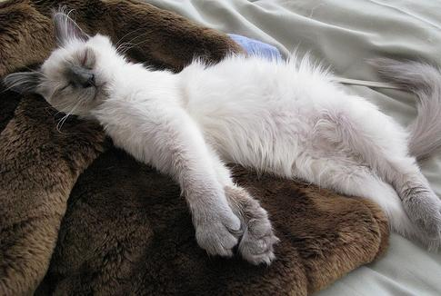
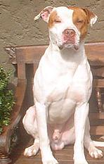
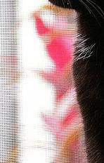

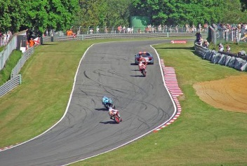

Challenges in modeling the non-object class
True Detections
Bad Localization
Confused with Similar Object
Confused with Dissimilar Objects
Misc. Background

Slide 20
General Process of Object Recognition
Specify Object Model
What are the object parameters?
Generate Hypotheses
Score Hypotheses
Resolve Detections

Slide 21
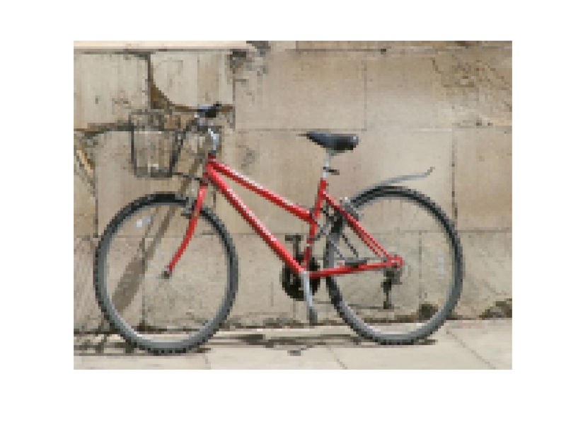
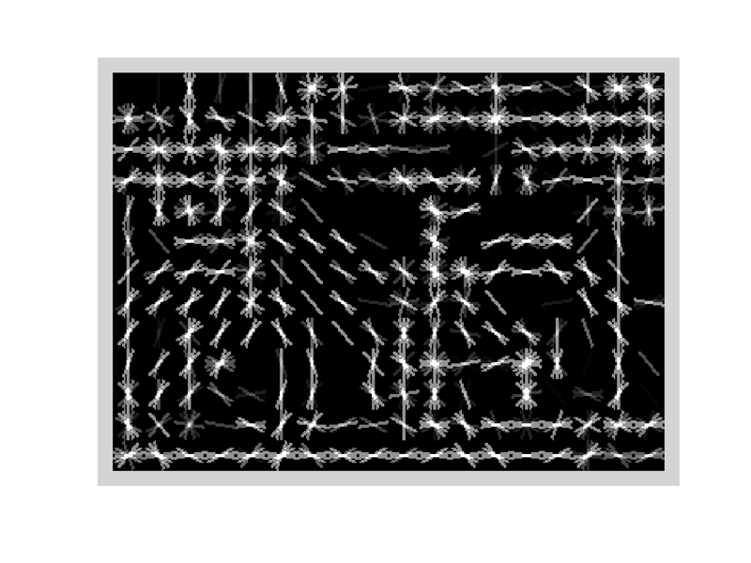
Specifying an object model
Statistical Template in Bounding Box
  Object is some (x,y,w,h) in image
  Features defined wrt bounding box coordinates
Image
Template Visualization
Images from Felzenszwalb

Slide 22
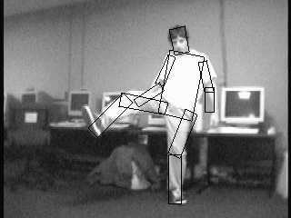
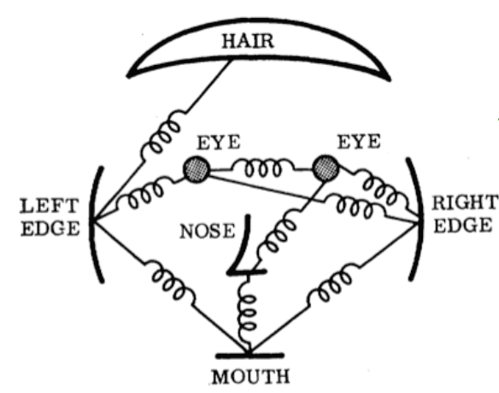
Specifying an object model
2. Articulated parts model
  Object is configuration of parts
  Each part is detectable
Images from Felzenszwalb

Slide 23
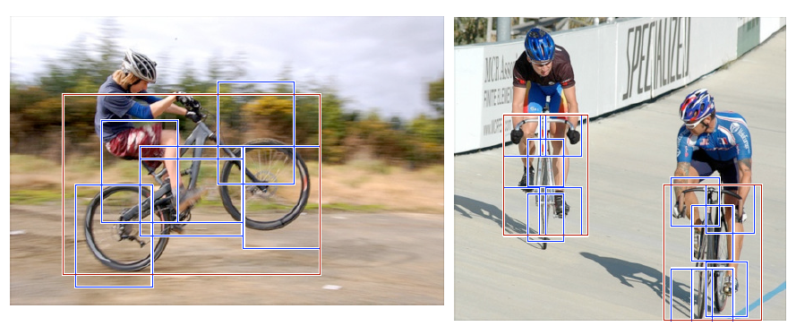
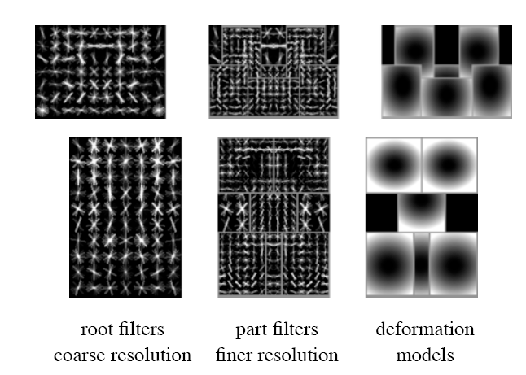
Specifying an object model
3. Hybrid template/parts model
Detections
Template Visualization
Felzenszwalb et al. 2008

Slide 24
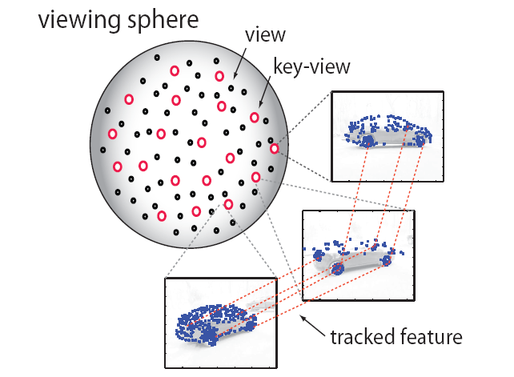
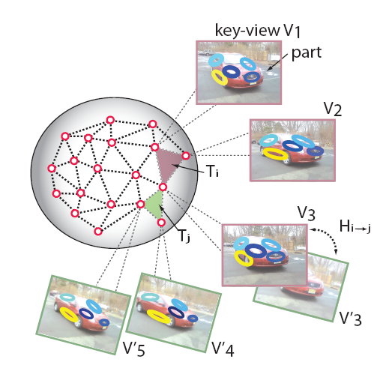
Specifying an object model
3D-ish model
Object is collection of 3D planar patches under affine transformation

Slide 25
General Process of Object Recognition
Specify Object Model
Generate Hypotheses
Propose an alignment of the model to the image
Score Hypotheses
Resolve Detections

Slide 26
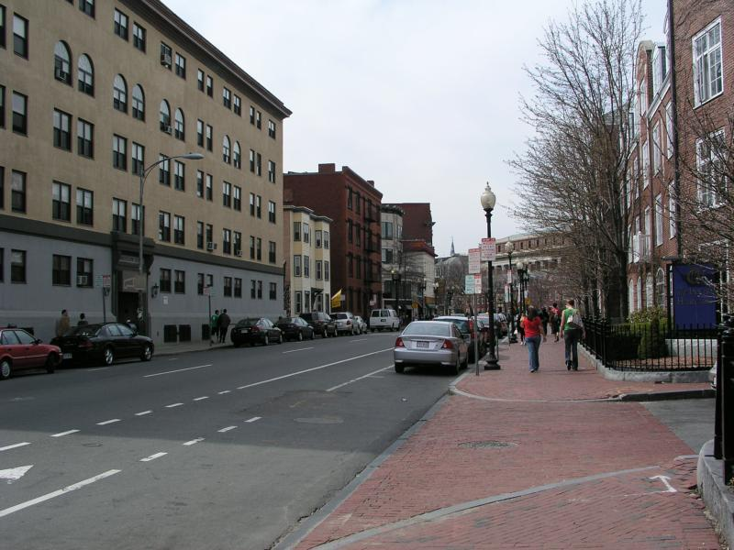
Generating hypotheses
Sliding window
  Test patch at each location and scale

Slide 27
Generating hypotheses
Sliding window
  Test patch at each location and scale
Note – Template did not change size

Slide 28
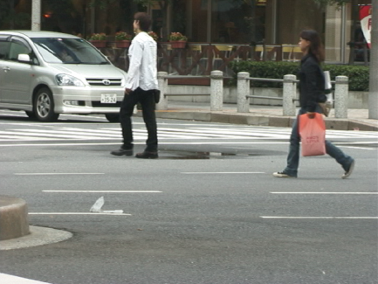
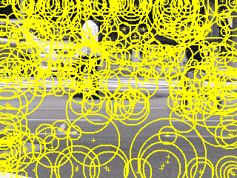
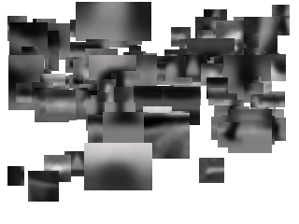
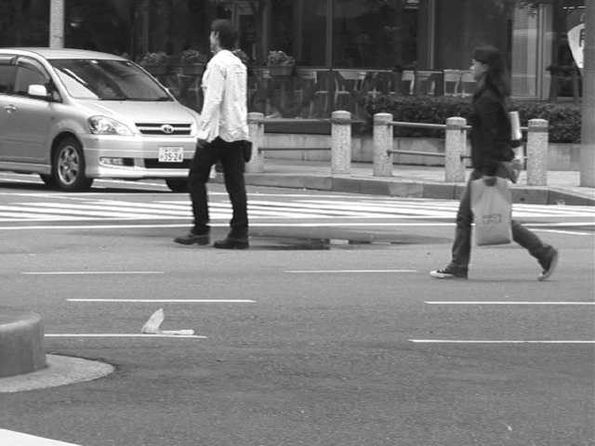
Generating hypotheses
2. Voting from patches/keypoints
Matched Codebook
Entries
Probabilistic
Voting
Interest Points
y
s
3D Voting Space
(continuous)
x
ISM model by Leibe et al.

Slide 29
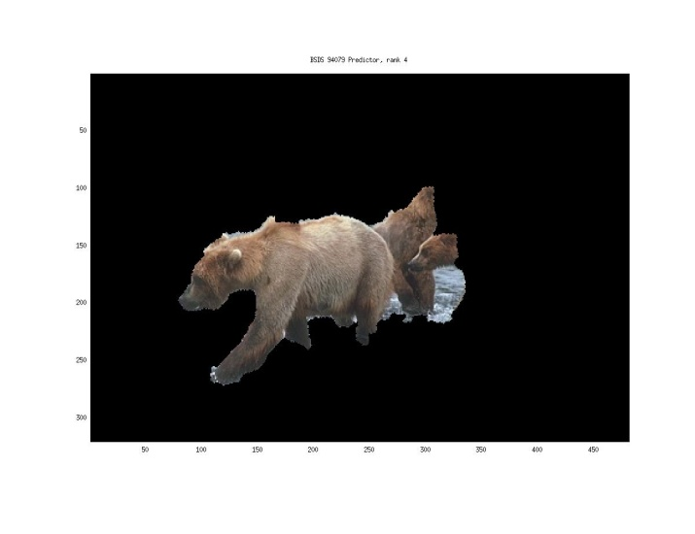
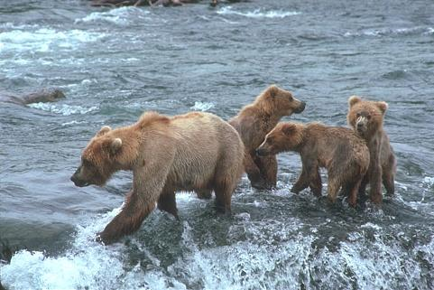
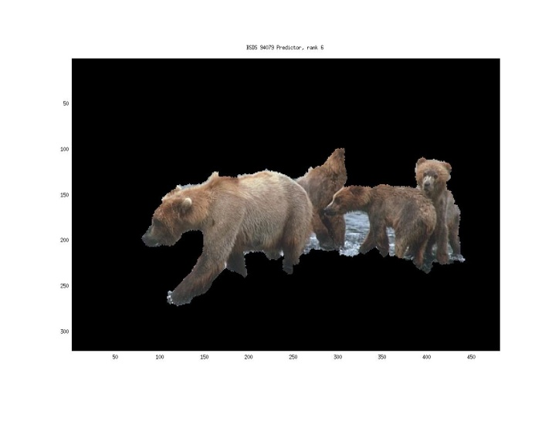
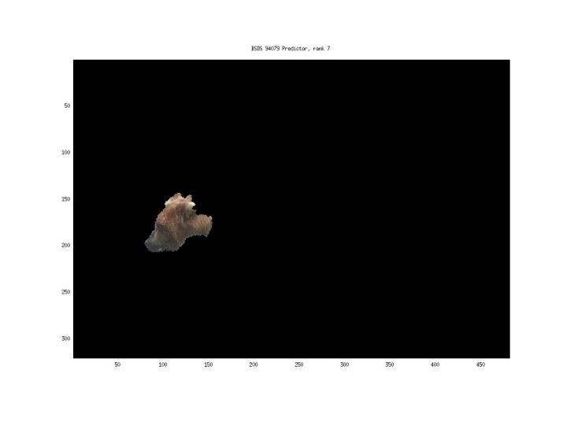
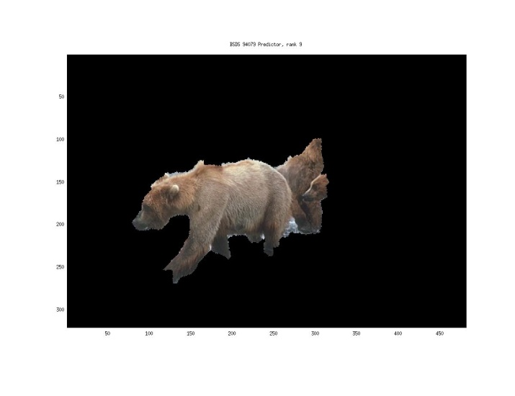
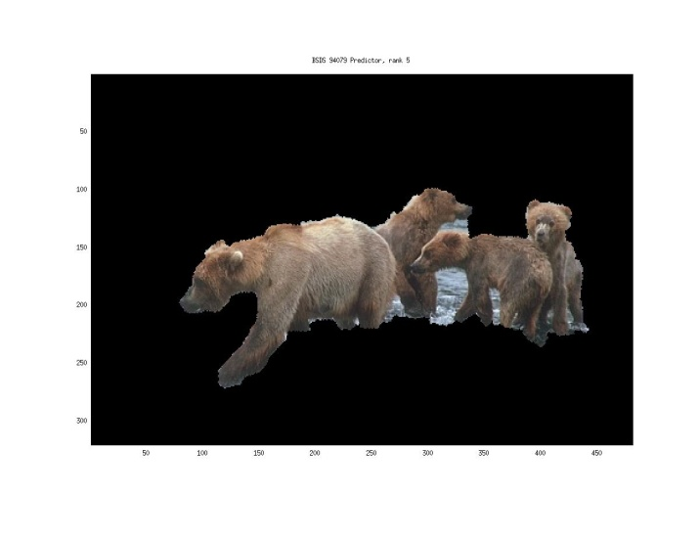
Generating hypotheses
3. Region-based proposal
Endres Hoiem 2010

Slide 30
General Process of Object Recognition
Specify Object Model
Generate Hypotheses
Mainly-gradient based features, usually based on summary representation, many classifiers
Score Hypotheses
Resolve Detections

Slide 31
General Process of Object Recognition
Specify Object Model
Generate Hypotheses
Score Hypotheses
Resolve Detections
Rescore each proposed object based on whole set

Slide 32
Resolving detection scores
Non-max suppression
Score = 0.8
Score = 0.8
Score = 0.1

Slide 33
Resolving detection scores
Non-max suppression
Score = 0.8
Score = 0.8
Score = 0.1
Score = 0.1
“Overlap” score is below some threshold

Slide 34
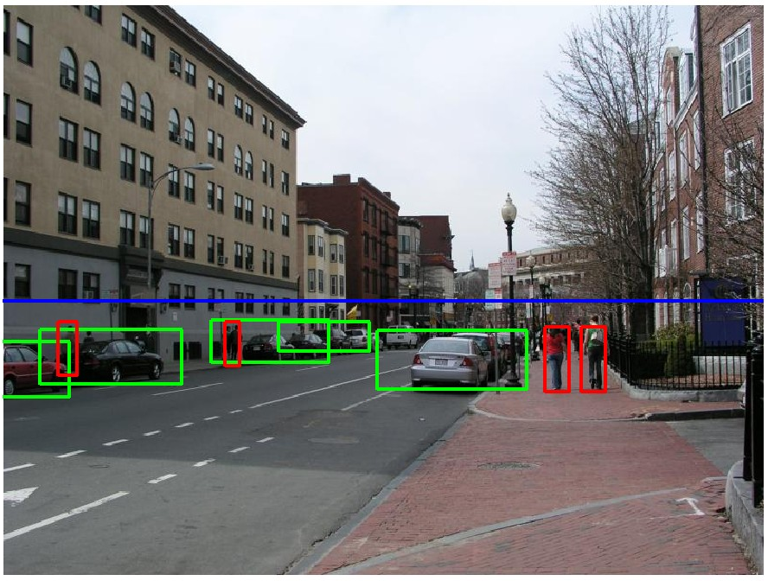
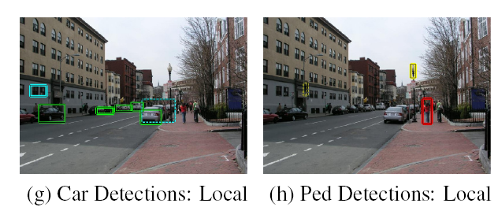
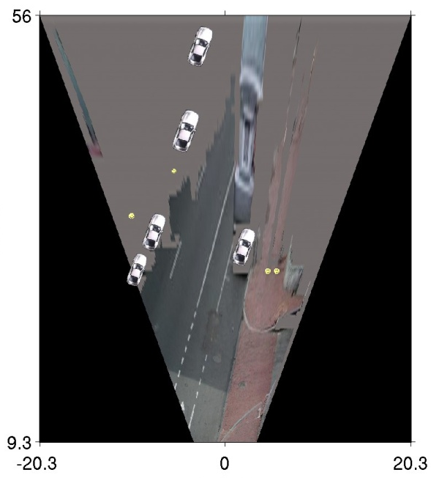
Resolving detection scores
2. Context/reasoning
meters
Hoiem et al. 2006
meters

Slide 35
Object category detection in computer vision
Goal: detect all pedestrians, cars, monkeys, etc in image

Slide 36
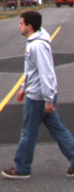
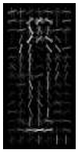
Basic Steps of Category Detection
Align
  E.g., choose position, scale orientation
  How to make this tractable?
Compare
  Compute similarity to an example object or to a summary representation
  Which differences in appearance are important?
Aligned
Possible Objects
Exemplar
Summary

Slide 37
Sliding window: a simple alignment solution
…
…

Slide 38
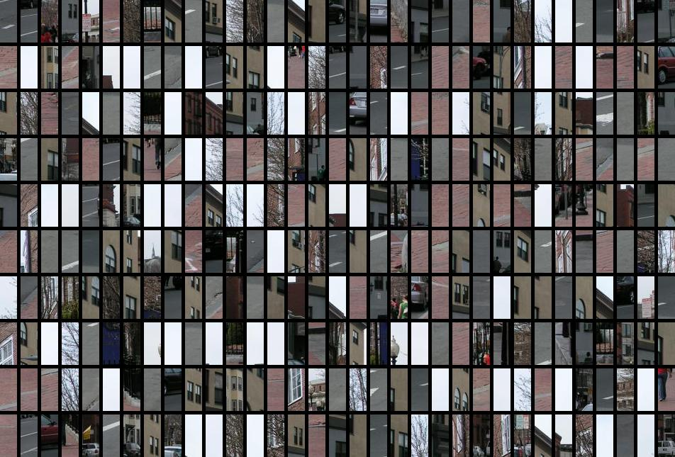
Each window is separately classified

Slide 39
Statistical Template
Object model = sum of scores of features at fixed positions
?
+3
+2
-2
-1
-2.5
= -0.5
> 7.5
Non-object
?
+4
+1
+0.5
+3
+0.5
= 10.5
> 7.5
Object

Slide 40
Design challenges
How to efficiently search for likely objects
  Even simple models require searching hundreds of thousands of positions and scales
Feature design and scoring
  How should appearance be modeled? What features correspond to the object?
How to deal with different viewpoints?
  Often train different models for a few different viewpoints
Implementation details
  Window size
  Aspect ratio
  Translation/scale step size
  Non-maxima suppression

Slide 41
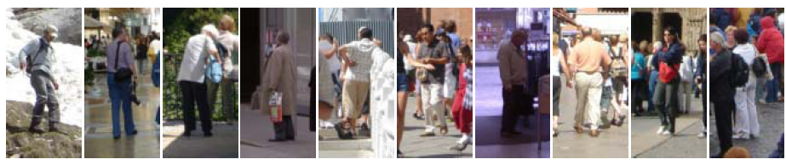
Example: Dalal-Triggs pedestrian detector
Extract fixed-sized (64x128 pixel) window at each position and scale
Compute HOG (histogram of gradient) features within each window
Score the window with a linear SVM classifier
Perform non-maxima suppression to remove overlapping detections with lower scores
Navneet Dalal and Bill Triggs, Histograms of Oriented Gradients for Human Detection, CVPR05
Notes:
6000+ citations, another of the most influential papers in computer vision!

Slide 42

Slides by Pete Barnum
Navneet Dalal and Bill Triggs, Histograms of Oriented Gradients for Human Detection, CVPR05

Slide 43
Tested with
  RGB
  LAB
  Grayscale
Gamma Normalization and Compression
  Square root
  Log
Slightly better performance vs. grayscale
Very slightly better performance vs. no adjustment

Slide 44
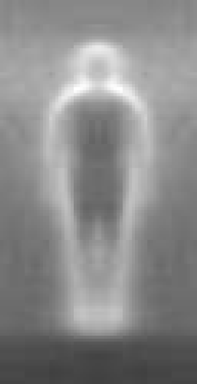

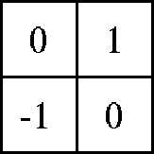

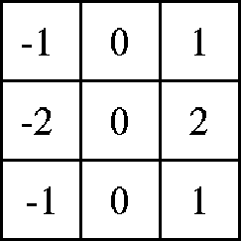

Outperforms
centered
diagonal
uncentered
cubic-corrected
Sobel
Slides by Pete Barnum
Navneet Dalal and Bill Triggs, Histograms of Oriented Gradients for Human Detection, CVPR05

Slide 45



Histogram of gradient orientations
  Votes weighted by magnitude
  Bilinear interpolation between cells
Orientation: 9 bins (for unsigned angles)
Histograms in
k x k pixel cells
Slides by Pete Barnum
Navneet Dalal and Bill Triggs, Histograms of Oriented Gradients for Human Detection, CVPR05

Slide 46

Normalize with respect to surrounding cells
Slides by Pete Barnum
Navneet Dalal and Bill Triggs, Histograms of Oriented Gradients for Human Detection, CVPR05

Slide 47
Original Formulation
# orientations
# features = 15 x 7 x 9 x 4 = 3780
# cells
# normalizations by neighboring cells
X=
UoCTTI variant
# orientations
# features = 15 x 7 x (3 x 9) + 4 = 3780
# cells
magnitude of neighbor cells
Slides by Pete Barnum
Navneet Dalal and Bill Triggs, Histograms of Oriented Gradients for Human Detection, CVPR05
Notes:
Note – this is not a “bag of features”, these gradient measurements have fixed spatial positions

Slide 48


pos w
neg w
Slides by Pete Barnum
Navneet Dalal and Bill Triggs, Histograms of Oriented Gradients for Human Detection, CVPR05

Slide 49



pedestrian
Slides by Pete Barnum
Navneet Dalal and Bill Triggs, Histograms of Oriented Gradients for Human Detection, CVPR05

Slide 50

Detection examples

Slide 51
Something to think about…
Sliding window detectors work
  very well for faces
  fairly well for cars and pedestrians
  badly for cats and dogs
Why are some classes easier than others?

Slide 52
Strengths and Weaknesses of Statistical Template Approach
Strengths
Works very well for non-deformable objects with canonical orientations: faces, cars, pedestrians
Fast detection
Weaknesses
Not so well for highly deformable objects or “stuff”
Not robust to occlusion
Requires lots of training data

Slide 53
Tricks of the trade
Details in feature computation really matter
  E.g., normalization in Dalal-Triggs improves detection rate by 27% at fixed false positive rate
Template size
  Typical choice is size of smallest detectable object
“Jittering” to create synthetic positive examples
  Create slightly rotated, translated, scaled, mirrored versions as extra positive examples
Bootstrapping to get hard negative examples
  Randomly sample negative examples
  Train detector
  Sample negative examples that score > -1
  Repeat until all high-scoring negative examples fit in memory

Slide 54
Influential Works in Detection
Sung-Poggio (1994, 1998) : ~2000 citations
  Basic idea of statistical template detection (I think), bootstrapping to get “face-like” negative examples, multiple whole-face prototypes (in 1994)
Rowley-Baluja-Kanade (1996-1998) : ~3600
  “Parts” at fixed position, non-maxima suppression, simple cascade, rotation, pretty good accuracy, fast
Schneiderman-Kanade (1998-2000,2004) : ~1700
  Careful feature engineering, excellent results, cascade
Viola-Jones (2001, 2004) : ~11,000
  Haar-like features, Adaboost as feature selection, hyper-cascade, very fast, easy to implement
Dalal-Triggs (2005) : ~6500
  Careful feature engineering, excellent results, HOG feature, online code
Felzenszwalb-Huttenlocher (2000): ~2100
  Efficient way to solve part-based detectors
Felzenszwalb-McAllester-Ramanan (2008): ~1300
  Excellent template/parts-based blend

Slide 55

Things to remember
Sliding window for search
Features based on differences of intensity (gradient, wavelet, etc.)
  Excellent results require careful feature design
Boosting for feature selection
Integral images, cascade for speed
Bootstrapping to deal with many, many negative examples
Stage 1
H₁(x) > t₁?
Yes
Stage 2
H₂(x) > t₂?
…
Stage N
H_{N}(x) > t_{N}?
Yes
Pass
Examples
No
No
No
Reject
Reject
Reject

Slide 56
Next class
Deformable parts models and the distance transform

