Slide 1


Slide 2
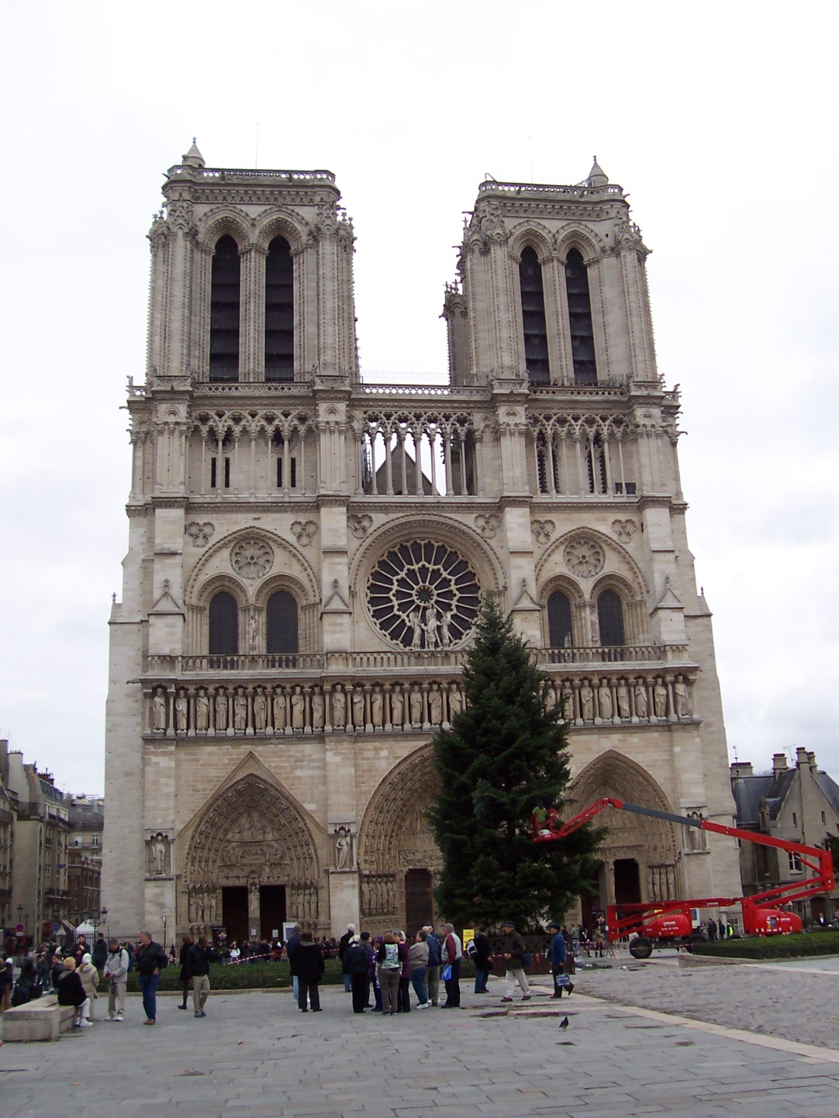
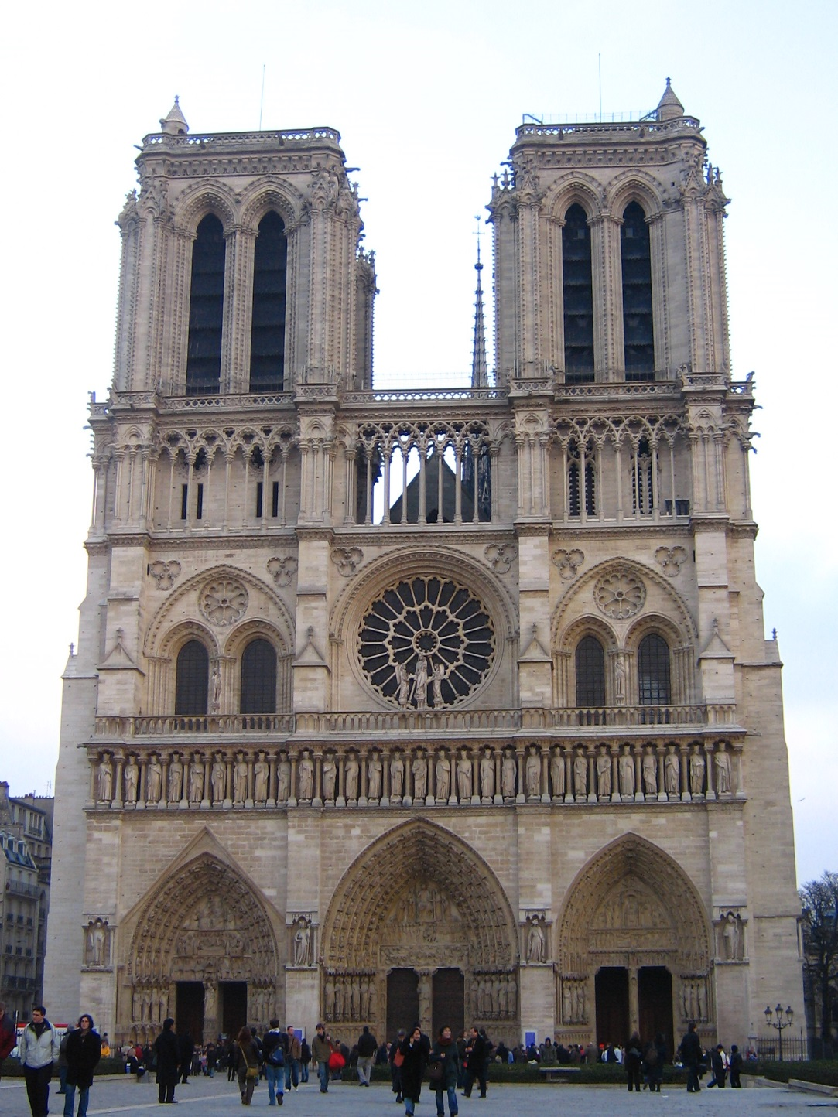
How do we decide which features match?
Distance: 0.34, 0.30, 0.40
Distance: 0.61, 1.22

Slide 3
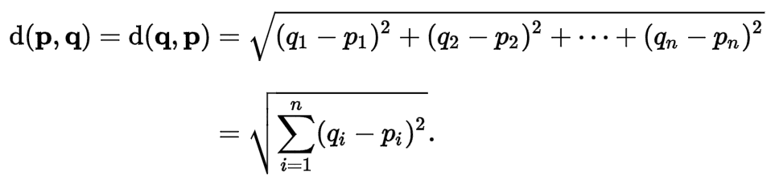

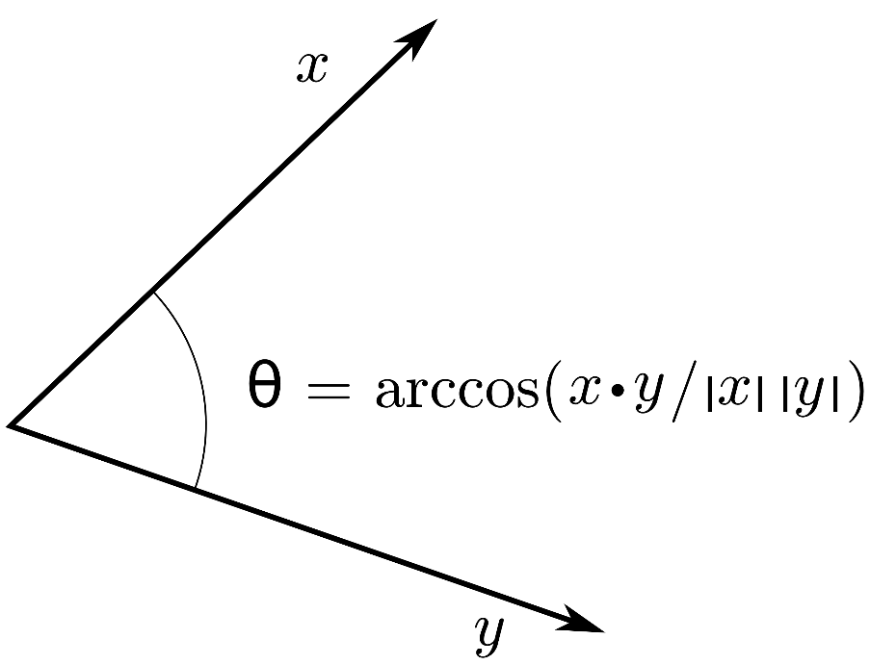


Euclidean distance vs. Cosine Similarity
Euclidean distance:
Cosine similarity:
Wikipedia
Notes:
https://en.wikipedia.org/wiki/Inner_product_space

Slide 4
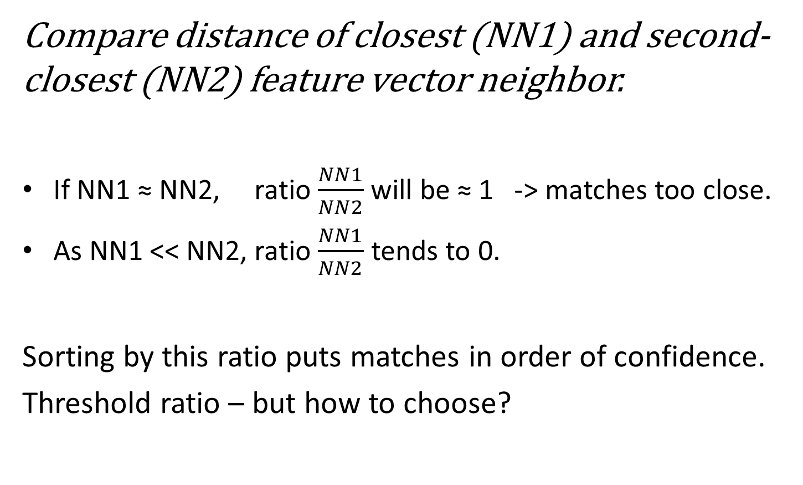
Nearest Neighbor Distance Ratio
Compare distance of closest (NN1) and second-closest (NN2) feature vector neighbor.
If NN1 ≈ NN2, ratio $\frac{NN1}{NN2}$ will be ≈ 1 -> matches too close.
As NN1 << NN2, ratio $\frac{NN1}{NN2}$ tends to 0.
Sorting by this ratio puts matches in order of confidence.
Threshold ratio – but how to choose?

Slide 5
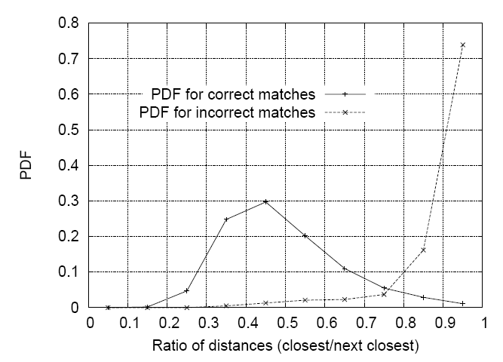
Nearest Neighbor Distance Ratio
Lowe computed a probability distribution functions of ratios
40,000 keypoints with hand-labeled ground truth
Ratio threshold depends on your application’s view on the trade-off between the number of false positives and true positives!
Lowe IJCV 2004
Notes:
Figure 11: The probability that a match is correct can be determined by taking the ratio of distance from the closest neighbor to the distance of the second closest. Using a database of 40,000 keypoints, the solid line shows the PDF of this ratio for correct matches, while the dotted line is for matches that were incorrect.

Slide 6
Where to go from our basic building block?
Feature Points
Recognition
Scenes, places, objects,
~ 5 weeks (inc. CNNs)
Reconstruction
Geometric understanding
~10th November

Slide 7
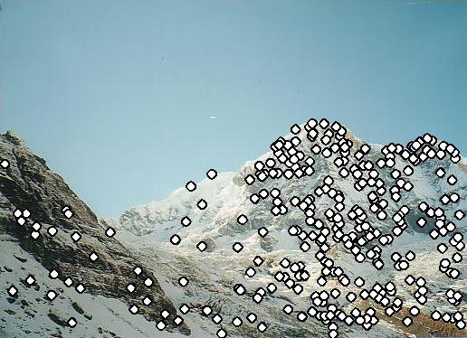
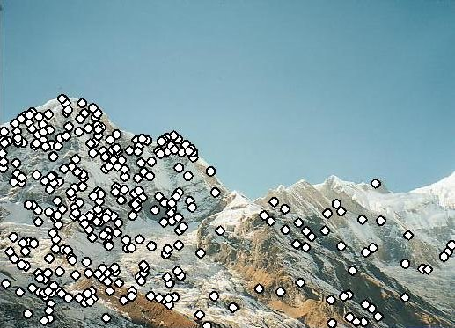
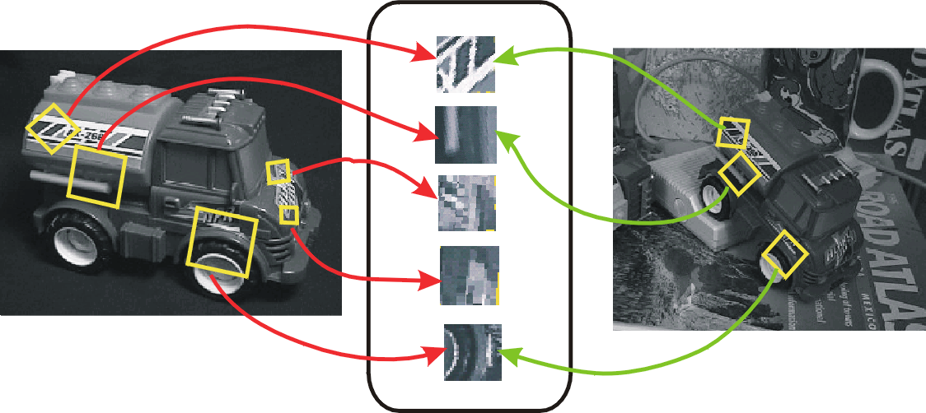
Panorama stitching / instance recognition
Often needs geometric understanding…
…but we’ll see it later on.

Slide 8
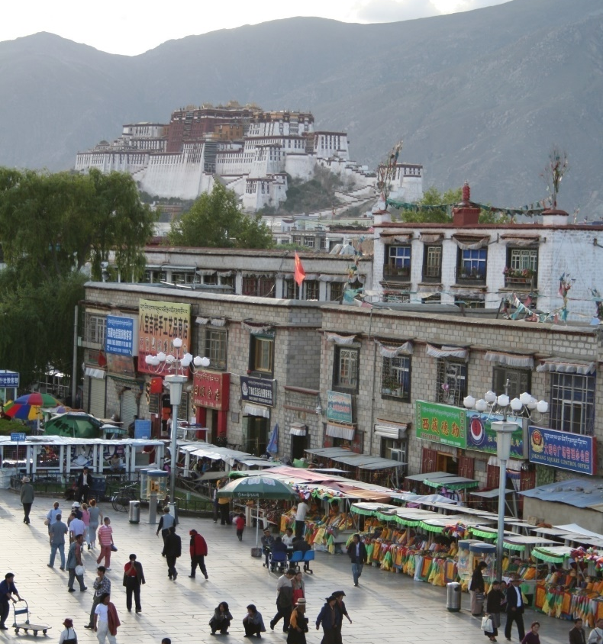

Recognition
Often needs machine learning
for compact descriptions of the visual world.
Scene recognition
- City/forest/factory/…
Find pedestrians

Slide 9
ML Crash course

Slide 10
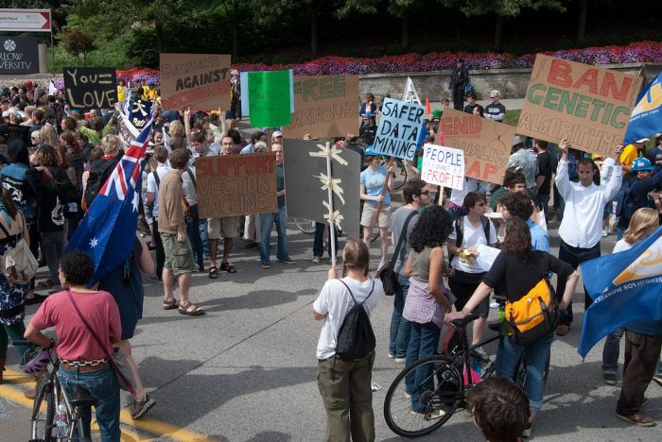
Photo: CMU Machine Learning Department Protests G20
Slides: James Hays, Isabelle Guyon, Erik Sudderth,
Mark Johnson, Derek Hoiem
Notes:
Date for photo?

Slide 11
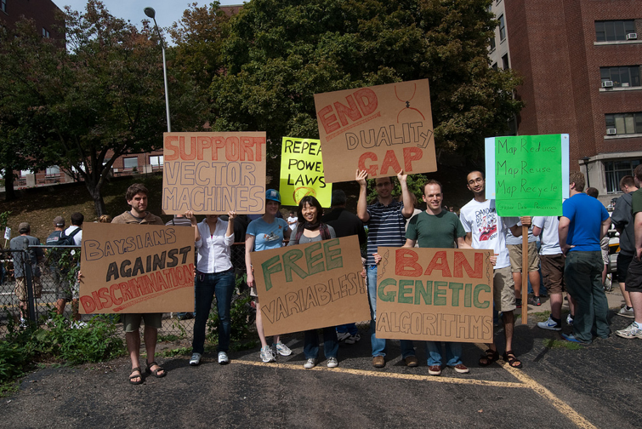
Photo: CMU Machine Learning Department Protests G20
Slides: James Hays, Isabelle Guyon, Erik Sudderth,
Mark Johnson, Derek Hoiem
Notes:
Date for photo?

Slide 12
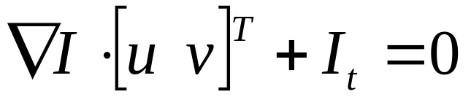
Recap: Multiple Views and Motion
Epipolar geometry
  Relates cameras in two positions
  Fundamental matrix maps from a point in one image to a line (its epipolar line) in the other
  Can solve for F given corresponding points (e.g., interest points)
Stereo depth estimation
  Estimate disparity by finding corresponding points along epipolar lines
  Depth is inverse to disparity
Motion Estimation
  By assuming brightness constancy, truncated Taylor expansion leads to simple and fast patch matching across frames
  Assume local motion is coherent
  “Aperture problem” is resolved by coarse to fine approach

Slide 13
“It is a rare criticism of elite American university students that they do not think big enough. But that is exactly the complaint from some of the largest technology companies and the federal government.
At the heart of this criticism is data. Researchers and workers in fields as diverse as bio-technology, astronomy and computer science will soon find themselves overwhelmed with information.
The next generation of computer scientists has to think in terms of what could be described as Internet scale.”
New York Times
Training to Climb an Everest of Digital Data.
By Ashlee Vance.
Published: October 11, 2009

Slide 14
Our approach
We will look at ML as a tool. We will not detail the underpinnings of each learning method.
Please take a machine learning course if you want to know more!

Slide 15
Machine Learning
Learn from and make predictions on data.
Arguably the greatest export from computing to other scientific fields.
Statisticians might disagree with CompScis on the true origins…

Slide 16
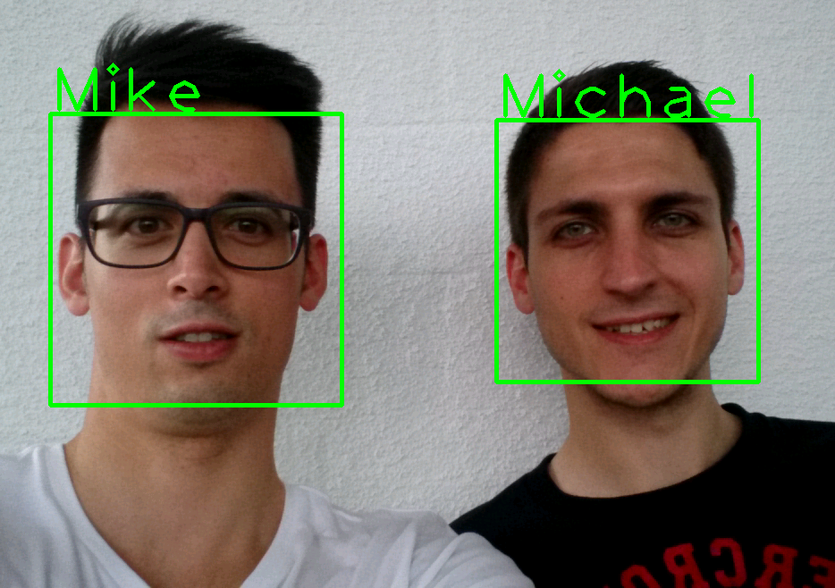
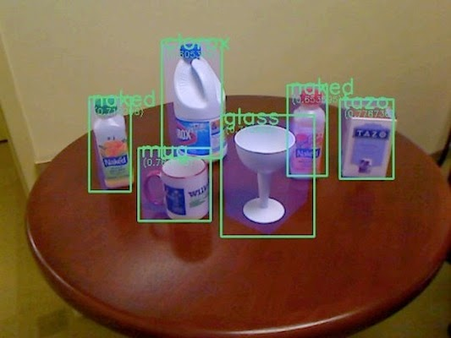
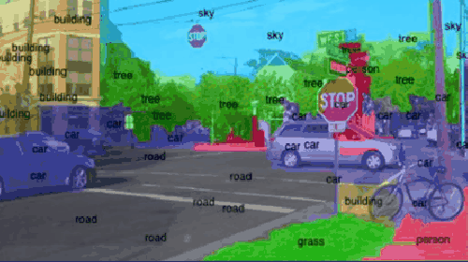
ML for Computer Vision
Face Recognition
Object Classification
Scene Segmentation
Notes:
Faces: https://play.google.com/store/apps/details?id=ch.zhaw.facerecognition – “Face Recognition” Android app
Objects: http://simon-mcav.blogspot.com/2014/09/revision-essay-in-50-minutes-object.html
Street gif: http://www.somatic.io/blog/imagenet-the-original-machine-learning-database

Slide 17
Data, data, data!
Norvig – “The Unreasonable Effectiveness of Data” (IEEE Intelligent Systems, 2009)
  “... invariably, simple models and a lot of data trump more elaborate models based on less data”

Slide 18
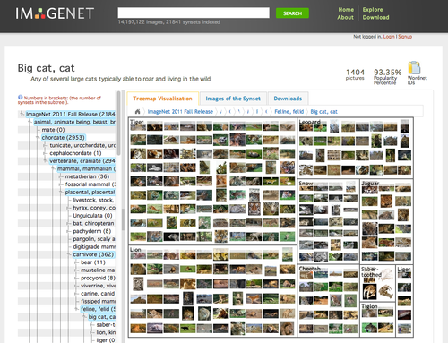
ImageNet
Images for each category of WordNet
1000 classes
1.2mil images
100k test
Top 5 error
Notes:
ImageNet Large Scale Visual Recognition Challenge
https://arxiv.org/pdf/1409.0575.pdf

Slide 19
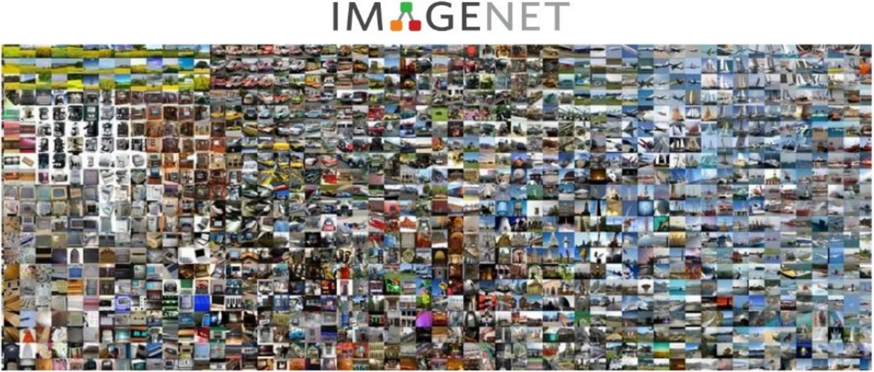
Notes:
ImageNet Large Scale Visual Recognition Challenge
https://arxiv.org/pdf/1409.0575.pdf
Thanks to Xavier Giro, https://www.slideshare.net/xavigiro/deep-learning-for-computer-vision-imagenet-challenge-upc-2016

Slide 20
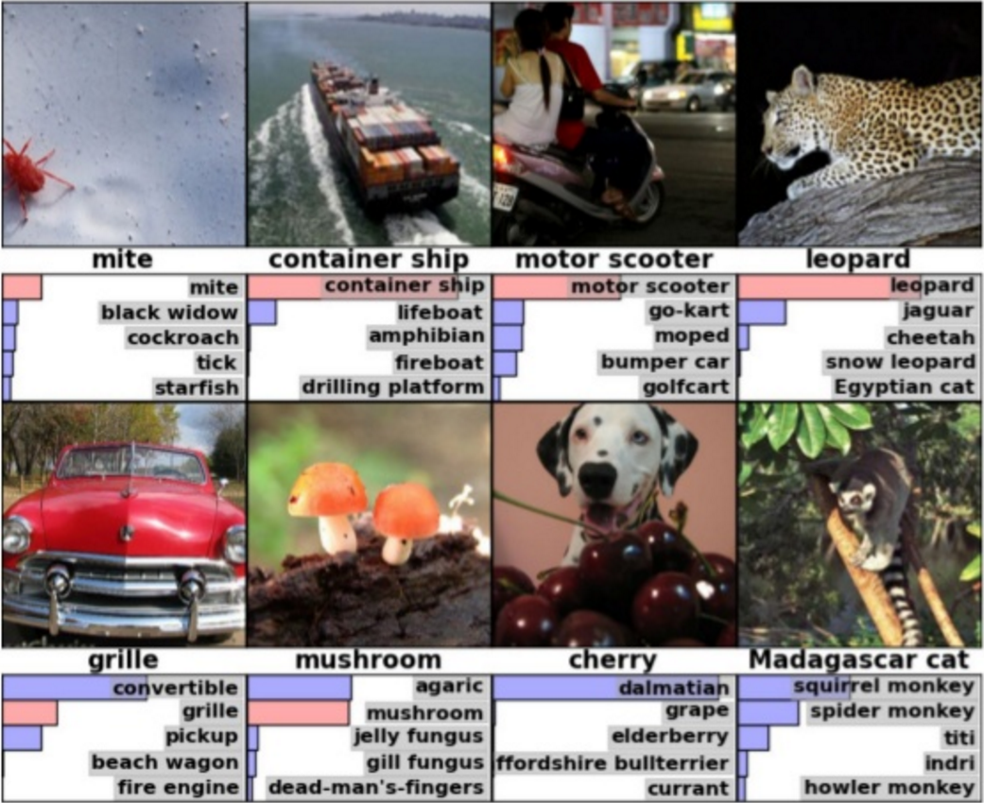

Slide 21
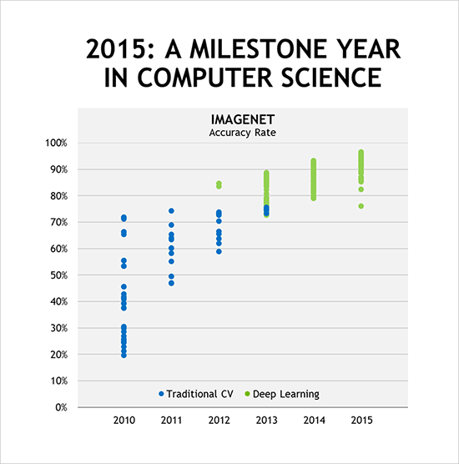
ImageNet Competition
Krizhevsky, 2012
Google, Microsoft 2015
  Beat the best human score in the ImageNet challenge.
NVIDIA
Notes:
https://blogs.nvidia.com/blog/2016/01/12/accelerating-ai-artificial-intelligence-gpus/
Alex Krizhevsky of the University of Toronto won the 2012 ImageNet computer image recognition competition.

Slide 22
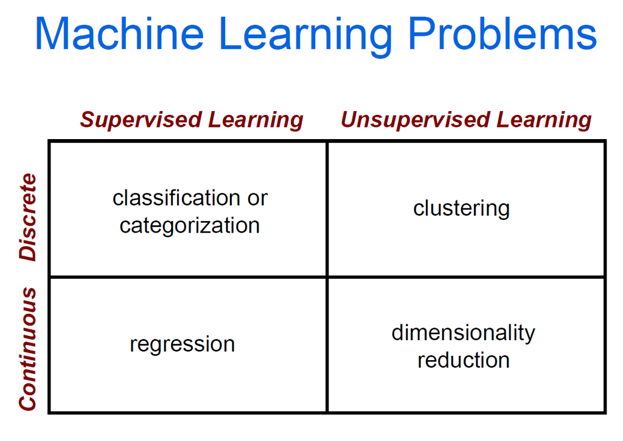

Slide 24
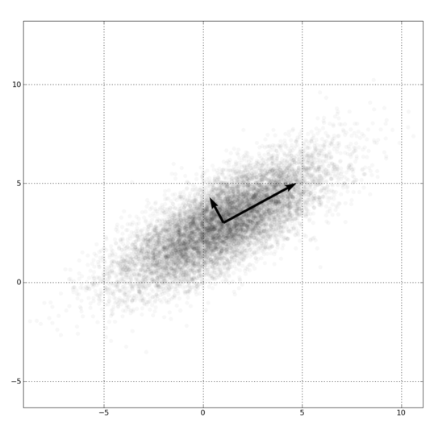
Dimensionality Reduction
PCA, ICA, LLE, Isomap
Principal component analysis
  Creates a basis where the axes represent the dimensions of variance, from high to low.
  Finds correlations in data dimensions to produce best possible lower-dimensional representation based on linear projections.

Slide 25
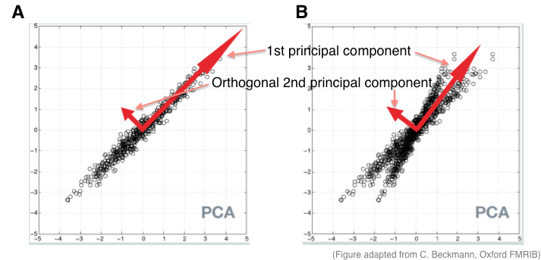

PCA
Notes:
https://www.quora.com/What-is-an-intuitive-explanation-for-PCA

Slide 26
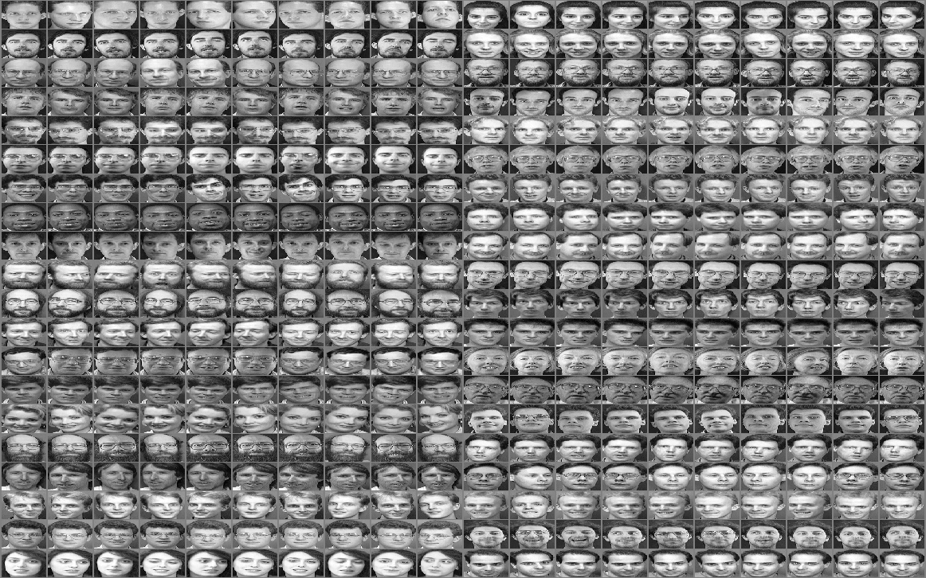
Eigenfaces
The ATT face database (formerly the ORL database), 10 pictures of 40 subjects each
Notes:
ATT Face Database
http://rduin.nl/manual/PRTools_8.html

Slide 27
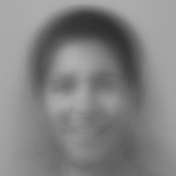
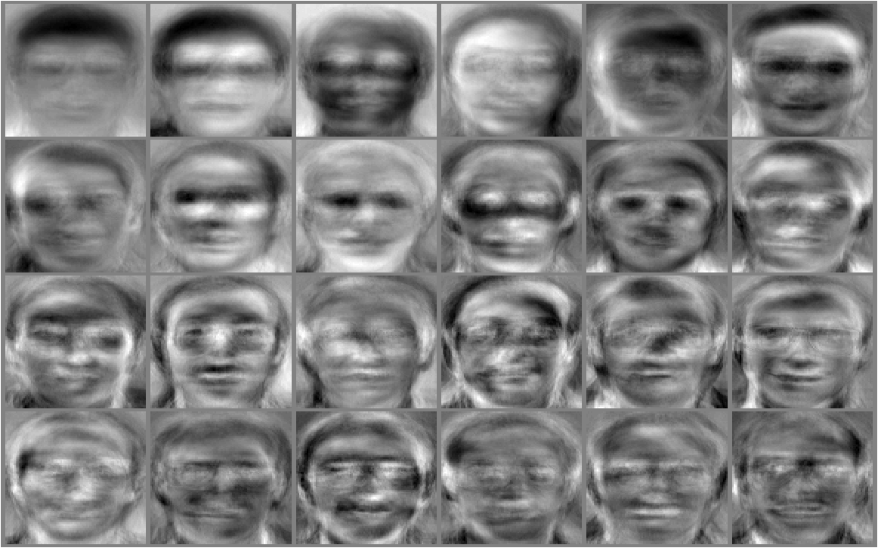
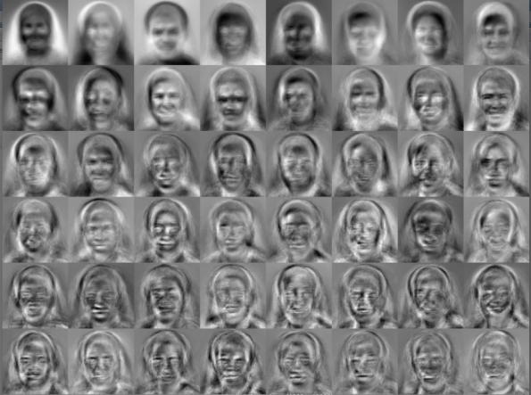
Eigenfaces
Note: the mean face is associated with this set of eigenvectors below, thanks to Kaushiik Baskaran.
Mean face
Basis of variance (eigenvectors)
M. Turk; A. Pentland (1991). "Face recognition using eigenfaces" (PDF).
Proc. IEEE Conference on Computer Vision and Pattern Recognition. pp. 586–591.
R.P.W. Duin
Notes:
https://kausherald.wordpress.com/category/final-year-project/

Slide 29
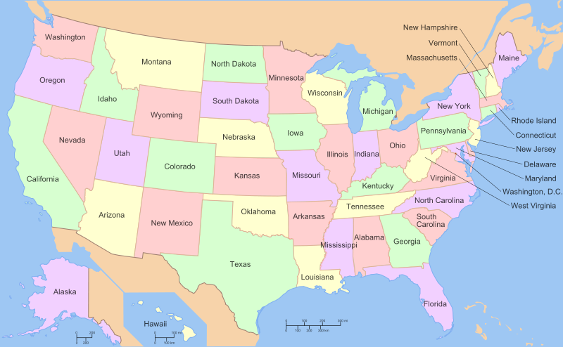

Slide 30
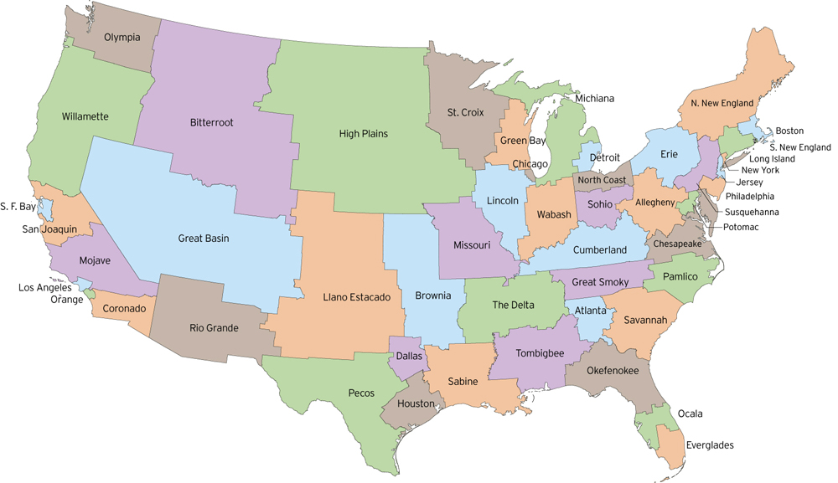
http://fakeisthenewreal.org/reform/
Notes:
~5,617,000 population in each state

Slide 31
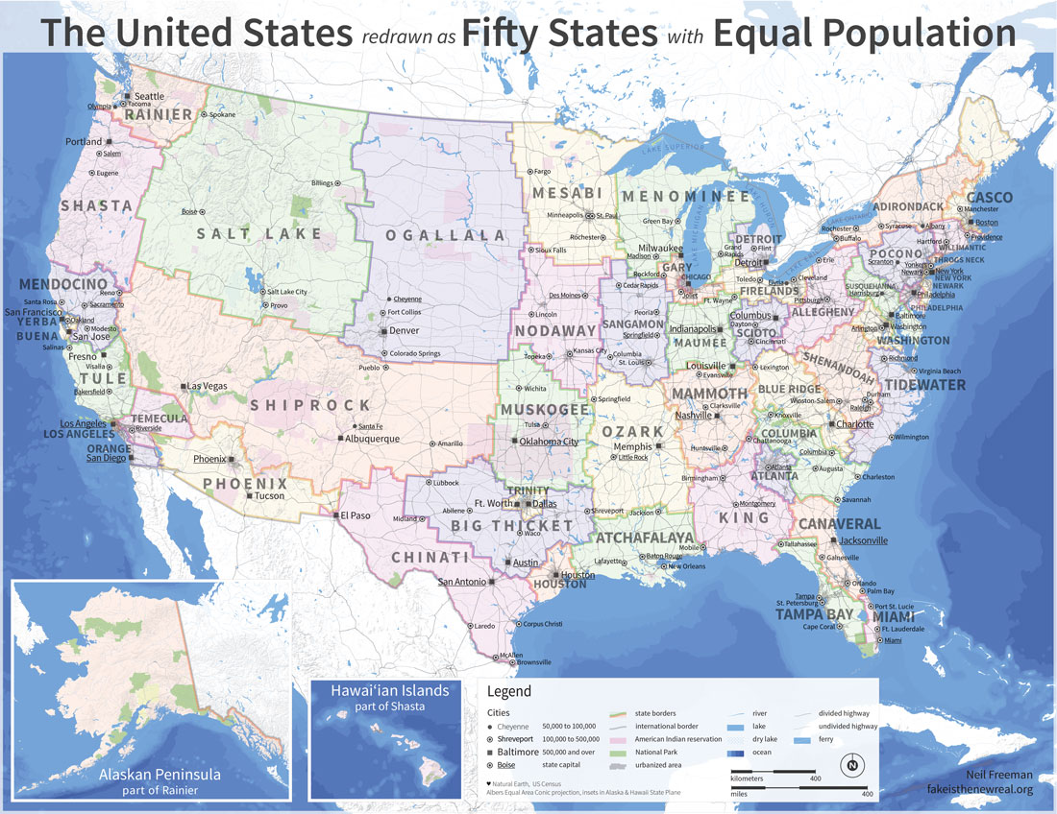
Notes:
~5,617,000 population in each state

Slide 32
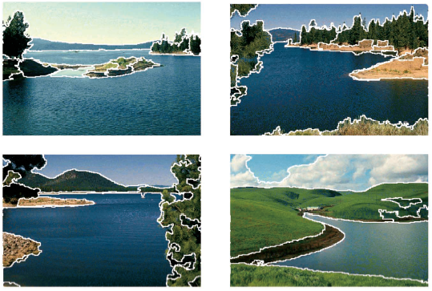
Clustering example: image segmentation
Goal: Break up the image into meaningful or perceptually similar regions

Slide 33
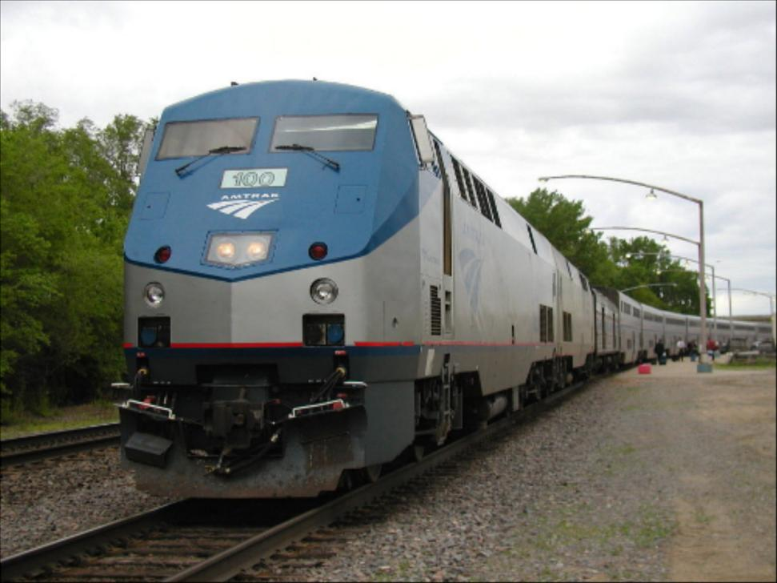
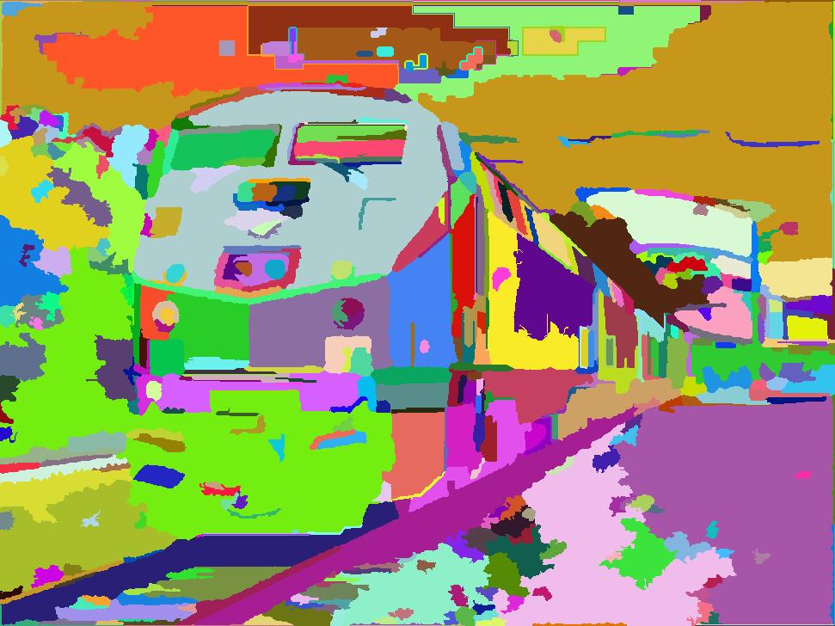

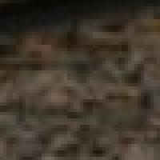
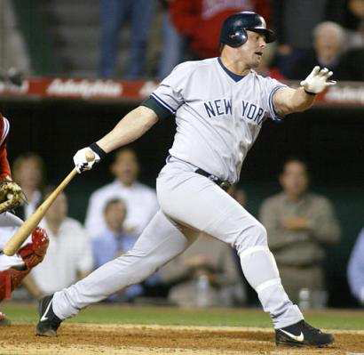
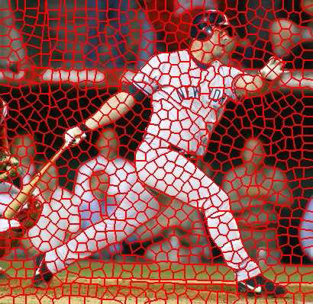
Segmentation for feature support or efficiency
50x50 Patch
50x50 Patch
[Felzenszwalb and Huttenlocher 2004]
Superpixels!
[Shi and Malik 2001]
Derek Hoiem
[Hoiem et al. 2005, Mori 2005]

Slide 34
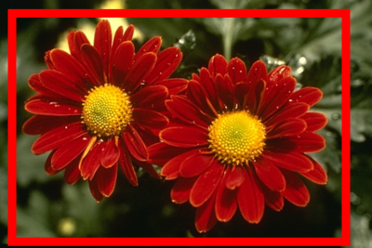
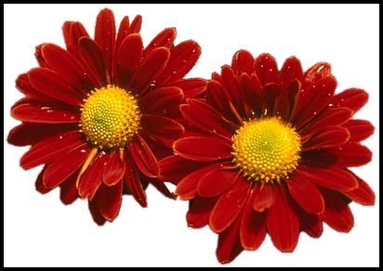
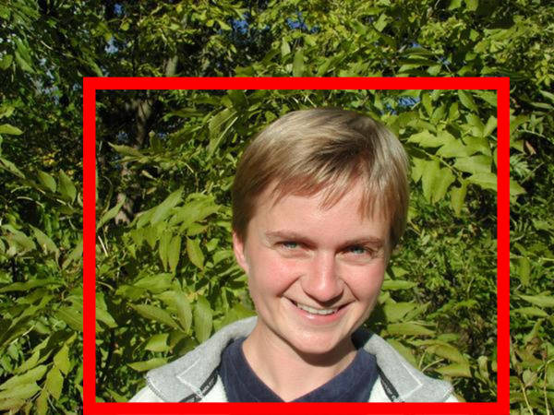
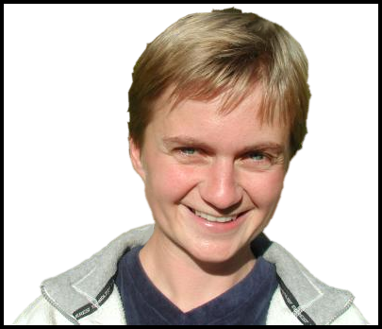
Segmentation as a result
GrabCut, Rother et al. 2004

Slide 35
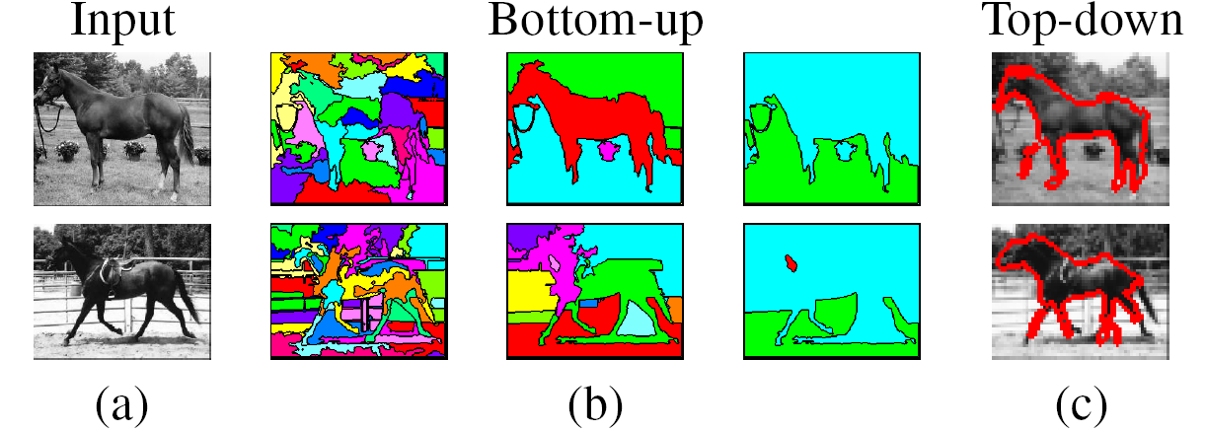
Types of segmentations
Oversegmentation
Undersegmentation
Hierarchical Segmentations

Slide 36
Major processes for segmentation
Bottom-up: group tokens with similar features
Top-down: group tokens that likely belong to the same object
[Levin and Weiss 2006]

Slide 37
Clustering
Group together similar ‘points’ and represent them with a single token.
Key Challenges:
1) What makes two points/images/patches similar?
2) How do we compute an overall grouping from pairwise similarities?
Derek Hoiem

Slide 38
Why do we cluster?
Summarizing data
  Look at large amounts of data
  Patch-based compression or denoising
  Represent a large continuous vector with the cluster number
Counting
  Histograms of texture, color, SIFT vectors
Segmentation
  Separate the image into different regions
Prediction
  Images in the same cluster may have the same labels
Derek Hoiem

Slide 39
How do we cluster?
K-means
  Iteratively re-assign points to the nearest cluster center
Agglomerative clustering
  Start with each point as its own cluster and iteratively merge the closest clusters
Mean-shift clustering
  Estimate modes of pdf
Spectral clustering
  Split the nodes in a graph based on assigned links with similarity weights

Slide 40
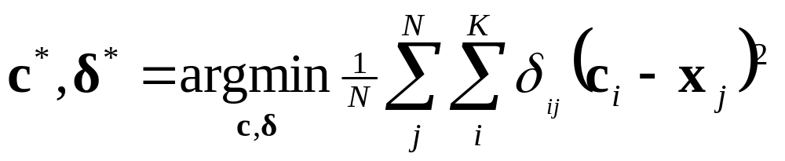
Clustering for Summarization
Goal: cluster to minimize variance in data given clusters
  Preserve information
Cluster center
Data
Whether x_{j} is assigned to c_{i}
Slide: Derek Hoiem

Slide 41
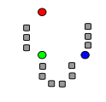
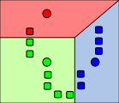
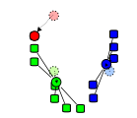
K-means algorithm
1. Randomly select K centers
2. Assign each point to nearest center
3. Compute new center (mean) for each cluster
Illustration: http://en.wikipedia.org/wiki/K-means_clustering

Slide 42
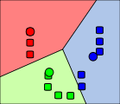
K-means algorithm
1. Randomly select K centers
2. Assign each point to nearest center
Back to 2
3. Compute new center (mean) for each cluster
Illustration: http://en.wikipedia.org/wiki/K-means_clustering

Slide 43
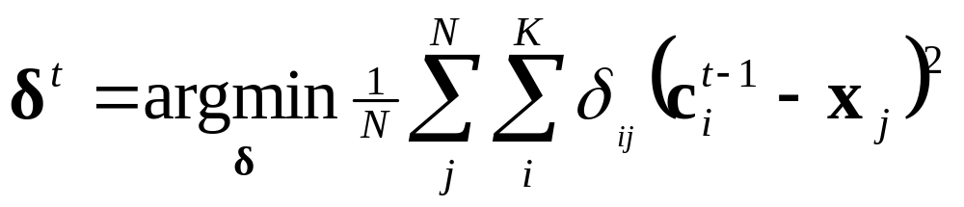
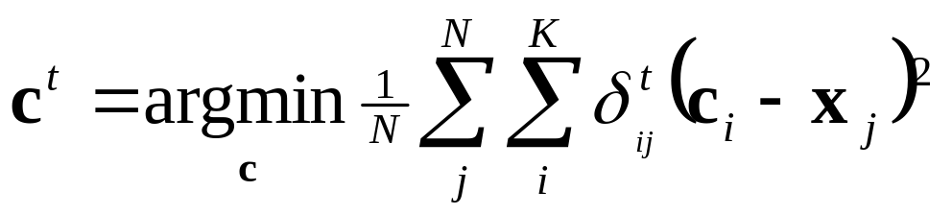
K-means
Initialize cluster centers: c⁰ ; t=0
Assign each point to the closest center
Update cluster centers as the mean of the points
Repeat 2-3 until no points are re-assigned (t=t+1)
Slide: Derek Hoiem

Slide 44
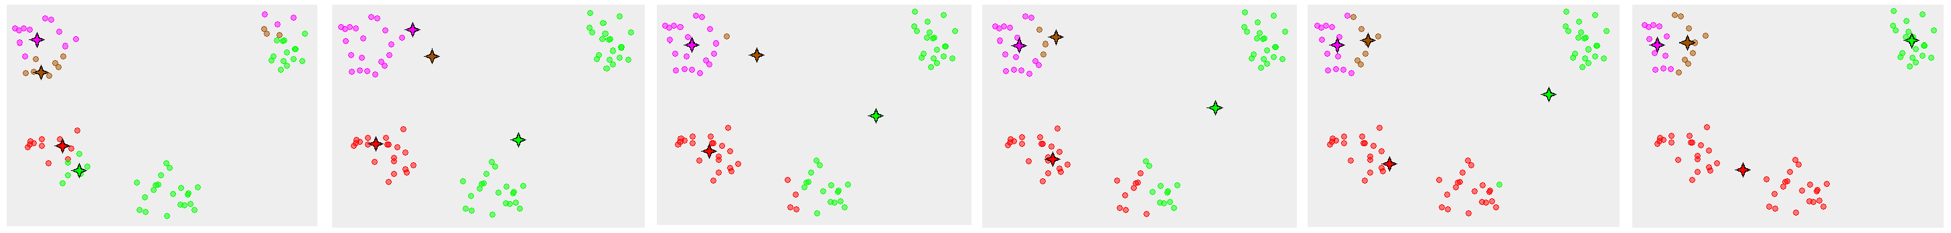
K-means convergence

Slide 45
Think-Pair-Share
What is good about k-means?
What is bad about k-means?
Where could you apply k-means?

Slide 46
K-means: design choices
Initialization
  Randomly select K points as initial cluster center
  Or greedily choose K points to minimize residual
Distance measures
  Traditionally Euclidean, could be others
Optimization
  Will converge to a local minimum
  May want to perform multiple restarts

Slide 47
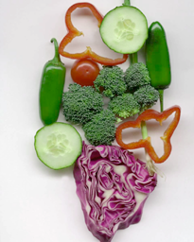


K-means clustering using intensity or color
Image
Clusters on intensity
Clusters on color
Notes:
I gave each pixel the mean intensity or mean color of its cluster --- this is basically just vector quantizing the image intensities/colors. Notice that there is no requirement that clusters be spatially localized and they’re not.

Slide 48
How to choose the number of clusters?
Validation set
  Try different numbers of clusters and look at performance
    When building dictionaries (discussed later), more clusters typically work better.
Slide: Derek Hoiem

Slide 49

How to choose the number of clusters?
Minimum Description Length (MDL) principal for model comparison
Minimize Schwarz Criterion
  also called Bayes Information Criteria (BIC)

Slide 50
How to evaluate clusters?
Generative
  How well are points reconstructed from the clusters?
Discriminative
  How well do the clusters correspond to labels?
    Purity
  Note: unsupervised clustering does not aim to be discriminative
Slide: Derek Hoiem

Slide 51
K-means demos
General
http://home.dei.polimi.it/matteucc/Clustering/tutorial_html/AppletKM.html
http://www.cs.washington.edu/research/imagedatabase/demo/kmcluster/
Color clustering

Slide 52

K-Means pros and cons
Pros
  Finds cluster centers that minimize conditional variance (good representation of data)
  Simple and fast*
  Easy to implement
Cons
  Need to choose K
  Sensitive to outliers
  Prone to local minima
  All clusters have the same parameters (e.g., distance measure is non-adaptive)
  *Can be slow: each iteration is O(KNd) for N d-dimensional points
Usage
  Cluster features to build visual dictionaries

Slide 53

Building Visual Dictionaries
Sample features from a database
  E.g., 128 dimensional SIFT vectors
Cluster to build dictionary
  Cluster centers are the dictionary words
To match new features, assign to the nearest cluster to save rebuilding dictionary

Slide 54

Examples of learned codewords
Most likely codewords for 4 learned “topics”
EM with multinomial (problem 3) to get topics
http://www.robots.ox.ac.uk/~vgg/publications/papers/sivic05b.pdf
Sivic et al. ICCV 2005

Slide 55

Agglomerative clustering

Slide 56

Agglomerative clustering

Slide 57

Agglomerative clustering

Slide 58

Agglomerative clustering

Slide 59

Agglomerative clustering

Slide 60

Agglomerative clustering
How to define cluster similarity?
Average distance between points, maximum distance, minimum distance
Distance between means or medoids
How many clusters?
Clustering creates a dendrogram (a tree)
Threshold based on max number of clusters or based on distance between merges
distance

Slide 61
Agglomerative clustering demo
http://home.dei.polimi.it/matteucc/Clustering/tutorial_html/AppletH.html

Slide 62
Conclusions: Agglomerative Clustering
Good
Simple to implement, widespread application
Clusters have adaptive shapes
Provides a hierarchy of clusters
Bad
May have imbalanced clusters
Still have to choose number of clusters or threshold
Need to use an “ultrametric” to get a meaningful hierarchy
Notes:
Ultrametric – stronger requirement than triangle inequality. Distance between two points must be at least a large as the distance of connecting those two points through any intermediate point.

Slide 63

Mean shift segmentation
D. Comaniciu and P. Meer, Mean Shift: A Robust Approach toward Feature Space Analysis, PAMI 2002.
Versatile technique for clustering-based segmentation

Slide 64



Mean shift algorithm
Try to find modes of a non-parametric density.
Color space
clusters
Color
space

Slide 65

Attraction basin
Attraction basin: the region for which all trajectories lead to the same mode
Cluster: all data points in the attraction basin of a mode
Slide by Y. Ukrainitz & B. Sarel

Slide 66

Attraction basin

Slide 67
Mean shift
Region of
interest
Center of
mass
Mean Shift
vector
Slide by Y. Ukrainitz & B. Sarel

Slide 68
Mean shift
Region of
interest
Center of
mass
Mean Shift
vector
Slide by Y. Ukrainitz & B. Sarel

Slide 69
Mean shift
Region of
interest
Center of
mass
Mean Shift
vector
Slide by Y. Ukrainitz & B. Sarel

Slide 70
Mean shift
Region of
interest
Center of
mass
Mean Shift
vector
Slide by Y. Ukrainitz & B. Sarel

Slide 71
Mean shift
Region of
interest
Center of
mass
Mean Shift
vector
Slide by Y. Ukrainitz & B. Sarel

Slide 72
Mean shift
Region of
interest
Center of
mass
Mean Shift
vector
Slide by Y. Ukrainitz & B. Sarel

Slide 73
Mean shift
Region of
interest
Center of
mass
Slide by Y. Ukrainitz & B. Sarel

Slide 74


Kernel density estimation
Kernel density estimation function
Gaussian kernel

Slide 75


Computing the Mean Shift
Simple Mean Shift procedure:
Compute mean shift vector m(x)
Iteratively translate the kernel window by m(x) until convergence.
Slide by Y. Ukrainitz & B. Sarel

Slide 76
Mean shift clustering
The mean shift algorithm seeks modes of the given set of points
  Choose kernel and bandwidth
  For each point:
    Center a window on that point
    Compute the mean of the data in the search window
    Center the search window at the new mean location
    Repeat (b,c) until convergence
  Assign points that lead to nearby modes to the same cluster

Slide 77

Segmentation by Mean Shift
Compute features for each pixel (color, gradients, texture, etc.).
Set kernel size for features K_{f} and position K_{s}.
Initialize windows at individual pixel locations.
Perform mean shift for each window until convergence.
Merge windows that are within width of K_{f} and K_{s}.

Slide 78




Mean shift segmentation results
Comaniciu and Meer 2002
Notes:
Clustering based on feature (LUV colors), location (x y coordinates), and eliminating small clusters

Slide 79
Comaniciu and Meer 2002

Slide 80
Mean-shift: other issues
Speedups
  Binned estimation
  Fast search of neighbors
  Update each window in each iteration (faster convergence)
Other tricks
  Use kNN to determine window sizes adaptively
Lots of theoretical support
  D. Comaniciu and P. Meer, Mean Shift: A Robust Approach toward Feature Space Analysis, PAMI 2002.

Slide 81
Mean shift pros and cons
Pros
  Good general-practice segmentation
  Flexible in number and shape of regions
  Robust to outliers
Cons
  Have to choose kernel size in advance
  Not suitable for high-dimensional features
When to use it
  Oversegmentation
  Multiple segmentations
  Tracking, clustering, filtering applications

Slide 82

Spectral clustering
Group points based on links in a graph
B
A

Slide 83

Cuts in a graph
B
A
Normalized Cut
  a cut penalizes large segments
  fix by normalizing for size of segments
  volume(A) = sum of costs of all edges that touch A
Source: Seitz

Slide 84

Normalized cuts for segmentation

Slide 85
Visual PageRank
Determining importance by random walk
  What’s the probability that you will randomly walk to a given node?
    Create adjacency matrix based on visual similarity
    Edge weights determine probability of transition
Jing Baluja 2008

Slide 86


Which algorithm to use?
Quantization/Summarization: K-means
  Aims to preserve variance of original data
  Can easily assign new point to a cluster
Summary of 20,000 photos of Rome using “greedy k-means”
http://grail.cs.washington.edu/projects/canonview/
Quantization for computing histograms

Slide 87




Which algorithm to use?
Image segmentation: agglomerative clustering
  More flexible with distance measures (e.g., can be based on boundary prediction)
  Adapts better to specific data
  Hierarchy can be useful
http://www.cs.berkeley.edu/~arbelaez/UCM.html

Slide 88


Things to remember
K-means useful for summarization, building dictionaries of patches, general clustering
Agglomerative clustering useful for segmentation, general clustering
Spectral clustering useful for determining relevance, summarization, segmentation

