Slide 1


Slide 2
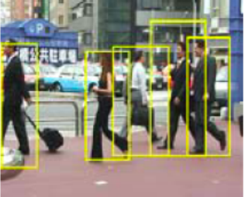
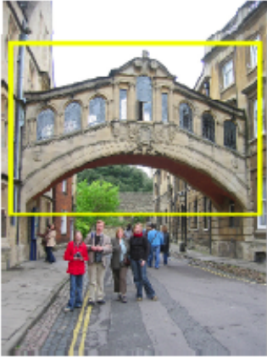
Category vs. instance recognition
Category:
  Find all the people
  Find all the buildings
  Often within a single image
  Often ‘sliding window’
Instance:
  Is this face James?
  Find this specific famous building
  Often within a database of images
Notes:
Hertford Bridge, often called "the Bridge of Sighs“ - https://en.wikipedia.org/wiki/Bridge_of_Sighs_(Oxford)
Oxford, UK

Slide 3
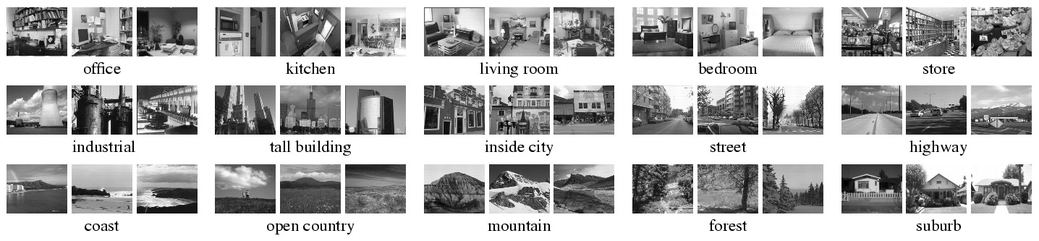
Scene recognition dataset
Instance or category?

Slide 4


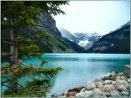

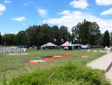
Recognition
Training
Training Labels
Training Images
Image Features
Classifier Training
Trained Classifier
Testing
Image Features
Trained Classifier
Prediction
Outdoor
Test Image

Slide 5
Recognition Issues
How to summarize the content of an entire image? How to gauge overall similarity?
How large should the vocabulary be?
How to perform quantization efficiently?
How to score the retrieval results?
How might we add more spatial verification?
Kristen Grauman

Slide 6
Recognition Issues
How to summarize the content of an entire image? How to gauge overall similarity?
How large should the vocabulary be?
How to perform quantization efficiently?
How to score the retrieval results?
How might we add more spatial verification?
Kristen Grauman

Slide 7

Analogy to documents
Of all the sensory impressions proceeding to the brain, the visual experiences are the dominant ones. Our perception of the world around us is based essentially on the messages that reach the brain from our eyes. For a long time it was thought that the retinal image was transmitted point by point to visual centers in the brain; the cerebral cortex was a movie screen, so to speak, upon which the image in the eye was projected. Through the discoveries of Hubel and Wiesel we now know that behind the origin of the visual perception in the brain there is a considerably more complicated course of events. By following the visual impulses along their path to the various cell layers of the optical cortex, Hubel and Wiesel have been able to demonstrate that the message about the image falling on the retina undergoes a step-wise analysis in a system of nerve cells stored in columns. In this system each cell has its specific function and is responsible for a specific detail in the pattern of the retinal image.
China is forecasting a trade surplus of $90bn (£51bn) to $100bn this year, a threefold increase on 2004's $32bn. The Commerce Ministry said the surplus would be created by a predicted 30% jump in exports to $750bn, compared with a 18% rise in imports to $660bn. The figures are likely to further annoy the US, which has long argued that China's exports are unfairly helped by a deliberately undervalued yuan. Beijing agrees the surplus is too high, but says the yuan is only one factor. Bank of China governor Zhou Xiaochuan said the country also needed to do more to boost domestic demand so more goods stayed within the country. China increased the value of the yuan against the dollar by 2.1% in July and permitted it to trade within a narrow band, but the US wants the yuan to be allowed to trade freely. However, Beijing has made it clear that it will take its time and tread carefully before allowing the yuan to rise further in value.
sensory, brain,
visual, perception,
retinal, cerebral cortex,
eye, cell, optical
nerve, image
Hubel, Wiesel
China, trade,
surplus, commerce,
exports, imports, US,
yuan, bank, domestic,
foreign, increase,
trade, value
ICCV 2005 short course, L. Fei-Fei

Slide 8
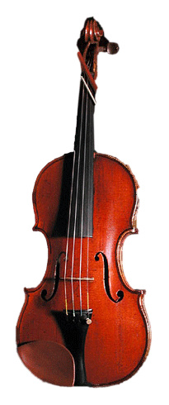
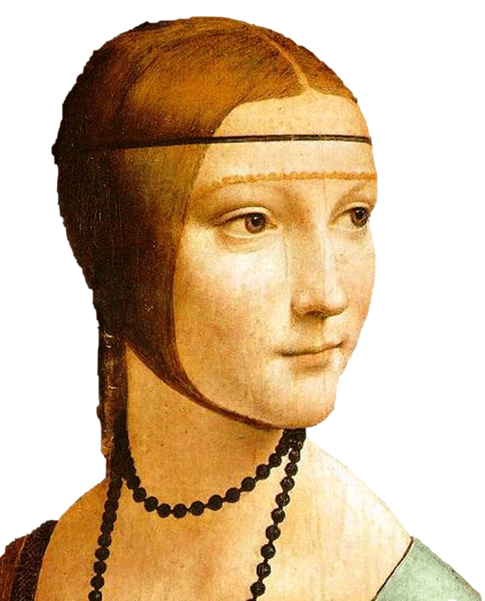
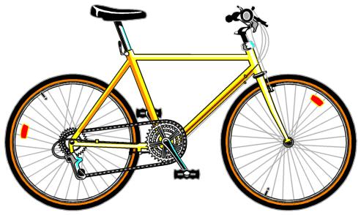
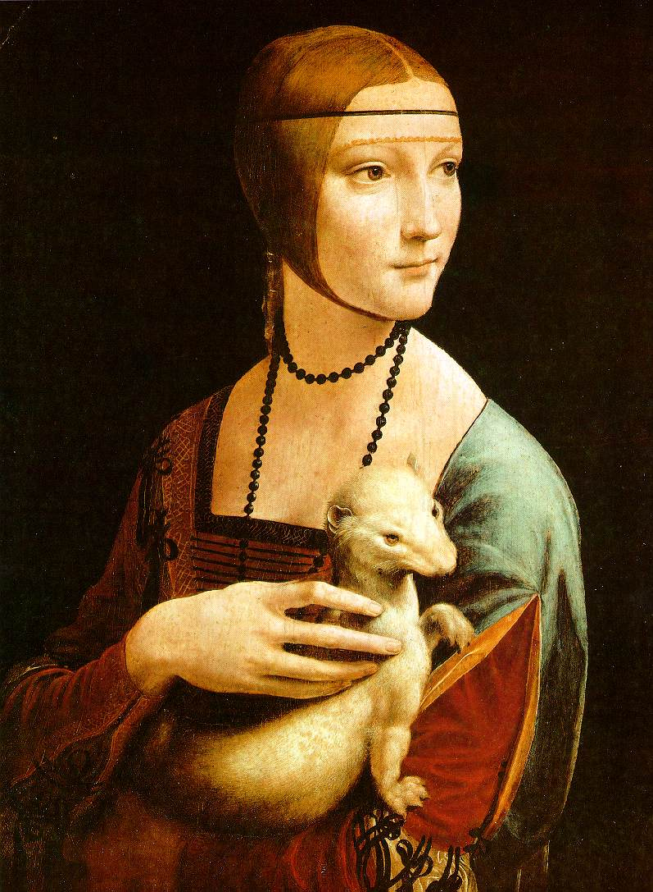
Visual words
Bag of visual words histograms
Notes:
Summarize entire image based on its distribution (histogram) of word occurrences.
Analogous to bag of words representation commonly used for documents.

Slide 9
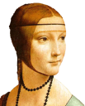






Bags of visual words
Bag of visual words histograms
Summarize entire image based on its distribution (histogram) of word occurrences.
Analogous to bag of words representation commonly used for documents.
Visual words
Notes:
9

Slide 10








Objects as texture
All of these are treated as being the same
No distinction between foreground and background: scene recognition?
Svetlana Lazebnik
Notes:
Motivation slide. Clearly location has to help, but bag-of-words doesn’t have it…

Slide 11


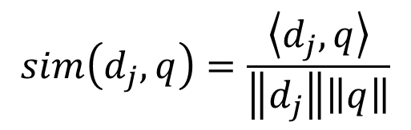
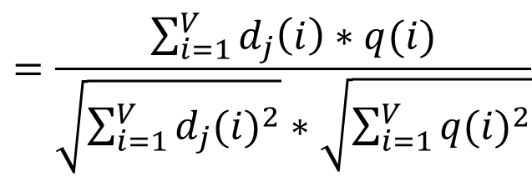





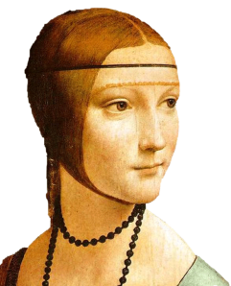
Comparing bags of words
Compute cosine similarity (normalized scalar (dot) product) between their occurrence counts, then rank and pick smallest. Nearest neighbor search for similar images.
Database image
Query
×
×
for vocabulary of V words
Kristen Grauman
Notes:
Why do we normalize the bag of words histogram feature vectors?
Allows us to cope with large differences in the number of occurrences in the images, e.g., one bicycle vs a hundred bicycles.

Slide 12
Comparing bags of words
Why might we use cosine similarity here?
What ‘intuitive’ effect does this provide?
Database image
Query
×
×
for vocabulary of V words
Kristen Grauman
Notes:
What do we use cosine similarity?
Why do we normalize the bag of words histogram feature vectors?
Only care about ‘presence’ and not ‘number’.
Allows us to cope with large differences in the number of occurrences in the images, e.g., one bicycle vs. a hundred bicycles.

Slide 13
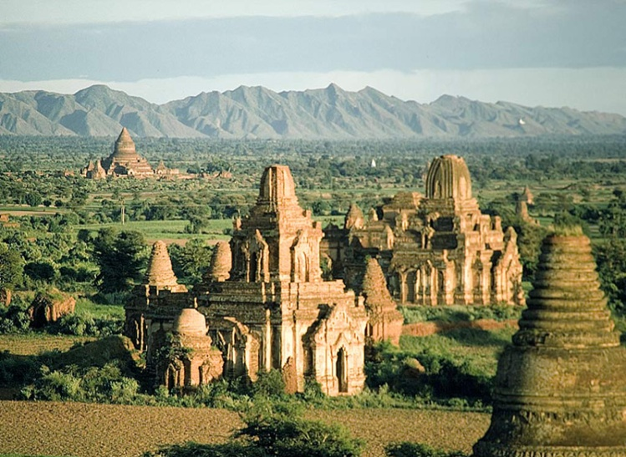
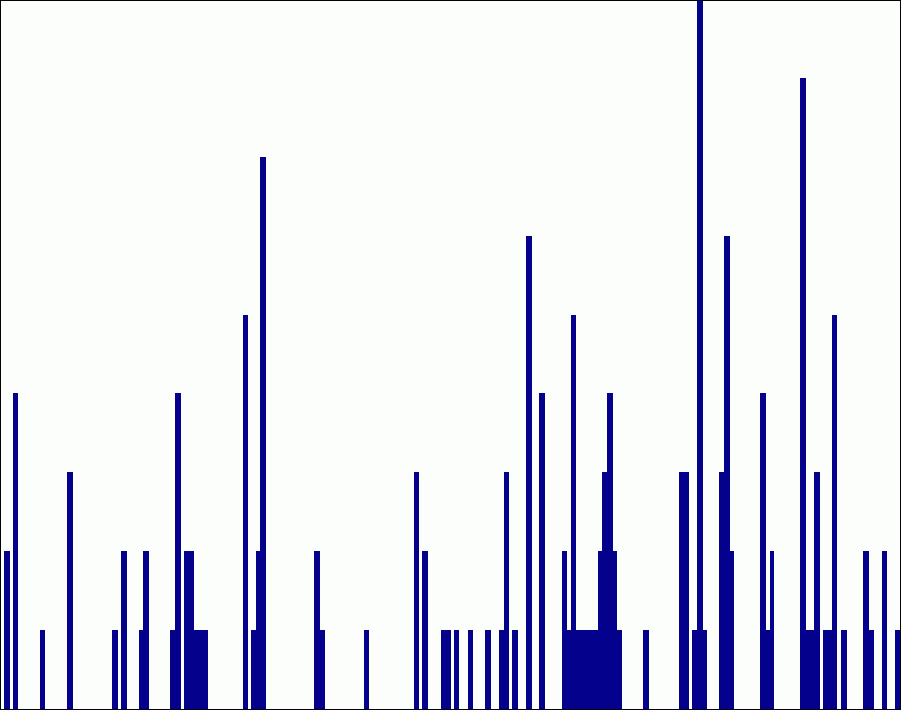










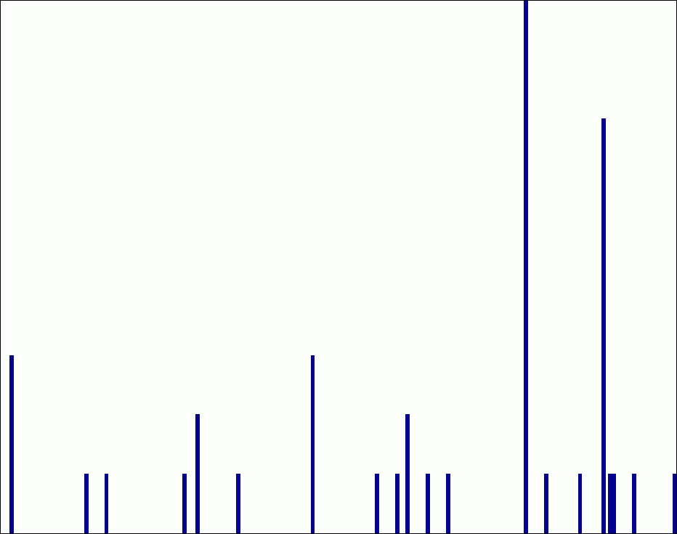
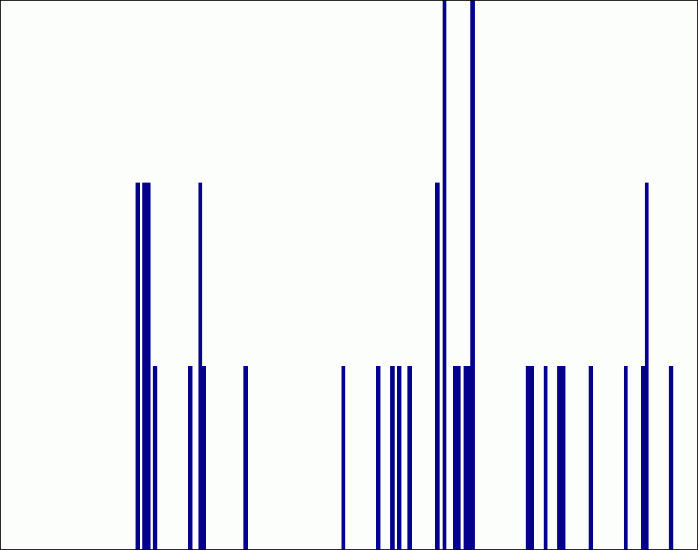








Spatial pyramid representation
Extension of a bag of features
Locally orderless representation at several levels of resolution
level 0
level 1
level 2
Lazebnik, Schmid & Ponce (CVPR 2006)

Slide 14
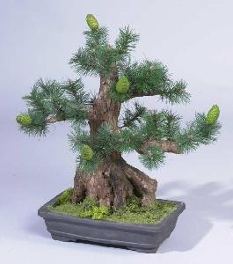
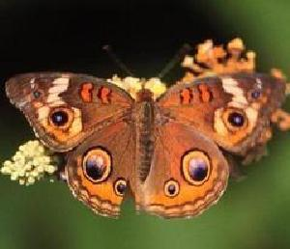
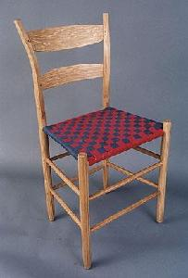
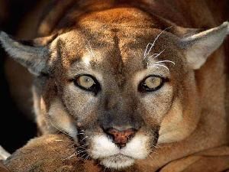

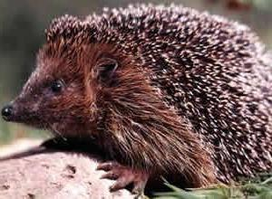
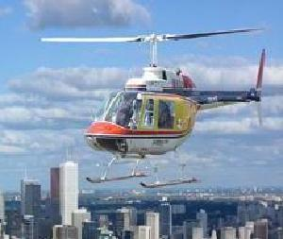
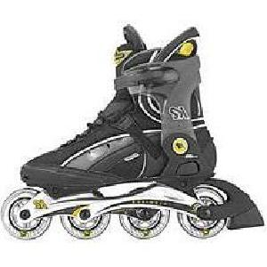
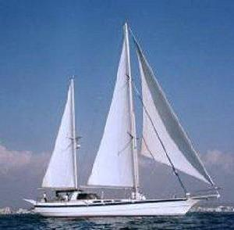

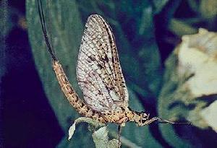
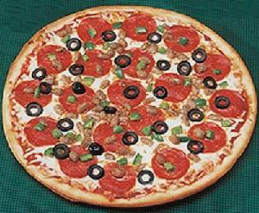
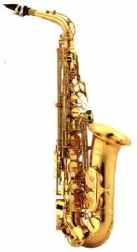
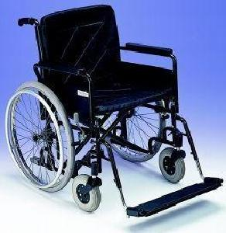
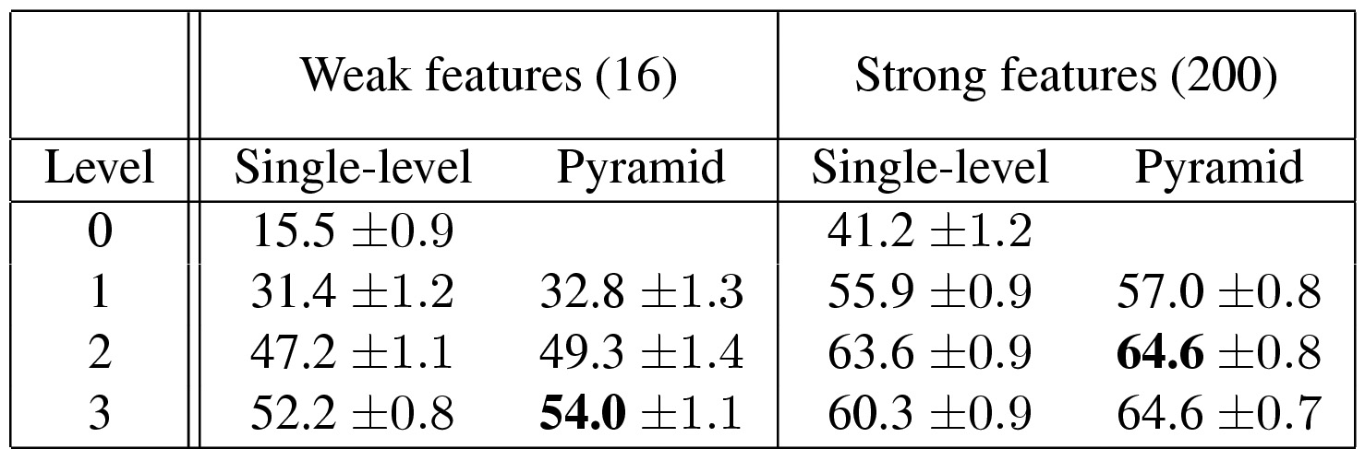
Caltech101 dataset
http://www.vision.caltech.edu/Image_Datasets/Caltech101/Caltech101.html
Multi-class classification results (30 training images per class)

Slide 15
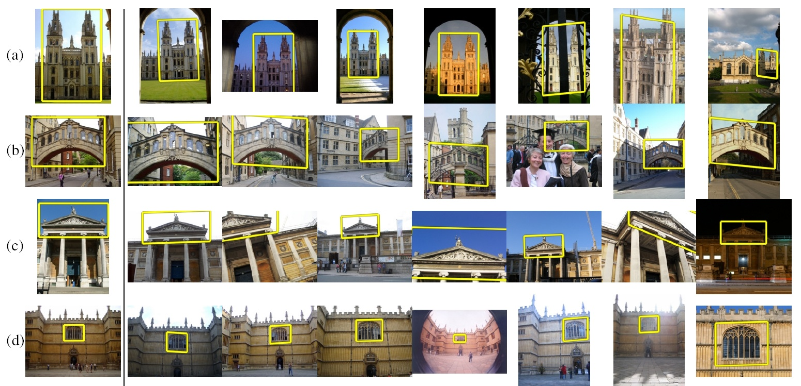
How can we quickly find images in a large database that match a given image region?
Instance recognition

Slide 16

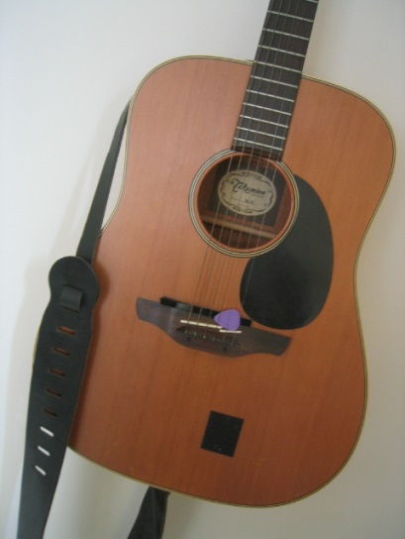
Simple idea
See how many keypoints are close to keypoints in each other image
Lots of Matches
Few or No Matches
But this will be really, really slow!

Slide 17
Indexing local features
Each patch / region has a descriptor, which is a point in some high-dimensional feature space (e.g., SIFT).
Descriptor feature space
Kristen Grauman
Notes:
17

Slide 18
Indexing local features
When we see close points in feature space, we have similar descriptors, which indicates similar local content.
Query image
Descriptor feature space
Easily can have millions of features to search!
Database images

Slide 19
Visual words
Map high-dimensional descriptors to tokens/words by quantizing the feature space.
Quantize via clustering; cluster centers are the visual “words”
Word #2
Assign word to each image region by finding the closest cluster center.
Descriptor feature space
Kristen Grauman

Slide 20
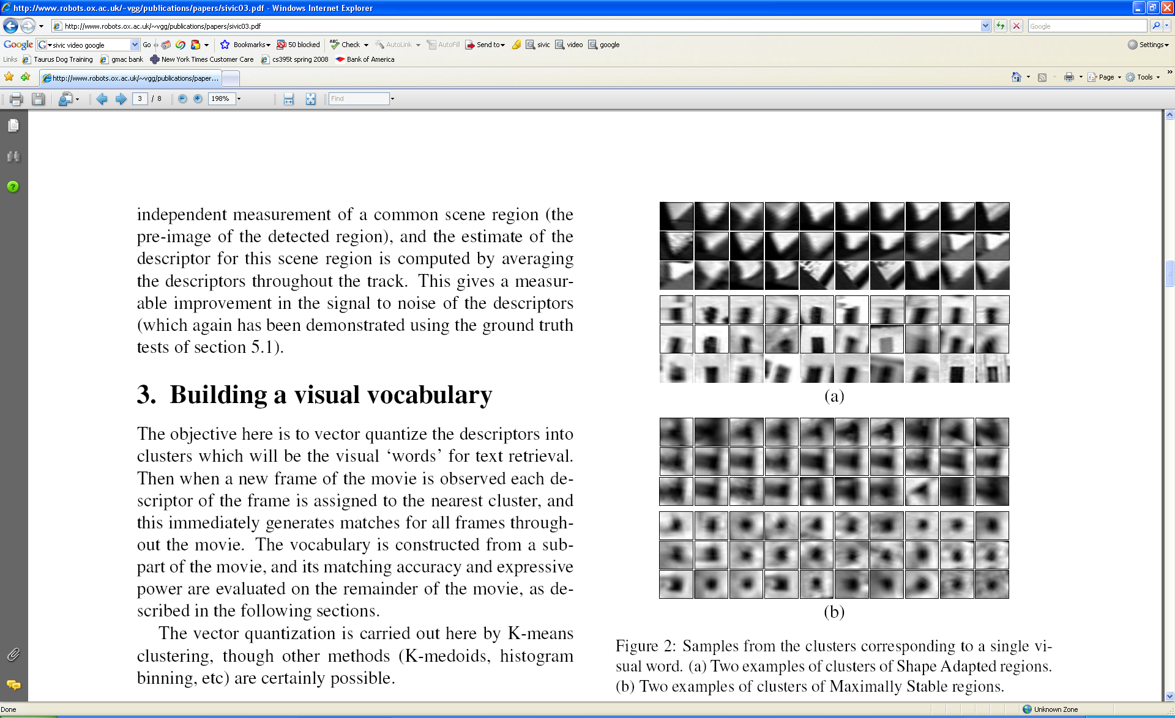
Visual words
Example: each group of patches belongs to the same visual word
Figure from Sivic & Zisserman, ICCV 2003
Kristen Grauman

Slide 21
Visual vocabulary formation
Issues:
Vocabulary size, number of words
Sampling strategy: where to extract features?
Clustering / quantization algorithm
Unsupervised vs. supervised
What corpus provides features (universal vocabulary?)
Kristen Grauman

Slide 22
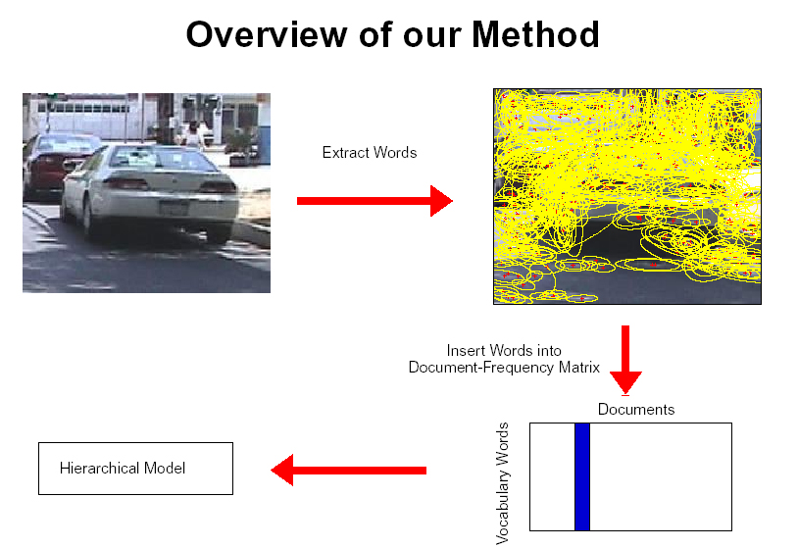
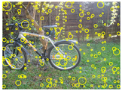
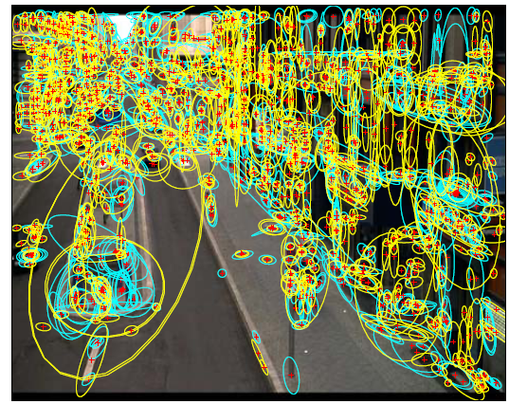
Sampling strategies
Sparse, at interest points
Dense, uniformly
Randomly
To find specific textured objects, sparse sampling from interest points often more reliable.
Multiple complementary interest operators offer more image coverage.
For object categorization, dense sampling offers better coverage.
[See Nowak, Jurie & Triggs, ECCV 2006]
Multiple interest operators
Image credits: F-F. Li, E. Nowak, J. Sivic

Slide 23
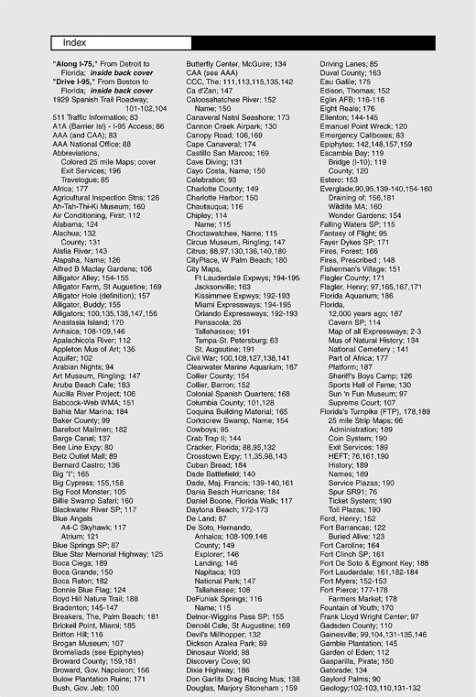
Fast lookup: inverted index
For text documents, an efficient way to find all pages on which a word occurs is to use an index…
We want to find all images in which a feature occurs.
Kristen Grauman
Notes:
‘Inverted’ is in contrast to a ‘forward index’, which maps from documents (images) to content (features).

Slide 24
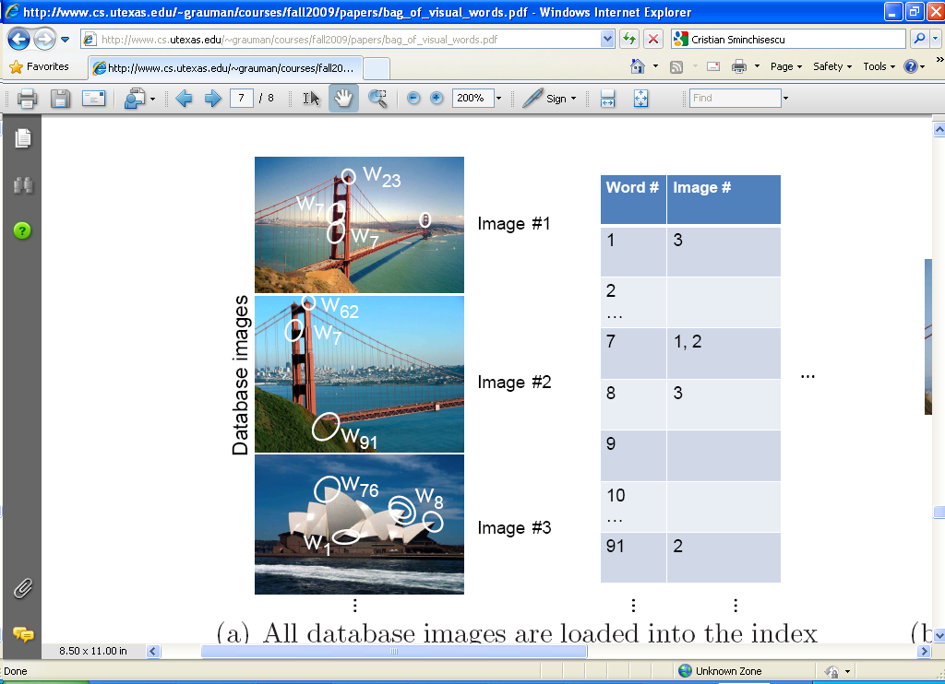
Build Inverted Index from Database
Kristen Grauman

Slide 25
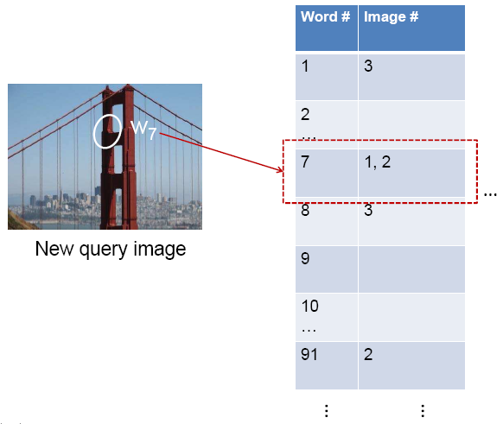
Query Inverted Index
Candidate matches
Kristen Grauman

Slide 26
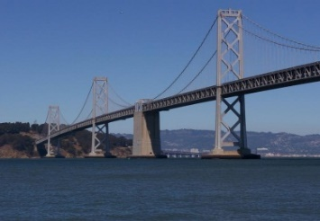
Query Inverted Index
Candidate matches
w₉₁
Extract words in query
Inverted file index to
find relevant frames
Compare/sort word counts
Kristen Grauman
Notes:
Often we wish to return not just the best matching, but a top k matching images.
What is the critical condition on this index being efficient?

Slide 27
Inverted index
Key requirement: sparsity.
If most images contain most words, then we’re not better off than exhaustive search.
  Exhaustive search would mean comparing the visual word distribution of a query versus every page.

Slide 28
Recognition Issues
How to summarize the content of an entire image? And gauge overall similarity?
How large should the vocabulary be? How to perform quantization efficiently?
How to score the retrieval results?
How might we add more spatial verification?
Following slides by David Nister (CVPR 2006)
Kristen Grauman

Slide 29
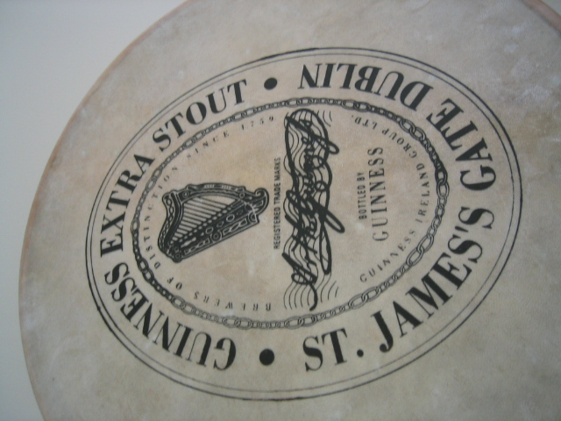
Training the vocabulary tree
Notes:
I will now try to describe the approach with an animation.
The first, offline phase, is to train the vocabulary tree.
We use Maximally Stable Extremal Regions by Matas et al. and then we extract SIFT descriptors from the MSER regions.
Regarding the feature extraction, we are not really claiming anything other than down-in-the-trenches nose-to-the-grindstone hard work to get good implementations of the state-of-the-art, and since we are all obsessed with novelty I will not spend any time talking about the feature extraction.
We believe that the vocabulary tree approach will work well on any of your favorite descriptors.

Slide 30
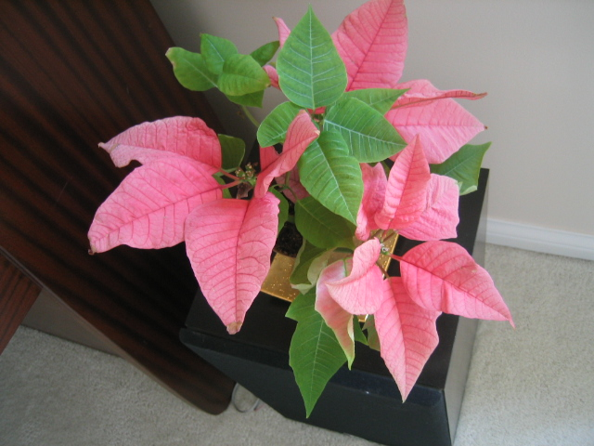
Training the vocabulary tree
Notes:
All the descriptor vectors are thrown into a common space.
This is done for many images, the goal being to acquire enough statistics on how natural images distribute points in the descriptor space.

Slide 31
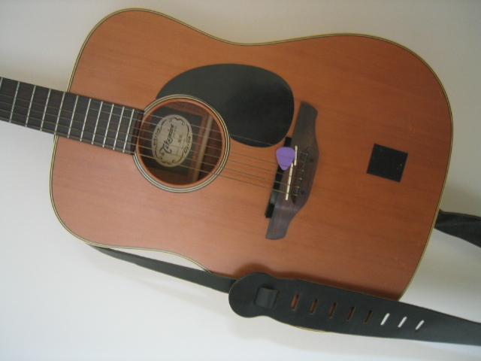
Training the vocabulary tree

Slide 32
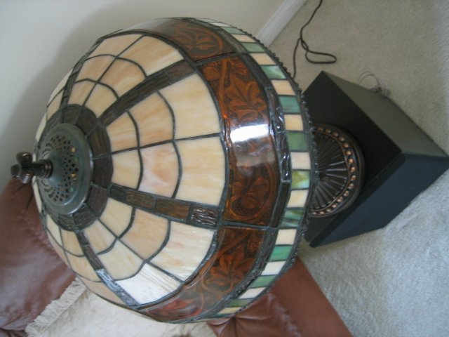
Training the vocabulary tree

Slide 33

Training the vocabulary tree

Slide 34
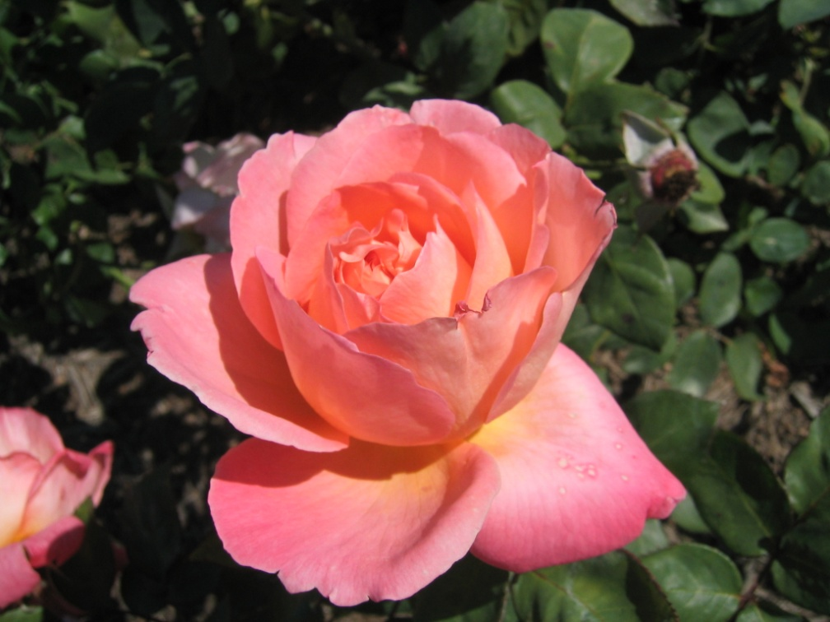
Training the vocabulary tree

Slide 36
Notes:
We then run k-means on the descriptor space. In this setting, k defines what we call the branch-factor of the tree, which indicates how fast the tree branches.
In this illustration, k is three. We then run k-means again, recursively on each of the resulting quantization cells.
This defines the vocabulary tree, which is essentially a hierarchical set of cluster centers and their corresponding Voronoi regions.
We typically use a branch-factor of 10 and six levels, resulting in a million leaf nodes. We lovingly call this the Mega-Voc.

Slide 46
Vocabulary tree built recursively
Notes:
We now have the vocabulary tree, and the online phase can begin.
In order to add an image to the database, we perform feature extraction. Each descriptor vector is now dropped down from the root of the tree and quantized very efficiently into a path down the tree, encoded by a single integer.
Each node in the vocabulary tree has an associated inverted file index.
Indices back to the new image are then added to the relevant inverted files.
This is a very efficient operation that is carried out whenever we want to add an image.

Slide 47
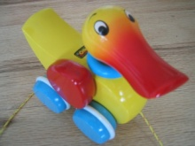

Each leaf has inverted index

Slide 48
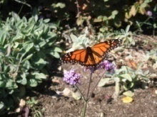


Slide 49
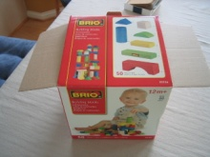


Slide 50
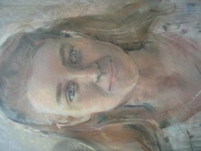

Inverted index built.

Slide 51
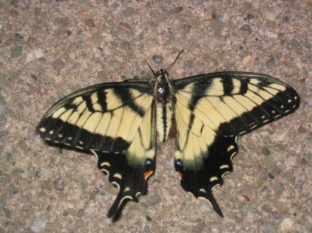
Query image
Notes:
When we then wish to query on an input image, we quantize the descriptor vectors of the input image in a similar way, and accumulate scores for the images in the database with so called term frequency inverse document frequency (tf-idf). This is effectively an entropy weighting of the information. The winner is the image in the database with the most common information with the input image.

Slide 52


Vocabulary size
Recognition with 6347 images
Branching factors
Nister & Stewenius, CVPR 2006
Influence on performance, sparsity
Kristen Grauman

Slide 53

Higher branch factor works better (but slower)
Notes:
We also find that performance improves with the branch factor.
This improvement is not dramatic, but it is interesting to note that very low branch factors are somewhat weak, and a branch factor of two results in partitioning the space with planes.

Slide 54
Vocabulary trees: complexity
Number of words given tree parameters: branching_factor^^{number_of_levels}
Word assignment cost vs. flat vocabulary:
O(k) for flat
O(log_{branching_factor}(k) * branching_factor)
Is this like a kd-tree?
Yes, but with better partitioning and defeatist search.
This hierarchical data structure is lossy – you might not find your true nearest cluster.
Notes:
Number of words = (branching_factor)^(number_of_levels)
Assignment cost for flat hierarchy O(k), for tree O(log(base branching_factor)(k) * branching_factor)

Slide 55



(2006) 110,000,000 images in 5.8 Seconds
Slide
David Nister
Notes:
Very recently, we have scaled the system even further.
The system we just demo’d searches a 50 thousand image index in the RAM of this laptop at real-time rates.
We have built and programmed a desktop system at home in which we currently have 12 hard drives. We bypass the operating system and
read and write the disk surfaces directly.
Last week this system clocked in on 110 Million images in 5.8 seconds, so roughly 20Million images per second and machine.
The images consist of around 10 days of four TV channels, so more than a month of TV.
Soon we don’t have to watch TV, because we’ll have machines doing it for us.

Slide 56


Slide
David Nister
Notes:
To continue the analogy, if we printed all these images on paper, and stacked them,

Slide 57

Slide
David Nister
Notes:
The pile would stack, as high as

Slide 58

David Nister
Notes:
Mount Everest.
Another way to put perspective on this is, Google image search not too long ago claimed to index 2 billion images,
although based on meta-data, while we do it based on image content.
So, with about 20 desktop systems like the one I just showed, it seems that it may be possible to build a web-scale content-based image search engine,
and we are sort of hoping that this paper will fuel the race for the first such search engine.
So, that is some motivation.
Let me now move to the contribution of the paper.
As you can guess by now, it is about scalability of recognition and retrieval.

Slide 59































Performance
Notes:
One of the reasons we managed to take the system this far is that we have worked with rigorous performance testing against a database with ground truth.
We now have a benchmark database with over 10000 images grouped in sets of four images of the same object. We query on one of the images in the group and see how many of the other images in the group make it to the top of the query.
In the paper, we have tested this up to a million images, by embedding the ground truth database into a database encompassing all the frames of 10 feature length movies.

Slide 60
Visual words/bags of words
+ flexible to geometry / deformations / viewpoint
+ compact summary of image content
+ provides fixed dimensional vector representation for sets
+ very good results in practice
background and foreground mixed when bag covers whole image -> is it really instance recognition?
optimal vocabulary formation remains unclear
basic model ignores geometry – must verify afterwards, or encode via features
Kristen Grauman
Notes:
60

Slide 61
Recognition Issues
How to summarize the content of an entire image? And gauge overall similarity?
How large should the vocabulary be? How to perform quantization efficiently?
How to score the retrieval results?
How might we add more spatial verification?
Kristen Grauman

Slide 62


Precision and Recall
True positive (tp) – correct attribution
True negative (tn) – correct rejection
False positive (fp) – incorrect attribution
False negative (fn) – incorrect rejection
Precision = #relevant / #returned
Recall = #relevant / #total relevant
By Walber - Own work, CC BY-SA 4.0,
https://commons.wikimedia.org/w/index.php?curid=36926283

Slide 63











Scoring retrieval quality
Results (ordered):
Database size: 10 images
Relevant (total): 5 images
Query
precision = #relevant / #returned
recall = #relevant / #total relevant
1
0.8
0.6
precision
0.4
0.2
0
0
0.2
0.4
0.6
0.8
1
recall
Slide credit: Ondrej Chum

Slide 64
What else can we borrow from text retrieval?
China is forecasting a trade surplus of $90bn (£51bn) to $100bn this year, a threefold increase on 2004's $32bn. The Commerce Ministry said the surplus would be created by a predicted 30% jump in exports to $750bn, compared with a 18% rise in imports to $660bn. The figures are likely to further annoy the US, which has long argued that China's exports are unfairly helped by a deliberately undervalued yuan. Beijing agrees the surplus is too high, but says the yuan is only one factor. Bank of China governor Zhou Xiaochuan said the country also needed to do more to boost domestic demand so more goods stayed within the country. China increased the value of the yuan against the dollar by 2.1% in July and permitted it to trade within a narrow band, but the US wants the yuan to be allowed to trade freely. However, Beijing has made it clear that it will take its time and tread carefully before allowing the yuan to rise further in value.
China, trade,
surplus, commerce,
exports, imports, US,
yuan, bank, domestic,
foreign, increase,
trade, value

Slide 65

tf-idf weighting
Term frequency – inverse document frequency
Describe image by frequency of each word within it, downweight words that appear often in the database
(Standard weighting for text retrieval)
Number of occurrences of word i in document d
Total number of documents in database
Number of documents word i occurs in, in whole database
Number of words in document d
Kristen Grauman

Slide 66
Query expansion
Query: golf green
Results:
- How can the grass on the greens at a golf course be so perfect?
For example, a skilled golfer expects to reach the green on a par-four hole in ...
- Manufactures and sells synthetic golf putting greens and mats.
Irrelevant result can cause a `topic drift’:
Volkswagen Golf, 1999, Green, 2000cc, petrol, manual, , hatchback, 94000miles, 2.0 GTi, 2 Registered Keepers, HPI Checked, Air-Conditioning, Front and Rear Parking Sensors, ABS, Alarm, Alloy
Slide credit: Ondrej Chum
Notes:
Query expansion is a technique to increase recall, possibly at the expense of precision.

Slide 67















Query expansion
Results
…
Spatial verification
Query image
New results
New query
Chum, Philbin, Sivic, Isard, Zisserman: Total Recall…, ICCV 2007
Ondrej Chum

Slide 68
Recognition Issues
How to summarize the content of an entire image? And gauge overall similarity?
How large should the vocabulary be? How to perform quantization efficiently?
How to score the retrieval results?
How might we add more spatial verification?
Kristen Grauman

Slide 69
Can we be more accurate?
So far, we treat each image as containing a “bag of words”, with no spatial information
Which matches better?
e
h
a
e
z
f
e
a
f
e
h
a
f
e
e
Real objects have
consistent geometry

Slide 70







Multi-view matching
?
vs
…
Matching two given views for depth
Search for a matching view for recognition
Kristen Grauman

Slide 71


Spatial Verification
Query
Query
DB image with high BoW similarity
DB image with high BoW similarity
Both image pairs have many visual words in common.
Slide credit: Ondrej Chum

Slide 72


Spatial Verification
Query
Query
DB image with high BoW similarity
DB image with high BoW similarity
Only some of the matches are mutually consistent
with real-world geometry imaged by a camera.
Ondrej Chum

Slide 73
Spatial Verification: two basic strategies
RANSAC
  Typically sort by BoW similarity as initial filter
  Verify by checking support (inliers) for possible transformations
    e.g., “success” if find a transformation with > N inlier correspondences
Generalized Hough Transform
  Let each matched feature cast a vote on location, scale, orientation of the model object
  Verify parameters with enough votes
Kristen Grauman

Slide 74
RANSAC verification

Slide 75




Recall: Fitting an affine transformation
Approximates viewpoint changes for roughly planar objects and roughly orthographic cameras.

Slide 76
RANSAC verification
No verification
Fails to meet threshold on # inliers! Good!

Slide 77
Recognition via alignment
  Pros:
  Effective for reliable features within clutter
  Great for matching specific instances
  Cons:
  Expensive post-process (how long for proj3?!)
  Not suited for category recognition
Kristen Grauman

Slide 78
Summary
Bag of words: quantize feature space into discrete visual words
  Summarize image by distribution of words
Inverted index: visual word index for faster query time
Evaluation:
Additional spatial verification alignment:
  Robust fitting : RANSAC, Generalized Hough Transform
  We will do this in detail later on in the course
Kristen Grauman

Slide 79
Lessons from a decade later
For Category recognition (project 3)
  Bag of Feature models remained the state of the art until Deep Learning.
  Spatial layout either isn't that important or its too difficult to encode.
  Quantization error is, in fact, the bigger problem. Advanced feature encoding methods address this.
  Bag of feature models are nearly obsolete.
  At best they seem to be inspiring tweaks to deep models e.g., NetVLAD.
James Hays

Slide 80
Lessons from a decade later
For instance retrieval (this lecture):
  deep learning is taking over.
  learn better local features (replace SIFT)
  e.g., MatchNet 2015
  learn better image embeddings (replace visual word histograms)
  e.g., Vo and Hays 2016.
  learn spatial verification
  e.g., DeTone, Malisiewicz, and Rabinovich 2016.
  learn a monolithic deep network to recognition all locations
  e.g., Google’s PlaNet 2016.
James Hays

Slide 81






Things to remember
Object instance recognition
  Find keypoints, compute descriptors
  Match descriptors
  Vote for / fit affine parameters
  Return object if # inliers > T
Keys to efficiency
  Visual words
    Used for many applications
  Inverse document file
    Used for web-scale search

Slide 82










Video Google System
Query region
Collect all words within query region
Inverted file index to find relevant frames
Compare word counts
Spatial verification
Sivic & Zisserman, ICCV 2003
Demo online at : http://www.robots.ox.ac.uk/~vgg/research/vgoogle/index.html
Retrieved frames
Kristen Grauman
Notes:
82

Slide 83


Example Applications
Aachen Cathedral
Mobile tourist guide
Self-localization
Object/building recognition
Photo/video augmentation
[Quack, Leibe, Van Gool, CIVR’08]

Slide 84

Application: Large-Scale Retrieval
Query
Results from 5k Flickr images (demo available for 100k set)
[Philbin CVPR’07]

Slide 85

Web Demo: Movie Poster Recognition
50’000 movie
posters indexed
Query-by-image
from mobile phone
available in Switzer-
land
http://www.kooaba.com/en/products_engine.html#

Slide 86





Application: Image Auto-Annotation
Moulin Rouge
Old Town Square (Prague)
Tour Montparnasse
Colosseum
Viktualienmarkt
Maypole
Left: Wikipedia image
Right: closest match from Flickr
[Quack CIVR’08]

Slide 87


Notes:
http://www.google.com/mobile/goggles

