Slide 1


Slide 2
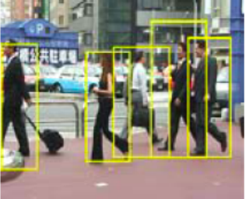
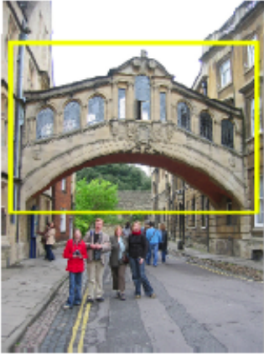
Category vs. instance recognition
Category:
  Find all the people
  Find all the buildings
  Often within a single image
  Often ‘sliding window’
Instance:
  Is this face James?
  Find this specific famous building
  Often within a database of images
Notes:
Hertford Bridge, often called "the Bridge of Sighs“ - https://en.wikipedia.org/wiki/Bridge_of_Sighs_(Oxford)
Oxford, UK

Slide 3
Object detection vs. Scene Recognition
Scenes can be defined by distribution of “stuff” – materials and surfaces with arbitrary shape.
Objects are “things” that own their boundaries
Bag of words models are less popular for object detection because they throw away shape info.
James Hays

Slide 4
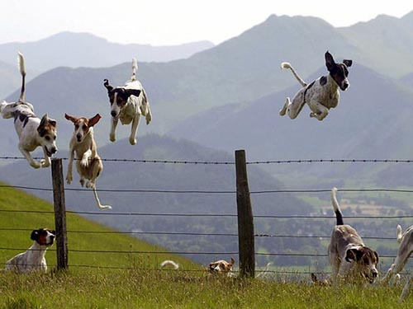
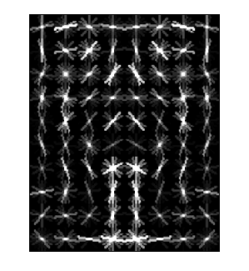
Object Category Detection
Focus on object search: “Where is it?”
Build templates that quickly differentiate object patch from background patch
Dog Model
…
Object or
Non-Object?
James Hays

Slide 5
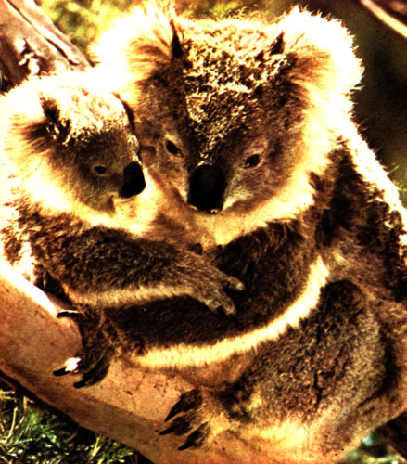
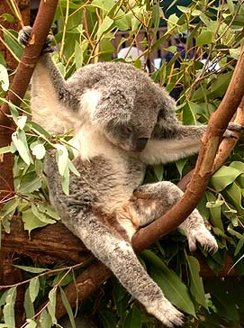

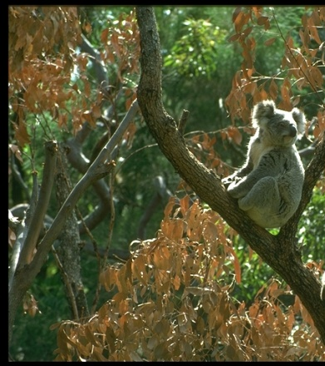
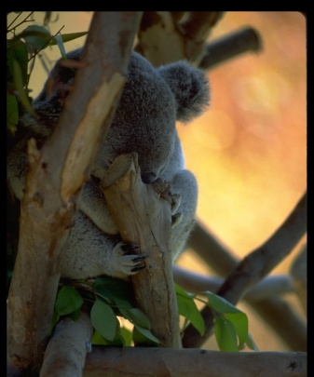
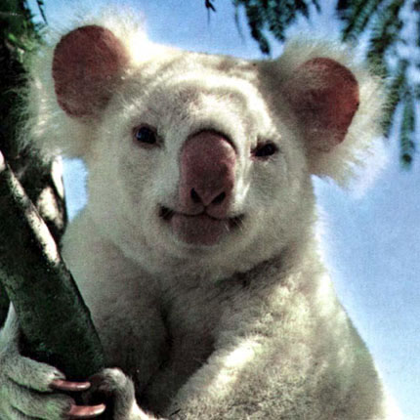
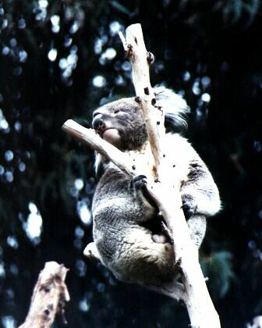
Challenges in modeling the object class
Illumination
Object pose
‘Clutter’
Occlusions
Intra-class appearance
Viewpoint
Slide from K. Grauman, B. Leibe

Slide 6
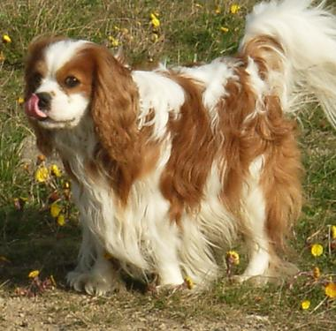
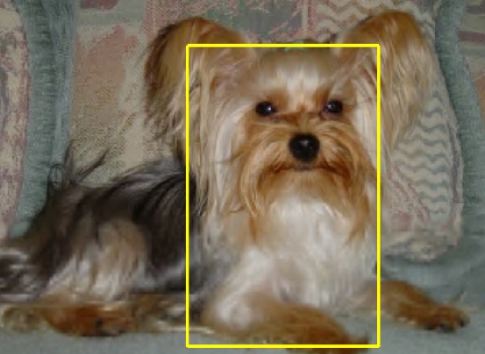
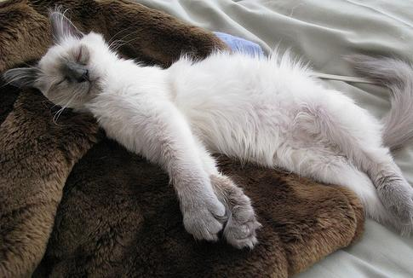
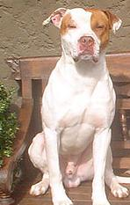
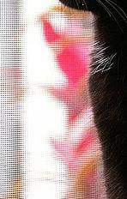

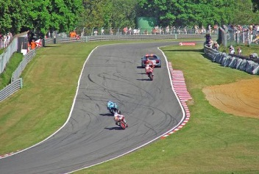

Challenges in modeling the non-object class
True Detections
Bad Localization
Confused with Similar Object
Confused with Dissimilar Objects
Misc. Background
James Hays

Slide 7
Object Detection Design challenges
How to efficiently search for likely objects
  Even simple models require searching hundreds of thousands of positions and scales.
Feature design and scoring
  How should appearance be modeled?
  What features correspond to the object?
How to deal with different viewpoints?
  Often train different models for a few different viewpoints

Slide 8
General Process of Object Recognition
Specify Object Model
What are the object parameters?
Generate Hypotheses
Score Hypotheses
Resolve Detections
James Hays

Slide 9
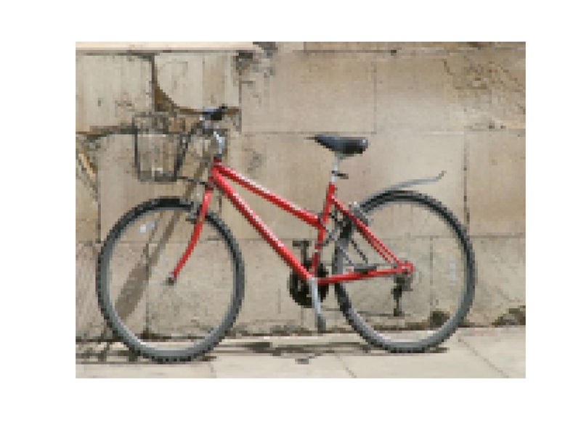
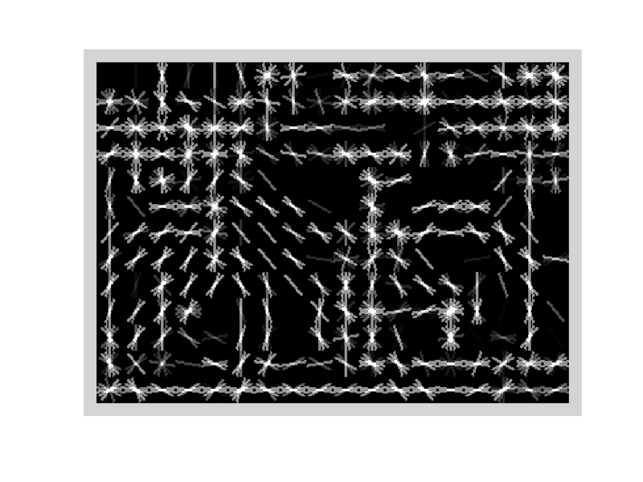
Specifying an object model
Statistical Template in Bounding Box
  Object is some (x,y,w,h) in image
  Features defined wrt bounding box coordinates
Image
Template Visualization
Images from Felzenszwalb

Slide 10
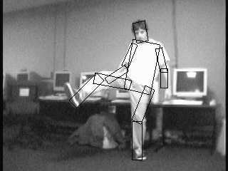
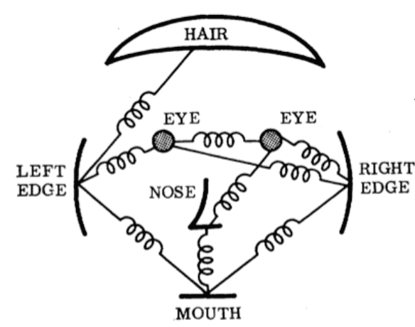
Specifying an object model
2. Articulated parts model
  Object is configuration of parts
  Each part is detectable
Images from Felzenszwalb

Slide 11
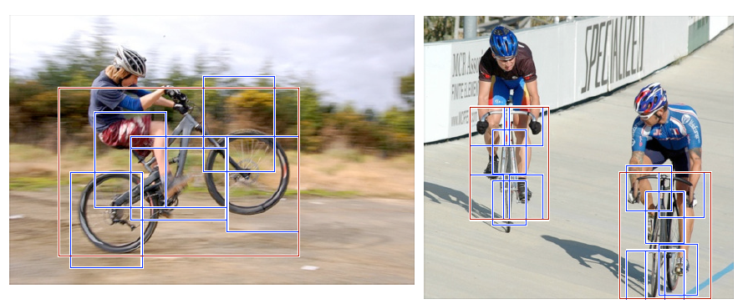
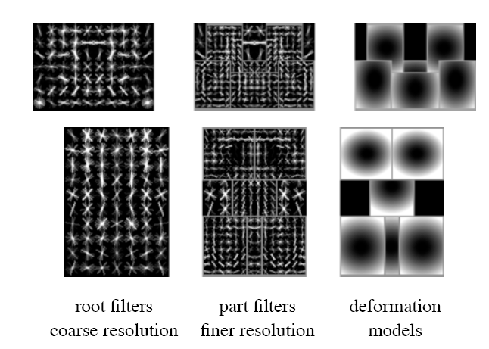
Specifying an object model
3. Hybrid template/parts model
Detections
Template Visualization
Felzenszwalb et al. 2008

Slide 12
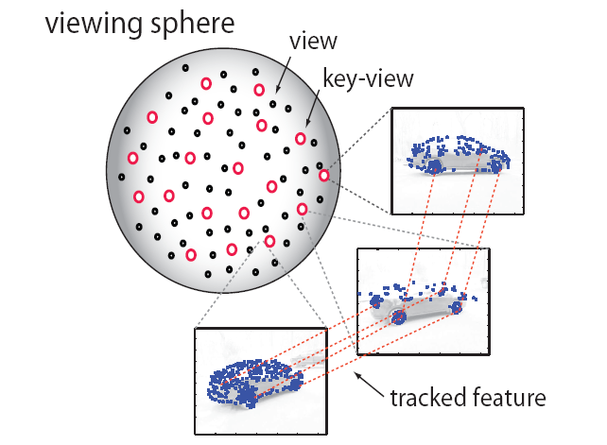
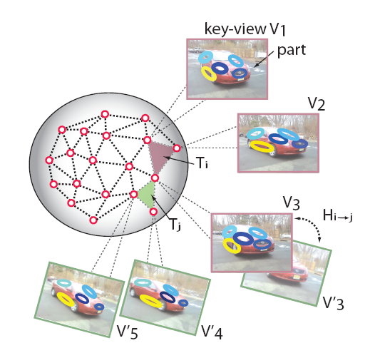
Specifying an object model
3D-ish model
Object is collection of 3D planar patches under affine transformation

Slide 13
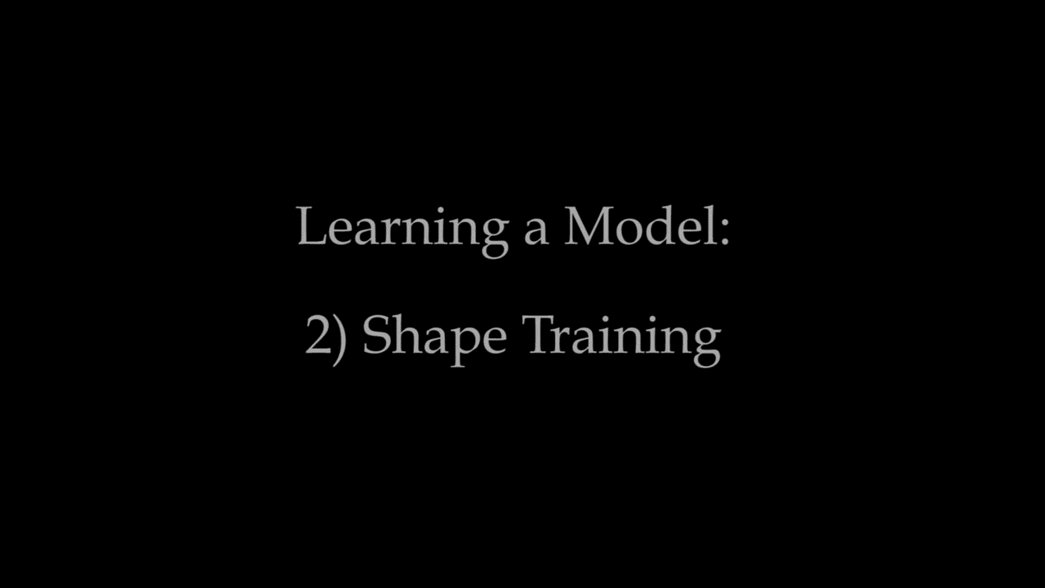
Specifying an object model
Loper et al. 2015
5. Deformable 3D model
Object is a parameterized space of shape/pose/deformation of class of 3D object
Notes:
http://smpl.is.tue.mpg.de/

Slide 14
Why not just pick the most complex model?
Inference is harder
  More parameters
  Harder to ‘fit’ (infer / optimize fit)
  Longer computation

Slide 15
General Process of Object Recognition
Specify Object Model
Generate Hypotheses
Propose an alignment of the model to the image
Score Hypotheses
Resolve Detections
James Hays

Slide 16
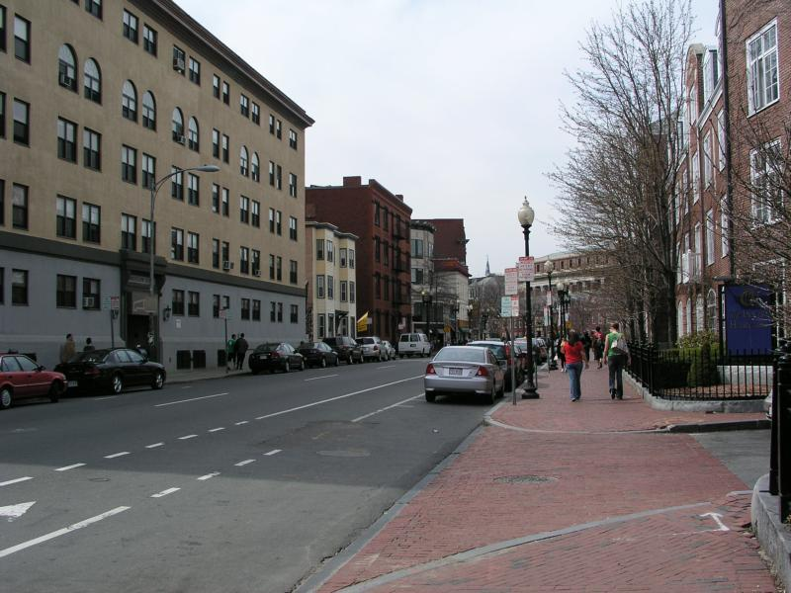
Generating hypotheses
Sliding window
  Test patch at each location and scale
James Hays

Slide 17
Generating hypotheses
Sliding window
  Test patch at each location and scale
Note – Template did not change size

Slide 18
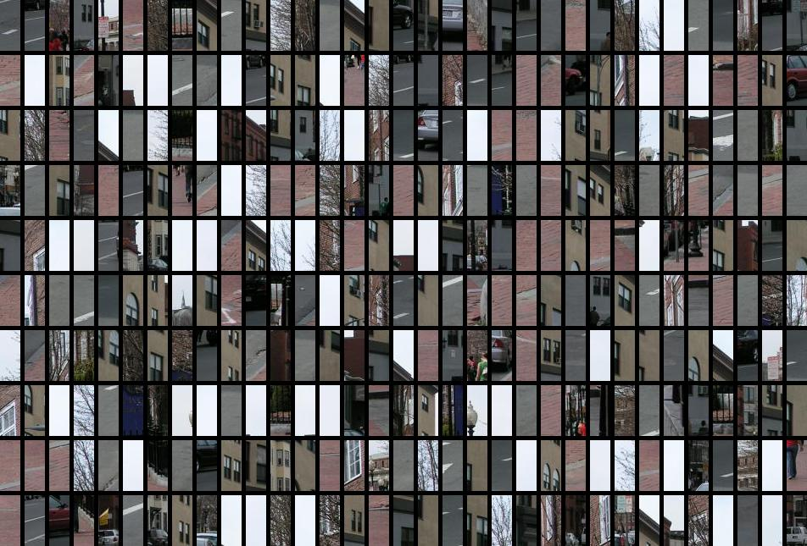
Each window is separately classified

Slide 19
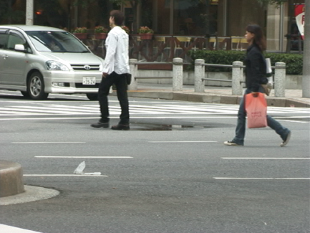
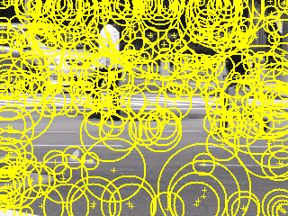
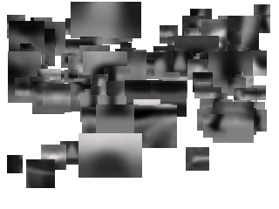
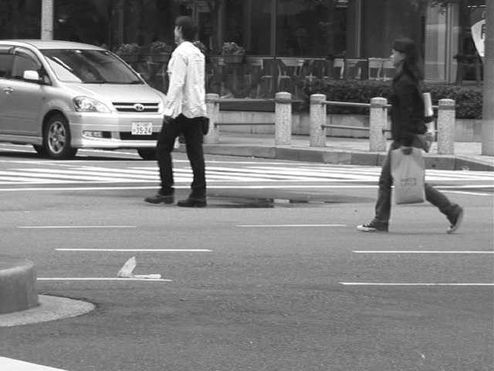
Generating hypotheses
2. Voting from patches/keypoints
Matched Codebook
Entries
Probabilistic
Voting
Interest Points
3D Voting Space
(continuous)
Implicit Shape Model by Leibe et al.
Notes:
http://web.eecs.umich.edu/~silvio/teaching/EECS598/papers/leibe-ism-slcv04.pdf

Slide 20
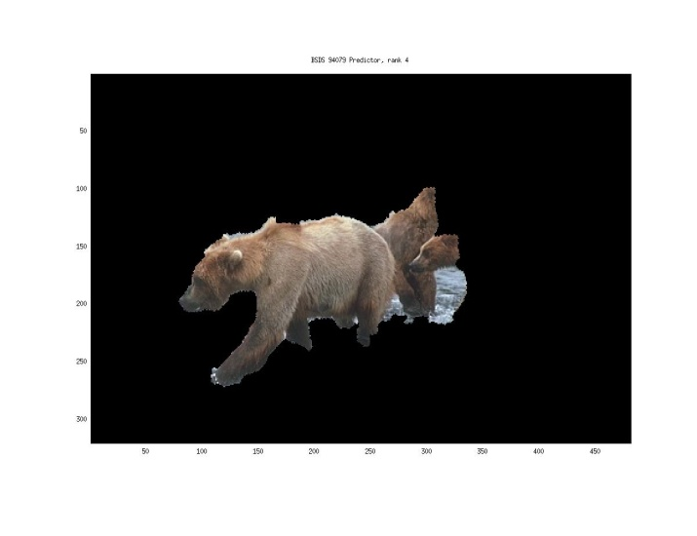
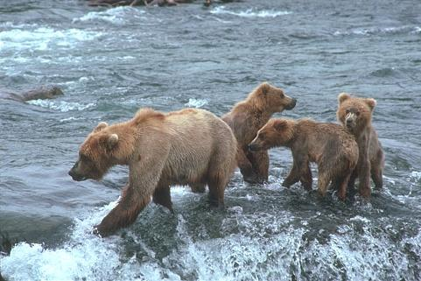
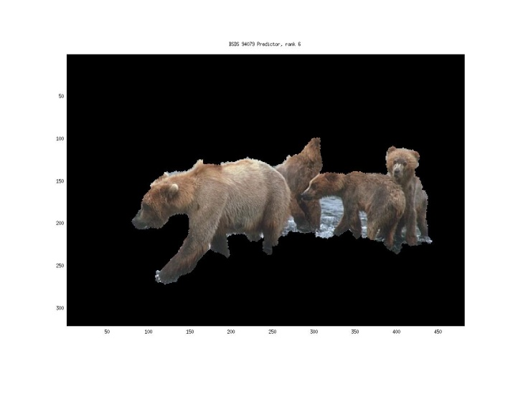
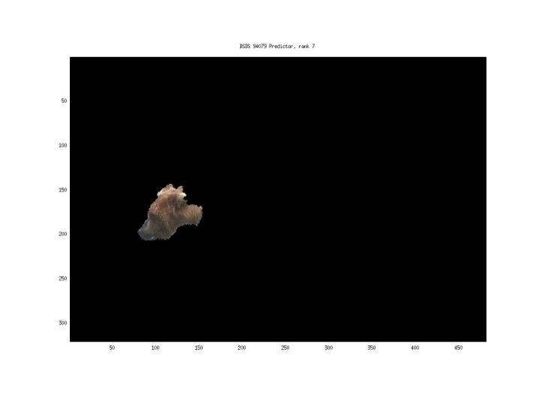
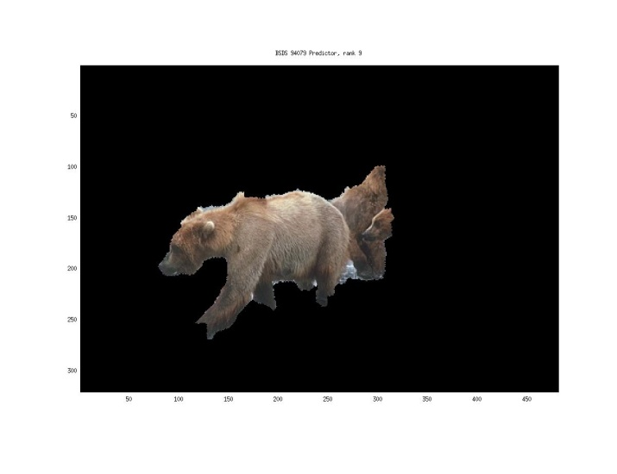
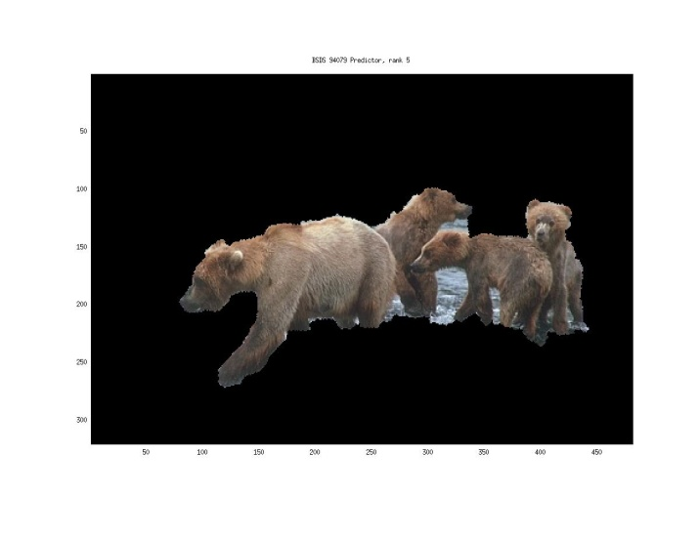
Generating hypotheses
3. Region-based proposal
Endres Hoiem 2010

Slide 21
General Process of Object Recognition
Specify Object Model
Generate Hypotheses
Mainly-gradient based features, usually based on summary representation, many classifiers
Score Hypotheses
Resolve Detections

Slide 22
General Process of Object Recognition
Specify Object Model
Generate Hypotheses
Score Hypotheses
Resolve Detections
Rescore each proposed object based on whole set

Slide 23
Resolving detection scores
Non-max suppression
Score = 0.8
Score = 0.8
Score = 0.1
James Hays

Slide 24
Resolving detection scores
Non-max suppression
Score = 0.8
Score = 0.8
Score = 0.1
Score = 0.1
“Overlap” score is below some threshold

Slide 25
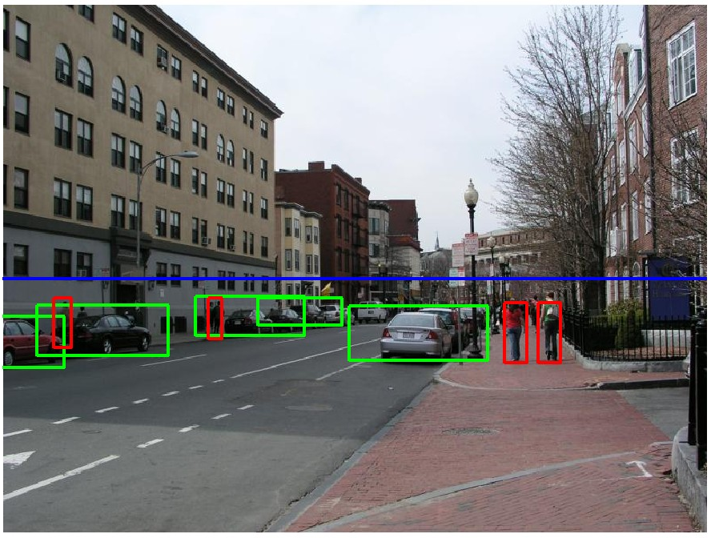
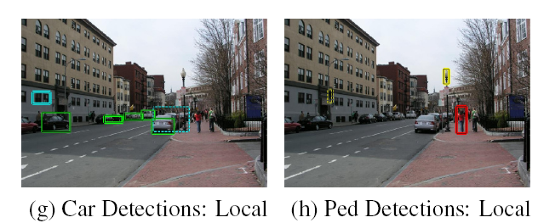
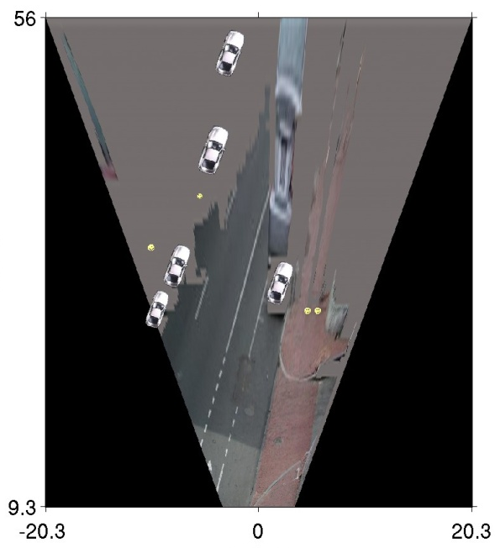
Resolving detection scores
2. Context/reasoning
meters
Hoiem et al. 2006
meters

Slide 26
Object category detection in computer vision
Goal: detect all pedestrians, cars, monkeys, etc in image

Slide 27
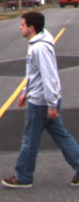
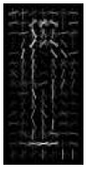
Basic Steps of Category Detection
Align
  E.g., choose position, scale orientation
  How to make this tractable?
Compare
  Compute similarity to an example object or to a summary representation
  Which differences in appearance are important?
Aligned
Possible Objects
Exemplar
Summary

Slide 28
Sliding window: a simple alignment solution
…
…

Slide 29
Influential Works in Detection
Sung-Poggio (1994, 1998) : ~2000 citations
  Basic idea of statistical template detection, bootstrapping to get “face-like” negative examples, multiple whole-face prototypes (in 1994)
Rowley-Baluja-Kanade (1996-1998) : ~3600
  “Parts” at fixed position, non-maxima suppression, simple cascade, rotation, pretty good accuracy, fast
Schneiderman-Kanade (1998-2000,2004) : ~1700
  Careful feature engineering, excellent results, cascade
Viola-Jones (2001, 2004) : ~13,000
  Haar-like features, Adaboost as feature selection, hyper-cascade, very fast
Dalal-Triggs (2005) : ~16,000 citations
  Careful feature engineering, excellent results, HOG feature, online code
Felzenszwalb-McAllester-Ramanan (2008): ~4,600 citations
  Template/parts-based blend
Girshick et al. (2013): ~2000 citations
  R-CNN / Fast R-CNN / Faster R-CNN. Deep learned models on object proposals.
James Hays

Slide 30
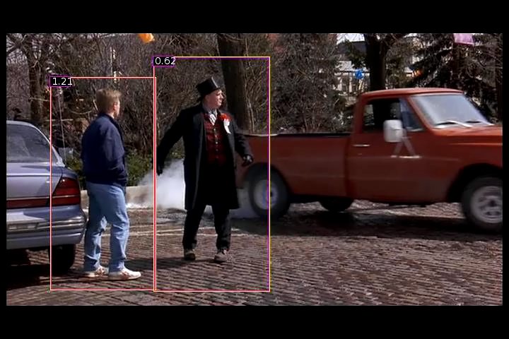
Dalal Triggs: Person detection with HOG & linear SVM
Histograms of Oriented Gradients for Human Detection, Navneet Dalal, Bill Triggs, International Conference on Computer Vision & Pattern Recognition - June 2005
http://lear.inrialpes.fr/pubs/2005/DT05/

Slide 31
Statistical Template
Object model =
sum of scores of features at fixed positions
?
+3
+2
-2
-1
-2.5
= -0.5
> 7.5
Non-object
?
+4
+1
+0.5
+3
+0.5
= 10.5
> 7.5
Object

Slide 32
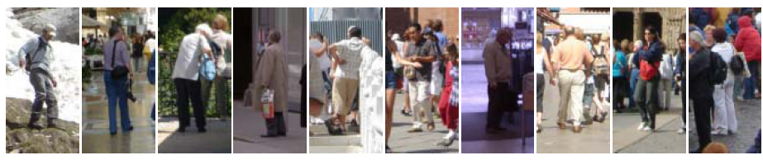
Example: Dalal-Triggs pedestrian detector
Extract fixed-sized (64x128 pixel) window at each position and scale
Compute HOG (histogram of gradient) features within each window
Score the window with a linear SVM classifier
Perform non-maxima suppression to remove overlapping detections with lower scores
Navneet Dalal and Bill Triggs, Histograms of Oriented Gradients for Human Detection, CVPR05
Notes:
6000+ citations, another of the most influential papers in computer vision!

Slide 33

Slides by Pete Barnum
Navneet Dalal and Bill Triggs, Histograms of Oriented Gradients for Human Detection, CVPR05

Slide 34
Tested with
  RGB
  LAB
  Grayscale
Gamma Normalization and Compression
  Square root
  Log
Slightly better performance vs. grayscale
Very slightly better performance vs. no adjustment

Slide 35
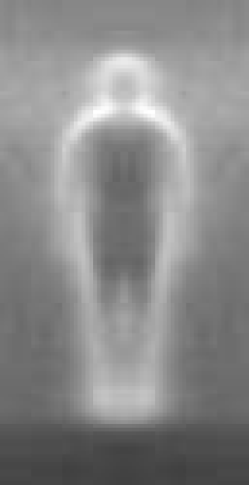

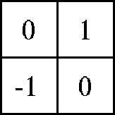

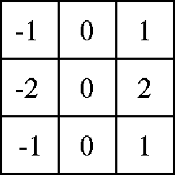

Outperforms
centered
diagonal
uncentered
cubic-corrected
Sobel
Slides by Pete Barnum
Navneet Dalal and Bill Triggs, Histograms of Oriented Gradients for Human Detection, CVPR05

Slide 36
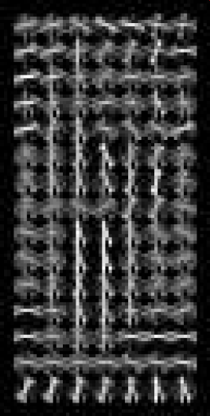
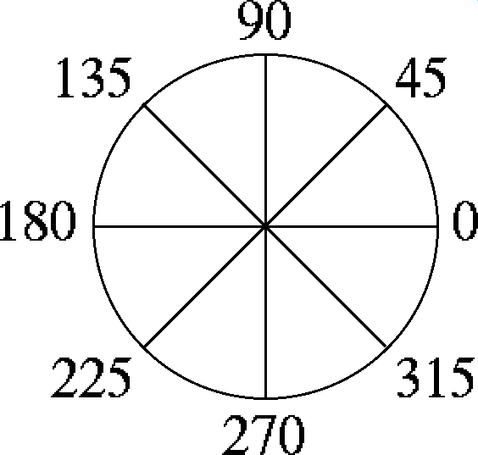

Histogram of Oriented Gradients
  Votes weighted by magnitude
  Bilinear interpolation between cells
Orientation: 9 bins (for unsigned angles 0 -180)
Histograms in
k x k pixel cells
Slides by Pete Barnum
Navneet Dalal and Bill Triggs, Histograms of Oriented Gradients for Human Detection, CVPR05

Slide 37
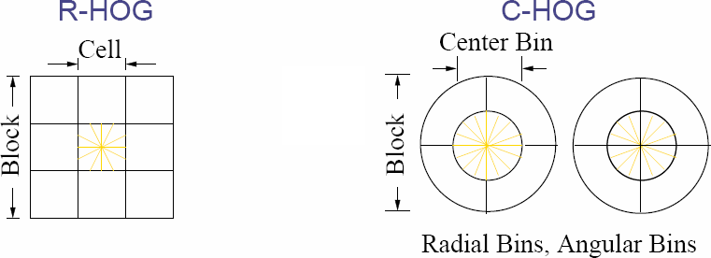

Normalize with respect to surrounding cells
Rectangular HOG (R-HOG)
How to normalize?
Concatenate all cell responses from block into vector.
Normalize vector.
Extract responses from cell of interest.
e is a small constant (for empty bins)
Slides by Pete Barnum
Navneet Dalal and Bill Triggs, Histograms of Oriented Gradients for Human Detection, CVPR05
Notes:
R-HOG: Rectangular HOG
Also C-HOG exists – Circular HOG

Slide 38
Normalize with respect to surrounding cells
Rectangular HOG (R-HOG)
Circular HOG also exist, but trickier implementation
e is a small constant (for empty bins)
Slides by Pete Barnum
Navneet Dalal and Bill Triggs, Histograms of Oriented Gradients for Human Detection, CVPR05
Notes:
R-HOG: Rectangular HOG
Also C-HOG exists – Circular HOG

Slide 39
# orientations
# features = 15 x 7 x 9 x 4 = 3780
X=
# cells
# normalizations by neighboring cells
Slides by Pete Barnum
Navneet Dalal and Bill Triggs, Histograms of Oriented Gradients for Human Detection, CVPR05
Notes:
Note – this is not a “bag of features”, these gradient measurements have fixed spatial positions

Slide 40
Original Formulation
# orientations
# features = 15 x 7 x 9 x 4 = 3780
# cells
# normalizations by neighboring cells
X=
UoCTTI variant
# orientations
# features = 15 x 7 x (3 x 9) + 4 = 3780
# cells
magnitude of neighbor cells
Slides by Pete Barnum
Navneet Dalal and Bill Triggs, Histograms of Oriented Gradients for Human Detection, CVPR05
Notes:
Note – this is not a “bag of features”, these gradient measurements have fixed spatial positions

Slide 41


pos w
neg w
Slides by Pete Barnum
Navneet Dalal and Bill Triggs, Histograms of Oriented Gradients for Human Detection, CVPR05

Slide 42



pedestrian
Slides by Pete Barnum
Navneet Dalal and Bill Triggs, Histograms of Oriented Gradients for Human Detection, CVPR05

Slide 43




Pedestrian detection with HOG
Learn a pedestrian template using a support vector machine
At test time, compare feature map with template over sliding windows.
Find local maxima of response
Multi-scale: repeat over multiple levels of a HOG pyramid
HOG feature map
Template
Detector response map
Can be continuous for more sophisticated maxima finding
N. Dalal and B. Triggs, Histograms of Oriented Gradients for Human Detection, CVPR 2005

Slide 44

INRIA pedestrian database
Notes:
http://vislab.isr.ist.utl.pt/wp-content/uploads/2012/12/onPurity.pdf

Slide 45

INRIA pedestrian database issues
Notes:
http://vislab.isr.ist.utl.pt/wp-content/uploads/2012/12/onPurity.pdf

Slide 46

How good is HOG at person detection?
Miss rate =
1 - recall

Slide 47
Something to think about…
Sliding window detectors work
  very well for faces
  fairly well for cars and pedestrians
  badly for cats and dogs
Why are some classes easier than others?

Slide 48
Strengths/Weaknesses of Statistical Template Approach
Strengths
Works very well for non-deformable objects with canonical orientations: faces, cars, pedestrians
Fast detection
Weaknesses
Not so well for highly deformable objects or “stuff”
Not robust to occlusion
Requires lots of training data

Slide 49
Tricks of the trade
Details in feature computation really matter
  E.g., normalization in Dalal-Triggs improves detection rate by 27% at fixed false positive rate
Template size
  Typical choice is size of smallest expected detectable object
“Jittering” or “augmenting” to create synthetic positive examples
  Create slightly rotated, translated, scaled, mirrored versions as extra positive examples.
Bootstrapping to get hard negative examples
  Randomly sample negative examples
  Train detector
  Sample negative examples that score > -1
  Repeat until all high-scoring negative examples fit in memory

