Slide 1


Slide 2
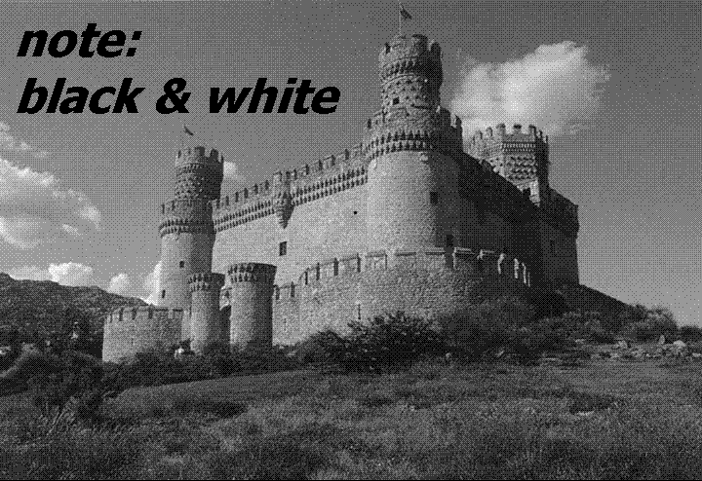

Slide 3
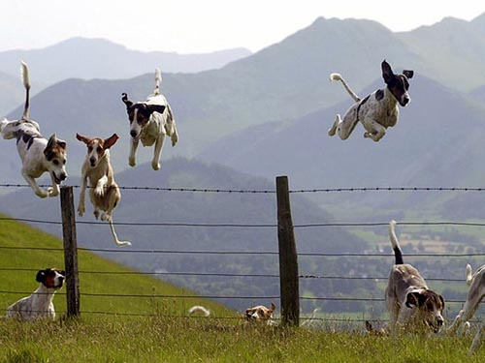
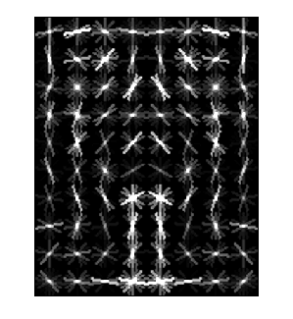
Object Category Detection
Focus on object search: “Where is it?”
Build templates that quickly differentiate object patch from background patch
Dog Model
…
Object or
Non-Object?
James Hays

Slide 4
Object Detection
Overview
Dalal-Triggs (pedestrian detection)
  Histogram of Oriented Gradients
  Database learning with SVM

Slide 5
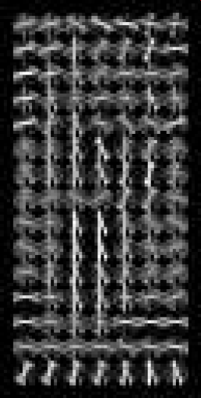
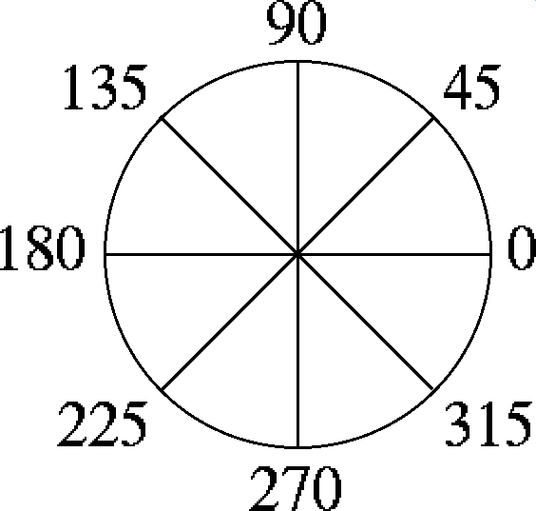
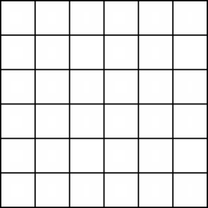
Histogram of Oriented Gradients
  Votes weighted by magnitude
  Bilinear interpolation between cells
Orientation: 9 bins (for unsigned angles 0 -180)
Histograms in
k x k pixel cells
Slides by Pete Barnum
Navneet Dalal and Bill Triggs, Histograms of Oriented Gradients for Human Detection, CVPR05

Slide 6
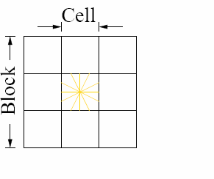
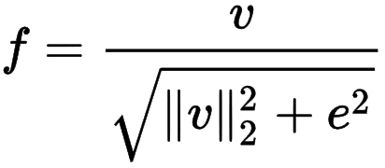
Normalize with respect to surrounding cells
Rectangular HOG (R-HOG)
How to normalize?
Concatenate all cell responses from block into vector.
Normalize vector.
Extract responses from cell of interest.
Do this 4x for each overlapping block.
e is a small constant (for empty bins)
Slides by Pete Barnum
Navneet Dalal and Bill Triggs, Histograms of Oriented Gradients for Human Detection, CVPR05
Notes:
R-HOG: Rectangular HOG
Also C-HOG exists – Circular HOG

Slide 7
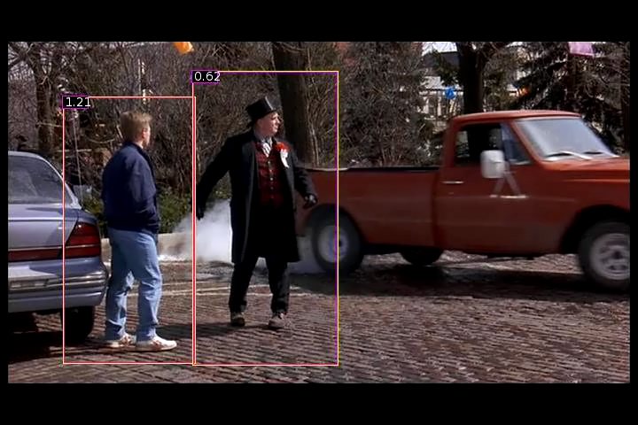
Person detection with HoG’s & linear SVM’s
Histograms of Oriented Gradients for Human Detection, Navneet Dalal, Bill Triggs, International Conference on Computer Vision & Pattern Recognition - June 2005
http://lear.inrialpes.fr/pubs/2005/DT05/

Slide 8
Dalal-Triggs uses a template with a rigid form – humans are boxed shaped.
But…is there a way to learn the spatial layout more fluidly?
  Might help us capture more appearance variation…
What about faster, too?
Notes:
Note: humans aren’t boxed shape; this is the assumption that the template makes.

Slide 9
Face detection

Slide 10
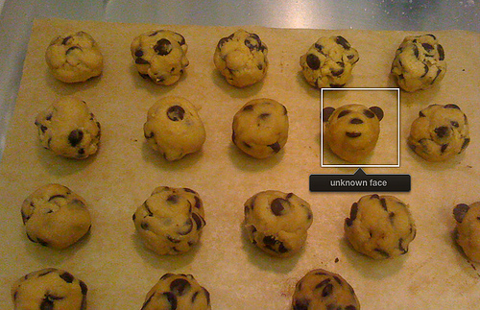
Consumer application: Apple iPhoto
Things iPhoto thinks are faces

Slide 11
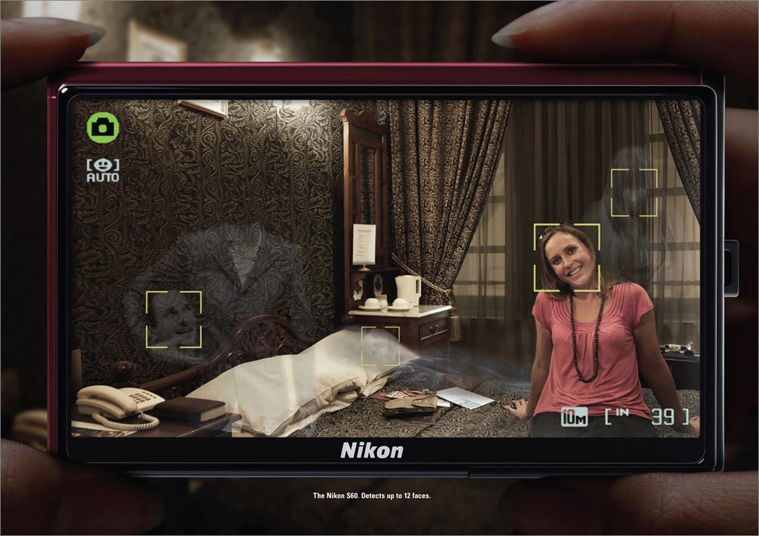
"The Nikon S60 detects up to 12 faces."

Slide 12
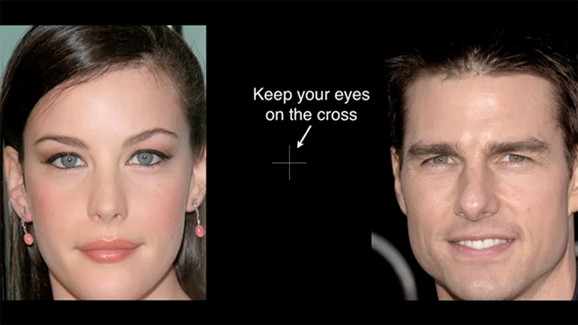
“Flashed Face Distortion”
2nd Place in the 8th Annual Best Illusion of the Year Contest , VSS 2012

Slide 14
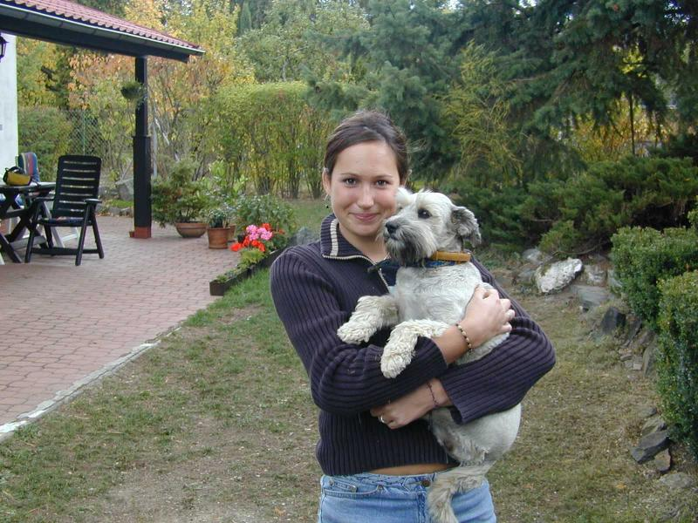
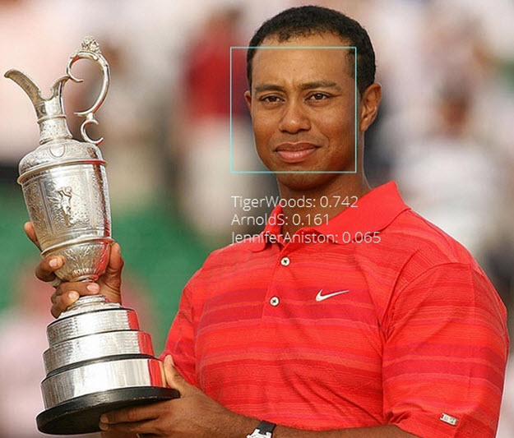

Face detection and recognition
Detection
Recognition
“Sally”

Slide 15
Challenges of face detection
Sliding window = tens of thousands of location/scale evaluations
  One megapixel image has ~10⁶ pixels, and a comparable number of candidate face locations
Faces are rare: 0–10 per image
  For computational efficiency, spend as little time as possible on the non-face windows.
  For 1 Mpix, to avoid having a false positive in every image, our false positive rate has to be less than 10⁻⁶
James Hays

Slide 16
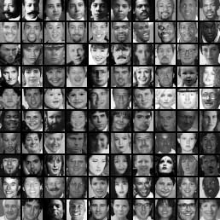
Sliding Window Face Detection with Viola-Jones
P. Viola and M. Jones. Rapid object detection using a boosted cascade of simple features. CVPR 2001.
P. Viola and M. Jones. Robust real-time face detection. IJCV 57(2), 2004.
Many Slides from Lana Lazebnik

Slide 17
The Viola/Jones Face Detector
A seminal approach to real-time object detection.
Training is slow, but detection is very fast
Key ideas:
1. Integral images for fast feature evaluation
2. Boosting for feature selection
3. Attentional cascade for fast non-face window rejection

Slide 18
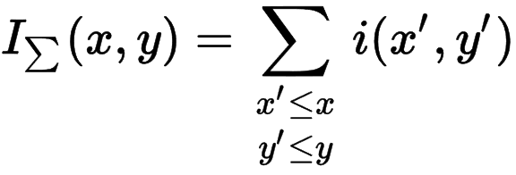
1. Integral images for fast feature evaluation
The integral image computes a value at each pixel (x,y) that is the sum of all pixel values above and to the left of (x,y), inclusive.
This can quickly be computed in one pass through the image.
‘Summed area table’
i(x,y)

Slide 19
Computing the integral image
Image
Region already computed
Current pixel

Slide 20
Computing the integral image
ii(x, y-1)
s(x-1, y)
i(x, y)
Cumulative row sum: s(x, y) = s(x–1, y) + i(x, y)
Integral image: ii(x, y) = ii(x, y−1) + s(x, y)
MATLAB: ii = cumsum(cumsum(double(i)), 2);

Slide 21
Computing sum within a rectangle
Let A,B,C,D be the values of the integral image at the corners of a rectangle
The sum of original image values within the rectangle can be computed as:
  sum = A – B – C + D
D
B
C
A
Only 3 additions are required for any size of rectangle!

Slide 22
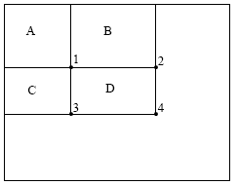
Integral Images
ii = cumsum(cumsum(im, 1), 2)
x, y
ii(x,y) = Sum of the values in the grey region
SUM within Rectangle D is
ii(4) - ii(2) - ii(3) + ii(1)

Slide 23
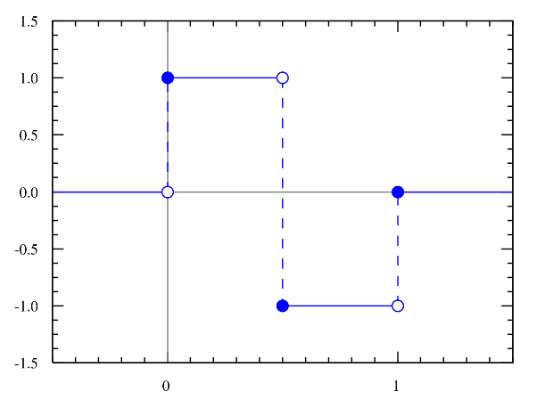
Features that are fast to compute
Haar wavelet
“Haar-like features”
  Differences of sums of intensity
  Computed at different positions and scales
  within sliding window
-1
+1
Two-rectangle features
Three-rectangle features
Etc.
CC BY-SA 3.0, https://commons.wikimedia.org/w/index.php?curid=801361

Slide 24

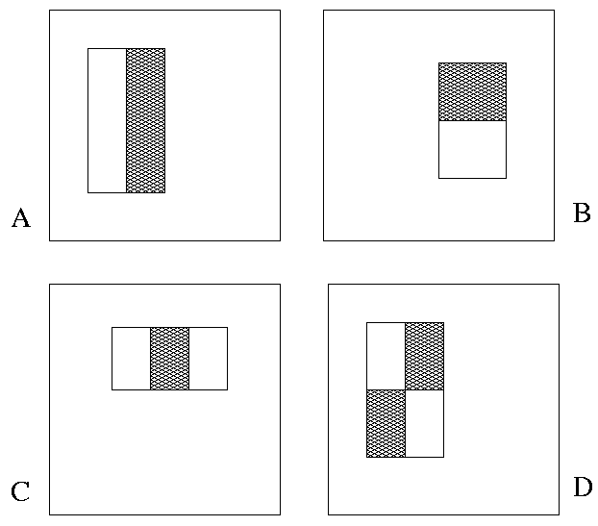
Image Features
“Rectangle filters”
Value = ∑(pixels in white area)
– ∑(pixels in black area)
Notes:
For real problems results are only as good as the features used...
This is the main piece of ad-hoc (or domain) knowledge
Rather than the pixels, we have selected a very large set of simple functions
Sensitive to edges and other critcal features of the image
** At multiple scales
Since the final classifier is a perceptron it is important that the features be non-linear… otherwise the final classifier will be a simple perceptron.
We introduce a threshold to yield binary features
Image: Sadiq Khan; major of London

Slide 25
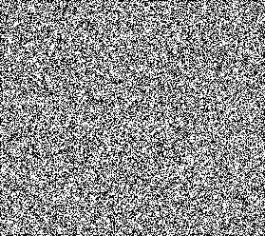



Example
Source
Result

Slide 26


Computing a rectangle feature
Integral Image

Slide 27
But these features are rubbish…!
Yes, individually they are ‘weak classifiers’
Jargon: ‘feature’ and ‘classifier’ are used interchangeably here.
Also with ‘learner’.
But, what if we combine thousands of them…
-1
+1
Two-rectangle features
Three-rectangle features
Etc.
CC BY-SA 3.0, https://commons.wikimedia.org/w/index.php?curid=801361

Slide 28
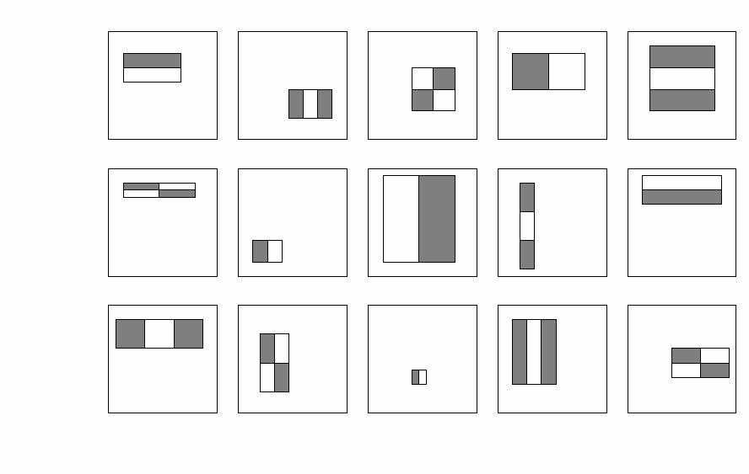
How many features are there?
For a 24x24 detection region, the number of possible rectangle features is ~160,000!
Notes:
So, how many can we get?

Slide 29
How many features are there?
For a 24x24 detection region, the number of possible rectangle features is ~160,000!
At test time, it is impractical to evaluate the entire feature set.
Can we learn a ‘strong classifier’ using just a small subset of all possible features?

Slide 30
2. Boosting for feature selection
Initially, weight each training example equally.
Weight = size of point
Slide credit: Paul Viola

Slide 31
2. Boosting for feature selection
In each boosting round:
Find the weak classifier
that achieves the lowest
weighted training error.
Raise the weights of
training examples
misclassified by
current weak classifier.
Round 1:
Weak
Classifier 1
Slide credit: Paul Viola

Slide 32
Boosting illustration
In each boosting round:
Find the weak classifier
that achieves the lowest
weighted training error.
Raise the weights of
training examples
misclassified by
current weak classifier.
Round 1:
Weights
Increased

Slide 33
Boosting illustration
In each boosting round:
Find the weak classifier
that achieves the lowest
weighted training error.
Raise the weights of
training examples
misclassified by
current weak classifier.
Round 2:
Weak
Classifier 2

Slide 34
Boosting illustration
In each boosting round:
Find the weak classifier
that achieves the lowest
weighted training error.
Raise the weights of
training examples
misclassified by
current weak classifier.
Round 2:
Weights
Increased

Slide 35
Boosting illustration
In each boosting round:
Find the weak classifier
that achieves the lowest
weighted training error.
Raise the weights of
training examples
misclassified by
current weak classifier.
Round 3:
Weak
Classifier 3

Slide 36
Boosting illustration
Round 3:
Compute final classifier as linear combination of all weak classifier.
Weight of each classifier is directly proportional to its accuracy.
Exact formulas for re-weighting and combining weak learners depend on the particular boosting scheme (e.g., AdaBoost).
Y. Freund and R. Schapire, A short introduction to boosting,
Journal of Japanese Society for Artificial Intelligence, 14(5):771-780, September, 1999.

Slide 37
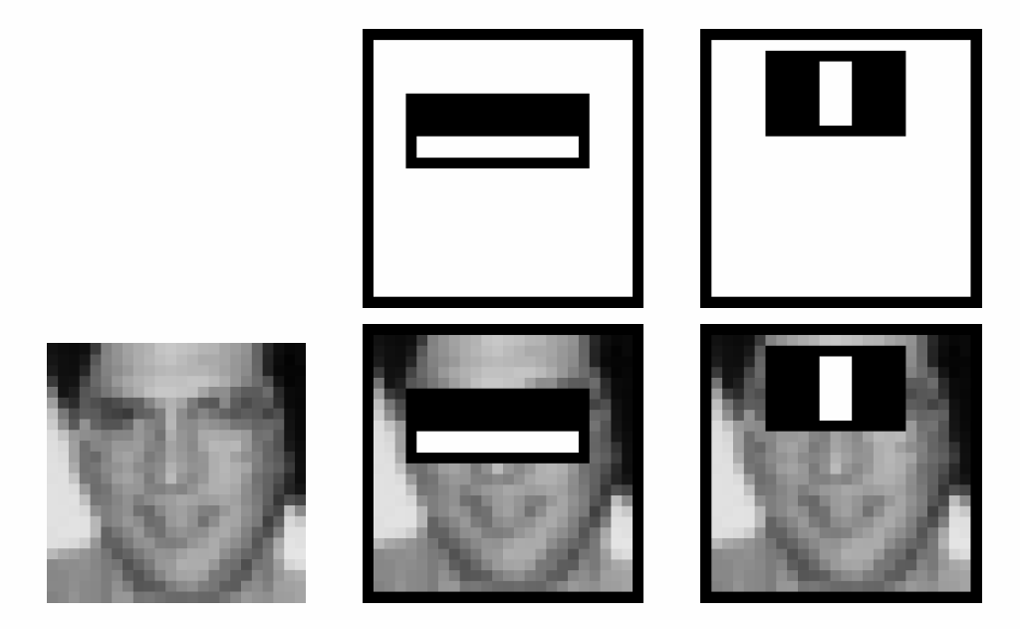
Boosting for face detection
First two features selected by boosting:
This feature combination can yield 100% recall and 50% false positive rate

Slide 38
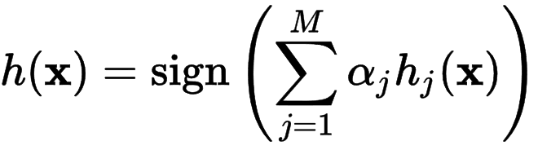
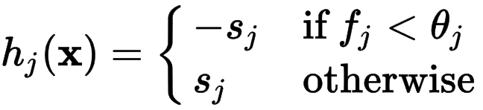

Feature selection with boosting
Create a large pool of features (180K)
Select discriminative features that work well together
  “Weak learner” = feature + threshold + ‘polarity’
  Choose weak learner that minimizes error on the weighted training set, then reweight
Weak learner
Final strong learner
window
Learner weight
value of rectangle feature
threshold
‘polarity’ = black or white region flip

Slide 39
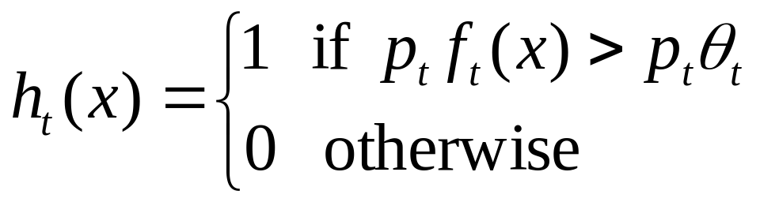
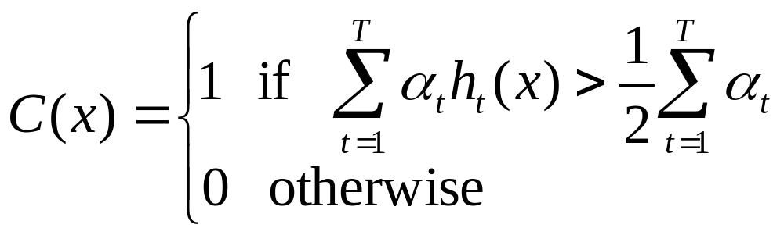
2. Boosting for feature selection
Boosting is a learning scheme that combines weak learners into a more accurate ensemble classifier
Weak learners based on rectangle filters:
Ensemble classification function:
value of rectangle feature
parity
threshold
window
learned weights
Notes:
What is the point of the parity p if we have alpha weights anyway?

Slide 40
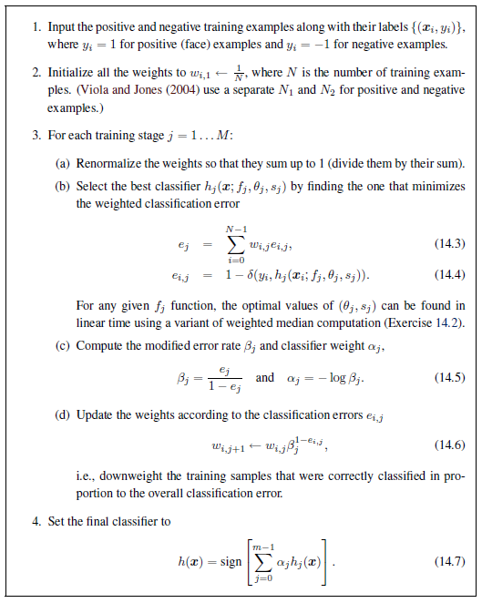
Adaboost pseudocode
Szeliski p665

Slide 41
Boosting vs. SVM
Advantages of boosting
  Integrates classifier training with feature selection
  Complexity of training is linear instead of quadratic in the number of training examples
  Flexibility in the choice of weak learners, boosting scheme
  Testing is fast
Disadvantages
  Needs many training examples
  Training is slow
  Often doesn’t work as well as SVM (especially for many-class problems)

Slide 42
Cascade for Fast Detection
Fast classifiers early in cascade which reject many negative examples but detect almost all positive examples.
Slow classifiers later, but most examples don’t get there.
Stage 1
h₁(x) > t₁?
Yes
Stage 2
h₂(x) > t₂?
Stage N
h_{n}(x) > t_{n}?
Yes
…
Pass
No
No
No
Examples
Reject
Reject
Reject

Slide 43
Attentional cascade
Chain classifiers that are progressively more complex and have lower false positive rates:
Receiver operating characteristic
% False Pos
0
50
vs
false
neg
determined by
0 100
% True positive
T
T
T
IMAGE
SUB-WINDOW
T
FACE
Classifier 1
Classifier 2
Classifier 3
F
F
F
NON-FACE
NON-FACE
NON-FACE
Notes:
In general simple classifiers, while they are more efficient, they are also weaker.
We could define a computational risk hierarchy (in analogy with structural risk minimization)…
A nested set of classifier classes
The training process is reminiscent of boosting…
- previous classifiers reweight the examples used to train subsequent classifiers
The goal of the training process is different
- instead of minimizing errors minimize false positives

Slide 44
Attentional cascade
The detection rate and the false positive rate of the cascade are found by multiplying the respective rates of the individual stages
A detection rate of 0.9 and a false positive rate on the order of 10⁻⁶ can be achieved by a
10-stage cascade if each stage has a detection rate of 0.99 (0.99¹⁰ ≈ 0.9) and a false positive rate of about 0.30 (0.3¹⁰ ≈ 6×10⁻⁶)
T
T
T
IMAGE
SUB-WINDOW
T
FACE
Classifier 1
Classifier 2
Classifier 3
F
F
F
NON-FACE
NON-FACE
NON-FACE

Slide 45
Training the cascade
Set target detection and false positive rates for each stage
Keep adding features to the current stage until its target rates have been met
  Need to lower boosting threshold to maximize detection
  (as opposed to minimizing total classification error)
  Test on a validation set
If the overall false positive rate is not low enough, then add another stage
Use false positives from current stage as the negative training examples for the next stage

Slide 46

The implemented system
Training Data
  5000 faces
    All frontal, rescaled to
    24x24 pixels
  300 million non-faces
    9500 non-face images
  Faces are normalized
    Scale, translation
Many variations
  Across individuals
  Illumination
  Pose
Notes:
This situation with negative examples is actually quite common… where negative examples are free.

Slide 47
Viola-Jones details
38 stages with 1, 10, 25, 50 … features
  6061 total used out of 180K candidates
  10 features evaluated on average
Training Examples
  4916 positive examples
  10000 negative examples collected after each stage
Scanning
  Scale detector rather than image
  Scale steps = 1.25 (factor between two consecutive scales)
  Translation 1*scale (# pixels between two consecutive windows)
Non-max suppression: average coordinates of overlapping boxes
Train 3 classifiers and take vote

Slide 48
System performance
Training time: “weeks” on 466 MHz Sun workstation
38 cascade layers, total of 6061 features
Average of 10 features evaluated per window on test set
“On a 700 Mhz Pentium III processor, the face detector can process a 384 by 288 pixel image in about .067 seconds”
  15 Hz
  15 times faster than previous detector
  of comparable accuracy (Rowley et al., 1998)

Slide 49
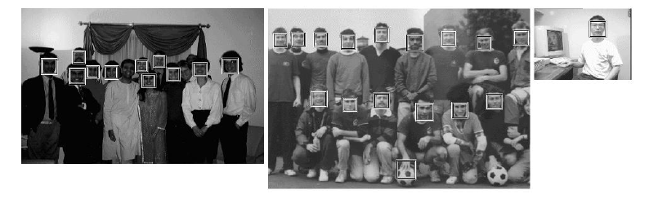
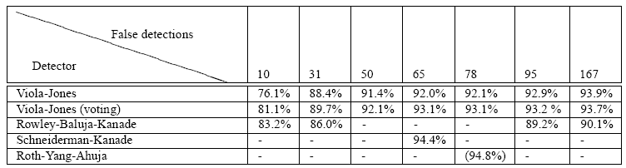
Viola Jones Results
Speed = 15 FPS (in 2001)
MIT + CMU face dataset

Slide 50
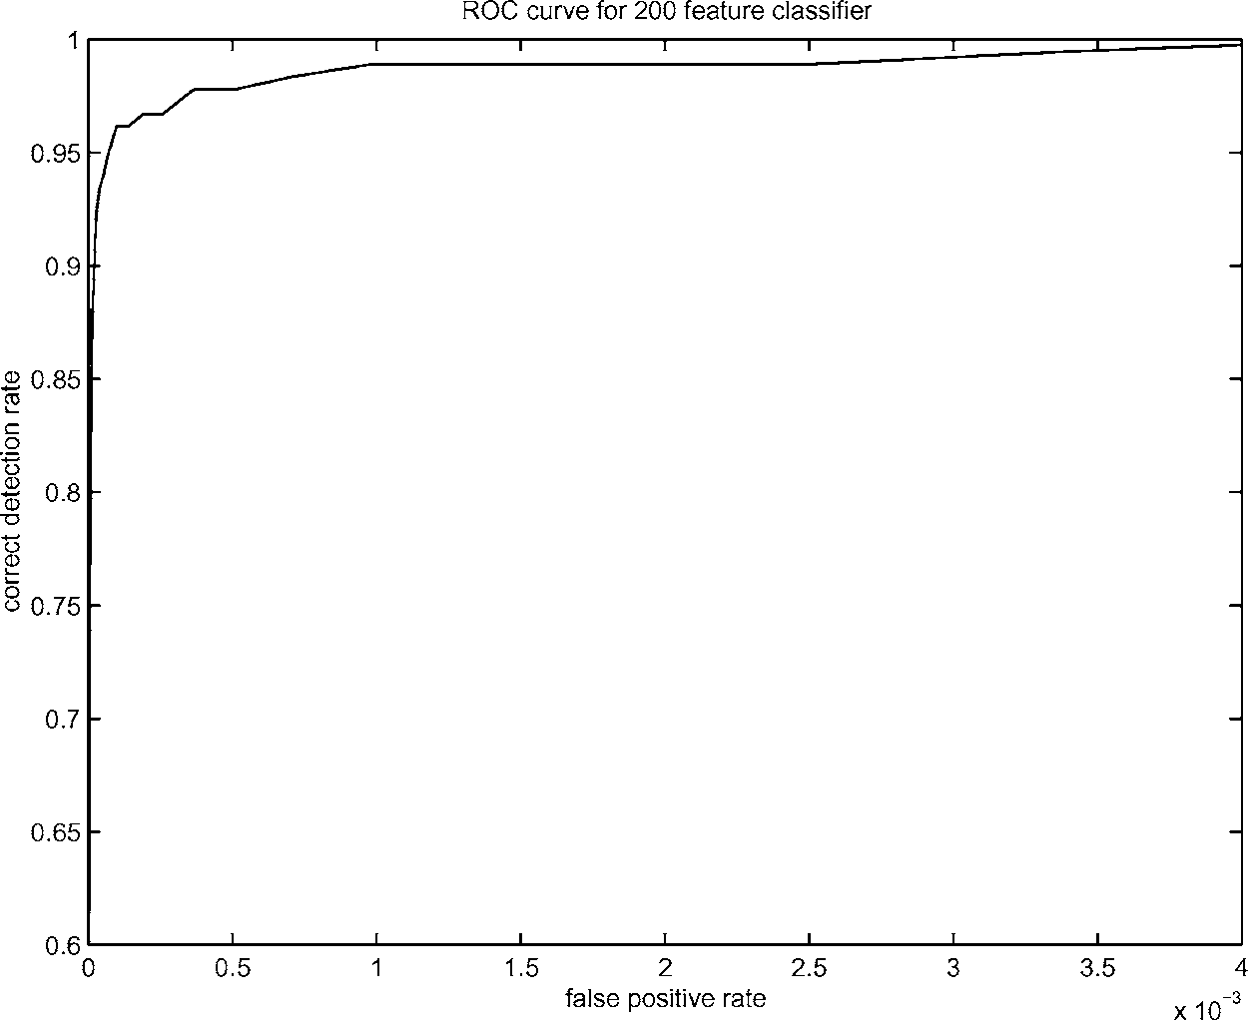
Boosting for face detection
A 200-feature classifier can yield 95% detection rate and a false positive rate of 1 in 14084
True positive rate
Not good enough!
Receiver operating characteristic (ROC) curve

Slide 51
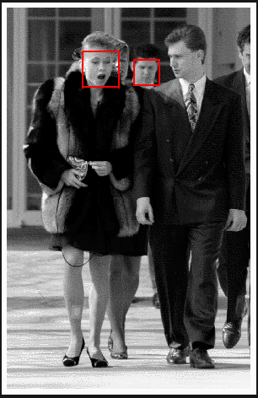
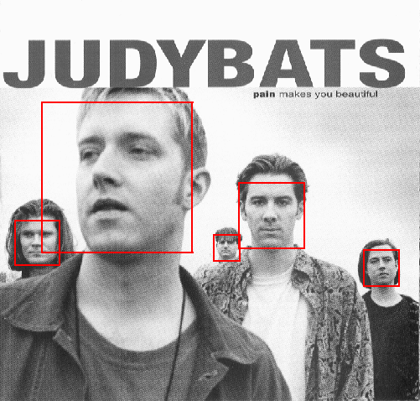
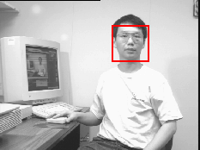
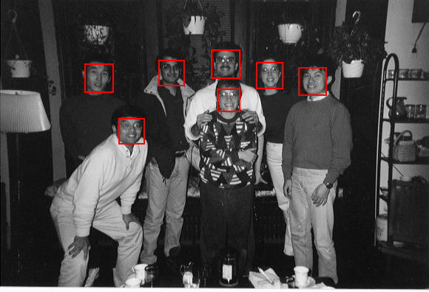
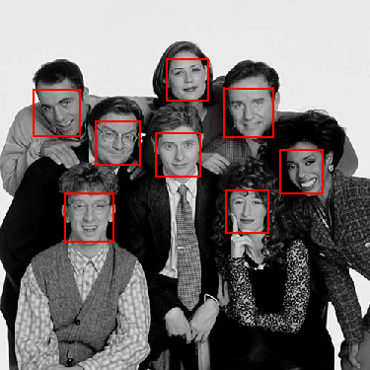
Output of Face Detector on Test Images
Notes:
Newsroom

Slide 52
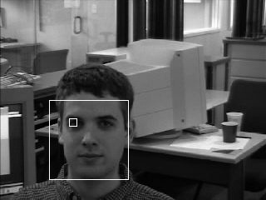
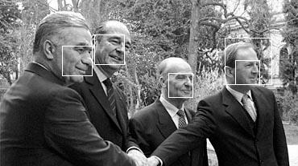
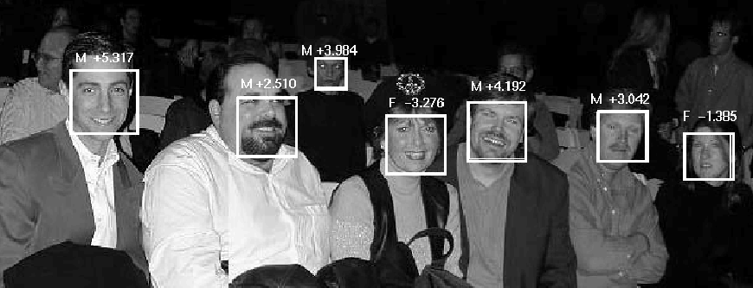
Other detection tasks
Facial Feature Localization
Profile Detection
Male vs.
female

Slide 53
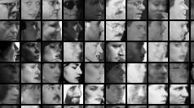
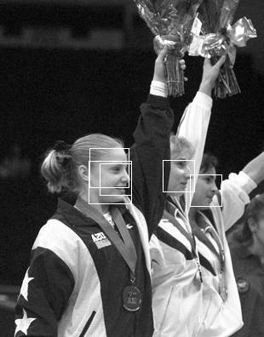
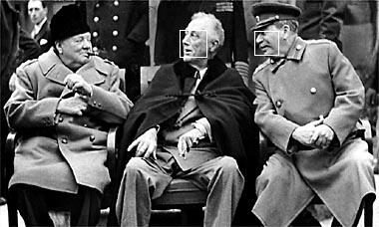
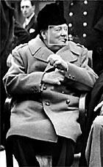
Profile Detection

Slide 54
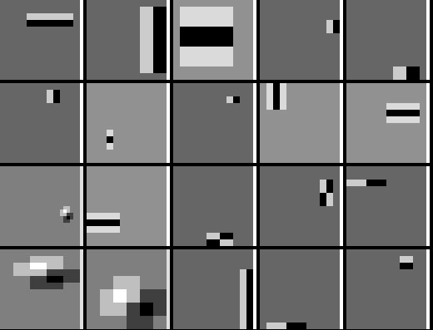
Profile Features

Slide 55
Live demo

Slide 56
Summary: Viola/Jones detector
Rectangle features
Integral images for fast computation
Boosting for feature selection
Attentional cascade for fast rejection of negative windows

Slide 57
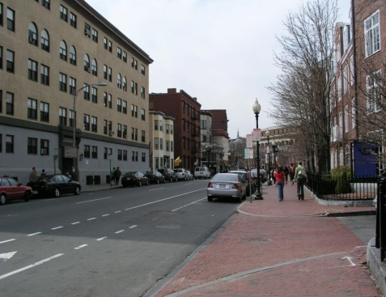
Things to remember
Sliding window for search
Features based on differences of intensity (gradient, wavelet, etc.)
  Excellent results = careful feature design
Boosting for feature selection
Integral images, cascade for speed
Bootstrapping to deal with many, many negative examples
Stage 1
H₁(x) > t₁?
Yes
Stage 2
H₂(x) > t₂?
…
Stage N
H_{N}(x) > t_{N}?
Yes
Pass
Examples
No
No
No
Reject
Reject
Reject

