Slide 1
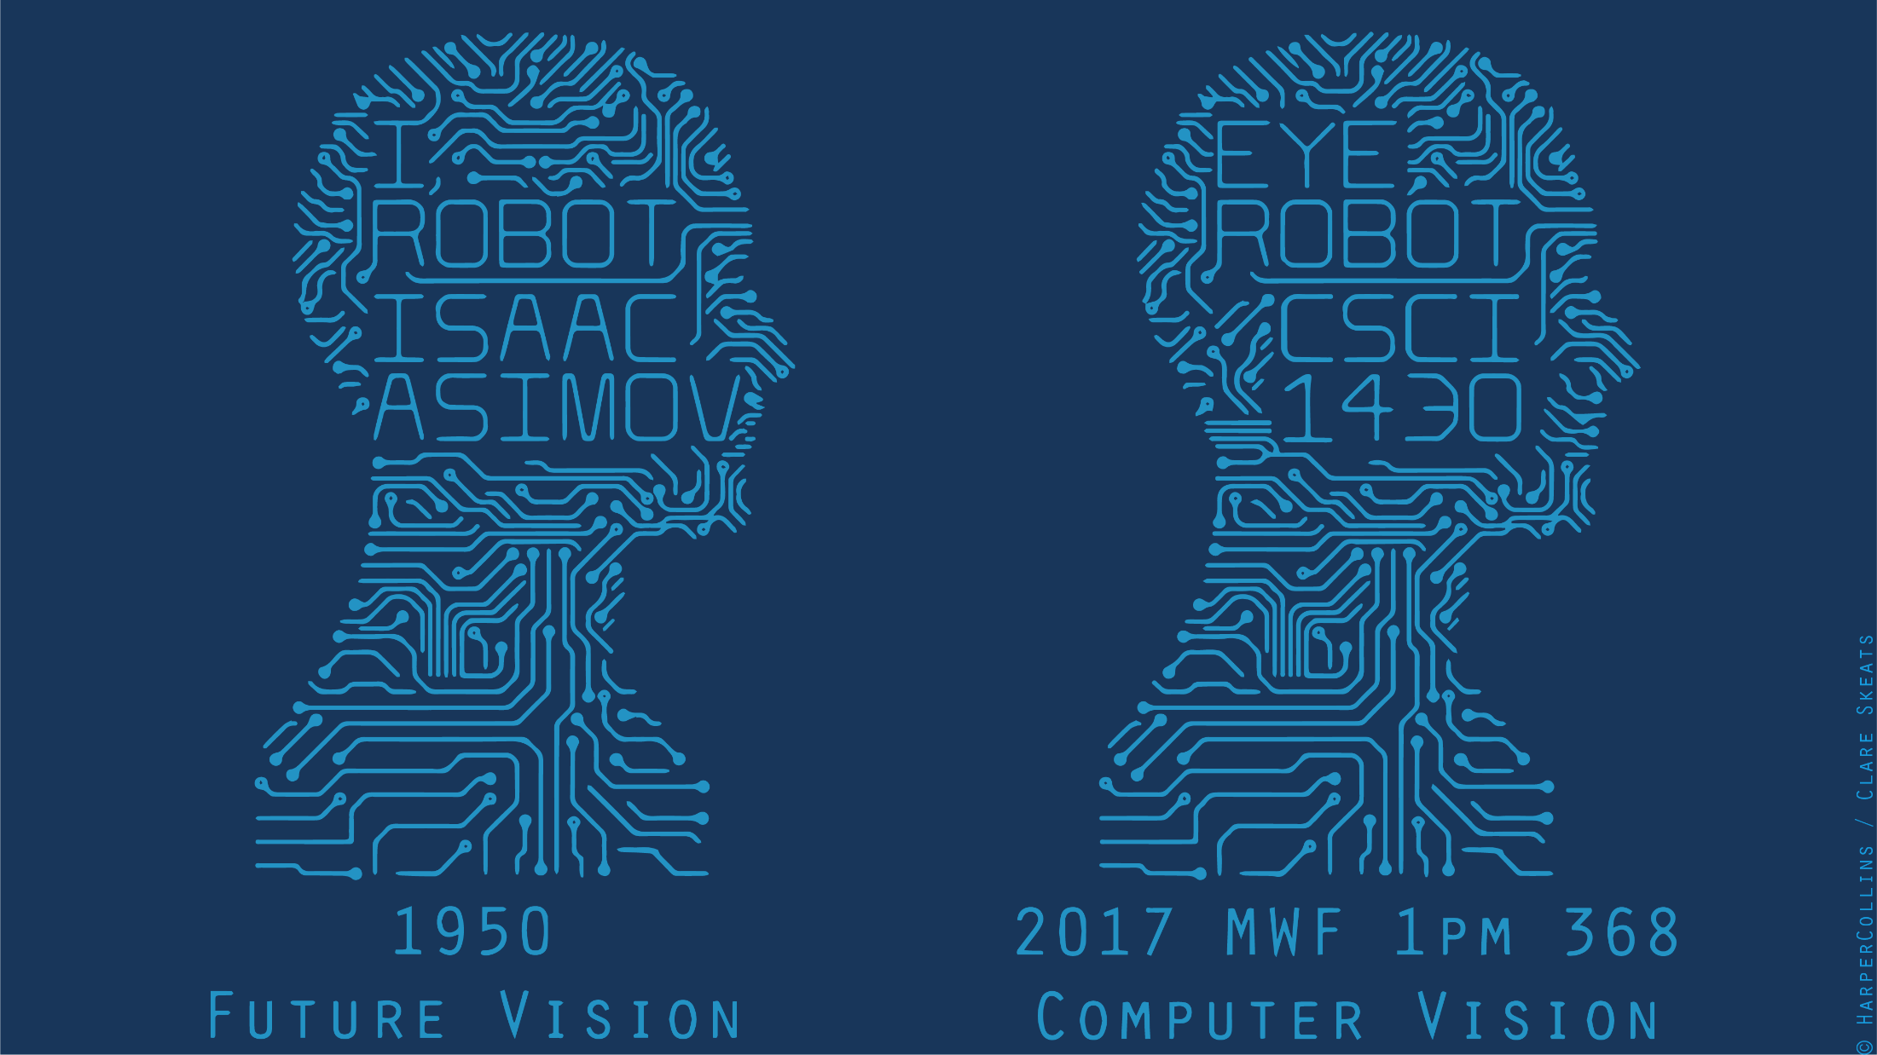

Slide 2
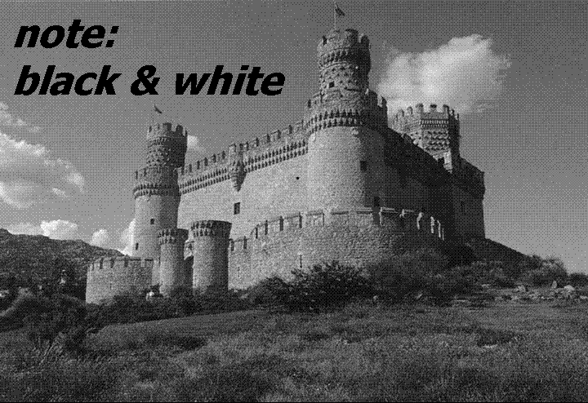

Slide 3
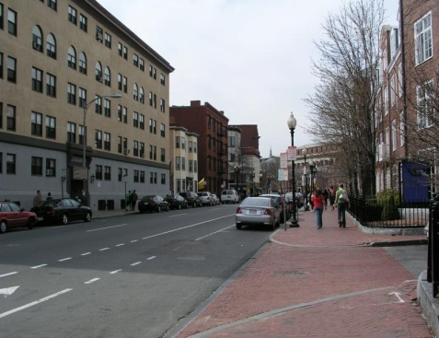
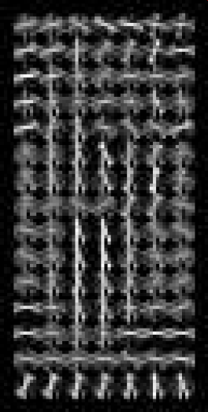
Object detection
Sliding window for search
Features based on differences of intensity (gradient, wavelet, etc.)
Boosting for feature selection
Integral images, cascade for speed
Bootstrapping to deal with many, many negative examples
Stage 1
H₁(x) > t₁?
Yes
Stage 2
H₂(x) > t₂?
…
Stage N
H_{N}(x) > t_{N}?
Yes
Pass
Examples
No
No
No
Reject
Reject
Reject

Slide 4
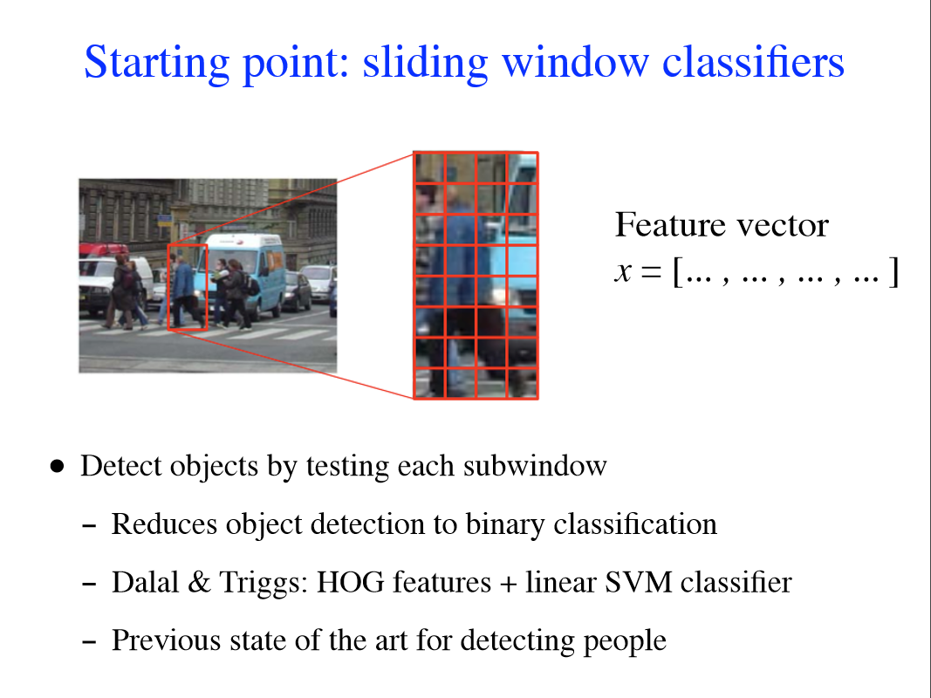
Felzenszwalb
Notes:
Slide source: http://cs.brown.edu/~pff/talks/mlss.pdf

Slide 5
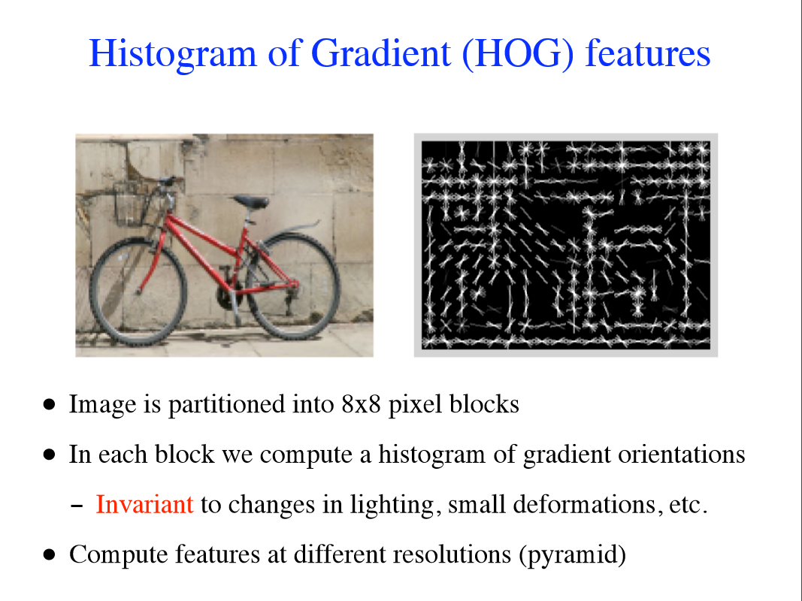
Felzenszwalb

Slide 6
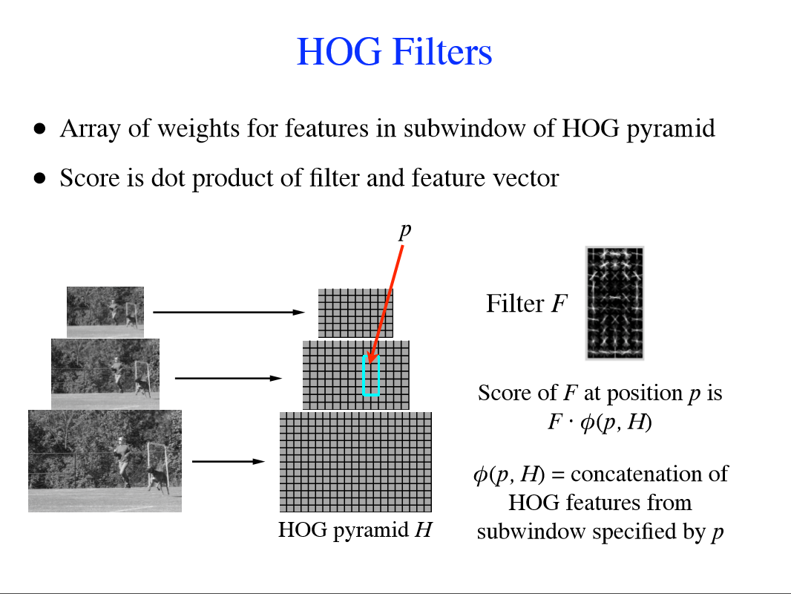
Felzenszwalb

Slide 7
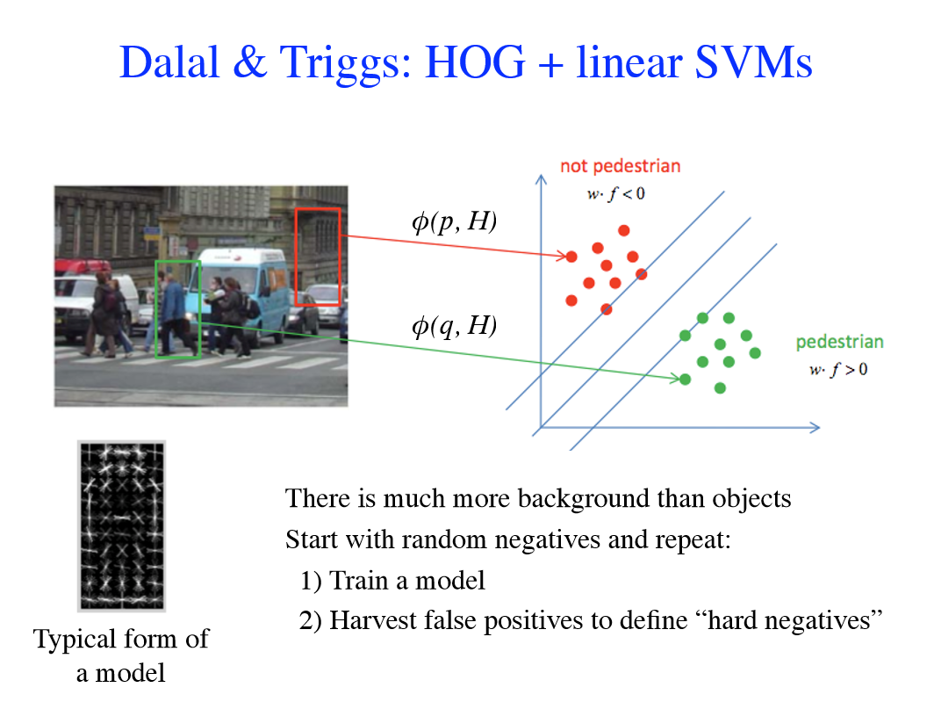
Felzenszwalb

Slide 8
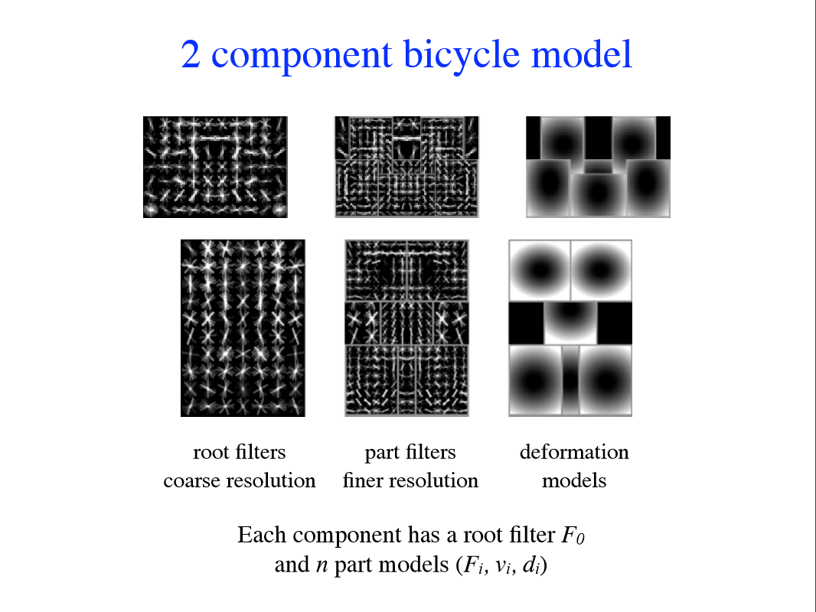
Discriminative part-based models
Felzenszwalb

Slide 9
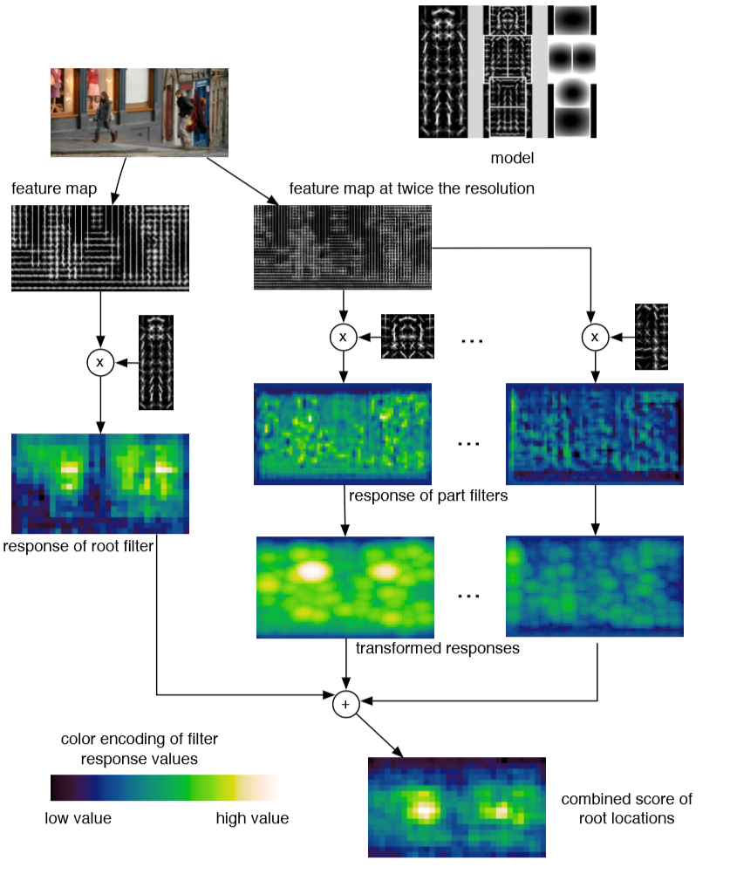

Slide 10
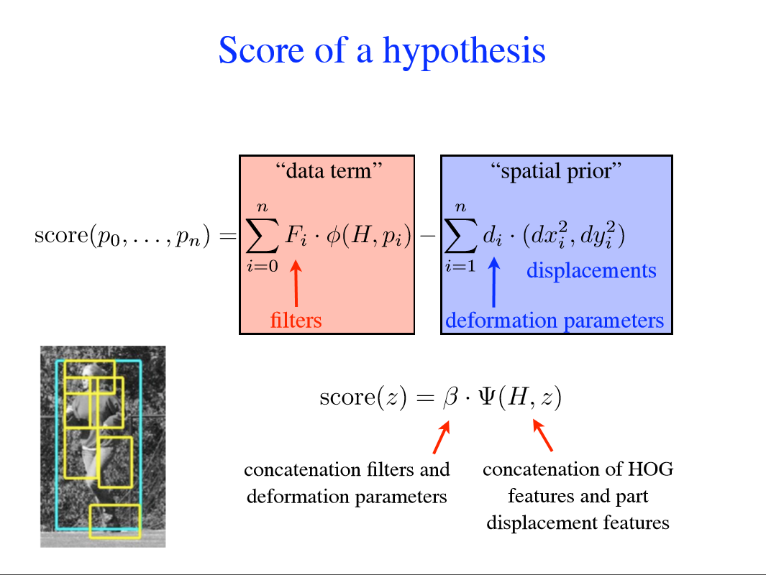
Felzenszwalb
Notes:
http://cs.brown.edu/~pff/talks/mlss.pdf
How would we evaluate one of these deformable part-based models?

Slide 11
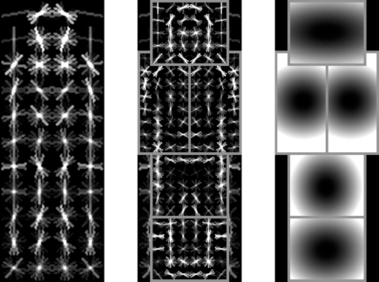
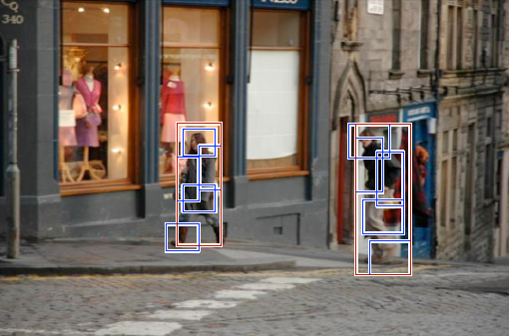
Discriminative part-based models
Root filter
Part filters
Deformation weights
P. Felzenszwalb, R. Girshick, D. McAllester, D. Ramanan, Object Detection with Discriminatively Trained Part Based Models, PAMI 32(9), 2010
Felzenszwalb

Slide 12


Car model
Component 1
Component 2
Felzenszwalb

Slide 13
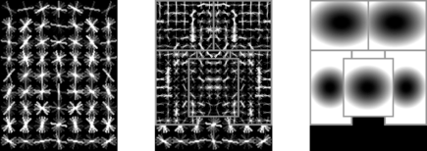
Person model
Felzenszwalb

Slide 14
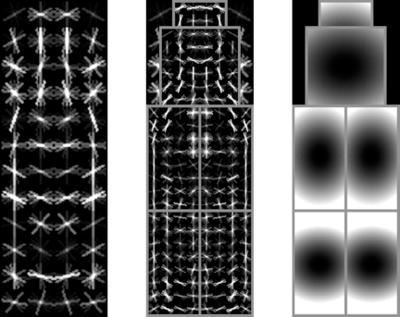
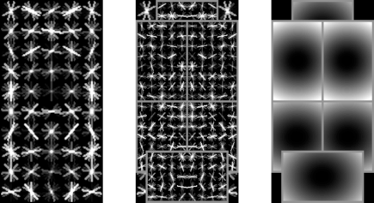
Bottle model
Felzenszwalb

Slide 15
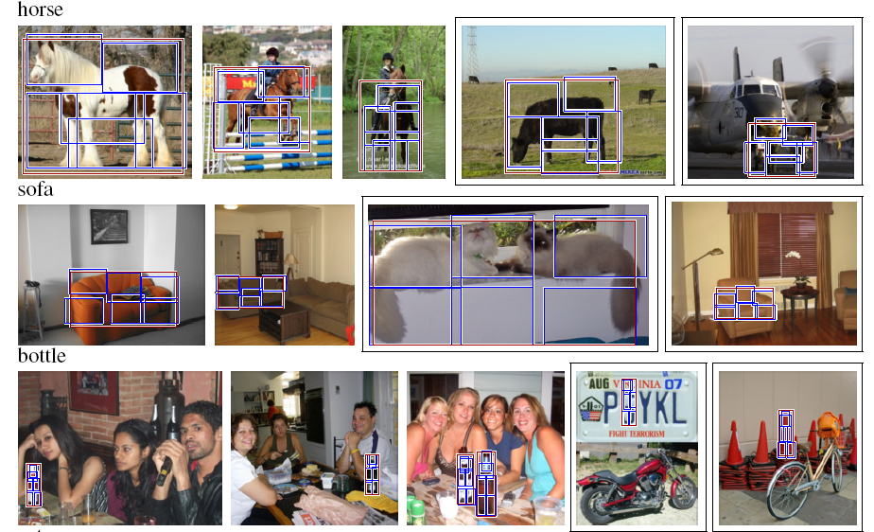
Good detections?
Notes:
PASCAL 2007 dataset
How can we know what the features are ‘seeing’?

Slide 16
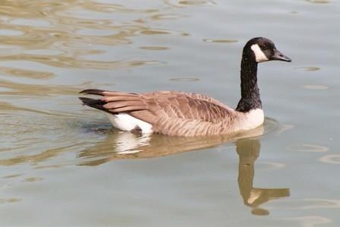
HOGgles (Vondrick et al. ICCV 2013)
Vondrick et al.

Slide 17

Car
Vondrick et al.

Slide 18
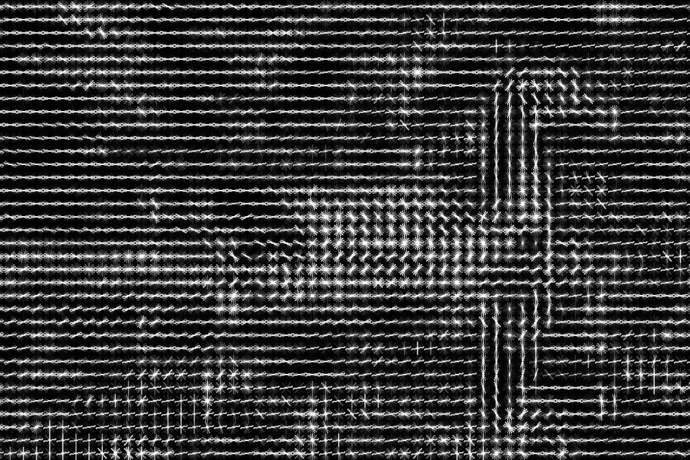
Car
Vondrick et al.

Slide 19
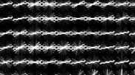
Car
Vondrick et al.

Slide 20
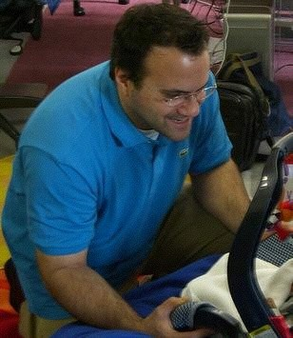

What information is lost?
Vondrick et al.

Slide 21
What information is lost?
Vondrick et al.

Slide 22
How can we ‘invert’ lossy HOG?
Gradient computation
  Without width or ‘edge blur’, i.e., not edges from Eldar 1999
Oriented magnitude sum (via bins)
  Loss of precision
  Loss of specificity – any number of values can sum to the same total
Normalization
  No way to unnormalize without knowing normalization factors
Many different image patches translate to the same HOG feature : (

Slide 23
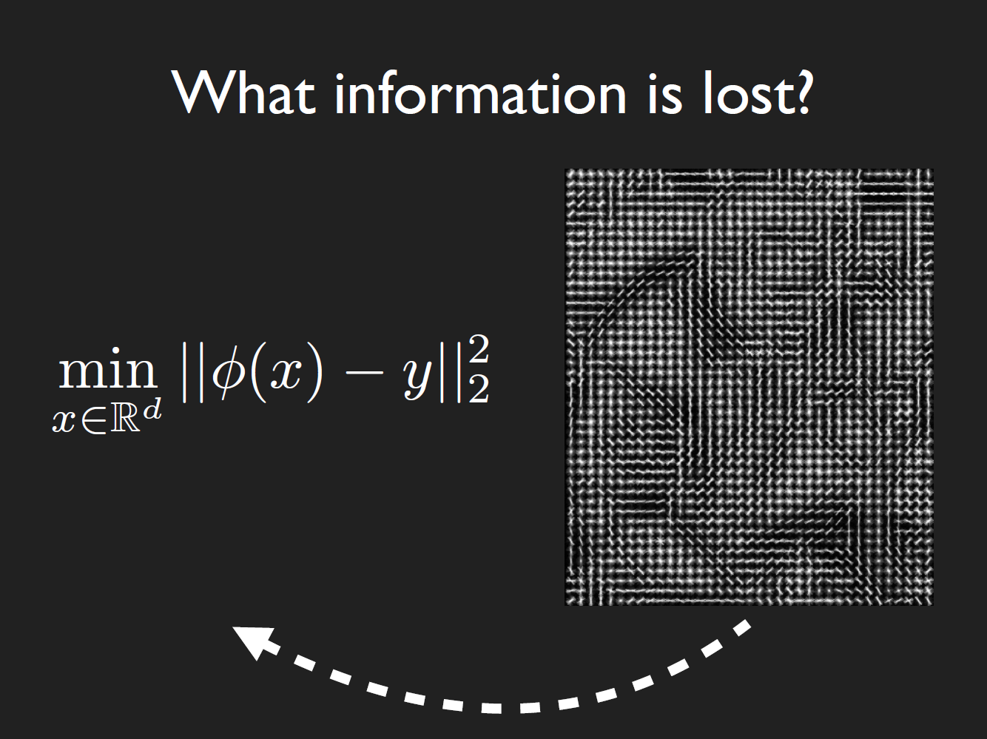

$$x=input patch$$
$$y=HOG descriptor$$
$$φ\left(x\right)=HOG transform$$
Hard to optimize!
Many-to-one = unconstrained!
Vondrick et al.
Notes:
How can we optimize this?
The paper tries five approaches:
Gradient descent
Exemplar LDA
Ridge regression
Direct optimization
Paired dictionary learning

Slide 24
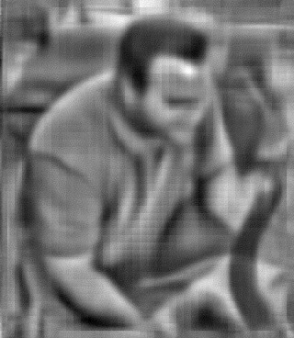
What information is lost?
Vondrick et al.
Notes:
But, it’s possible to recover something like this

Slide 25
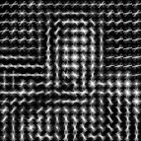
Method: Paired Dictionary
Vondrick et al.
Notes:
How can we optimize this?
The paper tries five approaches:
Gradient descent
Exemplar LDA
Ridge regression
Direct optimization
Paired dictionary learning

Slide 26
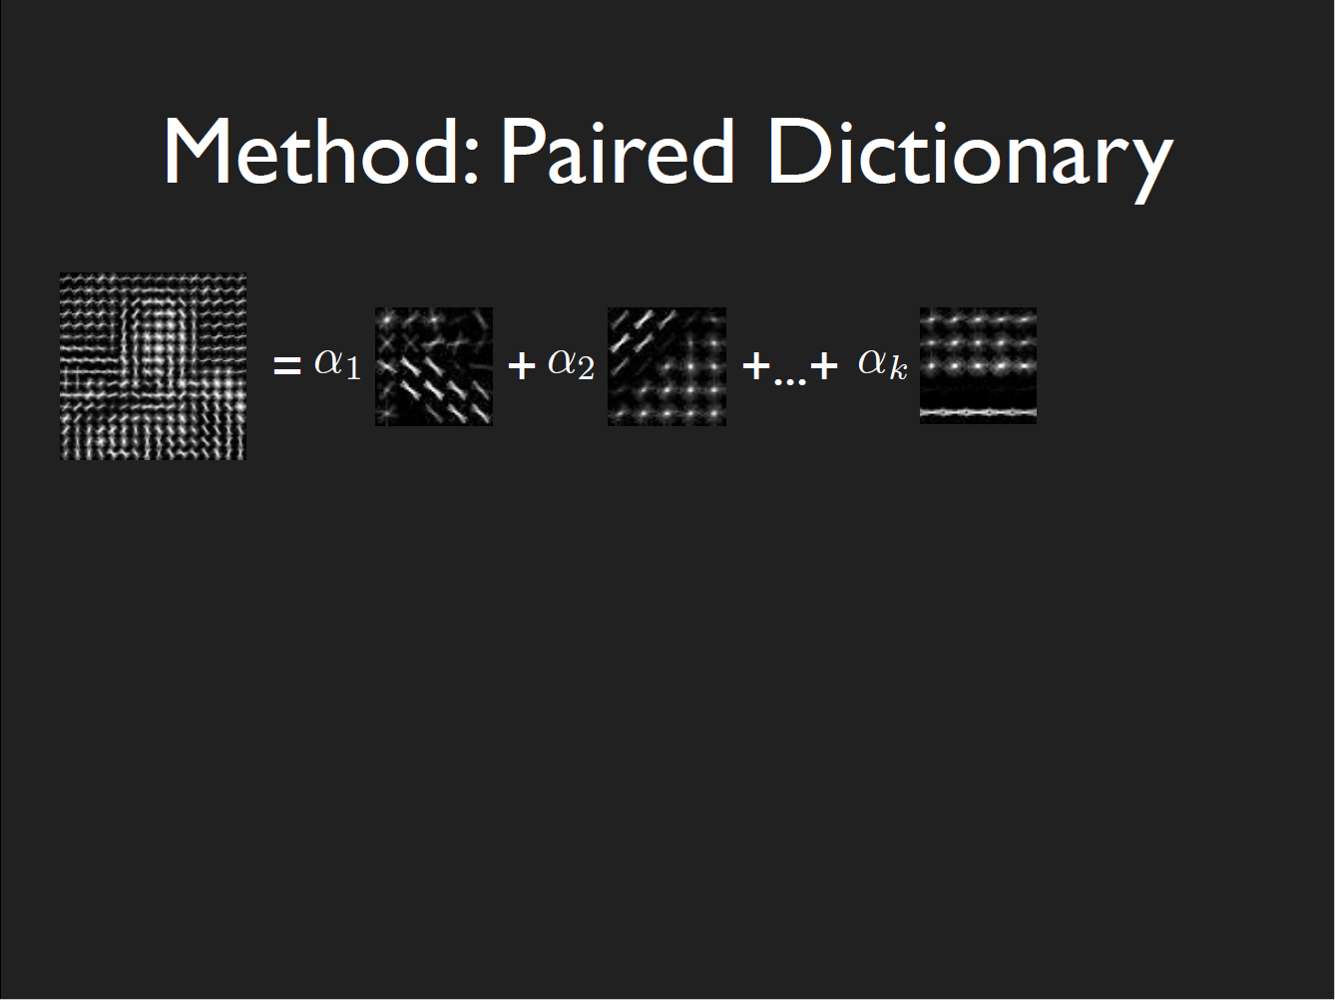
How to constrain (two parts):
Learn a basis over HOG windows
Vondrick et al.
Notes:
Split up 5x5 HOG patches into a _basis_ for HOG using a database of HOG patches.
Learn

Slide 27
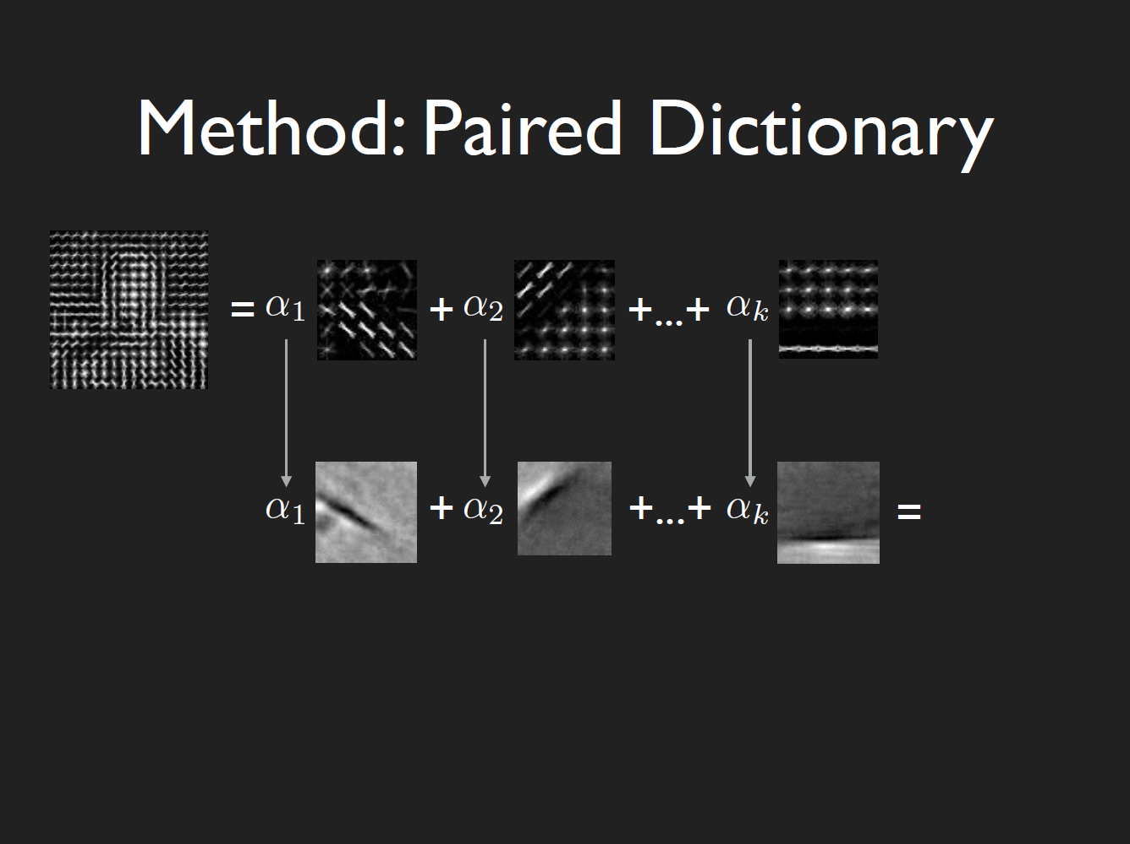

How to constrain (two parts):
Learn a basis over HOG windows
Simultaneously learn a basis over input windows,
and share the weights $α_{1}…a_{k}$ over the training data
Vondrick et al.
Notes:
Simultaneously learn a second basis _with the same weights_ but in image space.
Training data = PASCAL VOC

Slide 28
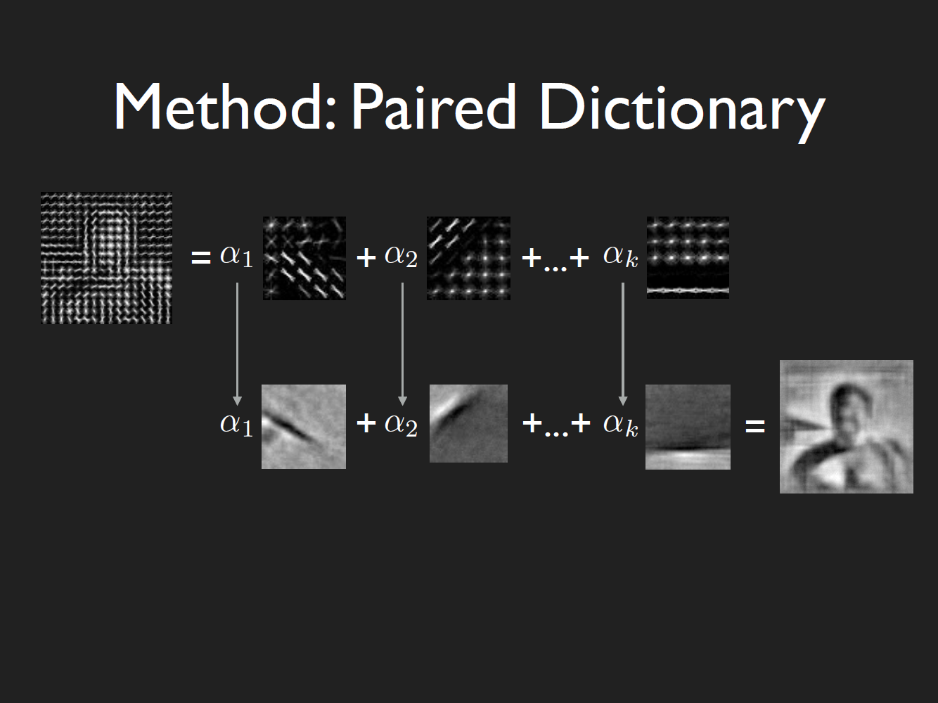
Inference to invert HOG:
Transform HOG patch into basis vectors
Take weights and apply to input basis
Vondrick et al.

Slide 29
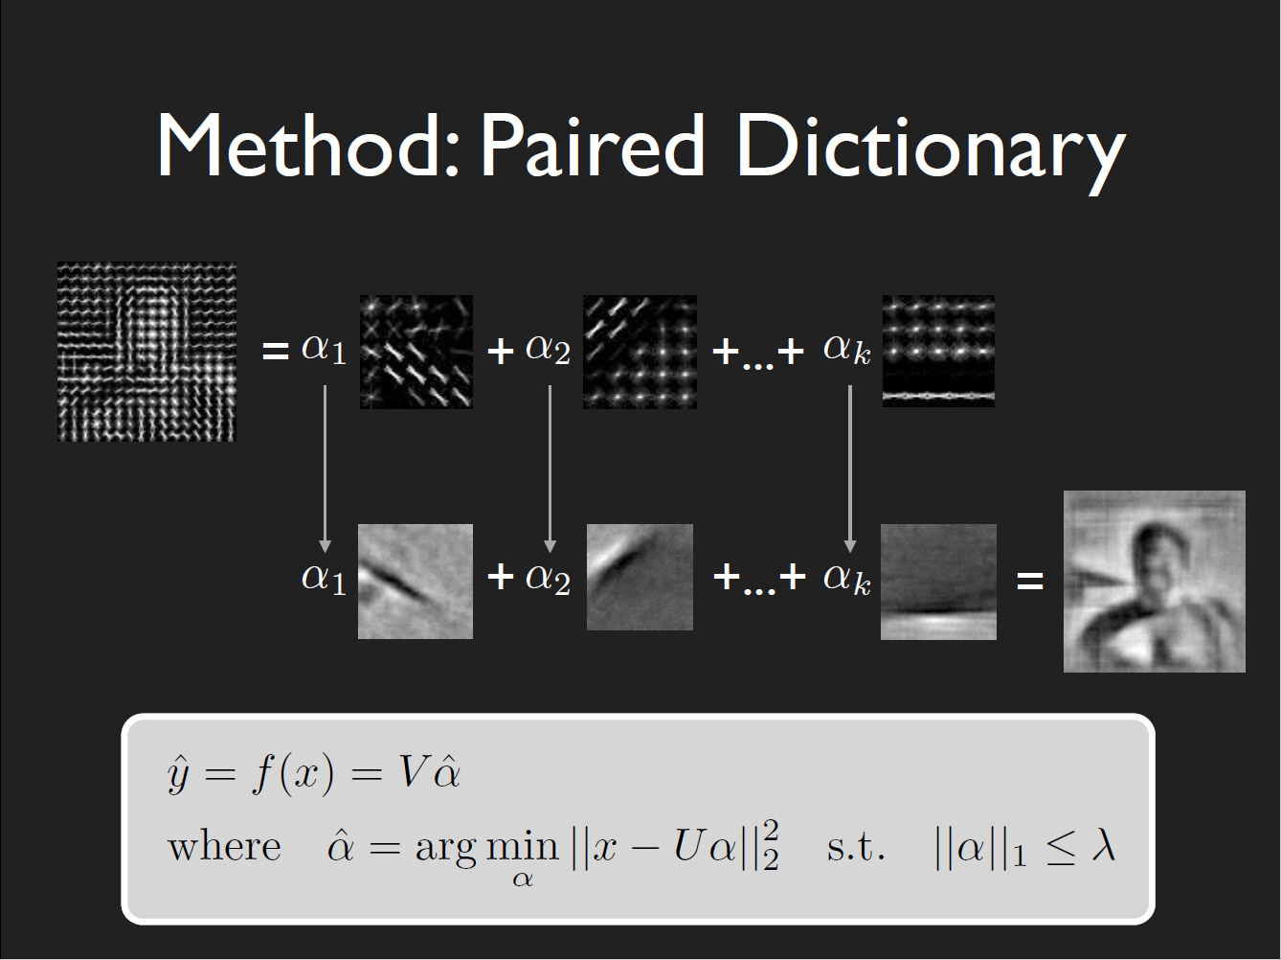

Slide 30
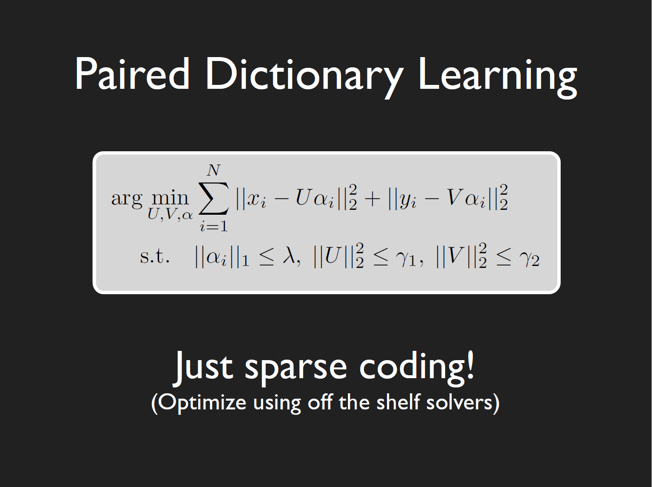

Slide 31
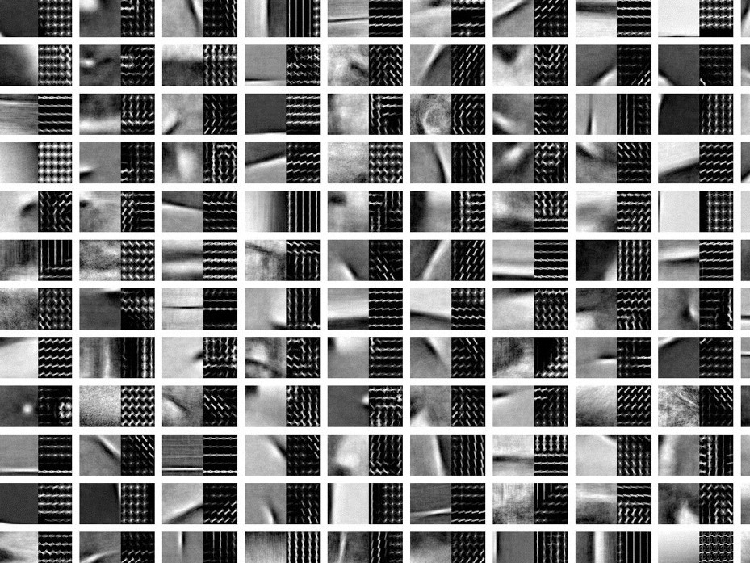

Slide 32

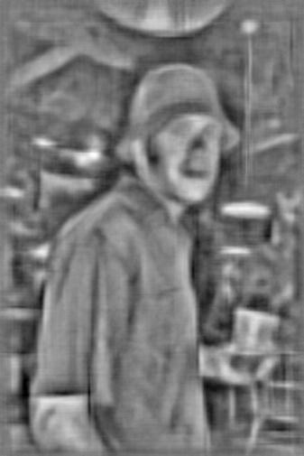
vs
Human Vision
HOG Vision
Vondrick et al.

Slide 33
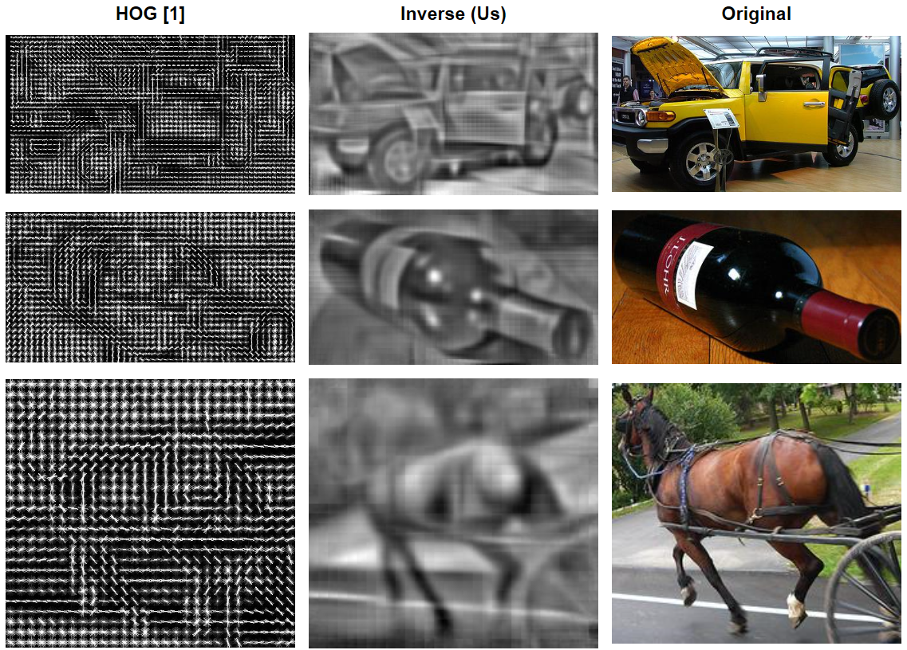
HOGgles (Vondrick et al. ICCV 2013)

Slide 34
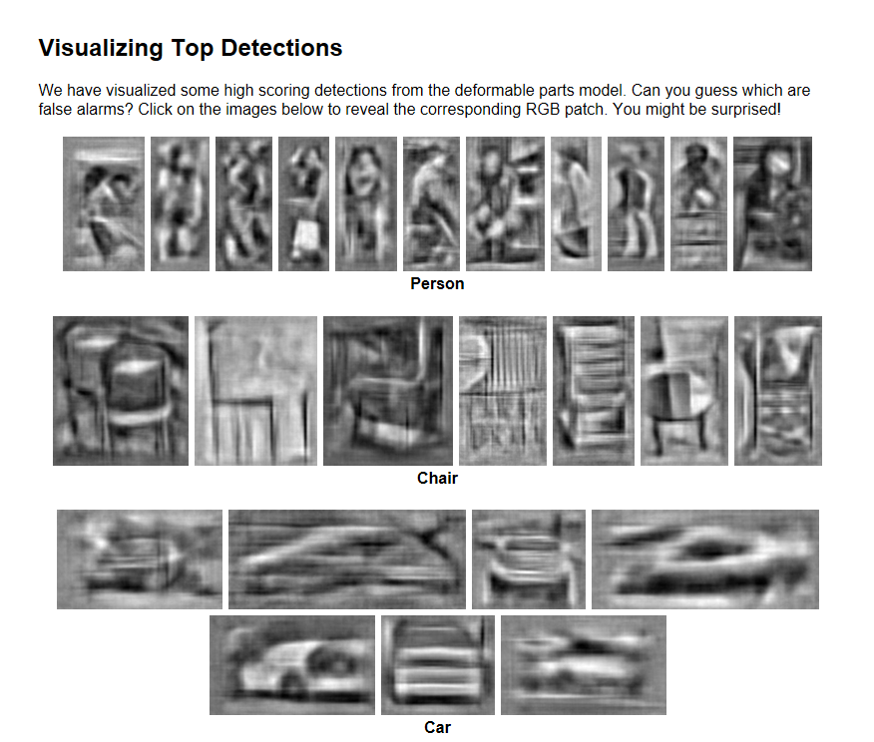
Vondrick et al.
Notes:
Go to webpage
carlvondrick.com/ihog/
Play with demo
Person
Airplane wing,

Slide 35
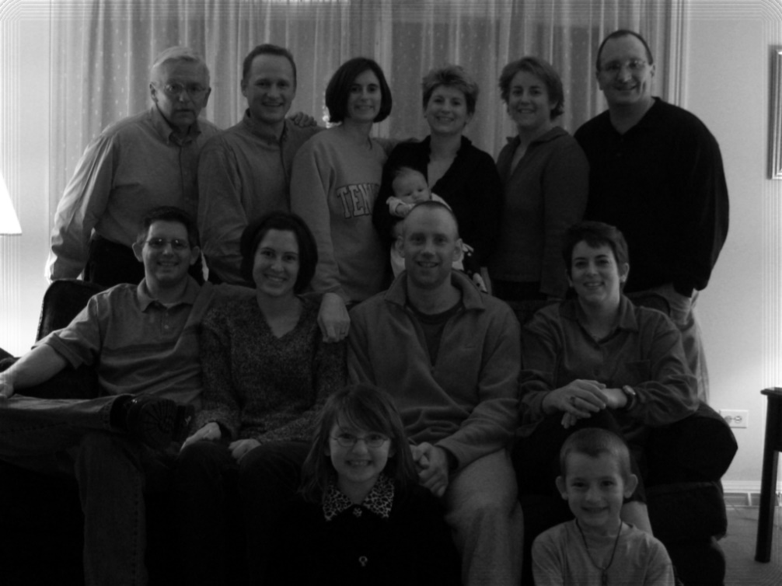
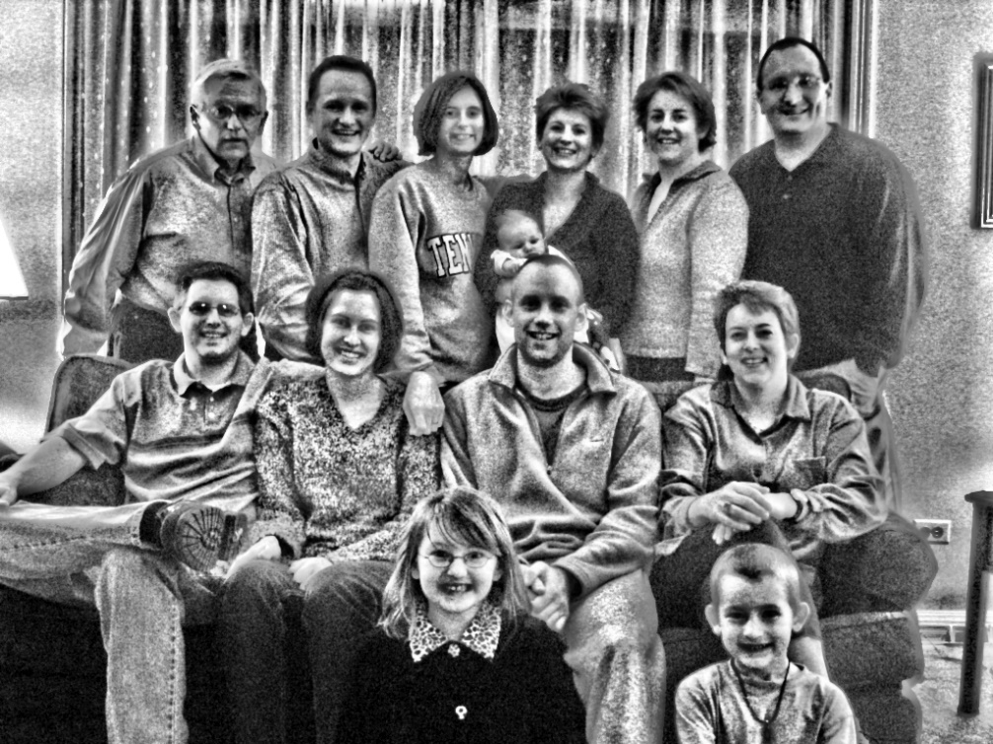
Looks a lot like…
Contrast-limited Adaptive Histogram Equalization! (CLAHE)
Scheidegger
Notes:
http://www.sci.utah.edu/~cscheid/spr05/imageprocessing/project1/

Slide 36
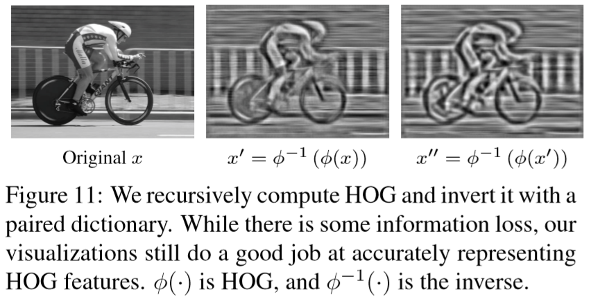
Recursive HOG!

Slide 37
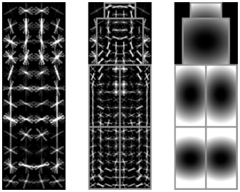
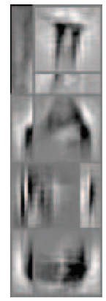
Bottle Deformable Parts Models + HOGgles

Slide 38
Why did the detector fail?
Car
Vondrick et al.

Slide 39
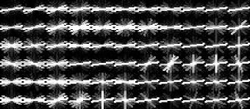
Why did the detector fail?
Car
Vondrick et al.

Slide 40
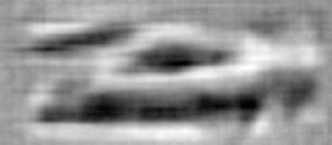
Why did the detector fail?
Car
Vondrick et al.

Slide 41
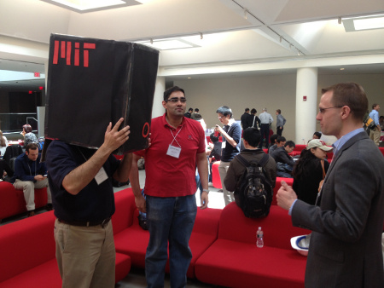
Code Available
Try it on your projects!
http://web.mit.edu/vondrick/ihog/
ihog = invertHOG(feat);

Slide 42
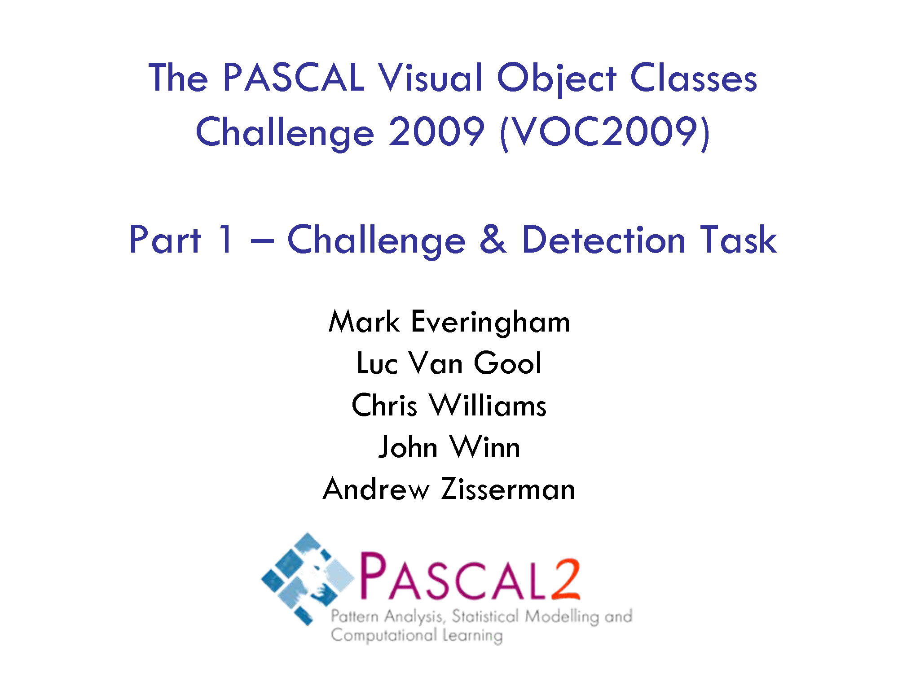
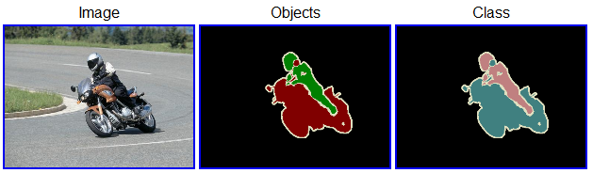
Twenty object categories (aeroplane to TV/monitor)
Three challenges:
  Classification challenge (is there an X in this image?)
  Detection challenge (draw a box around every X)
  Segmentation challenge
Snavely
Notes:
Both of the two previous works were trained on the PASCAL VOC dataset, which for a time was the best benchmark dataset we had for object detection.

Slide 43
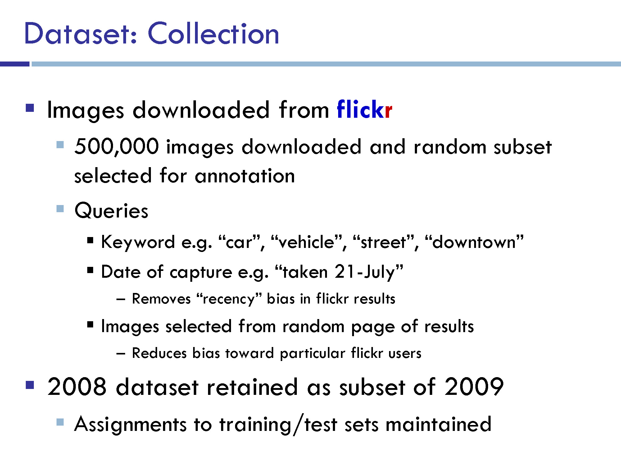

Slide 44
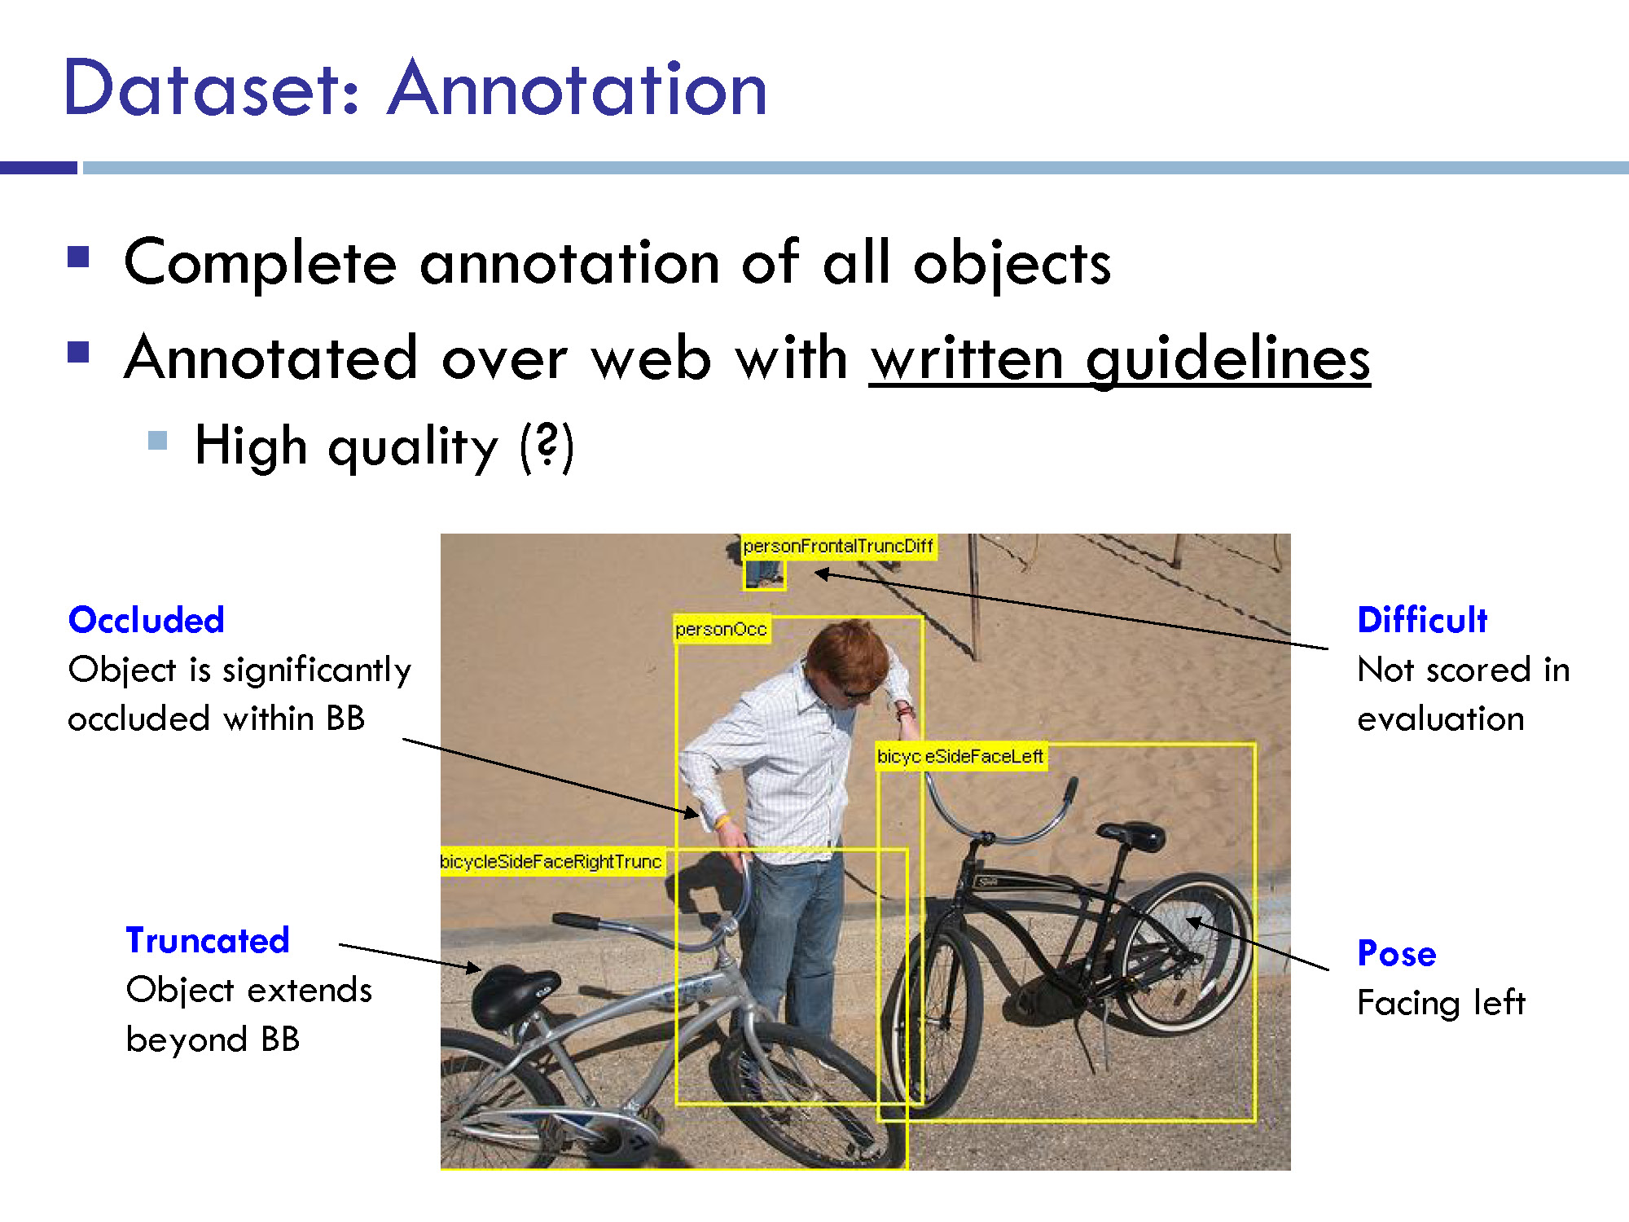
“
“

Slide 45
“
“
20 classes.
- Train / validation data has 11,530 images containing 27,450 ROI annotated objects and 6,929 segmentations.

Slide 46
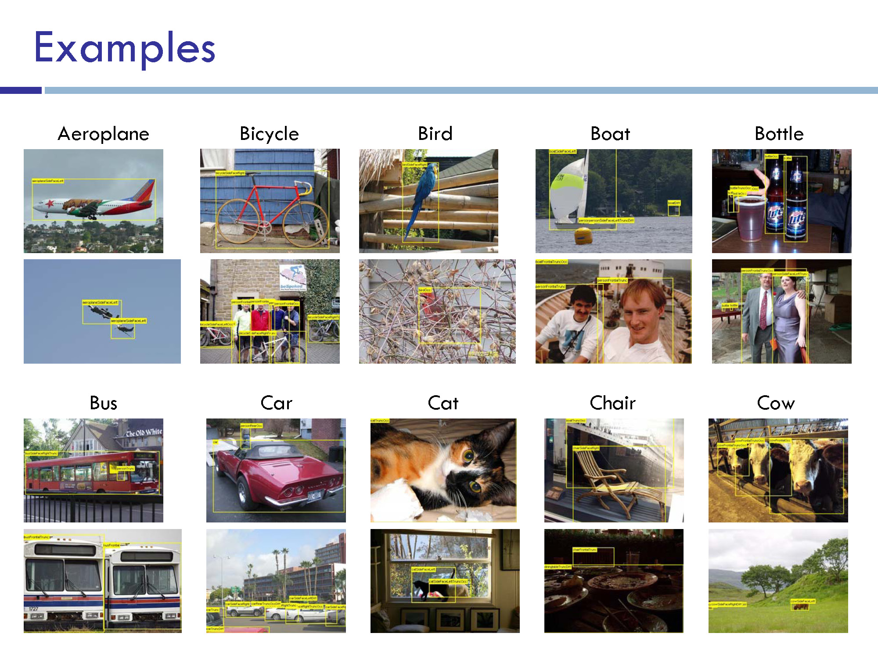

Slide 47
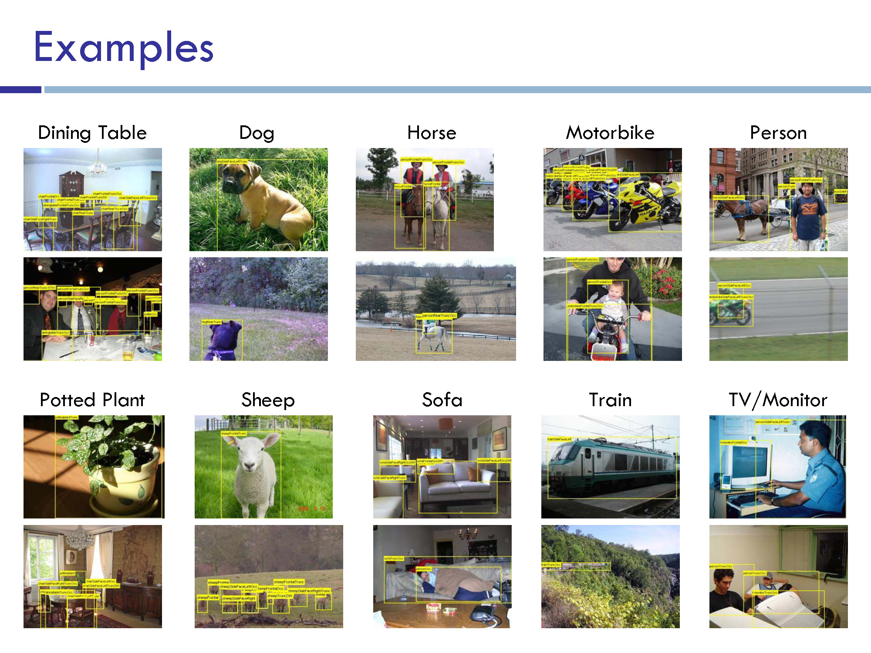

Slide 48
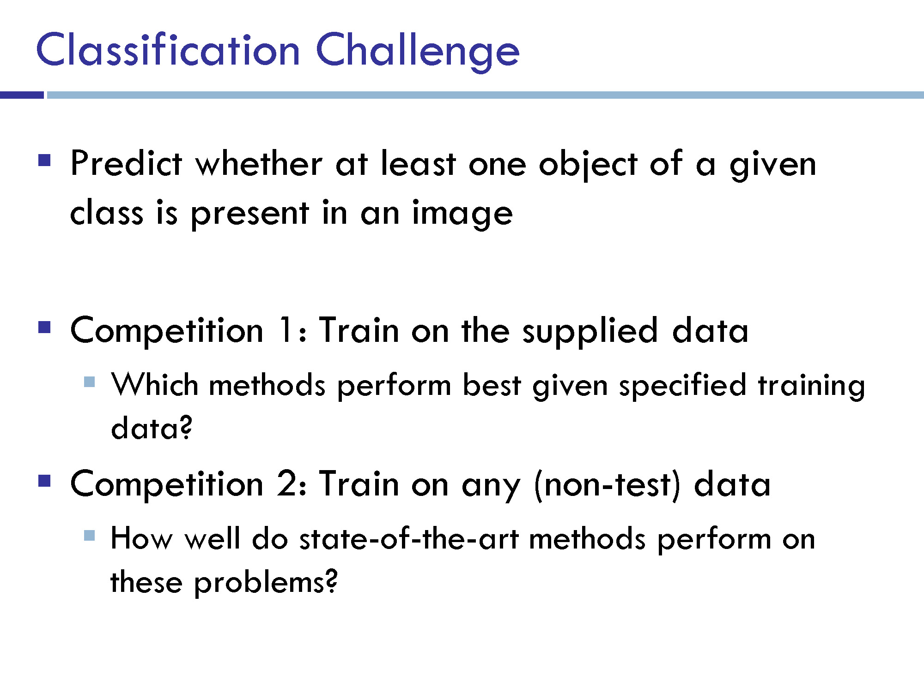
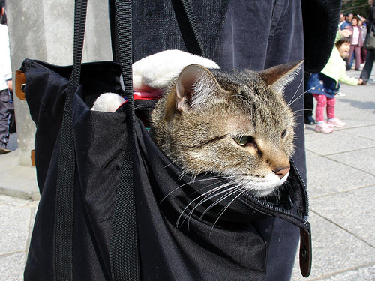
is
is there a cat?

Slide 49
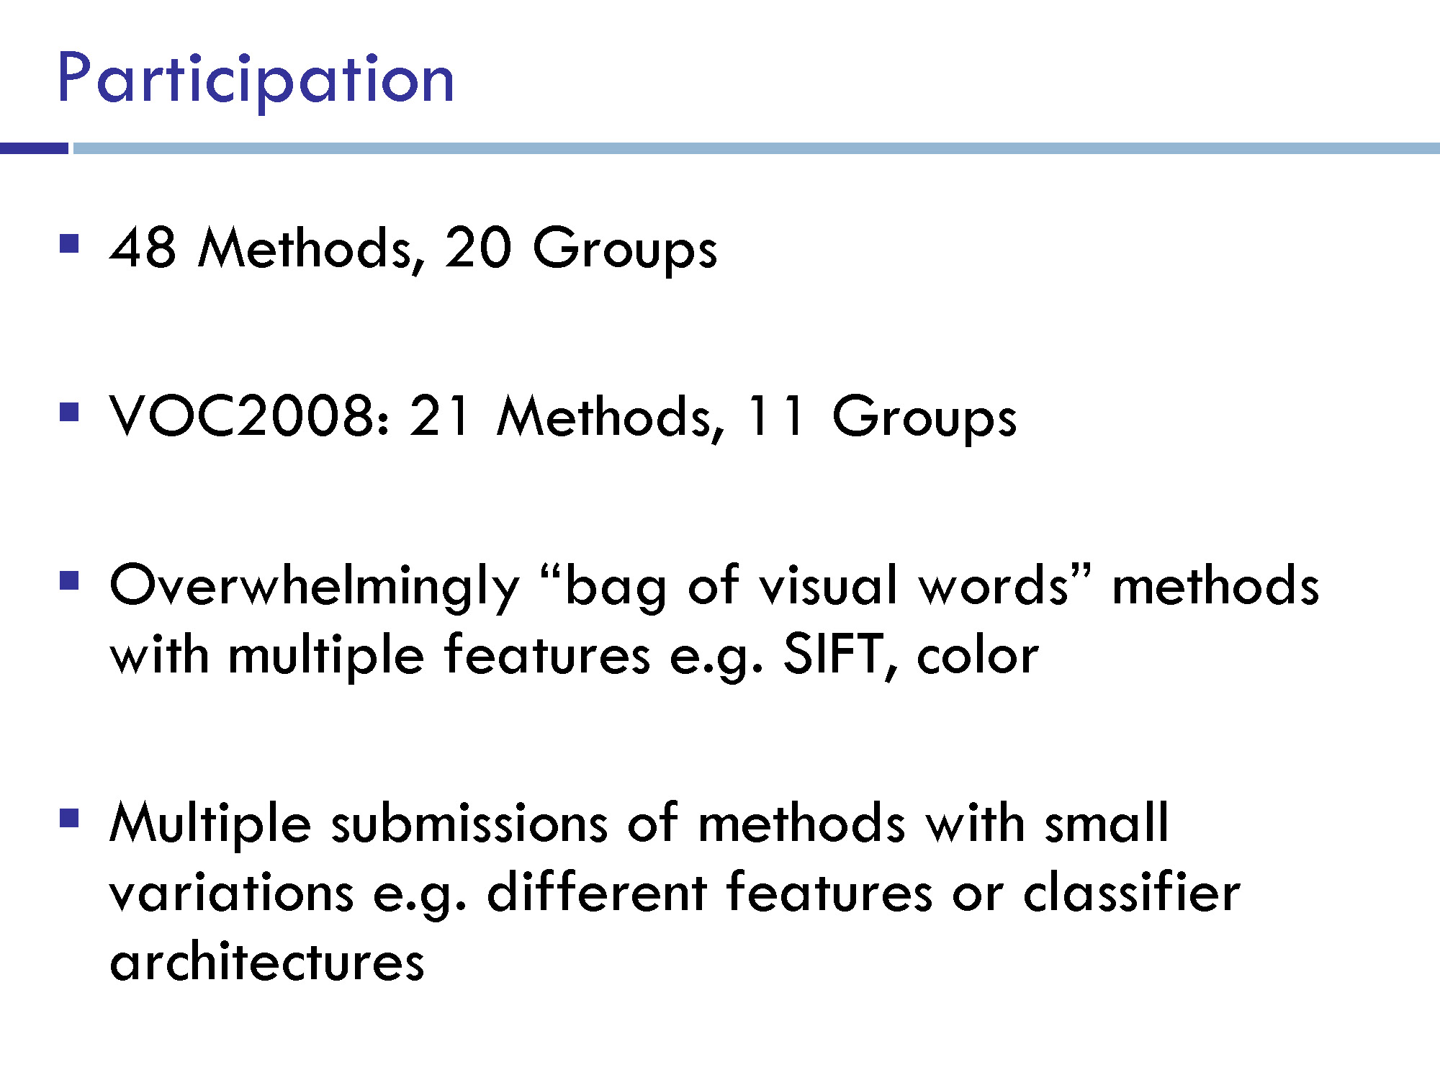

Slide 50

Notes:
~48 methods, 20 groups

Slide 51

AP = average precision

Slide 52


Set threshold on ‘detection’ to create one pair of precision / recall values.
Vary threshold across all values to generate precision / recall curves:
precision
recall
Notes:
http://aiweb.cs.washington.edu/ai/mln/images/image001.png

Slide 53

precision
recall

Slide 54

precision
recall

Slide 55


Slide 56


Slide 57



Slide 58


Slide 59


Slide 60

Chance essentially 0

Slide 61


Slide 62


Slide 63


Slide 64


Slide 65


Slide 66


Slide 67


Slide 68


Slide 69

Shuicheng Yan
Notes:
There aren’t enough images in PASCAL challenge, so they learn feature representations on ImageNet!
http://www.ee.oulu.fi/~jiechen/ACCV2014_Workshop_RoLoD.files/ACCV14-Workshop-keynote-speech.pdf

Slide 70

Opportunities of Scale
Many slides from James Hays, Alyosha Efros, and Derek Hoiem
Graphic from Antonio Torralba

Slide 71
Computer Vision so far
The geometry of image formation
  Ancient / Renaissance
Signal processing / Convolution
  1800, but really the 50’s and 60’s
Hand-designed Features for recognition, either instance-level or categorical
  1999 (SIFT), 2003 (Video Google), 2005 (Dalal-Triggs), 2006 (spatial pyramid)
Learning from Data
  1991 (EigenFaces) but late 90’s to now especially
Notes:
Omitting tracking / Multiview

Slide 72
What has changed in the last decade?
The Internet
Crowdsourcing
Learning representations from the data these sources provide (deep learning)

Slide 73
Opportunities of Scale: Data-driven methods
Today’s class
  Scene completion
  Im2gps

Slide 74


Google and massive data-driven algorithms
A.I. for the postmodern world:
  all questions have already been answered…many times, in many ways
  Google is dumb, the “intelligence” is in the data

Slide 75


Slide 76


Slide 77

Google Translate
http://ackuna.com/badtranslator
Notes:
http://translationparty.com/#9988025
http://ackuna.com/badtranslator

Slide 78

Chinese Room, John Searle (1980)
If a machine can convincingly simulate an intelligent conversation, does it necessarily understand? In the experiment, Searle imagines himself in a room, acting as a computer by manually executing a program that convincingly simulates the behavior of a native Chinese speaker.
Most of the discussion consists of attempts to refute it. "The overwhelming majority," notes BBS editor Stevan Harnad,“ still think that the Chinese Room Argument is dead wrong." The sheer volume of the literature that has grown up around it inspired Pat Hayes to quip that the field of cognitive science ought to be redefined as "the ongoing research program of showing Searle's Chinese Room Argument to be false.
Notes:
The experiment is the centerpiece of Searle's Chinese Room Argument which holds that a program cannot give a computer a "mind" or "understanding", regardless of how intelligently it may make it behave. He concludes that "programs are neither constitutive of nor sufficient for minds." "I can have any formal program you like, but I still understand nothing."
Searle “according to strong AI, . . . the appropriately programmed computer really is a mind, in the sense that computers given the right programs can be literally said to understand and have other cognitive states.”

Slide 79


Slide 80
Big Idea
Do we need computer vision systems to have strong AI-like reasoning about our world?
What if invariance / generalization isn’t actually the core difficulty of computer vision?
What if we can perform high level reasoning with brute-force, data-driven algorithms?

Slide 81

What should the missing region contain?
Notes:
81
What should go here and why?

Slide 82


Slide 83

Notes:
83
Introduce gist.

Slide 84


Slide 85
Which is the original?
(a)
(c)
(b)

Slide 86


How it works
Find a similar image from a large dataset
Blend a region from that image into the hole
Dataset

Slide 87
General Principal
Huge Dataset
Images
image
matching
Info from Most Similar Images
Input Image
Associated Info
Hopefully, If you have enough images, the dataset will contain very similar images that you can find with simple matching methods.

Slide 88
How many images is enough?

Slide 89










Nearest neighbors from a
collection of 20 thousand images
Notes:
89

Slide 90









Nearest neighbors from a
collection of 2 million images
Notes:
90

Slide 91
Image Data on the Internet
Flickr (as of Sept. 19th, 2010)
  5 billion photographs
  100+ million geotagged images
Facebook (as of 2009)
  15 billion
http://royal.pingdom.com/2010/01/22/internet-2009-in-numbers/

Slide 92
Image Data on the Internet
Flickr (as of Nov 2013)
  10 billion photographs
  100+ million geotagged images
  3.5 million a day
Facebook (as of Sept 2013)
  250 billion+
  300 million a day
Instagram
  55 million a day

Slide 93
Image completion: how it works
[Hays and Efros. Scene Completion Using Millions of Photographs. SIGGRAPH 2007 and CACM October 2008.]

Slide 94
The Algorithm
Notes:
94
Introduce gist.

Slide 95
Scene Matching
Notes:
95
Introduce gist.

Slide 96

Scene Descriptor
Notes:
Edge energy is just the magnitude of directional derivatives of image intensity.
96

Slide 97


Scene Descriptor
Scene Gist Descriptor
(Oliva and Torralba 2001)

Slide 98

Scene Descriptor
+
Scene Gist Descriptor
(Oliva and Torralba 2001)

Slide 99

2 Million Flickr Images
Notes:
99
Now we take our gist (and mask and color image) and find it’s L2 nearest neighbors in the database of 2.3 million images, and here they are

Slide 100


… 200 total
Notes:
100

Slide 101


Context Matching

Slide 102


Graph cut + Poisson blending

Slide 103





Result Ranking
We assign each of the 200 results a score which is the sum of:
The scene matching distance
The context matching distance
(color + texture)
The graph cut cost
Notes:
103
Johnson et al. used the graph cut cost to sort results for users in Semantic Photo Synthesis

Slide 105


Slide 106


Slide 108

Notes:
108

Slide 109

Notes:
109

Slide 110

Notes:
110

Slide 111


… 200 scene matches
Notes:
111

Slide 112

Notes:
112
Not actually the same scene, even though they’re startlingly similar

Slide 114


Slide 115


Slide 116


Slide 117


Which is the original?

Slide 118


Slide 119

Notes:
119

Slide 120

Notes:
120
Can justify broader use of image completion here

Slide 121

Diffusion Result
Notes:
121

Slide 122

Efros and Leung result
Notes:
122
Efros and leung result

Slide 123

Scene Completion Result

