Slide 1


Slide 2
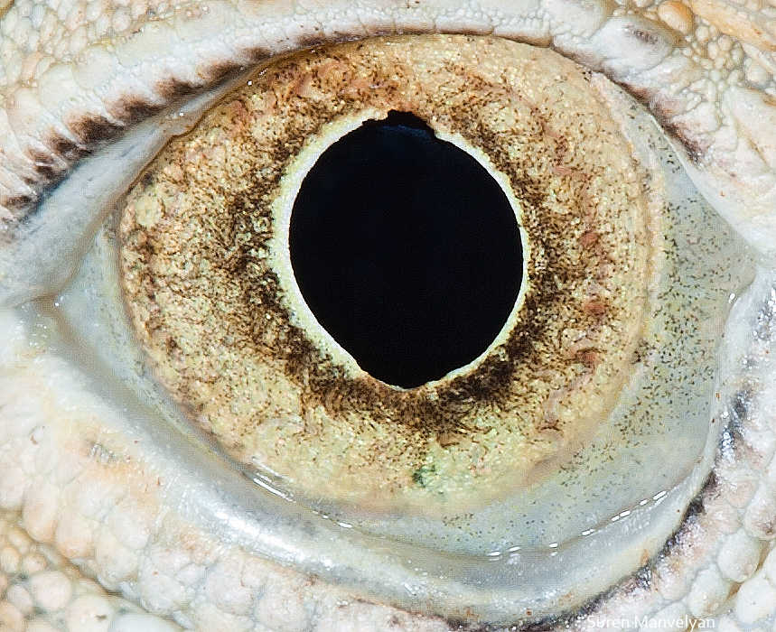
By Suren Manvelyan, http://www.surenmanvelyan.com/gallery/7116
Notes:
http://www.surenmanvelyan.com/gallery/7116
iguana

Slide 3
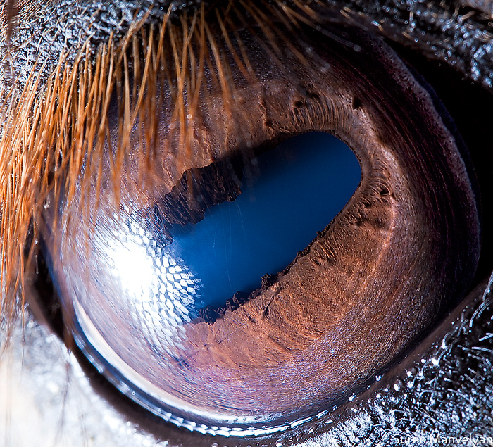
By Suren Manvelyan, http://www.surenmanvelyan.com/gallery/7116
Notes:
http://www.surenmanvelyan.com/gallery/7116
horse

Slide 4
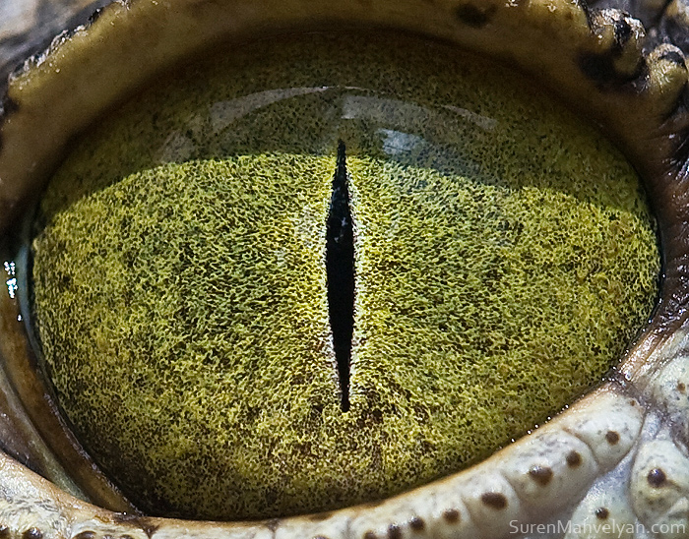
By Suren Manvelyan, http://www.surenmanvelyan.com/gallery/7116
Notes:
http://www.surenmanvelyan.com/gallery/7116
Crocodile (nile crocodile?)

Slide 5
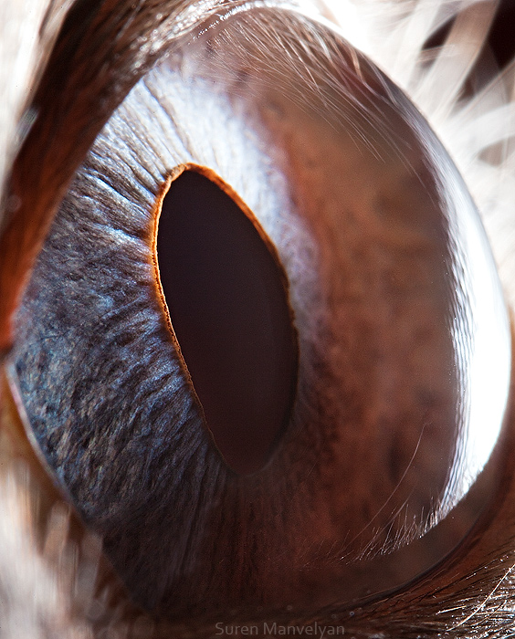
By Suren Manvelyan, http://www.surenmanvelyan.com/gallery/7116
Notes:
http://www.surenmanvelyan.com/gallery/7116
Siam cat

Slide 6
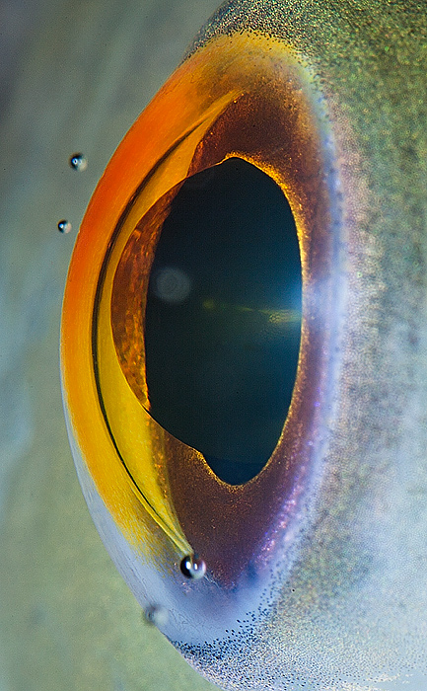
By Suren Manvelyan, http://www.surenmanvelyan.com/gallery/7116
Notes:
http://www.surenmanvelyan.com/gallery/7116
fish

Slide 7
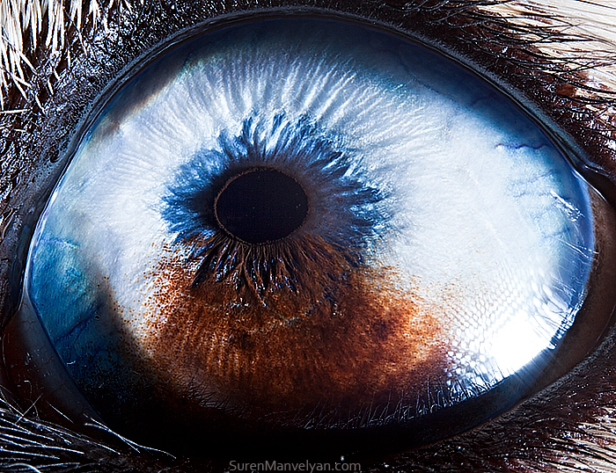
By Suren Manvelyan, http://www.surenmanvelyan.com/gallery/7116
Notes:
http://www.surenmanvelyan.com/gallery/7116
Husky with heterochromia

Slide 8
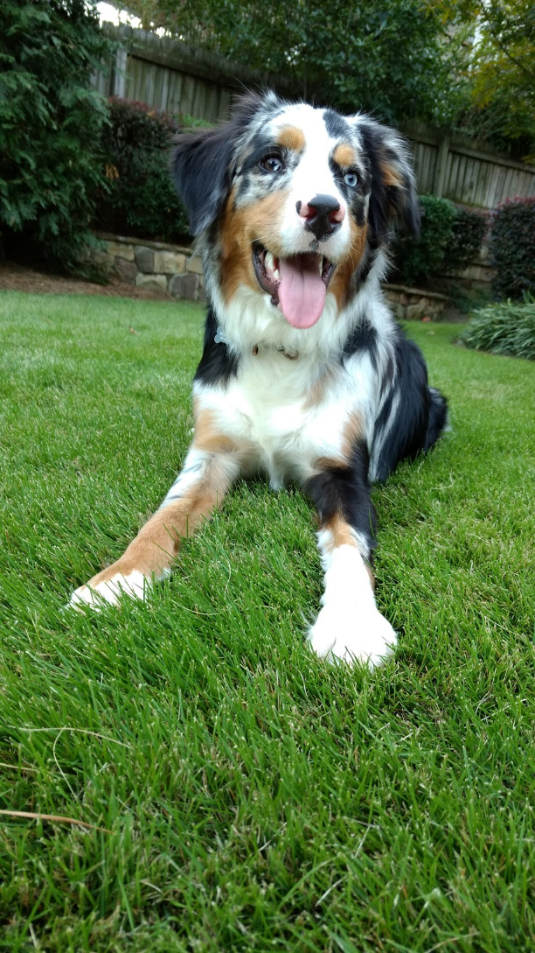
Indy
Notes:
http://www.surenmanvelyan.com/gallery/7116
Is this James Hays’ dog?!?!

Slide 9
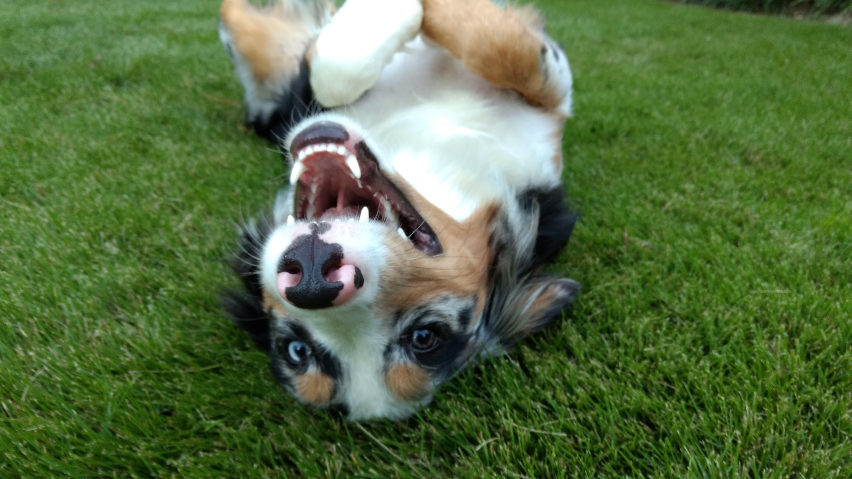
Indy
Notes:
http://www.surenmanvelyan.com/gallery/7116
Is this James Hays’ dog?!?!

Slide 10
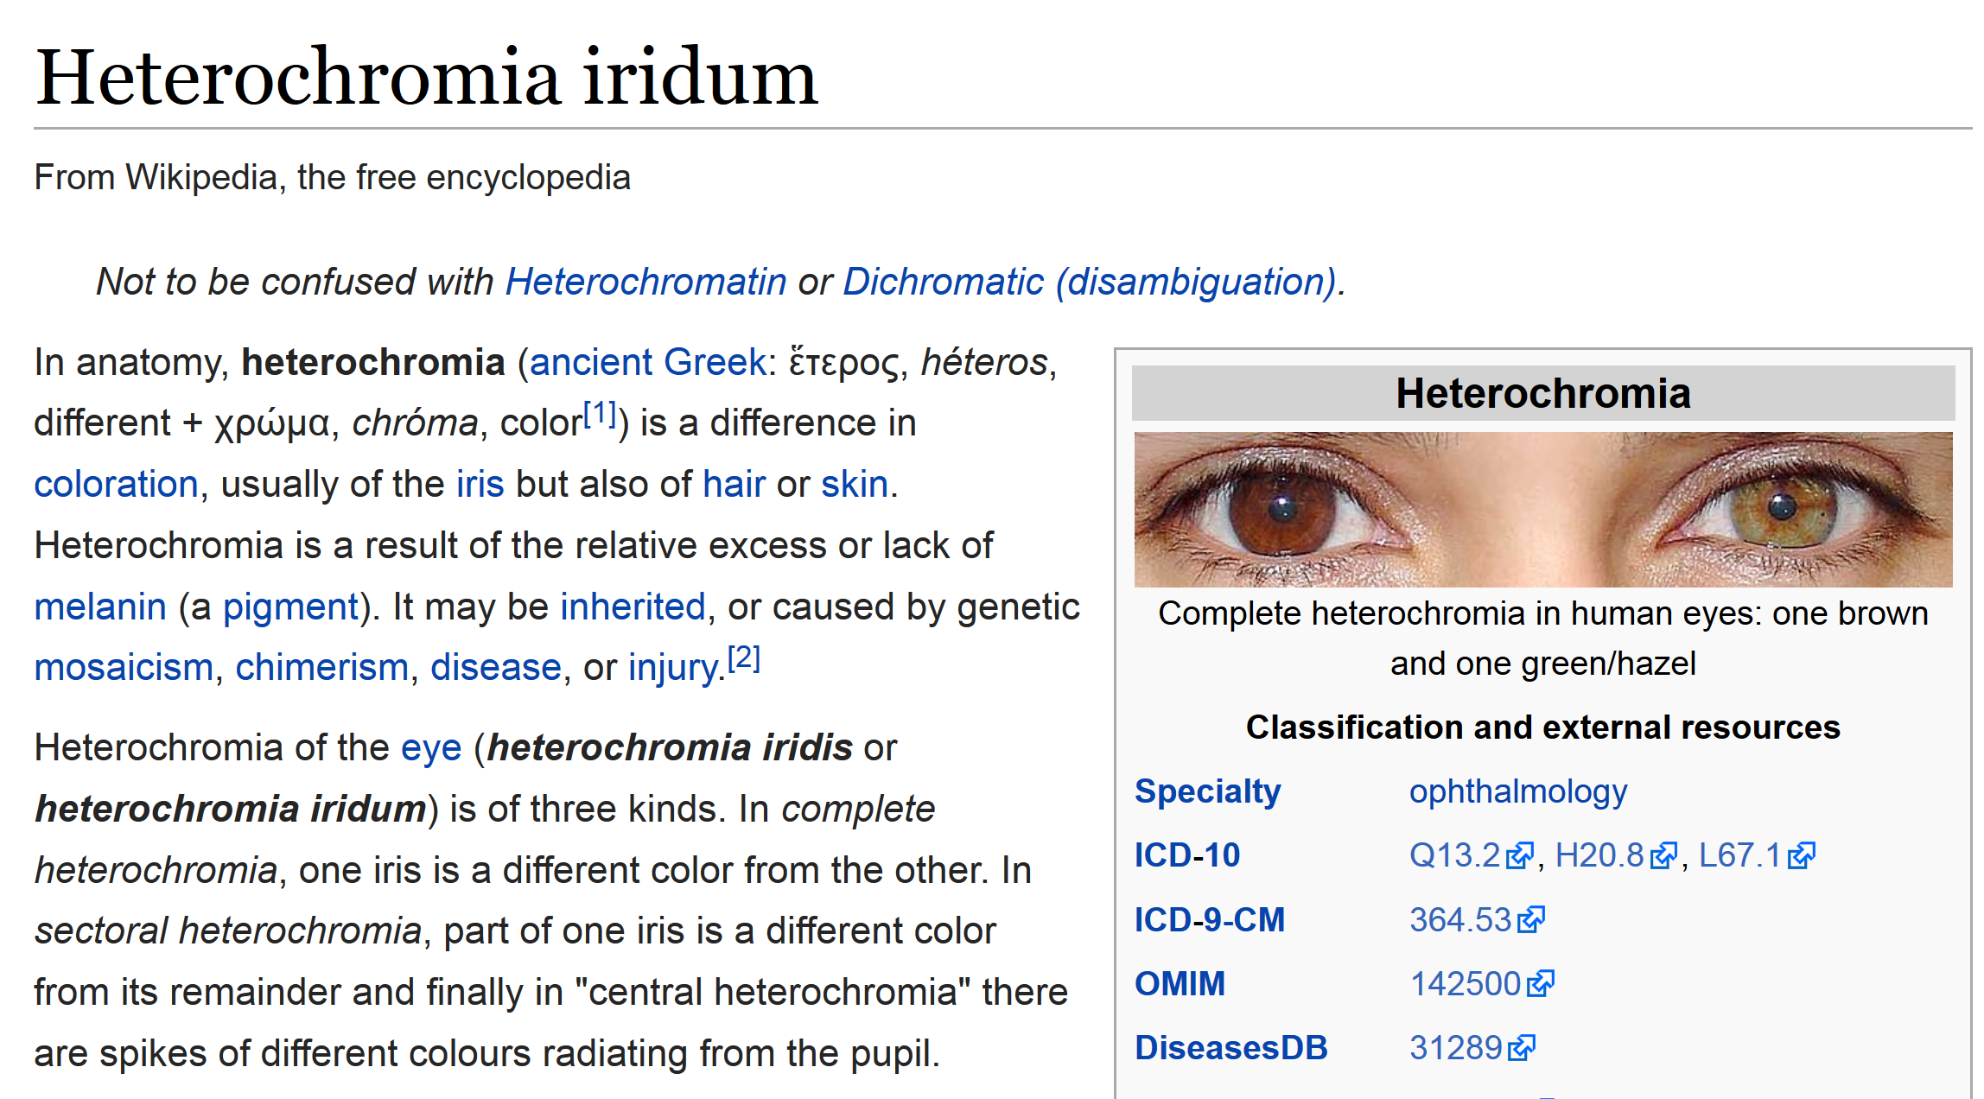

Slide 11
Project 4 is training and fine-tuning CNNs.
MATLAB can do this, but it’s not a common practice.
For more real-world experience, we will use TensorFlow – a Python package.
So…how’s your Python?

Slide 12
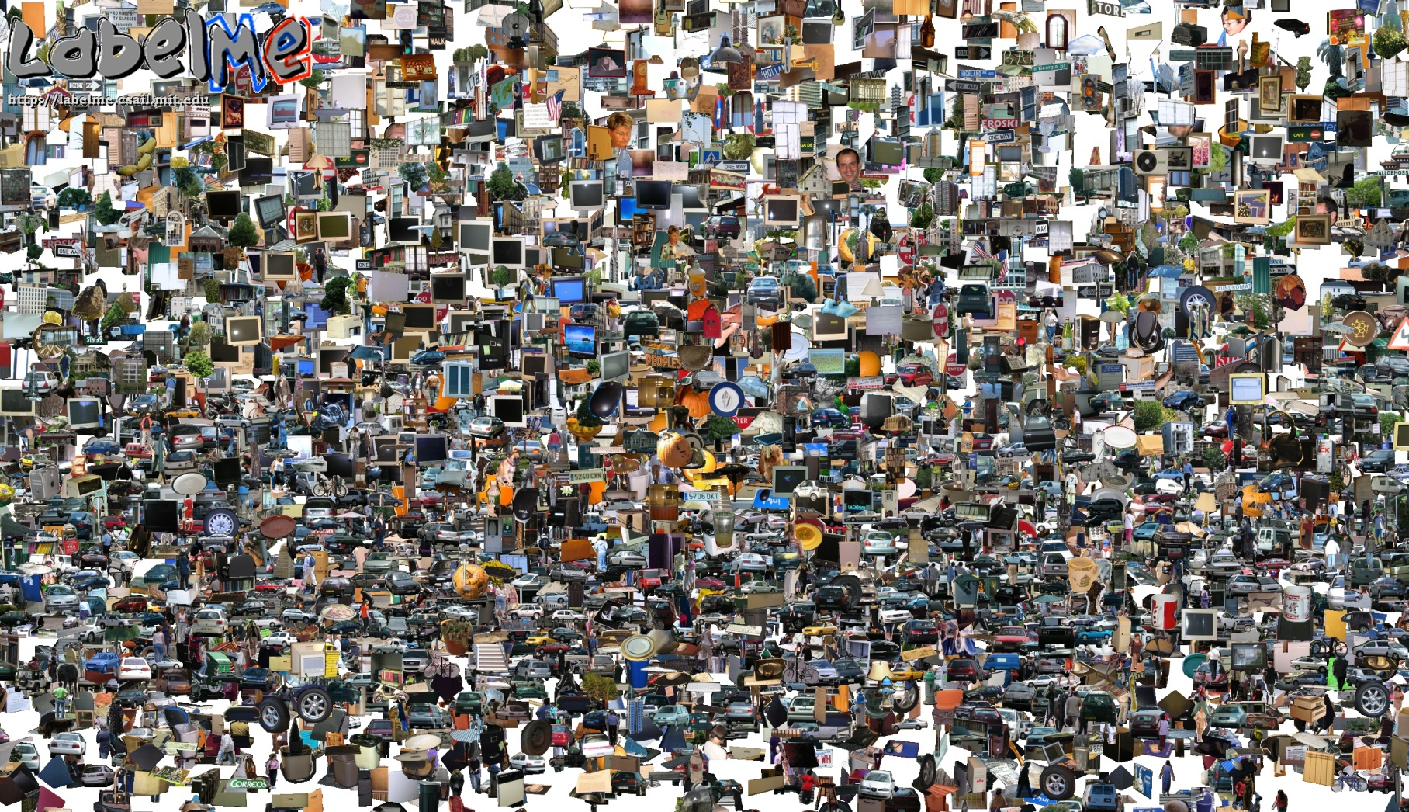
Opportunities of Scale
Many slides from James Hays, Alyosha Efros, and Derek Hoiem
Graphic from Antonio Torralba

Slide 13
General Principal
Huge Dataset
Images
image
matching
Info from Most Similar Images
Input Image
Associated Info
Application
Hopefully, If you have enough images, the dataset will contain very similar images that you can find with simple matching methods.

Slide 14
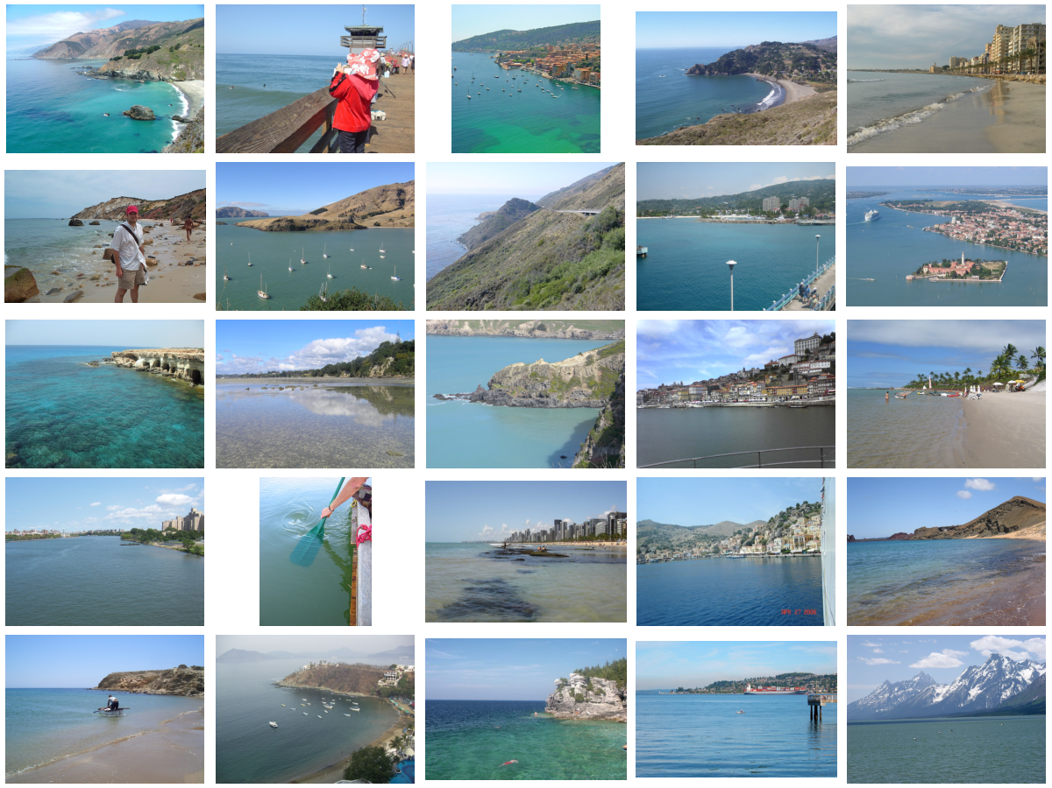
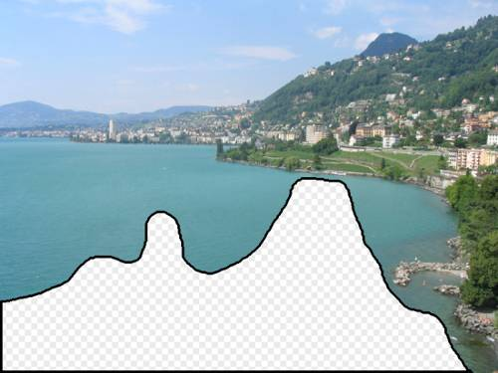
… 200 total
Notes:
14

Slide 15
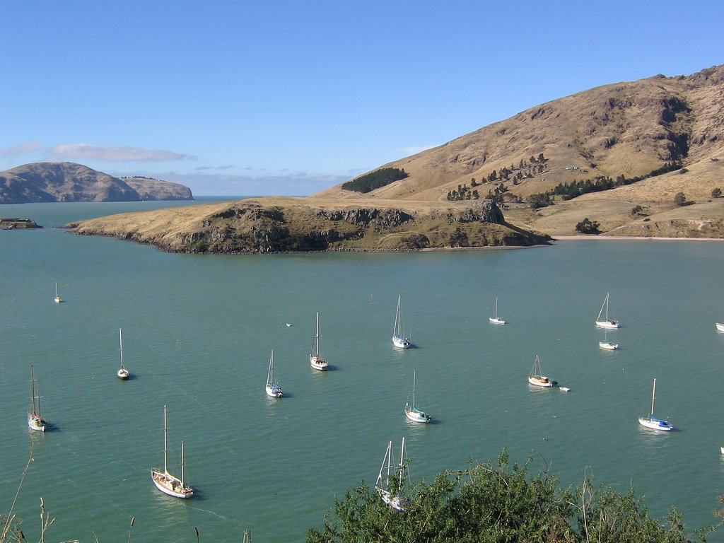
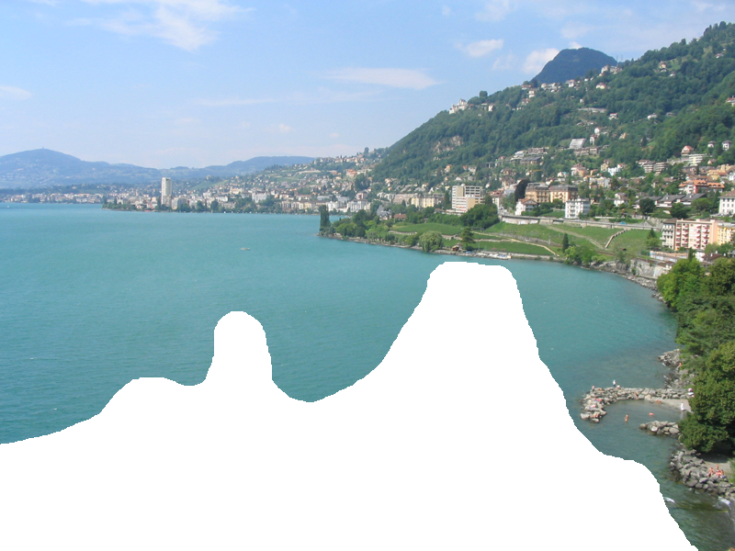
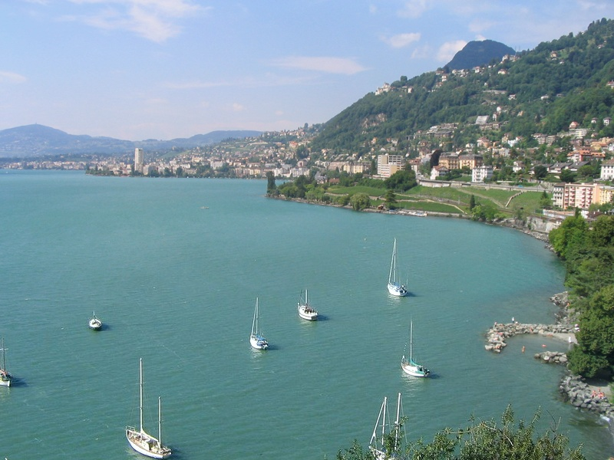
Graph cut + Poisson blending

Slide 16
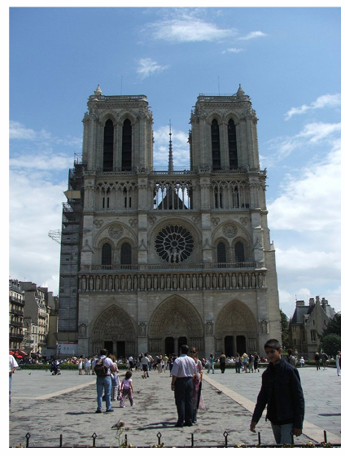
How much can an image tell about its geographic location?
Notes:
Think Pair Share -> How might I work out where this image is?

Slide 17
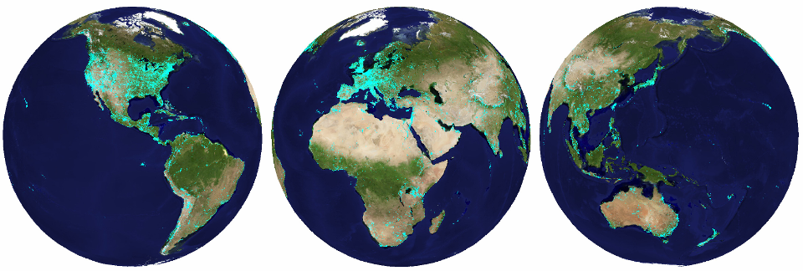
im2gps (Hays & Efros, CVPR 2008)
How much can an image tell about its geographic location?
6 million geo-tagged Flickr images
http://graphics.cs.cmu.edu/projects/im2gps/

Slide 18
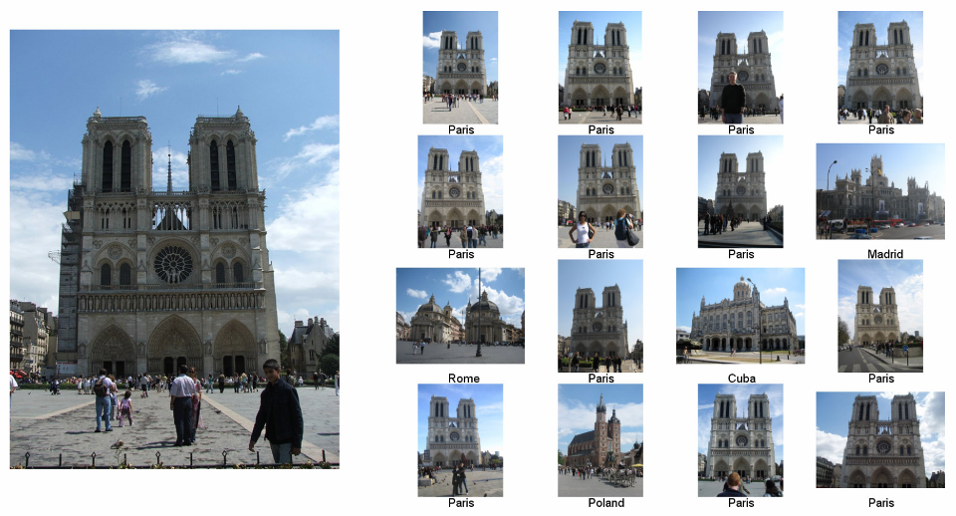
Nearest Neighbors according to gist + bag of SIFT + color histogram + a few others

Slide 19
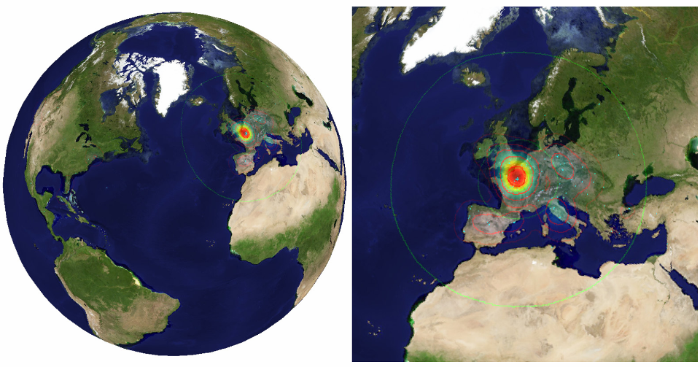

Slide 20
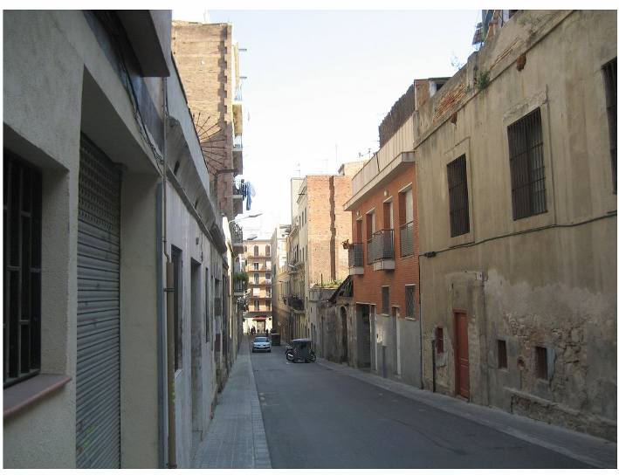
Im2gps

Slide 21
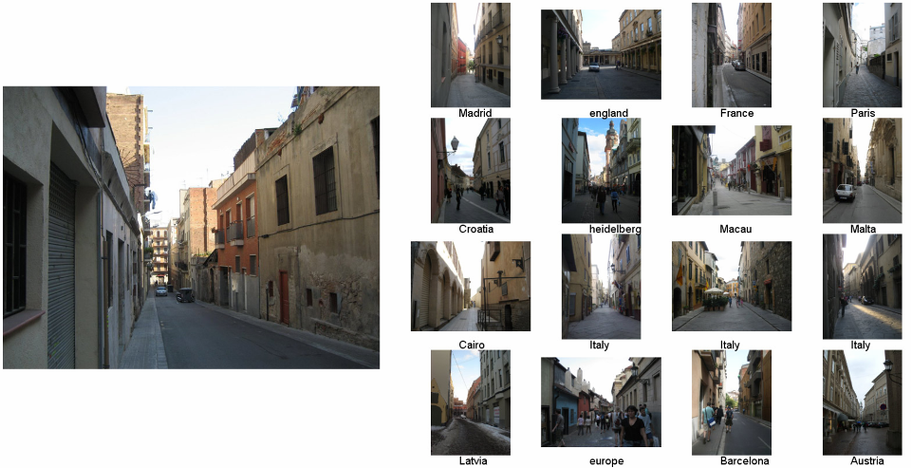
Example Scene Matches

Slide 22
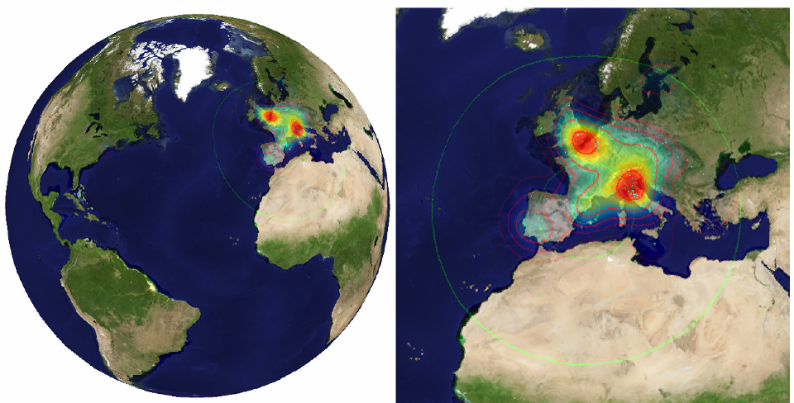
Voting Scheme
Notes:
Probability map for that same image
Explain the green circles and how they relate to evaluation
22

Slide 23
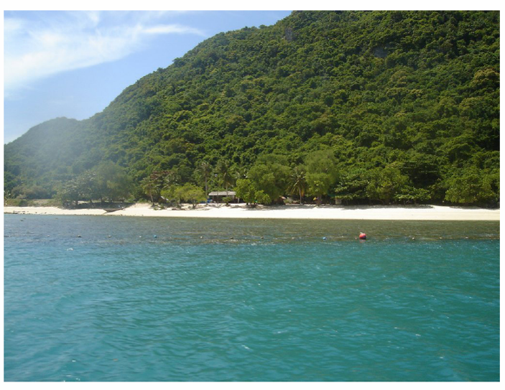
im2gps

Slide 24
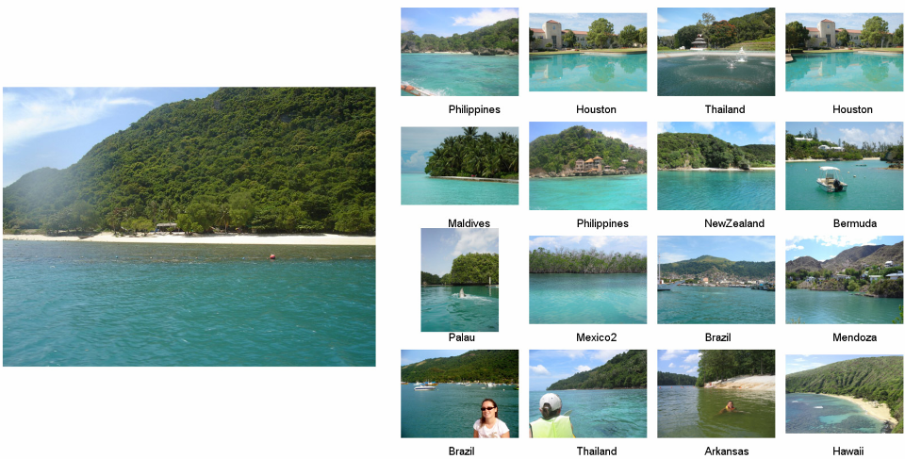

Slide 25
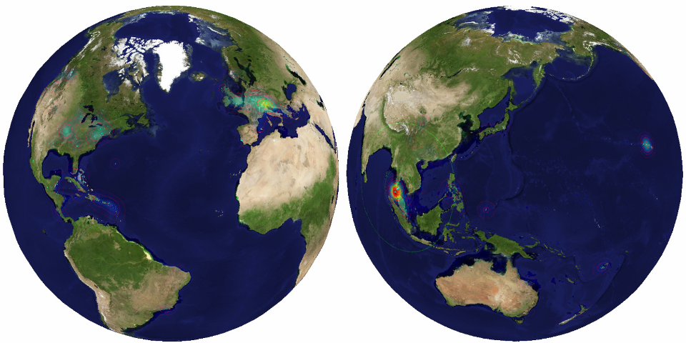

Slide 26
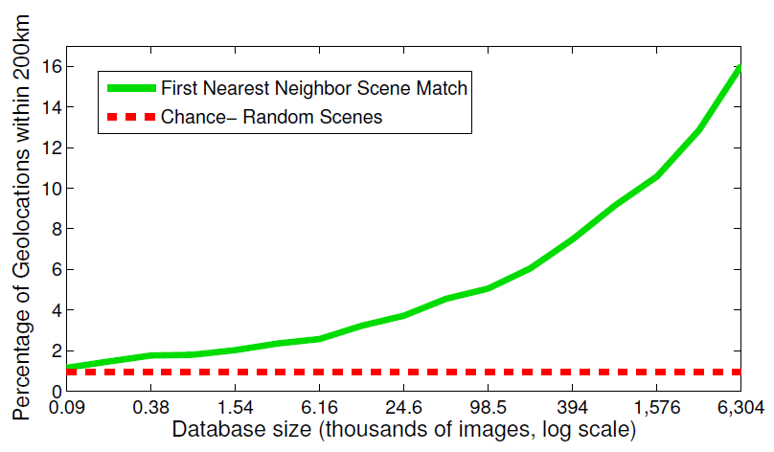
Effect of Dataset Size

Slide 27
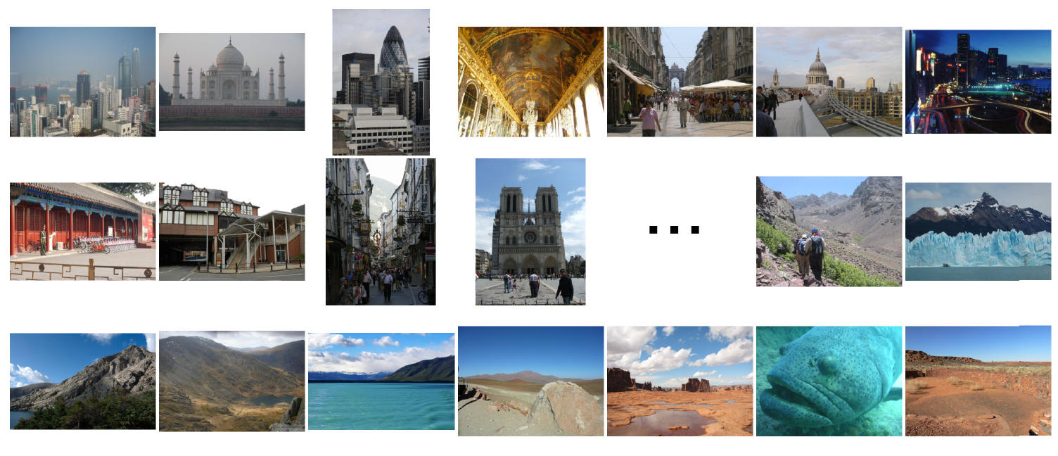
Population density ranking
High Predicted Density
Low Predicted Density

Slide 28
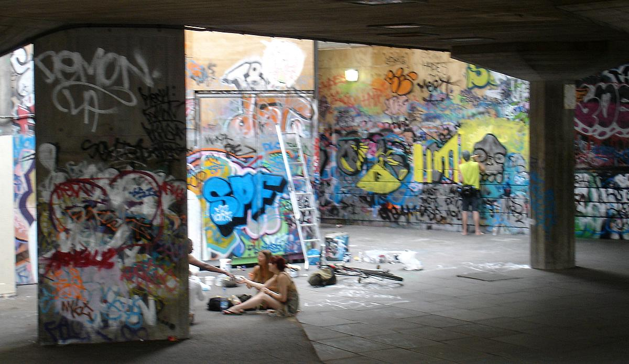
Where is This?
[Vesselova, Kalogerakis, Hertzmann, Hays, Efros. Image Sequence Geolocation. ICCV’09]
Notes:
28

Slide 29
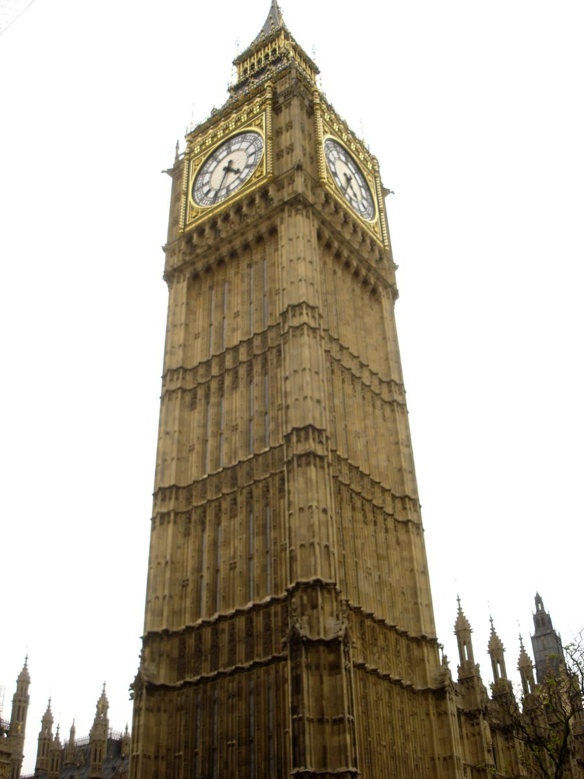
Where is This?

Slide 30


Where are These?
15:14,
June 18th, 2006
16:31,
June 18th, 2006
Notes:
Individually each photograph is 16%, but together they reinforce each other well
30

Slide 31
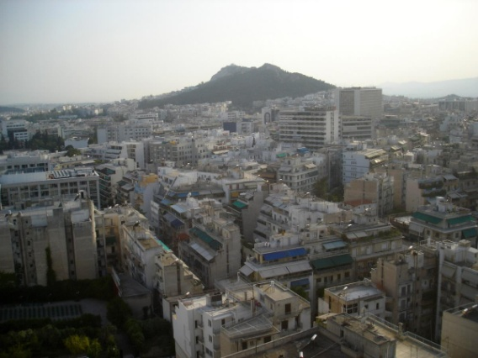
Where are These?
15:14,
June 18th, 2006
16:31,
June 18th, 2006
17:24,
June 19th, 2006
Notes:
If you know that brits love to vacation in greece…
31

Slide 32
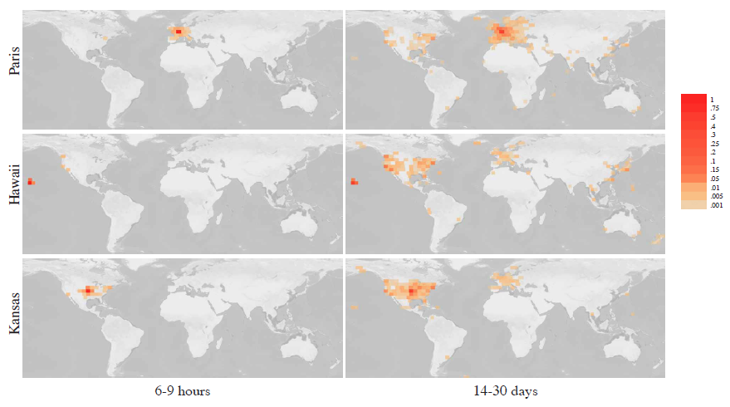
Results
im2gps – 10% (geo-loc within 400 km)
temporal im2gps – 56%

Slide 33
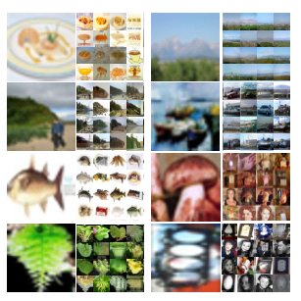
Tiny Images
80 million tiny images: a large dataset for non-parametric object and scene recognition
Antonio Torralba, Rob Fergus and William T. Freeman. PAMI 2008.
http://groups.csail.mit.edu/vision/TinyImages/

Slide 34
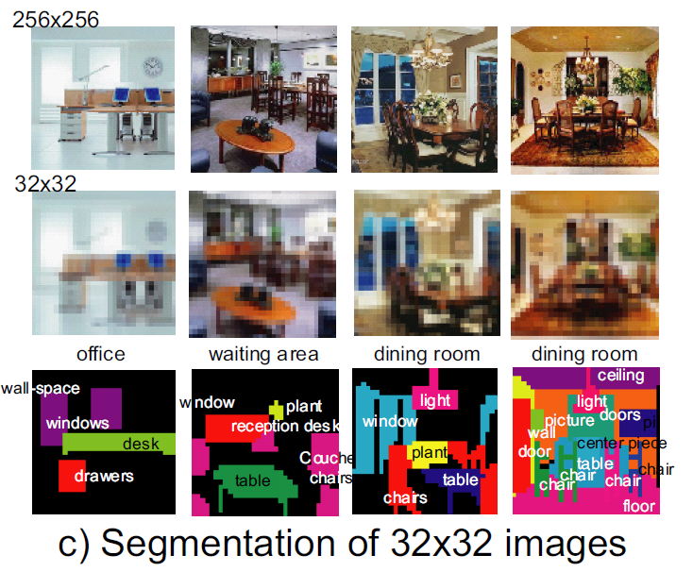
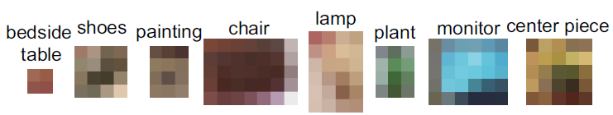

Slide 38
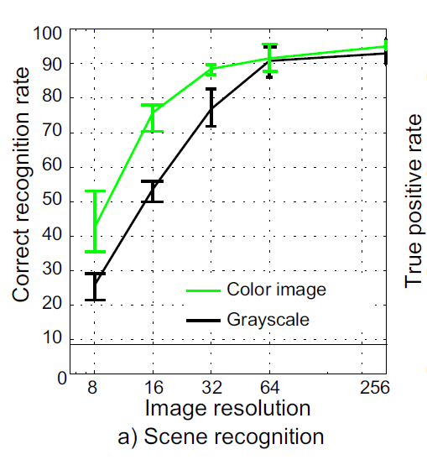
Given a benchmark, resolution and human scene recognition accuracy increase to a limit
Torralba et al.

Slide 39
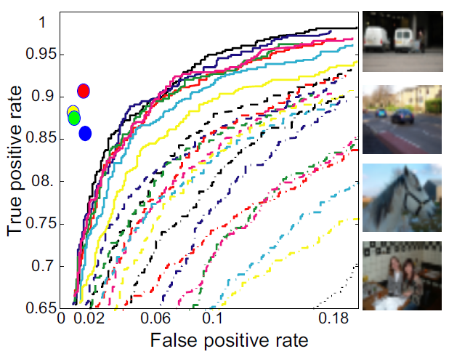
Humans vs. Computers: Car Classification
Various computer vision algorithms for full resolution images
Humans for 32 pixel tall images
Example test images
Torralba et al.

Slide 40
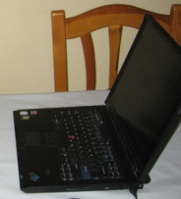
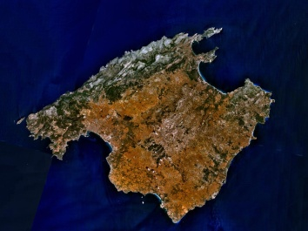
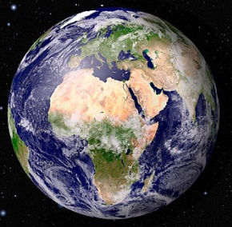
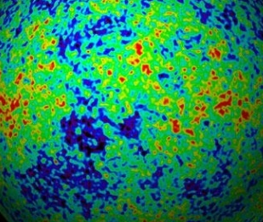

Powers of 10
Number of images on my hard drive: 10⁶
Number of images seen during my first 10 years: 10⁸
(3 images/second * 60 * 60 * 16 * 365 * 10 = 630,720,000)
Number of images seen by all humanity: 10²⁰
106,456,367,669 humans¹ * 60 years * 3 images/second * 60 * 60 * 16 * 365 =
1 from http://www.prb.org/Articles/2002/HowManyPeopleHaveEverLivedonEarth.aspx
Number of photons in the universe: 10⁸⁸
Number of all 32x32 images: 10⁷³⁷³
256 ^{32*32*3} ~ 10⁷³⁷³
Notes:
so don’t listen to anyone claiming to brute force image space
But most of image space is empty, never observed. If you were to run the rand() command in Matlab, how often would it generate a plausible image?

Slide 41
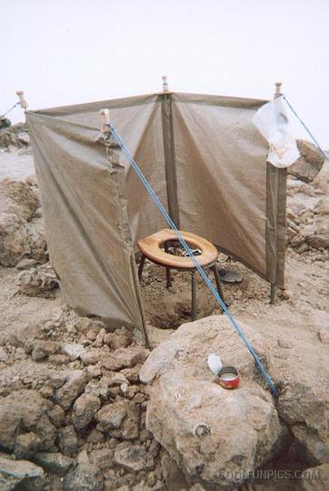
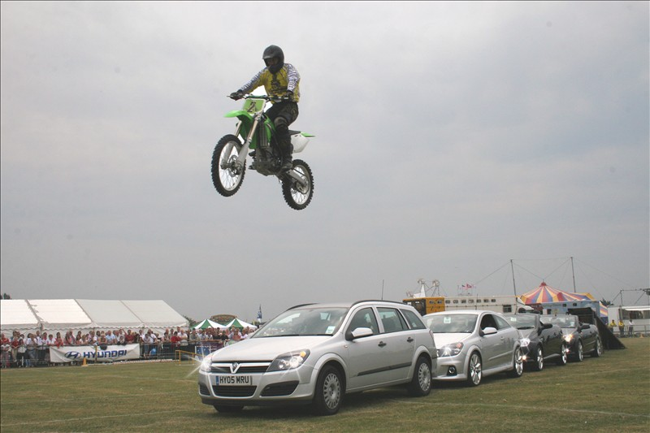
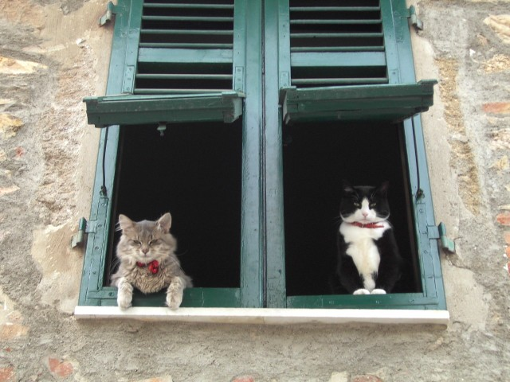
Understanding scenes encompasses all kinds of knowledge
Notes:
Scene and object recognition at human performance is very hard because we are able to deal with so many different kinds of scenes…
Scenes are so unique.

Slide 42
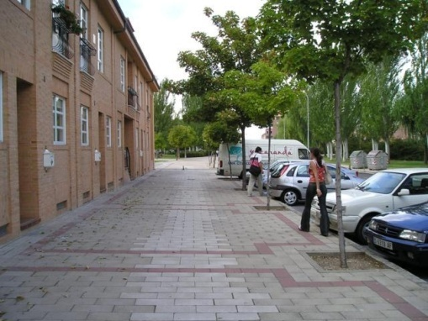
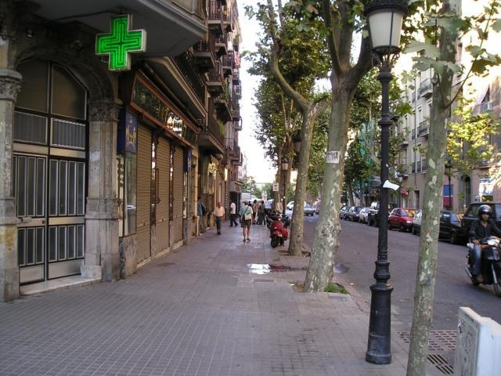
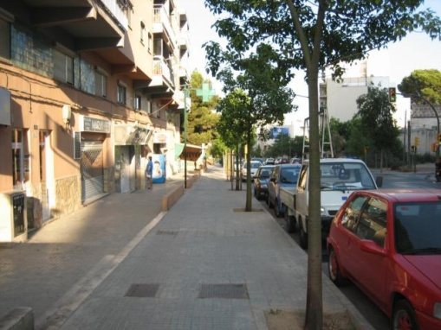
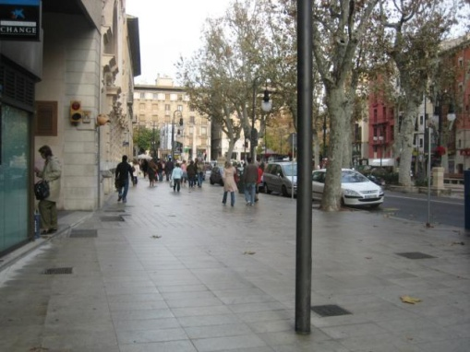
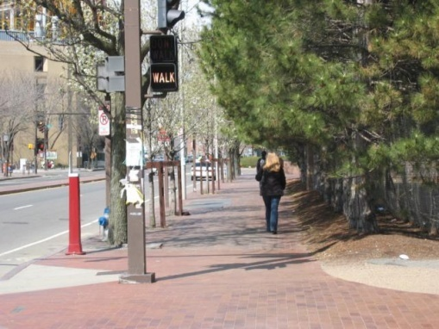
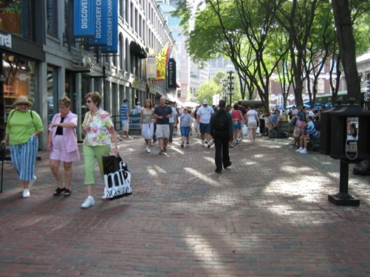
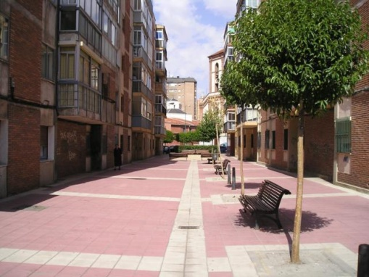


But not all scenes are so original
Notes:
But most scenes are not really like that. Most of the time, scenes are boring places in which nothing really surprising happens. For instance, this street… there is nothing really special about it. In fact, I can easily find thousands of other street pictures that look just like this. Of course, these scenes are different in the details, just as two faces are different, but at a coarser level they are form by similar objects arranged in a similar spatial configuration.

Slide 43

Lots
Of
Images
A. Torralba, R. Fergus, W.T.Freeman. PAMI 2008

Slide 44
Lots
Of
Images
A. Torralba, R. Fergus, W.T.Freeman. PAMI 2008

Slide 45
Lots
Of
Images

Slide 46






Application: Automatic Colorization
Input
Color Transfer
Color Transfer
Matches (gray)
Matches (w/ color)
Avg Color of Match

Slide 47






Application: Automatic Colorization
Input
Color Transfer
Color Transfer
Matches (gray)
Matches (w/ color)
Avg Color of Match

Slide 48

Application: Person Detection
80 million “tiny images” downloaded by keyword search.
80 nearest neighbors vote for image category.

Slide 49

Re-ranking Altavista search for “person”

Slide 50

Automatic Orientation Examples
A. Torralba, R. Fergus, W.T.Freeman. 2008
Notes:
Based on average correlation to the top 50 nearest neighbors. Note that this doesn’t really beat just assuming that the image is upright.
50

Slide 51

Short cuts to AI
With billions of images on the web, it’s often possible to find a close nearest neighbor.
We can shortcut hard problems by “looking up” the answer, stealing the labels from our nearest neighbor.
Notes:
Wikipedia:
Searle's thought experiment begins with this hypothetical premise: suppose that artificial intelligence research has succeeded in constructing a computer that behaves as if it understands Chinese. It takes Chinese characters as input and, by following the instructions of a computer program, produces other Chinese characters, which it presents as output. Suppose, says Searle, that this computer performs its task so convincingly that it comfortably passes the Turing test: it convinces a human Chinese speaker that the program is itself a live Chinese speaker. To all of the questions that the person asks, it makes appropriate responses, such that any Chinese speaker would be convinced that they are talking to another Chinese-speaking human being.
The question Searle wants to answer is this: does the machine literally "understand" Chinese? Or is it merely simulating the ability to understand Chinese?^{[6][c]} Searle calls the first position "strong AI" and the latter "weak AI".^{[d]}

Slide 52
So what is intelligence?
Weak AI: The simulation of a ‘mind’ is a model for the ‘mind’.
Strong AI: The simulation of a ‘mind’ is a ‘mind’.

Slide 53

Chinese Room experiment, John Searle (1980)
Notes:
Searle supposes that he is in a closed room and has a book with an English version of the computer program, along with sufficient paper, pencils, erasers, and filing cabinets. Searle could receive Chinese characters through a slot in the door, process them according to the program's instructions, and produce Chinese characters as output. If the computer had passed the Turing test this way, it follows, says Searle, that he would do so as well, simply by running the program manually.
Searle asserts that there is no essential difference between the roles of the computer and himself in the experiment. Each simply follows a program, step-by-step, producing a behavior which is then interpreted as demonstrating intelligent conversation. However, Searle would not be able to understand the conversation. ("I don't speak a word of Chinese",^{[9]} he points out.)
Therefore, he argues, it follows that the computer would not be able to understand the conversation either.
Searle argues that, without "understanding" (or "intentionality"), we cannot describe what the machine is doing as "thinking" and, since it does not think, it does not have a "mind" in anything like the normal sense of the word. Therefore, he concludes that "strong AI" is a false idea; impossible.
Searle, American philosopher, Berkeley

Slide 54
Chinese Room experiment, John Searle (1980)
If a machine can convincingly simulate an intelligent conversation, does understand?
Searle imagines himself in a room, acting as a computer by manually executing a program that convincingly simulates the behavior of a native Chinese speaker.
Most of the discussion consists of attempts to refute it.
"The overwhelming majority," notes BBS editor Stevan Harnad,“ still think that the Chinese Room Argument is dead wrong.“
The sheer volume of the literature that has grown up around it inspired Pat Hayes to quip that the field of cognitive science ought to be redefined as "the ongoing research program of showing Searle's Chinese Room Argument to be false.
Notes:
The experiment is the centerpiece of Searle's Chinese Room Argument which holds that a program cannot give a computer a "mind" or "understanding", regardless of how intelligently it may make it behave. He concludes that "programs are neither constitutive of nor sufficient for minds." "I can have any formal program you like, but I still understand nothing."
Searle “according to strong AI, . . . the appropriately programmed computer really is a mind, in the sense that computers given the right programs can be literally said to understand and have other cognitive states.”
https://en.wikipedia.org/wiki/Chinese_room

Slide 55

Notes:
Q1. Does the Chinese Room argument prove the impossibility of machine consciousness?
A1: Hell no.
Q2. Do we want to live in a world that we share with ethical robots?
A2: sure beats living in a world with robots that have no sense of ethics and morality, and no sense the notion of common good..
Q3. Some people think that experiments in programming machine morality will help us better to understand human morality. Do you agree?
A3: Yes, absolutely.
Q4. If we succeed in programming machine morality, must it be always and everywhere the same? Or should we allow for the possibility that the moral behavior of robots might vary as widely as does human moral behavior?
A4: probably allow for some variation, as the ideal of morality and ethics varies across cultures.

Slide 56




The Unreasonable Effectiveness of Math
“The miracle of the appropriateness of the language of mathematics…”
Eugene Wigner
“The most incomprehensible thing about the universe is that it is comprehensible.”
Albert Einstein
“There is only one thing which is more unreasonable than the unreasonable effectiveness of mathematics in physics, and this is the unreasonable ineffectiveness of mathematics in biology.”
Israel Gelfand
“We should stop acting as if our goal is to author extremely elegant theories, and instead embrace complexity and make use of the best ally we have:
the unreasonable effectiveness of data.”
Peter Norvig

Slide 57


Mechanical Turk
von Kempelen, 1770.
Robotic chess player.
Clockwork routines.
Magnetic induction (not vision)
Toured the world; played
Napoleon Bonaparte
and Benjamin Franklin.
Notes:
Wolfgang von Kempelen
https://ericscrivner.me/2015/04/mechanical-python-guide-1/
Modern reconstruction - John Gaughan

Slide 58

Mechanical Turk
It was all a ruse!
Ho ho ho.
Notes:
Image - Racknitz - Wikipedia

Slide 59

Amazon Mechanical Turk
Artificial artificial intelligence.
Launched 2005.
Small tasks, small pay.
Used extensively in data collection.
Image: Gizmodo
Notes:
Image: http://gizmodo.com/my-brief-and-curious-life-as-a-mechanical-turk-1587864671

Slide 60

Amazon Mechanical Turk
Workers
Task: Dog?
Task
Broker
Answer: Yes
Pay: $0.01
Is this a dog?
o Yes
o No
www.mturk.com
$0.01

Slide 61

Luis von Ahn and Laura Dabbish. Labeling Images with a Computer Game. ACM Conf. on Human Factors in Computing Systems, CHI 2004

Slide 62


Slide 63
Vision (Segmentation): LabelMe
http://labelme.csail.mit.edu
“Open world” database annotated by the community*
Notes on Image Annotation, Barriuso and Torralba 2012. http://arxiv.org/abs/1210.3448
Notes:
* - Torralba jokes that most of LabelMe was completed by his doting mother.

Slide 64

Utility data annotation via Amazon Mechanical Turk
X 100 000 = $5000
Alexander Sorokin
David Forsyth
CVPR Workshops 2008
Slides by Alexander Sorokin

Slide 65


Slide 66
Issues
Quality?
  How good is it?
  How to be sure?
Price?
  Trade off between throughput and cost
    NOT as much of a trade off with quality
  Higher pay can actually attract scammers

Slide 67





Annotation quality
How much agreement is there on ‘ground truth’ and turker-labeled joint positions? Points must agree within 5-10 pixels on 500x500 image.
Number of images
Image-space error sum
A
C
E
G
Yellow ring = ‘ground truth’; Blue circle = human labeled
Notes:
How many images in this experiment?

Slide 68

Ensuring Annotation Quality
Consensus in multiple annotations
“Wisdom of the Crowds”
Gold Standard / Sentinel
  Special case: qualification exam
Grading Tasks
  A second tier of workers who grade others
Not enough on its own, but widely used
Widely used & important. Find good annotators; keep them honest.
Not widely used

Slide 69


Slide 70


Slide 71


Slide 72


Slide 73


Slide 74


Slide 75


Slide 76


Slide 77

By Suren Manvelyan, http://www.surenmanvelyan.com/gallery/7116
Notes:
http://www.surenmanvelyan.com/gallery/7116
rabbit

Slide 78

By Suren Manvelyan, http://www.surenmanvelyan.com/gallery/7116
Notes:
http://www.surenmanvelyan.com/gallery/7116
Tiger python

Slide 79

By Suren Manvelyan, http://www.surenmanvelyan.com/gallery/7116
Notes:
http://www.surenmanvelyan.com/gallery/7116
Snail
Ommatophore = eye stalk

Slide 80
Visual Recognition with Humans in the Loop
Steve Branson, Catherine Wah, Florian Schroff, Boris Babenko, Peter Welinder, Pietro Perona, Serge Belongie
Part of the Visipedia project
Slides from Brian O’Neil

Slide 81

Introduction:
Computers starting to get good at this.
If it’s hard for humans, it’s probably too hard for computers.
Semantic feature extraction difficult for computers.
Combine strengths to solve this problem.
Notes:
Visual recognition approaches typically tackle (A): Fully autonomous recognition on relatively easy datsets.
(B) Is hard for non-expert humans. Also difficult for computers: State of the art 28-45% on fine-scale data.
(C) Human capacity to extract salient visual features is amazing and natural.

Slide 82
The Approach: What is progress?
Supplement visual recognition with the human capacity for visual feature extraction to tackle difficult (fine-grained) recognition problems.
Typical progress is viewed as increasing data difficulty while maintaining full autonomy
Reduction in human effort on difficult data.

Slide 83

The Approach: 20 Questions
Ask the user a series of discriminative visual questions to make the classification.

Slide 84



Which 20 questions?
At each step, exploit the image itself and the user response history to select the most informative question to ask next.
No
Image x
Ask user a question
Stop?
Yes

Slide 85
Which question to ask?
The question that will reduce entropy the most, taking into consideration the computer vision classifier confidences for each category.

Slide 86

Some definitions:
Set of possible questions
Possible answers to question i
Possible confidence in answer i (Guessing, Probably, Definitely)
User response
History of user responses at time t

Slide 87

Question selection
Seek the question that gives the maximum information gain (entropy reduction) given the image and the set of previous user responses.
Probability of obtaining
Response u_{i} given the image
And response history
Entropy when response is
Added to history
Entropy before response
is added.
where

Slide 88
Incorporating vision
Bayes Rule
A visual recognition algorithm outputs a probability distribution across all classes that is used as the prior.
A posterior probability is then computed based on the probability of obtaining a particular response history given each class.

Slide 89

Modeling user responses
Assume that the questions are answered independently.
Required for posterior computation
Required for information gain
computation

Slide 90









The Dataset: Birds-200
6033 images of 200 species

Slide 91

Implementation
Assembled 25 visual questions encompassing 288 visual attributes extracted from www.whatbird.com
Mechanical Turk users asked to answer questions and provide confidence scores.

Slide 92

User Responses.

Slide 93
Visual recognition
Any vision system that can output a probability distribution across classes will work.
Authors used Andrea Vedaldis’s code.
  Color/gray SIFT
  VQ geometric blur
  1 v All SVM
Authors added full image color histograms and VQ color histograms

Slide 94
Experiments
No
Image x
Ask user a question
Stop?
Yes
2 Stop criteria:
  Fixed number of questions – evaluate accuacy
  User stops when bird identified – measure number of questions required.
Notes:
Assume people are perfect verifiers

Slide 95

Results
Average number of questions to make ID reduced from 11.11 to 6.43
Method allows CV to handle the easy cases, consulting with users only on the more difficult cases.

Slide 96

Results
Vision allows the questions to be salient right away.
User input can correct gross errors from CV

Slide 97
Key Observations
Visual recognition reduces labor over a pure “20 Q” approach.
Visual recognition improves performance over a pure “20 Q” approach. (69% vs 66%)
User input dramatically improves recognition results. (66% vs 19%)
Hays

Slide 98
Strengths and weaknesses
Handles very difficult data and yields excellent results.
Plug-and-play with many recognition algorithms.
Requires significant user assistance
Reported results assume humans are perfect verifiers
Is the reduction from 11 questions to 6 really that significant?
Hays

