Slide 1


Slide 2
Course so far
Image formation and color!
Filtering!
Image frequency!
Feature points!
Bags of words!
Classifiers!
Sliding windows!
Big data!

Slide 3
Course coming up
Neural Nets
Convolutional Neural Nets
  Project 4
Current state of the art
- - -
Camera geometry
Stereo
  Project 5 (not very long)

Slide 4
Project 6 - WebGazer
Team project – of 4 -> no single person teams
  Show to class on Dec 11th
  Report/code due Dec 12th
Starts after project 4 CNNs (~Nov 10th)
But _organize now_

Slide 5



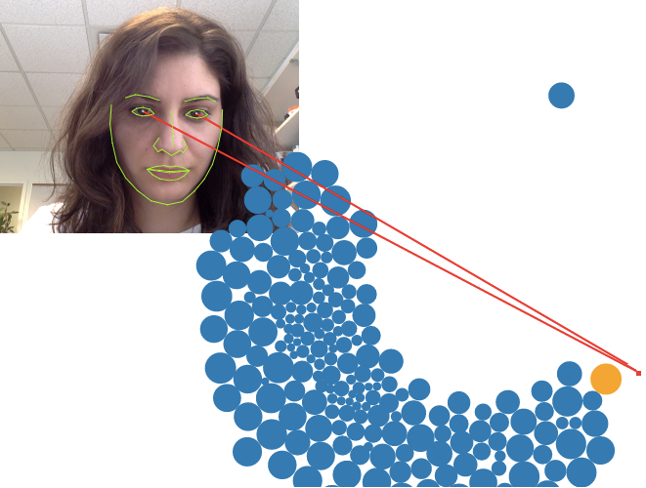


WebGazer - https://webgazer.cs.brown.edu/
Pure Javascript real-time eye tracking
Exploits gaze/mouse click interaction coherence
Yuze (Harry) He
IJCAI 2016
Notes:
Give a demo

Slide 6
Why eye tracking?
Eye gaze is important cue in human-human communication.
-> Implicitly a fundamental technique to
future natural computing interfaces

Slide 7
Some state of the art stuff
Mturk-based CNN for eye tracking
https://blogs.nvidia.com/blog/2016/08/30/eye-tracking-deep-learning/
AI-based Co-Pilot for driving
https://www.youtube.com/watch?v=h9npvMFI-mc
Eyetracking for avatar eye capture (e.g., for virtual reality)
Eyetracking for foveated rendering for virtual reality
https://venturebeat.com/2017/09/06/eye-tracking-is-virtual-realitys-next-frontier/

Slide 8
Some state of the art stuff
Alexandra projects (user behavior analysis):
Eye tracking for remote studies of Web search
Eye tracking as a typing aid; for touch typist identification
Eye tracking as a human development aid,
as a cue to learning disability or disease

Slide 9
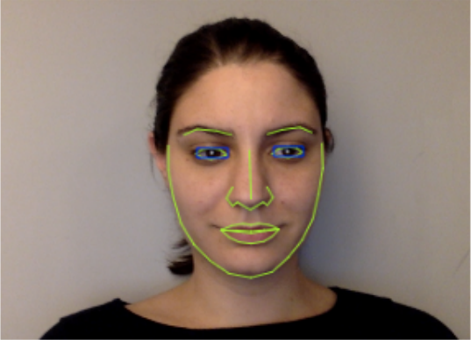
How does WebGazer work right now?
Step 1: Detailed face detection
clmtrackr -> Javascript learning-based facial feature tracker
Returns image locations of these landmarks.

Slide 10
How does WebGazer work right now?
Step 2: Pupil detection
-> Compute integral image of eye region
-> Sliding window detector
-> 2D Haar-like feature
Maximize ratio of
inner to outer regions.

Slide 11
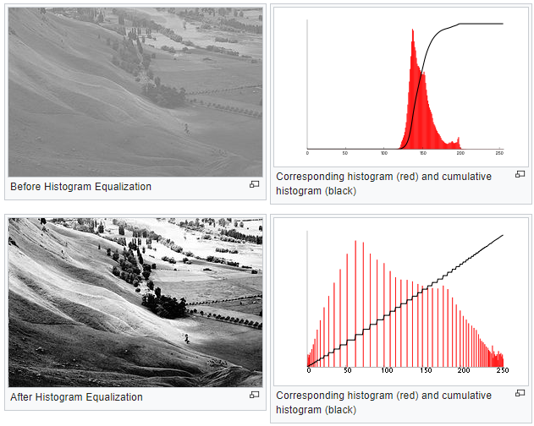
How does WebGazer work right now?
Step 3: Eye feature (120 dim)
-> Extract 6x10 pixel rectangle around pupil (!)
-> Grayscale intensity
-> Histogram
equalization

Slide 12
How does WebGazer work right now?
Step 4: Linear regression (with regularization)
Goal: Learn a function which maps
eye feature to screen position.
f(x) = y
x = eye feature
y = mouse click data – you look where you click!

Slide 13



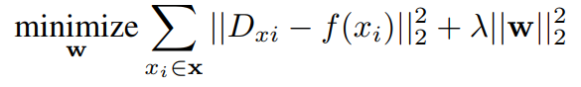

Reminder: linear regression
Eye features
Display click horizontal
Estimate
s.t.
Closed-form solution
(matrix notation)
Regularization!
Train one function for horizontal, one for vertical.

Slide 14
Hypothetical program loop pseudocode
Thread 1:
while(true)
eyeloc = clmtracker.trackFace( webcam.getImage() );
Thread 2:
allEyeFeats = []; % Eye feature storage
allClickLocations = []; % 2D click locations
onMouseClick( MouseEvent me )
allEyeFeats(i) = extractEyeFeat( findPupil(eyeloc) );
allClickLocations(i) = me.xy;
f = linearRegression( allEyeFeats, allClickLocations );
Thread 3:
gaze = predict( f, extractEyeFeat( findPupil(eyeloc) ) );
Notes:
Note: I made all this up.

Slide 15

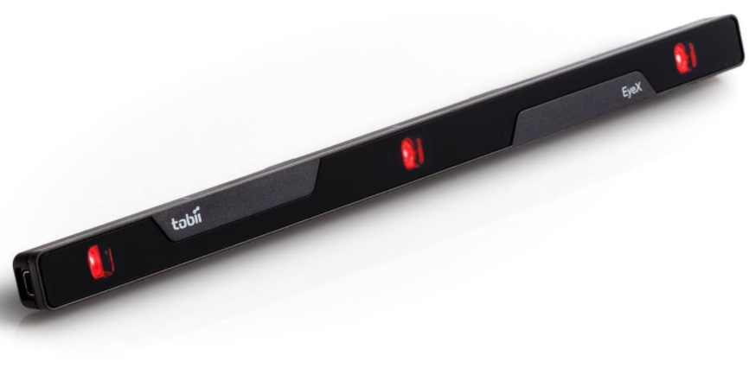
How do we know if it works?
Tobii Pro X3-120 eye tracker
Accurate to 1 degree at desktop range
~ 1.7 cm
Or ~ 50 pixels at 72 dpi
WebGazer error against Tobii EyeX number is 150 pixel mean, 140 std.dev.

Slide 16
Can we do better?
WebGazer assumes no prior knowledge
It learns as you click –advantages/disadvantages?
Could we improve it in this scenario?
What about with a little data?

Slide 17
Training data
51 participants, 30 minutes each @ 30 Hz
Webcam videos
Mouse click data
Tobii Pro X3-120 eyetracking data
Screen captures
Alexandra collected all of this, and wants us to exploit it!
http://cs.brown.edu/courses/csci1430/proj_webgazer/webgazer_data.pdf

Slide 18
Training data, but show them to me
Mention the calibration process, James!

Slide 19
Train / test split
We will give you some of the data.
We will use the rest as a testing set to measure both WebGazer’s performance and your performance.

Slide 20
Compute
We will get you some compute.
Still sorting things out…

Slide 21
Project 6 - WebGazer
‘Pure’ challenge
  Must work in ~real time in browser
  Must be deployable as Javascript library
Fallback ‘wild’ challenge
  No restrictions.

Slide 22
Project 6 - WebGazer
It is a real research problem.
It is multifaceted, and it can be as much of a challenge as you wish.
You can use anything and everything.

Slide 23
Jeff’s Carrot
If you can “visibly improve the eye tracking”,
and keep the Web/real-time constraints…
…then Jeff has money for you to integrate your work with WebGazer,
for you to become co-authors on the project, and for you to share the IP.
Go Jeff.
Notes:
Could also be something you turn into a senior thesis, with either Jeff or I, or a UTRA next summer if you’re interested in that.

Slide 24
Rest of today: Challenge discussion
Medium groups – 6-10 (not your project groups!)
Identify possible WebGazer problems.
Discuss different solutions.
Investigate what might be done.
‘Back of envelope’ computation costs.
Write! Sketch! Ask me questions!
Last 10 minutes: class discussion on what you came up with.
http://cs.brown.edu/courses/csci1430/proj_webgazer/webgazer_data.pdf

Slide 25
First steps
Try out WebGazer
Use the library on a page of your own
Read the Webgazer paper
http://cs.brown.edu/people/alexpap/papers/ijcai2016webgazer.pdf
Don’t get hung up on things you might not understand yet; barrel through.
Fork it.
Test it on the challenge data (next few weeks).

