Slide 1


Slide 2
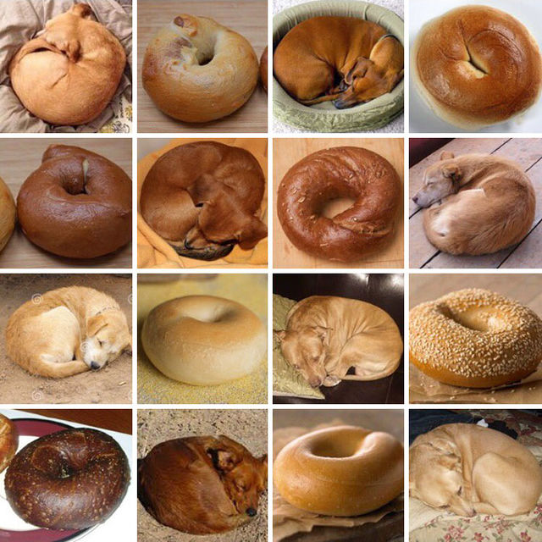

Slide 3
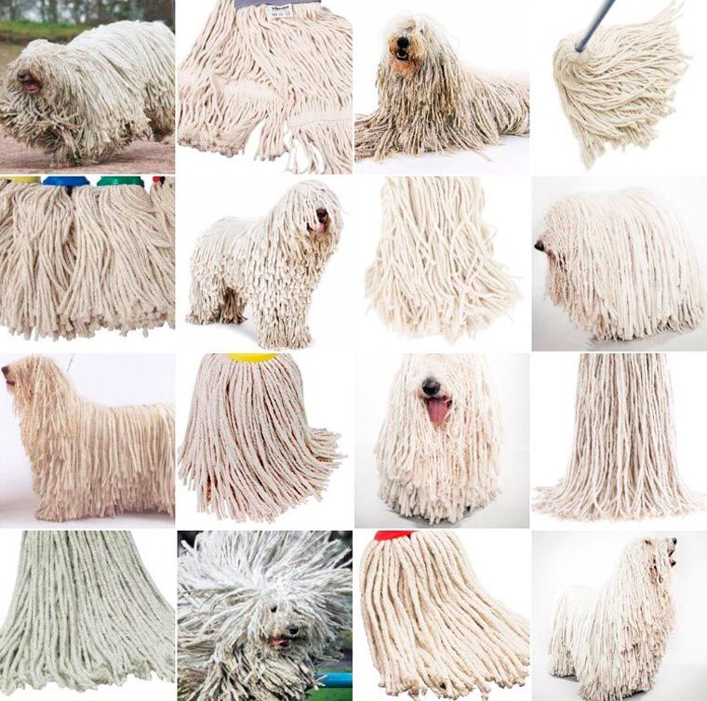

Slide 4
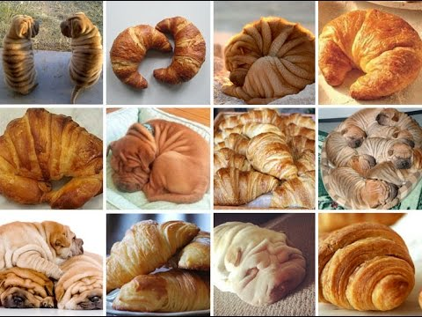

Slide 5
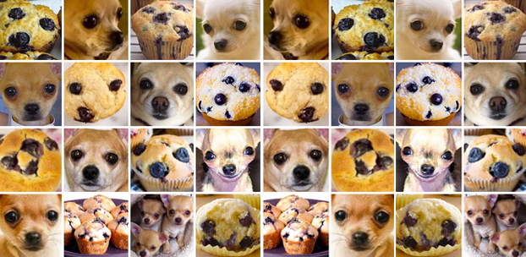

Slide 6
!!! Warning !!!
Learning jargon is always painful…
…even if the concepts behind the jargon are not hard.
So, let’s get used to it.
“In mathematics you don't understand things.
You just get used to them.”
von Neumann (a joke)
Notes:
John von Neumann (/vɒn ˈnɔɪmən/; Hungarian: Neumann János Lajos, pronounced [ˈnɒjmɒn ˈjaːnoʃ ˈlɒjoʃ]; December 28, 1903 – February 8, 1957) was a Hungarian-American mathematician, physicist, inventor, computer scientist, and polymath. He made major contributions to a number of fields, including mathematics (foundations of mathematics, functional analysis, ergodic theory, geometry, topology, and numerical analysis), physics (quantum mechanics, hydrodynamics, and quantum statistical mechanics), economics (game theory), computing (Von Neumann architecture, linear programming, self-replicating machines, stochastic computing), and statistics.

Slide 7
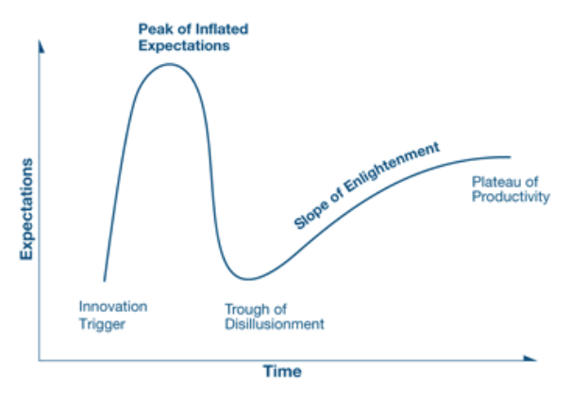
Gartner Hype Cycle
Notes:
Gartner, Inc. is an American research and advisory firm providing information technology related insight for IT and other business leaders located across the world. Its headquarters are in Stamford, Connecticut, United States. It was known as Gartner Group, Inc until 2000, when it was then changed to Gartner.^{[6]}
http://www.gartner.com/technology/research/methodologies/hype-cycle.jsp
https://en.wikipedia.org/wiki/Hype_cycle#/media/File:Hype-Cycle-General.png
Apologies for the low resolution…

Slide 8

Rocket AI
Notes:
https://medium.com/the-mission/rocket-ai-2016s-most-notorious-ai-launch-and-the-problem-with-ai-hype-d7908013f8c9
Temporally Recurrent Optimal Learning = TROL(L)

Slide 9
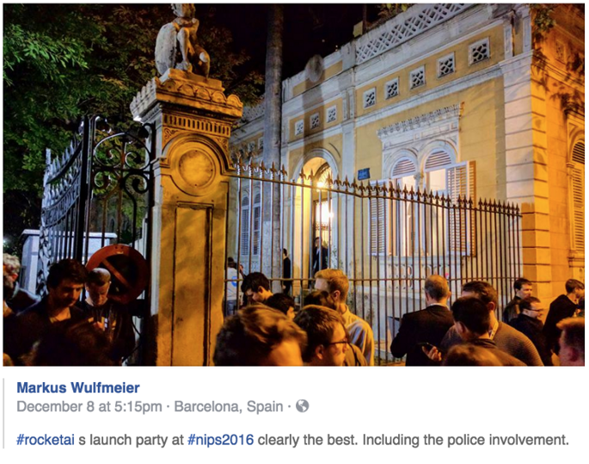
Rocket AI
Launch party
@ NIPS 2016
Neural
Information
Processing
Systems
Academic
conference
Notes:
https://medium.com/the-mission/rocket-ai-2016s-most-notorious-ai-launch-and-the-problem-with-ai-hype-d7908013f8c9

Slide 10
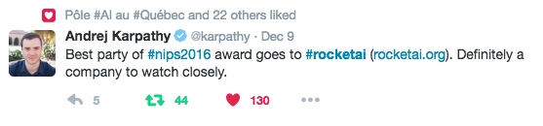
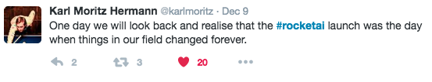
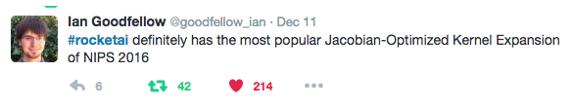
Rocket AI
Notes:
Jacobian-Optimized Kernel Expansion = J-O-K-E

Slide 11
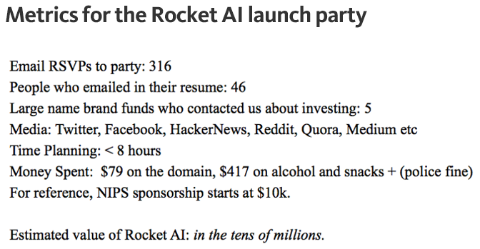
Rocket AI
Article by Riva-Melissa Tez
Notes:
https://medium.com/the-mission/rocket-ai-2016s-most-notorious-ai-launch-and-the-problem-with-ai-hype-d7908013f8c9

Slide 12
Rocket AI
Notes:
https://medium.com/the-mission/rocket-ai-2016s-most-notorious-ai-launch-and-the-problem-with-ai-hype-d7908013f8c9
Temporally Recurrent Optimal Learning = TROL(L)

Slide 13
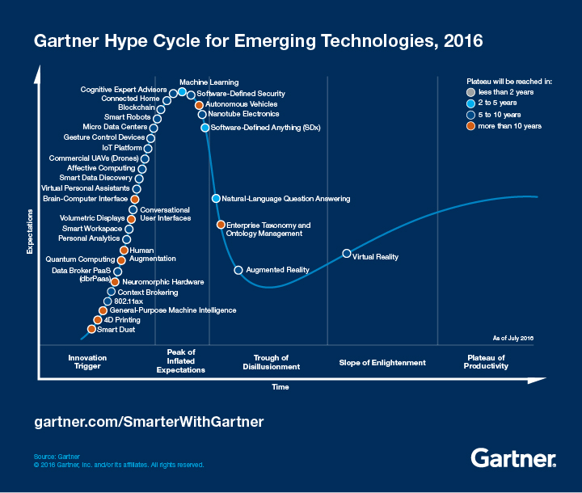
Gartner Hype Cycle
Notes:
Most of what has been making ‘machine learning’ hot is ‘deep neural networks’

Slide 14
The limits of learning?

Slide 15
So far…
PASCAL VOC = ~75%
ImageNet = ~75%; human performance = ~95%
Smart human brains used intuition and understanding of how we think vision works, and it’s pretty good.

Slide 16
Image formation (+database+labels)
Filtering (gradients/transforms)
Feature points (saliency+description)
Dictionary building (compression)
Classifier (decision making)
Captured+manual.
Hand designed.
Hand designed.
Hand designed.
Learned.
Recognition:
Classification
Object Detection
Segmentation

Slide 17
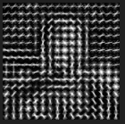
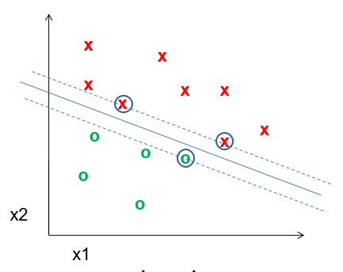
Well, what do we have?
Best performing visions systems have commonality:
Hand designed features
  Gradients + non-linear operations
  (exponentiation, clamping, binning)
  Features in combination (parts-based models)
  Multi-scale representations
Machine learning from databases
Linear classifiers (SVM)

Slide 18
But it’s still not that good…
PASCAL VOC = ~75%
ImageNet = ~75%; human performance = ~95%
Problems:
Lossy features
Lossy quantization
Imperfect classifier

Slide 19
But it’s still not that good…
PASCAL VOC = ~75%
ImageNet = ~75%; human performance = ~95%
How to solve?
  Features: More principled modeling?
  We know why the world looks (it’s physics!);
  Let’s build better physically-meaningful models.
  Quantization: More data and more compute?
  It’s just an interpolation problem; let’s represent the space with less approximation.
  Classifier: …

Slide 20
Previous claim:
It is more important to have
more or better labeled data than to use
a different supervised learning technique.
“The Unreasonable Effectiveness of Data” - Norvig

Slide 21
No free lunch theorem
Hume (c.1739):
“‘Even after the observation of the frequent or constant conjunction of objects, we have no reason to draw any inference concerning any object beyond those of which we have had experience.”
-> Learning beyond our experience is impossible.
Notes:
http://www.no-free-lunch.org/
David Hume – 18th century Scottish philosopher, known for empiricism. E.g., all human knowledge is found through experience, and genuine knowledge must either be directly traceable to objects perceived in experience, or result from abstract reasoning about relations between ideas which are derived from experience.
-> calling the rest "nothing but sophistry and illusion“ (sophistry -> false argument, esp. intended to deceive)

Slide 22
No free lunch theorem
Wolpert (1996):
‘No free lunch’ for supervised learning:
“In a noise-free scenario where the loss function is the misclassification rate, if one is interested in off-training-set error, then there are no a priori distinctions between learning algorithms.”
-> Averaged over all possible datasets, no learning algorithm is better than any other.
Notes:
http://www.no-free-lunch.org/
Algorithm A learns to find the minimum of a cost function, and outperforms algorithm B. For another cost function, algorithm B
"We show that all algorithms that search for an extremum of a cost function perform exactly the same, when averaged over all possible cost functions. In particular, if algorithm A outperforms algorithm B on some cost functions, then loosely speaking there must exist exactly as many other functions where B outperforms A. Starting from this we analyze a number of the other a priori characteristics of the search problem, like its geometry and its information-theoretic aspects. This analysis allows us to derive mathematical benchmarks for assessing a particular search algorithm's performance. We also investigate minimax aspects of the search problem, the validity of using characteristics of a partial search over a cost function to predict future behavior of the search algorithm on that cost function, and time-varying cost functions. We conclude with some discussion of the justifiability of biologically-inspired search methods."
Wolpert and Macready (1995)

Slide 23
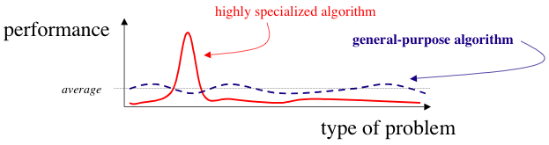
OK, well, let’s give up. Class over.
No, no, no!
We can build a classifier which better matches the characteristics of the problem!
Notes:
Or….high performance is possible by making more assumptions.

Slide 24
But…didn’t we just do that?
PASCAL VOC = ~75%
ImageNet = ~75%; human performance = ~95%
We used intuition and understanding of how we think vision works, but it still has limitations.
Why?

Slide 25
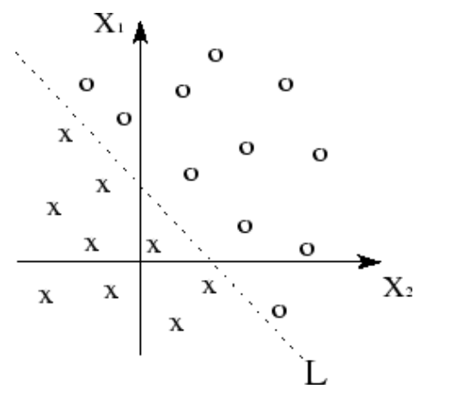
Linear spaces - separability
+ kernel trick to transform space.
Linearly separable data
+ linear classifer = good.
Kawaguchi
Notes:
http://www.ece.utep.edu/research/webfuzzy/docs/kk-thesis/kk-thesis-html/node19.html

Slide 26
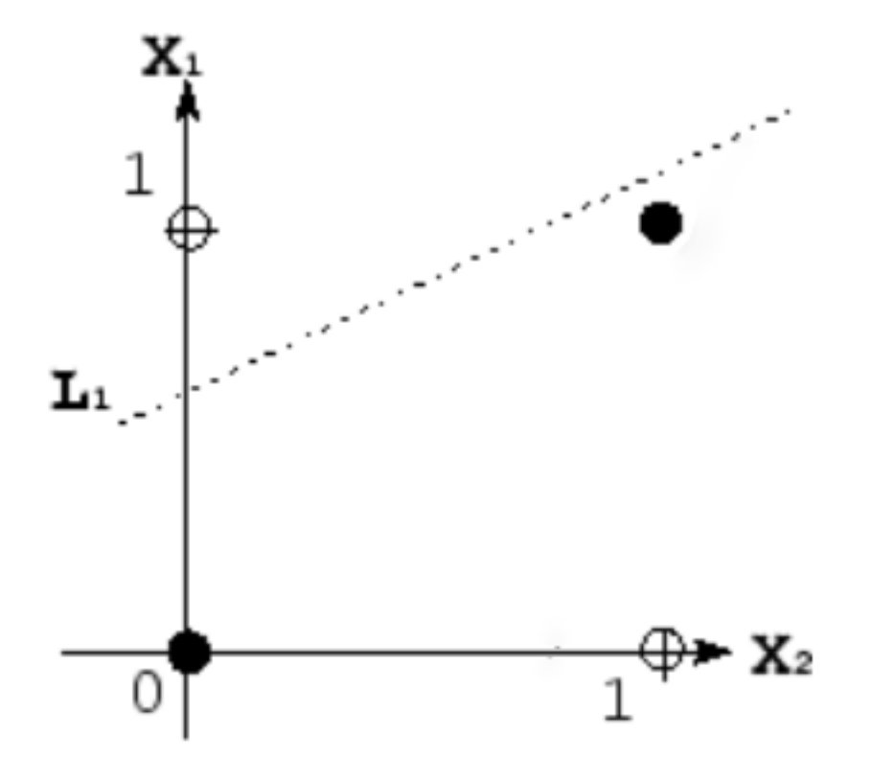
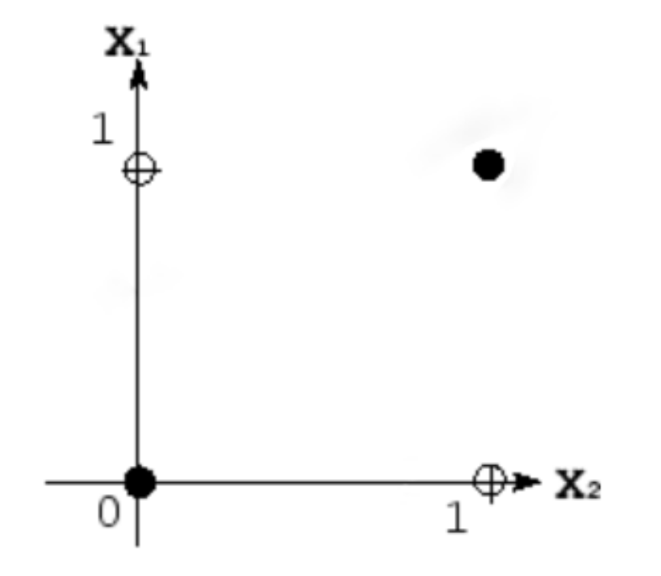
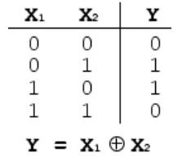
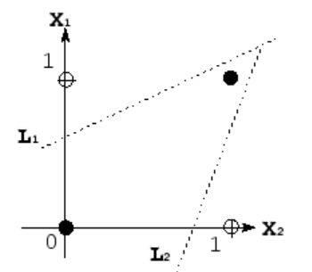
Non-linear spaces - separability
Take XOR – exclusive OR
E.G., human face has two eyes XOR sunglasses
Kawaguchi
Notes:
http://www.ece.utep.edu/research/webfuzzy/docs/kk-thesis/kk-thesis-html/node19.html
Human face example: human appearance has two eyes OR sunglasses

Slide 27
Non-linear spaces - separability
Linear functions are insufficient on their own.
Kawaguchi
Notes:
http://www.ece.utep.edu/research/webfuzzy/docs/kk-thesis/kk-thesis-html/node19.html

Slide 28
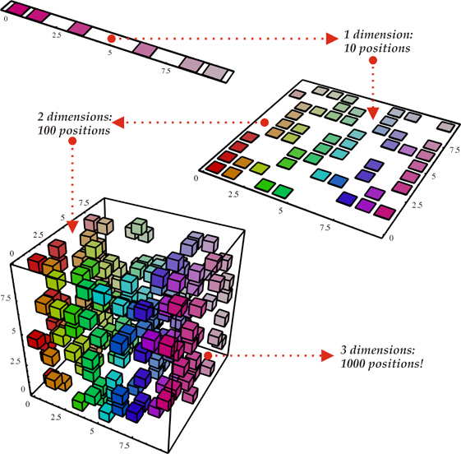
Curse of Dimensionality
Every feature that we
add requires us to
learn the useful
regions in a much
larger volume.
d binary variables =
O(2^{d}) combinations
Notes:
https://haifengl.wordpress.com/2016/02/29/there-is-no-big-data-in-machine-learning/
“In high-dimensional learning, is there ever ‘big data’?”

Slide 29
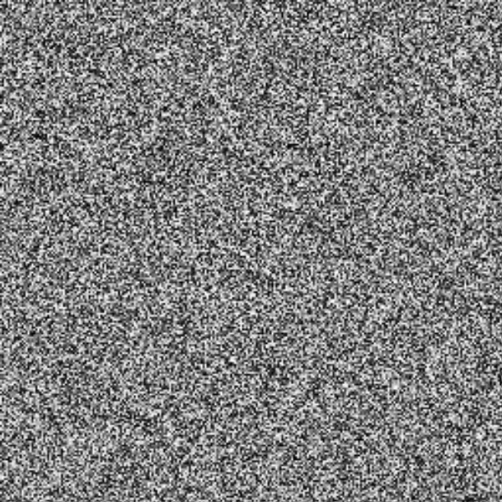
Curse of Dimensionality
Not all regions of this high-dimensional space are meaningful.
>> I = rand(256,256);
>> imshow(I);
@ 8bit = 256 values ^ 65,536

Slide 30
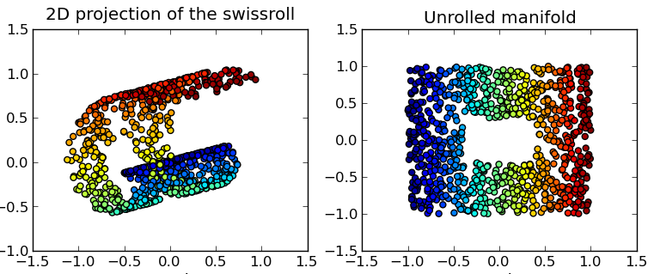
Related: Manifold Learning
Learning locally low-dimensional Euclidean spaces connected and embedded within a high-dim. space.
Wikipedia
Notes:
Classic toy example: Swiss roll

Slide 31
Local constancy / smoothness of feature space
All existing learning algorithms we have seen assume smoothness or local constancy.
  -> New example will be near existing examples
  -> Each region in feature space requires an example
  Smoothness is ‘averaging’ or ‘interpolating’.

Slide 32
Local constancy / smoothness of feature space
At the extreme: Take k-NN classifier.
The number of regions cannot be more than the number of examples.
-> No way to generalize beyond examples
How to try and represent a complex function with
more factors than regions?

Slide 33
More specialization?
PASCAL VOC = ~75%
ImageNet = ~75%; human performance = ~95%
Is there a way to make our system
better suited to the problem?

Slide 34
Wouldn’t it be great if we could…
Image formation (+database+labels)
Filtering (gradients/transforms)
Feature points (saliency+description)
Dictionary building (compression)
Classifier (decision making)
Captured+manual.
Learned.
(space specified a bit)
Learned.
End to end learning!
Learned.
Learned.
Recognition:
Classification
Object Detection
Segmentation

Slide 35
Well if we can do that, then what about…
Image formation (+database)
Filtering (gradients/transforms)
Feature points (saliency+description)
Dictionary building (compression)
Classifier (decision making)
Captured+no labels.
Learned.
(space specified a bit)
Learned.
Unsupervised
End to end learning!
Learned.
Learned.
Recognition:
Classification
Object Detection
Segmentation

Slide 36
Goals
Build a classifier which is more powerful
at representing complex functions
and more suited to the learning problem.
What does this mean?
1. Assume that the underlying data generating function relies on a composition of factors in a hierarchy.
Dependencies between regions in feature space
= factor composition

Slide 37
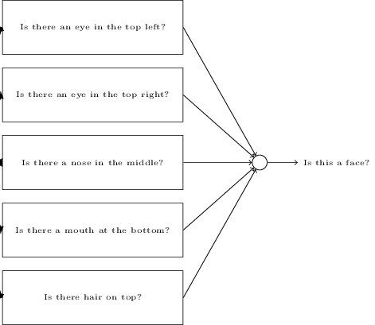
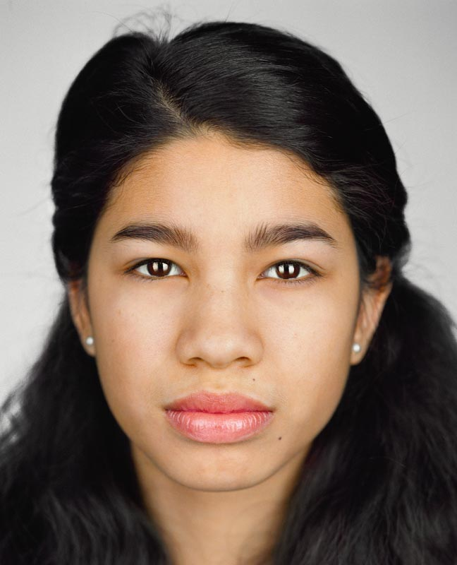
Example
Nielsen, National Geographic
Notes:
We saw this a bit with decision trees, Viola Jones, etc., but we’re going to generalize this concept farther.
http://neuralnetworksanddeeplearning.com/chap1.html
Face (National Geographic): http://ngm.nationalgeographic.com/2013/10/changing-faces/schoeller-photography

Slide 38
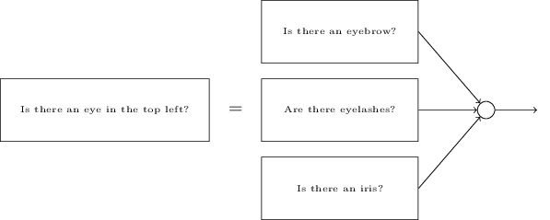
Example
Nielsen, National Geographic

Slide 39
Non-linear spaces - separability
Composition of linear functions can represent
more complex functions.
Kawaguchi
Notes:
http://www.ece.utep.edu/research/webfuzzy/docs/kk-thesis/kk-thesis-html/node19.html

Slide 40
Goals
Build a classifier which is more powerful
at representing complex functions
and more suited to the learning problem.
What does this mean?
1. Assume that the underlying data generating function relies on a composition of factors in a hierarchy.
2. Learn a feature representation specific to the dataset.
10k/100k + data points + factor composition
= sophisticated representation.

Slide 41

Reminder: Viola Jones Face Detector
Combine thousands of ‘weak classifiers’
-1
+1
Two-rectangle features
Three-rectangle features
Etc.
Learn how to combine in cascade with boosting
Stage 1
H₁(x) > t₁?
Yes
Stage 2
H₂(x) > t₂?
Stage N
H_{N}(x) > t_{N}?
Yes
…
Pass
No
No
No
Examples
Reject
Reject
Reject
CC BY-SA 3.0, https://commons.wikimedia.org/w/index.php?curid=801361

Slide 42
Viola Jones
Image formation (+database+labels)
Features (saliency+description)
Classifier
(decision making)
Captured+manual.
Specified space, but selected automatically.
Learned combination.
Recognition:
Object Detection

Slide 43
Neural Networks

Slide 44






Neural Networks
Basic building block for composition is a
perceptron (Rosenblatt c.1960)
Linear classifier – vector of weights w and a ‘bias’ b
$$x_{1}$$
$$w=(w_{1},w_{2},w_{3})$$
$$b=0.3$$
$$x_{2}$$
Output (binary)
$$x_{3}$$

Slide 45
Binary classifying an image
Each pixel of the image would be an input.
So, for a 28 x 28 image, we vectorize.
x = 1 x 784
w is a vector of weights for each pixel, 784 x 1
b is a scalar bias per perceptron
result = xw + b -> (1x784) x (784x1) + b = (1x1)+b

Slide 46



Neural Networks - multiclass
Add more perceptrons
$$x_{1}$$
Binary output
$$x_{2}$$
Binary output
$$x_{3}$$
Binary output

Slide 47
Multi-class classifying an image
Each pixel of the image would be an input.
So, for a 28 x 28 image, we vectorize.
x = 1 x 784
W is a matrix of weights for each pixel/each perceptron
  W = 10 x 784 (10-class classification)
b is a bias per perceptron (vector of biases); (1 x 10)
result = xW + b -> (1x784) x (784 x 10) + b
-> (1 x 10) + (1 x 10) = output vector

Slide 48




Bias convenience
To turn this classification operation into a multiplication only:
  Create a ‘fake’ feature with value 1 to represent the bias
  Add an extra weight that can vary
1
$$x_{1}$$
$$w=({b,w}_{1},w_{2},w_{3})$$
$$x_{2}$$
Output (binary)
$$x_{3}$$

Slide 49
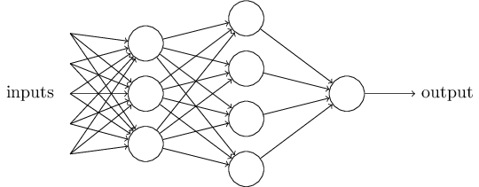
Composition
Attempt to represent complex functions as compositions of smaller functions.
Outputs from one perception are fed into inputs of another perceptron.
Nielsen

Slide 50
Composition
Layer 1
Layer 2
Sets of layers and the connections (weights) between them define the network architecture.
Nielsen

Slide 51
Composition
Hidden Layer 1
Hidden Layer 2
Layers that are in between the input and the output are called hidden layers, because we are going to learn their weights via an optimization process.
Nielsen

Slide 52
Composition
Hidden Layer 1
Hidden Layer 2
Multiple
Matrix!
Matrix!
Matrix!
It’s all just matrix multiplication!
GPUs -> special hardware for fast/large matrix multiplication.
Nielsen

Slide 53
Problem 1 with all linear functions
We have formed chains of linear functions.
We know that linear functions can be reduced
  g = f(h(x))
Our composition of functions is really
just a single function : (

Slide 54
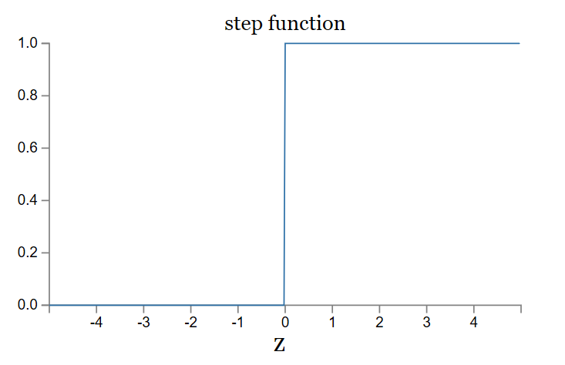
Problem 2 with all linear functions
Linear classifiers: small change in input can cause large change in binary output
= problem for composition of functions
Activation function
Nielsen

Slide 55
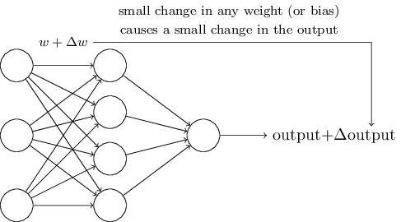
Problem 2 with all linear functions
Linear classifiers: small change in input can cause large change in binary output.
We want:
Nielsen

Slide 56
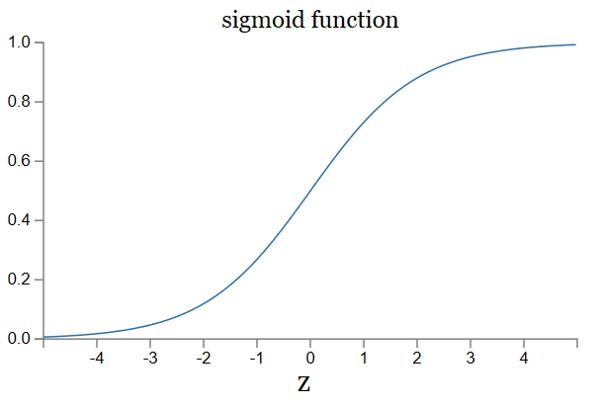


Let’s introduce non-linearities
We’re going to introduce non-linear functions to transform the features.
Nielsen

Slide 57

Rectified Linear Unit
ReLU

Slide 58
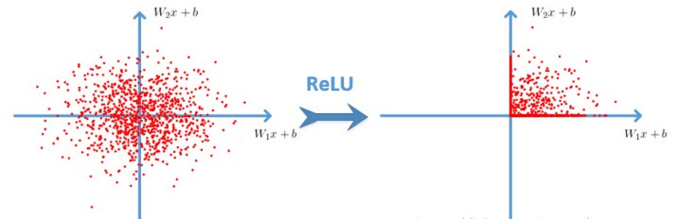
Cyh24 - http://prog3.com/sbdm/blog/cyh_24
Notes:
http://prog3.com/sbdm/blog/cyh_24
http://prog3.com/sbdm/blog/cyh_24/article/details/50593400

Slide 59
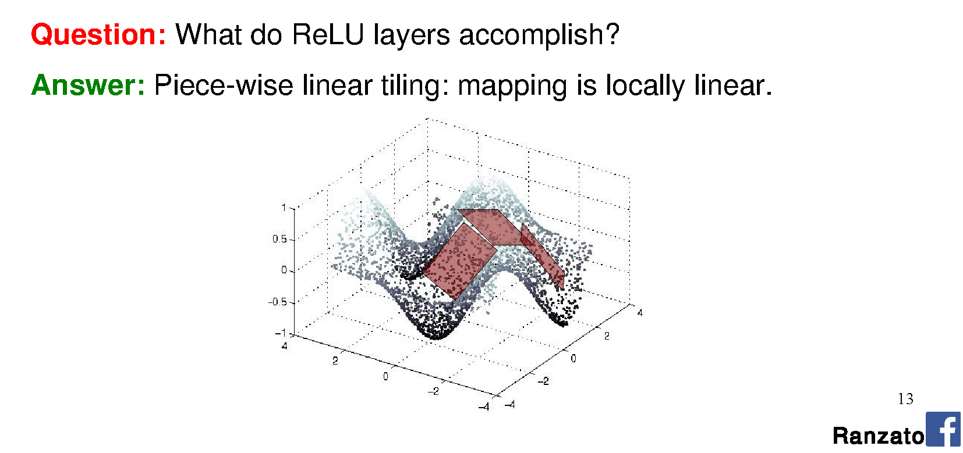
Rectified Linear Unit
Ranzato

Slide 60
Multi-layer perceptron (MLP)
…is a ‘fully connected’ neural network with non-linear activation functions.
‘Feed-forward’ neural network
Nielson

Slide 61
MLP
Use is grounded in theory
  Universal approximation theorem (Goodfellow 6.4.1)
Can represent a NAND circuit, from which any binary function can be built by compositions of NANDs
With enough parameters, it can approximate
any function (next lecture).

Slide 62
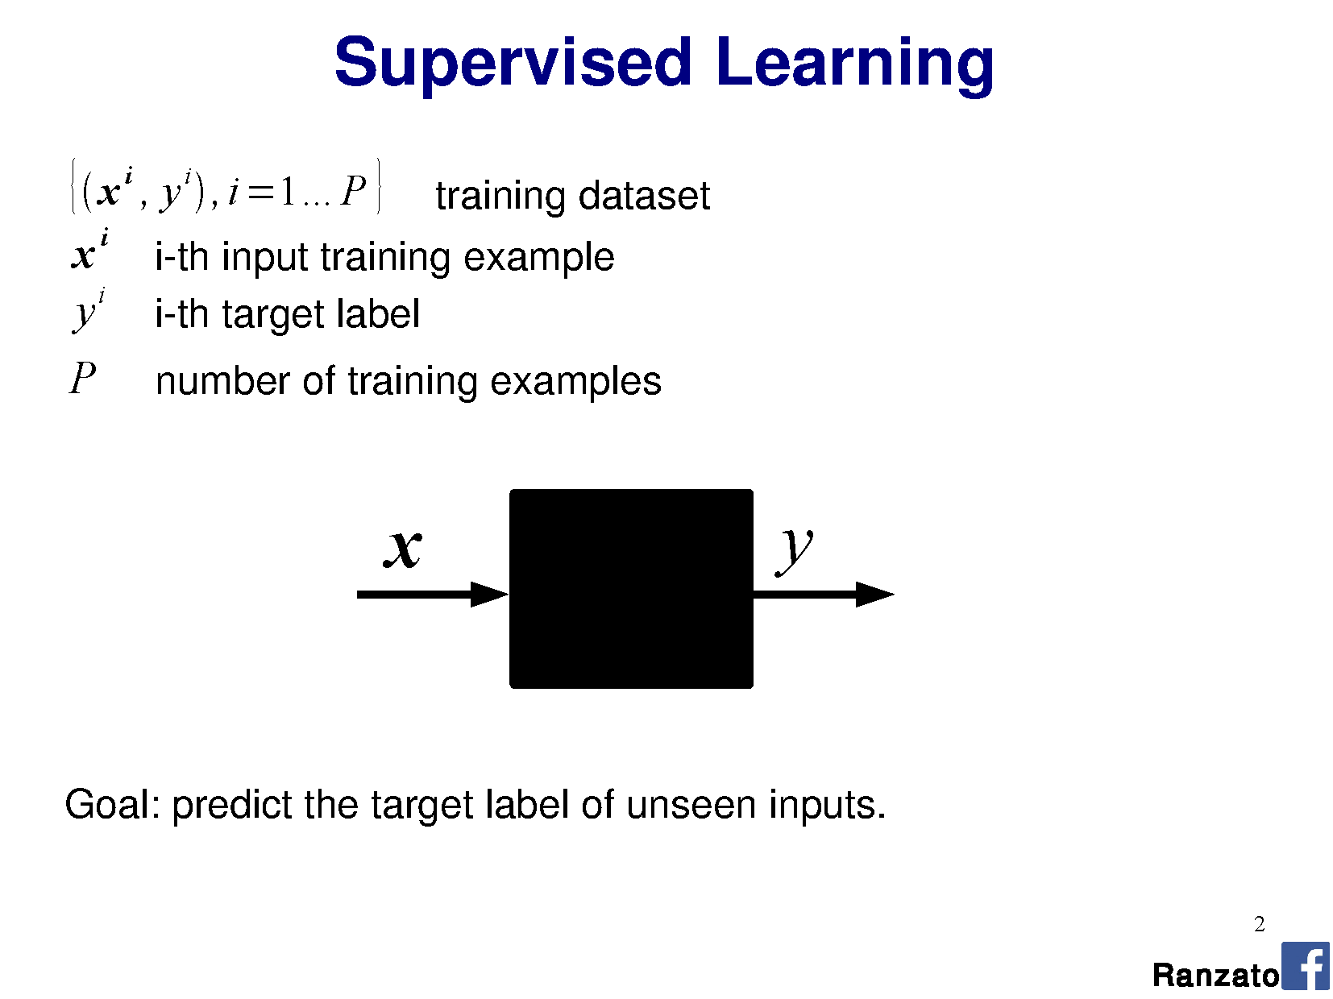
Notes:
Marc'Aurelio Ranzato

Slide 63
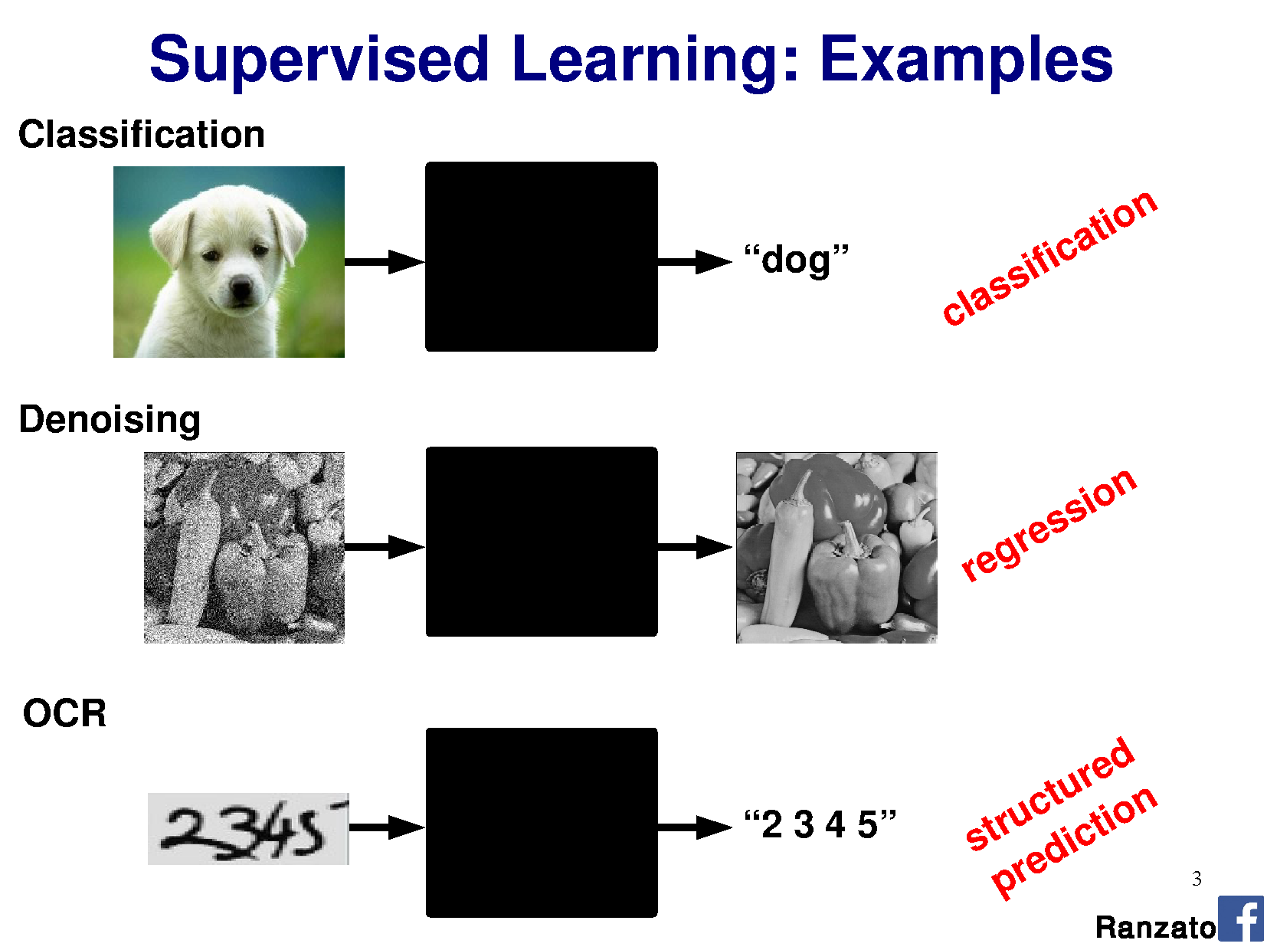

Slide 64
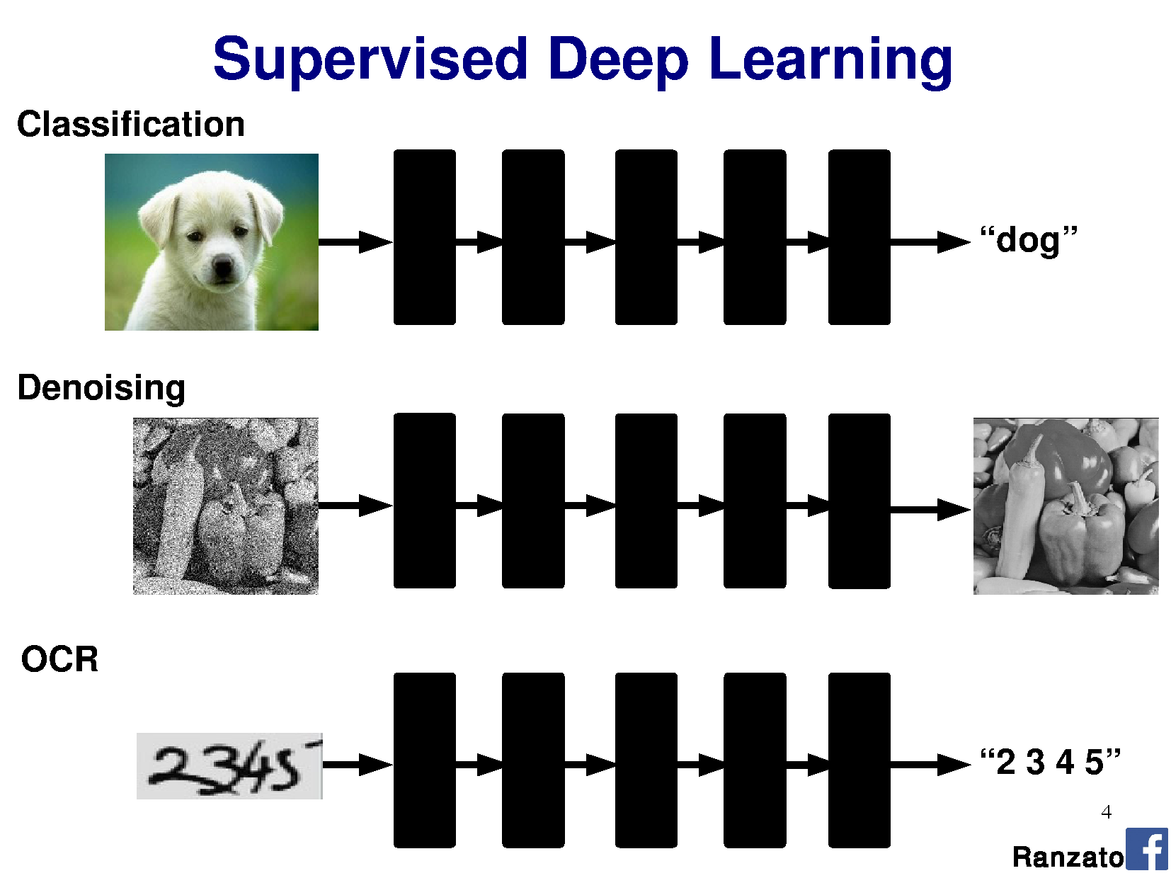
Notes:
Sequence together many linear classifiers to approximate a more complex function.

Slide 65
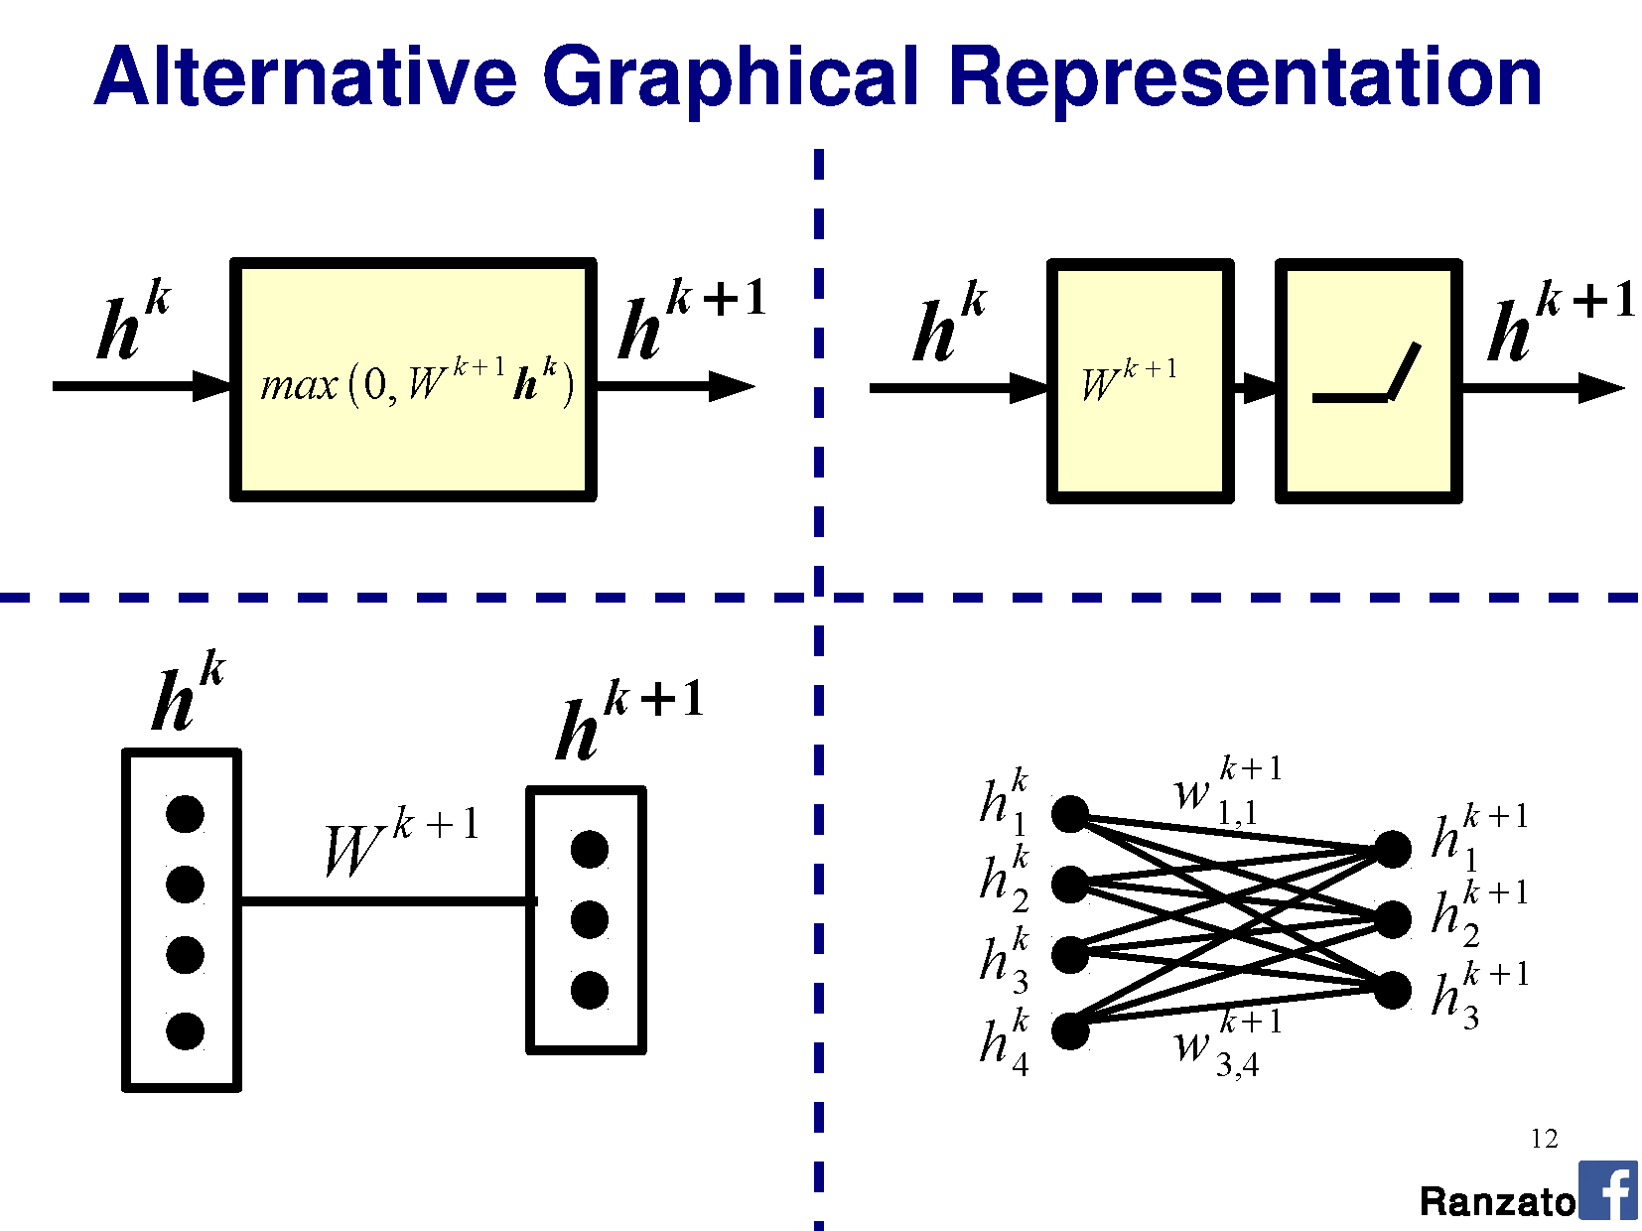

Slide 66
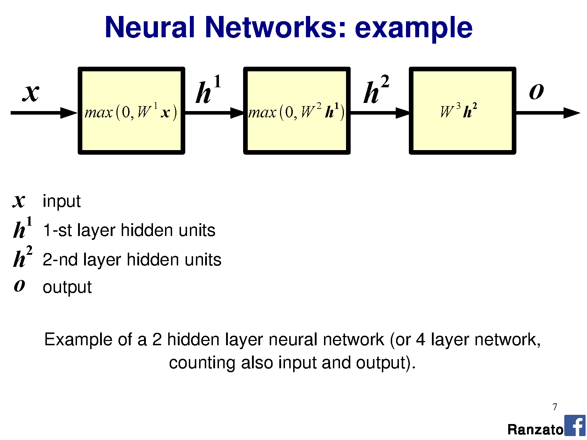

Slide 67
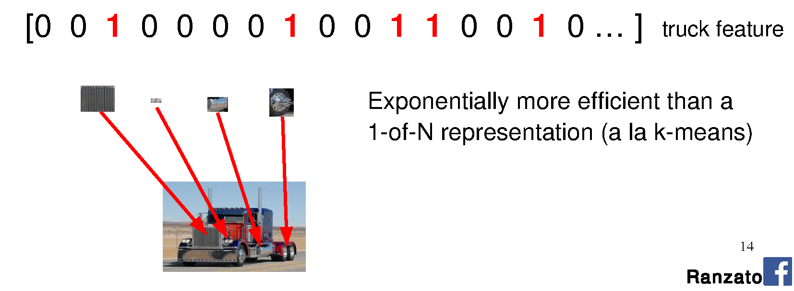
Why do we need many layers?
A hierarchical structure is potentially more efficient because we can reuse intermediate computations.
Different representations can be distributed across classes.

Slide 68
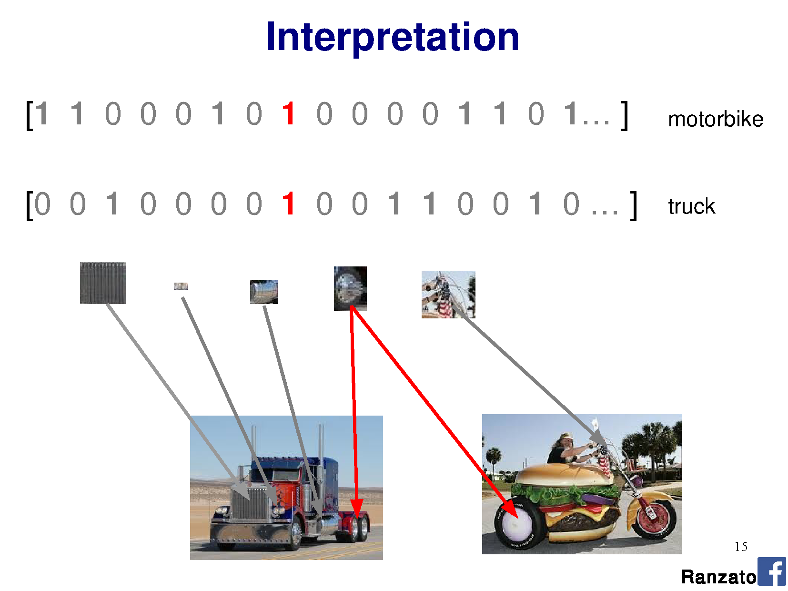

Slide 69
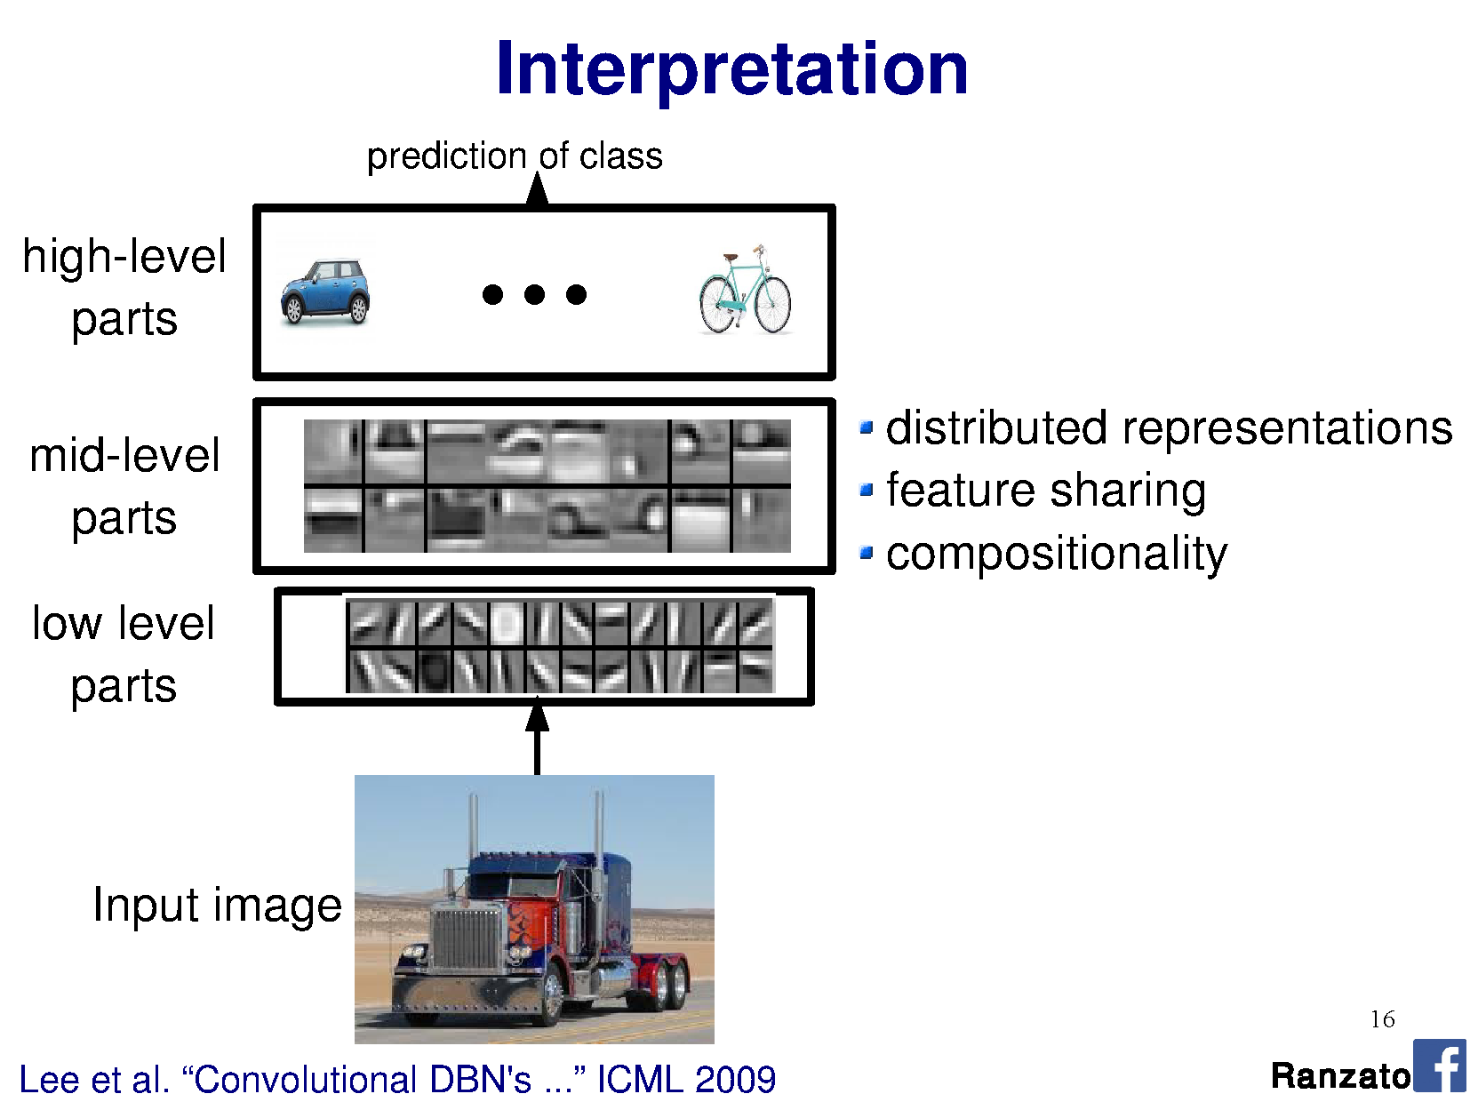

Slide 70
