Slide 1


Slide 2
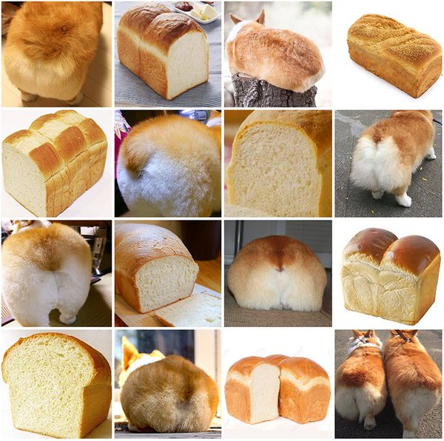
Notes:
Corgi

Slide 3
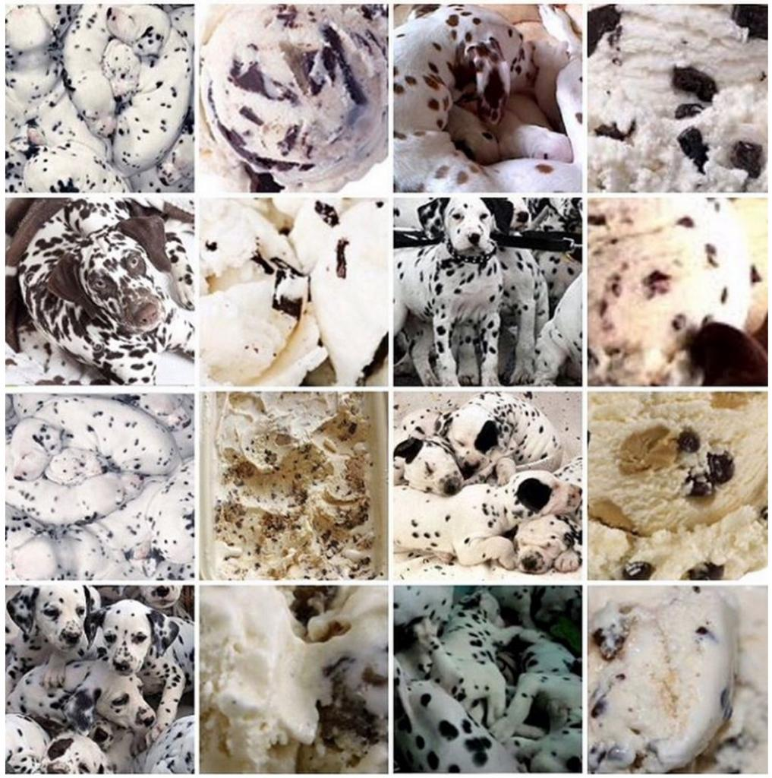
Notes:
Dalmatian

Slide 4
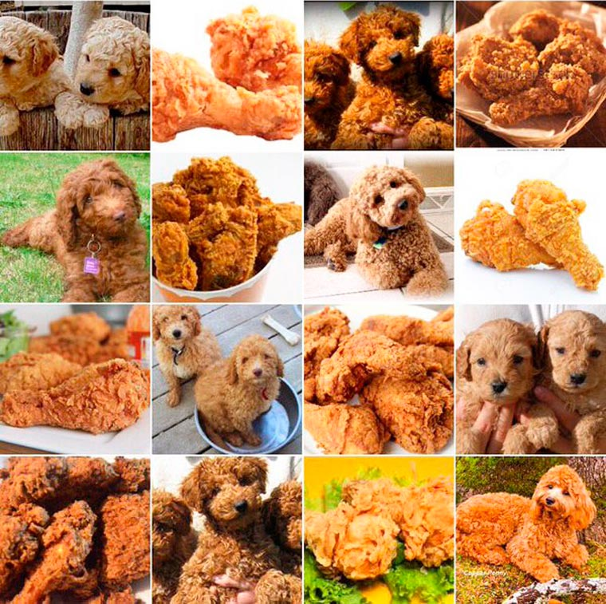
Notes:
Doodle
Poodle cross with …

Slide 5
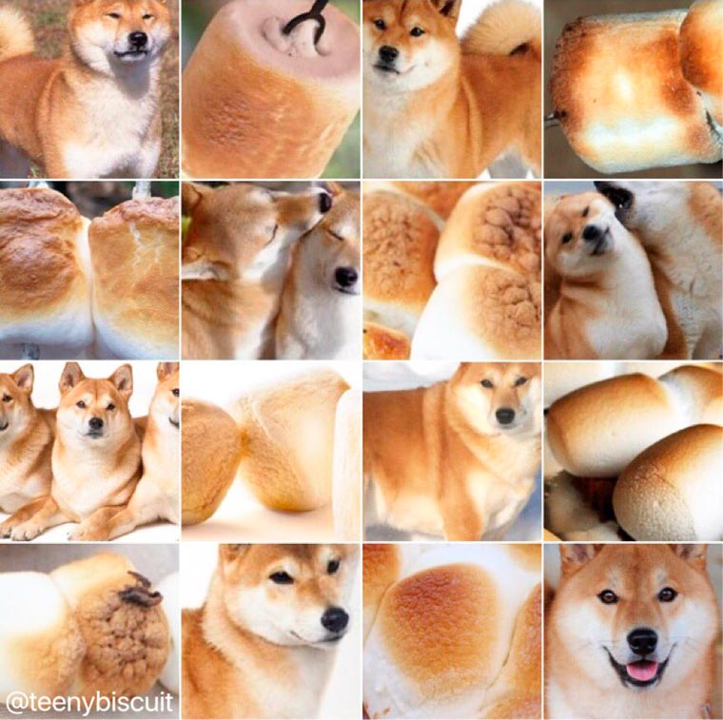
Wow
false positives
what class
no good filtr
so misclassified
cool kernel
Notes:
Shiba Inu

Slide 6
Goals
Build a classifier which is more powerful at representing complex functions and more suited to the learning problem.
What does this mean?
1. Assume that the underlying data generating function relies on a composition of factors.
2. Learn a feature representation that is specific to the dataset.

Slide 7






Neural Networks
Basic building block for composition is a
perceptron (Rosenblatt c.1960)
Linear classifier – vector of weights w and a ‘bias’ b
$$x_{1}$$
$$w=(w_{1},w_{2},w_{3})$$
$$b=0.3$$
$$x_{2}$$
Output (binary)
$$x_{3}$$
Notes:
What does the bias do?
It’s the y-intercept - pushes or pulls the space along the x axis from the 0 point.

Slide 8
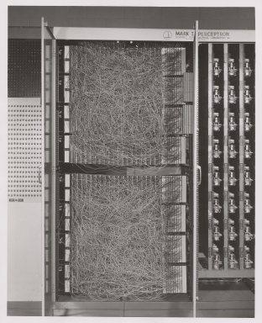
Mark 1 Perceptron
c.1960
20x20 pixel
camera feed
Wikipedia
Notes:
Rosenblatt - 1957 at the Cornell Aeronautical Laboratory
The Mark I Perceptron machine was the first implementation of the perceptron algorithm. The machine was connected to a camera that used 20×20 cadmium sulfide photocells to produce a 400-pixel image. The main visible feature is a patchboard that allowed experimentation with different combinations of input features. To the right of that are arrays of potentiometers that implemented the adaptive weights.[2]:213
In a 1958 press conference organized by the US Navy, Rosenblatt made statements about the perceptron that caused a heated controversy among the fledgling AI community; based on Rosenblatt's statements, The New York Times reported the perceptron to be "the embryo of an electronic computer that [the Navy] expects will be able to walk, talk, see, write, reproduce itself and be conscious of its existence."^{[4]}

Slide 9
Universality
A single-layer network can learn any function:
  So long as it is differentiable
  To some approximation;
  More perceptrons = a better approximation
Visual proof (Michael Nielson):
http://neuralnetworksanddeeplearning.com/chap4.html
Notes:
Visual proof is with sigmoid activation functions

Slide 10
If a single-layer network can learn any function…
…given enough parameters…
…then why do we go deeper?
Intuitively, composition is efficient because it allows reuse.
Empirically, deep networks do a better job than shallow networks at learning such hierarchies of knowledge.

Slide 11
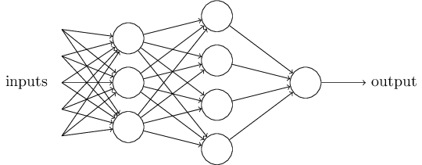
Composition
Hidden Layer 1
Hidden Layer 2
Layers that are in between the input and the output are called hidden layers, because we are going to learn their weights via an optimization process.
Nielson

Slide 12
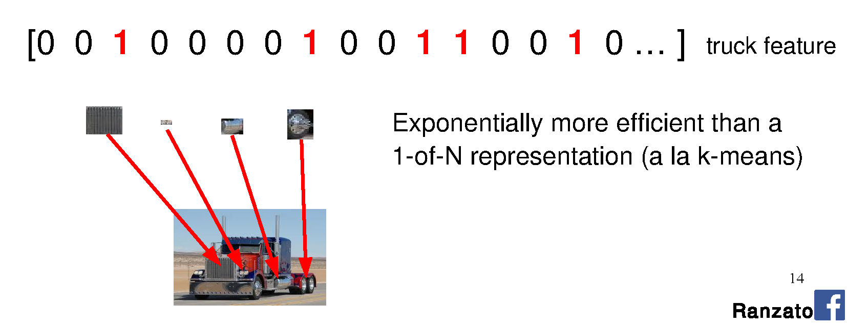
Interpretation of many layers

Slide 13
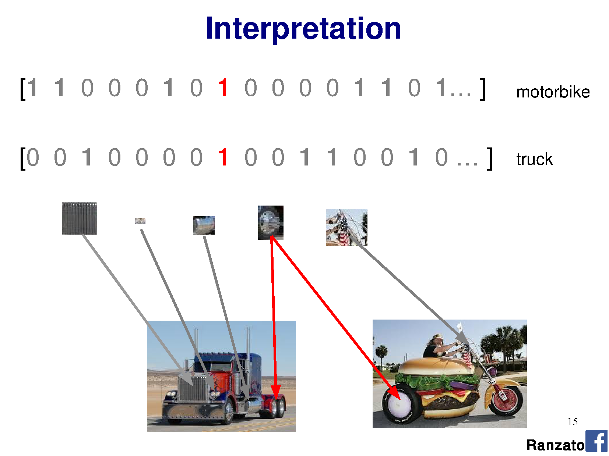

Slide 14
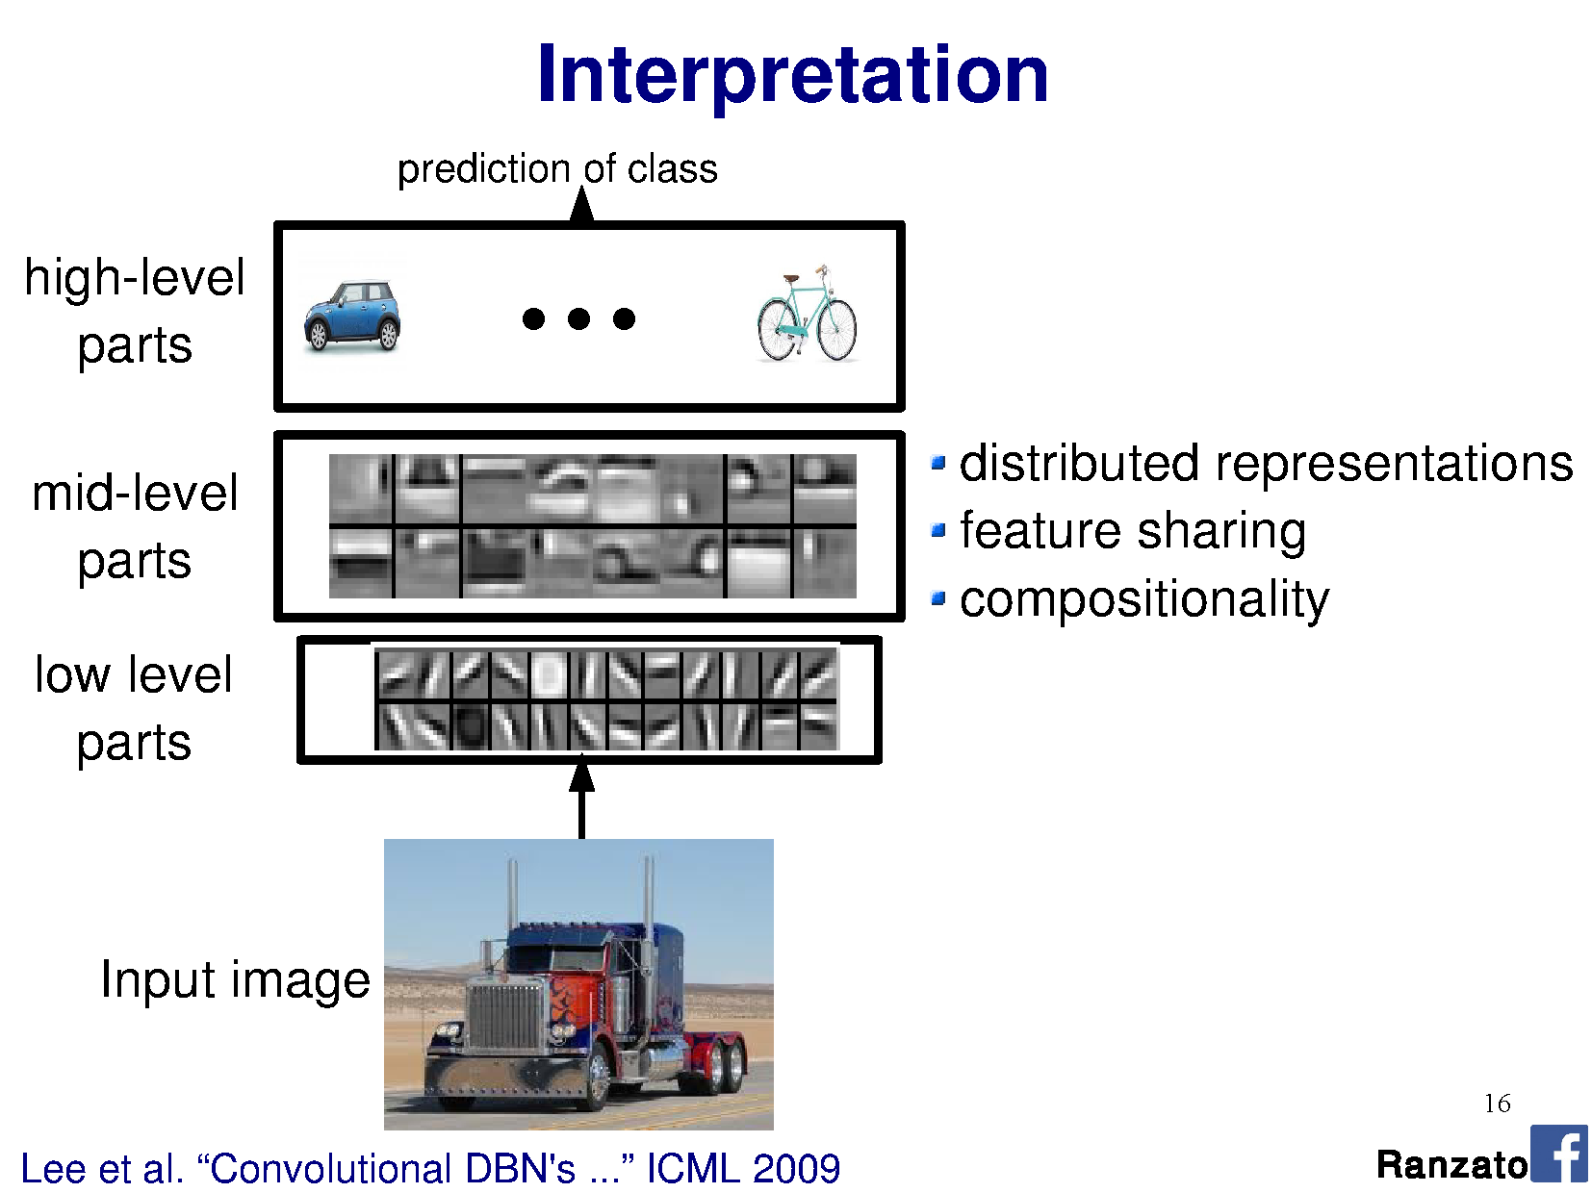
NOTE: Not actually the weights; a demonstrative visualization!

Slide 15

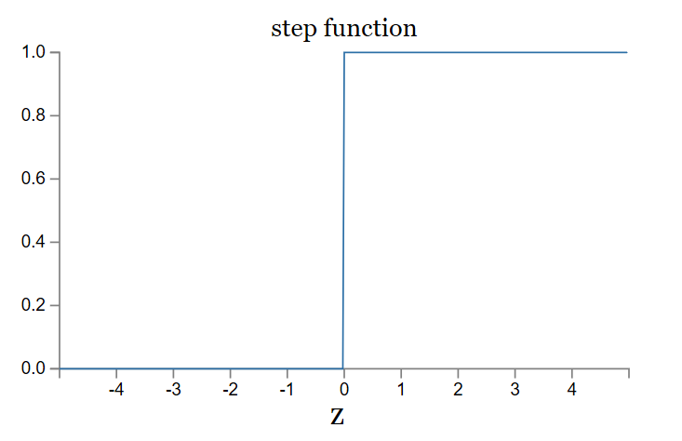
Activation functions:
Rectified Linear Unit
ReLU

Slide 16
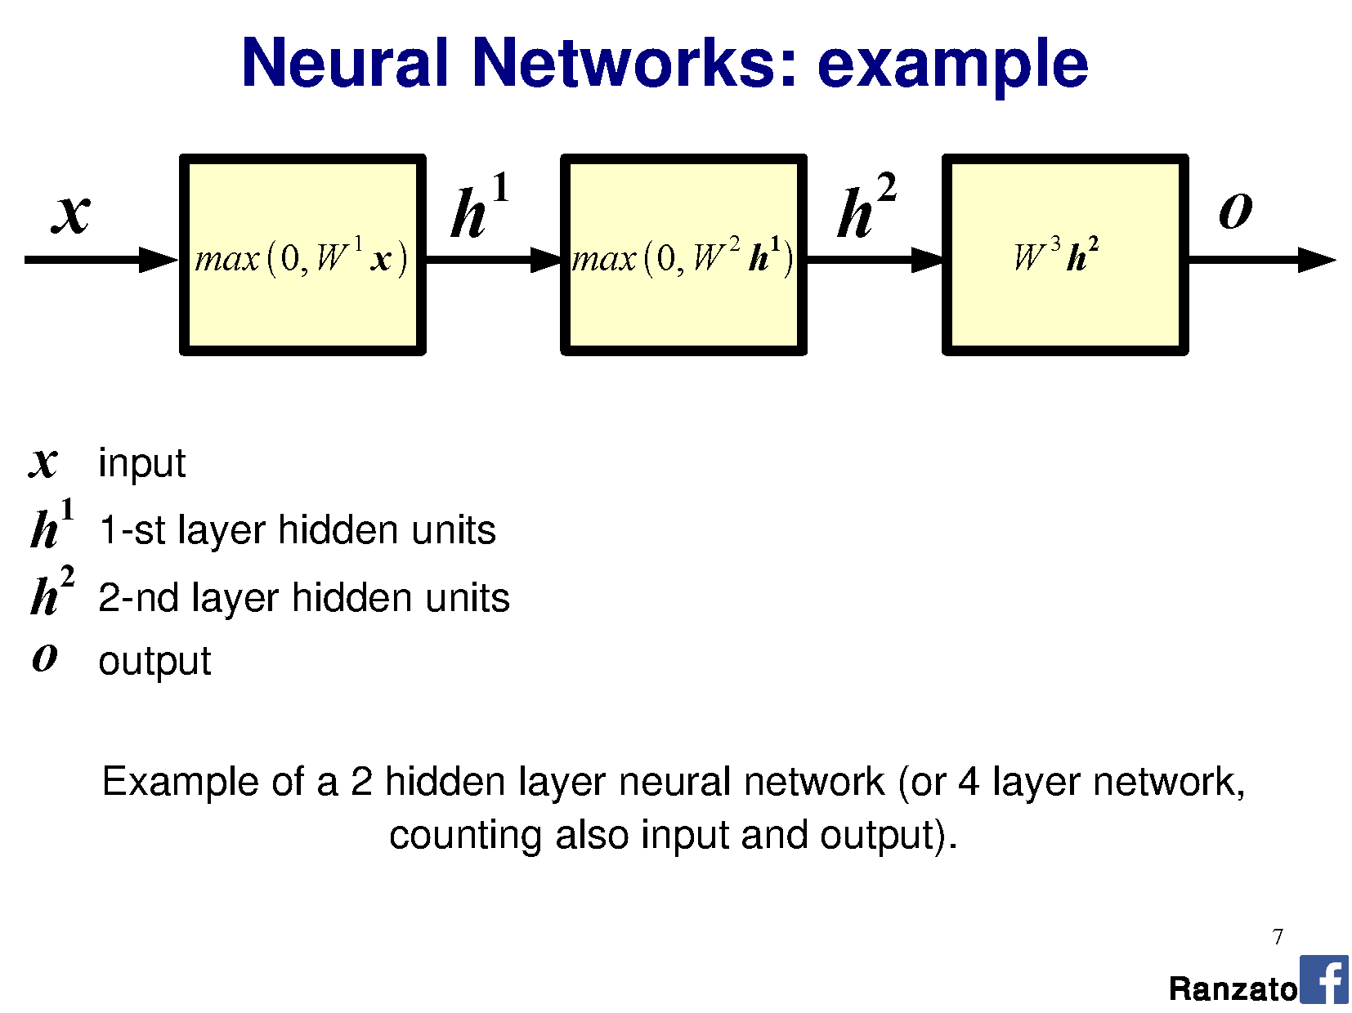

Slide 17
Does anyone pass along the weight without an activation function?
No – this is linear chaining.
Input
vector
Output vector

Slide 18
Does anyone pass along the weight without an activation function?
No – this is linear chaining.
Input
vector
Output vector

Slide 19
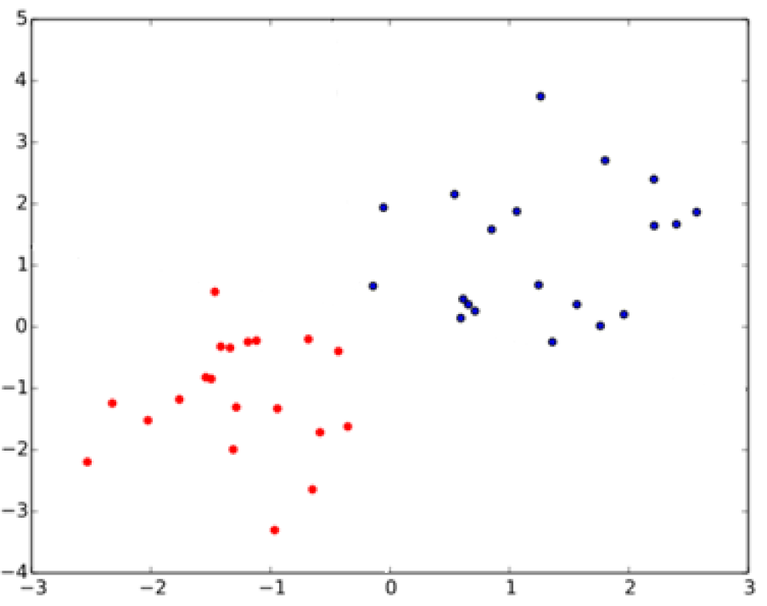
What is the relationship between SVMs and perceptrons?
SVMs attempt to learn the support vectors which maximize the margin between classes.
Notes:
In separable problems, perceptron training can also aim at finding the largest separating margin between the classes. The so-called perceptron of optimal stability can be determined by means of iterative training and optimization schemes, such as the Min-Over algorithm (Krauth and Mezard, 1987)^{[11]} or the AdaTron (Anlauf and Biehl, 1989)) .^{[12]} AdaTron uses the fact that the corresponding quadratic optimization problem is convex. The perceptron of optimal stability, together with the kernel trick, are the conceptual foundations of the support vector machine.
https://en.wikipedia.org/wiki/Perceptron
Perceptron of optimal stability can be computed via the Min-Over algorithm (Krauth and Mezard, 1987)^{[11]} or the AdaTron (Anlauf and Biehl, 1989) algorithm.

Slide 20
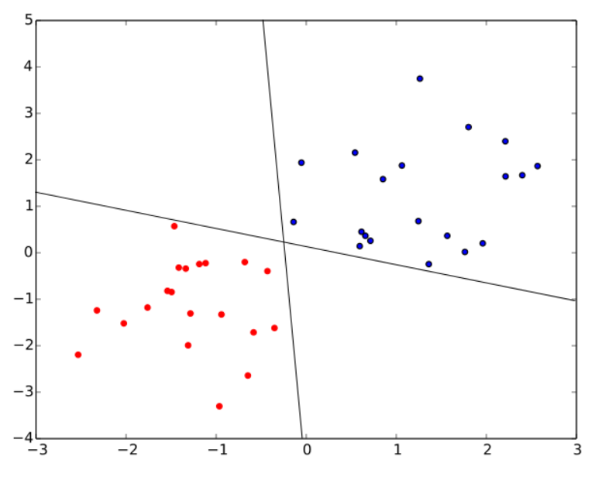
What is the relationship between SVMs and perceptrons?
SVMs attempt to learn the support vectors which maximize the margin between classes.
A perceptron does not.
Both of these perceptron classifiers are equivalent.
‘Perceptron of optimal
stability’ is used in SVM:
Perceptron
+ optimal stability
+ kernel trick
= foundations of SVM
Notes:
In separable problems, perceptron training can also aim at finding the largest separating margin between the classes. The so-called perceptron of optimal stability can be determined by means of iterative training and optimization schemes, such as the Min-Over algorithm (Krauth and Mezard, 1987)^{[11]} or the AdaTron (Anlauf and Biehl, 1989)) .^{[12]} AdaTron uses the fact that the corresponding quadratic optimization problem is convex. The perceptron of optimal stability, together with the kernel trick, are the conceptual foundations of the support vector machine.
https://en.wikipedia.org/wiki/Perceptron
Perceptron of optimal stability can be computed via the Min-Over algorithm (Krauth and Mezard, 1987)^{[11]} or the AdaTron (Anlauf and Biehl, 1989) algorithm.

Slide 21
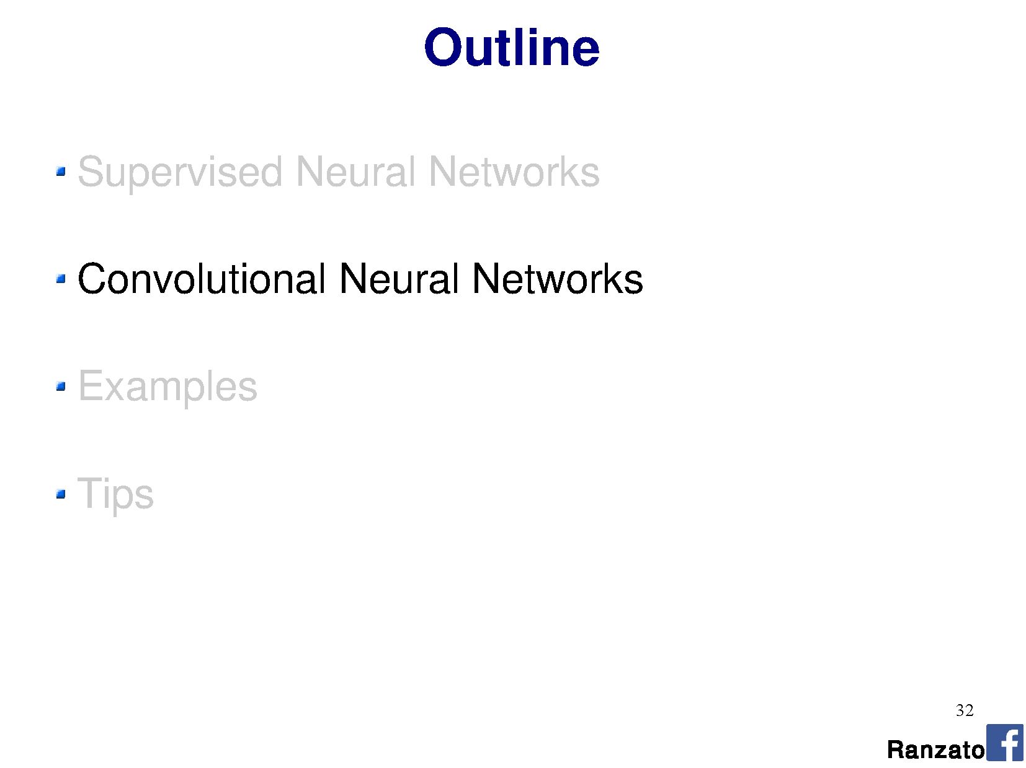

Slide 22
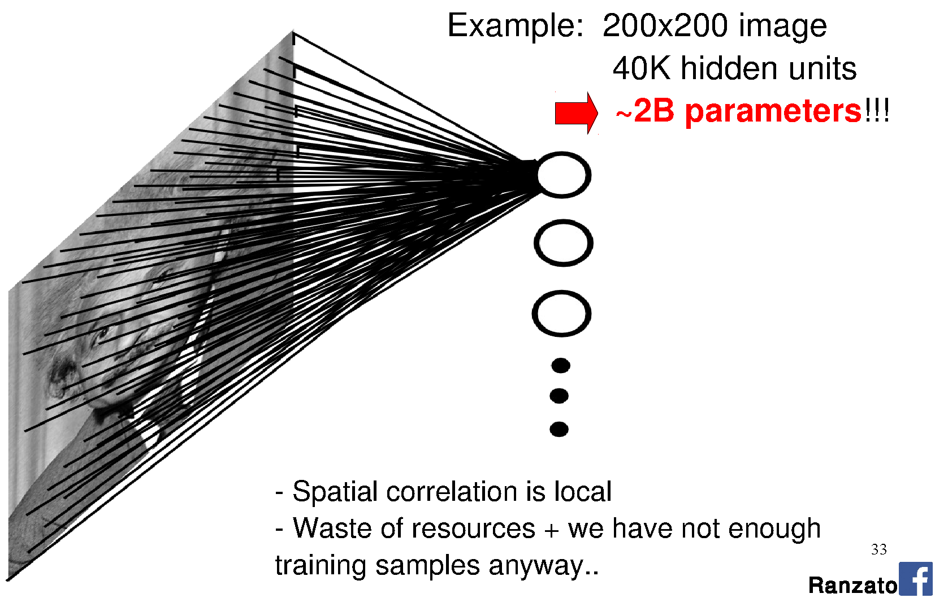
Images as input to neural networks
Notes:
Seems fine, right?
Going to learn a neural network to classify an image. Learn weights from a large database of images using back propagation.
How many perceptrons do you think we need to represent the ‘complexity’ of natural images?
How big are the weight matrices?
How many weight parameters did you learn in your HOG-based SVM classification? How big was the database? Did it work?
The more parameters we have, the larger the database we need to ‘map out’ the high-dimensional space.
Are we wasting any knowledge in this representation?

Slide 23
Images as input to neural networks

Slide 24
Images as input to neural networks

Slide 25
Motivation
Sparse interactions – receptive fields
  Assume that in an image, we care about ‘local neighborhoods’ only for a given neural network layer.
  Composition of layers will expand local -> global.

Slide 26
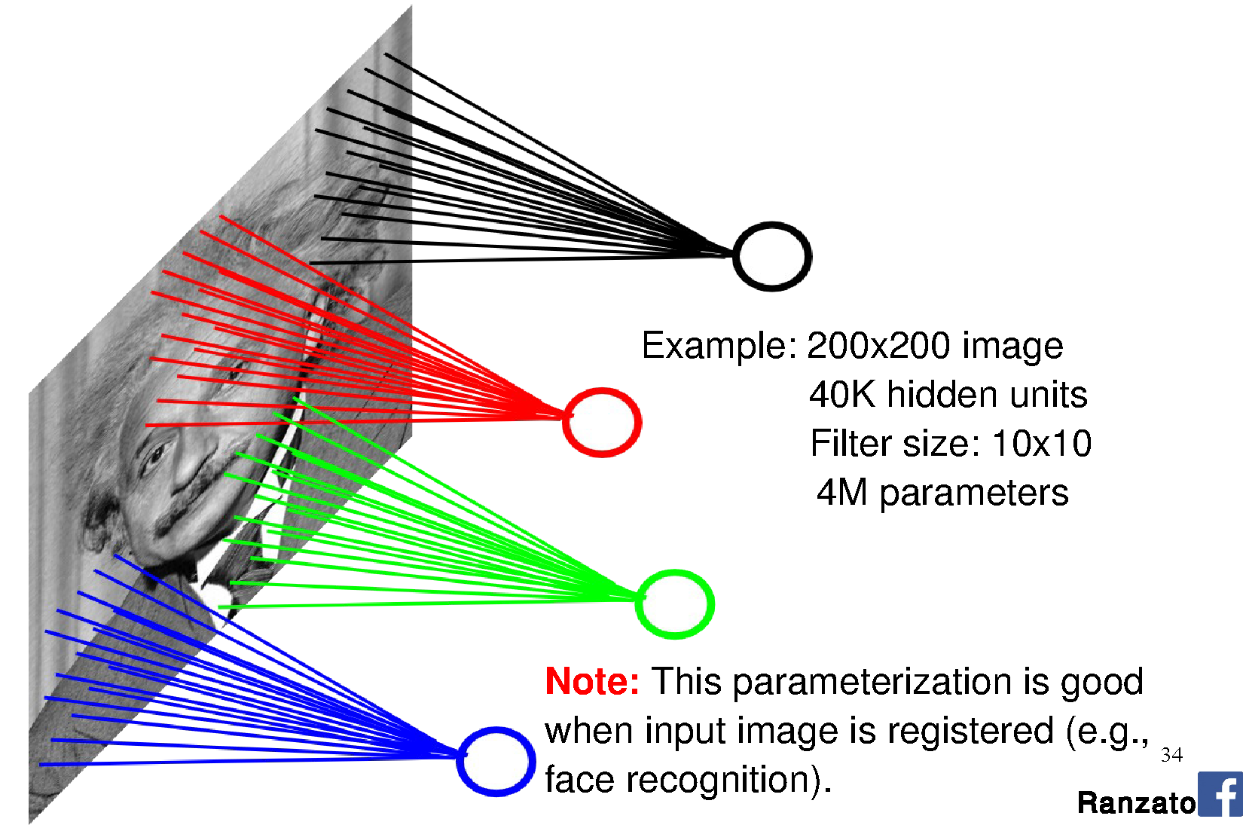

Slide 27
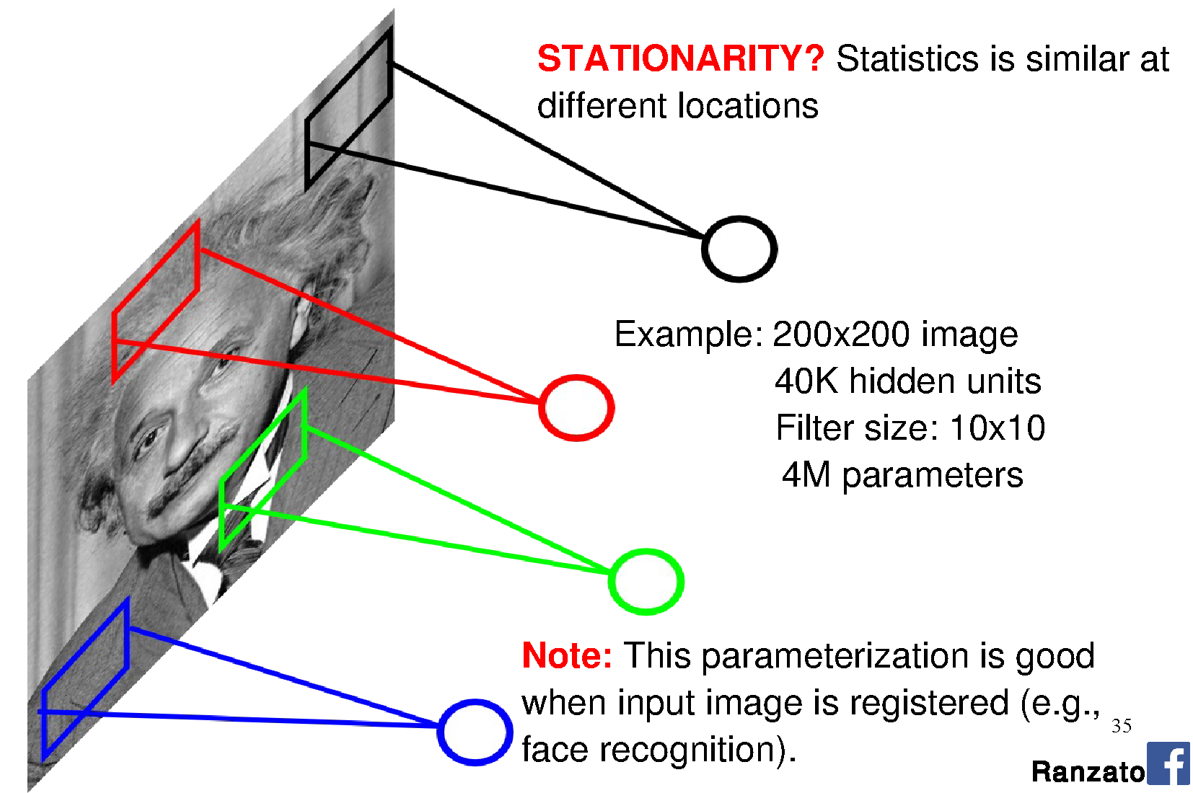

Slide 28
Motivation
Sparse interactions – receptive fields
  Assume that in an image, we care about ‘local neighborhoods’ only for a given neural network layer.
  Composition of layers will expand local -> global.
Parameter sharing
  ‘Tied weights’ – use same weights for more than one perceptron in the neural network.
  Leads to equivariant representation
    If input changes (e.g., translates), then output changes similarly

Slide 29
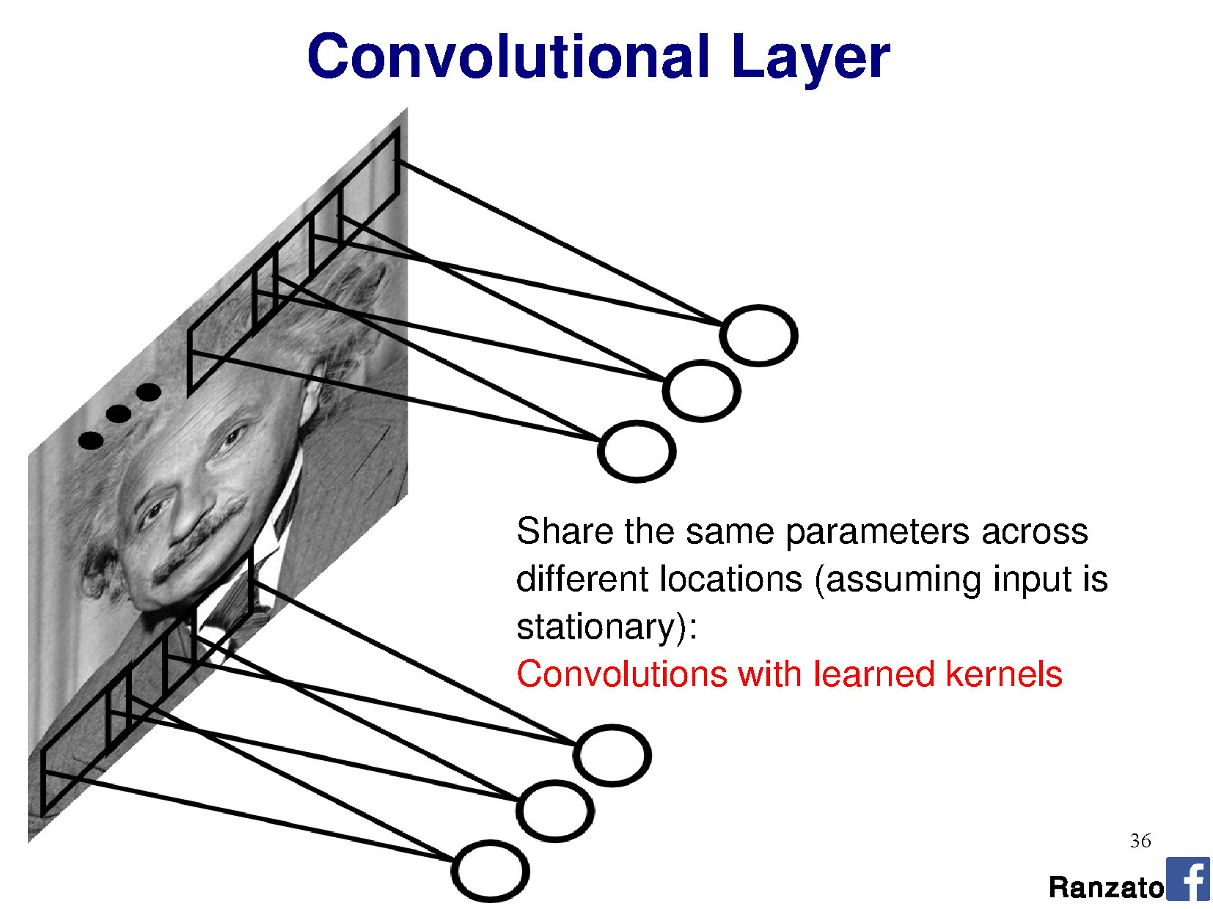

Slide 30
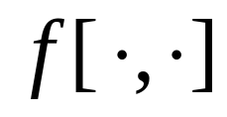
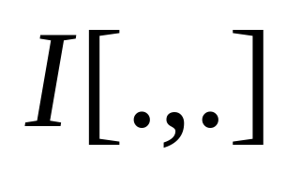
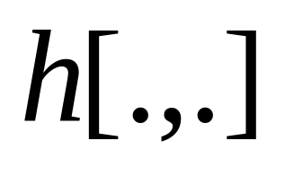
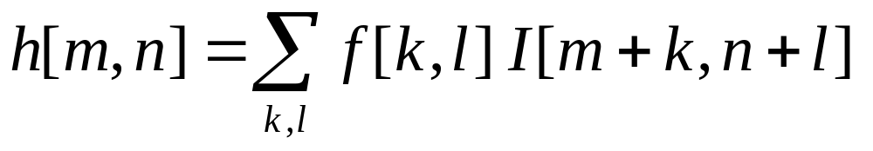
Filtering reminder:
Correlation (rotated convolution)
1
1
1
1
1
1
1
1
1
0 | 0 | 0 | 0 | 0 | 0 | 0 | 0 | 0 | 0
0 | 0 | 0 | 0 | 0 | 0 | 0 | 0 | 0 | 0
0 | 0 | 0 | 90 | 90 | 90 | 90 | 90 | 0 | 0
0 | 0 | 0 | 90 | 90 | 90 | 90 | 90 | 0 | 0
0 | 0 | 0 | 90 | 90 | 90 | 90 | 90 | 0 | 0
0 | 0 | 0 | 90 | 0 | 90 | 90 | 90 | 0 | 0
0 | 0 | 0 | 90 | 90 | 90 | 90 | 90 | 0 | 0
0 | 0 | 0 | 0 | 0 | 0 | 0 | 0 | 0 | 0
0 | 0 | 90 | 0 | 0 | 0 | 0 | 0 | 0 | 0
0 | 0 | 0 | 0 | 0 | 0 | 0 | 0 | 0 | 0
 | 0 | 10 | 20 | 30 | 30 | 30 | 20 | 10
 | 0 | 20 | 40 | 60 | 60 | 60 | 40 | 20
 | 0 | 30 | 60 | 90 | 90 | 90 | 60 | 30
 | 0 | 30 | 50 | 80 | 80 | 90 | 60 | 30
 | 0 | 30 | 50 | 80 | 80 | 90 | 60 | 30
 | 0 | 20 | 30 | 50 | 50 | 60 | 40 | 20
 | 10 | 20 | 30 | 30 | 30 | 30 | 20 | 10
 | 10 | 10 | 10 | 0 | 0 | 0 | 0 | 0
Credit: S. Seitz
Notes:
Correlation / convolution -> same thing for symmetric filters.
Many deep learning libraries use correlation but call it convolution. NBD. We can learn the difference (rotation) away

Slide 31
Perceptron:
This is convolution!

Slide 32
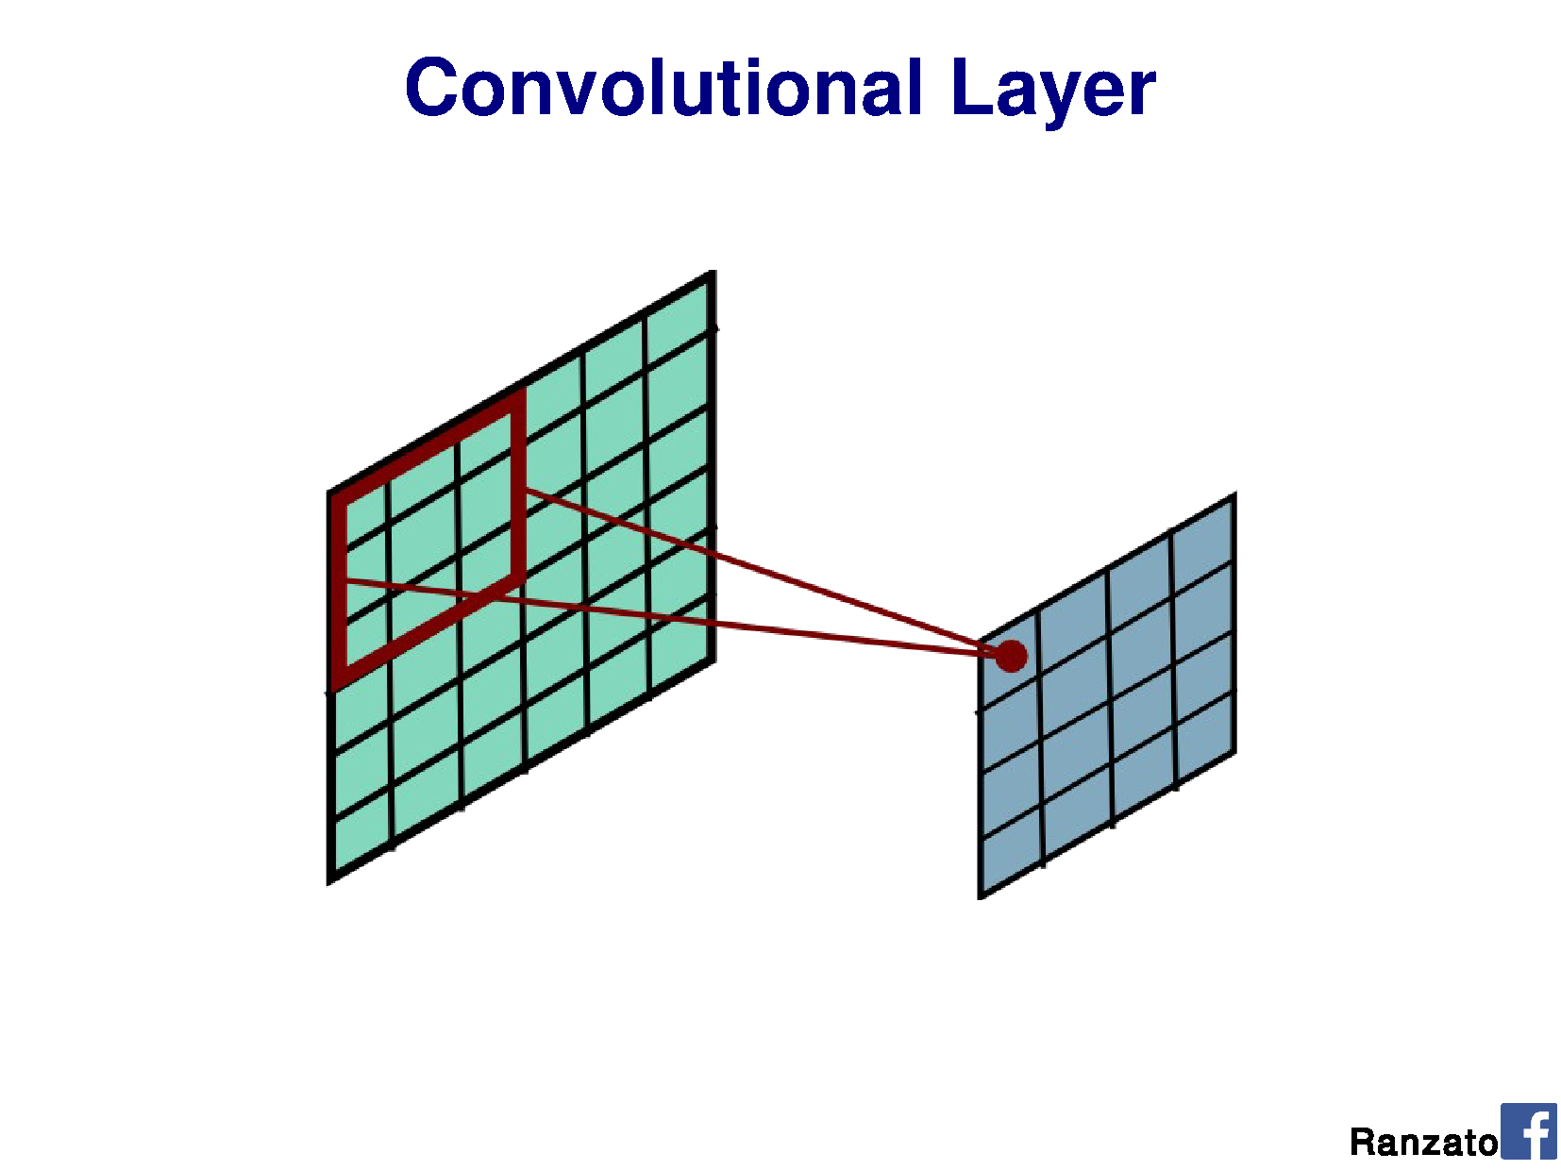

Slide 33
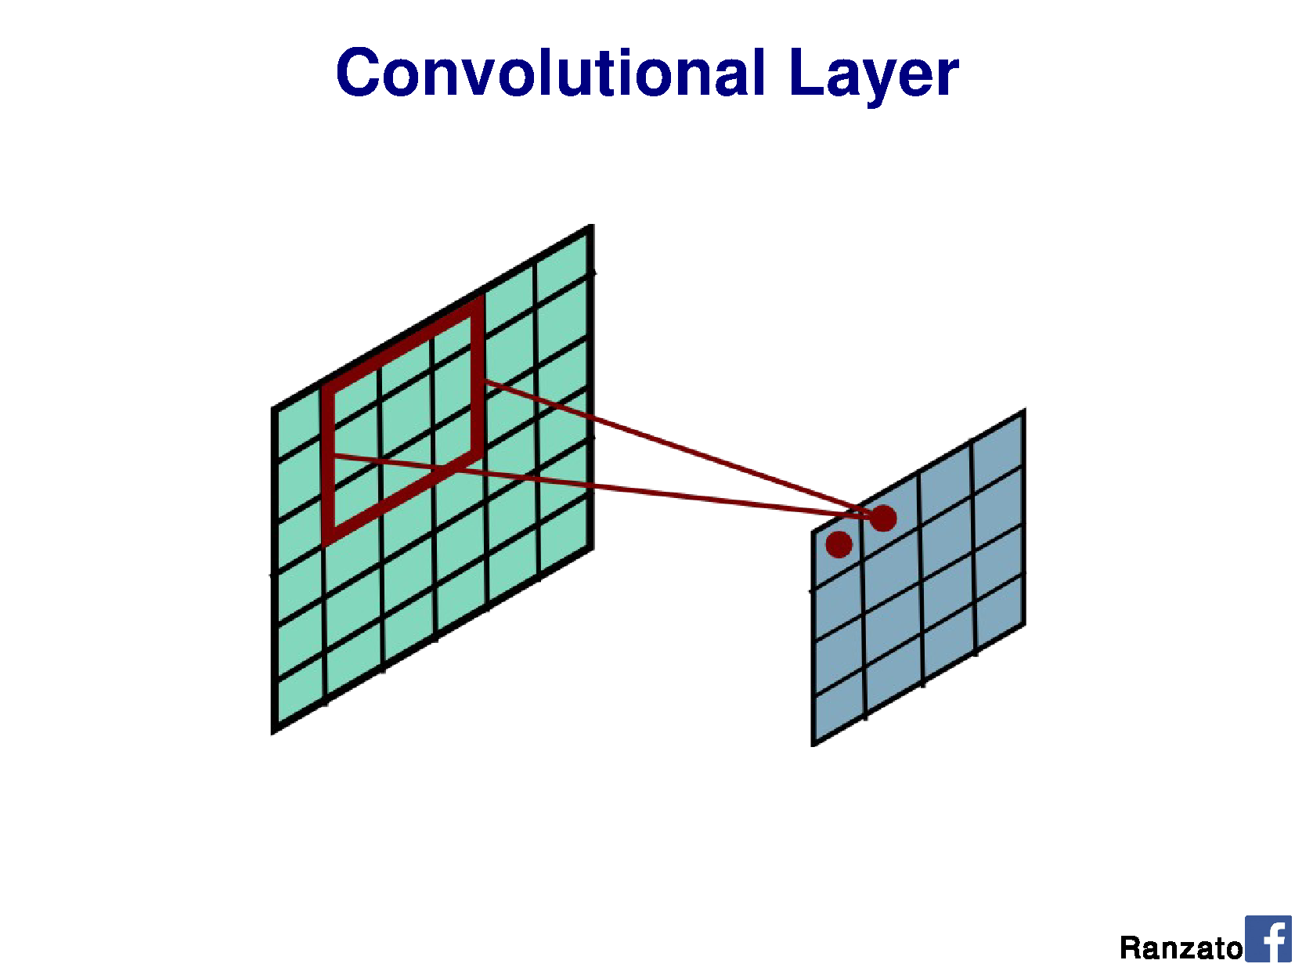

Slide 34
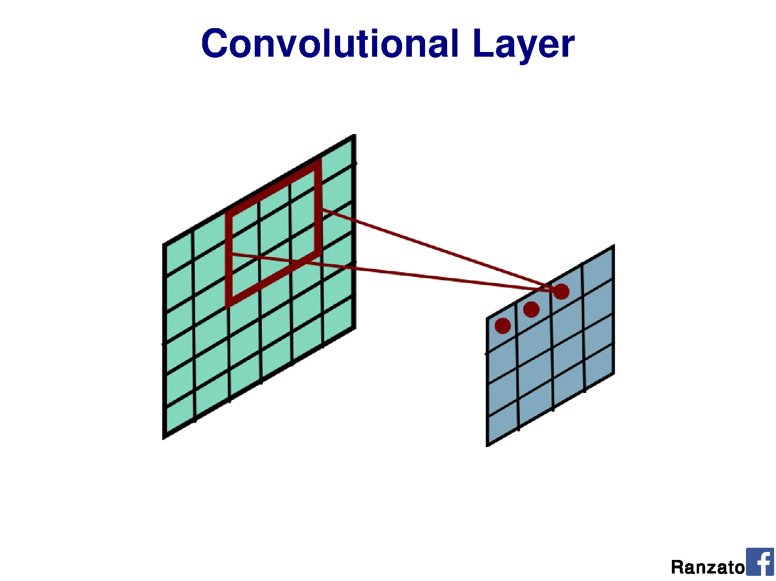

Slide 35
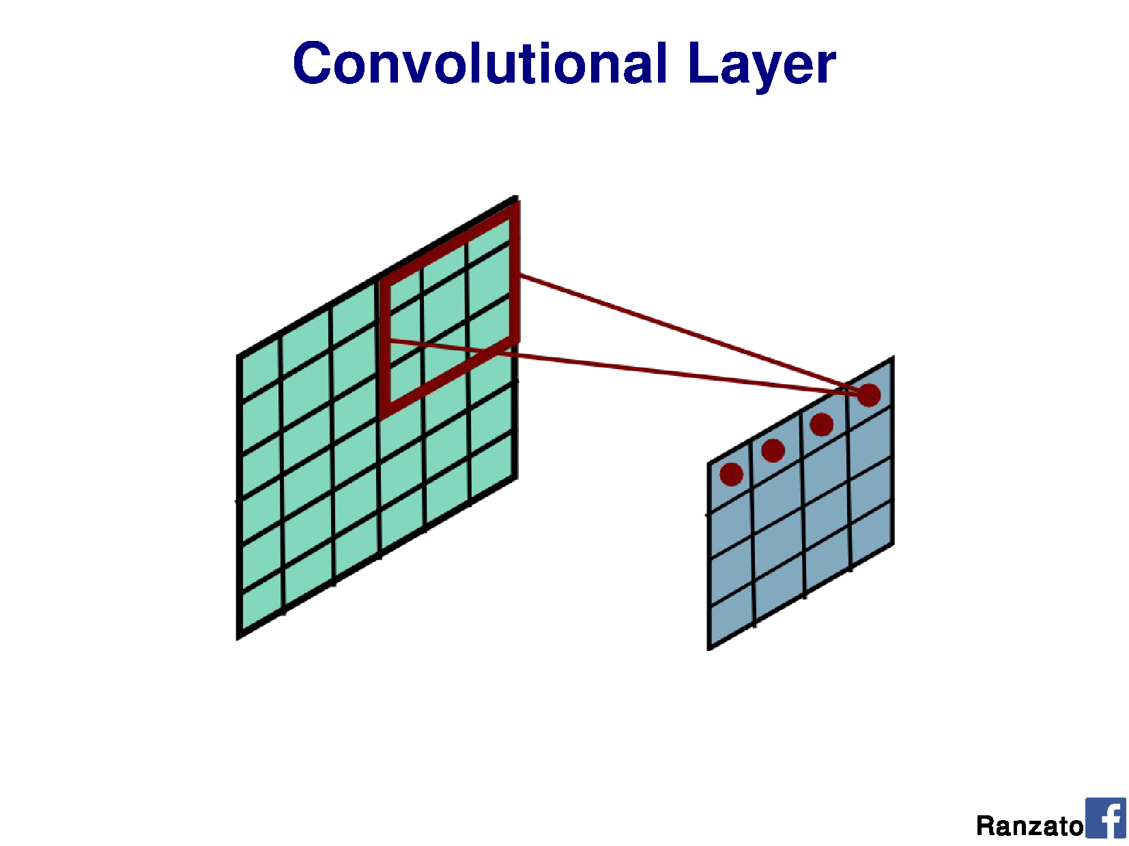

Slide 36
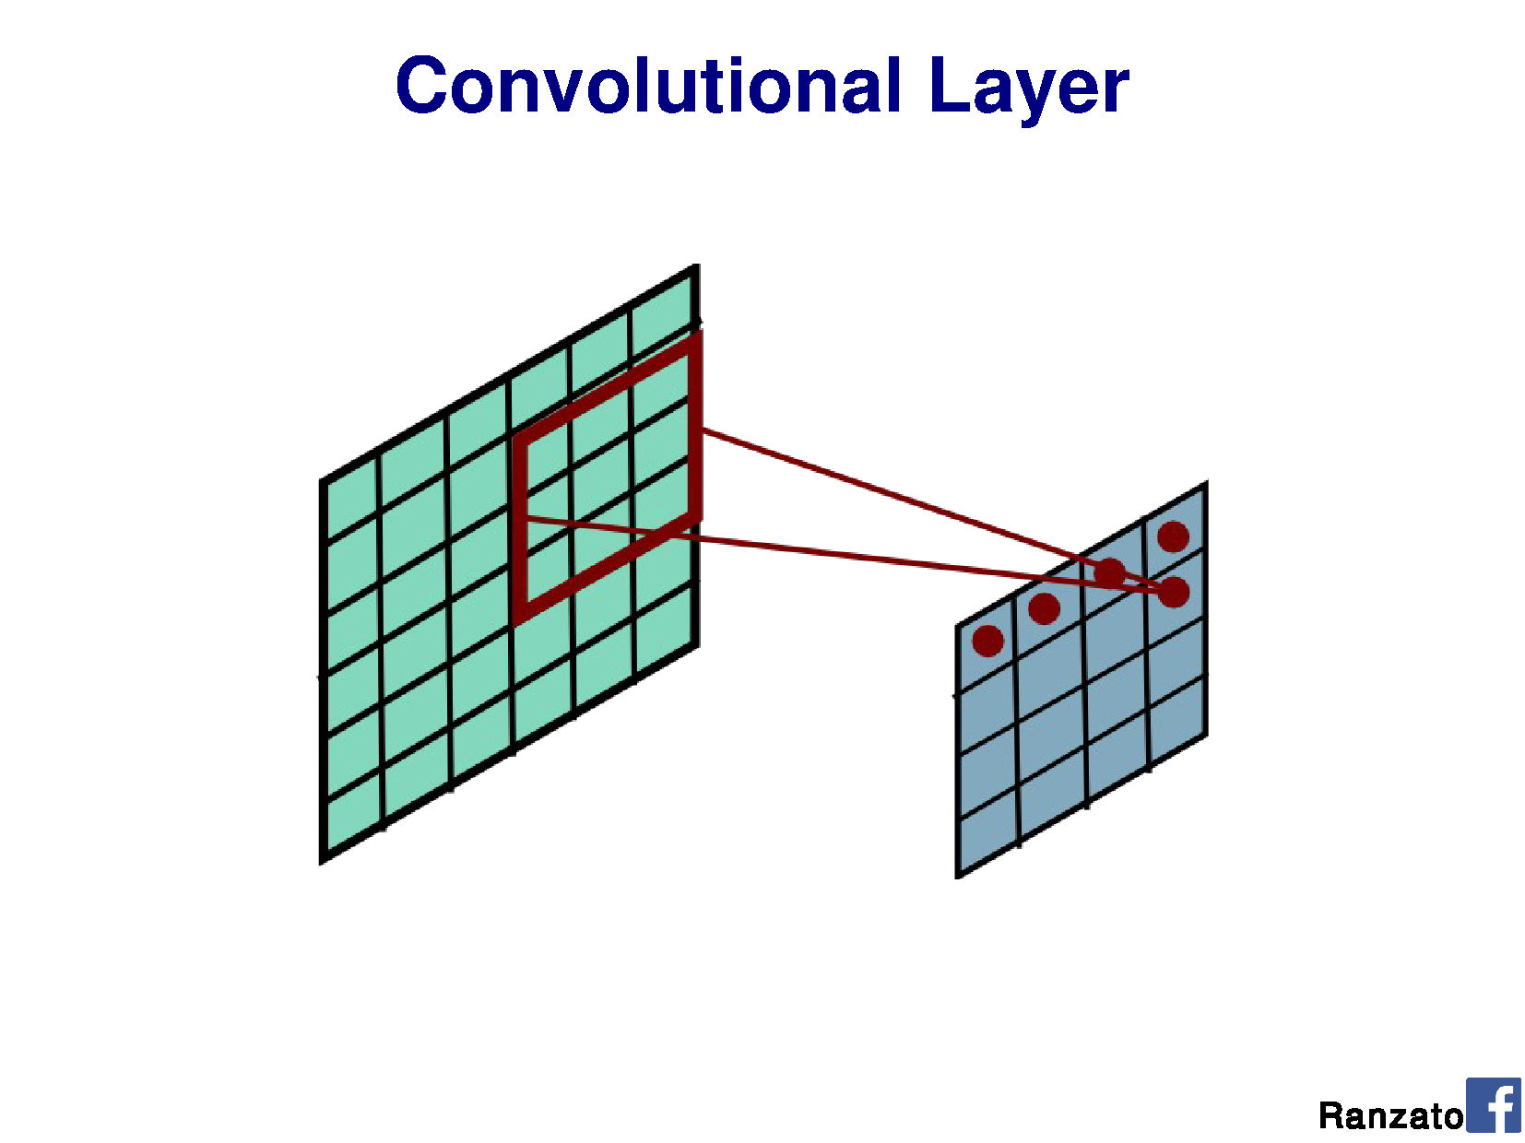

Slide 37
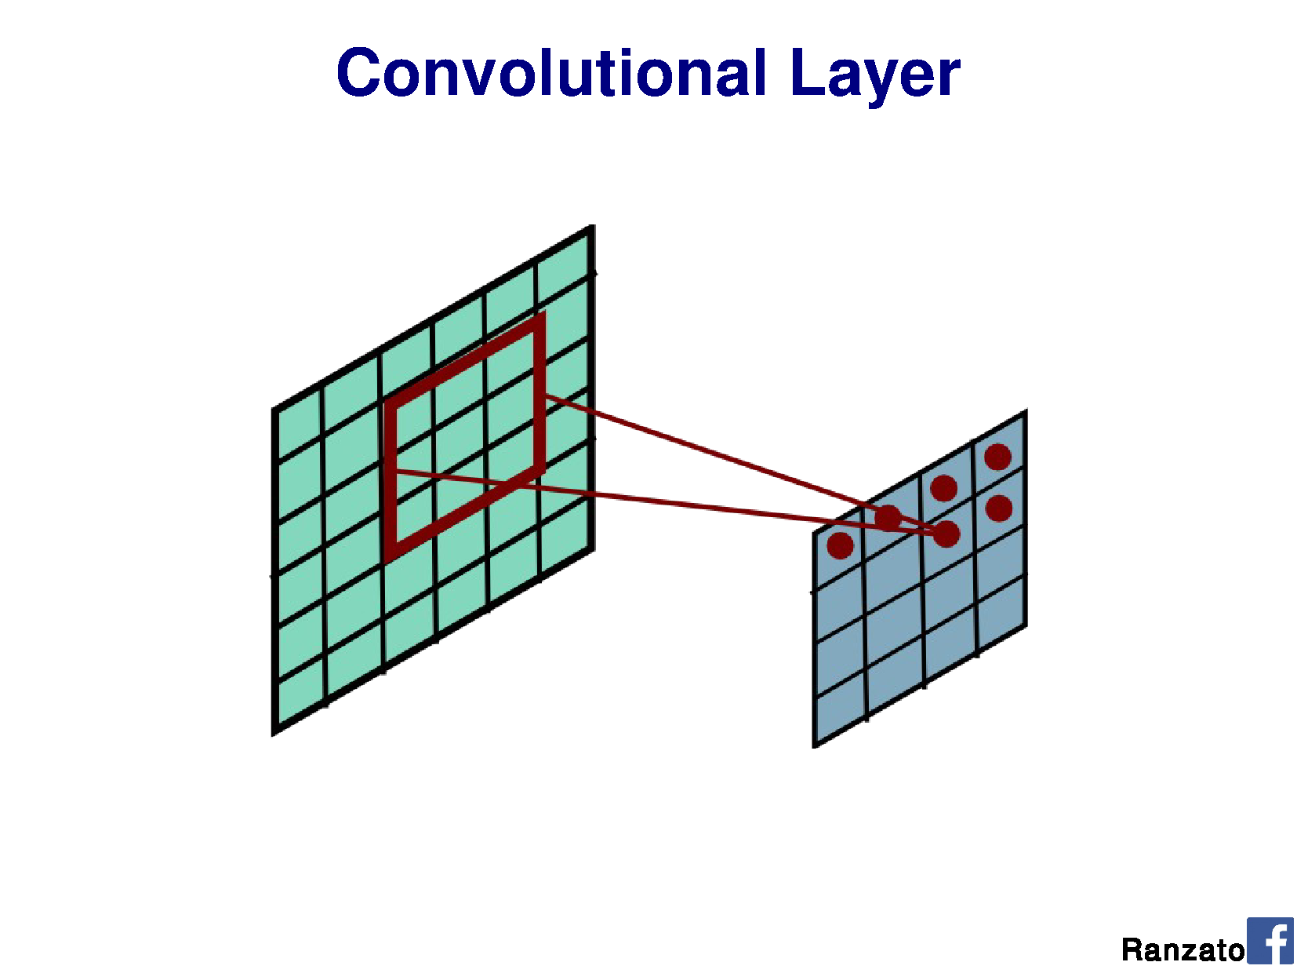

Slide 38
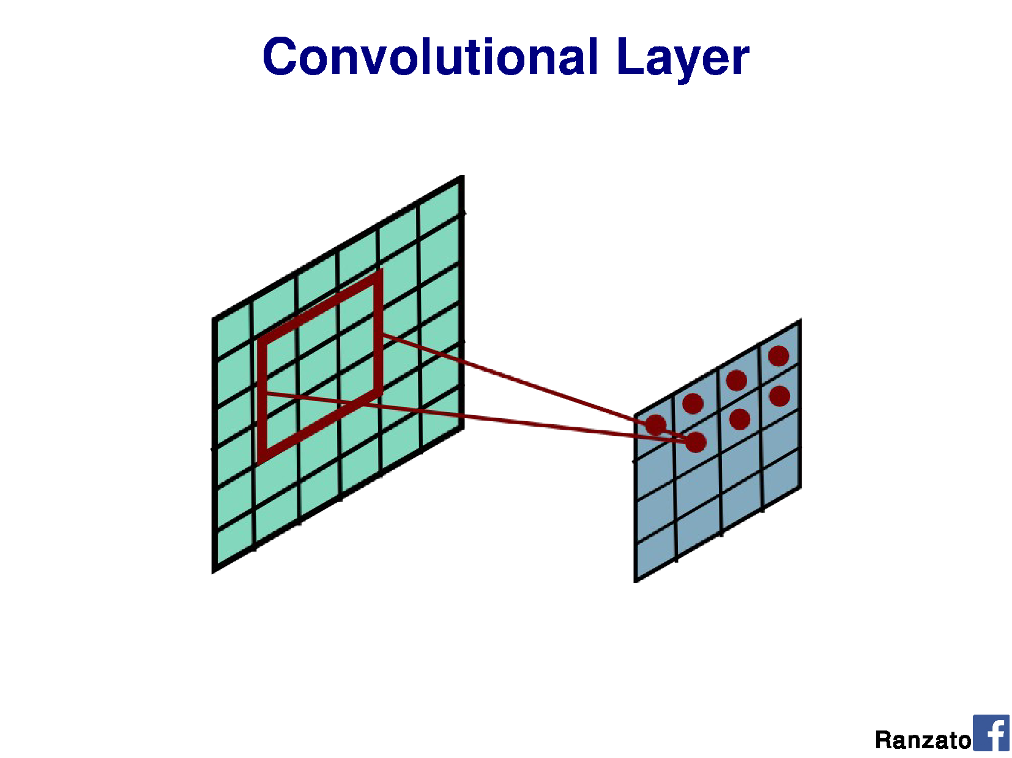

Slide 39
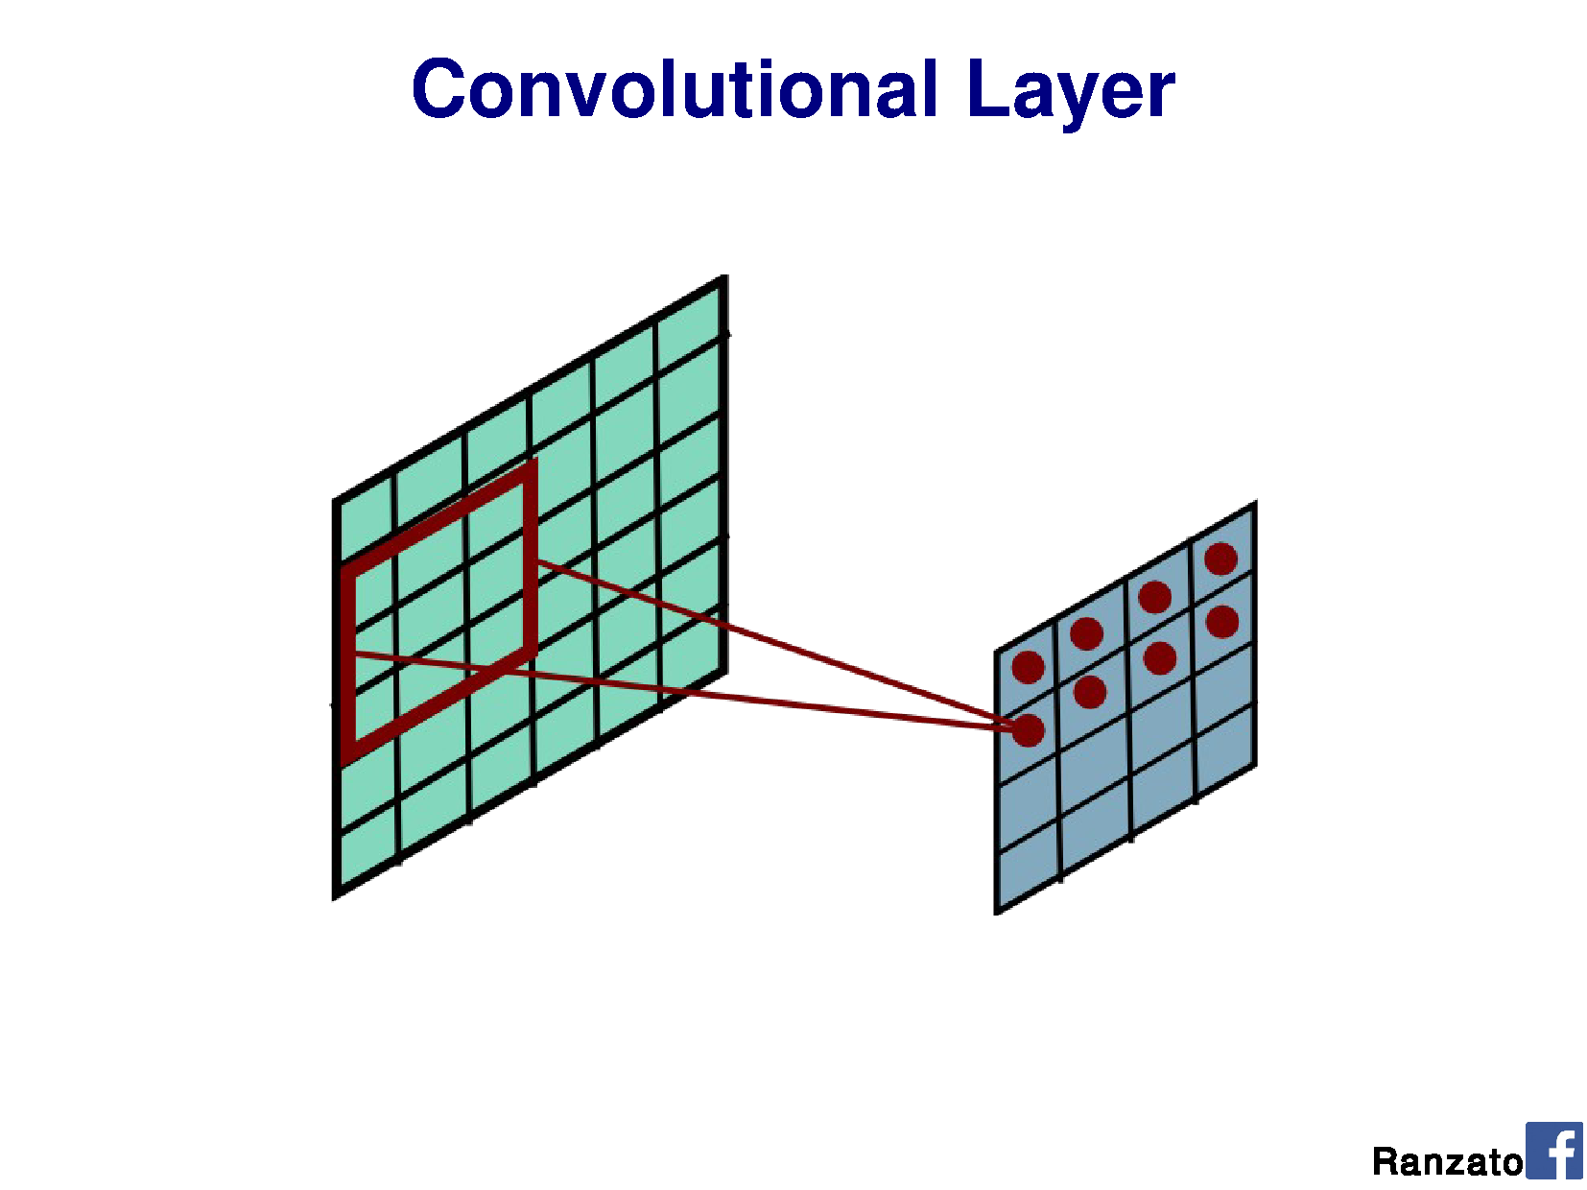

Slide 40
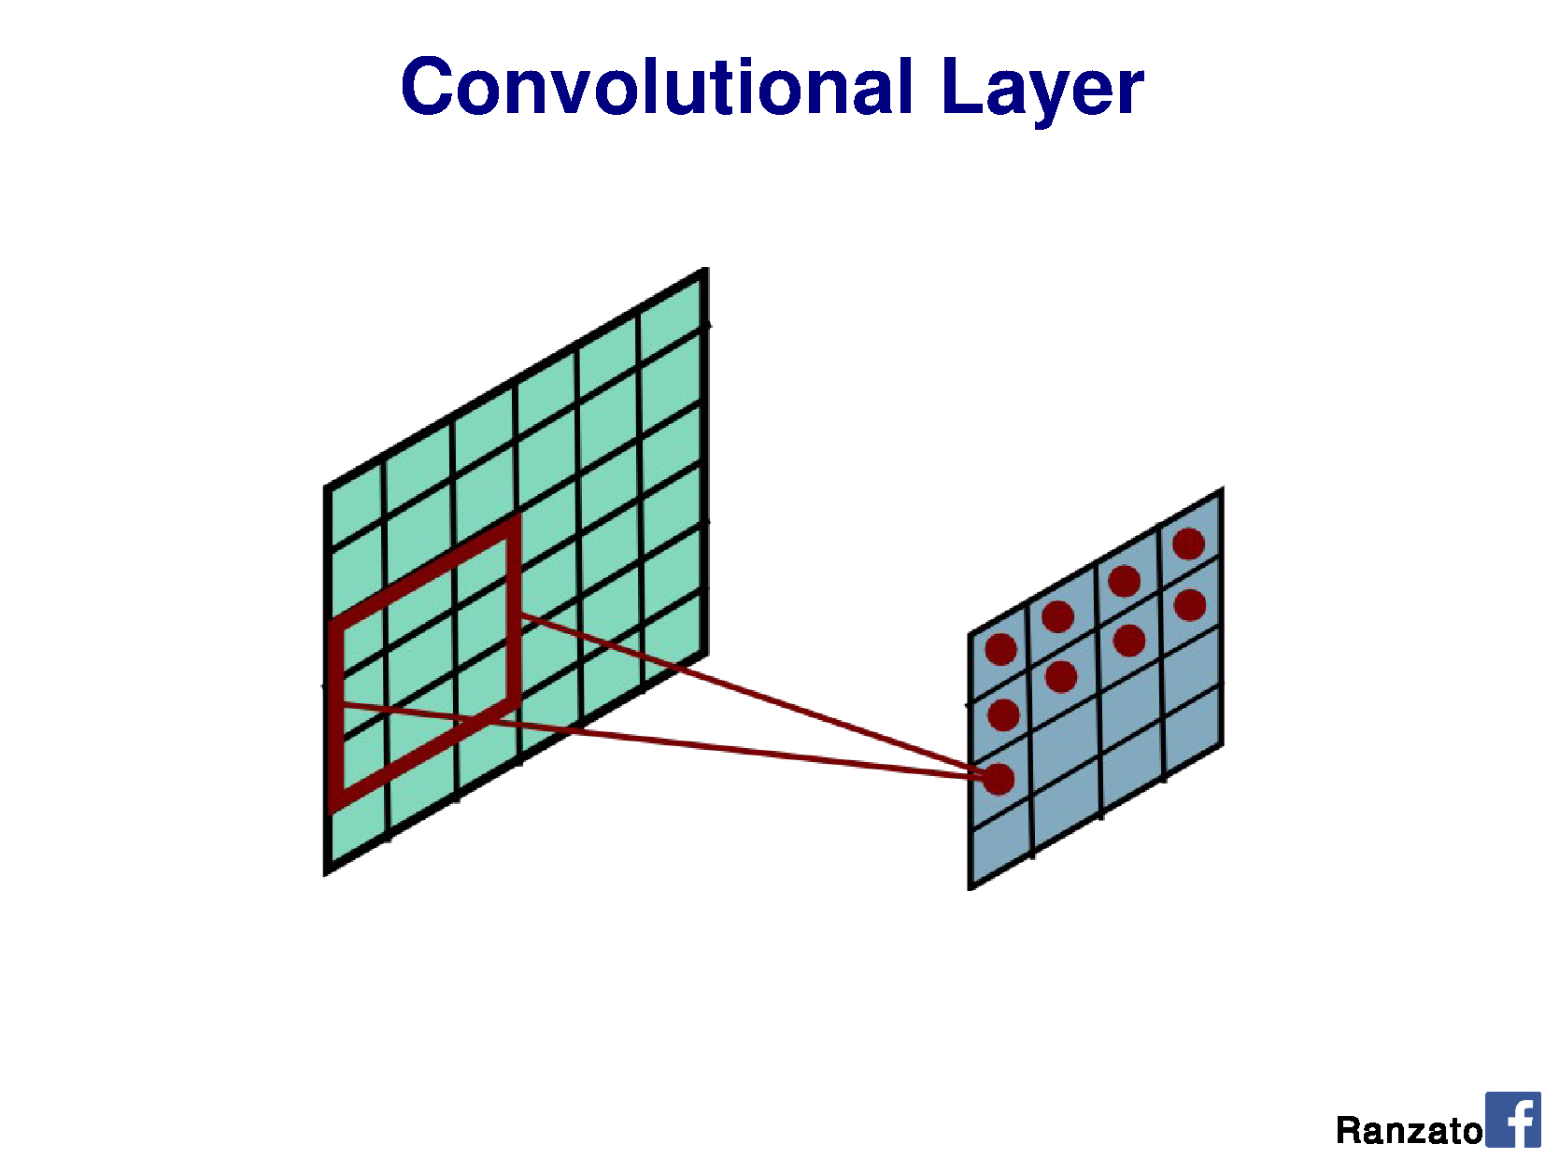

Slide 41
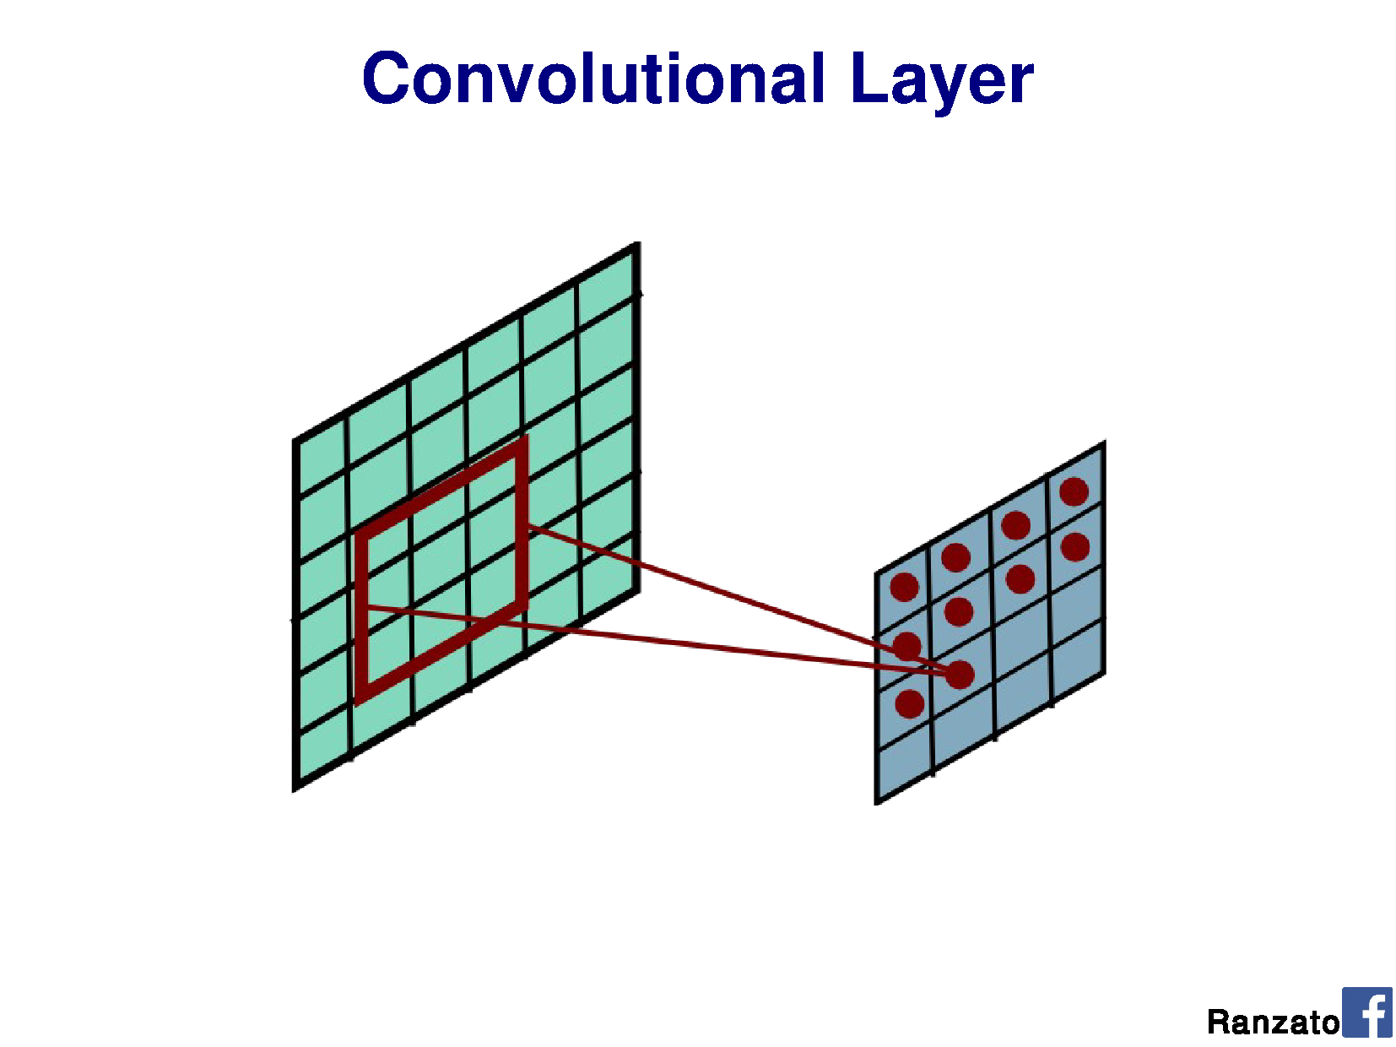

Slide 42
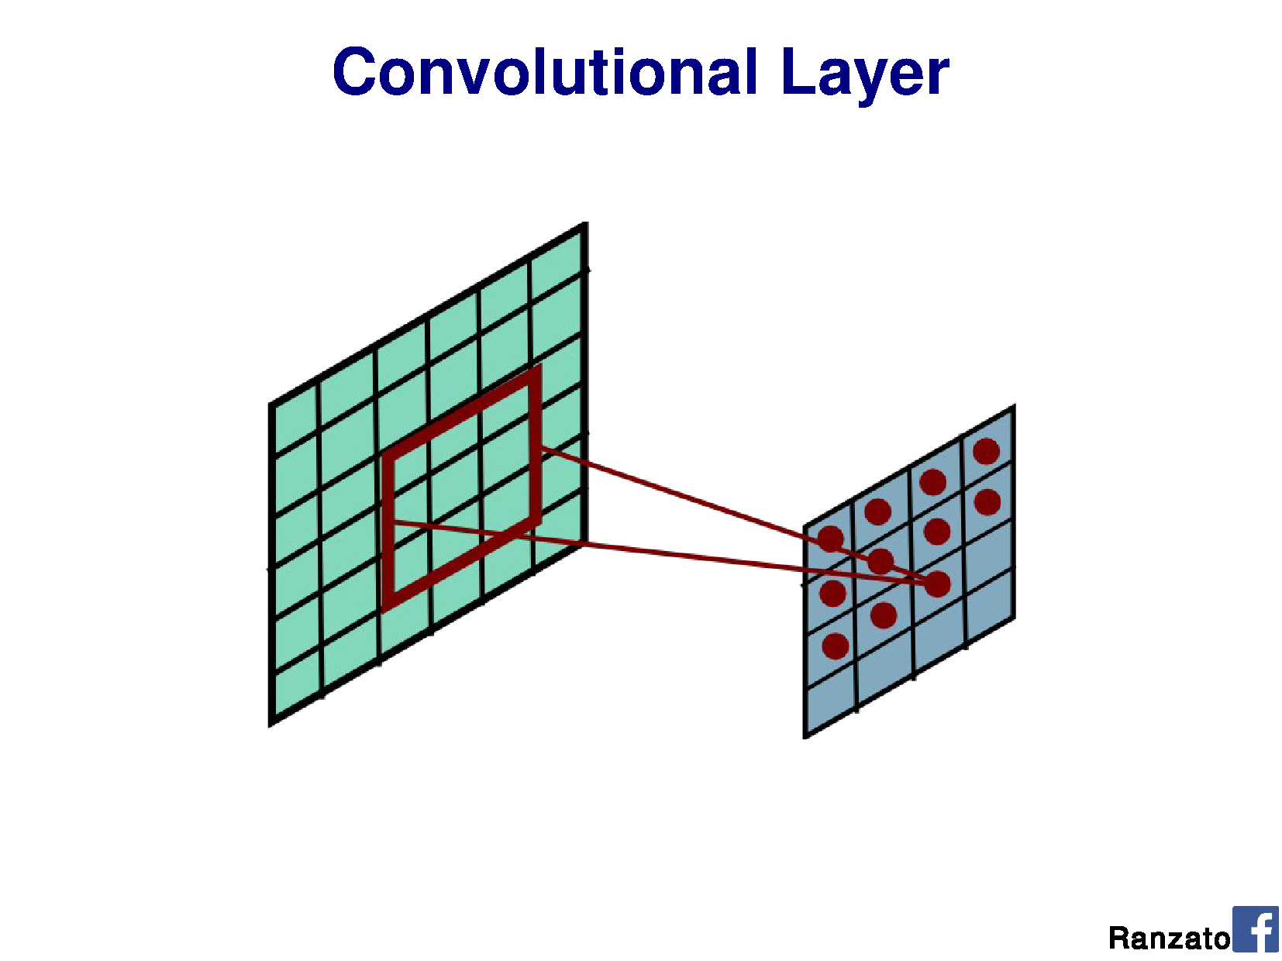

Slide 43
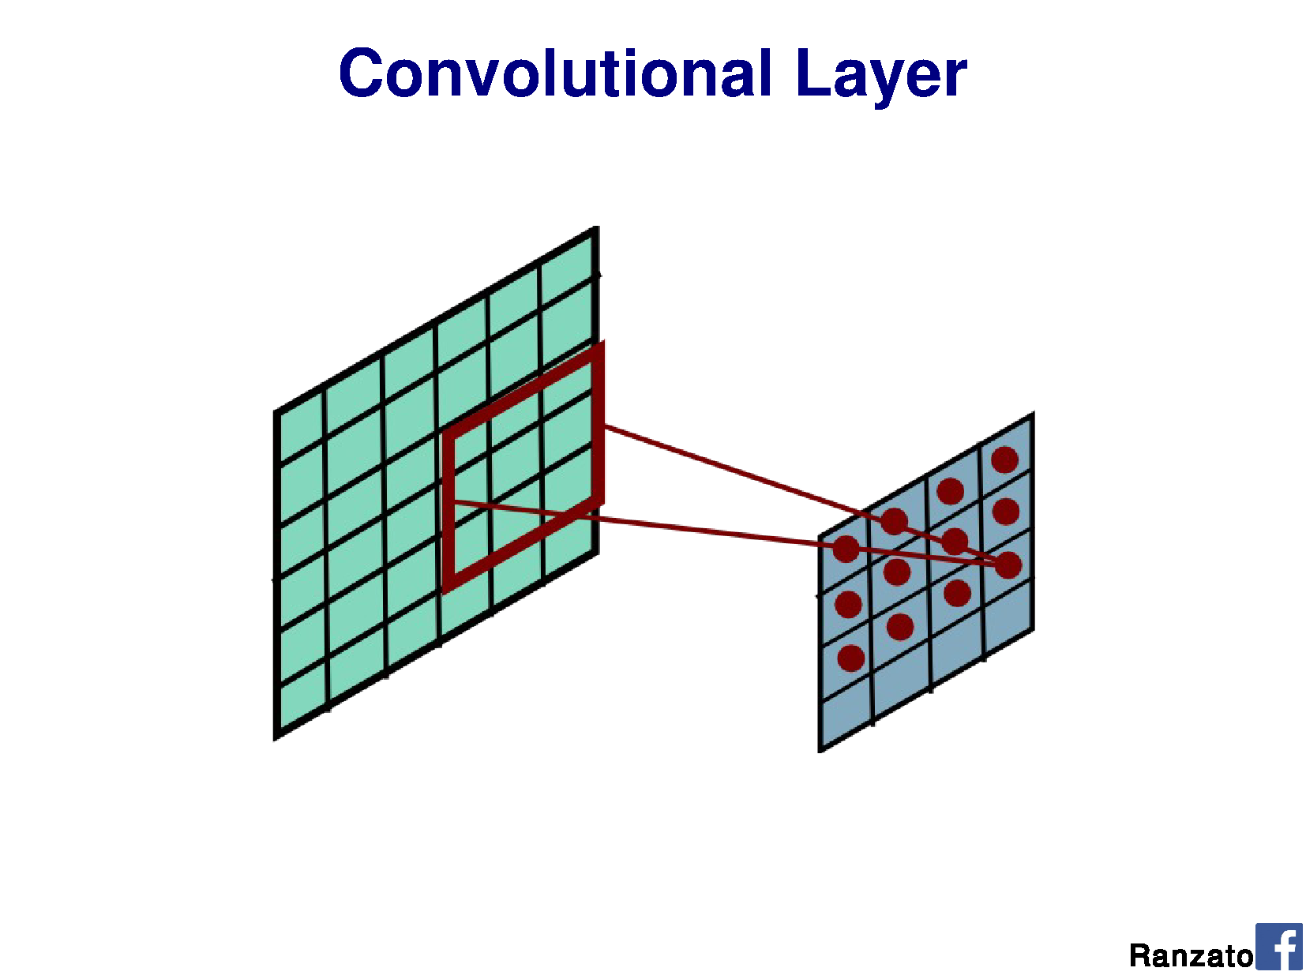

Slide 44


Slide 45


Slide 46
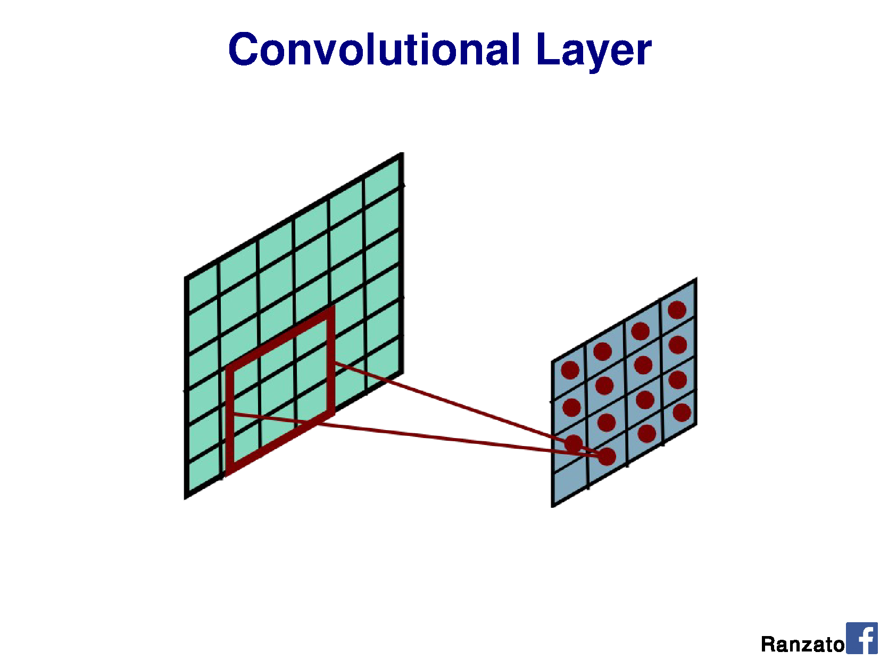

Slide 47
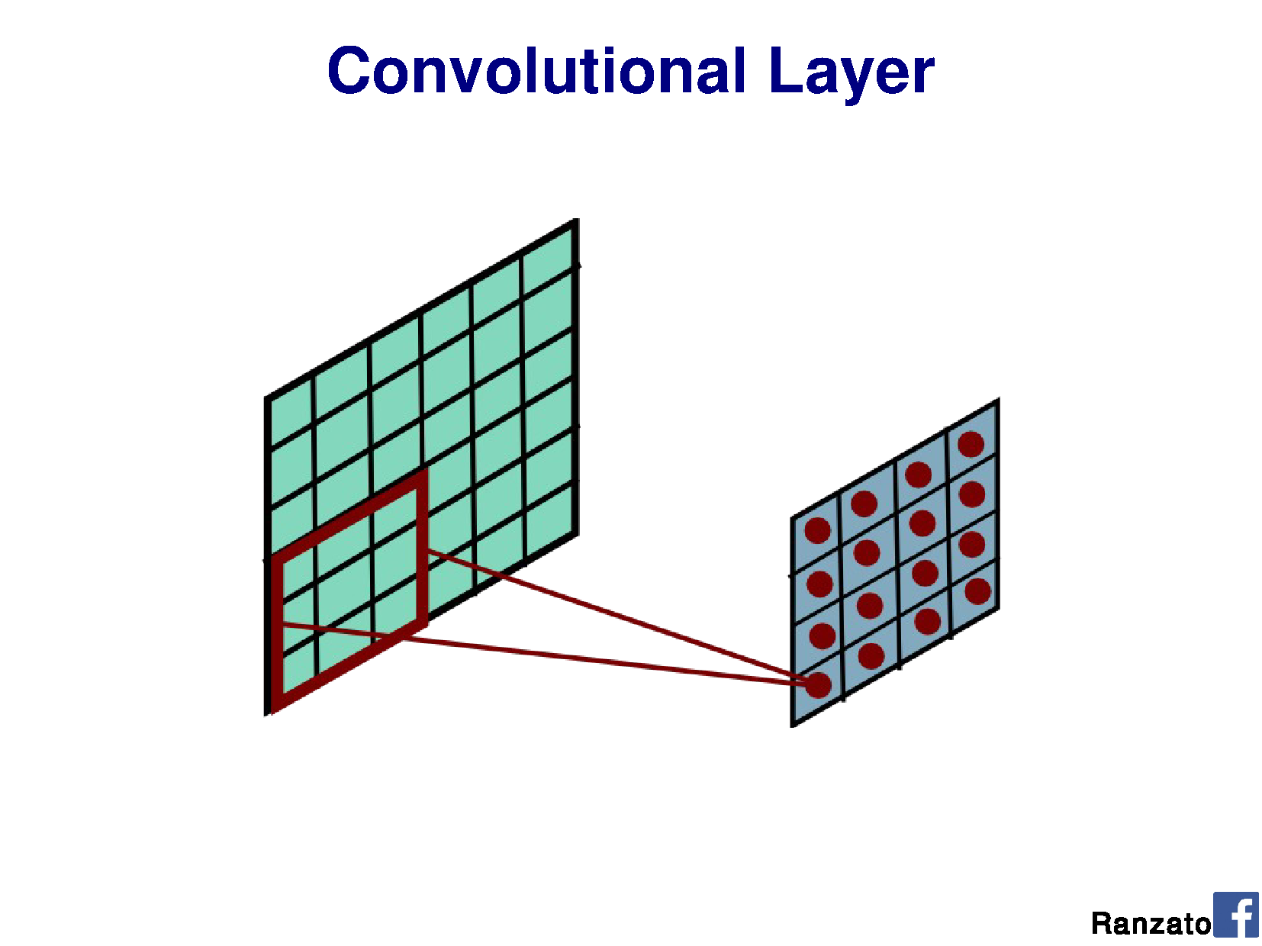

Slide 48
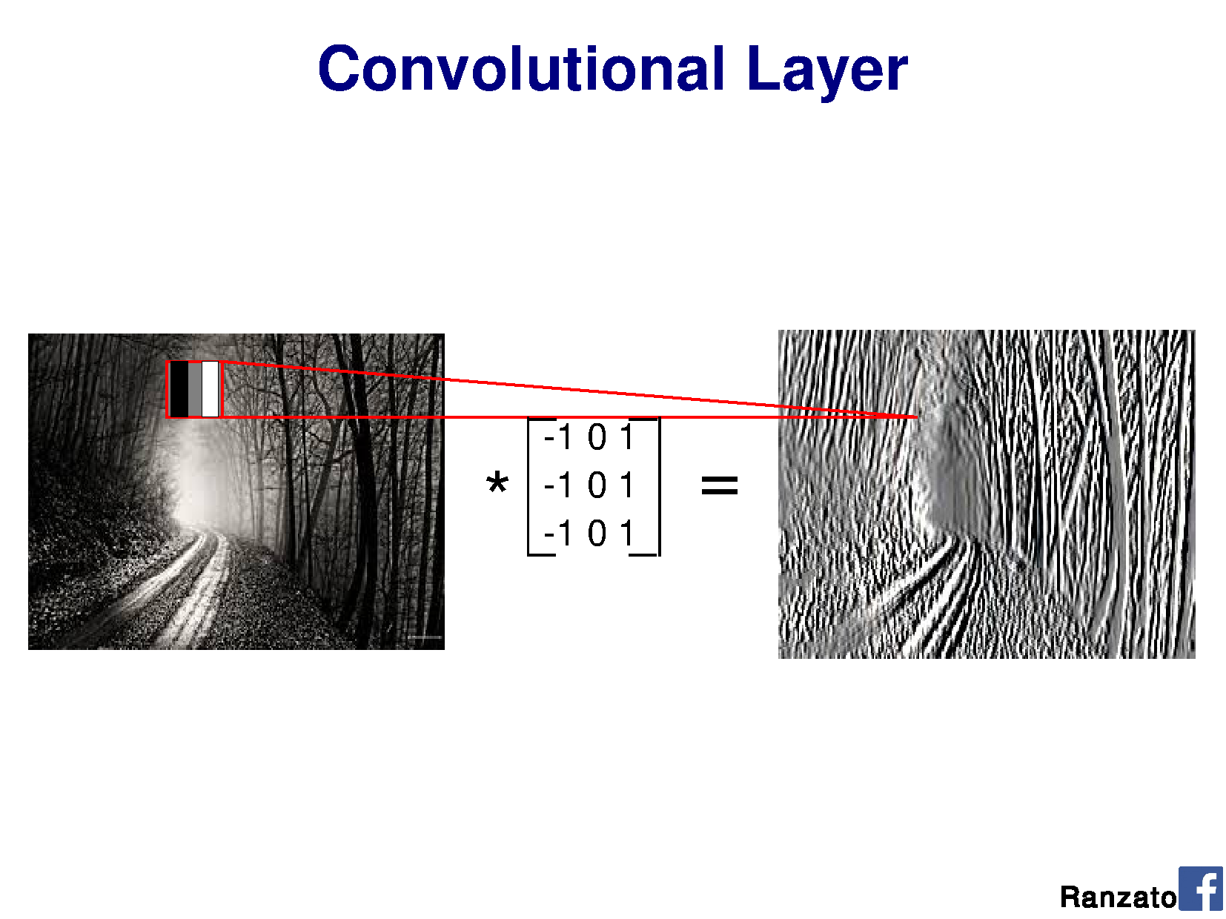
v
v
v
Shared weights
v
Notes:
Output should be a little smaller, as we aren’t padding

Slide 49
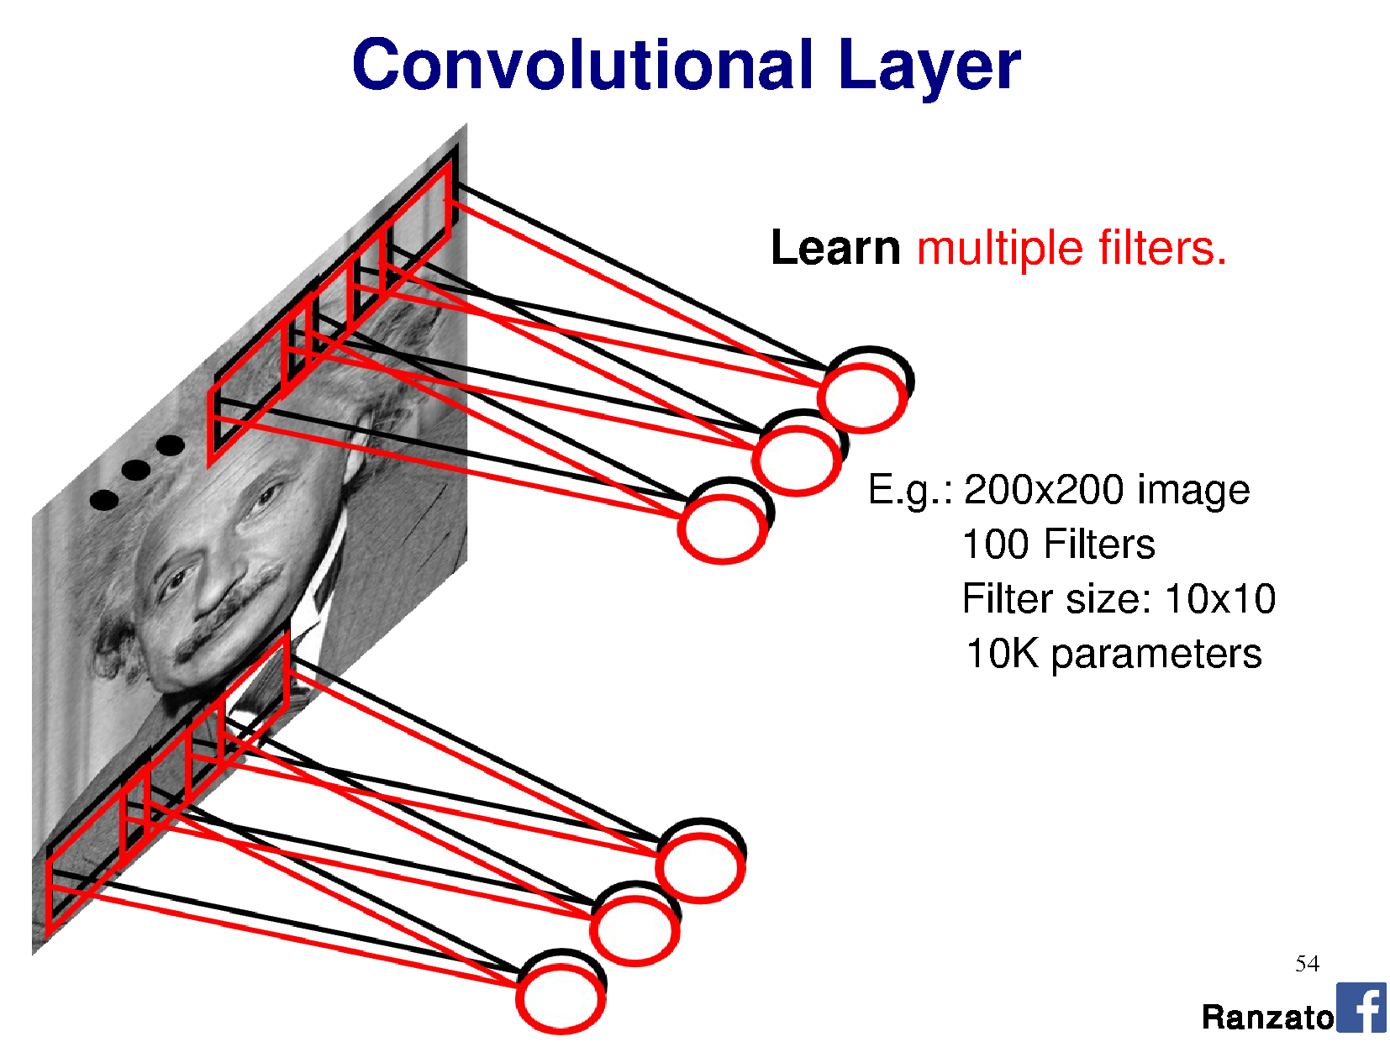
Filter = ‘local’ perceptron.
Also called kernel.
Notes:
This is the major trick.
For each layer of the neural network, we’re going to learn multiple filters.

Slide 51
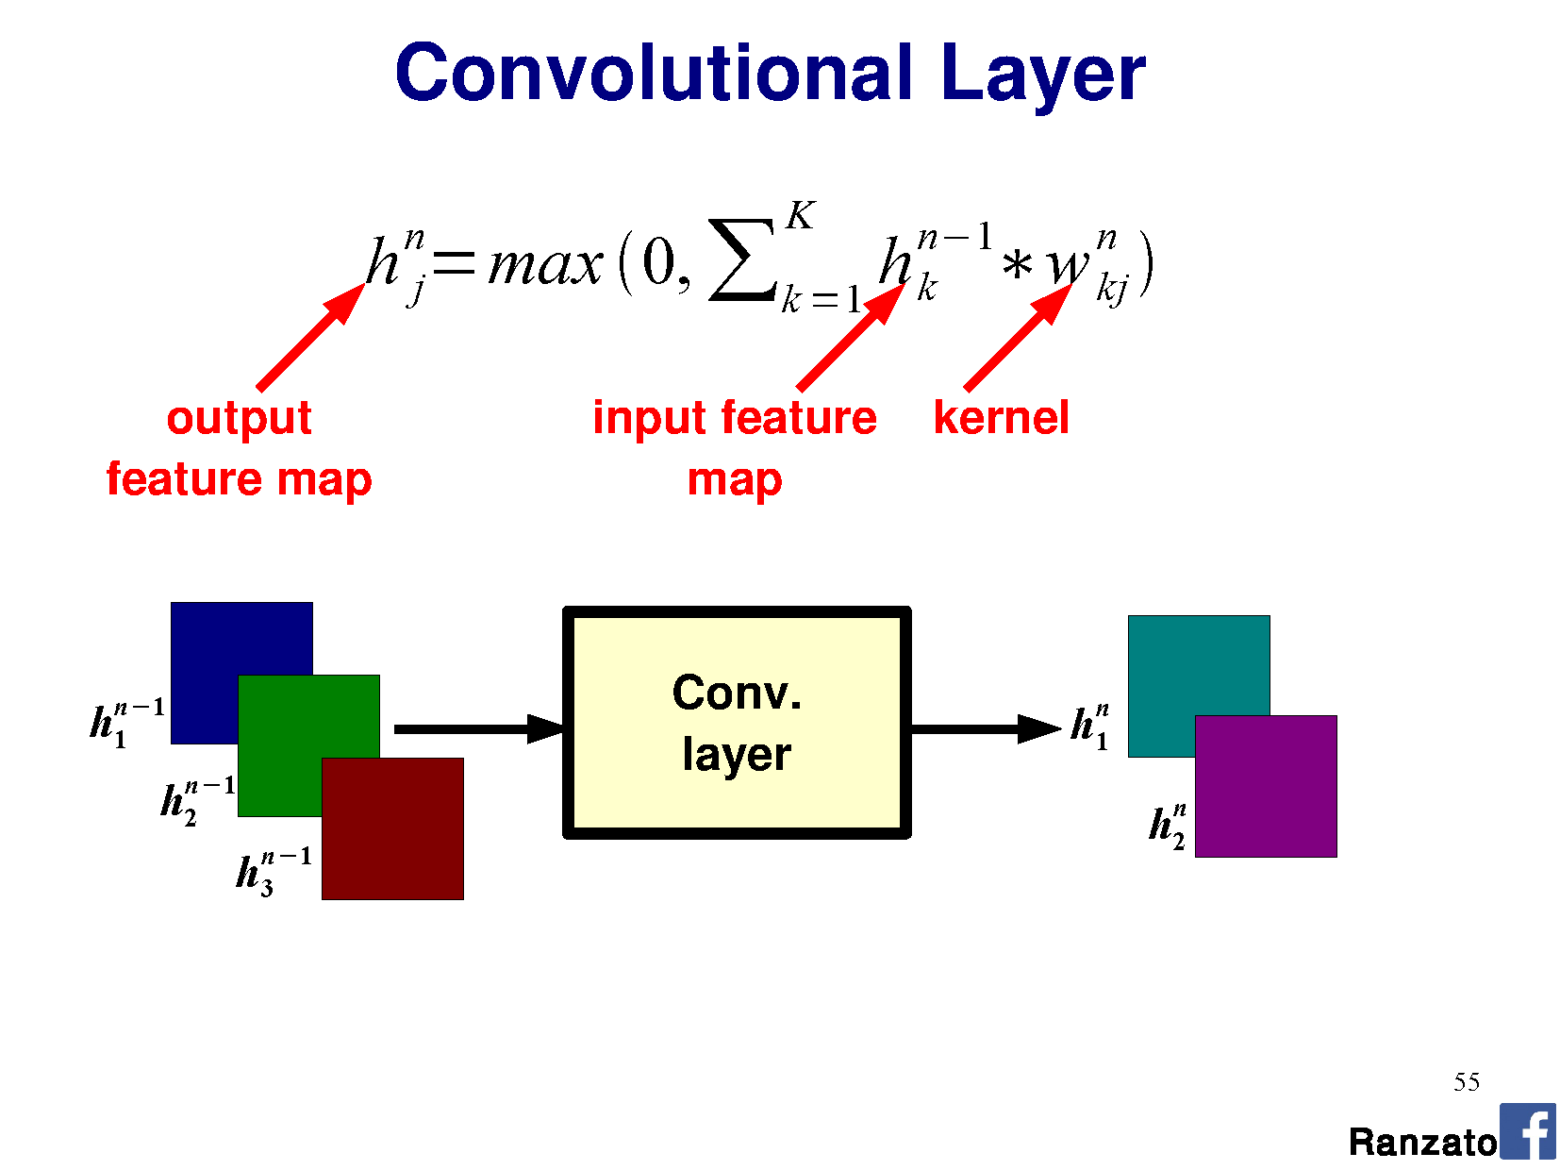
n = layer number
K = kernel size
j = # channels (input)
or # filters (depth)

Slide 52
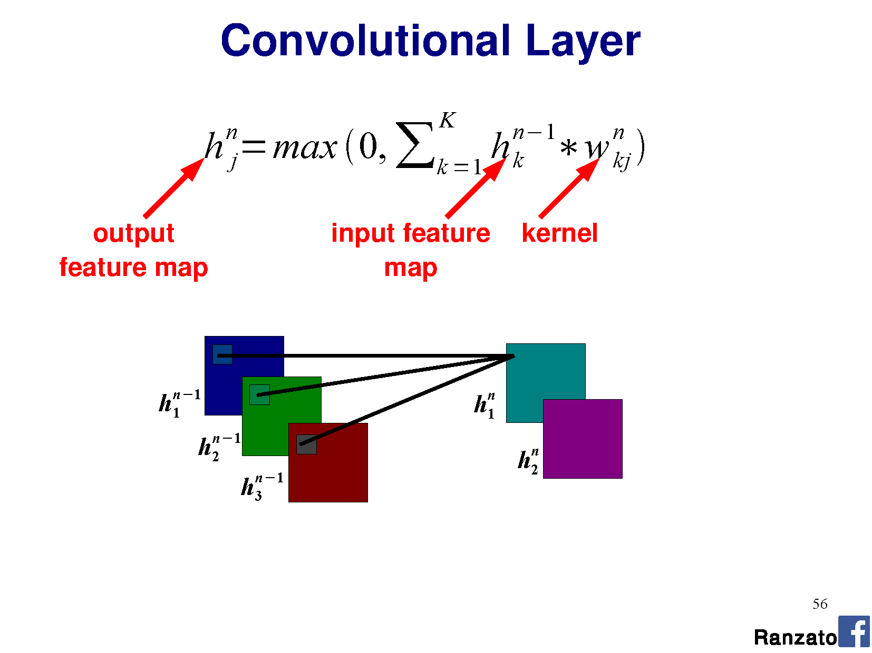

Slide 53
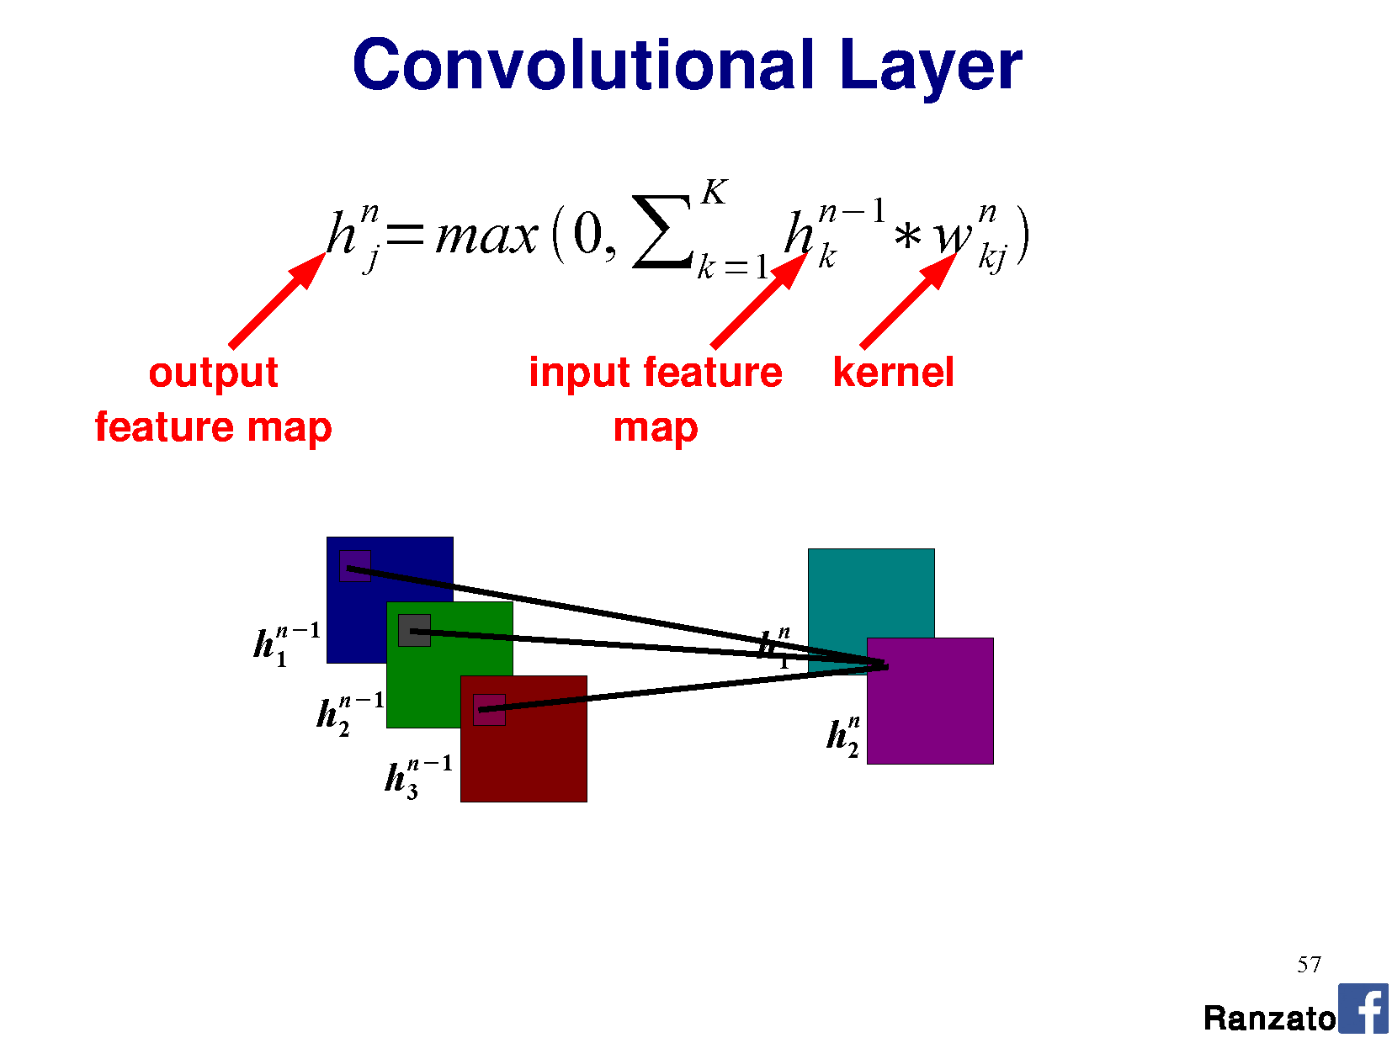

Slide 54
Stride = 1

Slide 55
Stride = 1

Slide 56
Stride = 3

Slide 57
Stride = 3

Slide 58
Stride = 3

Slide 59
Stride = 3

Slide 60
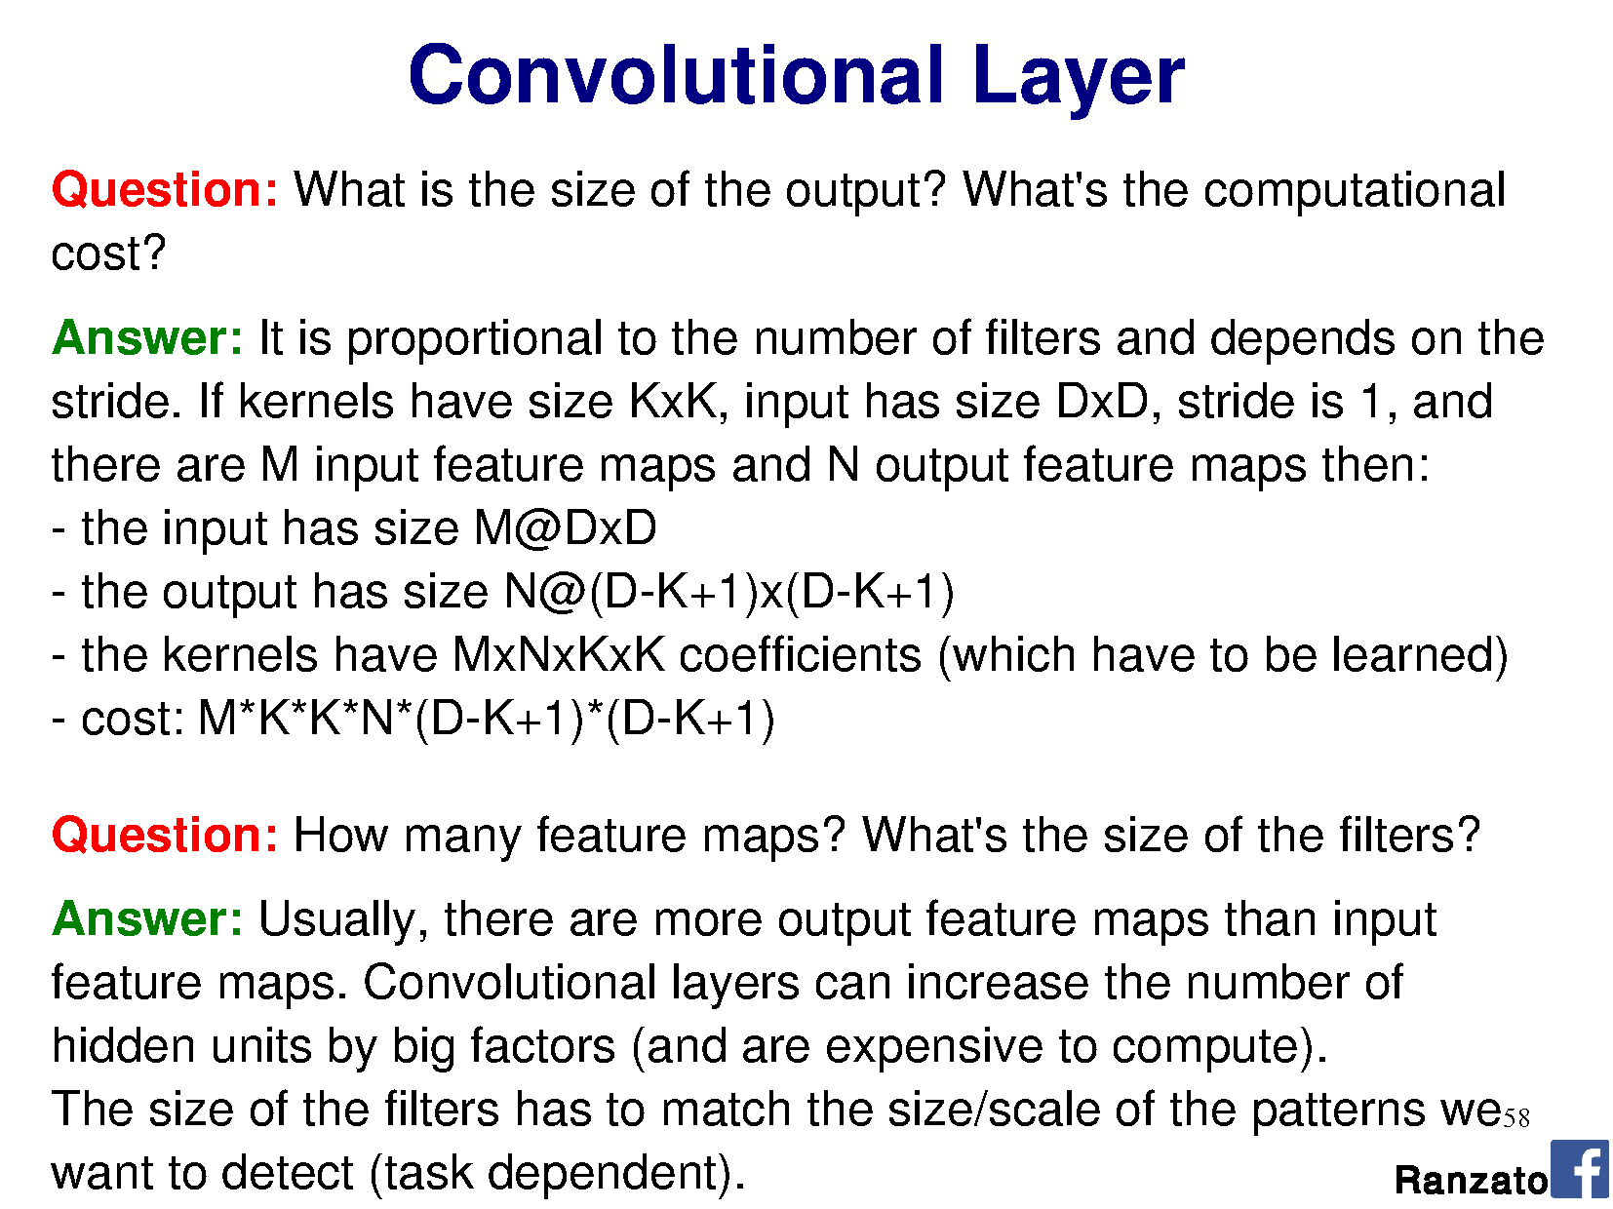

Slide 62
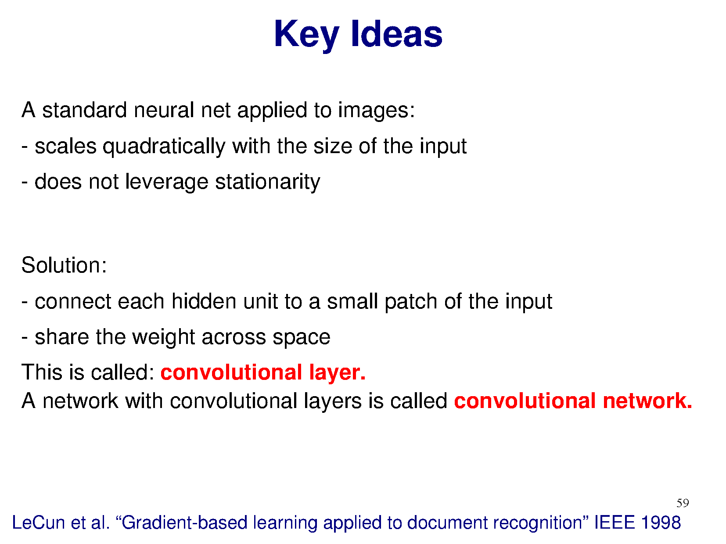

Slide 63
- add multiple filters per layer

Slide 64
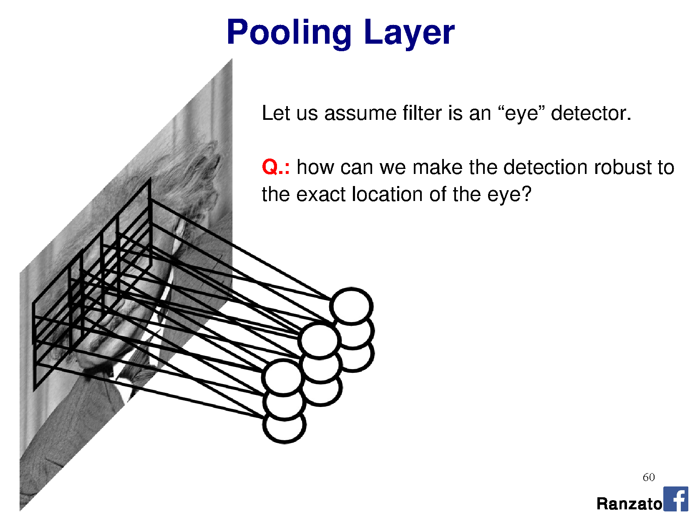

Slide 65
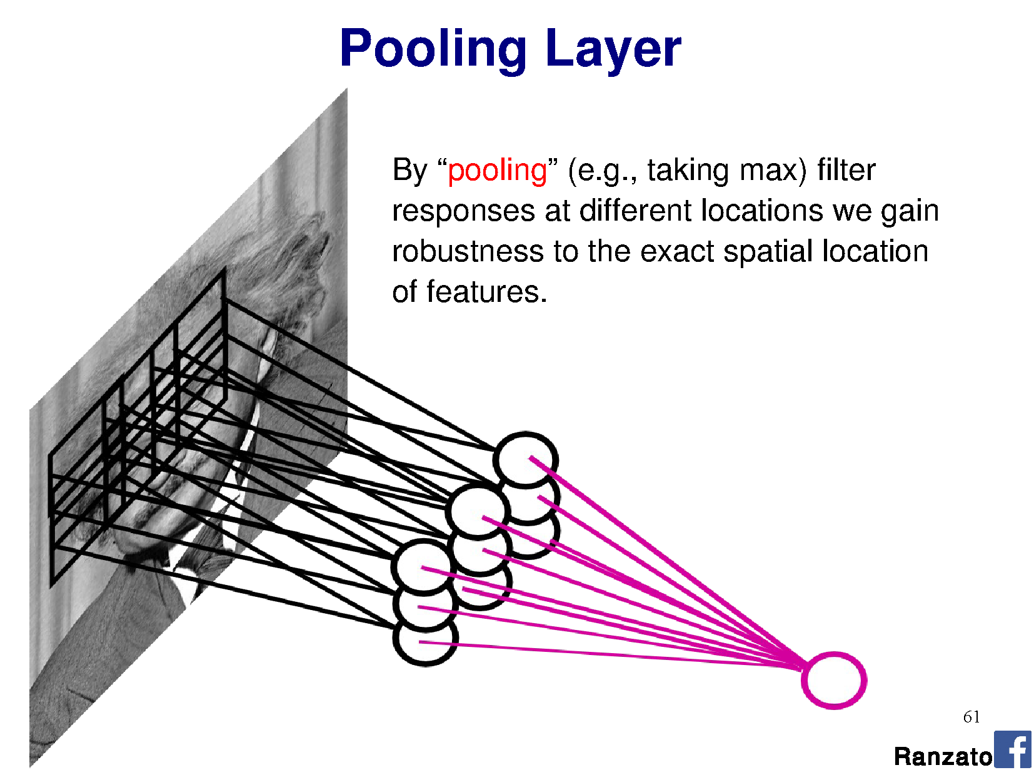
By pooling responses at different locations,
we gain robustness to the exact spatial location of image features.

Slide 66
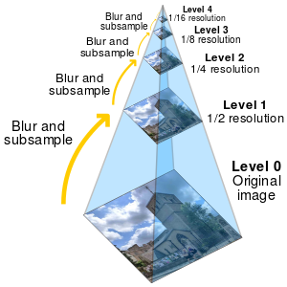
Pooling is similar to downsampling
…except sometimes we don’t want to blur,
as other functions might be better for classification.

Slide 67
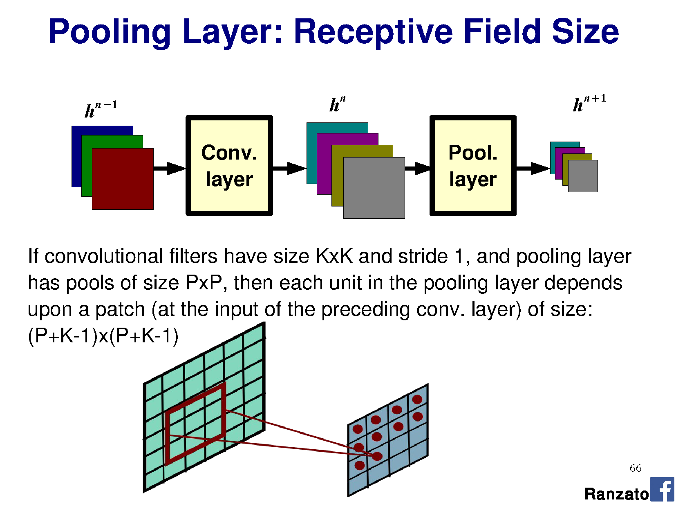

Slide 68
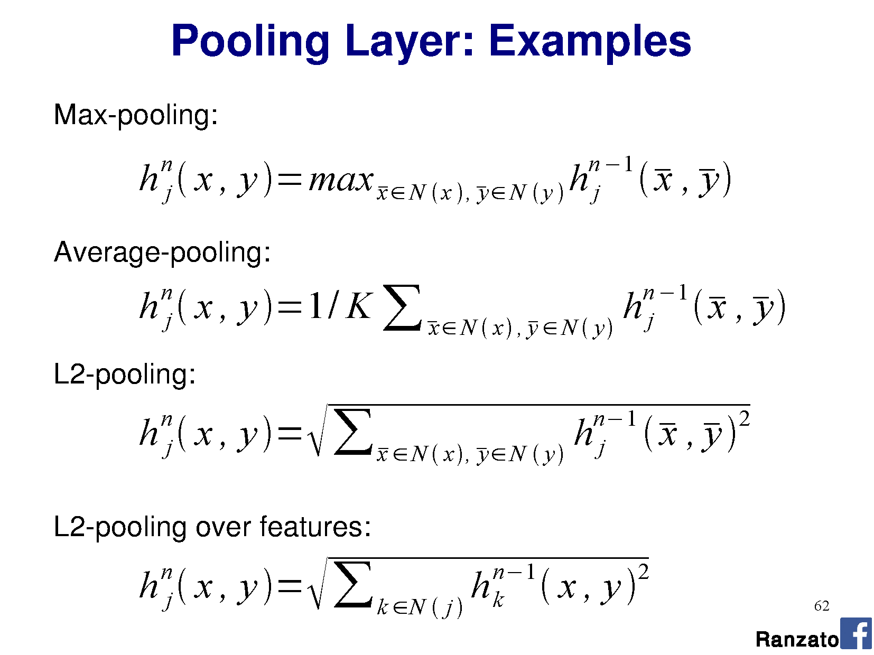

Slide 69
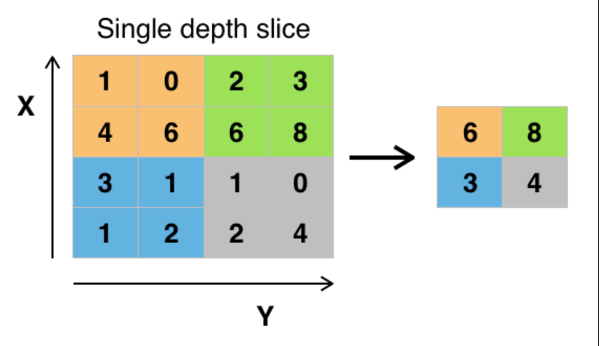
Max pooling
Wikipedia

Slide 71
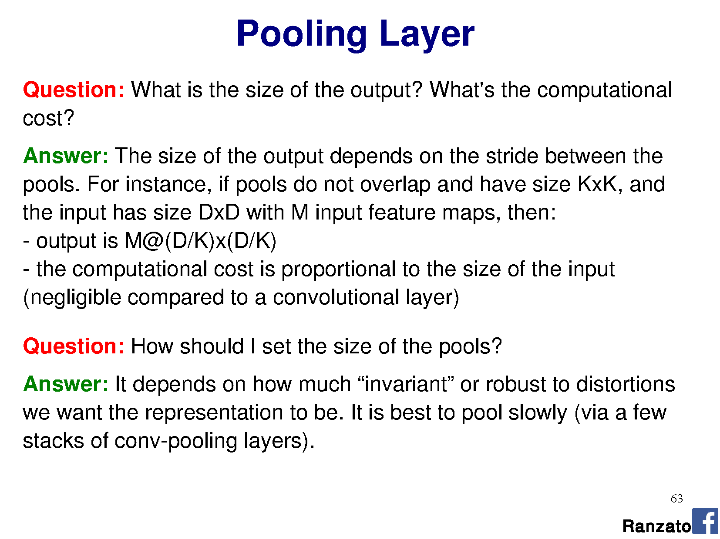

Slide 72


Slide 73


Slide 75


Slide 76


Slide 77


Slide 78

N(x,y) = model pixel values in window as a normal distribution
m = mean
σ = variance

Slide 80


Slide 81


Slide 82


Slide 83


Slide 84


Slide 85

Yann LeCun’s MNIST CNN architecture

Slide 86


Slide 88
a multi-layer perceptron (‘fully connected layers’).

Slide 89
a multi-layer perceptron (‘fully connected layers’).

Slide 90


Slide 91


Slide 92


Slide 93


Slide 94


Slide 95


Slide 96


Slide 97


Slide 98


Slide 99


Slide 100

Notes:
Stride 1
Stride 2
Stride 3

Slide 101

Our connectomics diagram
Auto-generated from network declaration by nolearn (for Lasagne / Theano)
Input
75x75x4
Conv 1
3x3x4
64 filters
Conv 2
3x3x64
48 filters
Conv 3
3x3x48
48 filters
Conv 4
3x3x48
48 filters
Max pooling
2x2 per filter
Max pooling
2x2 per filter
Max pooling
2x2 per filter
Max pooling
2x2 per filter
Notes:
https://github.com/dnouri/nolearn
More details: https://people.cs.pitt.edu/~kovashka/cs2750_sp17/ml_11_cnns.pdf

Slide 102

Reading architecture diagrams
Layers
Kernel sizes
Strides
# channels
# kernels
Max pooling

Slide 103

AlexNet diagram (simplified)
[Krizhevsky et al. 2012]
Input size
227 x 227 x 3
227
227
3x3
Stride 2
3x3
Stride 2
Conv 1
11 x 11 x 3
Stride 4
96 filters
Conv 2
5 x 5 x 48
Stride 1
256 filters
Conv 3
3 x 3 x 256
Stride 1
384 filters
Conv 4
3 x 3 x 192
Stride 1
384 filters
Conv 4
3 x 3 x 192
Stride 1
256 filters
Notes:
Input: 227 x 227 x 3 image.
11x11 kernel, stride 4 (AlexNet – 11x11x3 kernels, 96 of them)
5x5 kernel, stride 1, max pool 2x2 (AlexNet – 5x5x48 kernels, 256 of them)
3x3 kernels, (AlexNet – 3x3x256 kernels, 384 of them)
3x3 kernels (AlexNet – 3x3x192 kernels, 384 of them)
3x3 kernels, (AlexNet – 3x3x192 kernels, 256 of them)
FC – 2048 neurons
FC – 2048 neurons
Output – 1000 neurons

Slide 104

AlexNet diagram
Input size
227 x 227 x 3
227
227
Conv
11 x 11 x 3
Stride 4
48 filters
[Krizhevsky et al. 2012]
Notes:
Input: 227 x 227 x 3 image.
11x11 kernel, stride 4 (AlexNet – 11x11x3 kernels, 96 of them)
5x5 kernel, stride 1, max pool 2x2 (AlexNet – 5x5x48 kernels, 256 of them)
3x3 kernels, (AlexNet – 3x3x256 kernels, 384 of them)
3x3 kernels (AlexNet – 3x3x192 kernels, 384 of them)
3x3 kernels, (AlexNet – 3x3x192 kernels, 256 of them)
FC – 2048 neurons
FC – 2048 neurons
Output – 1000 neurons

Slide 105


Slide 106


Slide 107


Slide 108


Slide 109


Slide 110


Slide 111


Slide 112


Slide 113


Slide 114


Slide 115


Slide 116


Slide 117


Slide 118


Slide 119


Slide 120


Slide 121


Slide 122


Slide 123


Slide 124


Slide 125


Slide 126

Notes:
FLOPS = just to execute, not train.

Slide 127


Slide 128


Slide 129
Phew!
Friday:
Network training

Slide 130
More ConvNet explanations
https://ujjwalkarn.me/2016/08/11/intuitive-explanation-convnets/

