Slide 1

Notes:
Many slides and slide ideas thanks to Marc'Aurelio Ranzato and Michael Nielson.
http://www.cs.toronto.edu/~ranzato/files/ranzato_CNN_stanford2015.pdf
http://neuralnetworksanddeeplearning.com/

Slide 2
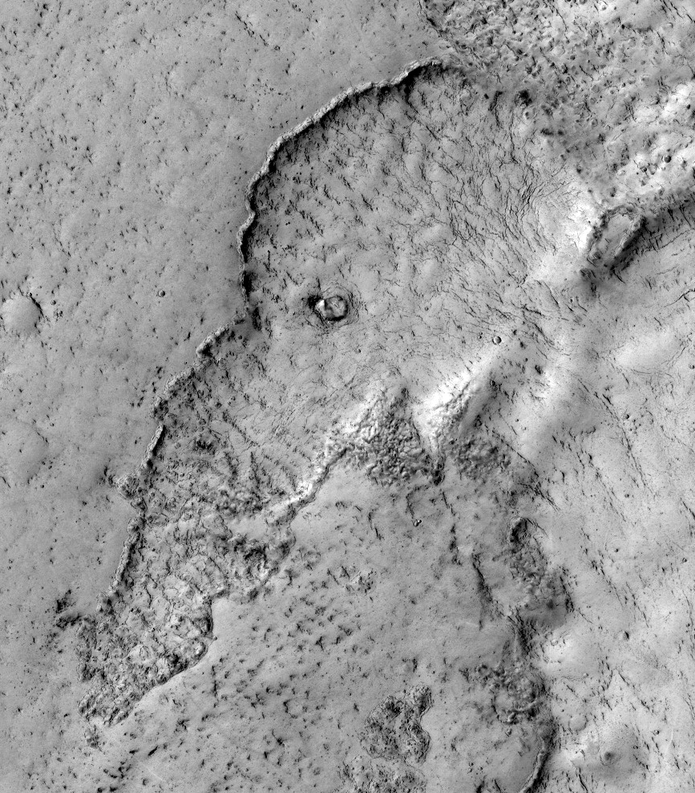
Martian lava field, NASA, Wikipedia
Notes:
https://en.wikipedia.org/wiki/Pareidolia#/media/File:Elephant_on_Mars.jpg

Slide 3
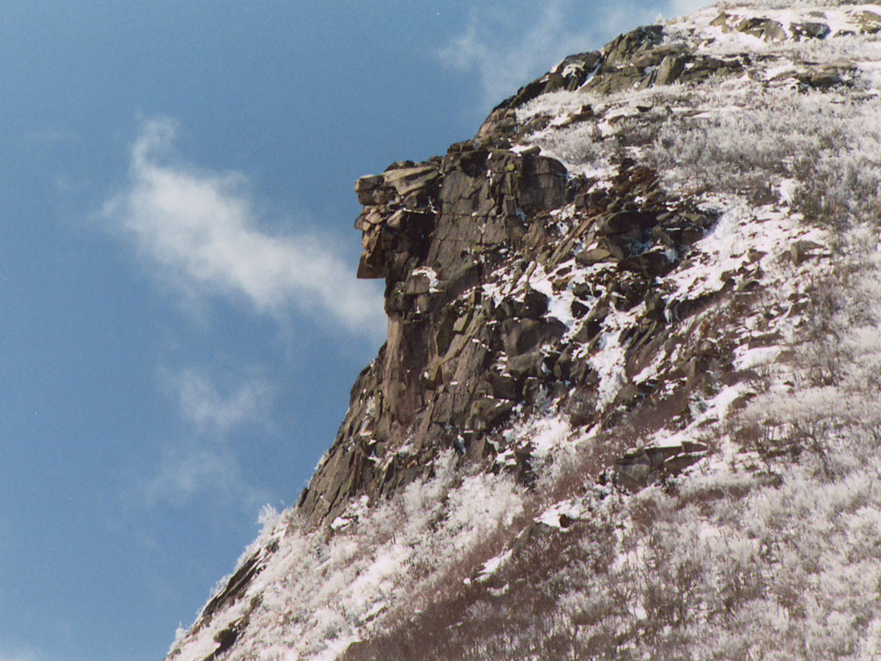
Old Man of the Mountain, Franconia, New Hampshire
Notes:
Now collapsed, 2003.

Slide 4
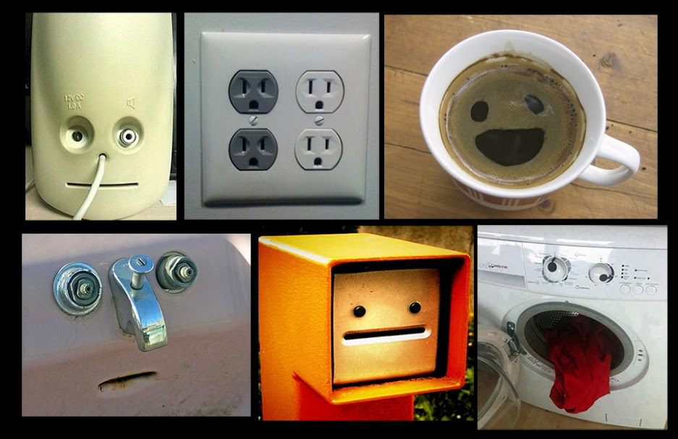
Pareidolia
http://smrt.ccel.ca/2013/12/16/pareidolia/

Slide 5

Reddit for more : )
https://www.reddit.com/r/Pareidolia/top/

Slide 6
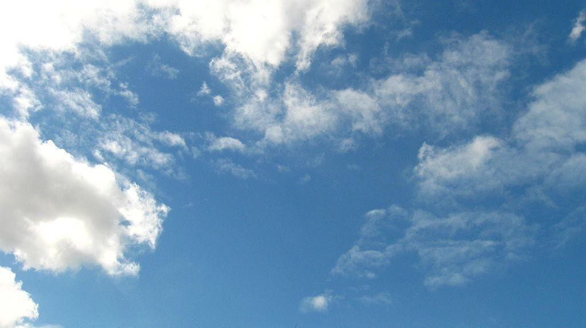
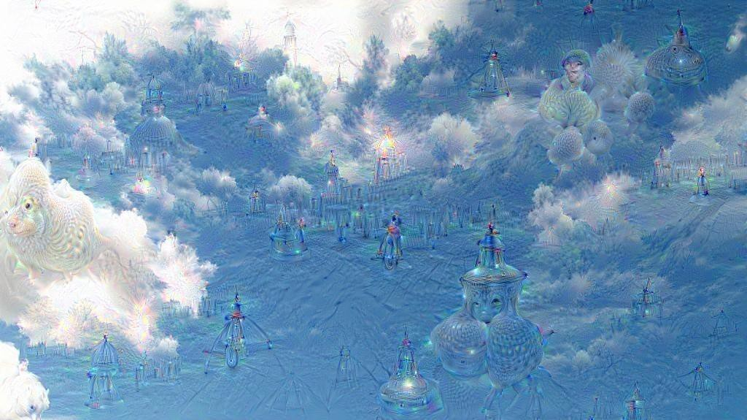
Pareidolia
Seeing things which aren’t really there…
DeepDream as reinforcement pareidolia
Notes:
The word derives from the Greek words para (παρά, "beside, alongside, instead [of]" — in this context meaning something faulty or wrong) and the noun eidōlon (εἴδωλον "image, form, shape" — the diminutive of eidos).
DeepDream is a kind of reinforcement pareidolia
Reddit for more : )
https://www.reddit.com/r/Pareidolia/top/

Slide 7
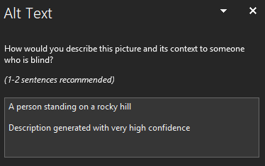
Powerpoint Alt-text Generator
Vision-based
caption generator

Slide 8
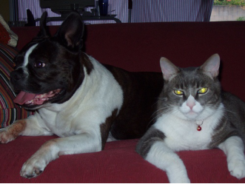
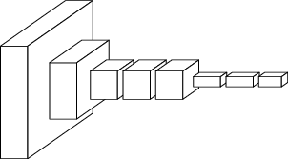
ConvNets perform classification
< 1 millisecond
“tabby cat”
1000-dim vector
end-to-end learning
[Slides from Long, Shelhamer, and Darrell]

Slide 9
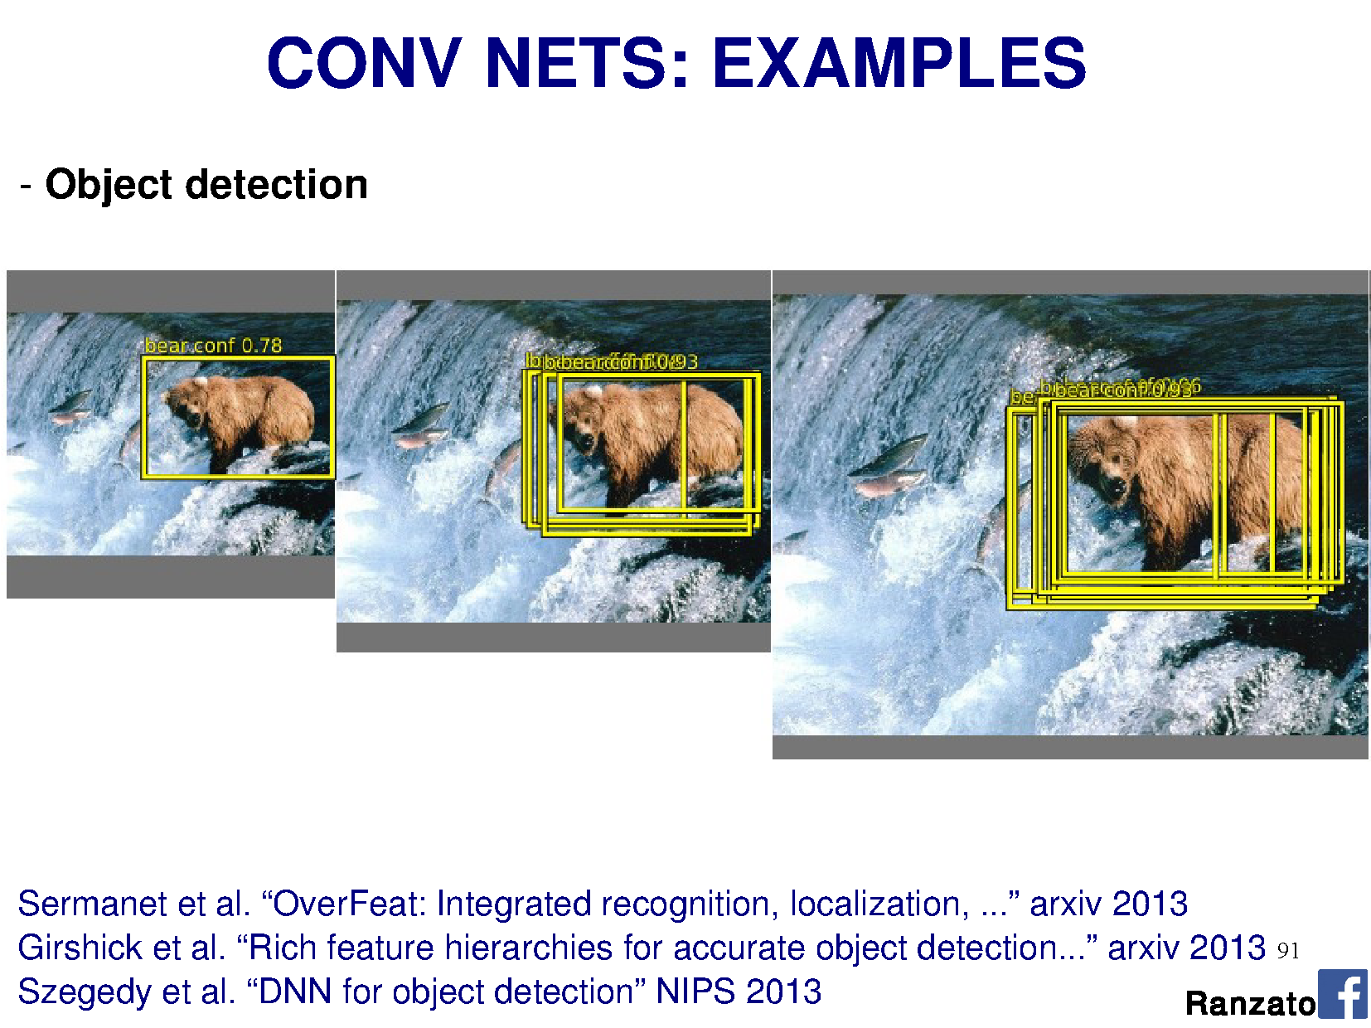

Slide 10
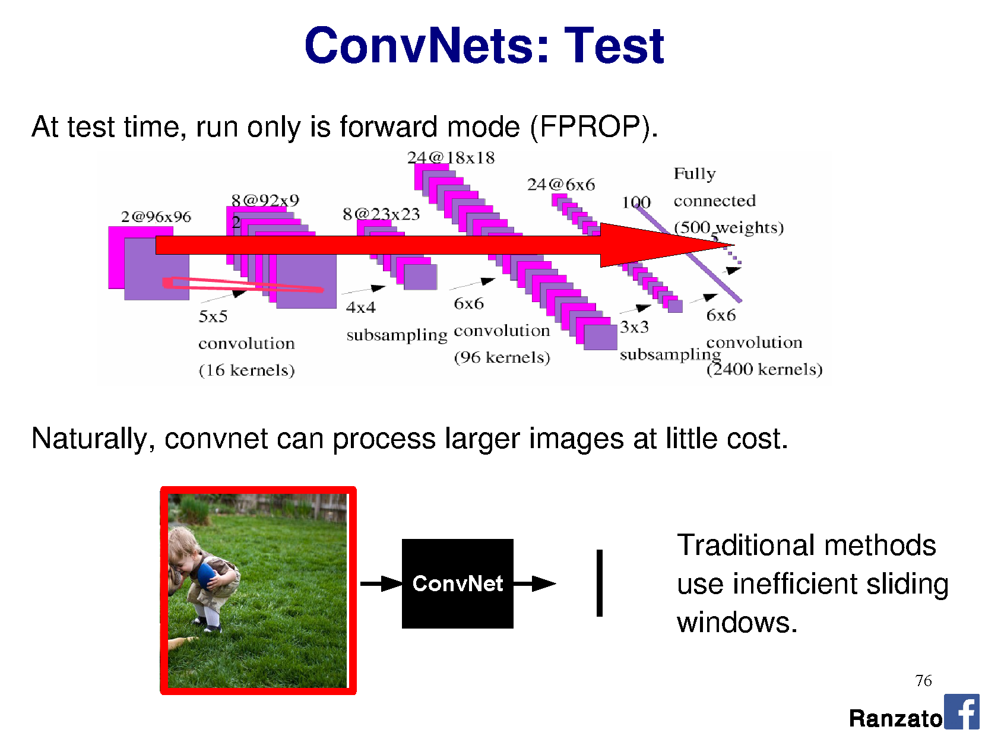

Slide 12
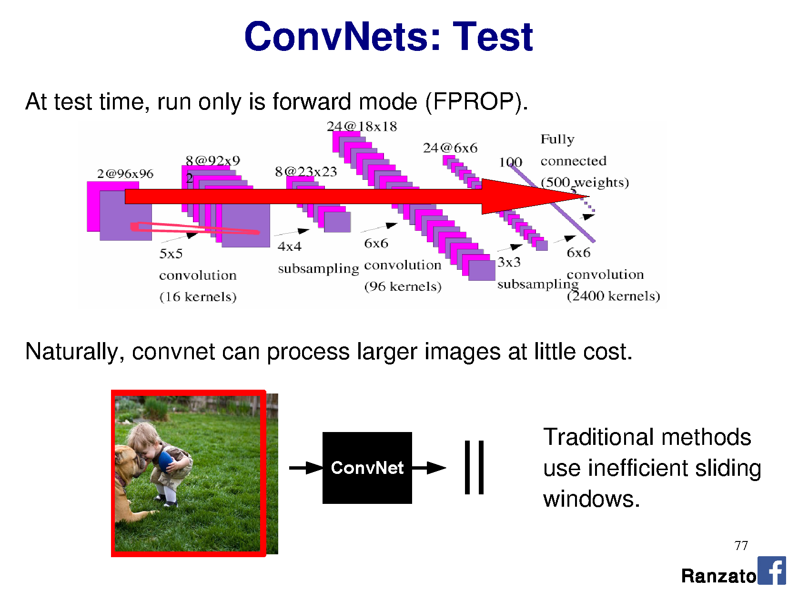

Slide 13
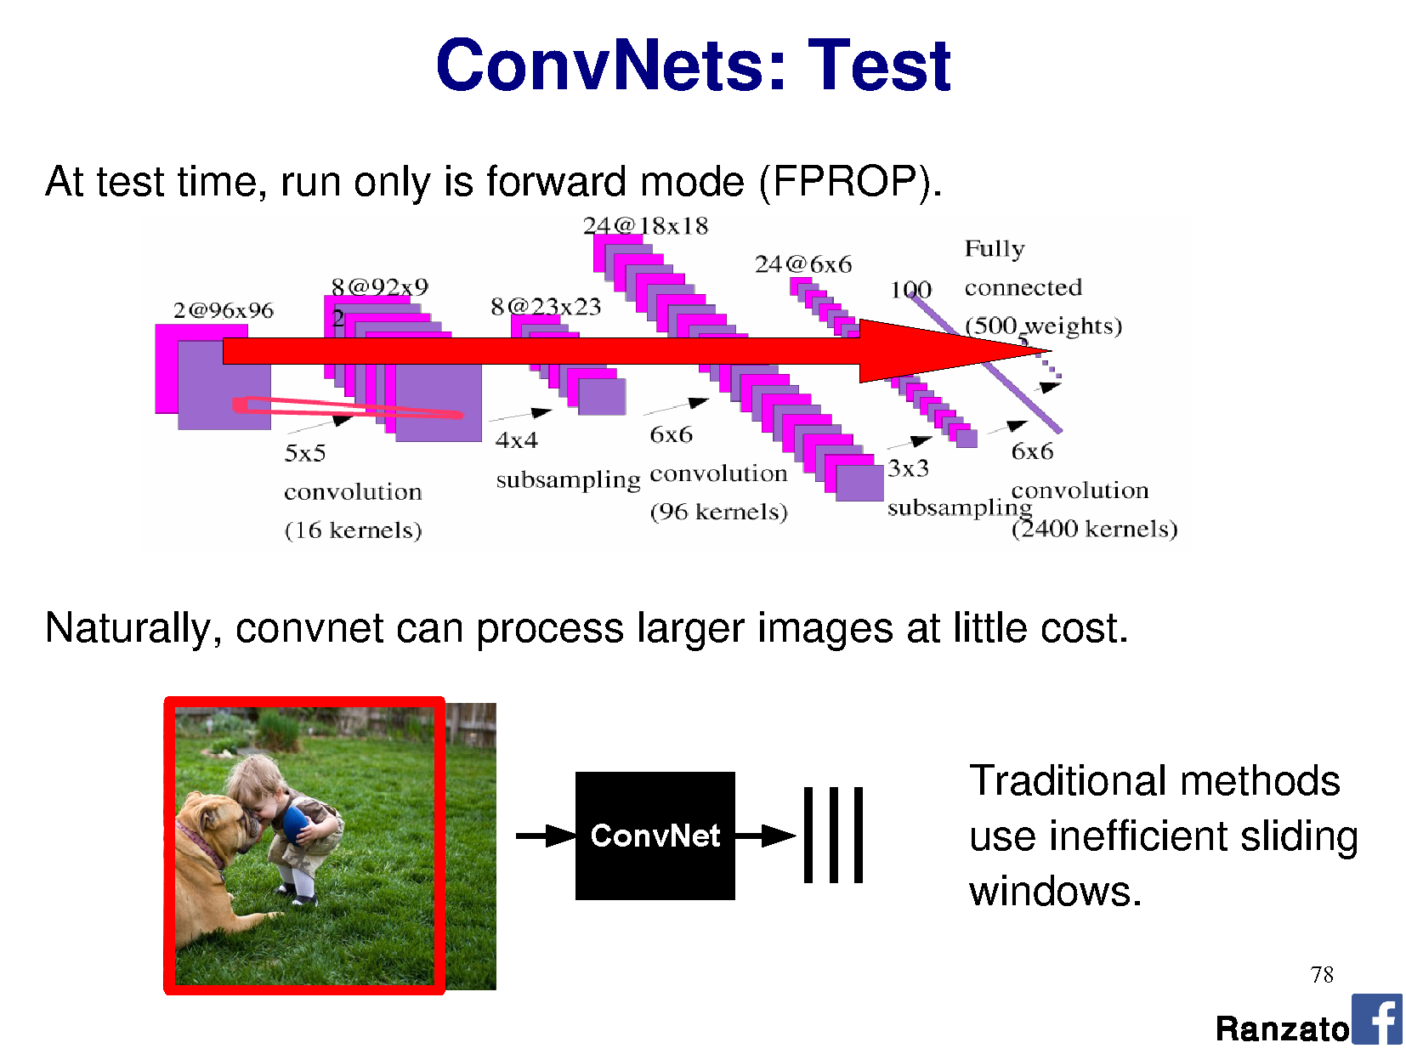

Slide 14
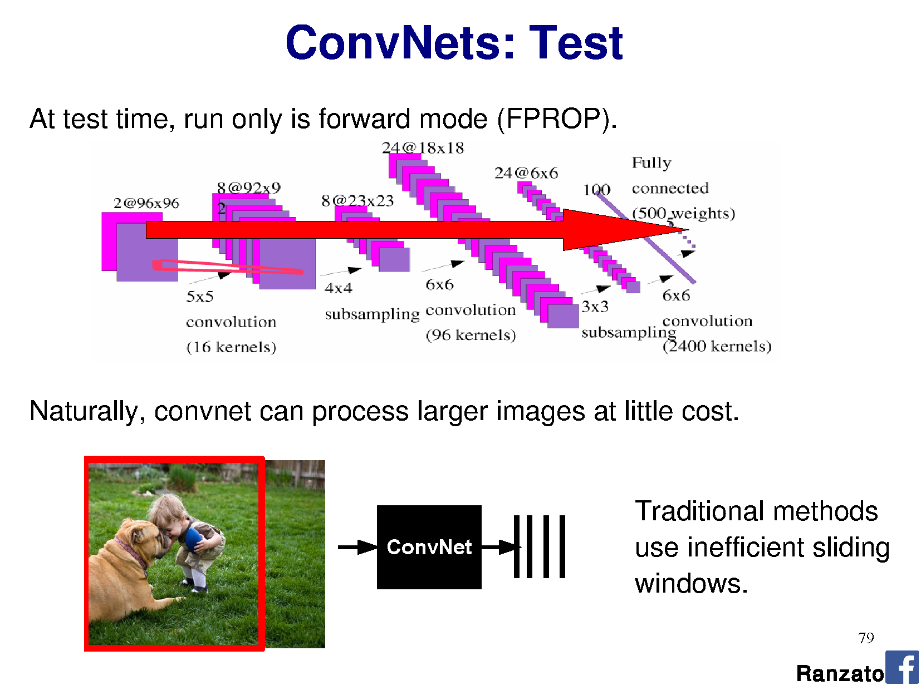

Slide 15
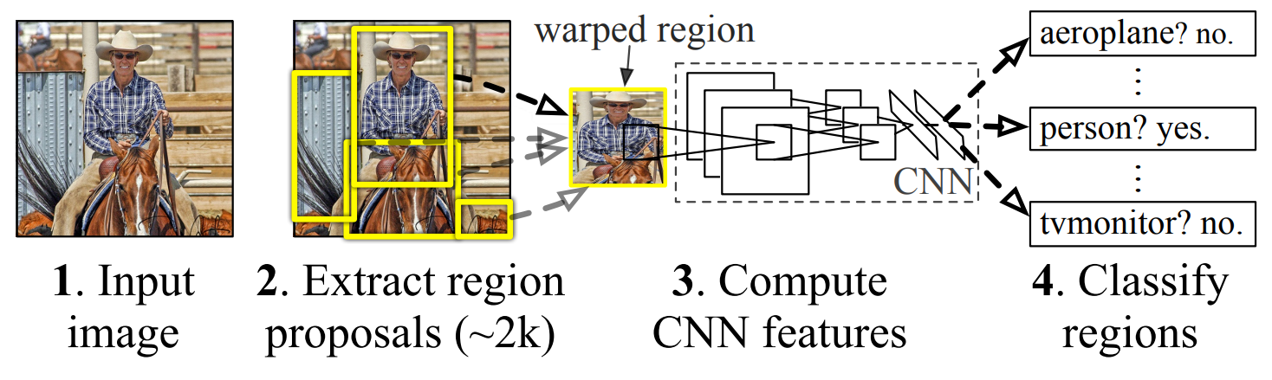
R-CNN: Region-based CNN
Figure: Girshick et al.
Notes:
https://blog.athelas.com/a-brief-history-of-cnns-in-image-segmentation-from-r-cnn-to-mask-r-cnn-34ea83205de4
http://www.cs.cornell.edu/courses/cs7670/2014sp/slides/VisionSeminar14.pdf
Where do the region proposals come from?
Step 3. Uses ‘selection search’ to find fewest bounding boxes with most recall.
Step 3. Features are pre-trained on ImageNet, then fine tuned end to end
Step 4. Classify regions = SVM on features learned from CNN.
I still have to test every region -> still slow.

Slide 16
Stage 2: Efficient region proposals?
Brute force on 1000x1000 = 250 billion rectangles
  Testing the CNN over each one is too expensive
Let’s use B.C. vision! Before CNNs
  Hierarchical clustering for segmentation
Uijlings et al., 2012, Selection Search
Thanks to Song Cao
Notes:
Brute force all shapes and sizes of rectangle over an image = ((m+1) choose 2 ) x ((n+1) choose 2)
B.C. vision = before CNNs

Slide 17
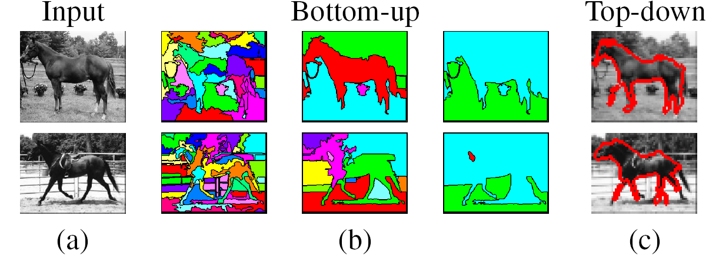
Remember clustering for segmentation?
Oversegmentation
Undersegmentation
Hierarchical Segmentations

Slide 18
Cluster low-level features
Define similarity on color, texture, size, ‘fill’
Greedily group regions together by selecting the pair with highest similarity
  Until the whole image become a single region
Draw a bounding box around each one
  Into a hierarchy
Notes:
http://www.cs.cornell.edu/courses/cs7670/2014sp/slides/VisionSeminar14.pdf
Fill = amount of bounding box full of the region (/ image size)

Slide 19
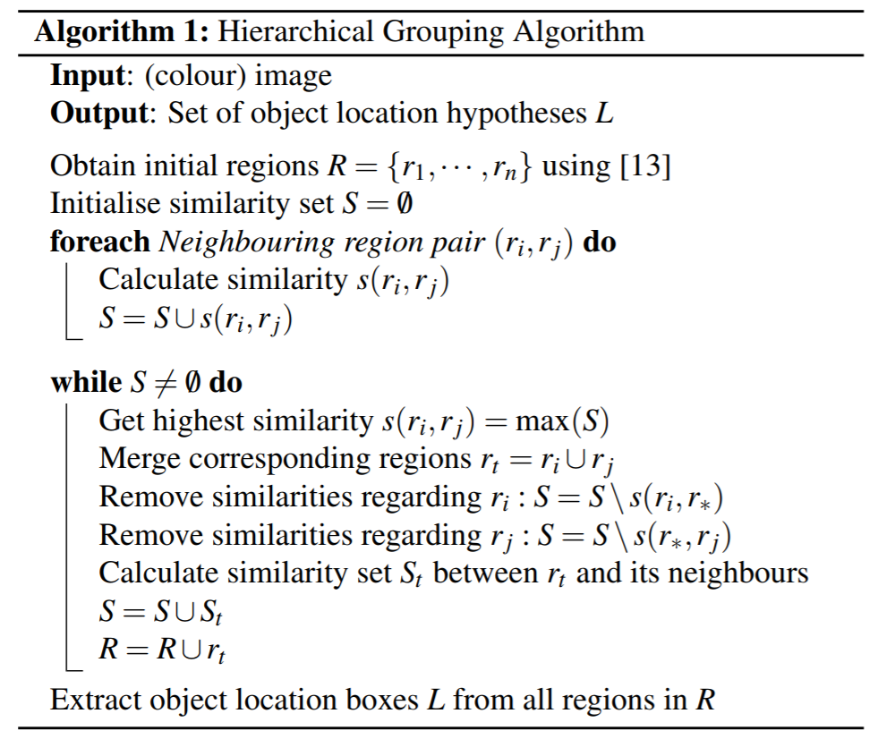
Algorithm
[13] Felzenszwalb and Huttenlocher - Efficient Graph-Based Image Segmentation, IJCV 2004

Slide 20
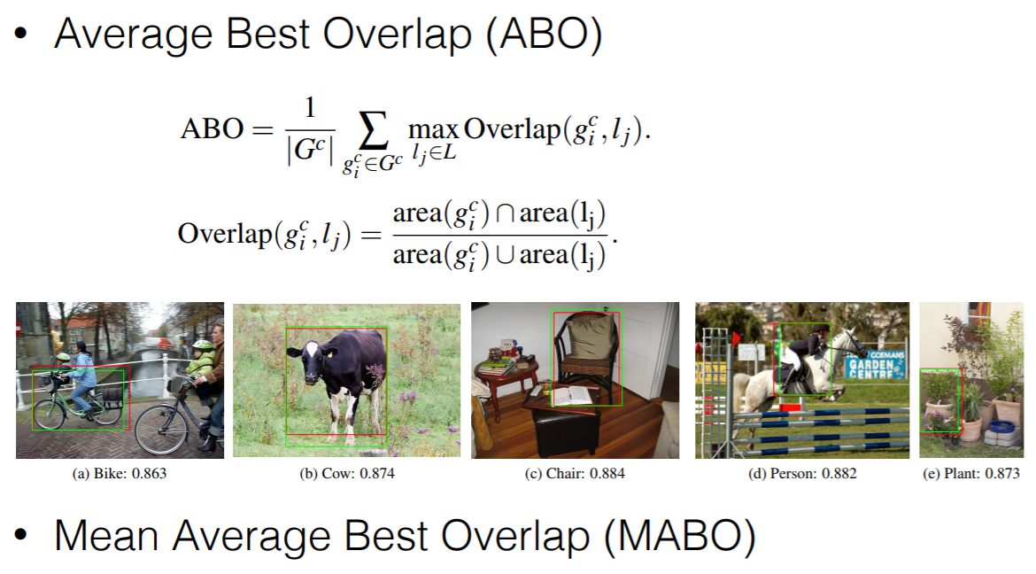
Vs Ground Truth
Thanks to Song Cao
Notes:
http://www.cs.cornell.edu/courses/cs7670/2014sp/slides/VisionSeminar14.pdf

Slide 21
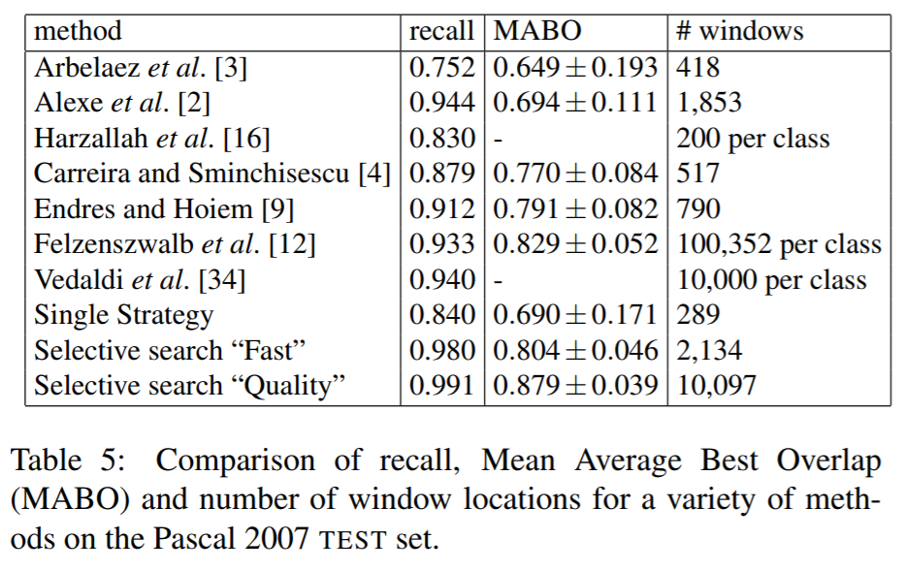
Thanks to Song Cao

Slide 22
R-CNN: Region-based CNN
Figure: Girshick et al.
10,000 proposals with recall 0.991 is better….
but still takes 17 seconds per image to generate them.
Then I have to test each one!
Notes:
https://blog.athelas.com/a-brief-history-of-cnns-in-image-segmentation-from-r-cnn-to-mask-r-cnn-34ea83205de4
http://www.cs.cornell.edu/courses/cs7670/2014sp/slides/VisionSeminar14.pdf
Where do the region proposals come from?
Step 3. Uses ‘selection search’ to find fewest bounding boxes with most recall.
Step 3. Features are pre-trained on ImageNet, then fine tuned end to end
Step 4. Classify regions = SVM on features learned from CNN.
I still have to test every region -> still slow.

Slide 23
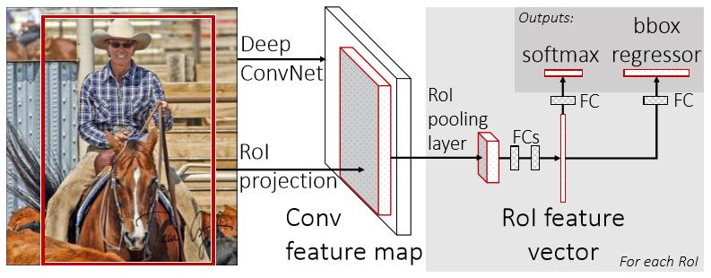
Fast R-CNN
Multi-task loss
RoI = Region of Interest
Figure: Girshick et al.
Notes:
Selection seach itself is slow – 20 seconds per image to generate regions.
Figure 1. Fast R-CNN architecture. An input image and multiple regions of interest (RoIs) are input into a fully convolutional network. Each RoI is pooled into a ﬁxed-size feature map and then mapped to a feature vector by fully connected layers (FCs). The network has two output vectors per RoI: softmax probabilities and per-class bounding-box regression offsets. The architecture is trained end-to-end with a multi-task loss.
Note: Calling your thing ‘fast’ in computing is not descriptive. In three years, it will no longer be fast, and you will look silly.

Slide 24
Fast R-CNN
Convolve whole image into feature map (many layers; abstracted)
For each candidate RoI:
  Squash feature map weights into fixed-size ‘RoI pool’ – adaptive subsampling!
    Divide RoI into H x W subwindows, e.g., 7 x 7, and max pool
  Learn classification on RoI pool with own fully connected layers (FCs)
  Output classification (softmax) + bounds (regressor)
Figure: Girshick et al.
Notes:
Figure 1. Fast R-CNN architecture. An input image and multiple regions of interest (RoIs) are input into a fully convolutional network. Each RoI is pooled into a ﬁxed-size feature map and then mapped to a feature vector by fully connected layers (FCs). The network has two output vectors per RoI: softmax probabilities and per-class bounding-box regression offsets. The architecture is trained end-to-end with a multi-task loss.

Slide 25
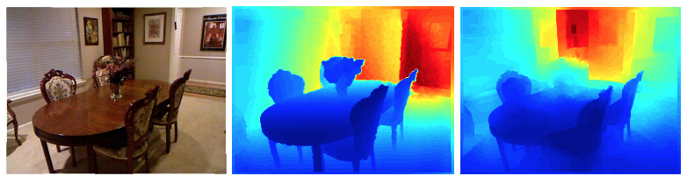

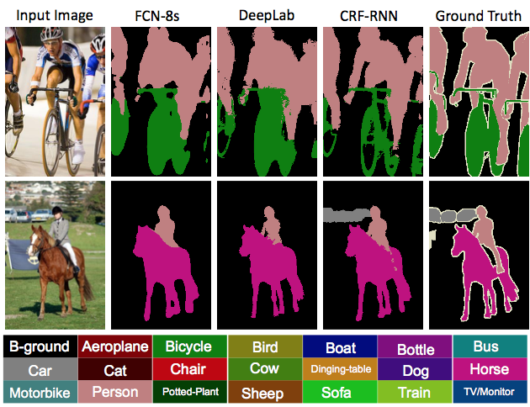
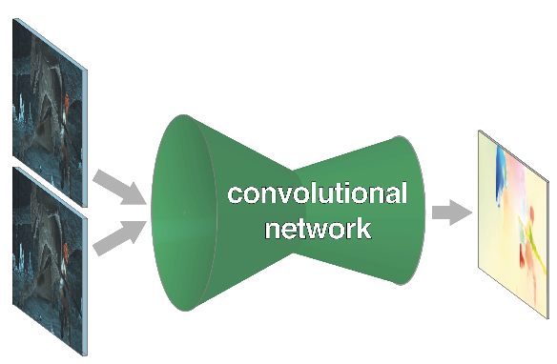
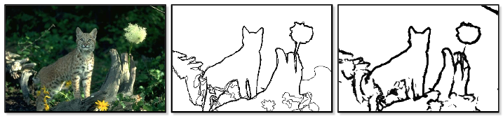
What if we want pixels out?
monocular depth estimation Eigen & Fergus 2015
semantic
segmentation
optical flow Fischer et al. 2015
boundary prediction Xie & Tu 2015
[Long et al.]
Notes:
these networks can not only do semantic segmentation, but many other pixelwise prediction tasks
these could likewise extend to video

Slide 26
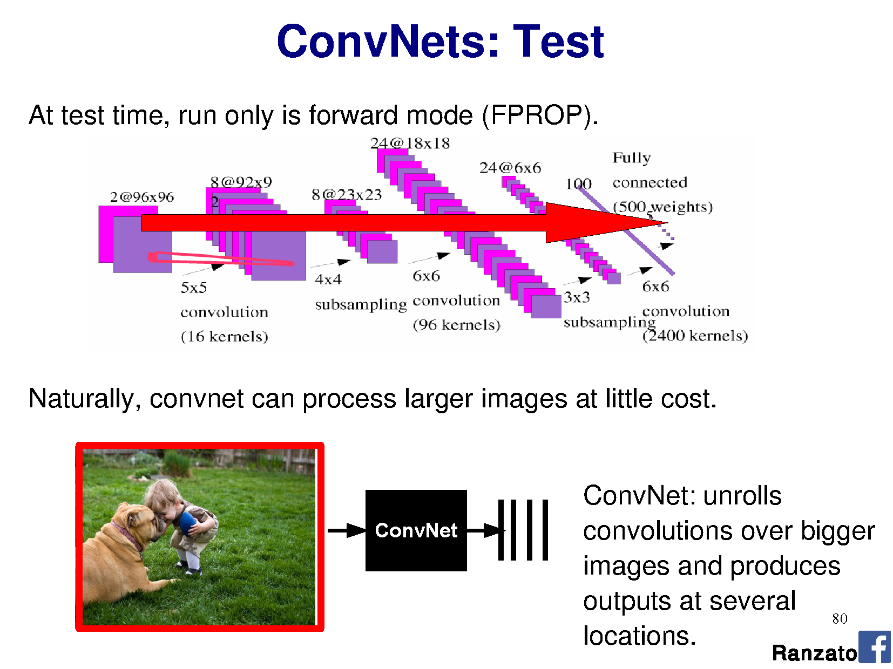

Slide 27
R-CNN does detection
many seconds
R-CNN
“dog”
“cat”
[Long et al.]

Slide 28
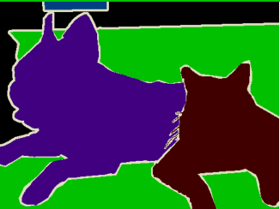
~1/10 second
???
end-to-end learning
[Long et al.]

Slide 29
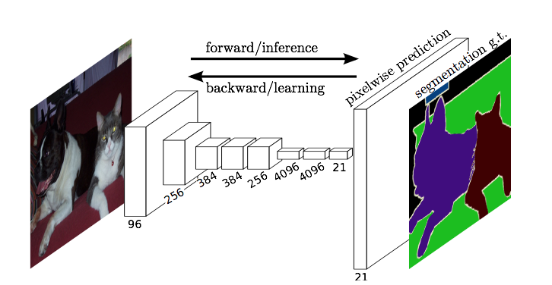
Fully Convolutional Networks for Semantic Segmentation
Jonathan Long* Evan Shelhamer* Trevor Darrell
UC Berkeley
[CVPR 2015] Slides from Long, Shelhamer, and Darrell

Slide 30
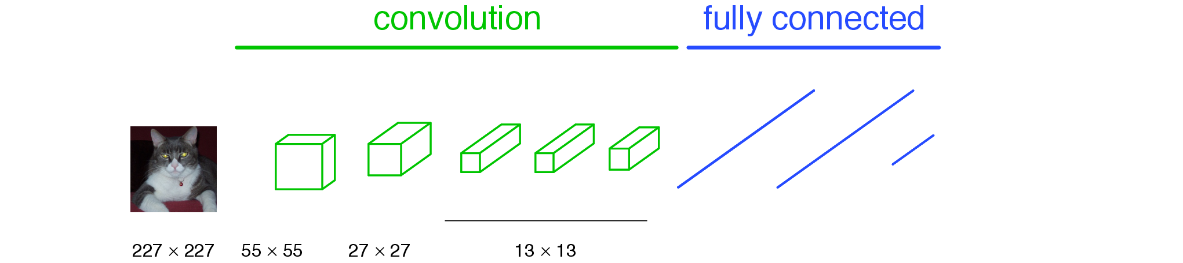
A classification network…
Number of perceptrons in MLP layer, e.g., 1024
Number of filters, e.g., 64
“tabby cat”
[Long et al.]
Notes:
note omissions
“activations”
fixed size input, single label output
desire: efficient per-pixel output

Slide 31

A classification network…
“tabby cat”
[Long et al.]
Notes:
note omissions
“activations”
fixed size input, single label output
desire: efficient per-pixel output

Slide 32
A classification network…
…
“tabby cat”
The response of every kernel across all positions are attached densely to the array of perceptrons in the fully-connected layer.
[Long et al.]
Notes:
note omissions
“activations”
fixed size input, single label output
desire: efficient per-pixel output

Slide 33
A classification network…
…
“tabby cat”
The response of every kernel across all positions are attached densely to the array of perceptrons in the fully-connected layer.
AlexNet: 256 filters over 6x6 response map
Each 2,359,296 response is attached to one of 4096 perceptrons, leading to 37 mil params.
[Long et al.]
Notes:
note omissions
“activations”
fixed size input, single label output
desire: efficient per-pixel output

Slide 34
Problem
We want a label at every pixel
Current network gives us a label for the whole image.
Approach:
  Make CNN for every sub-image size ?
  ‘Convolutionalize’ all layers of network, so that we can treat it as one (complex) filter and slide around our full image.

Slide 35
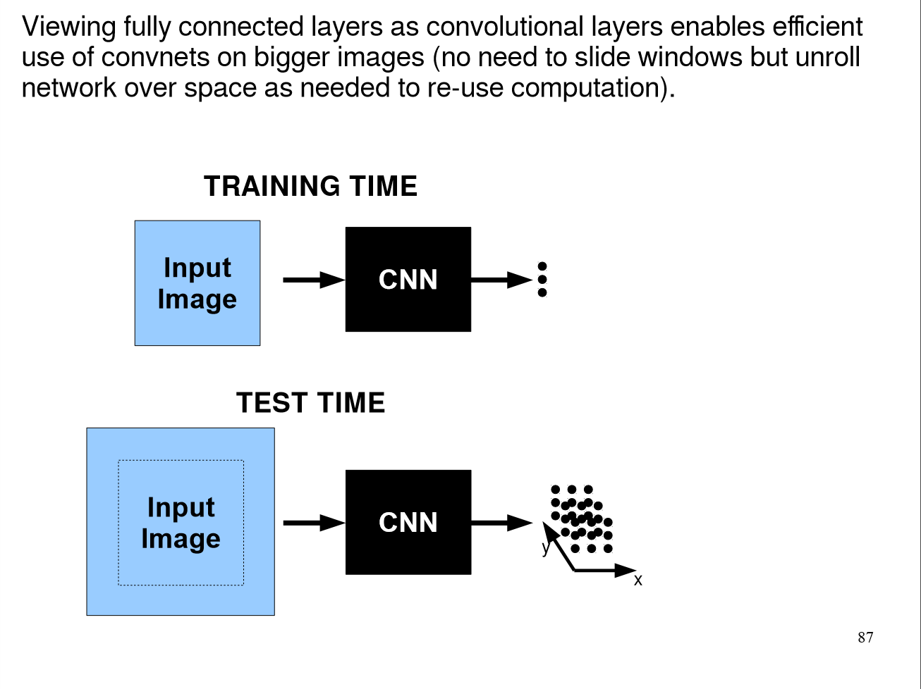

Slide 36
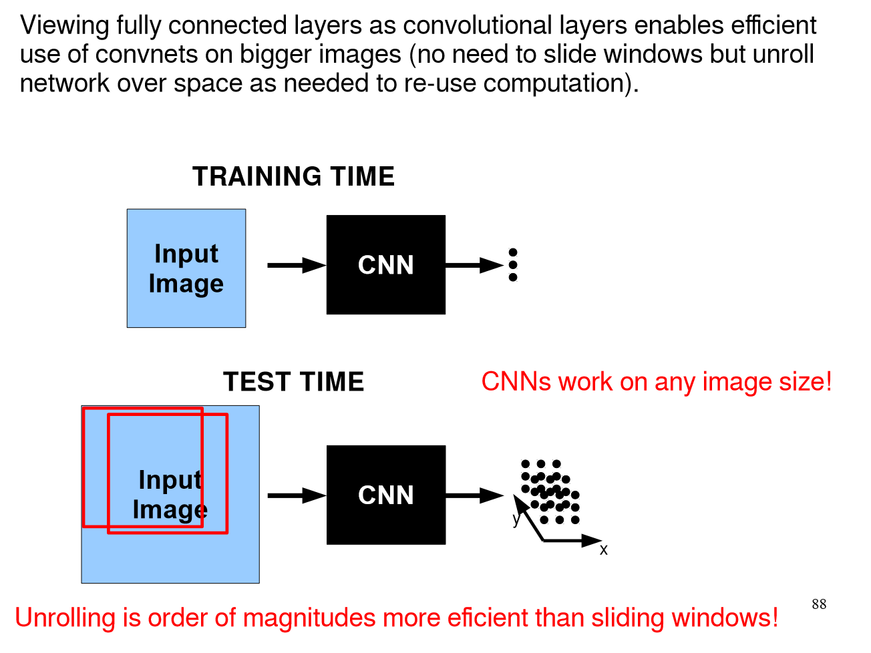

Slide 37
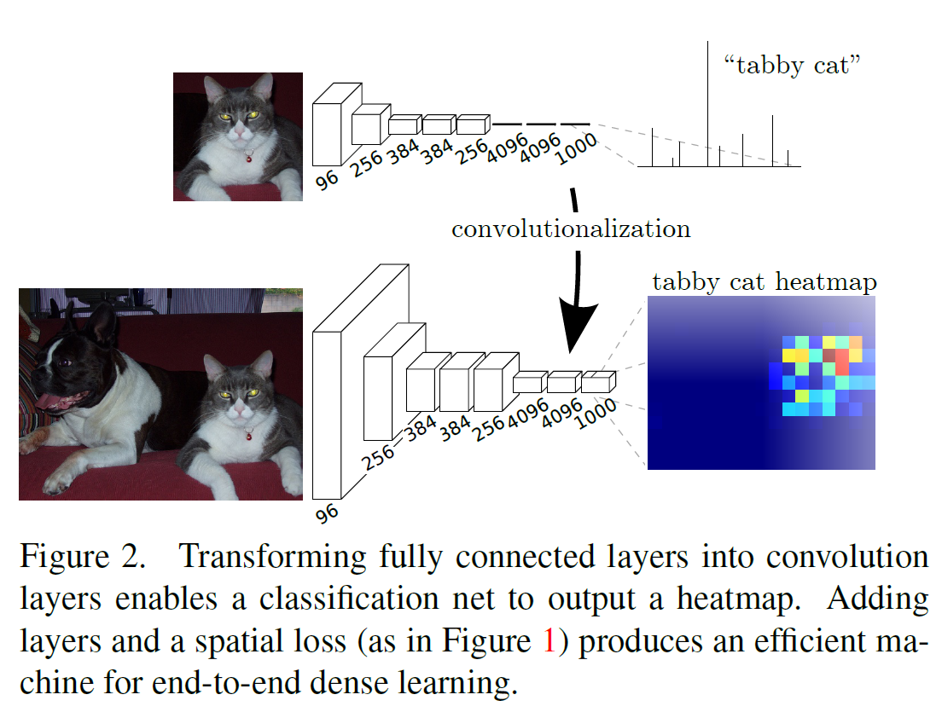
Long, Shelhamer, and Darrell 2014

Slide 38
A classification network…
…
“tabby cat”
The response of every kernel across all positions are attached densely to the array of perceptrons in the fully-connected layer.
AlexNet: 256 filters over 6x6 response map
Each 2,359,296 response is attached to one of 4096 perceptrons, leading to 37 mil params.
[Long et al.]
Notes:
note omissions
“activations”
fixed size input, single label output
desire: efficient per-pixel output

Slide 39
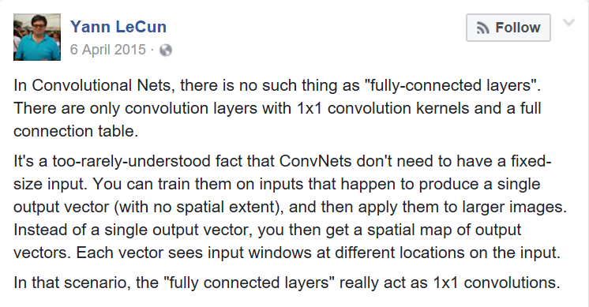

Slide 40
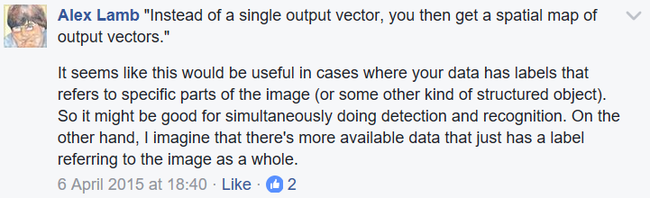
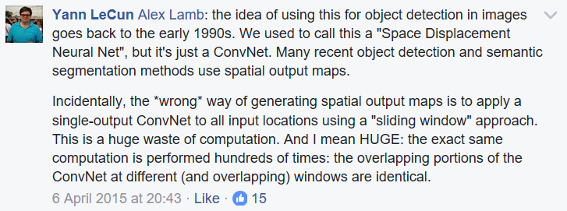

Slide 41
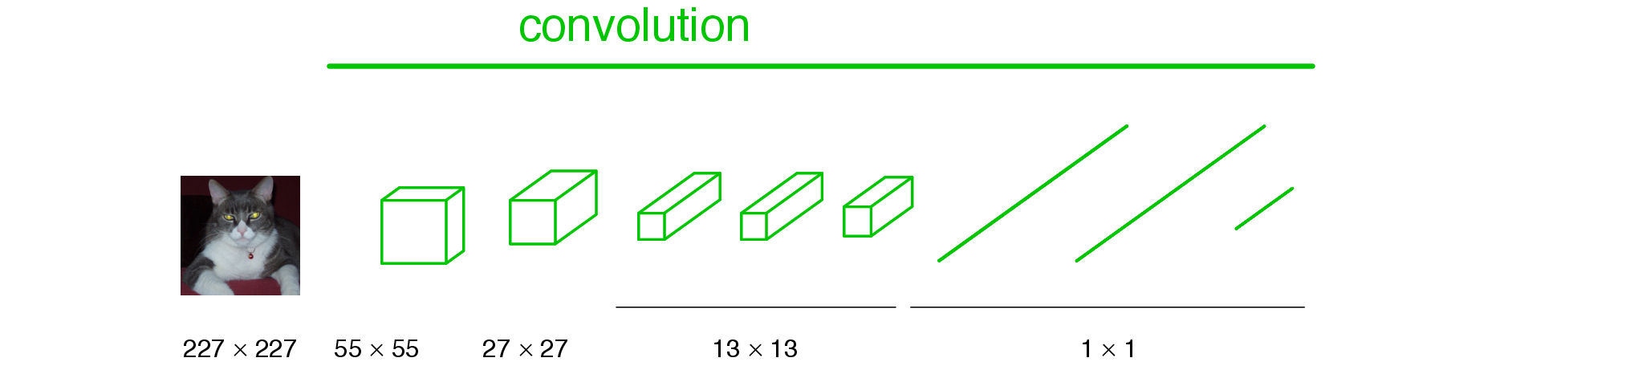
Convolutionalization
Number of filters
Number of filters
1x1 convolution operates across all filters in the previous layer, and is slid across all positions.
[Long et al.]

Slide 42

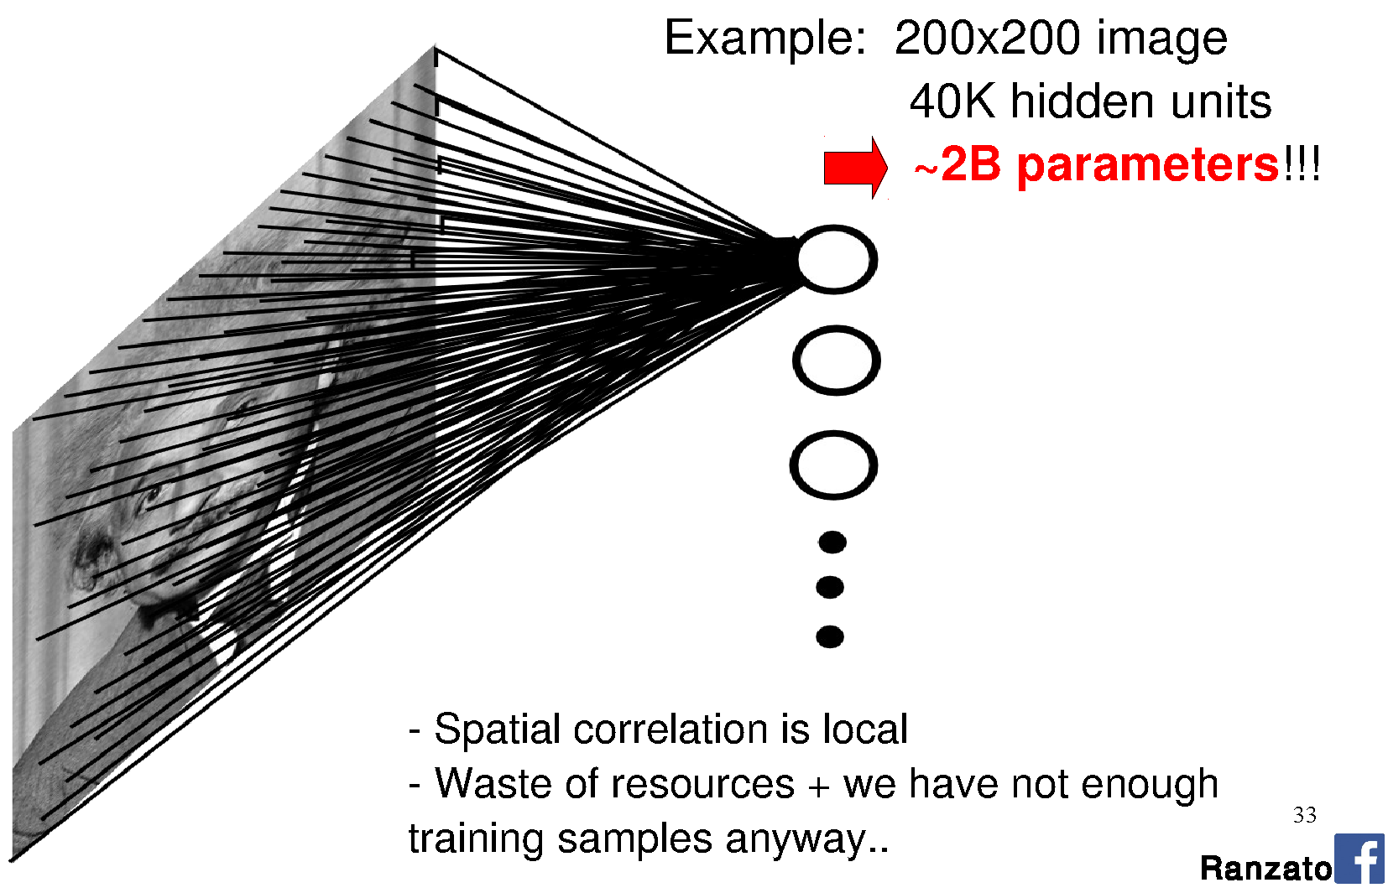

Back to the fully-connected perceptron…
Perceptron is connected to every
value in the previous layer
(across all channels; 1 visible).
[Long et al.]
Notes:
Seems fine, right?
Going to learn a neural network to classify an image. Learn weights from a large database of images using back propagation.
How many perceptrons do you think we need to represent the ‘complexity’ of natural images?
How big are the weight matrices?
How many weight parameters did you learn in your HOG-based SVM classification? How big was the database? Did it work?
The more parameters we have, the larger the database we need to ‘map out’ the high-dimensional space.
Are we wasting any knowledge in this representation?

Slide 43
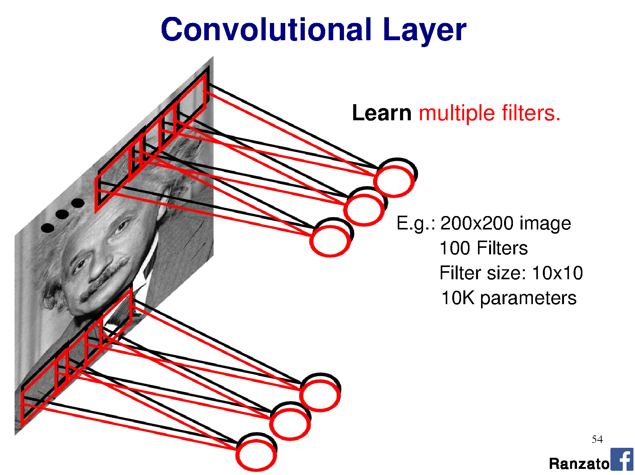
Notes:
This is the major trick.
For each layer of the neural network, we’re going to learn multiple filters.

Slide 44
1x1
100
Notes:
This is the major trick.
For each layer of the neural network, we’re going to learn multiple filters.

Slide 45
Convolutionalization
# filters, e.g. 1024
# filters, e.g., 64
1x1 convolution operates across all filters in the previous layer, and is slid across all positions.
e.g., 64x1x1 kernel, with shared weights over 13x13 output, x1024 filters = 11mil params.
[Long et al.]

Slide 46
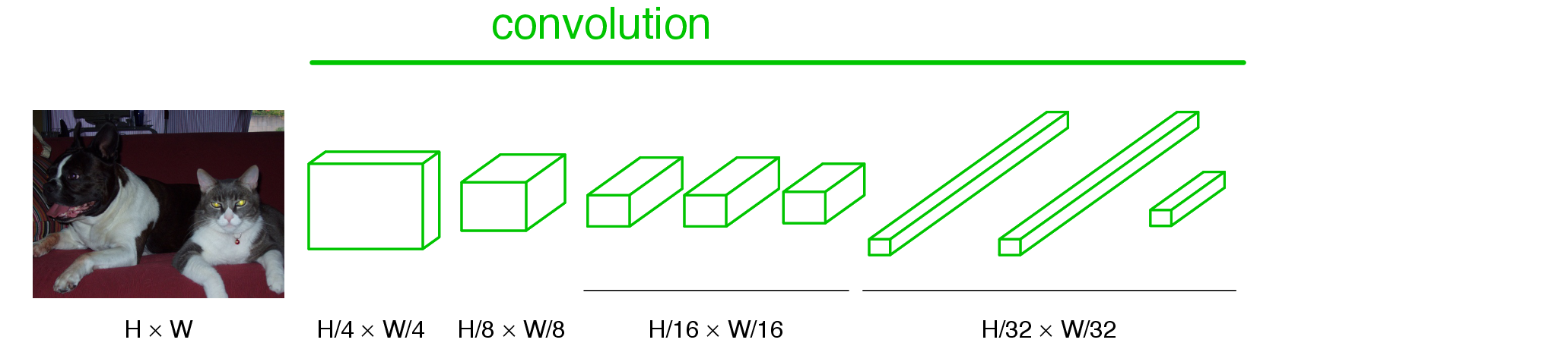
Becoming fully convolutional
Multiple outputs
Arbitrary-sized image
When we turn these operations into a convolution, the 13x13 just becomes another parameter and our output size adjust dynamically.
Now we have a vector/matrix output, and our network acts itself like a complex filter.
[Long et al.]

Slide 47
Long, Shelhamer, and Darrell 2014

Slide 48
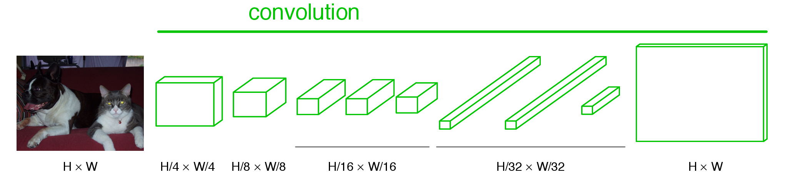
Upsampling the output
Some upsampling algorithm to return us to H x W
[Long et al.]

Slide 49
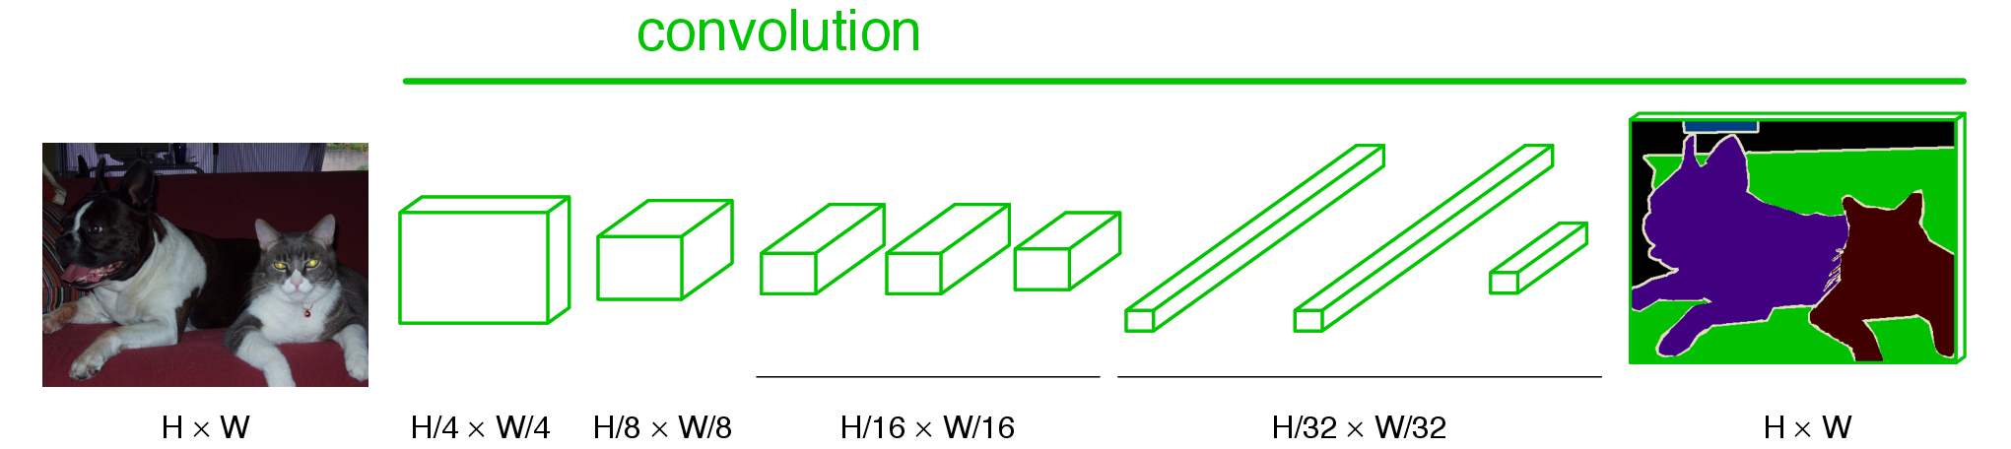
End-to-end, pixels-to-pixels network
[Long et al.]

Slide 50
End-to-end, pixels-to-pixels network
upsampling
conv, pool,
nonlinearity
pixelwise
output + loss
[Long et al.]

Slide 51
What is the upsampling layer?
This one.
Hint: it’s actually an upsampling network
[Long et al.]

Slide 52
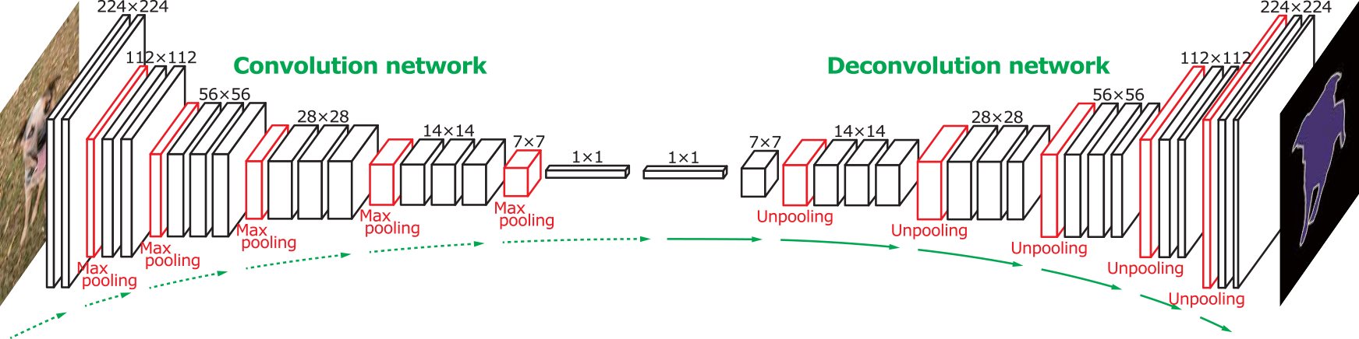
‘Deconvolution’ networks learn to upsample
Often called “deconvolution”, but misnomer.
Not the deconvolution that we saw in deblurring -> that is division in the Fourier domain.
‘Transposed convolution’ is better.
Zeiler et al., Deconvolutional Networks, CVPR 2010
Noh et al., Learning Deconvolution Network for Semantic Segmentation, ICCV 2015
Notes:
The network architecture here is VGG
Six days to train on an NVIDIA Titan X GPU

Slide 53
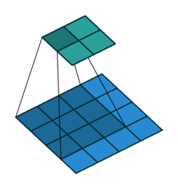
Upsampling with transposed convolution
Convolution
Notes:
https://www.quora.com/How-do-fully-convolutional-networks-upsample-their-coarse-output
https://github.com/vdumoulin/conv_arithmetic
https://en.wikipedia.org/wiki/Deconvolution
Also called ‘backwards strided convolution’.
Where the convolutions overlap, we ADD the output.
How do we apply the weights when the kernel crosses multiple input pixels from the previous layer?

Slide 54
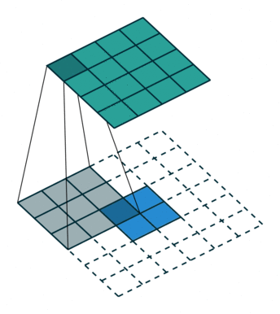
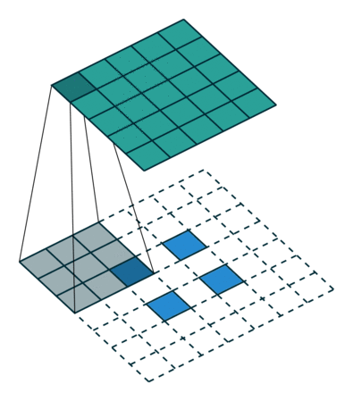
Upsampling with transposed convolution
Transposed convolution = padding/striding smaller image then weighted sum of input x filter: ‘stamping’ kernel
Convolution
2x2, stride 1, 3x3 kernel,
upsample to 4x4
2x2, stride 2, 3x3 kernel,
upsample to 5x5.
Notes:
https://www.quora.com/How-do-fully-convolutional-networks-upsample-their-coarse-output
https://github.com/vdumoulin/conv_arithmetic
https://en.wikipedia.org/wiki/Deconvolution
Also called ‘backwards strided convolution’.
Where the convolutions overlap, we ADD the output.
How do we apply the weights when the kernel crosses multiple input pixels from the previous layer?

Slide 55
Kernel
1
1
1
1
1
1
1
1
1
Feature map
1 | 2
3 | 4
Padded feature map
 |  | 1 | 2
 |  | 3 | 4
Inspired by andriys
Notes:
Thanks to andriys
https://datascience.stackexchange.com/questions/6107/what-are-deconvolutional-layers
Note that the kernel here is not normalized, so if we were applying it as an image processing operation, then it would brighten the image significantly.
Note also that, in CNNs, there’s no need to normalize kernels – the operations on feature maps can learn to produce a large response if required.

Slide 56
Kernel
1
1
1
1
1
1
1
1
1
Output feature map
Input feature map
1 | 2
3 | 4
1 | 1 | 1
1 | 1 | 1
1 | 1 | 1
Padded input feature map
 |  | 1 | 2
 |  | 3 | 4
Inspired by andriys
Notes:
Thanks to andriys
https://datascience.stackexchange.com/questions/6107/what-are-deconvolutional-layers
Note that the kernel here is not normalized, so if we were applying it as an image processing operation, then it would brighten the image significantly.
Note also that, in CNNs, there’s no need to normalize kernels – the operations on feature maps can learn to produce a large response if required.

Slide 57
Kernel
1
1
1
1
1
1
1
1
1
Output feature map
Input feature map
1 | 2
3 | 4
1 | 4 | 4 | 3
1 | 4 | 4 | 3
1 | 4 | 4 | 3
Padded input feature map
 |  | 1 | 2
 |  | 3 | 4
Inspired by andriys
Notes:
Thanks to andriys
https://datascience.stackexchange.com/questions/6107/what-are-deconvolutional-layers
Note that the kernel here is not normalized, so if we were applying it as an image processing operation, then it would brighten the image significantly.
Note also that, in CNNs, there’s no need to normalize kernels – the operations on feature maps can learn to produce a large response if required.

Slide 58
Kernel
1
1
1
1
1
1
1
1
1
Output feature map
Input feature map
1 | 2
3 | 4
1 | 4 | 7 | 6 | 3
1 | 4 | 7 | 6 | 3
1 | 4 | 7 | 6 | 3
Padded input feature map
 |  | 1 | 2
 |  | 3 | 4
Inspired by andriys
Notes:
Thanks to andriys
https://datascience.stackexchange.com/questions/6107/what-are-deconvolutional-layers
Note that the kernel here is not normalized, so if we were applying it as an image processing operation, then it would brighten the image significantly.
Note also that, in CNNs, there’s no need to normalize kernels – the operations on feature maps can learn to produce a large response if required.

Slide 59
Kernel
1
1
1
1
1
1
1
1
1
Output feature map
Input feature map
1 | 2
3 | 4
1 | 4 | 7 | 8 | 5 | 2
1 | 4 | 7 | 8 | 5 | 2
1 | 4 | 7 | 8 | 5 | 2
Padded input feature map
 |  | 1 | 2
 |  | 3 | 4
Inspired by andriys
Notes:
Thanks to andriys
https://datascience.stackexchange.com/questions/6107/what-are-deconvolutional-layers
Note that the kernel here is not normalized, so if we were applying it as an image processing operation, then it would brighten the image significantly.
Note also that, in CNNs, there’s no need to normalize kernels – the operations on feature maps can learn to produce a large response if required.

Slide 60
Kernel
1
1
1
1
1
1
1
1
1
Output feature map
Input feature map
1 | 2
3 | 4
1 | 4 | 7 | 8 | 5 | 2
5 | 8 | 11 | 8 | 5 | 2
5 | 8 | 11 | 8 | 5 | 2
4 | 4 | 4
Padded input feature map
 |  | 1 | 2
 |  | 3 | 4
Inspired by andriys
Notes:
Thanks to andriys
https://datascience.stackexchange.com/questions/6107/what-are-deconvolutional-layers
Note that the kernel here is not normalized, so if we were applying it as an image processing operation, then it would brighten the image significantly.
Note also that, in CNNs, there’s no need to normalize kernels – the operations on feature maps can learn to produce a large response if required.

Slide 61
Kernel
1
1
1
1
1
1
1
1
1
Output feature map
Input feature map
1 | 2
3 | 4
1 | 4 | 7 | 8 | 5 | 2
5 | 18 | 21 | 18 | 5 | 2
5 | 18 | 21 | 18 | 5 | 2
4 | 14 | 14 | 10
Padded input feature map
 |  | 1 | 2
 |  | 3 | 4
Inspired by andriys
Notes:
Thanks to andriys
https://datascience.stackexchange.com/questions/6107/what-are-deconvolutional-layers
Note that the kernel here is not normalized, so if we were applying it as an image processing operation, then it would brighten the image significantly.
Note also that, in CNNs, there’s no need to normalize kernels – the operations on feature maps can learn to produce a large response if required.

Slide 62
Kernel
1
1
1
1
1
1
1
1
1
Output feature map
Input feature map
1 | 2
3 | 4
1 | 4 | 7 | 8 | 5 | 2
5 | 18 | 31 | 34 | 21 | 8
9 | 32 | 55 | 60 | 37 | 14
11 | 38 | 66 | 64 | 43 | 16
7 | 24 | 41 | 44 | 27 | 10
3 | 10 | 17 | 18 | 11 | 4
Padded input feature map
 |  | 1 | 2
 |  | 3 | 4
Inspired by andriys
Notes:
Thanks to andriys
https://datascience.stackexchange.com/questions/6107/what-are-deconvolutional-layers
Note that the kernel here is not normalized, so if we were applying it as an image processing operation, then it would brighten the image significantly.
Note also that, in CNNs, there’s no need to normalize kernels – the operations on feature maps can learn to produce a large response if required.

Slide 63
Kernel
1
1
1
1
1
1
1
1
1
Cropped output feature map
Input feature map
1 | 2
3 | 4
18 | 31 | 34 | 21
32 | 55 | 60 | 37
38 | 66 | 64 | 43
24 | 41 | 44 | 27
Padded input feature map
 |  | 1 | 2
 |  | 3 | 4
Inspired by andriys
Notes:
Thanks to andriys
https://datascience.stackexchange.com/questions/6107/what-are-deconvolutional-layers
Note that the kernel here is not normalized, so if we were applying it as an image processing operation, then it would brighten the image significantly.
Note also that, in CNNs, there’s no need to normalize kernels – the operations on feature maps can learn to produce a large response if required.

Slide 64
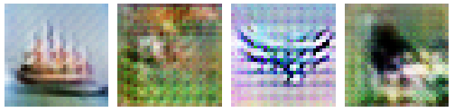
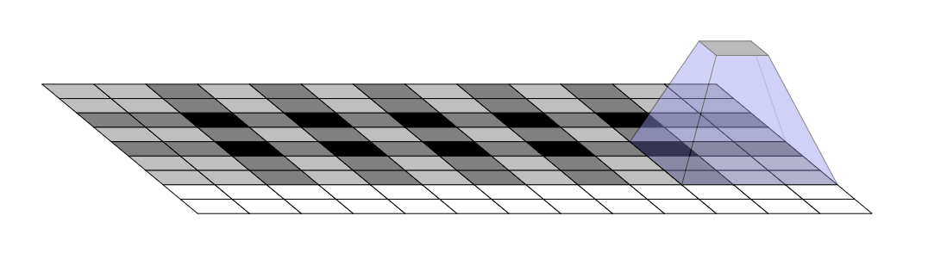
Is uneven overlap a problem?
Uneven overlap across output
Yes = causes grid artifacts
Could fix it by picking stride/kernel numbers which have no overlap…
Notes:
https://datascience.stackexchange.com/questions/6107/what-are-deconvolutional-layers
https://distill.pub/2016/deconv-checkerboard/

Slide 65
Is uneven overlap a problem?
Uneven overlap across output
Yes = causes grid artifacts
Could fix it by picking stride/kernel numbers which have no overlap…
Or…think in frequency!
Introduce explicit bilinear upsampling before transpose convolution; let kernels of transpose convolution learn to fill in only high-frequency detail.
https://distill.pub/2016/deconv-checkerboard/
Notes:
https://datascience.stackexchange.com/questions/6107/what-are-deconvolutional-layers
https://distill.pub/2016/deconv-checkerboard/

Slide 66
‘Deconvolution’ networks learn to upsample
Often called “deconvolution”, but misnomer.
Not the deconvolution that we saw in deblurring -> that is division in the Fourier domain.
‘Transposed convolution’ is better.
Zeiler et al., Deconvolutional Networks, CVPR 2010
Noh et al., Learning Deconvolution Network for Semantic Segmentation, ICCV 2015

Slide 67
But we have downsampled so far…
How do we ‘learn to create’ or ‘learn to restore’
new high frequency detail?

Slide 68
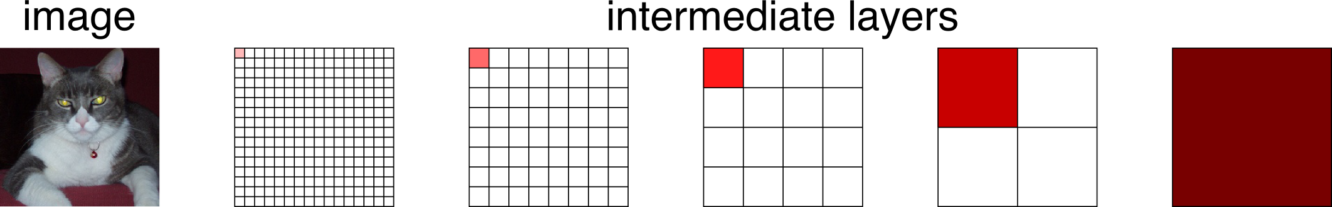
Spectrum of deep features
Combine where (local, shallow) with what (global, deep)
Fuse features into deep jet
(cf. Hariharan et al. CVPR15 “hypercolumn”)
[Long et al.]

Slide 69
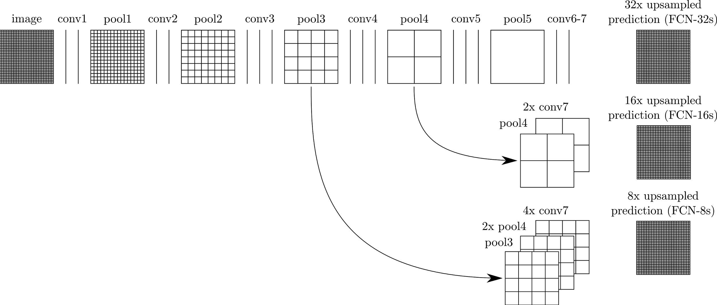
Learning upsampling kernels with skip layer refinement
interp + sum
Skip to fuse layers!
interp + sum
End-to-end, joint learning
of semantics and location
dense output
[Long et al.]

Slide 70
Learning upsampling kernels with skip layer refinement
interp + sum
Skip to fuse layers!
interp + sum
dense output
[Long et al.]

Slide 71
Learning upsampling kernels with skip layer refinement
interp + sum
Skip to fuse layers!
interp + sum
End-to-end, joint learning
of semantics and location
dense output
[Long et al.]

Slide 72
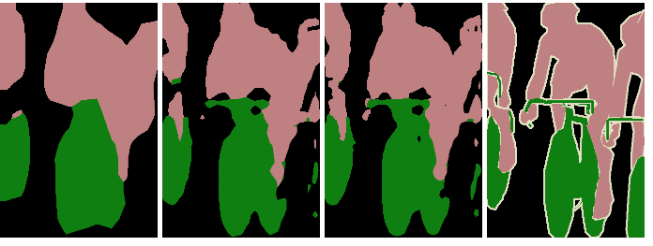
Skip layer refinement
input image
stride 32
stride 16
stride 8
ground truth
no skips
1 skip
2 skips
[Long et al.]

Slide 73
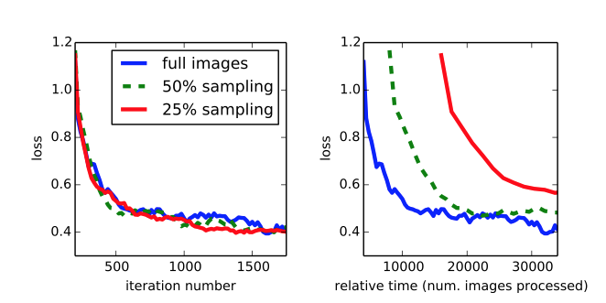
Training + testing
Train full image at a time without patch sampling
Reshape network to take input of any size
Forward time is ~100ms for 500 x 500 x 21 output
[Long et al.]

Slide 74
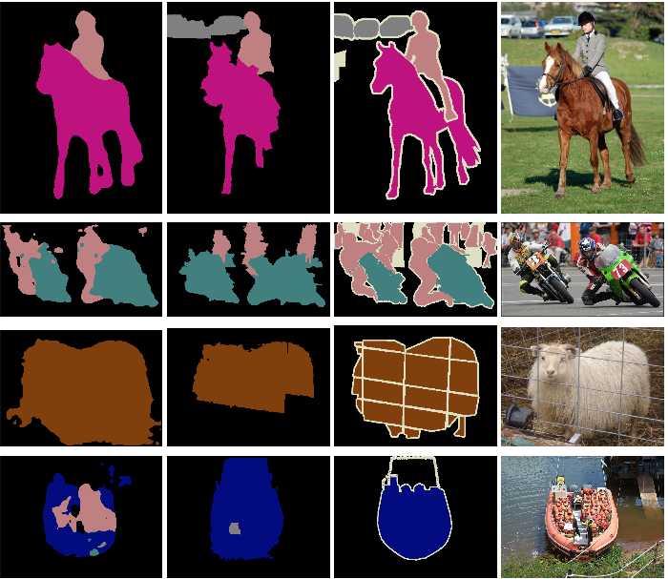
Results
FCN
SDS*
Truth
Input
Relative to prior state-of-the-art SDS:
30% relative improvement
for mean IoU
286× faster
*Simultaneous Detection and Segmentation Hariharan et al. ECCV14
[Long et al.]
Notes:
+ NYUD net for multi-modal input and SIFT Flow net for multi-task output

Slide 75

What can we do with an FCN?
Long, Shelhamer, and Darrell 2014

Slide 76

im2gps (Hays & Efros, CVPR 2008)
How much can an image tell about its geographic location?
6 million geo-tagged Flickr images
http://graphics.cs.cmu.edu/projects/im2gps/

Slide 77

Nearest Neighbors according to gist + bag of SIFT + color histogram + a few others

Slide 78


Slide 79
PlaNet - Photo Geolocation with Convolutional Neural Networks
Tobias Weyand, Ilya Kostrikov, James Philbin
ECCV 2016

Slide 80

Discretization of Globe

Slide 81
Network and Training
Network Architecture: Inception with 97M parameters
26,263 “categories” – places in the world
126 Million Web photos
2.5 months of training on 200 CPU cores

Slide 82


Slide 83

Notes:
Figure 7. The top-5 most confident images from the Flickr dataset for the S2 cells on the left, showing the diverse visual representation of places that PlaNet learns.

Slide 84


PlaNet vs im2gps (2008, 2009)
Notes:
Table 1. Comparison of PlaNet with Im2GPS. Percentages are the fraction of images from the Im2GPS test set that were localized within the given radius. (Numbers for the original Im2GPS are approximate as they were extracted from a plot in the paper.)
Table 3. Median localization error (km) by image category on the Im2GPS test set. Manmade Landmark are landmark buildings like the Eiffel Tower, Natural Landmark are geographical features like the Grand Canyon, City Scene and Natural Scene are photos taken in cities or in nature not showing any distinctive landmarks, and Animal are photos of individual animals.

Slide 85

Spatial support for decision
Notes:
Figure 10. Left: Input image, right: Heatmap of the probability of the correct class when sliding an occluding window over the image as in [53]. (a) Grand Canyon. Occluding the distinctive mountain formation makes the confidence in the correct location drop the most. (b) Norway. While the house in the foreground is fairly generic, the snowy mountain range on the left is the most important cue. (c) Shanghai. Confidence in the correct location increases if the palm trees in the foreground are covered since they are not common in Shanghai.

Slide 86

PlaNet vs Humans
Notes:
Figure 9. Top: GeoGuessr panorama, Bottom: Ground truth location (yellow), human guess (green), PlaNet guess (blue).

Slide 87

PlaNet vs. Humans
Notes:
Error increases up the y-axis, so human performance is worse than PlaNet.

Slide 88
PlaNet summary
Very fast geolocalization method by categorization.
Uses far more training data than previous work (im2gps)
Better than humans!

Slide 89

Even more:
Faster
R-CNN
(FCN)
‘Region Proposal Network’ uses CNN feature maps.
Then, FCN on top to classify.
End to end object detection.
Ren et al. 2016
https://arxiv.org/abs/1506.01497
Notes:
https://blogs.microsoft.com/next/2015/12/10/microsoft-researchers-win-imagenet-computer-vision-challenge/#sm.00017fqnl1bz6fqf11amuo0d9ttdp

Slide 90

Even more! Mask R-CNN
Extending Faster R-CNN for Pixel Level Segmentation
He et al. - https://arxiv.org/abs/1703.06870
Add new training data: segmentation masks
Second output which is segmentation mask
Notes:
TensorFlow implementation: https://github.com/CharlesShang/FastMaskRCNN

Slide 91


Slide 92


