Slide 1


Slide 2
Lena and Fabio

Slide 3
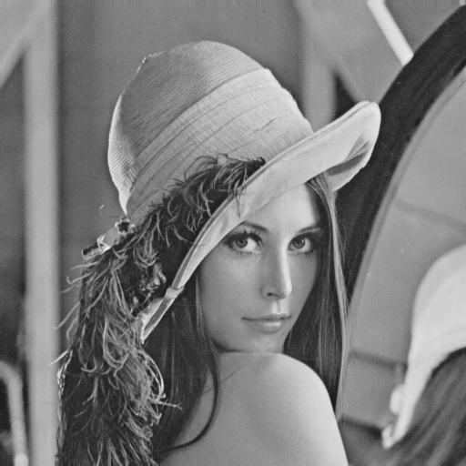
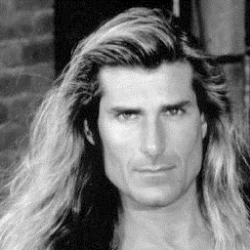
Examples: Controversy and Appropriateness
‘Lena’
‘Fabio’
Alexander Sawchuk @ USC, 1973
Deanna Needell @ Claremont McKenna, 2012
Notes:
Lena Söderberg
November 1972 Playboy
https://en.wikipedia.org/wiki/Lenna
“In 2015, Lena Söderberg was also guest of honor at the banquet of IEEE ICIP 2015.”
“To explain Lena's popularity, David C. Munson, editor-in-chief of IEEE Transactions on Image Processing, noted that it was a good test image because of its detail, flat regions, shading, and texture. However, he also noted that its popularity was largely because an image of an attractive woman appealed to the males in a male-dominated field.”
Fabio Lanzoni
All around 1980’s heartthrob
Deanna Needell introduced him in a 2012 paper.

Slide 4
If it wasn’t clear from class…
Use of Lena is now generally considered inappropriate, as it is not inclusive.
If you wish to include models, then please respect diversity.
We will approach diversity issues in more detail when we start to talk about machine learning and datasets.

Slide 5
CV as a social good bad?

Slide 6
CV / ML ‘human factors’
Computer vision / machine learning is a tool.
Tools are used under real world constraints.
  Time, money.
Like any tool, CVML can be used for good and for bad.
What good/bad is sometimes depends on your point of view.
Can also be used advertently or inadvertently.
With or without awareness of ‘human factors’
Notes:
I have tried to make this neutral / apolitical.
I do not intend to offend anyone; nor project my personal opinion onto you.

Slide 7
Computer vision domain
Eye
Optics
Dynamic range
Color
Digital processing
Low-level features
Calibration
Geometric
Photometric
Radiometric
Data collection
Labeling
Model fitting
Recognition
Classification
In the beginning, there was light.
Camera
Optics
Dynamic range
Color

Slide 8
Computer vision domain
Eye
Optics
Dynamic range
Color
Digital processing
Low-level features
Calibration
Geometric
Photometric
Radiometric
Data collection
Labeling
Model fitting
Recognition
Classification
In the beginning, there was light.
Camera
Optics
Dynamic range
Color

Slide 9
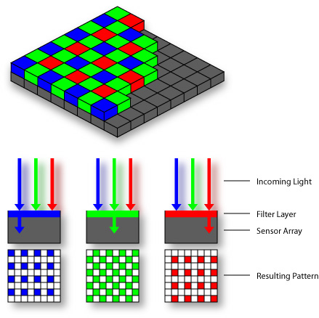
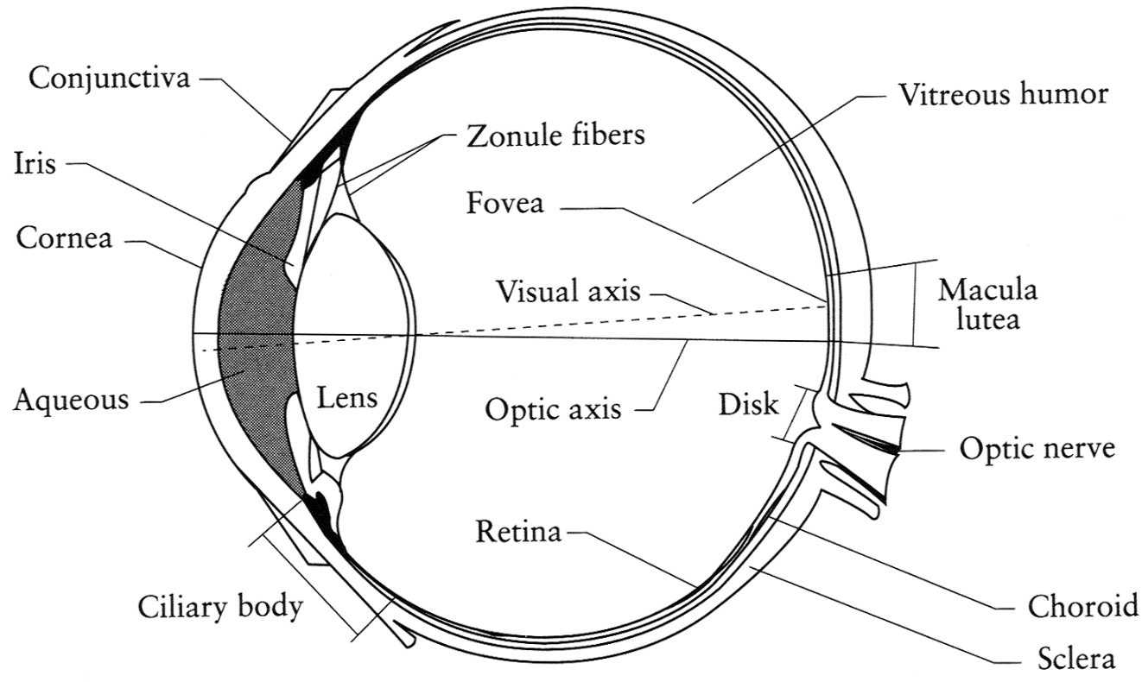
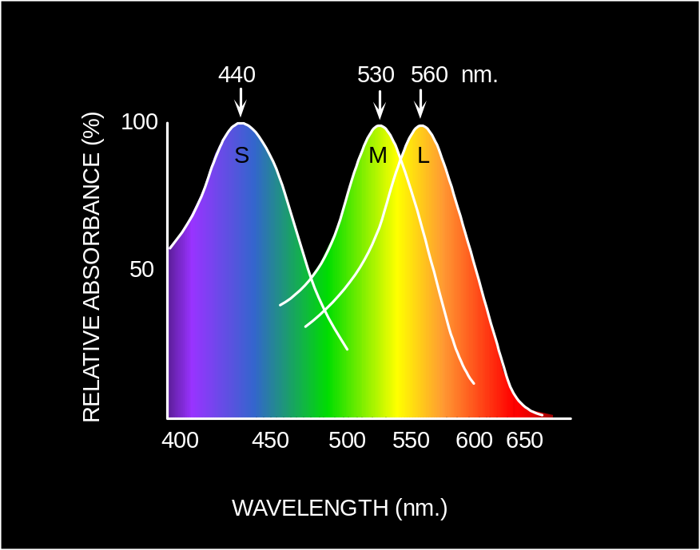
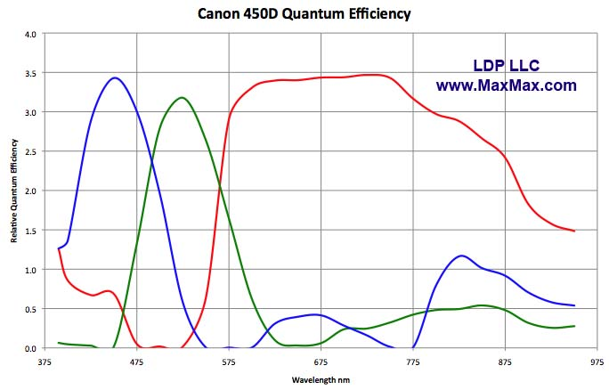
Light response curves
Eye
Sensor:
Camera
Sensor:
© Stephen E. Palmer, 2002
Notes:
http://www.npr.org/2014/11/13/363517842/for-decades-kodak-s-shirley-cards-set-photography-s-skin-tone-standard

Slide 10
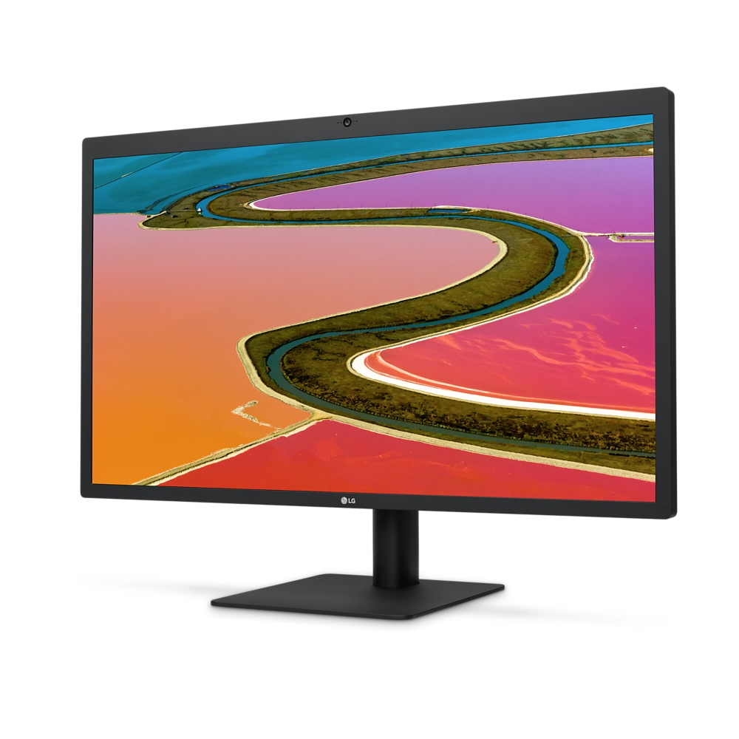
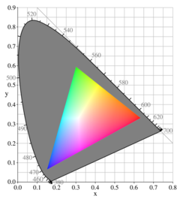
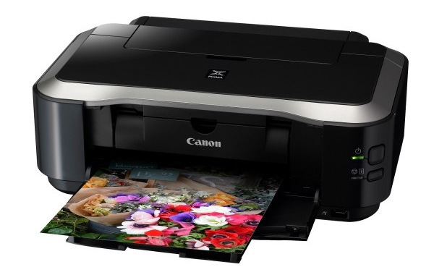
Light/reflectance output curves
250-500:1 contrast ratio (OLED = inf.)
6 / 8 / 10 bit dynamic range
3 / 4 additive primaries (RGB, rarely +yellow)
Defines a gamut
50-150:1 contrast ratio
??? dynamic range
4 subtractive primaries (CYMK)
Defines a gamut
Notes:
Cyan Yellow Magenta Black
Paper contrast ratios:
https://www.dpreview.com/forums/thread/2848210
Typical silver-halide photo lab printers such as Noritsu QSS or Fuji Frontier have a print contrast between 65-85:1.
Inkjets can top 150:1 on the glossiest papers with high-end inks or be well below 50:1 on fine art matte papers. Something, obviously, has to give between screen and print.

Slide 11
How do we calibrate these?
We want:
Colors we see with our eyes in the world
=
Colors we see with our eyes in the reproduction
Notes:
End of slide: so let’s go back in time to before digital cameras – let’s go back to the mid 1950s.

Slide 12
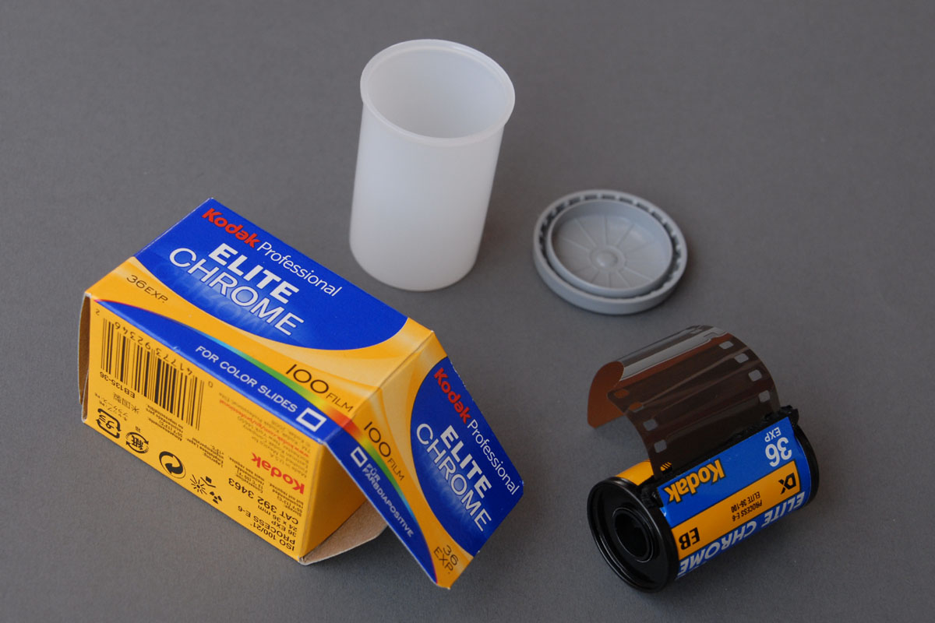
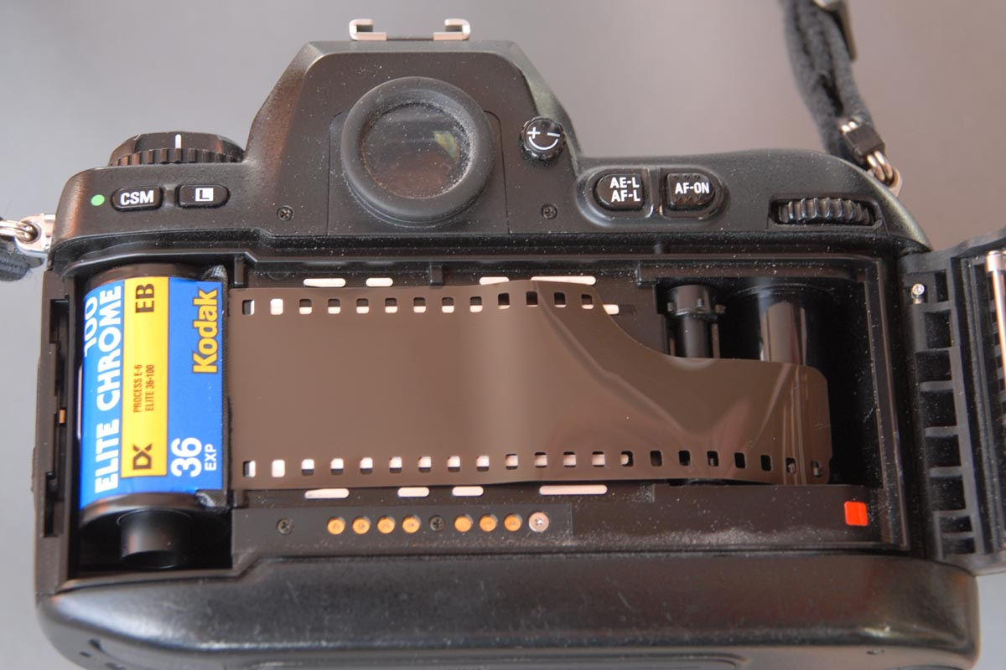
Time Warp: Film processing
http://www.picture-newsletter.com/kodak/
Notes:
https://en.wikipedia.org/wiki/Kodachrome
http://www.picture-newsletter.com/kodak/
Kodak produces a photosensitive chemical film.
Different compounds gave different spectral responses.
Kodak calibrates these responses using photometers and using test scenes.
You buy Kodak film from the store and put it in your camera.
Play with your family in the park
Take photos.
You take the film back to the store/lab for prints.
Kodak needs to reproduce the film spectral response on a printer
Needs to calibrate the printer
Printers are finicky, printers need regular color calibration.
Kodak sends test negatives and test prints to printer technicians for this job.

Slide 13
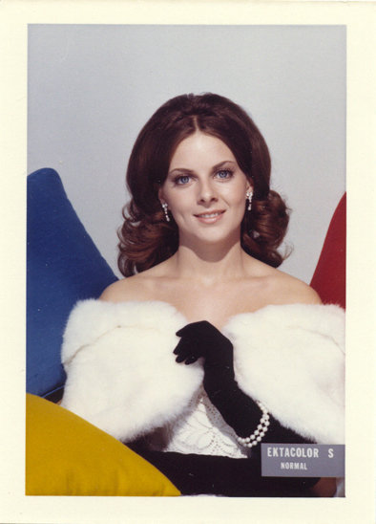
Kodak’s test input + output
‘Shirley cards’ – 1950s/60s
Shirley was photographed hundreds of times by Kodak.
One negative was processed as per Kodak specifications.
A new unexposed negative + processed output was sent to each printer lab.
Printer colors were calibrated on site to match the target Shirley card.
Circa 1960
Notes:
Anyone see any issues with this approach?

Slide 14
Kodak’s test input + output
‘Shirley cards’ – 1950s/60s
Any issues with this approach?
Circa 1960
Notes:
Anyone see any issues with this approach?

Slide 15
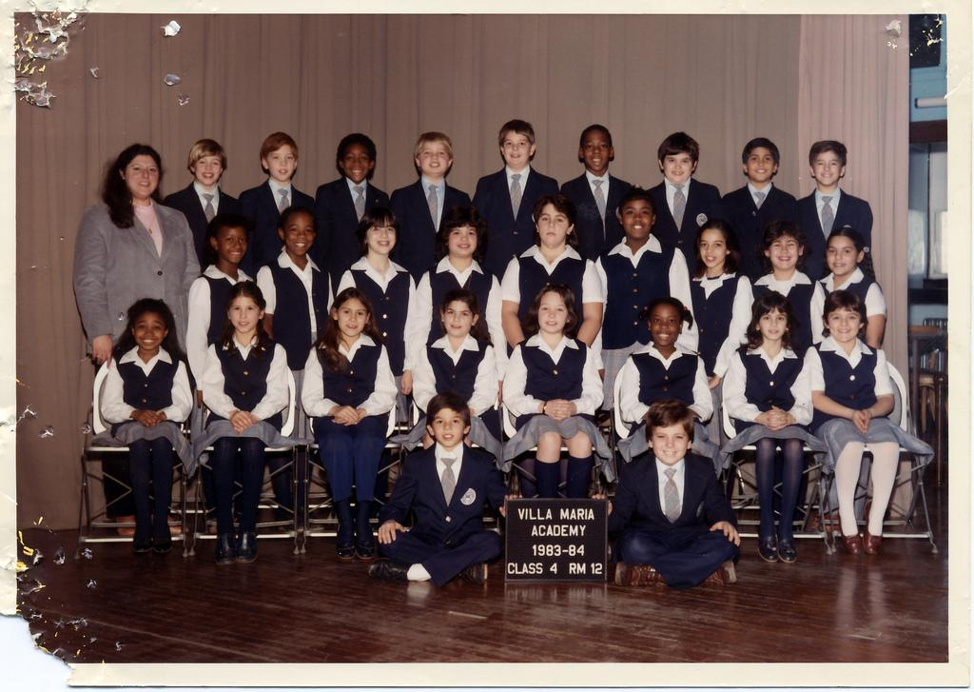

Slide 16
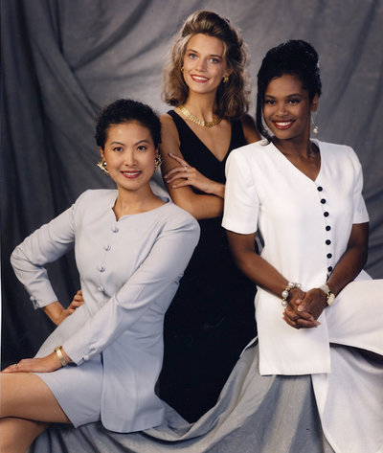
Over time
1978: Filmmaker Jean-Luc Godard refuses to use Kodachrome film in Mozambique.
1980s: Chocolate and furniture manufacturers complain.
1986: Kodacolor VR-G (or Gold) – film for dark browns.
  “Photograph the details of a dark horse in low light.”
Shirley card, 1996

Slide 17
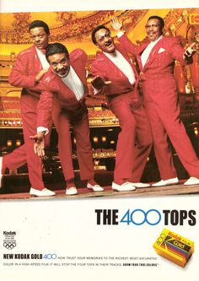
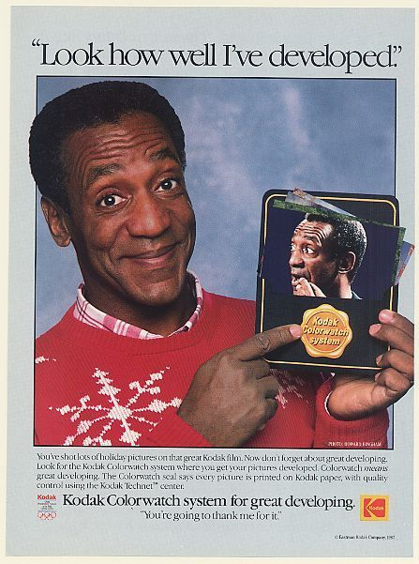
1980s – adverts
The Four Tops!
Bill Cosby!
Some other issues here now too : (
Notes:
Four Tops - Detroit, Michigan band who helped to define the city's Motown sound of the 1960s
Song: Reach out (I’ll be there)

Slide 18
What are the underlying problems?
…and how might we overcome them?
Think-pair-share.

Slide 19
Issues
Dynamic range: not enough!
Color balance:
Notes:
http://imgur.com/aWUHqz6

Slide 20
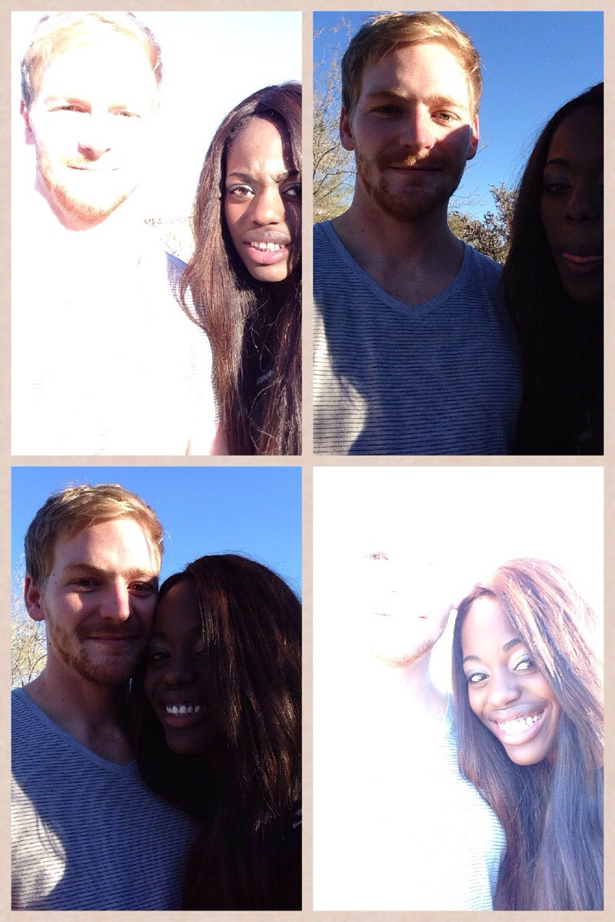
So digital fixes this, right?
Well…
“The hardest part of being in a biracial relationship is taking a picture together.”
whatthecaptcha
Notes:
https://www.reddit.com/r/funny/comments/1tpe5n/the_hardest_part_of_being_in_a_biracial/

Slide 21
So digital fixes this, right?
…it’s a lot better.
14-bit sensors (≈ eye’s static range)
High-dynamic range by combining low-dynamic range
Digital post-processing for color balance
Notes:
http://www.popphoto.com/gear/2014/08/camera-test-nikon-d810

Slide 22
References
Canadian Journal of Communication:
Roth et al., Looking at Shirley, the Ultimate Norm: Colour Balance, Image Technologies, and Cognitive Equity
http://www.cjc-online.ca/index.php/journal/article/view/2196
http://www.npr.org/2014/11/13/363517842/for-decades-kodak-s-shirley-cards-set-photography-s-skin-tone-standard/
https://priceonomics.com/how-photography-was-optimized-for-white-skin/
https://www.buzzfeed.com/syreetamcfadden/teaching-the-camera-to-see-my-skin/

Slide 23
Word of warning
Around 2013/2014 there were a lot of articles about this issue.
Many articles rewrite the same few sources.
Most do not have a technical background, and sometimes technical issues are confused.
‘Take care.’

Slide 24
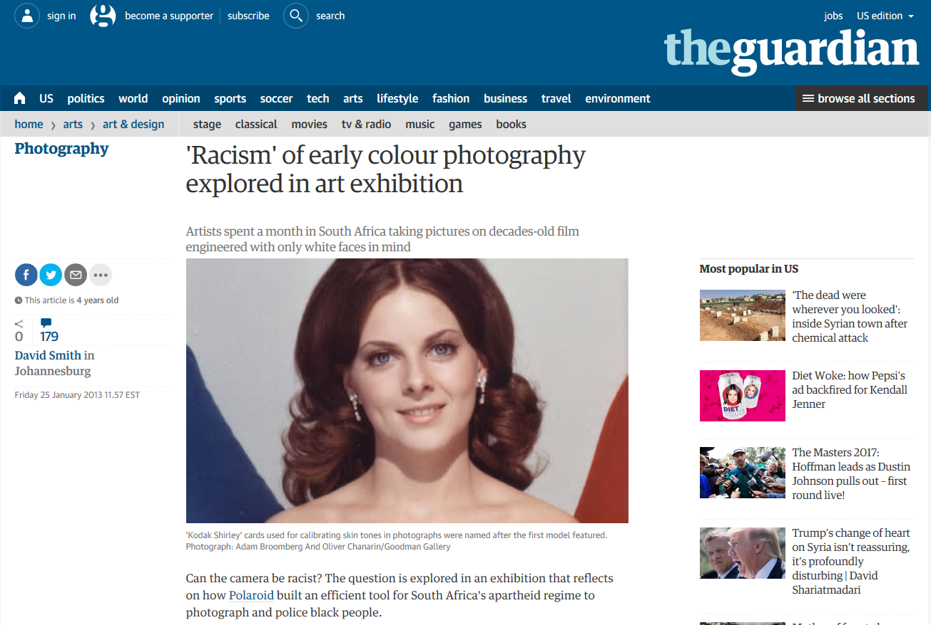

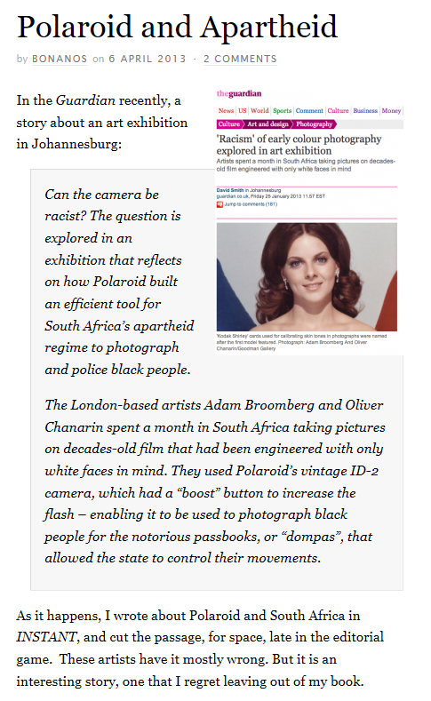
Polaroid and Apartheid
Notes:
https://www.theguardian.com/artanddesign/2013/jan/25/racism-colour-photography-exhibition
http://www.polaroidland.net/2013/04/06/polaroid-and-apartheid/
E.G., these articles on Polaroid and Apartheid are unconvincing as to what is truly going on.

Slide 25
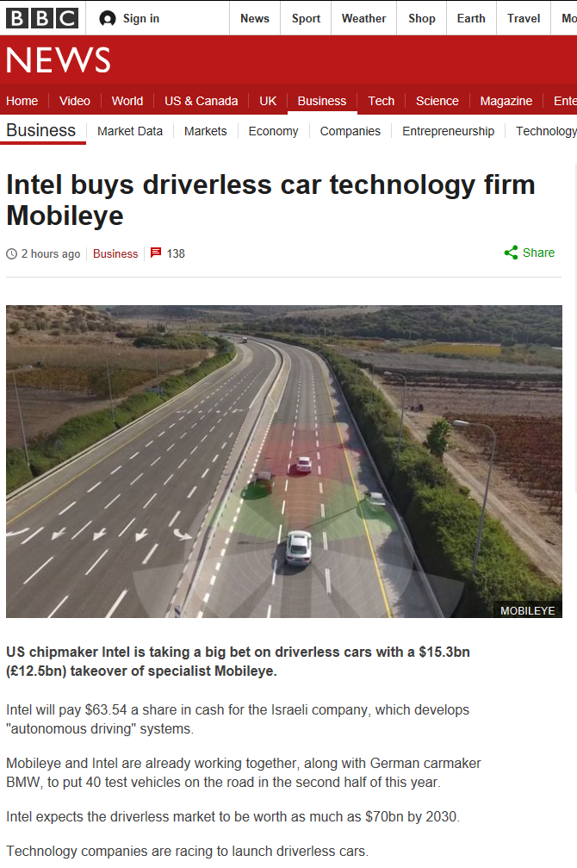
CV as making bank
Intel buys Mobileye!
$15 billion
Mobileye:
  Spin-off from Hebrew University, Israel
  450 engineers
  15 million cars installed
  313 car models
Notes:
As of March 13th 2017 - $15 billion is still less than Snap, Inc. – makers of Snapchat - $25 billion market capitalization
More than Hershey - $23 bil

Slide 26
June 2016 - Tesla left Mobileye
Fatal crash – car ‘autopilot’ ran into a tractor trailer.
“What we know is that the vehicle was on a divided highway with Autopilot engaged when a tractor trailer drove across the highway perpendicular to the Model S. Neither Autopilot nor the driver noticed the white side of the tractor trailer against a brightly lit sky, so the brake was not applied.” – Tesla blog.
What computer vision problems does this sound like?
Notes:
https://www.tesla.com/blog/tragic-loss
http://www.theverge.com/2016/7/1/12085218/tesla-autopilot-crash-investigation-radar-automatic-emergency-braking

Slide 27
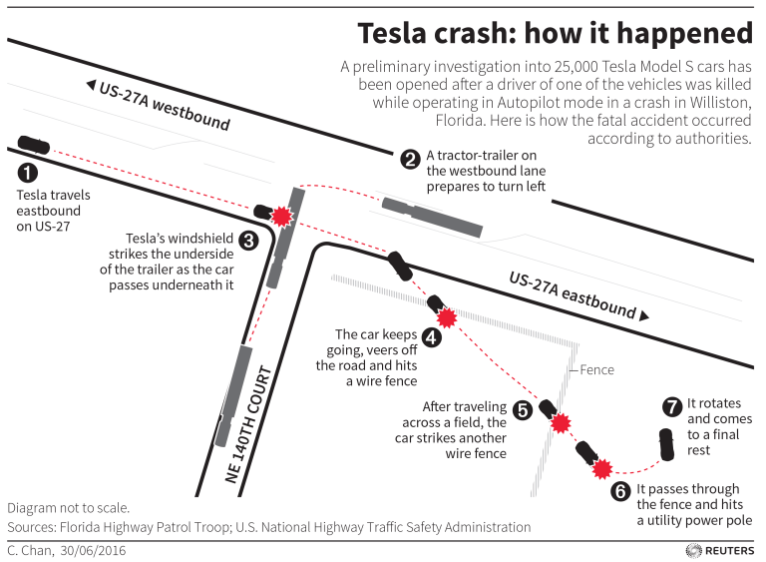

Slide 28
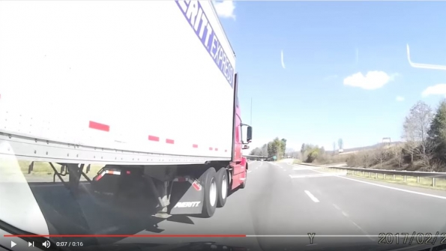
Notes:
http://trucker.com/dashcam/dash-cam-week-blind-spots-bs

Slide 29
June 2016 - Tesla left Mobileye
Fatal crash – car ‘autopilot’ ran into a tractor trailer.
“What we know is that the vehicle was on a divided highway with Autopilot engaged when a tractor trailer drove across the highway perpendicular to the Model S. Neither Autopilot nor the driver noticed the white side of the tractor trailer against a brightly lit sky, so the brake was not applied.” – Tesla blog.
What computer vision problems does this sound like?
What HCI problems does this sound like?
Notes:
https://www.tesla.com/blog/tragic-loss
http://www.theverge.com/2016/7/1/12085218/tesla-autopilot-crash-investigation-radar-automatic-emergency-braking

Slide 30

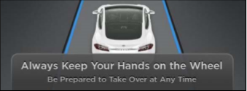
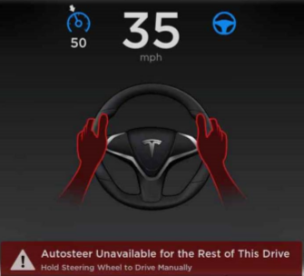
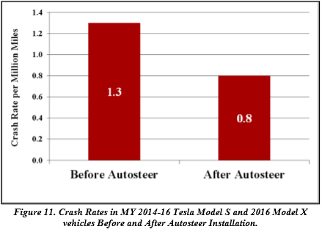
Autosteer
Notes:
https://www.tesla.com/sites/default/files/blog_attachments/tesla_survey_autopilot_awareness.pdf
https://static.nhtsa.gov/odi/inv/2016/INCLA-PE16007-7876.PDF

Slide 31
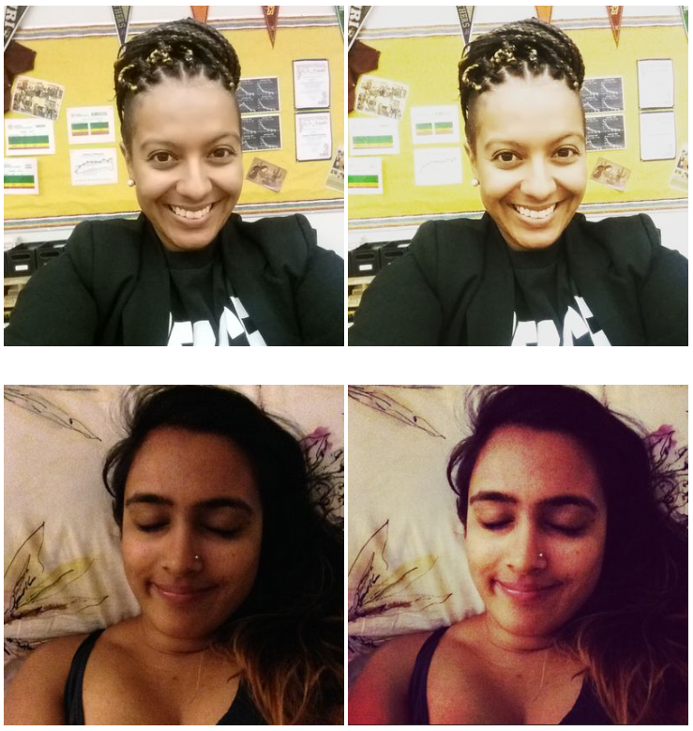
Instagram filters
Filters that brighten
Filters that darken
Filters can do anything!
Notes:
http://www.racked.com/2015/7/7/8906343/instagram-racism

Slide 32
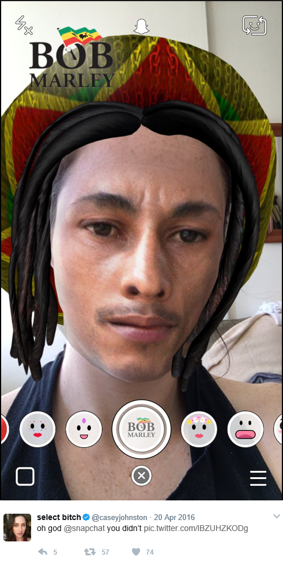
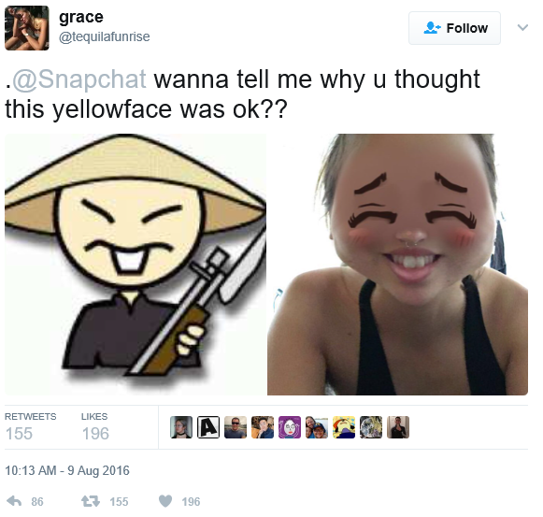
Snapchat
“Anime inspired”
4/20

Slide 33
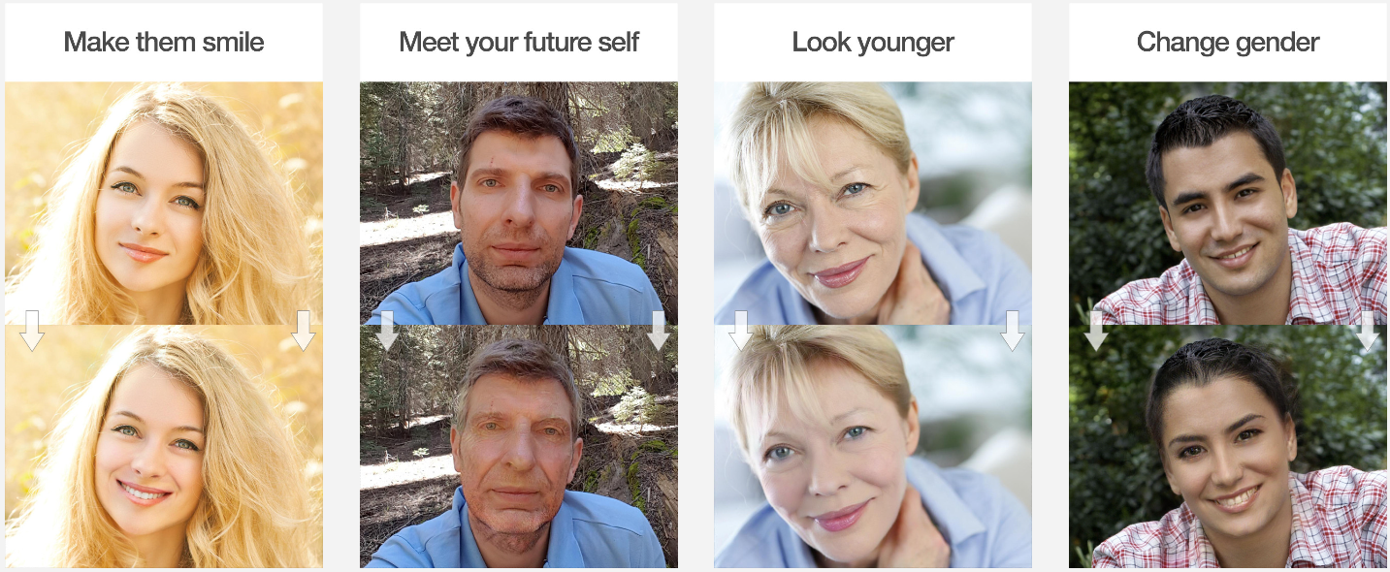
FaceApp
Learning-based face transformations
Notes:
What is FaceApp?
https://www.faceapp.com/

Slide 34
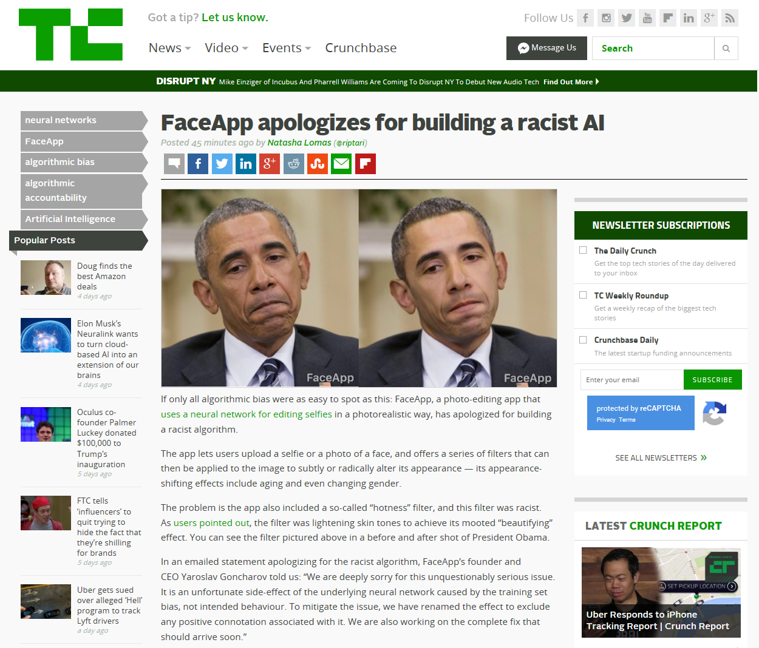
2017/04/25
Notes:
https://techcrunch.com/2017/04/25/faceapp-apologises-for-building-a-racist-ai/
http://www.theverge.com/2017/4/25/15419522/faceapp-hot-filter-racist-apology

Slide 35
Dataset Bias

Slide 36
Computer vision domain
Eye
Optics
Dynamic range
Color
Digital processing
Low-level features
Calibration
Geometric
Photometric
Radiometric
Data collection
Labeling
Model fitting
Recognition
Classification
In the beginning, there was light.
Camera
Optics
Dynamic range
Color

Slide 37
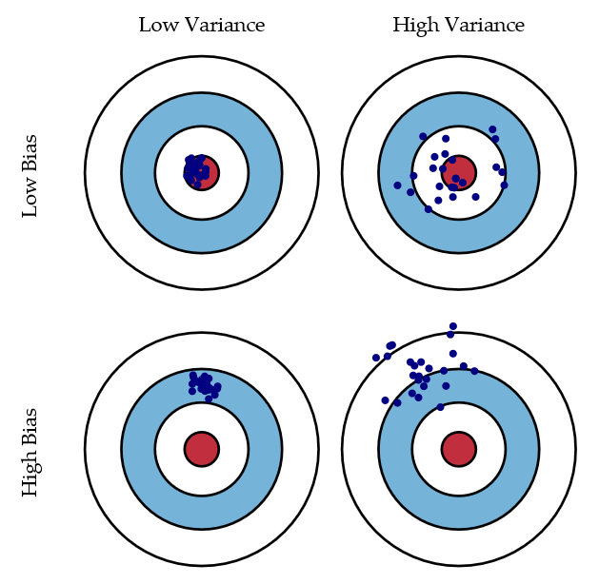
Bias/variance trade-off
Bias = accuracy
Variance = precision
Scott Fortmann-Roe
Notes:
http://scott.fortmann-roe.com/docs/BiasVariance.html
“Bias: The error due to bias is taken as the difference between the expected (or average) prediction of our model and the correct value which we are trying to predict.
Variance: The error due to variance is taken as the variability of a model prediction for a given data point.”

Slide 38
Unbiased Look at Dataset Bias
Torralba and Efros, CVPR 2011
“The authors would like to thank the Eyjafjallajokull volcano as well as the wonderful kirs at the Buvette in Jardin du Luxembourg for the motivation (former) and the inspiration (latter) to write this paper.“
Next few slide contents are from the paper

Slide 39
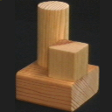
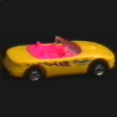
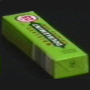
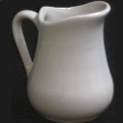
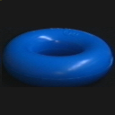
Progression of dataset complexity
COIL-100:
15 scenes: Out of the lab, backgrounds
Caltech-101: Google-mined, single object in middle.
LabelMe: Multiple objects, anywhere
PASCAL VOC: More rigorous testing standards
ImageNet: Internet-scale, real-world

Slide 40
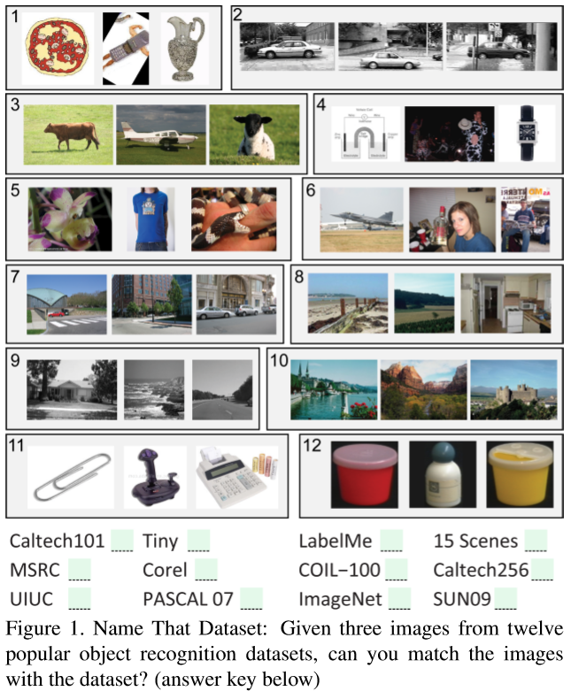
Notes:
Answer key: 1) Caltech-101, 2) UIUC, 3) MSRC, 4) Tiny Images, 5) ImageNet, 6) PASCAL VOC, 7) LabelMe, 8) SUN-09, 9) 15 Scenes, 10) Corel, 11) Caltech-256, 12) COIL-100.
Large-scale datasets are intended to be representative of the world and everything we see in it, but many of them are not.
In a vision-research lab, most people got 75% correct.

Slide 41
Quick reminder of all the ones we have seen so far
Caltech 101
LabelMe
SUN 09
15 Scenes
Tiny Images

Slide 42
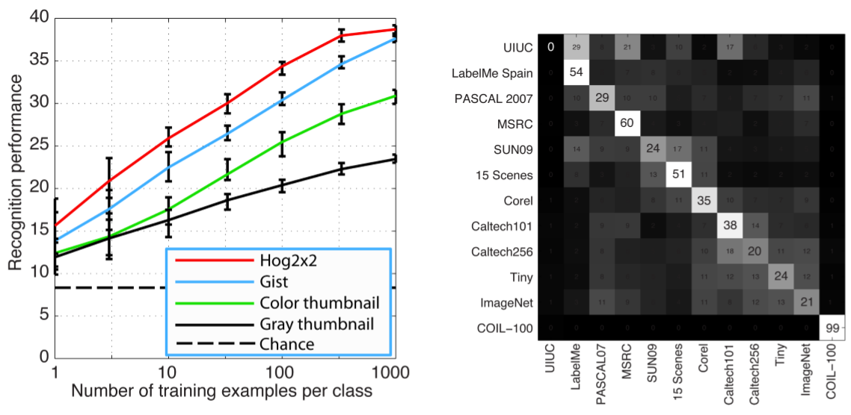
CV plays name that dataset!
Notes:
Of course, much of the bias can be accounted for by the divergent goals of the different datasets: some captured more urban scenes, others more rural landscapes; some collected professional photographs, others the amateur snapshots from the Internet; some focused on entire scenes, others on single objects, etc.
UIUC has poor performance because the test set is nothing like the training set (!)

Slide 43
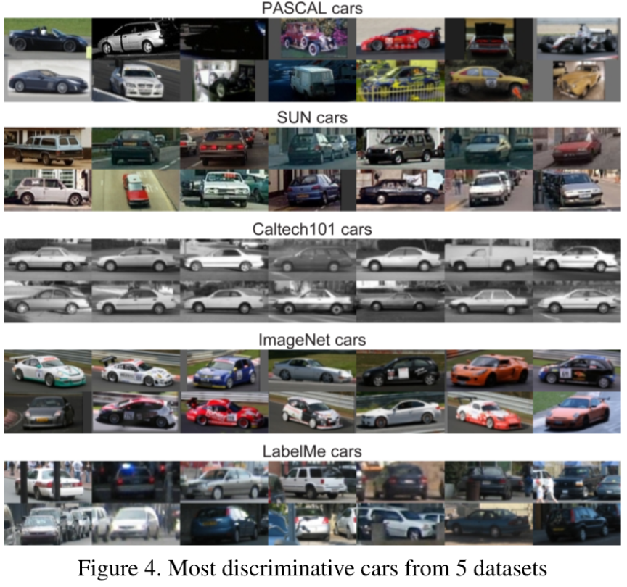
Notes:
What if we just look at one object class across the database?
Yet, even if we try to control for these capture biases by isolating speciﬁc objects of interest, we ﬁnd that the biases are still present in some form.
Classifier still does 61% against a 20% chance.

Slide 44
Measuring Dataset Bias
Idea: cross-dataset generalization
Train an object classifier on one dataset
Test on the same object class on another dataset
Observe performance as measure of bias

Slide 45
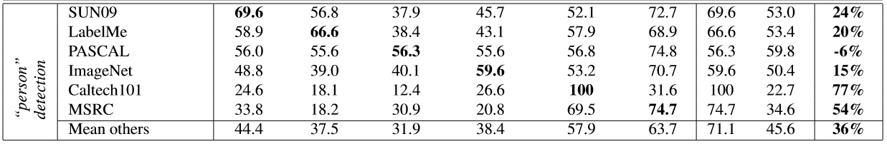
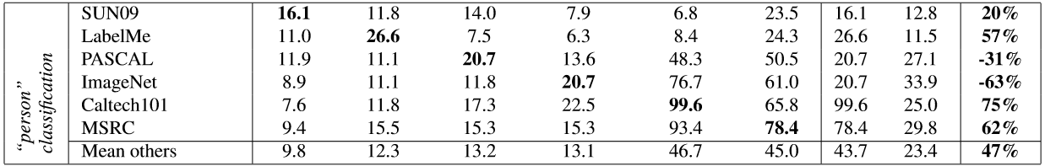

Slide 46
Different kinds of bias
Selection bias
  Retrieve different kinds of images; keywords/search engines can bias.
Capture bias
  Objects photographed in similar ways that do not generalize, e.g., object always in center, race track car vs. street car, mugs.
Notes:
E.G., a low negative set bias for the boat example would include lots of images of rivers and seas without boats.
Capture bias:
Class of ‘mug’
How to resolve selection bias?
“Start with a large collection of unannotated images and label them by crowd-sourcing.”

Slide 47

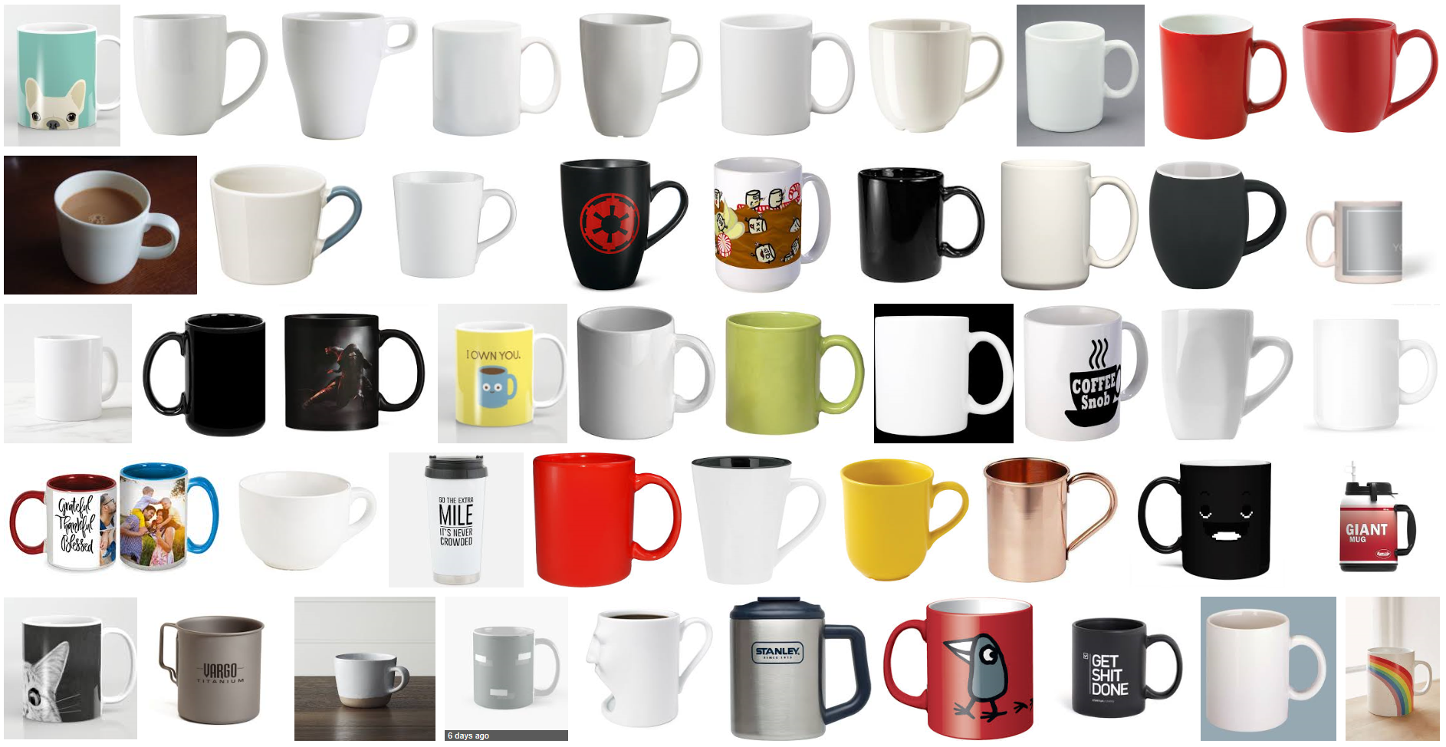
Notes:
Most handles point to the right.
Only 6 out of 50 point left.

Slide 48
Different kinds of bias
Selection bias
  Retrieve different kinds of images; keywords/search engines can bias.
Capture bias
  Objects photographed in similar ways that do not generalize, e.g., object always in center, race track car vs. street car, mugs.
Category/label bias
  Poorly-defined classes, e.g., painting vs. picture
Negative set bias
  In one vs. all classification, ‘all’ or “the rest of the world” is not well represented.
  “Are features which helps classify ‘boat’ object really the boat, or are they the water it sits on?”
    Low bias negative set would include many boat-free images of rivers and lakes.
Notes:
E.G., a low negative set bias for the boat example would include lots of images of rivers and seas without boats.
Capture bias:
Class of ‘mug’
How to resolve selection bias?
“Start with a large collection of unannotated images and label them by crowd-sourcing.”

Slide 49
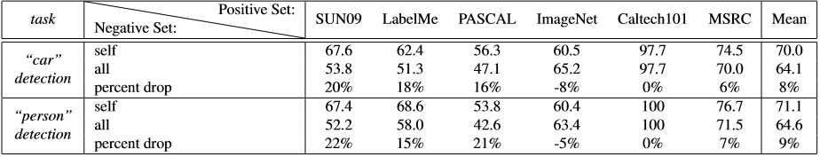
Measuring Negative Set Bias
Take negative examples from other datasets and add to superset; train against this.
Drop in performance of ‘all’ suggests negative examples are being misclassified

Slide 50
Overcoming bias at collection time
Selection bias
  Multiple keywords, search engines, countries.
  Collect unknown images and label them by crowd-sourcing.
Capture bias
  Better sampling
  Different transforms: noise, flips, rotations, affine, crops.
Notes:
For noise, go here:
The Unreasonable Effectiveness of Noisy Data for Fine-Grained Recognition
https://link.springer.com/chapter/10.1007/978-3-319-46487-9_19

Slide 51
Overcoming bias at collection time
Category/label bias
  Clear instruction to turkers; unambiguous classes (possible?)
  Pre-label clustering, or multiple acceptable answers.
Negative set bias
  Cross-dataset mining
  Mine for hard negatives from unlabeled set using a reliable algorithm and high threshold.
Notes:
Negative set bias:
Mark Everingham: use a few standard algorithms (e.g. bag of words) to actively mine hard negatives as part of dataset construction from a very large unlabelled set, and then manually going through them to weed out true positives. The down side is that the resulting dataset will be biased against existing algorithms.

Slide 52
Undoing the Damage of Dataset Bias
Khosla et al., ECCV 2012
“While it remains in question whether creating an unbiased dataset is possible given limited resources, we propose a discriminative framework that directly exploits dataset bias during training.”
Notes:
http://link.springer.com/chapter/10.1007/978-3-642-33718-5_12

Slide 53
More examples
https://www.quora.com/What-are-examples-of-computer-vision-bugs-related-to-race
http://www.telegraph.co.uk/technology/2016/12/07/robot-passport-checker-rejects-asian-mans-photo-having-eyes/
Thank you Tiffany Chen

Slide 54
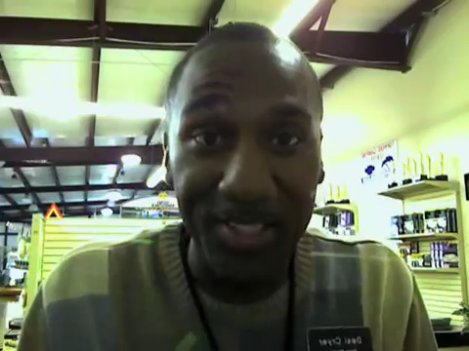
Viola-Jones with a bad training database
wzamen01

Slide 55
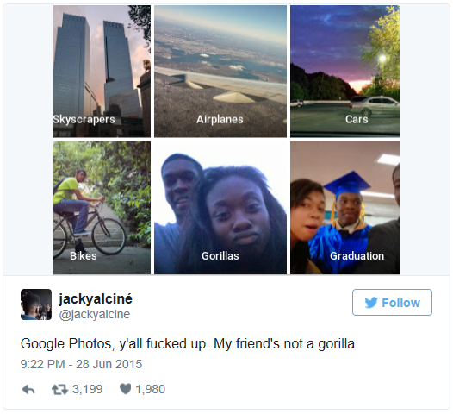
Google Photos (2015)
Jacky Alciné
Notes:
http://www.slate.com/blogs/future_tense/2015/06/30/google_s_image_recognition_software_returns_some_surprisingly_racist_results.html
Jacky Alciné – Brooklyn computer programmer

Slide 56
Google Photos (2015)
What do you think the problem was?
How could you fix it?
Has it been fixed? Anyone use Google Photos?

Slide 57
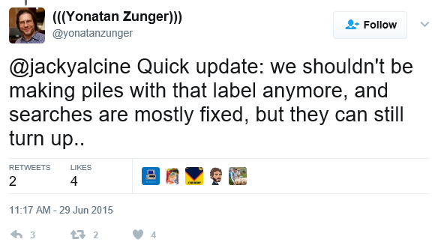
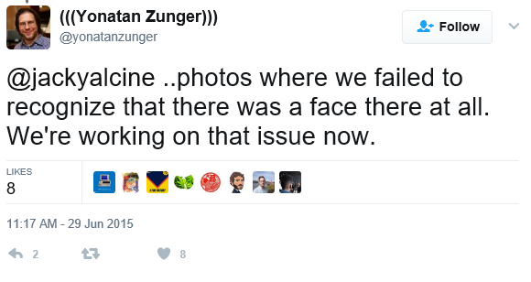
Google Photos (2015)
[in]
Notes:
Yonatan Zunger – Chief Architect of Social

Slide 58
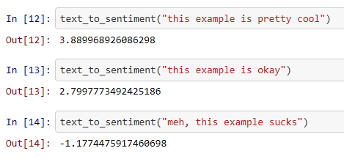
Not just a vision problem
Text embeddings also suffer:
https://gist.github.com/rspeer/ef750e7e407e04894cb3b78a82d66aed
‘Sentiment analysis’ ->
Rob Speer
Notes:
Does Anne Hathaway News Drive Berkshire Hathaway's Stock? https://www.theatlantic.com/technology/archive/2011/03/does-anne-hathaway-news-drive-berkshire-hathaways-stock/72661/

Slide 59
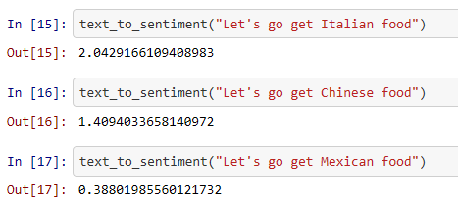
Not just a vision problem
Text embeddings also suffer:
https://gist.github.com/rspeer/ef750e7e407e04894cb3b78a82d66aed
‘Sentiment analysis’ ->
Rob Speer
Notes:
Does Anne Hathaway News Drive Berkshire Hathaway's Stock? https://www.theatlantic.com/technology/archive/2011/03/does-anne-hathaway-news-drive-berkshire-hathaways-stock/72661/
Debiasing Word Embeddings: https://arxiv.org/abs/1607.06520

Slide 60
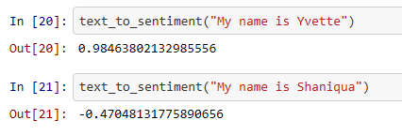

Word embedding trained on Google News – word2vec

Slide 61
AI ‘Safety’
Concrete Problems in AI Safety
https://arxiv.org/abs/1606.06565
In context of robots, but promising ideas
  Regularizer based on expert ‘risk’ of class confusion

Slide 62

Criminality
Wu and Zhang, Automated Inference on Criminality using Face Images, on arXiv 2016
https://arxiv.org/abs/1611.04135
Slide figures from paper

Slide 63
“Unlike a human examiner/judge, a computer vision algorithm or classifier has absolutely no subjective baggages, having no emotions, no biases whatsoever due to past experience, race, religion, political doctrine, gender, age, etc., no mental fatigue, no preconditioning of a bad sleep or meal. The automated inference on criminality eliminates the variable of meta-accuracy (the competence of the human judge/examiner) all together.”

Slide 64

Criminality
1100 non-criminal, 730 criminal Chinese face photos
Tested various features + classifiers

Slide 65

Criminality
K-means, averaging clusters
Notes:
Correlation does not equal causation.
Cited causes:
the curvature of upper lip which is on average 23 percent larger for criminals than for noncriminals;
the distance between two inner corners of the eyes, which is 6 percent shorter;
the angle between two lines drawn from the tip of the nose to the corners of the mouth, which is 20 percent smaller
Criminality

Slide 66
What biases might exist? Discuss!
Selection bias
Capture bias
Category/label bias
Negative set bias

Slide 67
Is this real?
Whatever the case, it needs care! Significant ramifications.
Humans might be able to do this:
  Small but statistically significant ability to tell criminal from non-criminal in photo.
Valla, J., Williams, W., & Ceci, S. J. (2011).
The accuracy of inferences about criminality based on facial appearance.
Journal of Social, Evolutionary, and Cultural Psychology, 5(1), 66-91.
MIT Technology Review has a good overview:
https://www.technologyreview.com/s/602955/neural-network-learns-to-identify-criminals-by-their-faces/
Notes:
PDF for human assessment of criminality trial:
http://emilkirkegaard.dk/en/wp-content/uploads/THE-ACCURACY-OF-INFERENCES-ABOUT-CRIMINALITY-.pdf
Predicting First Impressions with Deep Learning
https://arxiv.org/abs/1610.08119

Slide 68

Valla, J., Williams, W., & Ceci, S. J. (2011)
Notes:
Example test from the Valla study on previous slide.
1 – non-criminal
2 - non-criminal
3- rapist
4 – assault
5 – arson
6 – non-criminal

Slide 69

“Guns don't kill people, people kill people!”
“Machine learning doesn’t kill people,
training data kills people!”
- ML community, all the time.
@vielmetti
Notes:
With great power comes great responsibility!
Requiring a license to use ML? To collect a training data set?

Slide 70


Dataset improvement: MS COCO

Slide 71
Help Do Something About It: Upcoming Hackathon
May 11th 2017 @ Microsoft New England in Boston
Organized by New England Machine Learning Day
Hacking Bias in ML
Ex-Brown PhD will be there - Genevieve Patterson
https://www.eventbrite.com/e/new-england-machine-learning-hackathon-hacking-bias-in-ml-tickets-32951771636?aff=NEML

Slide 72

Decent Pew Overview on Big Picture
Rainie and Anderson
Code-Dependent:
Pros and Cons of the
Algorithm Age
http://www.pewinternet.org/2017/02/08/code-dependent-pros-and-cons-of-the-algorithm-age/
Notes:
http://www.slate.com/articles/technology/future_tense/2017/03/the_surprising_creepy_things_algorithms_can_glean_from_photographs.html

Slide 73

Help Do Something About It
Joy Buolamwini
https://www.theguardian.com/technology/2017/may/28/joy-buolamwini-when-algorithms-are-racist-facial-recognition-bias/
Founded ‘Algorithmic Justice League’
https://www.ajlunited.org/

Slide 74

Notes:
https://whitecollar.thenewinquiry.com/static/whitepaper.pdf
Brooklyn-based leftist magazine
cultural and literary criticism
We propose and develop a predictive policing algorithm, the White Collar Crime Early Warning System (WCCEWS), for identifying and assessing the risk of large-scale financial crime at the city block level. Our model achieves an impressive 90.12% accuracy at predicting the activity of white collar crime in a given area.

Slide 75

[https://whitecollar.thenewinquiry.com/]
Notes:
We collected data provided by the Financial Regulatory Authority (FINRA)14 to compile incidents of financial malfeasance dating back to 1964.
Our geographical data started in the form of street addresses, which we converted to latitude/longitude coordinates with a popular geocoding service.
By incorporating public data sources with a random forest classifier, we are able to achieve 90.12% predictive accuracy.

Slide 76



Slide 77


Slide 78

Face detection + facial landmark detection + image warping + averaging/PCA!

Slide 79

[https://whitecollar.thenewinquiry.com/]

Slide 80

[https://whitecollar.thenewinquiry.com/]

