Slide 1


Slide 2
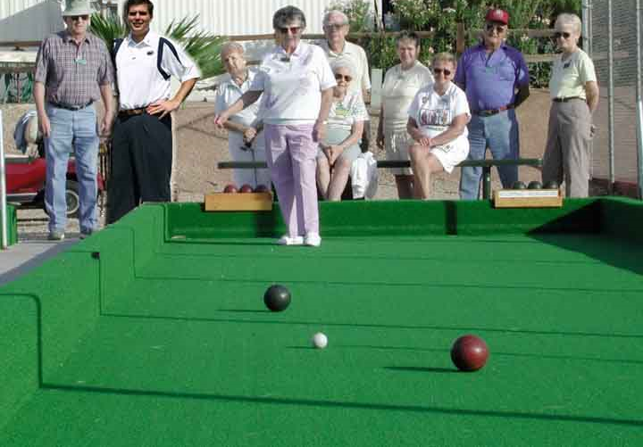
Cameras and World Geometry
How tall is this woman?
How high is the camera?
What is the camera rotation wrt. world?
Which ball is closer?
James Hays

Slide 3
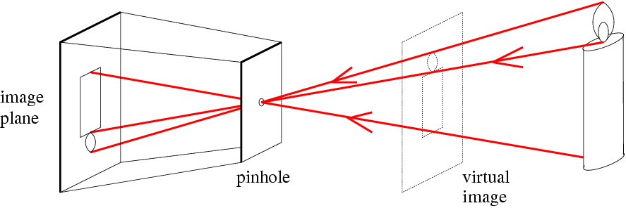
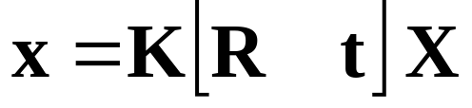
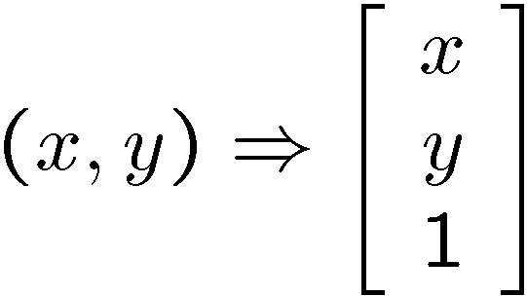
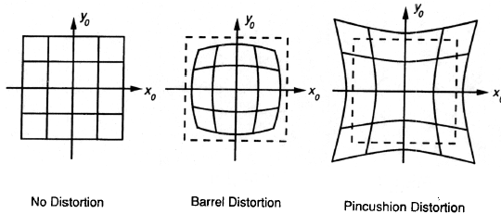
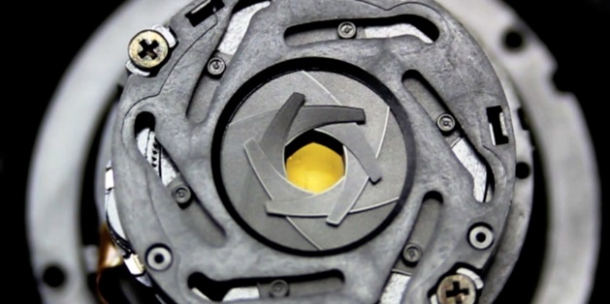
Things to remember
Hays
Pinhole camera model and camera (projection) matrix
Homogeneous coordinates allow projection as a matrix multiplication
Model approximates a camera
Lens distortion
Aperture

Slide 4
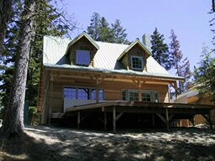
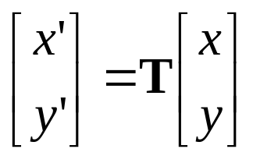
Parametric (global) transformations
T
p = (x,y)
p’ = (x’,y’)
Transformation T is a coordinate-changing machine:
p’ = T(p)
What does it mean that T is global?
  T is the same for any point p
  T can be described by just a few numbers (parameters)
For linear transformations, we can represent T as a matrix
p’ = Tp

Slide 5
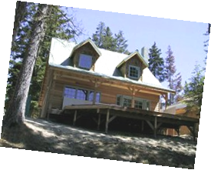
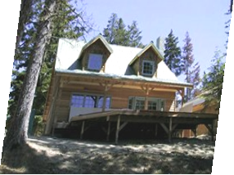
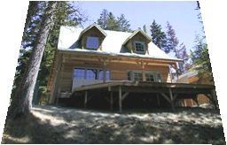
Common transformations
Original
Transformed
Translation
Rotation
Scaling
Affine
Perspective
Slide credit (next few slides): A. Efros and/or S. Seitz

Slide 6
Scaling
Scaling a coordinate means multiplying each of its components by a scalar
Uniform scaling means this scalar is the same for all components:
× 2

Slide 7
Scaling
Non-uniform scaling: different scalars per component:
X × 2,
Y × 0.5

Slide 8
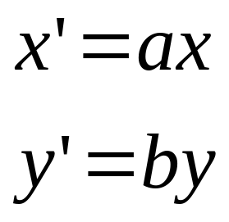
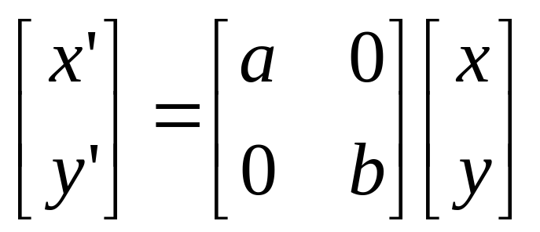
Scaling
Scaling operation:
Or, in matrix form:
scaling matrix S

Slide 9
2-D Rotation
y
(x’, y’)
(x, y)
x’ = x cos(θ) - y sin(θ)
y’ = x sin(θ) + y cos(θ)
θ
x

Slide 10
2-D Rotation
Polar coordinates…
x = r cos (φ)
y = r sin (φ)
x’ = r cos (φ + θ)
y’ = r sin (φ + θ)
Trig Identity…
x’ = r cos(φ) cos(θ) – r sin(φ) sin(θ)
y’ = r sin(φ) cos(θ) + r cos(φ) sin(θ)
Substitute…
x’ = x cos(θ) - y sin(θ)
y’ = x sin(θ) + y cos(θ)
(x’, y’)
(x, y)
θ
φ

Slide 11
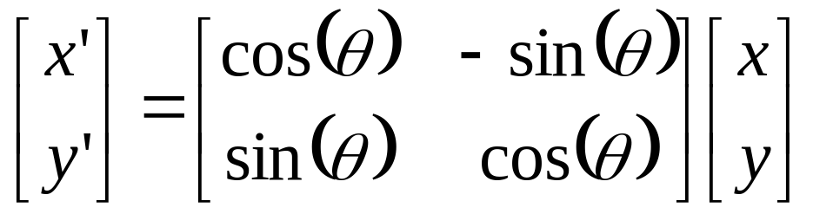

2-D Rotation
This is easy to capture in matrix form:
Even though sin(θ) and cos(θ) are nonlinear functions of θ,
  x’ is a linear combination of x and y
  y’ is a linear combination of x and y
What is the inverse transformation?
  Rotation by –θ
  For rotation matrices
R

Slide 12
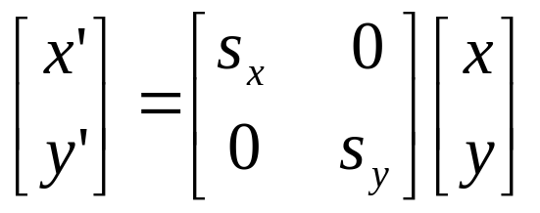
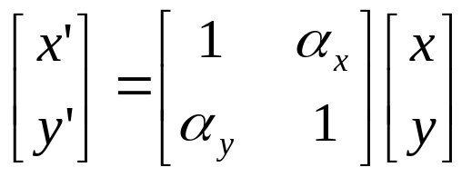
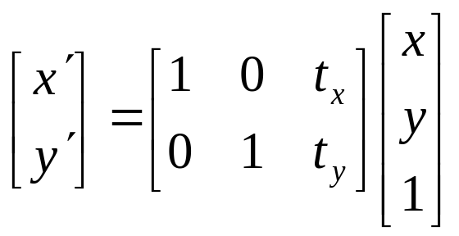
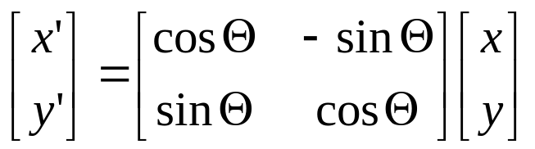
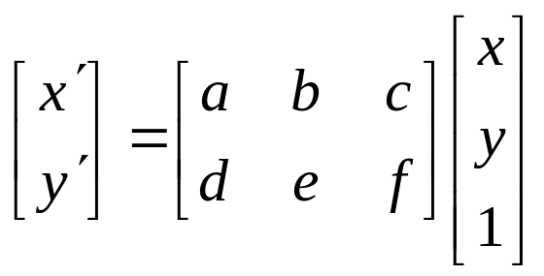
Basic 2D transformations
Scale
Shear
Rotate
Translate
Affine is any combination of translation, scale, rotation, and shear
Affine

Slide 13

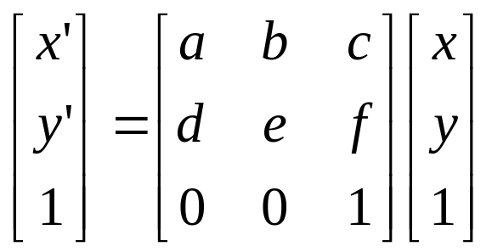
Affine Transformations
Affine transformations are combinations of
  Linear transformations, and
  Translations
Properties of affine transformations:
  Lines map to lines
  Parallel lines remain parallel
  Ratios are preserved
  Closed under composition
or
Notes:
Ratios of distances along straight lines are preserved, e.g. the relative length of two collinear line segments

Slide 14
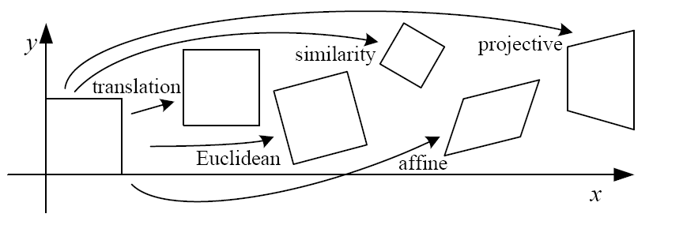
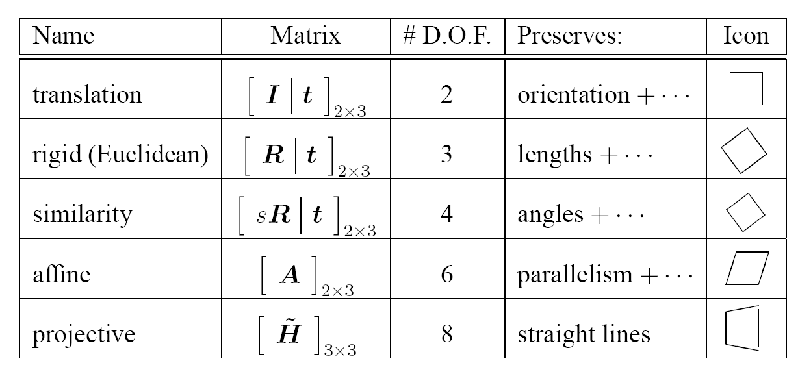
2D image transformations (reference table)
‘Homography’
Szeliski 2.1
Notes:
https://en.wikipedia.org/wiki/Homography_(computer_vision)

Slide 15
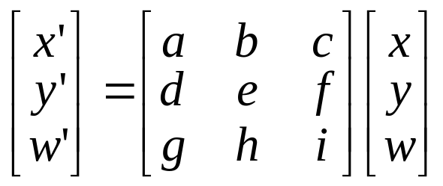
Projective Transformations
Projective transformations are combos of
  Affine transformations, and
  Projective warps
Properties of projective transformations:
  Lines map to lines
  Parallel lines do not necessarily remain parallel
  Ratios are not preserved
  Closed under composition
  Models change of basis
  Projective matrix is defined up to a scale (8 DOF)

Slide 16
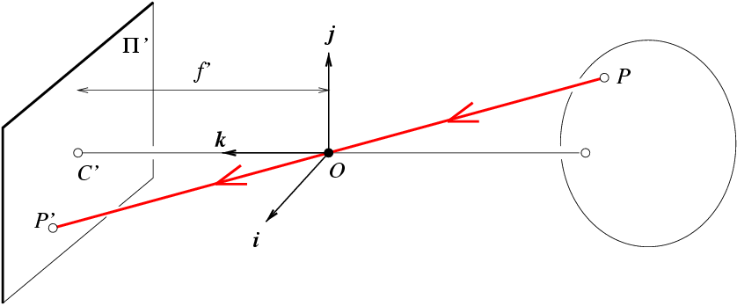

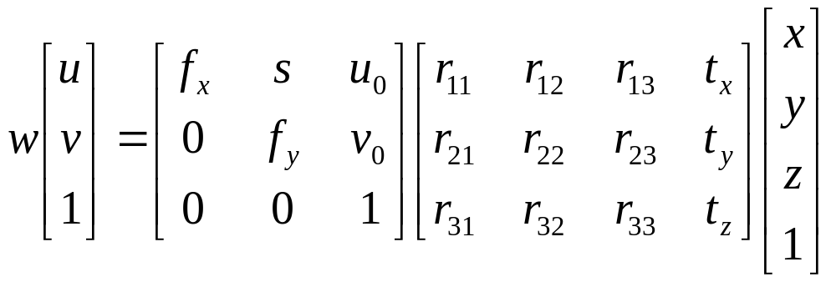
Camera (projection) matrix
Slide Credit: Savarese
R,t
j_{w}
X
k_{w}
O_{w}
x
i_{w}
x: Image Coordinates: (u,v,1)
K: Intrinsic Matrix (3x3)
R: Rotation (3x3)
t: Translation (3x1)
X: World Coordinates: (X,Y,Z,1)
Notes:
We can use homogeneous coordinates to write ‘camera matrix’ in linear form.

Slide 17
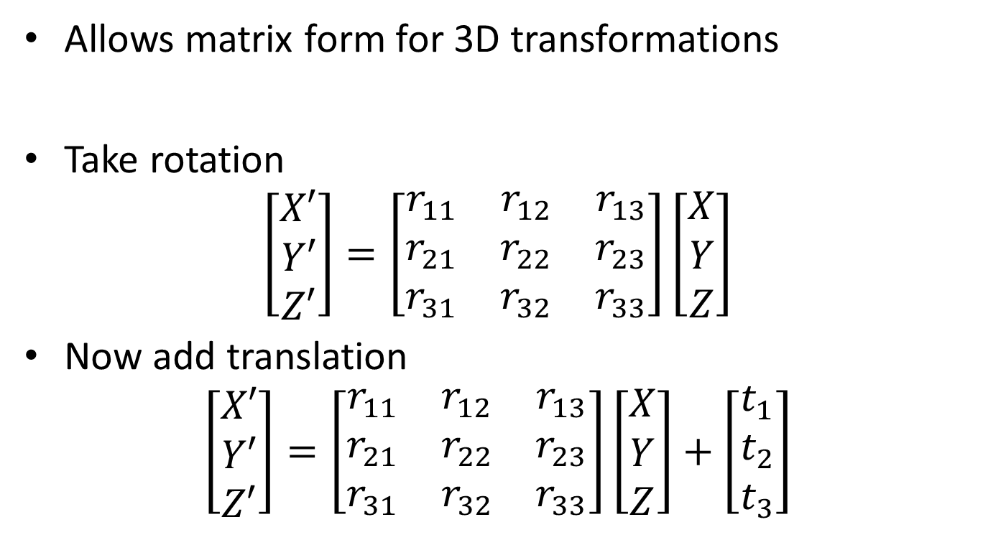
Homogeneous coordinates
Allows matrix form for 3D transformations
Take rotation
$$\left[\begin{matrix}X′ \\ Y′ \\ Z′\end{matrix}\right]=\left[\begin{matrix}r_{11} & r_{12} & r_{13} \\ r_{21} & r_{22} & r_{23} \\ r_{31} & r_{32} & r_{33}\end{matrix}\right]\left[\begin{matrix}X \\ Y \\ Z\end{matrix}\right]$$
Now add translation
$$\left[\begin{matrix}X′ \\ Y′ \\ Z′\end{matrix}\right]=\left[\begin{matrix}r_{11} & r_{12} & r_{13} \\ r_{21} & r_{22} & r_{23} \\ r_{31} & r_{32} & r_{33}\end{matrix}\right]\left[\begin{matrix}X \\ Y \\ Z\end{matrix}\right]+\left[\begin{matrix}t_{1} \\ t_{2} \\ t_{3}\end{matrix}\right]$$

Slide 18
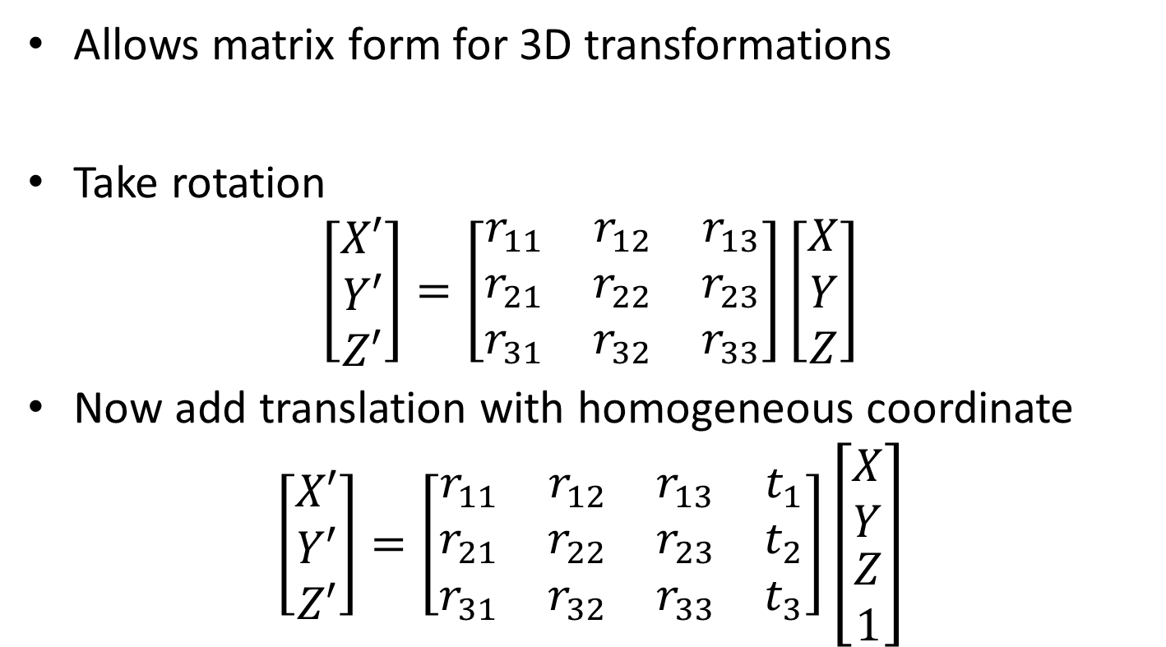
Homogeneous coordinates
Allows matrix form for 3D transformations
Take rotation
$$\left[\begin{matrix}X′ \\ Y′ \\ Z′\end{matrix}\right]=\left[\begin{matrix}r_{11} & r_{12} & r_{13} \\ r_{21} & r_{22} & r_{23} \\ r_{31} & r_{32} & r_{33}\end{matrix}\right]\left[\begin{matrix}X \\ Y \\ Z\end{matrix}\right]$$
Now add translation with homogeneous coordinate
$$\left[\begin{matrix}X′ \\ Y′ \\ Z′\end{matrix}\right]=\left[\begin{matrix}r_{11} & r_{12} & r_{13} & t_{1} \\ r_{21} & r_{22} & r_{23} & t_{2} \\ r_{31} & r_{32} & r_{33} & t_{3}\end{matrix}\right]\left[\begin{matrix}X \\ Y \\ \begin{aligned}Z \\ 1\end{aligned}\end{matrix}\right]$$

Slide 19
Camera (projection) matrix
Slide Credit: Savarese
R,t
j_{w}
X
k_{w}
O_{w}
x
i_{w}
x: Image Coordinates: (u,v,1)
K: Intrinsic Matrix (3x3)
R: Rotation (3x3)
t: Translation (3x1)
X: World Coordinates: (X,Y,Z,1)
Extrinsic Matrix
Notes:
We can use homogeneous coordinates to write ‘camera matrix’ in linear form.

Slide 20

Intrinsic and extrinsic matrices
Hays

Slide 21
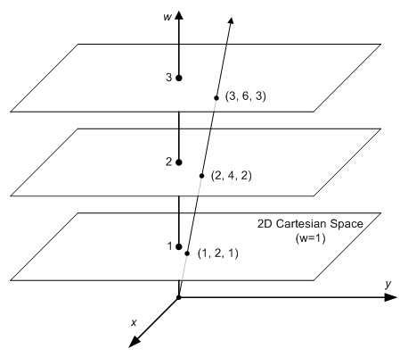
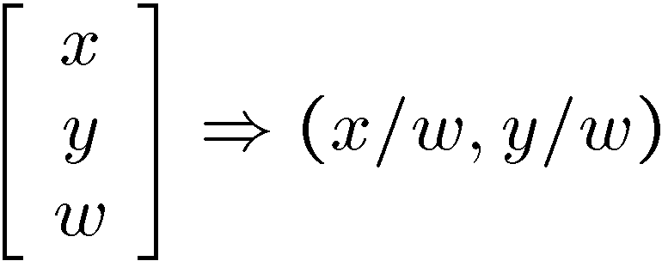
Homogeneous coordinates
Projective
Point becomes a line
To homogeneous
From homogeneous
Song Ho Ahn
Notes:
http://www.songho.ca/math/homogeneous/homogeneous.html

Slide 22
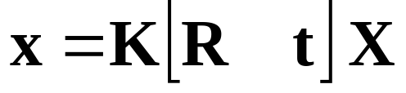
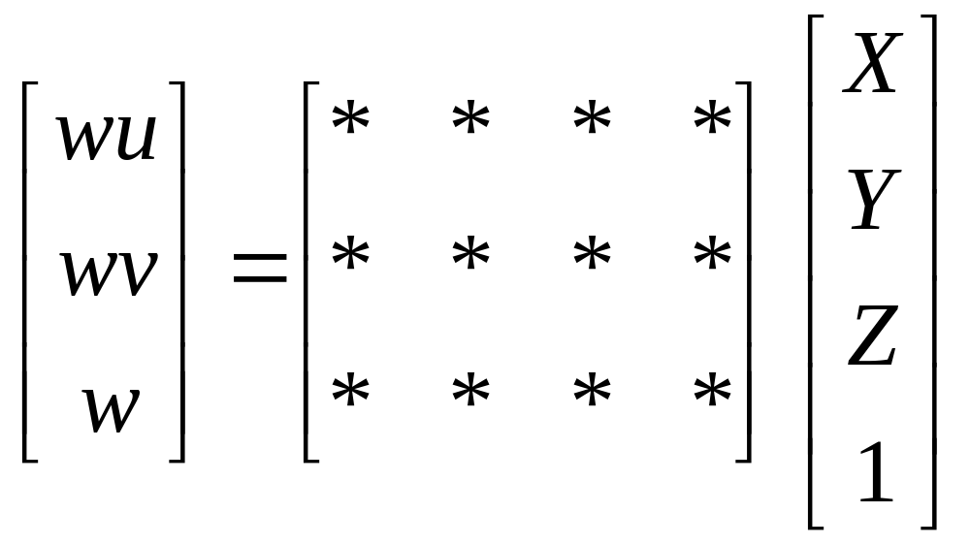

How to calibrate the camera?
(also called “camera resectioning”)
$$x=MX$$
Linear least-squares regression!
James Hays

Slide 23
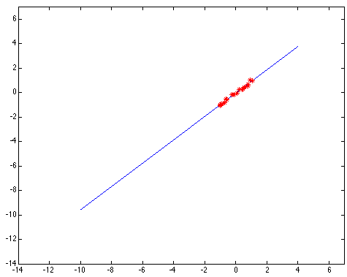
Simple example: Fitting a line

Slide 24
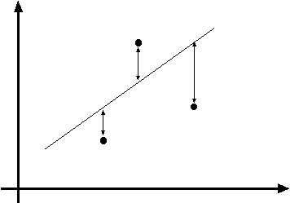
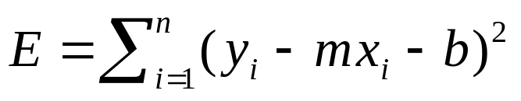
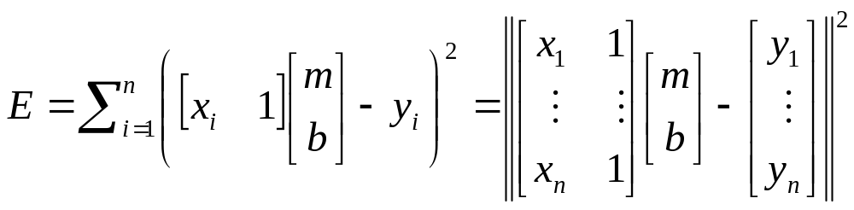
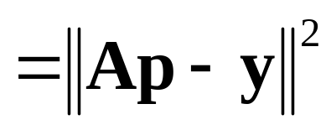

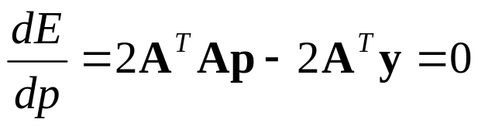
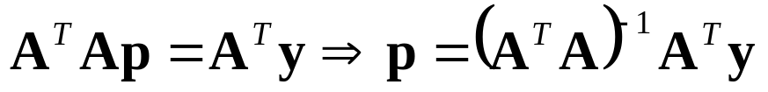
Least squares line fitting
Data: (x₁, y₁), …, (x_{n}, y_{n})
Line equation: y_{i} = m x_{i} + b
Find (m, b) to minimize
y=mx+b
(x_{i}, y_{i})
Matlab: p = A \ y;
(Closed form solution)
Modified from S. Lazebnik
Notes:
What is p here? p is [m b]’
The minimum is determined by calculating the partial derivatives of E with respect to p and setting them to zero.

Slide 25

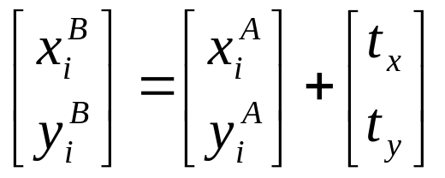
Example: solving for translation
A₁
A₂
A₃
B₁
B₂
B₃
Given matched points in {A} and {B}, estimate the translation of the object

Slide 26
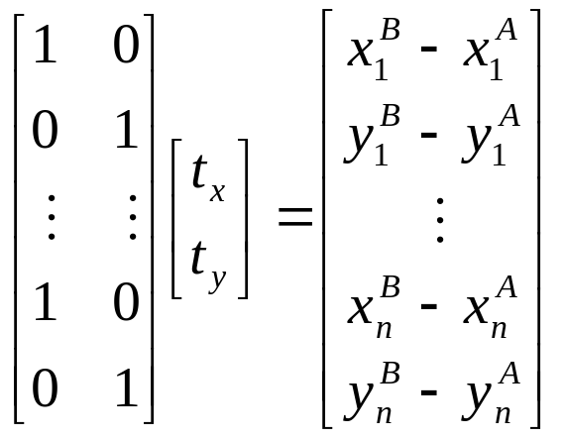
Example: solving for translation
A₁
A₂
A₃
(t_{x}, t_{y})
B₁
B₂
B₃
Least squares setup
Notes:
Solve using pseudo-inverse or eigenvalue decomposition

Slide 27
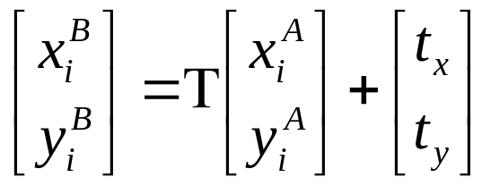
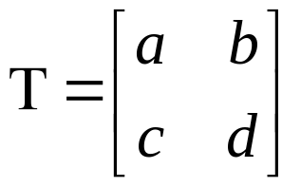
Example: discovering rot/trans/scale
A₁
B₁
A₂
A₃
B₂
B₃
Given matched points in {A} and {B}, estimate the transformation matrix

Slide 28
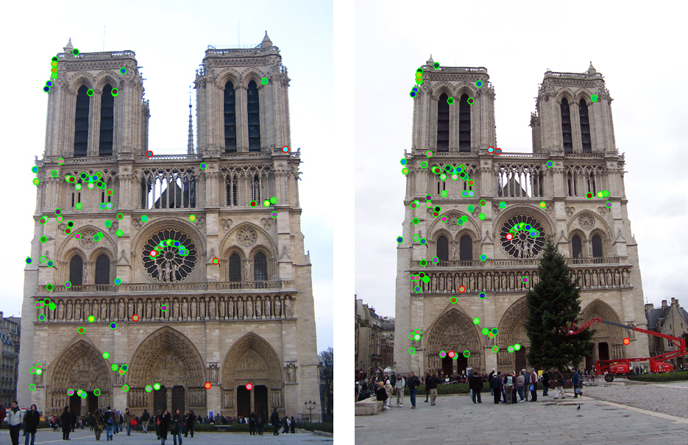
Are these transformations enough?

Slide 29
Example: solving for translation
A₁
A₂
A₃
(t_{x}, t_{y})
B₁
B₂
B₃
Least squares solution
Write down objective function
Derived solution
  Compute derivative
  Compute solution
Computational solution
  Write in form Ax=p
  Solve using closed-form solution
Notes:
Solve using pseudo-inverse or eigenvalue decomposition

Slide 30
Problem with “vertical” least squares
Not rotation-invariant
Fails completely for vertical lines
Slide from S. Lazebnik

Slide 31
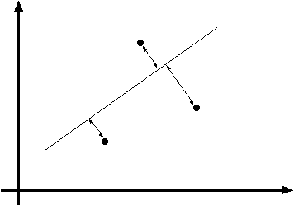

Total least squares
Slide modified from S. Lazebnik
If (a²+b²=1) then
Distance between point (x_{i}, y_{i}) is
|ax_{i} + by_{i} + c|
ax+by+c=0
Unit normal: N=(a, b)
(x_{i}, y_{i})
proof: http://mathworld.wolfram.com/Point-LineDistance2-Dimensional.html

Slide 32
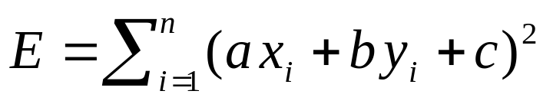
Total least squares
Slide modified from S. Lazebnik
If (a²+b²=1) then
Distance between point (x_{i}, y_{i}) is
|ax_{i} + by_{i} + c|
Find (a, b, c) to minimize the sum of squared perpendicular distances
ax+by+c=0
Unit normal: N=(a, b)
(x_{i}, y_{i})

Slide 33
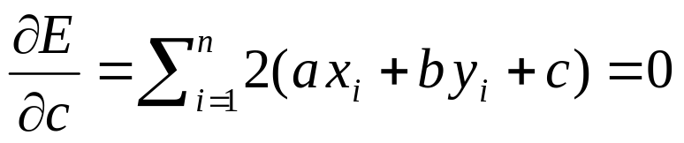
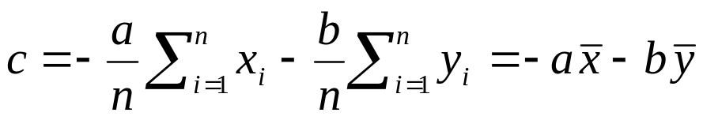
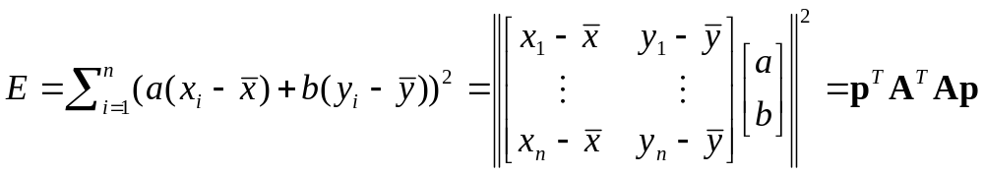
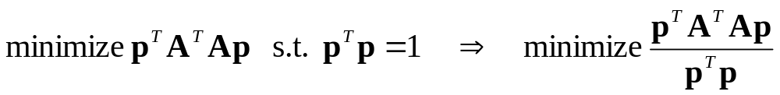
Total least squares
Slide modified from S. Lazebnik
Find (a, b, c) to minimize the sum of squared perpendicular distances
ax+by+c=0
Unit normal: N=(a, b)
(x_{i}, y_{i})
Solution is eigenvector corresponding to smallest eigenvalue of A^{T}A
See details on Raleigh Quotient: http://en.wikipedia.org/wiki/Rayleigh_quotient

Slide 34
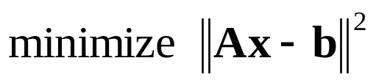





Recap: Two Common Optimization Problems
Problem statement
Solution
(matlab)
Problem statement
Solution

Slide 35
Least squares (global) optimization
Good
Clearly specified objective
Optimization is easy
Bad
Sensitive to outliers
  Bad matches, extra points
Doesn’t allow you to get multiple good fits
  Detecting multiple objects, lines, etc.

Slide 36

World vs Camera coordinates
James Hays

Slide 37


Calibrating the Camera
James Hays
Use an scene with known geometry
  Correspond image points to 3d points
  Get least squares solution (or non-linear solution)
Known 2d image coords
Known 3d
world locations
M
Unknown Camera Parameters

Slide 38

How do we calibrate a camera?
Known 2d image coords
Known 3d world locations
880 214
43 203
270 197
886 347
745 302
943 128
476 590
419 214
317 335
783 521
235 427
665 429
655 362
427 333
412 415
746 351
434 415
525 234
716 308
602 187
312.747 309.140 30.086
305.796 311.649 30.356
307.694 312.358 30.418
310.149 307.186 29.298
311.937 310.105 29.216
311.202 307.572 30.682
307.106 306.876 28.660
309.317 312.490 30.230
307.435 310.151 29.318
308.253 306.300 28.881
306.650 309.301 28.905
308.069 306.831 29.189
309.671 308.834 29.029
308.255 309.955 29.267
307.546 308.613 28.963
311.036 309.206 28.913
307.518 308.175 29.069
309.950 311.262 29.990
312.160 310.772 29.080
311.988 312.709 30.514
James Hays

Slide 39


What is least squares doing?
Given 3D point evidence, find best M which minimizes error between estimate (p’) and known corresponding 2D points (p).
.
Error between M estimate and known projection point
.
.
f
Z
Y
.
.
v
Camera center
p’ under M
u
p = distance from image center

Slide 40
What is least squares doing?
Best M occurs when p’ = p, or when p’ – p = 0
Form these equations from all point evidence
Solve for model via closed-form regression
.
Error between M estimate and known projection point
.
.
f
Z
Y
.
.
v
Camera center
p’ under M
u
p = distance from image center

Slide 41





Unknown Camera Parameters
Known 2d image coords
Known 3d locations
First, work out where X,Y,Z projects to under candidate M.
Two equations per 3D point correspondence
James Hays

Slide 42
Unknown Camera Parameters
Known 2d image coords
Known 3d locations
Next, rearrange into form where all M coefficients are individually stated in terms of X,Y,Z,u,v.
-> Allows us to form lsq matrix.

Slide 43
Unknown Camera Parameters
Known 2d image coords
Known 3d locations
Next, rearrange into form where all M coefficients are individually stated in terms of X,Y,Z,u,v.
-> Allows us to form lsq matrix.

Slide 44

Unknown Camera Parameters
Known 2d image coords
Known 3d locations
Finally, solve for m’s entries using linear least squares
Method 1 –
Ax=b form
M = A\Y;
M = [M;1];
M = reshape(M,[],3)';
James Hays
Notes:
Method 1 – nonhomogeneous linear system. Not related to homogeneous coordinates!! - https://en.m.wikipedia.org/wiki/System_of_linear_equations

Slide 45

Unknown Camera Parameters
Known 2d image coords
Known 3d locations
Or, solve for m’s entries using total linear least-squares.
Method 2 –
Ax=0 form
[U, S, V] = svd(A);
M = V(:,end);
M = reshape(M,[],3)';
James Hays
Notes:
Method 2 – homogeneous linear system. Not related to homogeneous coordinates!! - https://en.m.wikipedia.org/wiki/System_of_linear_equations

Slide 46
How do we calibrate a camera?
Known 2d image coords
Known 3d world locations
880 214
43 203
270 197
886 347
745 302
943 128
476 590
419 214
317 335
783 521
235 427
665 429
655 362
427 333
412 415
746 351
434 415
525 234
716 308
602 187
312.747 309.140 30.086
305.796 311.649 30.356
307.694 312.358 30.418
310.149 307.186 29.298
311.937 310.105 29.216
311.202 307.572 30.682
307.106 306.876 28.660
309.317 312.490 30.230
307.435 310.151 29.318
308.253 306.300 28.881
306.650 309.301 28.905
308.069 306.831 29.189
309.671 308.834 29.029
308.255 309.955 29.267
307.546 308.613 28.963
311.036 309.206 28.913
307.518 308.175 29.069
309.950 311.262 29.990
312.160 310.772 29.080
311.988 312.709 30.514
James Hays

Slide 47



Known 2d image coords
Known 3d world locations
1st point
880 214
43 203
270 197
886 347
745 302
943 128
476 590
419 214
335
…
$$(u1,v1)$$
312.747 309.140 30.086
305.796 311.649 30.356
307.694 312.358 30.418
310.149 307.186 29.298
311.937 310.105 29.216
311.202 307.572 30.682
307.106 306.876 28.660
309.317 312.490 30.230
307.435 310.151 29.318
…..
$$(X1,Y1,Z1)$$
Projection error defined by two equations – one for u and one for v

Slide 48



Known 2d image coords
Known 3d world locations
880 214
43 203
270 197
886 347
745 302
943 128
476 590
419 214
335
…
312.747 309.140 30.086
305.796 311.649 30.356
307.694 312.358 30.418
310.149 307.186 29.298
311.937 310.105 29.216
311.202 307.572 30.682
307.106 306.876 28.660
309.317 312.490 30.230
307.435 310.151 29.318
…..
2nd point
$$(u2,v2)$$
$$(X2,Y2,Z2)$$
Projection error defined by two equations – one for u and one for v

Slide 49

How many points do I need to fit the model?
Degrees of freedom?
5
6
Think 3:
Rotation around x
Rotation around y
Rotation around z
Notes:
How many known points are needed to estimate this?
Why 5?
Why 6? Don’t we have 12 parameters here?
But matrix is not full rank -> it’s a projection (we can tell because it isn’t square -> the column space is 4D, but the row space is 3D, so this matrix projects a 4D space to a 3D space)
One of the dimensions is lost – intuitive, dimensionality reduction machine.
Ambiguous scale in the camera projection matrix. This scale is in the null space of the matrix, i.e., there is a line of possible solutions (plane?)

Slide 50
How many points do I need to fit the model?
Degrees of freedom?
5
6
M is 3x4, so 12 unknowns, but projective scale ambiguity – 11 deg. freedom.
One equation per unknown -> 5 1/2 point correspondences determines a solution (e.g., either u or v).
More than 5 1/2 point correspondences -> overdetermined, many solutions to M.
Least squares is finding the solution that best satisfies the overdetermined system.
Why use more than 6? Robustness to error in feature points.
Notes:
How many known points are needed to estimate this?
Why 5?
Why 6? Don’t we have 12 parameters here?
8 equations in 2D -> 16 parameters
But matrix is not full rank -> it’s a projection (we can tell because it isn’t square -> the column space is 4D, but the row space is 3D, so this matrix projects a 4D space to a 3D space)
One of the dimensions is lost – intuitive, dimensionality reduction machine.
Ambiguous scale in the camera projection matrix. This scale is in the null space of the matrix, i.e., there is a line of possible solutions (plane?)
Actually only need 8 points to produce a valid (up to scale) projection matrix.

Slide 51
Solving - why two methods?
Any projection is inherently ambiguous
A space of possible solutions
Under projective model, this is our projective scale ambiguity.
x₁
x
v₁
v₂

Slide 52
Unknown Camera Parameters
Known 2d image coords
Known 3d locations
Method 1 – - p’ = p
To set scale, we artificially set m₃₄ to 1
Ax=b form
Note – you will see this form called ‘inhomogeneous’ linear system -> nothing to do with homogeneous coordinates
M = A\Y;
M = [M;1];
M = reshape(M,[],3)';
James Hays
Notes:
Method 1 – inhomogeneous linear system. Not related to homogeneous coordinates!! - https://en.m.wikipedia.org/wiki/System_of_linear_equations

Slide 53
Unknown Camera Parameters
Known 2d image coords
Known 3d locations
Method 2 – - p’ – p = 0
SVD – singular value decomposition
Computes pseudo-inverse
Ax=0 form
Note – you will see this form called ‘homogeneous’ linear system -> nothing to do with homogeneous coordinates
[U, S, V] = svd(A);
M = V(:,end);
M = reshape(M,[],3)';
James Hays
Notes:
Method 2 – homogeneous linear system. Not related to homogeneous coordinates!! - https://en.m.wikipedia.org/wiki/System_of_linear_equations

Slide 54
Calibration with linear method
Advantages
  Easy to formulate and solve
  Provides initialization for non-linear methods
Disadvantages
  Doesn’t directly give you camera parameters
  Doesn’t model radial distortion
  Can’t impose constraints, such as known focal length
Non-linear methods are preferred
  Define error as difference between projected points and measured points
  Minimize error using Newton’s method or other non-linear optimization
James Hays

Slide 55
Can we factorize M back to K [R | T]?
Yes!
We can directly solve for the individual entries of K [R | T].
James Hays

Slide 56

a_{n} = nth column of A
James Hays

Slide 57

James Hays

Slide 58

James Hays

Slide 59
Can we factorize M back to K [R | T]?
Yes!
We can also use RQ factorization (not QR)
  R in RQ is not rotation matrix R; crossed names!
R (right diagonal) is K
Q (orthogonal basis) is R.
T, the last column of [R | T], is inv(K) * last column of M.
  But you need to do a bit of post-processing to make sure that the matrices are valid. See http://ksimek.github.io/2012/08/14/decompose/
James Hays

Slide 60

Recovering the camera center
This is not the camera center C.
It is –RC, as the point is rotated before t_{x}, t_{y}, and t_{z} are added
t
So we need
-R⁻¹ K⁻¹ m₄ to get C.
m₄
This is t × K
So K⁻¹ m₄ is t
Q is K × R.
So we just need -Q⁻¹ m₄
Q
James Hays

Slide 61

Estimate of camera center
1.0486 -0.3645
-1.6851 -0.4004
-0.9437 -0.4200
1.0682 0.0699
0.6077 -0.0771
1.2543 -0.6454
-0.2709 0.8635
-0.4571 -0.3645
-0.7902 0.0307
0.7318 0.6382
-1.0580 0.3312
0.3464 0.3377
0.3137 0.1189
-0.4310 0.0242
-0.4799 0.2920
0.6109 0.0830
-0.4081 0.2920
-0.1109 -0.2992
0.5129 -0.0575
0.1406 -0.4527
1.5706 -0.1490 0.2598
-1.5282 0.9695 0.3802
-0.6821 1.2856 0.4078
0.4124 -1.0201 -0.0915
1.2095 0.2812 -0.1280
0.8819 -0.8481 0.5255
-0.9442 -1.1583 -0.3759
0.0415 1.3445 0.3240
-0.7975 0.3017 -0.0826
-0.4329 -1.4151 -0.2774
-1.1475 -0.0772 -0.2667
-0.5149 -1.1784 -0.1401
0.1993 -0.2854 -0.2114
-0.4320 0.2143 -0.1053
-0.7481 -0.3840 -0.2408
0.8078 -0.1196 -0.2631
-0.7605 -0.5792 -0.1936
0.3237 0.7970 0.2170
1.3089 0.5786 -0.1887
1.2323 1.4421 0.4506

Slide 62
Oriented and Translated Camera
R
j_{w}
t
k_{w}
O_{w}
i_{w}

Slide 63
One difficult example…

Slide 64

Erik Johansson – The Architect

