Slide 1


Slide 2
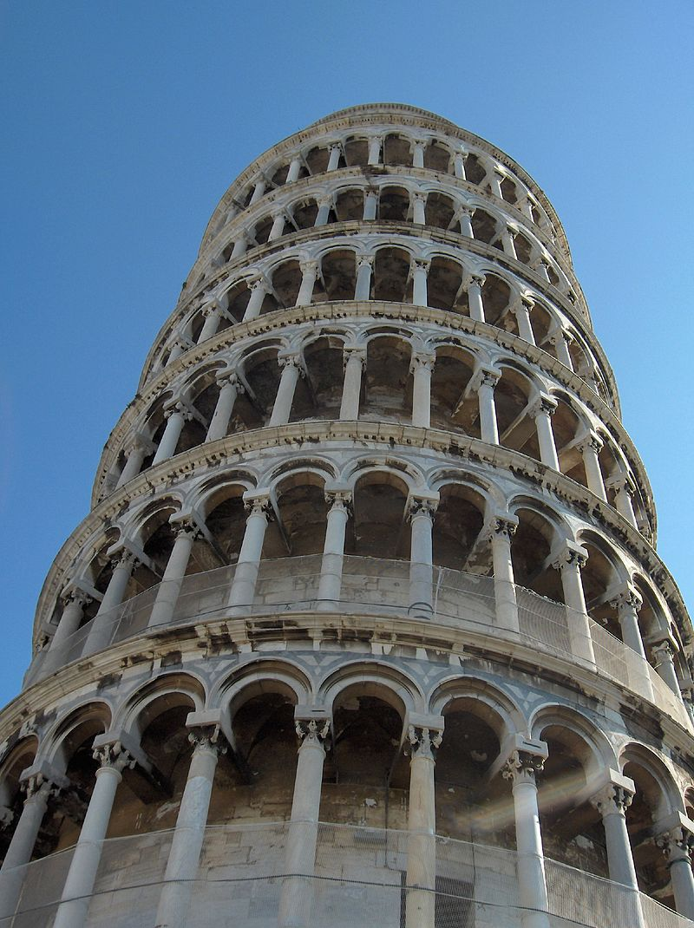
Notes:
https://en.wikipedia.org/wiki/Leaning_tower_illusion
Pisa

Slide 3
Notes:
https://en.wikipedia.org/wiki/Leaning_tower_illusion
Pisa

Slide 4
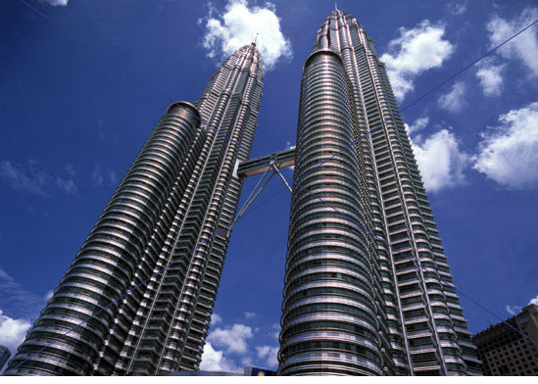
Frederick Kingdom
Notes:
https://en.wikipedia.org/wiki/Leaning_tower_illusion
http://www.scholarpedia.org/article/Leaning_tower_illusion
Petronas twin towers in Quala Lumpur
Even though the corresponding outlines of the two towers converge in the image due to perspective, from experience we expect them to be rising at the same angle, and so we perceive the towers to be parallel.

Slide 5
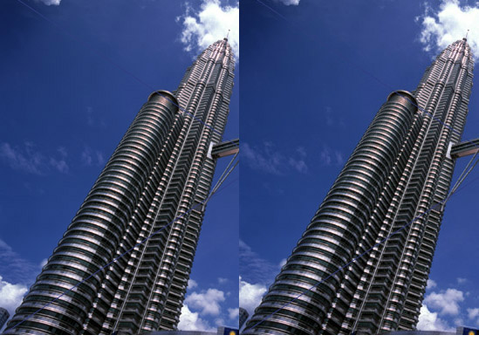
Frederick Kingdom
Notes:
https://en.wikipedia.org/wiki/Leaning_tower_illusion
http://www.scholarpedia.org/article/Leaning_tower_illusion
Petronas twin towers in Quala Lumpur
When the corresponding outlines of two receding towers do not converge but are parallel, the correction for perspective is removed, and the only reasonable interpretation is that the towers must be diverging.

Slide 6
Photo: Georges Jansoon. Illusion: Frederick Kingdom, Ali Yoonessi and Elena Gheorghiu
Notes:
https://en.wikipedia.org/wiki/Leaning_tower_illusion

Slide 7
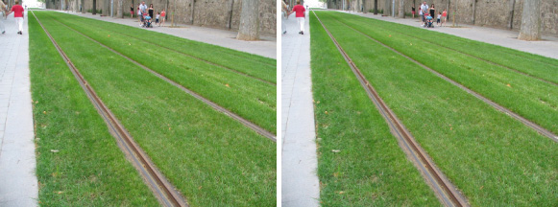
Frederick Kingdom

Slide 8
Depth from disparity
Goal: recover depth by finding image coordinate x’ that corresponds to x
X
X
x
z
x
x’
x'
f
f
O
Baseline
T
O’

Slide 9
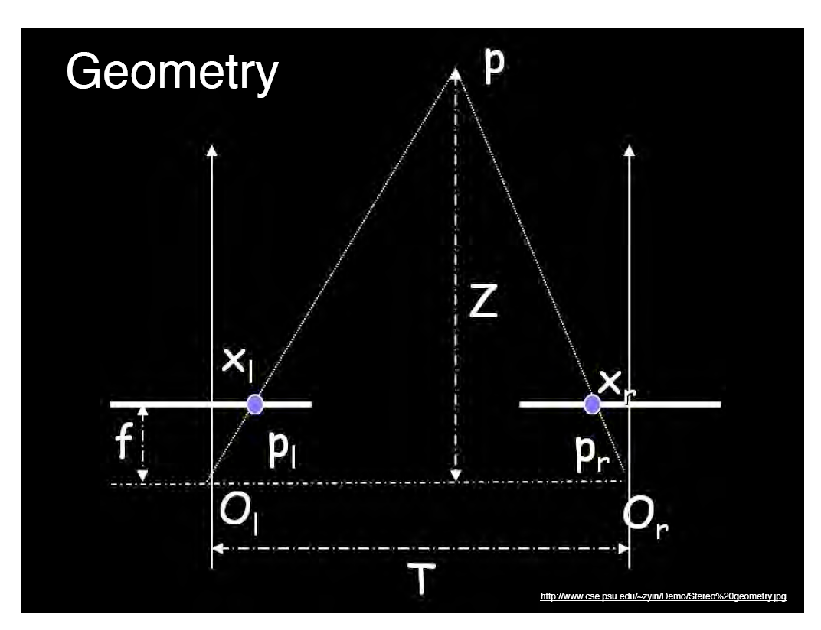
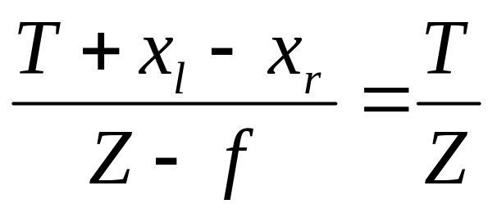
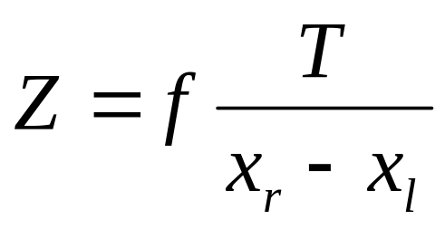
Geometry for a simple stereo system
Assume parallel optical axes, known camera parameters (i.e., calibrated cameras). What is expression for Z?
Similar triangles (p_{l}, P, p_{r}) and (O_{l}, P, O_{r}):
disparity
Notes:
9

Slide 10
Depth from disparity
Goal: recover depth by finding image coordinate x’ that corresponds to x
Sub-Problems
  Calibration: How do we recover the relation of the cameras (if not already known)?
  Correspondence: How do we search for the matching point x’?
X
x
x'

Slide 11
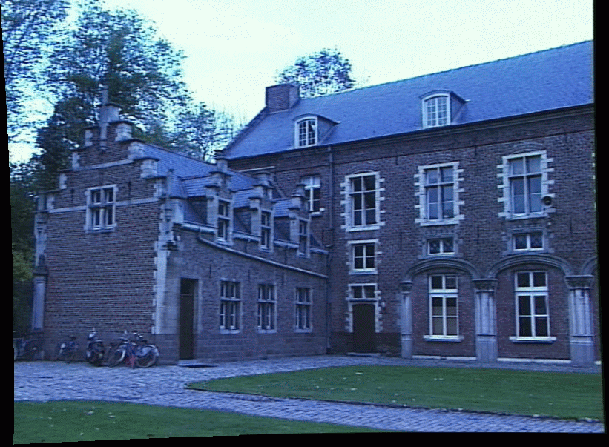
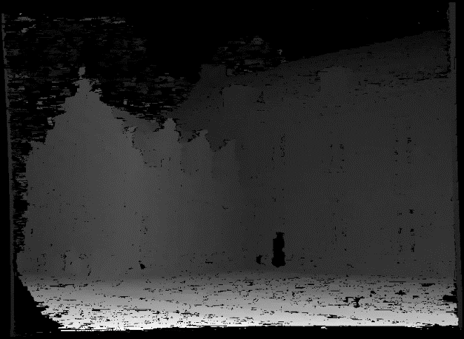
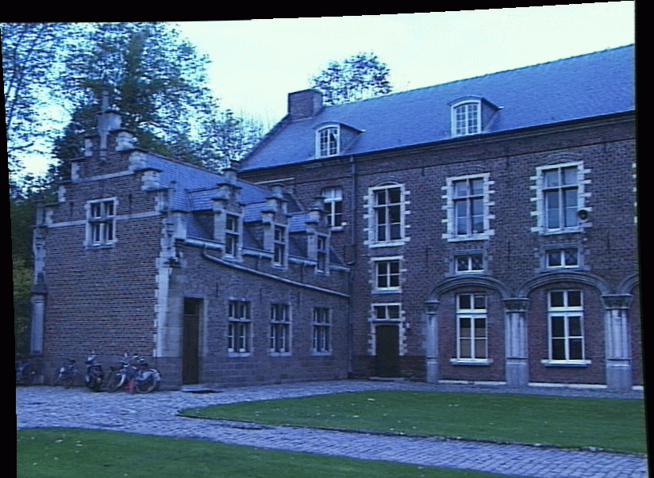
Depth from disparity
image I(x,y)
Disparity map D(x,y)
image I´(x´,y´)
(x´,y´)=(x+D(x,y), y)
If we could find the corresponding points in two images, we could estimate relative depth…
James Hays

Slide 12
What do we need to know?
Calibration for the two cameras.
  Intrinsic matrices for both cameras (e.g., f)
  Baseline distance T in parallel camera case
  R, t in non-parallel case
2. Correspondence for every pixel.
Like project 2, but project 2 is “sparse”.
We need “dense” correspondence!

Slide 13
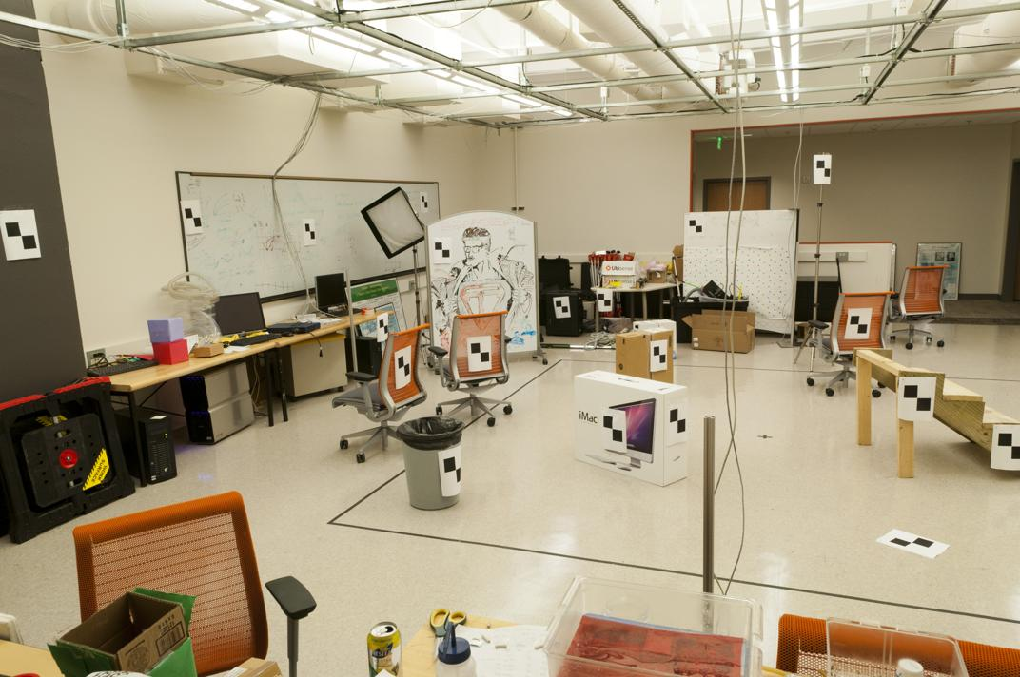
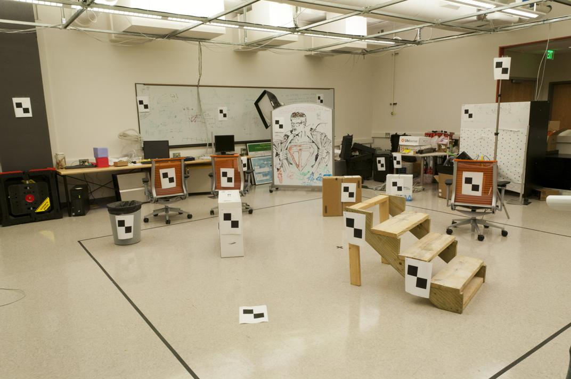
Correspondence for every pixel.
Where do we need to search?

Slide 14
Wouldn’t it be nice to know where matches can live?
Epipolar geometry
Constrains 2D search to 1D

Slide 15
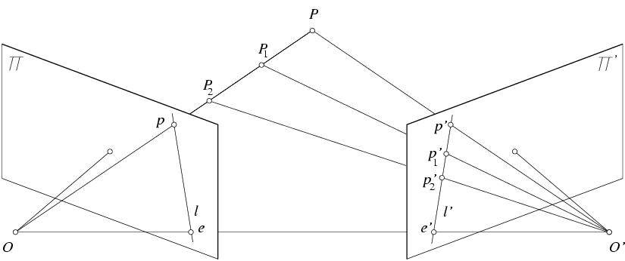
Key idea: Epipolar constraint
X
X
X
x
x’
x’
x’
Potential matches for x’ have to
lie on the corresponding line l.
Potential matches for x have to
lie on the corresponding line l’.

Slide 16
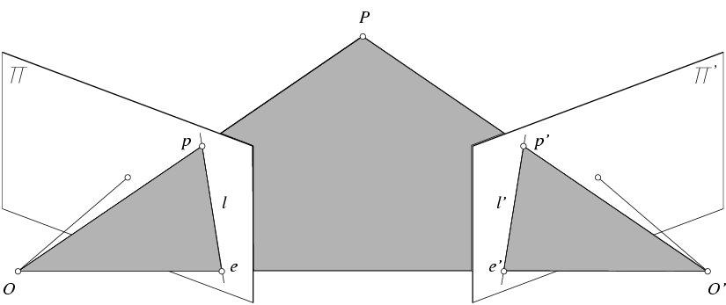
Epipolar geometry: notation
X
x
x’
Baseline – line connecting the two camera centers
Epipoles
= intersections of baseline with image planes
= projections of the other camera center
Epipolar Plane – plane containing baseline (1D family)

Slide 17
Epipolar geometry: notation
X
x
x’
Baseline – line connecting the two camera centers
Epipoles
= intersections of baseline with image planes
= projections of the other camera center
Epipolar Plane – plane containing baseline (1D family)
Epipolar Lines - intersections of epipolar plane with image
planes (always come in corresponding pairs)

Slide 18
Think Pair Share
= camera center
Where are the epipoles?
What do the epipolar lines look like?
X
X
a)
b)
X
X
c)
d)

Slide 19
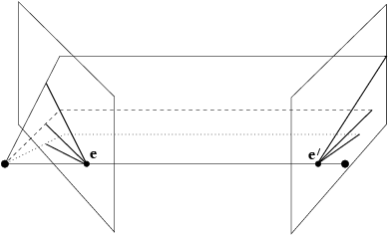
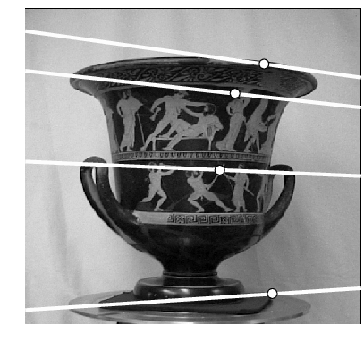
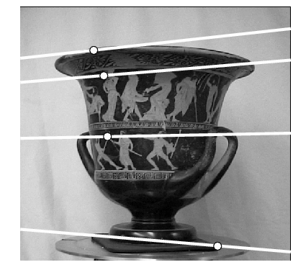
Example: Converging cameras

Slide 20
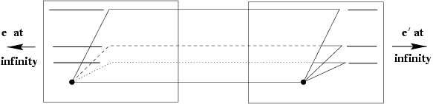
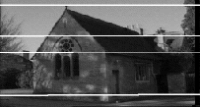
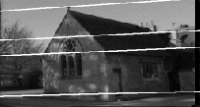
Example: Motion parallel to image plane

Slide 21
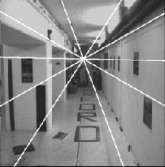
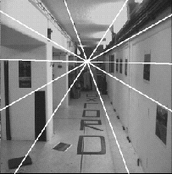
Example: Forward motion
e’
e
Epipole has same coordinates in both images.
Points move along lines radiating from e: “Focus of expansion”

Slide 22
What is this useful for?
X
x
x’
Find X: If I know x, and have calibrated cameras (known intrinsics K,K’ and extrinsic relationship), I can restrict x’ to be along l’.
Discover disparity for stereo.

Slide 23
What is this useful for?
X
x
x’
Given candidate x, x’ correspondences, estimate relative position and orientation between the cameras and the 3D position of corresponding image points.

Slide 24
What is this useful for?
X
x
x’
Model fitting: see if candidate x, x’ correspondences fit estimated projection models of cameras 1 and 2.

Slide 25
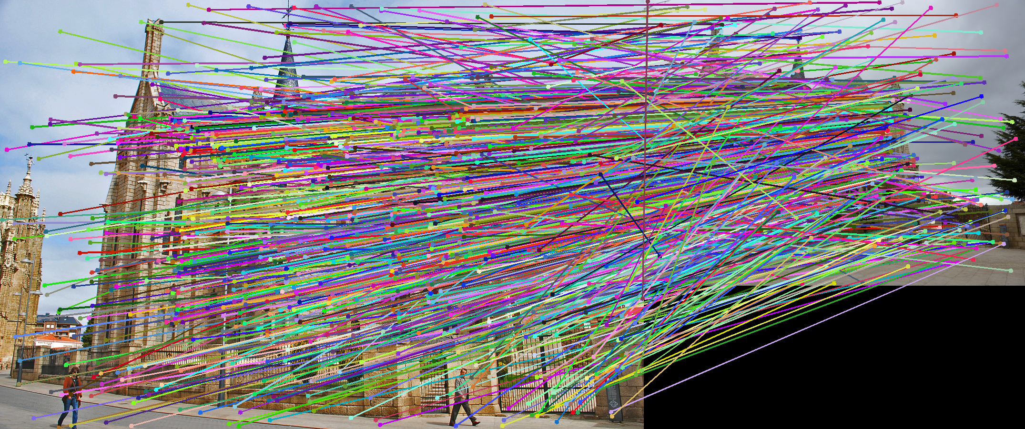
VLFeat’s 800 most confident matches among 10,000+ local features.

Slide 26
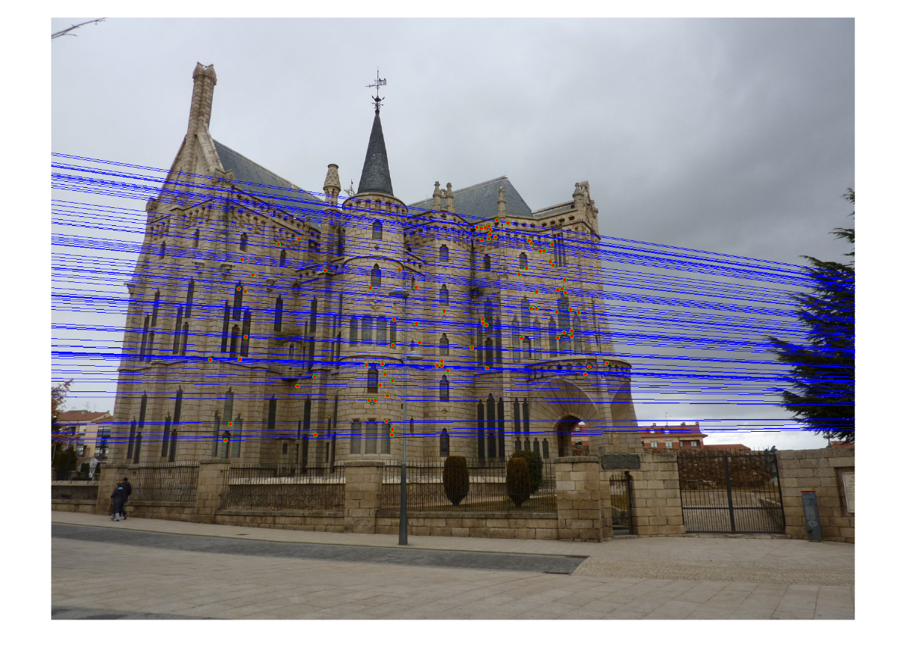
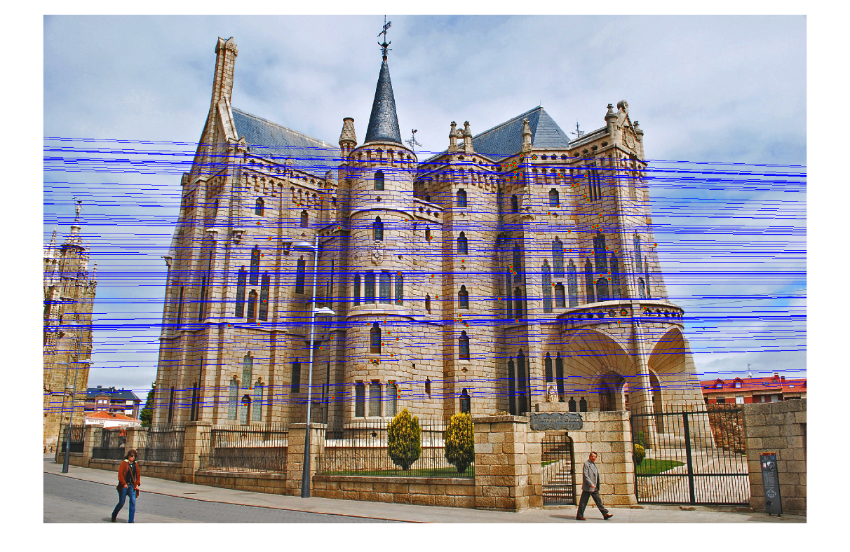
Epipolar lines

Slide 27
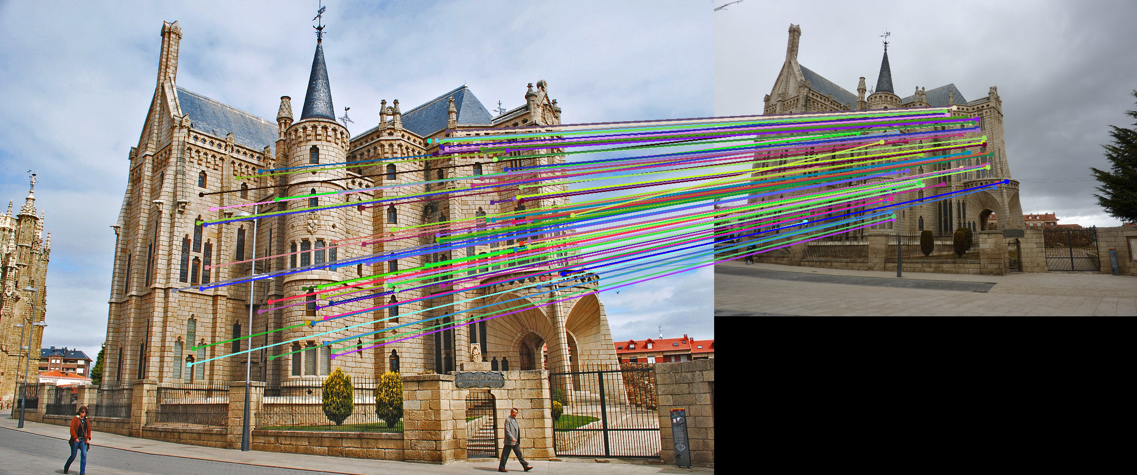
Keep only the matches at are “inliers” with respect to the “best” fundamental matrix

Slide 28

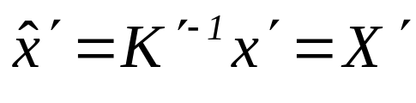
Epipolar constraint: Calibrated case
X
x
x’
Given the intrinsic parameters of the cameras:
  Convert to normalized coordinates by pre-multiplying all points with the inverse of the calibration matrix; set first camera’s coordinate system to world coordinates
3D scene point
Homogeneous 2d point (3D ray towards X)
2D pixel coordinate (homogeneous)
3D scene point in 2nd camera’s 3D coordinates

Slide 29


Epipolar constraint: Calibrated case
X
x
x’
Given the intrinsic parameters of the cameras:
  Convert to normalized coordinates by pre-multiplying all points with the inverse of the calibration matrix; set first camera’s coordinate system to world coordinates
  Define some R and t that relate X to X’ as below
for some scale factor

Slide 30
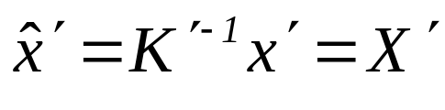




Epipolar constraint: Calibrated case
X
x
x’
$$\hat{x}$$
$${\hat{x}}^{′}$$
(because $\hat{x}, R{\hat{x}}^{′},$ and $t$ are co-planar)
Notes:
X’ is X in the second camera’s coordinate system
We can identify the non-homogeneous 3D vectors X and X’ with the homogeneous coordinate vectors x and x’ of the projections of the two points into the two respective images

Slide 31
Epipolar constraint: Calibrated case
X
x
x’
$$\hat{x}$$
$${\hat{x}}^{′}$$
3D scene point
Homogeneous 2d point (3D ray towards X)
2D pixel coordinate (homogeneous)
3D scene point in 2nd camera’s 3D coordinates
Notes:
X’ is X in the second camera’s coordinate system
We can identify the non-homogeneous 3D vectors X and X’ with the homogeneous coordinate vectors x and x’ of the projections of the two points into the two respective images

Slide 32

Epipolar constraint: Calibrated case
X
x
x’
$$\hat{x}$$
$${\hat{x}}^{′}$$
3D scene point
Homogeneous 2d point (3D ray towards X)
2D pixel coordinate (homogeneous)
3D scene point in 2nd camera’s 3D coordinates
(because $\hat{x}, R{\hat{x}}^{′},$ and $t$ are co-planar)
Notes:
X’ is X in the second camera’s coordinate system
We can identify the non-homogeneous 3D vectors X and X’ with the homogeneous coordinate vectors x and x’ of the projections of the two points into the two respective images

Slide 33

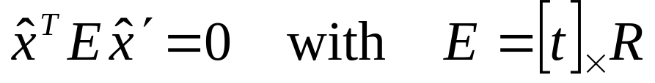
Essential matrix
X
x
x’
E is a 3x3 matrix which relates corresponding pairs of normalized homogeneous image points across pairs of images – for K calibrated cameras.
Estimates relative position/orientation.
Essential Matrix
(Longuet-Higgins, 1981)
Note: [t]× is matrix representation of cross product
Notes:
[t]_{x} is the skew symmetric matrix of t
Skew-symmetric matrix is a square matrix whose transpose is its negation, i.e., -A = A^T

Slide 34

Properties of the Essential matrix
X
x
x’
Drop ^ below to simplify notation
Skew-symmetric matrix
E x’ is the epipolar line associated with x’ (l = E x’)
E^{T}x is the epipolar line associated with x (l’ = E^{T}x)
E e’ = 0 and E^{T}e = 0
E is singular (rank two)
E has five degrees of freedom
  (3 for R, 2 for t because it’s up to a scale)

Slide 35
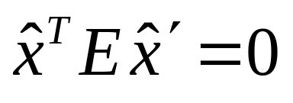
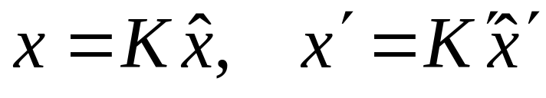
Epipolar constraint: Uncalibrated case
X
x
x’
If we don’t know K and K’, then we can write the epipolar constraint in terms of unknown normalized coordinates:

Slide 36
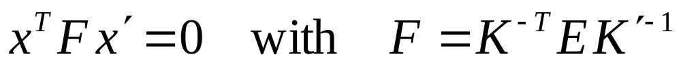

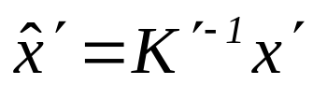
The Fundamental Matrix
Without knowing K and K’, we can define a similar relation using unknown normalized coordinates
Fundamental Matrix
(Faugeras and Luong, 1992)

Slide 37
Properties of the Fundamental matrix
X
x
x’
F x’ = 0 is the epipolar line l associated with x’
F^{T}x = 0 is the epipolar line l’ associated with x
F is singular (rank two): det(F)=0
F e’ = 0 and F^{T}e = 0 (nullspaces of F = e’; nullspace of F^{T} = e’)
F has seven degrees of freedom: 9 entries but defined up to scale, det(F)=0

Slide 38
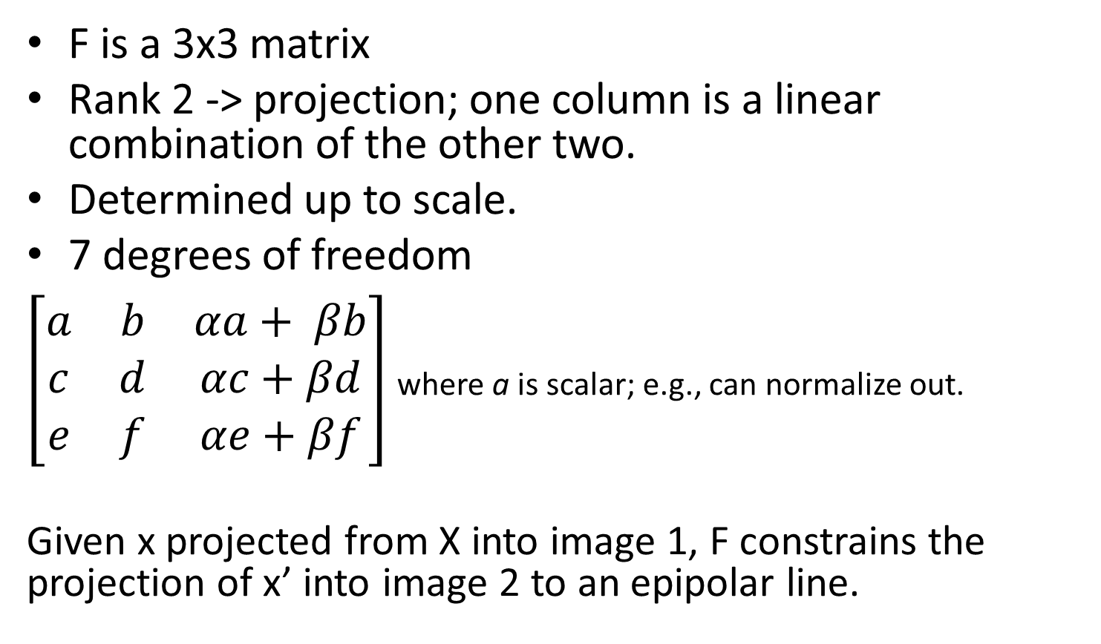
F in more detail
F is a 3x3 matrix
Rank 2 -> projection; one column is a linear combination of the other two.
Determined up to scale.
7 degrees of freedom
$\left[\begin{matrix}a & b & αa+ βb \\ c & d & αc+βd \\ e & f & αe+βf\end{matrix}\right]$ where a is scalar; e.g., can normalize out.
Given x projected from X into image 1, F constrains the projection of x’ into image 2 to an epipolar line.

Slide 39
Estimating the Fundamental Matrix
8-point algorithm
  Least squares solution using SVD on equations from 8 pairs of correspondences
  Enforce det(F)=0 constraint using SVD on F
Note: estimation of F (or E) is degenerate for a planar scene.

Slide 40
Estimating the Fundamental Matrix
8-point algorithm
  Least squares solution using SVD on equations from 8 pairs of correspondences
  Enforce det(F)=0 constraint using SVD on F
7-point algorithm
  Use least squares to solve for null space (two vectors) using SVD and 7 pairs of correspondences
  Solve for linear combination of null space vectors that satisfies det(F)=0
Minimize reprojection error
  Non-linear least squares
Note: estimation of F (or E) is degenerate for a planar scene.

Slide 41
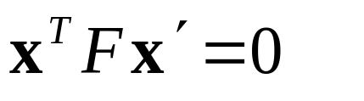
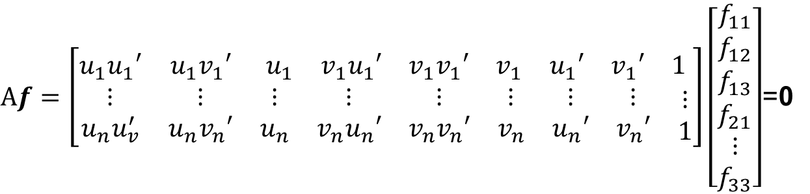
8-point algorithm
Solve a system of homogeneous linear equations
  Write down the system of equations
$$uu^{′}f_{11}+uv^{′}f_{12}+uf_{13}+vu^{′}f_{21}+vv^{′}f_{22}+vf_{23}+u^{′}f_{31}+v^{′}f_{32}+f_{33}=0$$
$Af=\left[\begin{matrix}u_{1}u_{1}′ & u_{1}v_{1}′ & \begin{matrix}u_{1} & v_{1}u_{1}′ & \begin{matrix}v_{1}v_{1}′ & v_{1} & \begin{matrix}u_{1}′ & v_{1}′ & 1\end{matrix}\end{matrix}\end{matrix} \\ \begin{matrix}⋮ \\ u_{n}u_{v}^{′}\end{matrix} & \begin{matrix}⋮ \\ u_{n}v_{n}′\end{matrix} & \begin{matrix}\begin{matrix}⋮ \\ u_{n}\end{matrix} & \begin{matrix}⋮ \\ v_{n}u_{n}′\end{matrix} & \begin{matrix}\begin{matrix}⋮ \\ v_{n}v_{n}′\end{matrix} & \begin{matrix}⋮ \\ v_{n}\end{matrix} & \begin{matrix}\begin{matrix}⋮ \\ u_{n}′\end{matrix} & \begin{matrix}⋮ \\ v_{n}′\end{matrix} & \begin{matrix}⋮ \\ 1\end{matrix}\end{matrix}\end{matrix}\end{matrix}\end{matrix}\right]\left[\begin{matrix}f_{11} \\ f_{12} \\ \begin{aligned}f_{13} \\ f_{21} \\ ⋮ \\ f_{33}\end{aligned}\end{matrix}\right]$=0

Slide 42
8-point algorithm
Solve a system of homogeneous linear equations
  Write down the system of equations
  Solve f from Af=0 using SVD
Matlab:
[U, S, V] = svd(A);
f = V(:, end);
F = reshape(f, [3 3])’;

Slide 43
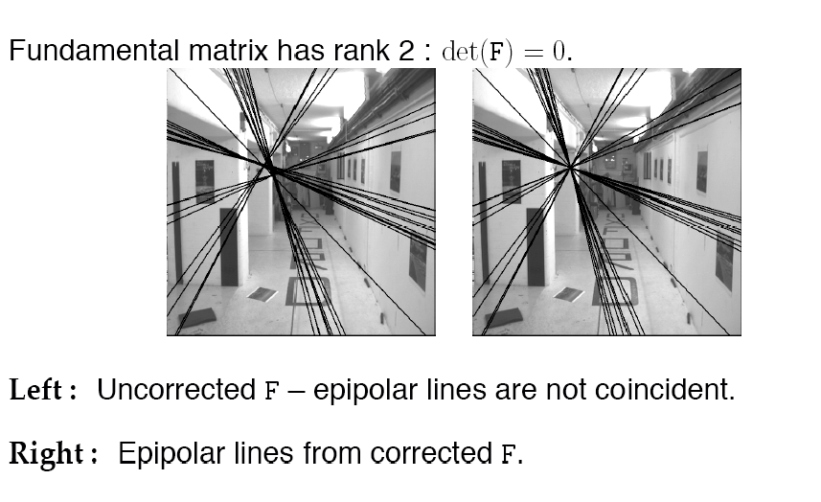
Need to enforce singularity constraint

Slide 44
8-point algorithm
Solve a system of homogeneous linear equations
  Write down the system of equations
  Solve f from Af=0 using SVD
Resolve det(F) = 0 constraint using SVD
Matlab:
[U, S, V] = svd(A);
f = V(:, end);
F = reshape(f, [3 3])’;
Matlab:
[U, S, V] = svd(F);
S(3,3) = 0;
F = U*S*V’;

Slide 45
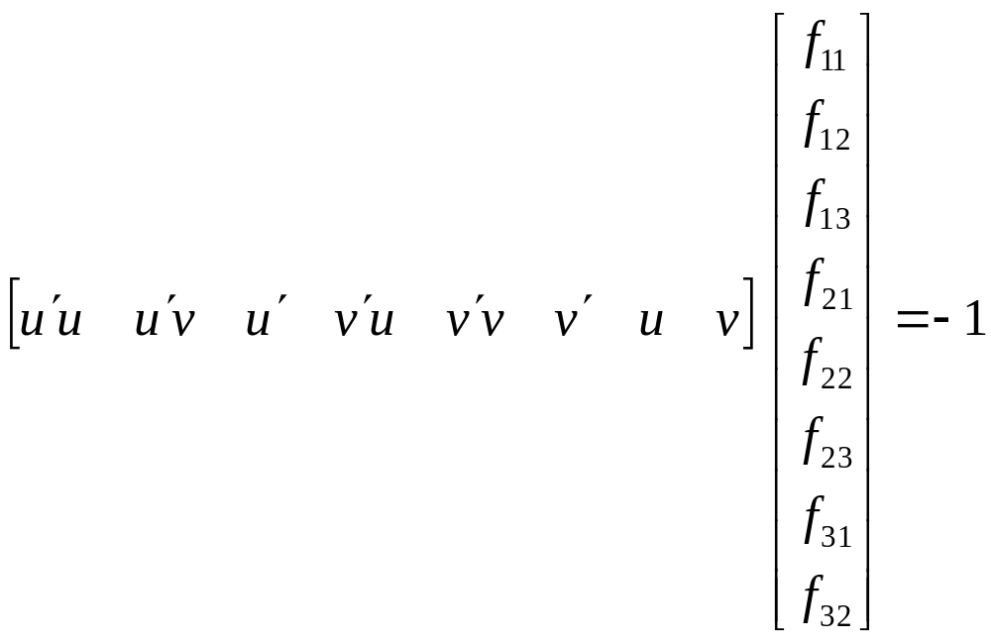
Problem with eight-point algorithm

Slide 46

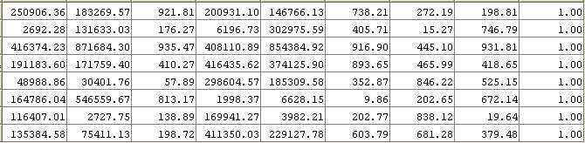
Problem with eight-point algorithm
Poor numerical conditioning
Can be fixed by rescaling the data

Slide 47
The normalized eight-point algorithm
(Hartley, 1995)
Center the image data at the origin, and scale it so the mean squared distance between the origin and the data points is 2 pixels
Use the eight-point algorithm to compute F from the normalized points
Enforce the rank-2 constraint (for example, take SVD of F and throw out the smallest singular value)
Transform fundamental matrix back to original units: if T and T’ are the normalizing transformations in the two images, than the fundamental matrix in original coordinates is T’^{T} F T

Slide 48
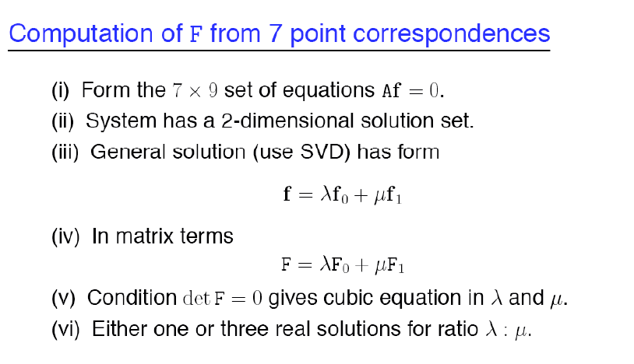
7-point algorithm
Faster (need fewer points) and could be more robust (fewer points), but also need to check for degenerate cases

Slide 49
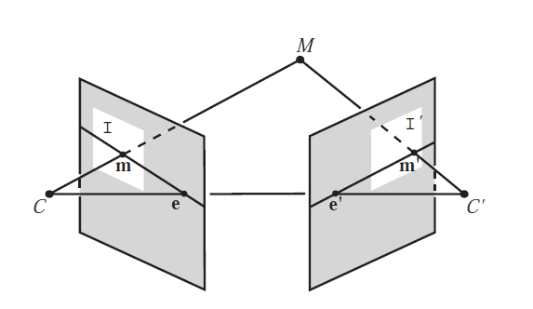
“Gold standard” algorithm
Use 8-point algorithm to get initial value of F
Use F to solve for P and P’ (discussed later)
Jointly solve for 3d points X and F that minimize the squared re-projection error
X
x
x'
See Algorithm 11.2 and Algorithm 11.3 in HZ (pages 284-285) for details

Slide 50
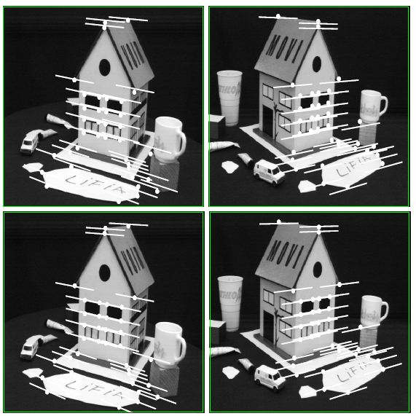
Comparison of estimation algorithms
 | 8-point | Normalized 8-point | Nonlinear least squares
Av. Dist. 1 | 2.33 pixels | 0.92 pixel | 0.86 pixel
Av. Dist. 2 | 2.18 pixels | 0.85 pixel | 0.80 pixel

Slide 51
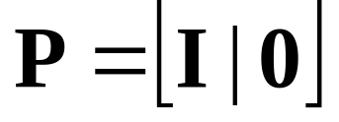
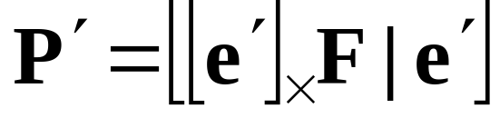
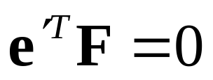
We can get projection matrices P and P’ up to a projective ambiguity
Code:
function P = vgg_P_from_F(F)
[U,S,V] = svd(F);
e = U(:,3);
P = [-vgg_contreps(e)*F e];
K’*rotation
K’*translation
See HZ p. 255-256
If we know the intrinsic matrices (K and K’), we can resolve the ambiguity

Slide 52
From epipolar geometry to camera calibration
If we know the calibration matrices of the two cameras, we can estimate the essential matrix: E = K^{T}FK’
The essential matrix gives us the relative rotation and translation between the cameras, or their extrinsic parameters.
Fundamental matrix lets us compute relationship up to scale for cameras with unknown intrinsic calibrations.
Estimating the fundamental matrix is a kind of “weak calibration”

Slide 53
Let’s recap…
Fundamental matrix song
http://danielwedge.com/fmatrix/

Slide 54
Among all my matches, how do I know which ones are good?

Slide 55
VLFeat’s 800 most confident matches among 10,000+ local features.

Slide 56
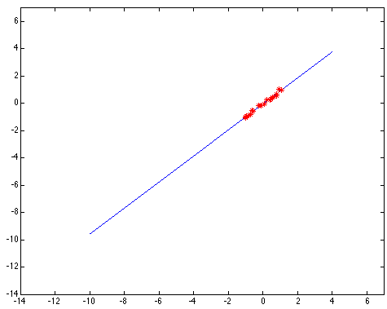
Least squares: Robustness to noise
Least squares fit to the red points:

Slide 57
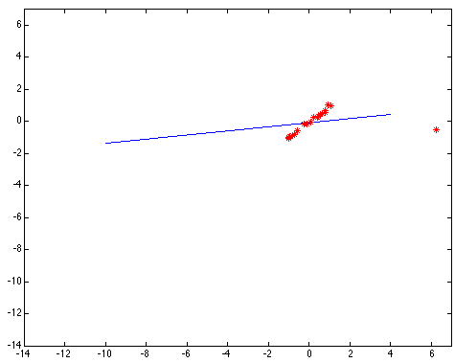
Least squares: Robustness to noise
Least squares fit with an outlier:
Problem: squared error heavily penalizes outliers

Slide 58
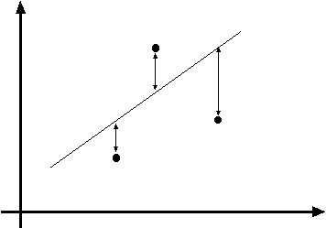
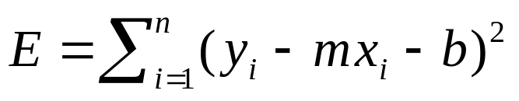
Least squares line fitting
Data: (x₁, y₁), …, (x_{n}, y_{n})
Line equation: y_{i} = m x_{i} + b
Find (m, b) to minimize
y=mx+b
(x_{i}, y_{i})
Matlab: p = A \ y;
(Closed form solution)
Modified from S. Lazebnik
Notes:
What is p here?

Slide 59
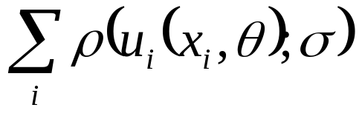



Robust least squares (to deal with outliers)
General approach:
minimize
u_{i} (x_{i}, θ) – residual of i^{th} point w.r.t. model parameters ϴ
ρ – robust function with scale parameter σ
The robust function ρ
Favors a configuration
with small residuals
Constant penalty for large residuals
Slide from S. Savarese

Slide 60

Choosing the scale: Just right
The effect of the outlier is minimized
Notes:
Fit to earlier data with an appropriate choice of s

Slide 61

Choosing the scale: Too small
The error value is almost the same for every
point and the fit is very poor

Slide 62

Choosing the scale: Too large
Behaves much the same as least squares

Slide 63
Robust estimation: Details
Robust fitting is a nonlinear optimization problem that must be solved iteratively
Scale of robust function should be chosen adaptively based on median residual
Least squares solution can be used for initialization

Slide 64
Fitting and Alignment: Methods
Global optimization / Search for parameters
  Least squares fit
  Robust least squares
  Iterative closest point (ICP)
Hypothesize and test
  Hough transform
  RANSAC

Slide 65





RANSAC
(RANdom SAmple Consensus) :
Learning technique to estimate
parameters of a model by random
sampling of observed data
Fischler & Bolles in ‘81.
Model parameters
such that:
Source: Savarese
Notes:
Let me give you an intuition of what is going on. Suppose we have the standard line fitting problem in presence of outliers.
We can formulate this problem as follows: want to find the best partition of points in inlier set and outlier set such that…
The objective consists of adjusting the parameters of a model function so as to best fit a data set.
"best" is defined by a function f that needs to be minimized.
Such that the best parameter of fitting the line give rise to a residual error lower that delta
as when the sum, S, of squared residuals

Slide 66
VLFeat’s 800 most confident matches among 10,000+ local features.

Slide 67
RANSAC
_{(RANdom SAmple Consensus) :}
Fischler & Bolles in ‘81.
Notes:
Let me give you an intuition of what is going on. Suppose we have the standard line fitting problem in presence of outliers.
We can formulate this problem as follows: want to find the best partition of points in inlier set and outlier set such that…
The objective consists of adjusting the parameters of a model function so as to best fit a data set.
"best" is defined by a function f that needs to be minimized.
Such that the best parameter of fitting the line give rise to a residual error lower that delta
as when the sum, S, of squared residuals

Slide 68
RANSAC
_{(RANdom SAmple Consensus) :}
Fischler & Bolles in ‘81.
Notes:
Let me give you an intuition of what is going on. Suppose we have the standard line fitting problem in presence of outliers.
We can formulate this problem as follows: want to find the best partition of points in inlier set and outlier set such that…
The objective consists of adjusting the parameters of a model function so as to best fit a data set.
"best" is defined by a function f that needs to be minimized.
Such that the best parameter of fitting the line give rise to a residual error lower that delta
as when the sum, S, of squared residuals

Slide 69
RANSAC
_{(RANdom SAmple Consensus) :}
Fischler & Bolles in ‘81.
This data is noisy, but we expect a good fit to a known model.
Notes:
Let me give you an intuition of what is going on. Suppose we have the standard line fitting problem in presence of outliers.
We can formulate this problem as follows: want to find the best partition of points in inlier set and outlier set such that…
The objective consists of adjusting the parameters of a model function so as to best fit a data set.
"best" is defined by a function f that needs to be minimized.
Such that the best parameter of fitting the line give rise to a residual error lower that delta
as when the sum, S, of squared residuals

Slide 70
RANSAC
_{(RANdom SAmple Consensus) :}
Fischler & Bolles in ‘81.
This data is noisy, but we expect a good fit to a known model.
Here, we expect to see a line, but least-squares fitting will produce the wrong result due to strong outlier presence.
Notes:
Let me give you an intuition of what is going on. Suppose we have the standard line fitting problem in presence of outliers.
We can formulate this problem as follows: want to find the best partition of points in inlier set and outlier set such that…
The objective consists of adjusting the parameters of a model function so as to best fit a data set.
"best" is defined by a function f that needs to be minimized.
Such that the best parameter of fitting the line give rise to a residual error lower that delta
as when the sum, S, of squared residuals

Slide 71
RANSAC
_{(RANdom SAmple Consensus) :}
Fischler & Bolles in ‘81.
Algorithm:
Sample (randomly) the number of points s required to fit the model
Solve for model parameters using samples
Score by the fraction of inliers within a preset threshold of the model
Repeat 1-3 until the best model is found with high confidence
Notes:
Let me give you an intuition of what is going on. Suppose we have the standard line fitting problem in presence of outliers.
We can formulate this problem as follows: want to find the best partition of points in inlier set and outlier set such that…
The objective consists of adjusting the parameters of a model function so as to best fit a data set.
"best" is defined by a function f that needs to be minimized.
Such that the best parameter of fitting the line give rise to a residual error lower that delta
as when the sum, S, of squared residuals

Slide 72
RANSAC
Line fitting example
Algorithm:
Sample (randomly) the number of points required to fit the model (s=2)
Solve for model parameters using samples
Score by the fraction of inliers within a preset threshold of the model
Repeat 1-3 until the best model is found with high confidence
Illustration by Savarese
Notes:
Let me give you an intuition of what is going on. Suppose we have the standard line fitting problem in presence of outliers.
We can formulate this problem as follows: want to find the best partition of points in inlier set and outlier set such that…
The objective consists of adjusting the parameters of a model function so as to best fit a data set.
"best" is defined by a function f that needs to be minimized.
Such that the best parameter of fitting the line give rise to a residual error lower that delta
as when the sum, S, of squared residuals

Slide 73
RANSAC
Line fitting example
Algorithm:
Sample (randomly) the number of points required to fit the model (s=2)
Solve for model parameters using samples
Score by the fraction of inliers within a preset threshold of the model
Repeat 1-3 until the best model is found with high confidence
Notes:
Let me give you an intuition of what is going on. Suppose we have the standard line fitting problem in presence of outliers.
We can formulate this problem as follows: want to find the best partition of points in inlier set and outlier set such that…
The objective consists of adjusting the parameters of a model function so as to best fit a data set.
"best" is defined by a function f that needs to be minimized.
Such that the best parameter of fitting the line give rise to a residual error lower that delta
as when the sum, S, of squared residuals

Slide 74

RANSAC
Line fitting example
Algorithm:
Sample (randomly) the number of points required to fit the model (s=2)
Solve for model parameters using samples
Score by the fraction of inliers within a preset threshold of the model
Repeat 1-3 until the best model is found with high confidence
Notes:
Let me give you an intuition of what is going on. Suppose we have the standard line fitting problem in presence of outliers.
We can formulate this problem as follows: want to find the best partition of points in inlier set and outlier set such that…
The objective consists of adjusting the parameters of a model function so as to best fit a data set.
"best" is defined by a function f that needs to be minimized.
Such that the best parameter of fitting the line give rise to a residual error lower that delta
as when the sum, S, of squared residuals

Slide 75

RANSAC
Algorithm:
Sample (randomly) the number of points required to fit the model (s=2)
Solve for model parameters using samples
Score by the fraction of inliers within a preset threshold of the model
Repeat 1-3 until the best model is found with high confidence
Notes:
Let me give you an intuition of what is going on. Suppose we have the standard line fitting problem in presence of outliers.
We can formulate this problem as follows: want to find the best partition of points in inlier set and outlier set such that…
The objective consists of adjusting the parameters of a model function so as to best fit a data set.
"best" is defined by a function f that needs to be minimized.
Such that the best parameter of fitting the line give rise to a residual error lower that delta
as when the sum, S, of squared residuals

Slide 76

How to choose parameters?
Number of algorithm iterations N
  Choose N so that, with probability p, at least one random sample is free from outliers (e.g., p=0.99) (outlier ratio: e)
Number of sampled points s
  Minimum number needed to fit the model
Distance threshold δ
  Choose δ so that a good point with noise is likely (e.g., prob=0.95) within threshold
  Zero-mean Gaussian noise with std. dev. σ: t²=3.84σ²
 | Proportion of outliers e
s | 5% | 10% | 20% | 25% | 30% | 40% | 50%
2 | 2 | 3 | 5 | 6 | 7 | 11 | 17
3 | 3 | 4 | 7 | 9 | 11 | 19 | 35
4 | 3 | 5 | 9 | 13 | 17 | 34 | 72
5 | 4 | 6 | 12 | 17 | 26 | 57 | 146
6 | 4 | 7 | 16 | 24 | 37 | 97 | 293
7 | 4 | 8 | 20 | 33 | 54 | 163 | 588
8 | 5 | 9 | 26 | 44 | 78 | 272 | 1177
For p = 0.99
modified from M. Pollefeys
Notes:
Table intuition:
s is the number of model parameters
e is the number of outliers in the dataset (data which doesn’t fit model) – 5 to 50 %
Tells us how many iterations of RANSAC we need to run to have a 99% confidence that we will sample has zero outliers in the sampling for the model parameters.
https://en.wikipedia.org/wiki/Random_sample_consensus

Slide 77


Example: solving for translation
A₁
A₂
A₃
B₁
B₂
B₃
Given matched points in {A} and {B}, estimate the translation of the object

Slide 78
Example: solving for translation
A₁
A₅
B₄
A₂
A₃
(t_{x}, t_{y})
B₁
A₄
B₂
B₃
B₅
Problem: outliers
RANSAC solution
Sample a set of matching points (1 pair)
Solve for transformation parameters
Score parameters with number of inliers
Repeat steps 1-3 N times

Slide 79
VLFeat’s 800 most confident matches among 10,000+ local features.

Slide 80
Epipolar lines

Slide 81
Keep only the matches at are “inliers” with respect to the “best” fundamental matrix

Slide 82
RANSAC conclusions
Good
Robust to outliers
Applicable for large number of objective function parameters (than Hough transform)
Optimization parameters are easier to choose (than Hough transform)
Bad
Computational time grows quickly with fraction of outliers and number of parameters
Not good for getting multiple fits
Common applications
Estimating fundamental matrix (relating two views)
Computing a homography (e.g., image stitching)

