Slide 1
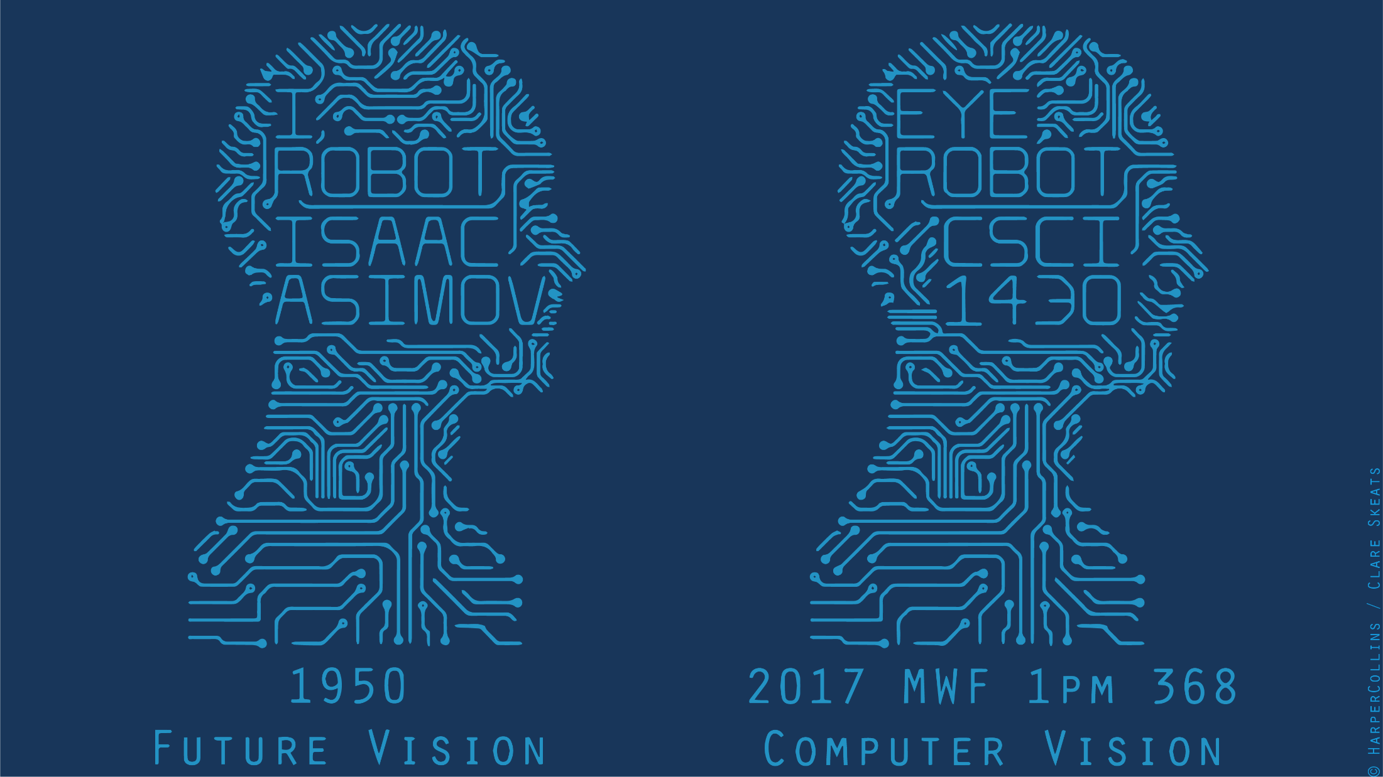

Slide 2
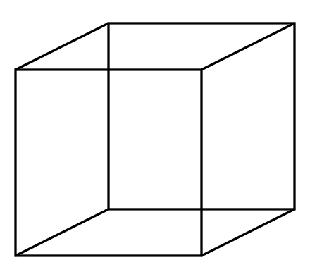
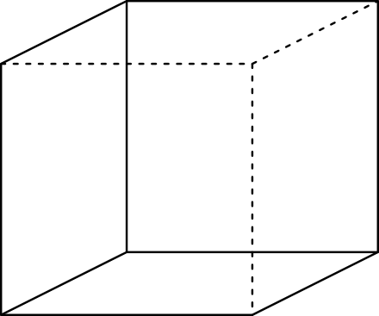
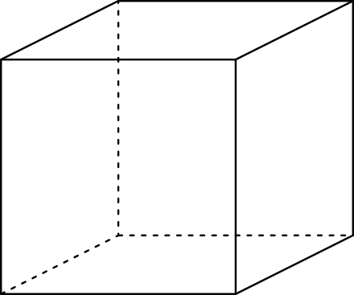
Multi-stable Perception
Necker Cube

Slide 3
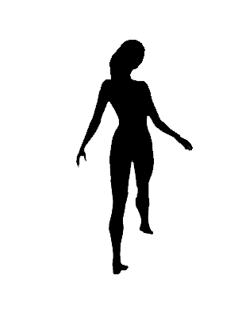
Spinning dancer illusion, Nobuyuki Kayahara

Slide 4
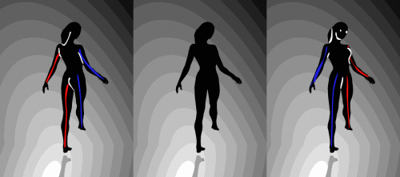

Slide 5
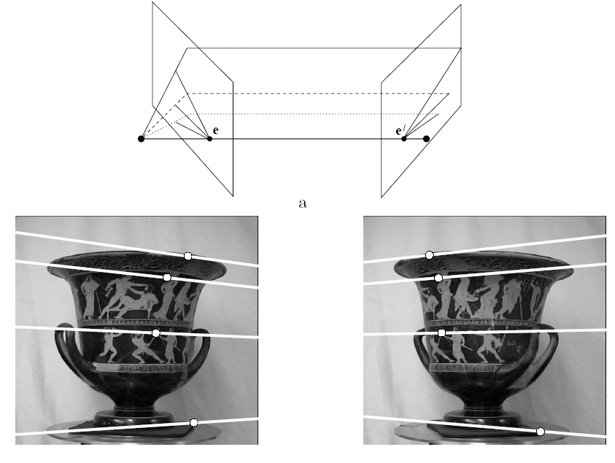
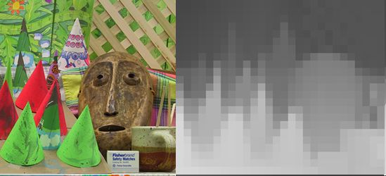
Multiple view geometry
Stereo vision
Epipolar geometry
Depth map extraction
Lowe
Hartley and Zisserman

Slide 6
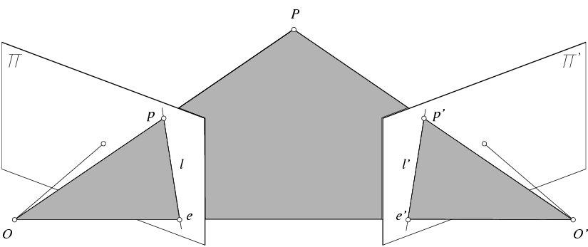

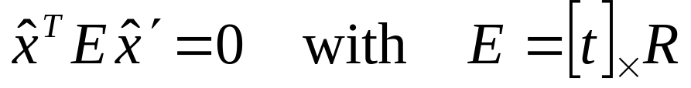
Essential matrix
X
x
x’
E is a 3x3 matrix which relates corresponding pairs of normalized homogeneous image points across pairs of images – for K calibrated cameras.
Estimates relative position/orientation.
Essential Matrix
(Longuet-Higgins, 1981)
Note: [t]× is matrix representation of cross product
Notes:
[t]_{x} is the skew symmetric matrix of t
Skew-symmetric matrix is a square matrix whose transpose is its negation, i.e., -A = A^T

Slide 7
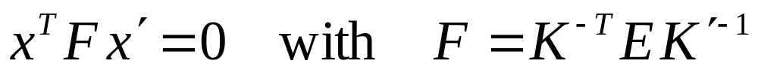
Fundamental matrix for uncalibrated cases
X
x
x’
F x’ = 0 is the epipolar line l associated with x’
F^{T}x = 0 is the epipolar line l’ associated with x
F is singular (rank two): det(F)=0
F e’ = 0 and F^{T}e = 0 (nullspaces of F = e’; nullspace of F^{T} = e’)
F has seven degrees of freedom: 9 entries but defined up to scale, det(F)=0

Slide 8
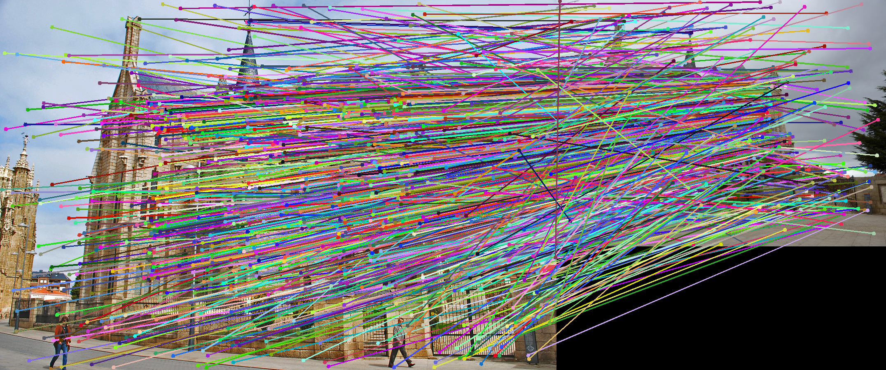
VLFeat’s 800 most confident matches among 10,000+ local features.

Slide 9

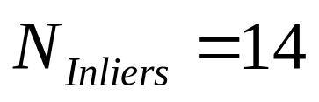
RANSAC
Algorithm:
Sample (randomly) the number of points required to fit the model (s=2)
Solve for model parameters using samples
Score by the fraction of inliers within a preset threshold of the model
Repeat 1-3 until the best model is found with high confidence
Notes:
Let me give you an intuition of what is going on. Suppose we have the standard line fitting problem in presence of outliers.
We can formulate this problem as follows: want to find the best partition of points in inlier set and outlier set such that…
The objective consists of adjusting the parameters of a model function so as to best fit a data set.
"best" is defined by a function f that needs to be minimized.
Such that the best parameter of fitting the line give rise to a residual error lower that delta
as when the sum, S, of squared residuals

Slide 10
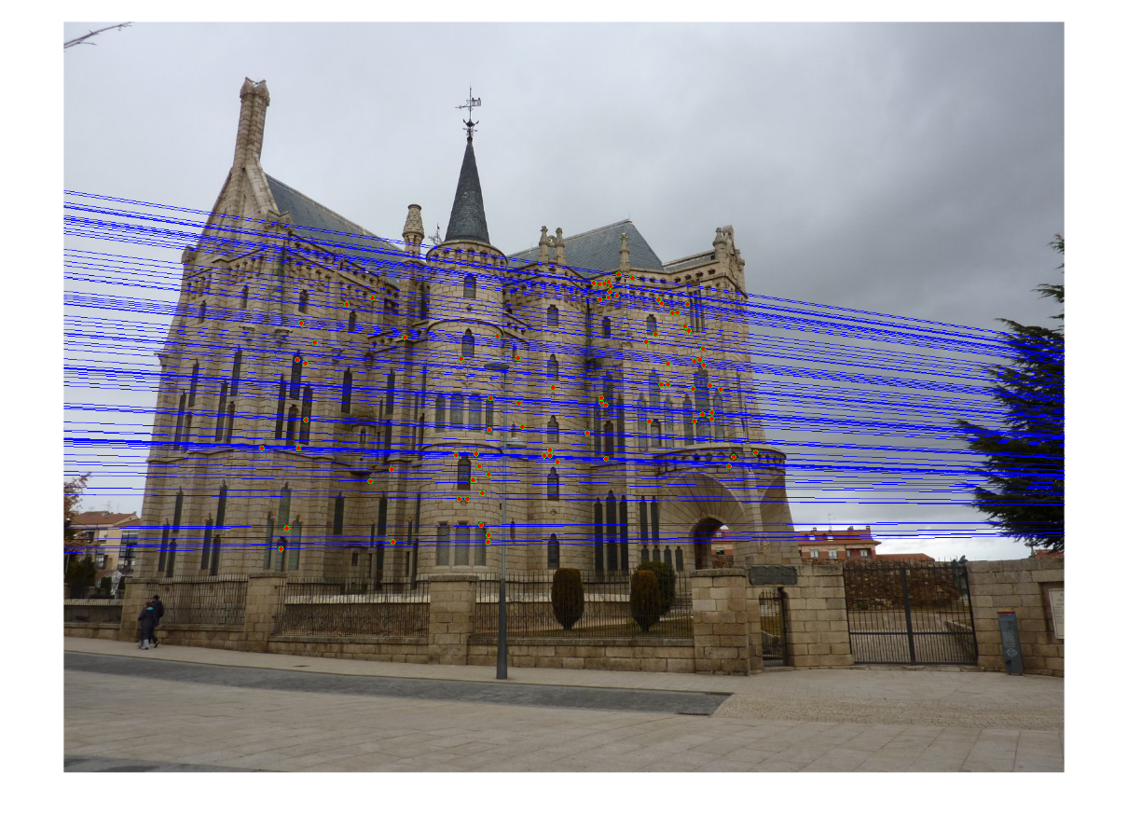
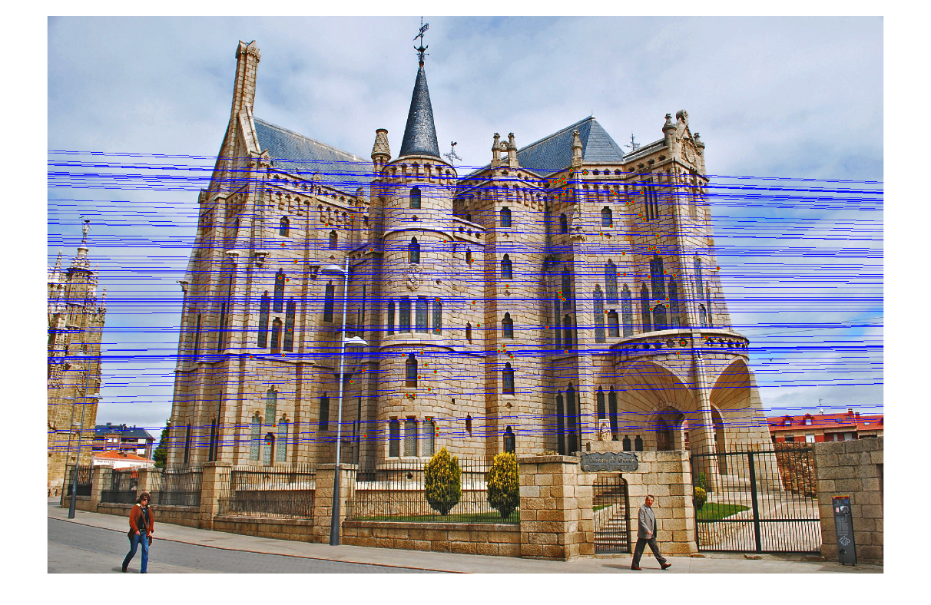
Epipolar lines

Slide 11
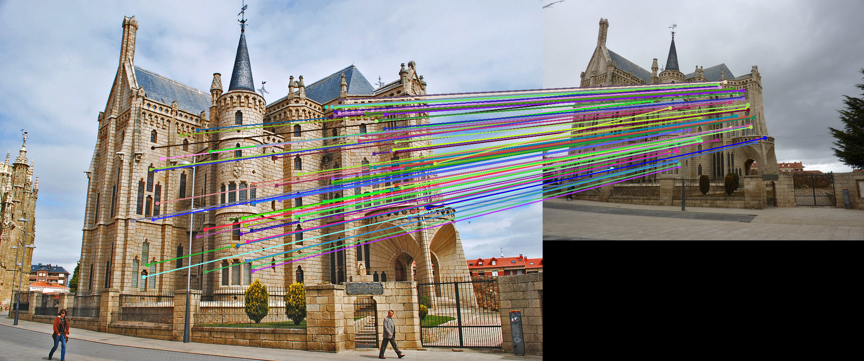
Keep only the matches at are “inliers” with respect to the “best” fundamental matrix

Slide 12
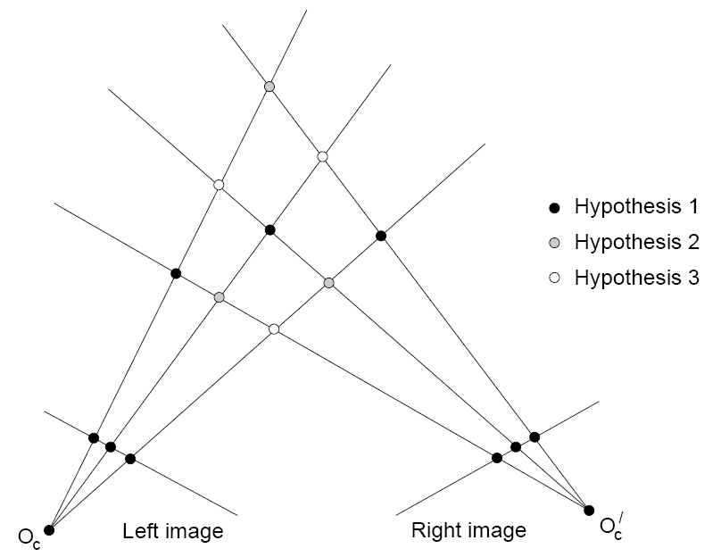
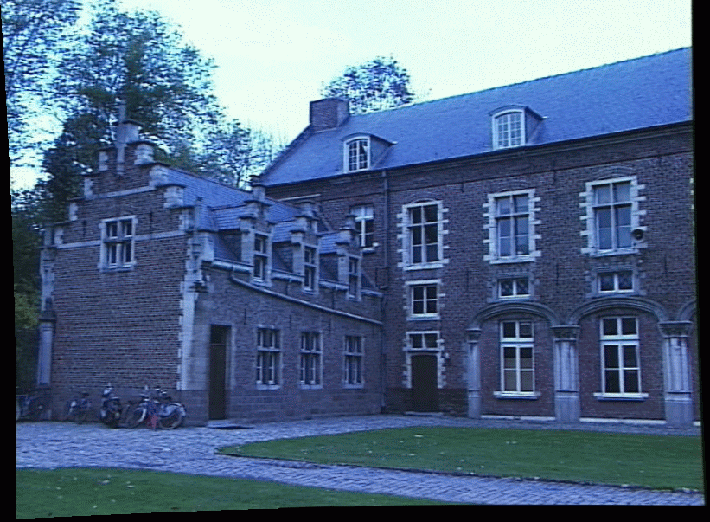
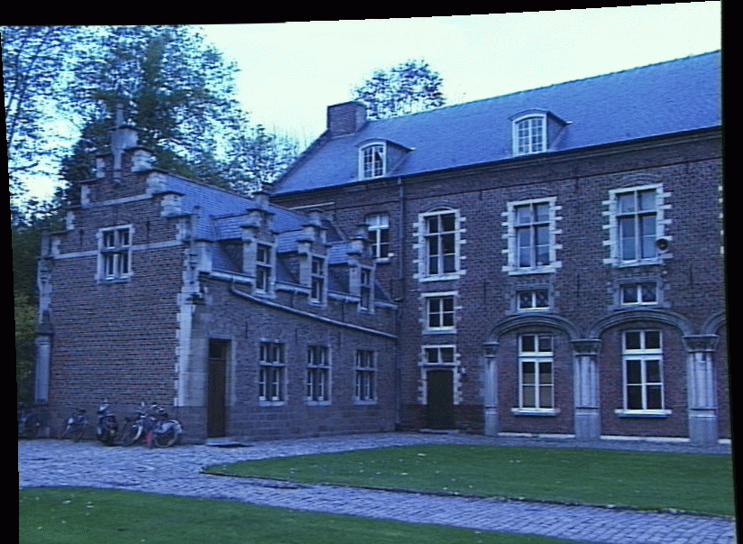
Dense correspondence problem
Multiple match hypotheses satisfy epipolar constraint, but which is correct?
Figure from Gee & Cipolla 1999

Slide 13
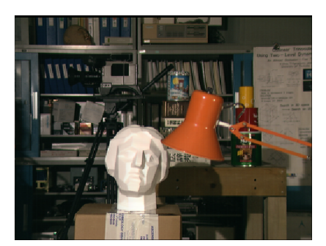


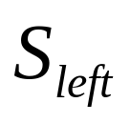
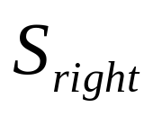
“Shortest paths” for scan-line stereo
Left image
Right image
Right occlusion
one-to-one
Right
occlusion
q
Left occlusion
t
Left occlusion
correspondence
s
p
  Can be implemented with dynamic programming
  Ohta & Kanade ’85, Cox et al. ’96, Intille & Bobick, ‘01
Slide credit: Y. Boykov

Slide 14
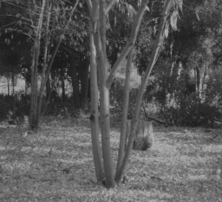
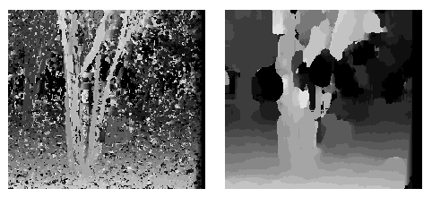
Effect of window size
W = 3
W = 20
Want window large enough to have sufficient intensity variation, yet small enough to contain only pixels with about the same disparity.
Figures from Li Zhang

Slide 15
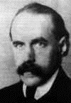
Motion and Gestalt laws of grouping
Gestalt psychology (Max Wertheimer, 1880-1943)
Notes:
Gestalt - means ‘shape, form’ in German
~1900 or so
“…Gestalt psychology is an attempt to understand the laws behind the ability to acquire and maintain meaningful perceptions in an apparently chaotic world…”
[Wikipedia]
Necker cube and dancing lady are examples of multistability – “the tendency of ambiguous perceptual experiences to pop back and forth unstably between two or more alternative interpretations”

Slide 16
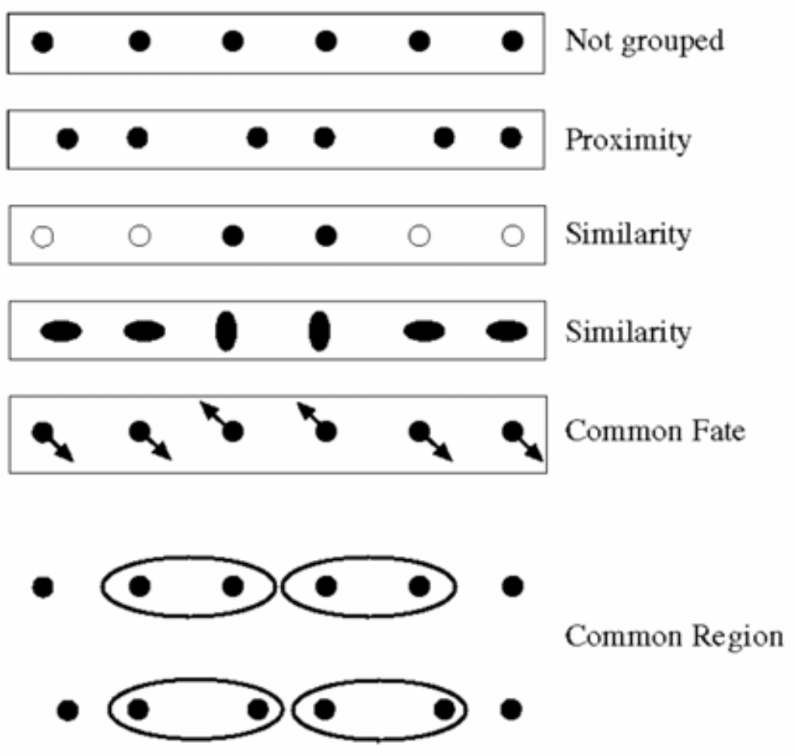
Motion and perceptual organization
Gestalt psychology (Max Wertheimer, 1880-1943)
…plus closure, continuation, ‘good form’

Slide 17
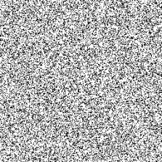
Motion and perceptual organization
Notes:
Now put another one. You probably don’t see anything special.

Slide 18
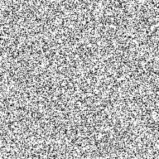
Motion and perceptual organization
Sometimes motion is the only cue…
Notes:
But put them in sequence…. And you see the moving square. The only indication of the square is the common motion.

Slide 19
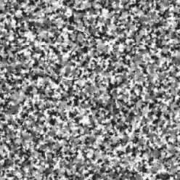
Motion and perceptual organization
http://www.youtube.com/watch?v=aEoxO_RdGhE
Notes:
Motion Stereopsis -> Binocular Depth-from-Motion

Slide 20
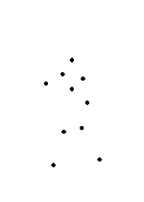
Motion and perceptual organization
Even “impoverished” motion data can evoke a strong percept

Slide 21
Motion and perceptual organization
Even “impoverished” motion data can evoke a strong percept

Slide 22
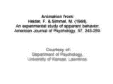
Motion and perceptual organization
Experimental study of apparent behavior.
Fritz Heider & Marianne Simmel. 1944

Slide 23
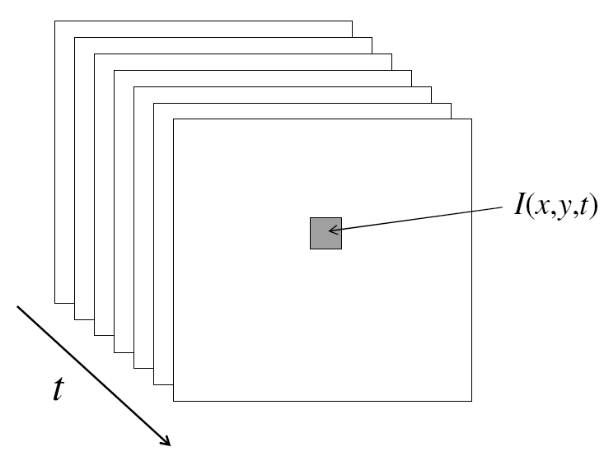
Video
A video is a sequence of frames captured over time
A ‘function’ of space (x, y) and time (t)

Slide 24
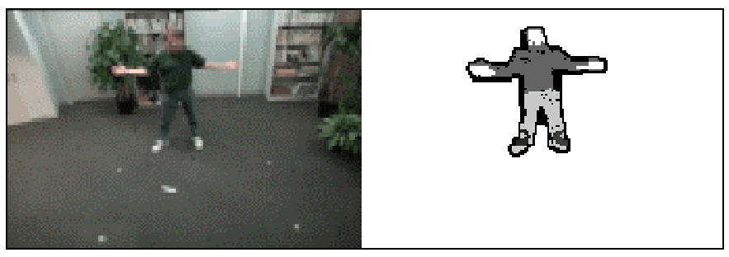
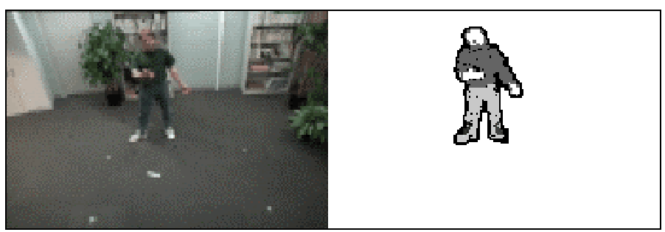
Motion Applications: Segmentation of video
Background subtraction
  A static camera is observing a scene
  Goal: separate the static background from the moving foreground

Slide 25
Applications of segmentation to video
Background subtraction
  Form an initial background estimate
  For each frame:
    Update estimate using a moving average
    Subtract the background estimate from the frame
    Label as foreground each pixel where the magnitude of the difference is greater than some threshold
    Use median filtering to “clean up” the results

Slide 26
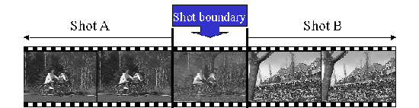
Motion Applications: Segmentation of video
Background subtraction
Shot boundary detection in edited video
  Edited video is usually composed of shots or sequences showing the same objects or scene
  Goal: segment video into shots for summarization and browsing (each shot can be represented by a single keyframe in a user interface)
  Difference from background subtraction: the camera is not necessarily stationary

Slide 27
Applications of segmentation to video
Background subtraction
Shot boundary detection
  For each frame
    Compute the distance between the current frame and the previous one
      Pixel-by-pixel differences
      Differences of color histograms
      Block comparison
    If the distance is greater than some threshold, classify the frame as a shot boundary

Slide 28
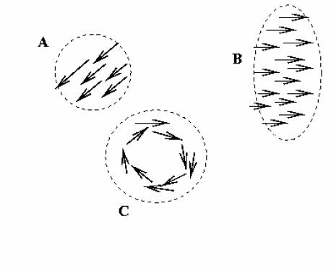
Motion Applications: Segmentation of video
Background subtraction
Shot boundary detection
Motion segmentation
  Segment the video into multiple coherently moving objects

Slide 29
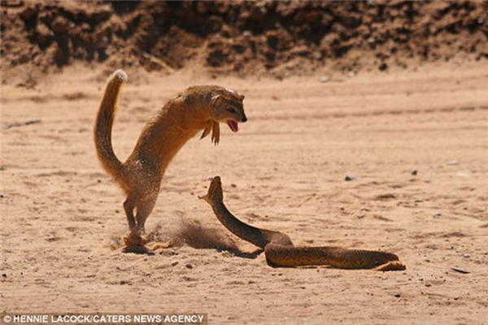
Motion Applications
Background subtraction
Shot boundary detection
Motion segmentation
  Segment the video into multiple coherently moving objects

Slide 30
More applications of motion
Segmentation of objects in space or time
Estimating 3D structure
Learning dynamical models – how things move
Recognizing events and activities
Improving video quality (motion stabilization)

Slide 31
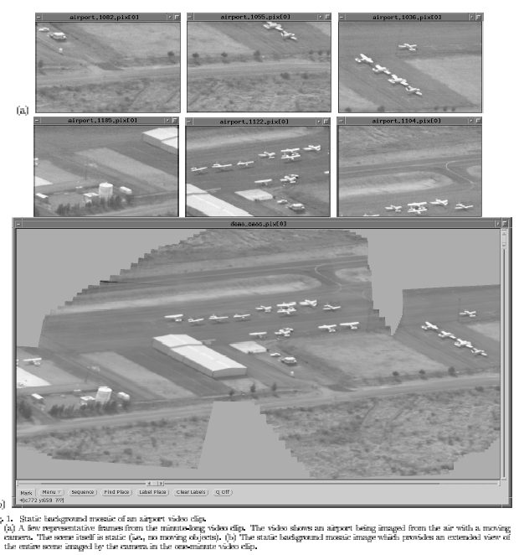
Mosaicing
(Michal Irani, Weizmann)

Slide 32
Mosaicing
(Michal Irani, Weizmann)

Slide 33
Mosaicing for Panoramas on Smartphones
Left to right sweep of video camera
Frame t
t+1
t+3
t+5
Compare small overlap for efficiency

Slide 34
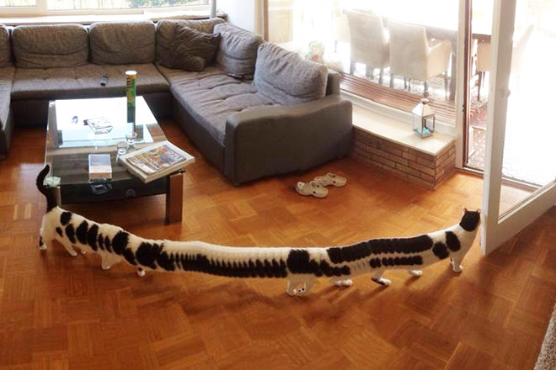
Mosaicing for Panoramas on Smartphones
Notes:
http://www.sadanduseless.com/2017/07/panorama/#uOiuM7ycKM5IX73x.01

Slide 35
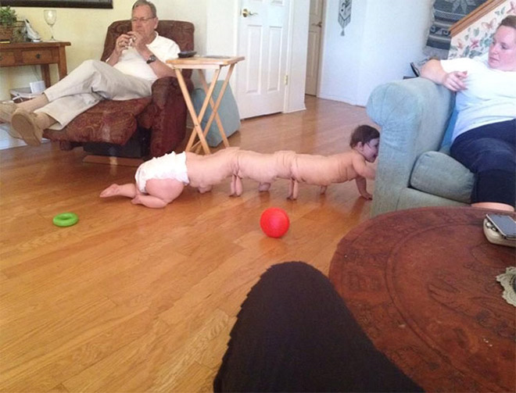
Mosaicing for Panoramas on Smartphones
Notes:
http://www.sadanduseless.com/2017/07/panorama/#uOiuM7ycKM5IX73x.01

Slide 36

Mosaicing for Panoramas on Smartphones
Notes:
http://www.sadanduseless.com/2017/07/panorama/#uOiuM7ycKM5IX73x.01
Unwrap Mosaics (!!) Fitzgibbon et al.

Slide 37
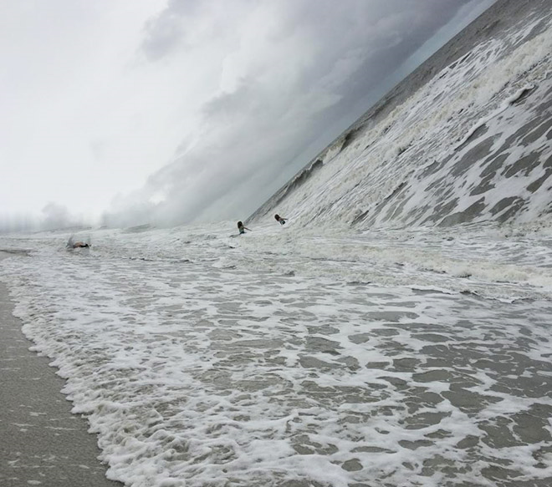
Mosaicing for Panoramas on Smartphones
Notes:
http://www.sadanduseless.com/2017/07/panorama/#uOiuM7ycKM5IX73x.01

Slide 38
Star Trek ‘shakycam;

Slide 39
Motion estimation techniques
Feature-based methods
  Extract visual features (corners, textured areas) and track them over multiple frames
  Sparse motion fields, but more robust tracking
  Suitable when image motion is large (10s of pixels)
Direct, dense methods
  Directly recover image motion at each pixel from spatio-temporal image brightness variations
  Dense motion fields, but sensitive to appearance variations
  Suitable for video and when image motion is small
    Optical flow!

Slide 40
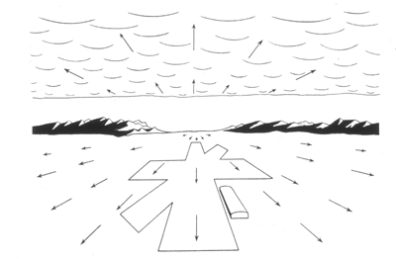
Computer Vision
Motion and Optical Flow
Many slides adapted from J. Hays, S. Seitz, R. Szeliski, M. Pollefeys, K. Grauman and others…
Notes:
Why do we see a runway here?
J.J. Gibson, 1960s? – Navy researcher who investigated how to help pilots land on runways and aircraft carriers. Noted that there was a point in the visual field from which all motion seemed to emanate. Named this point the ‘focus of expansion’, and named the visual field ‘optic flow’.

Slide 41
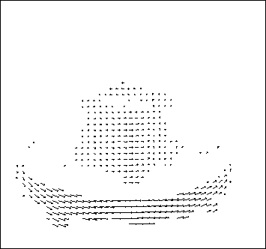
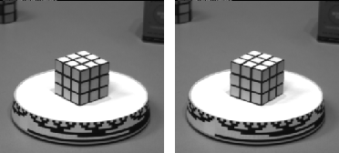
Motion estimation: Optical flow
Optic flow is the apparent motion of objects or surfaces
Will start by estimating motion of each pixel separately
Then will consider motion of entire image

Slide 42


Problem definition: optical flow
How to estimate pixel motion from image I(x,y,t) to I(x,y,t+1) ?
Solve pixel correspondence problem
  Given a pixel in I(x,y,t), look for nearby pixels of the same color in I(x,y,t+1)
Key assumptions
  Small motion: Points do not move very far
  Color constancy: A point in I(x,y,t) looks the same in I(x,y,t+1)
    For grayscale images, this is brightness constancy

Slide 43



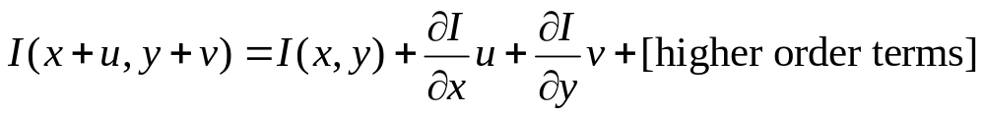
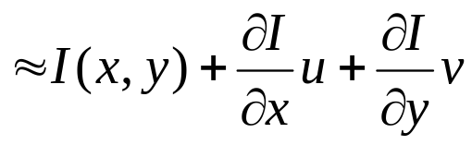
Optical flow constraints (grayscale images)
Let’s look at these constraints more closely
  Brightness constancy constraint (equation)
  Small motion: (u and v are less than 1 pixel, or smoothly varying) Taylor series expansion of I:
Notes:
A: H(x,y) = I(x+u, y+v)

Slide 44
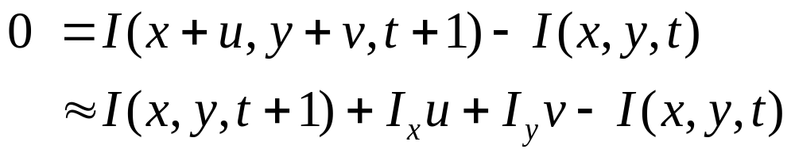
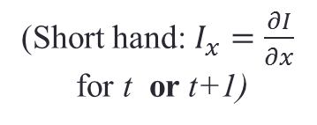
Optical flow equation
Combining these two equations
(Short hand: $I_{x}=\frac{∂I}{∂x}$
for t or t+1)

Slide 45
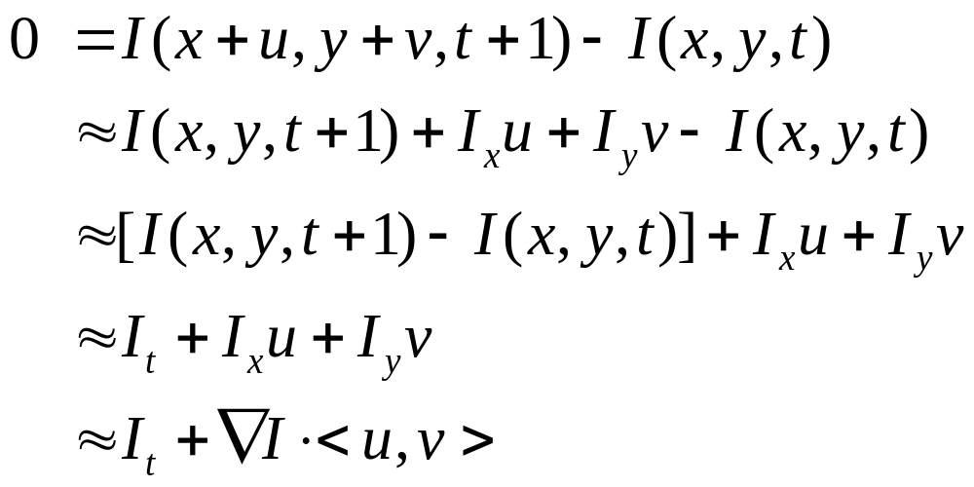
Optical flow equation
Combining these two equations
(Short hand: $I_{x}=\frac{∂I}{∂x}$
for t or t+1)

Slide 46
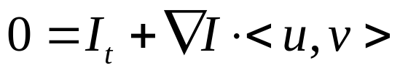

Optical flow equation
Combining these two equations
(Short hand: $I_{x}=\frac{∂I}{∂x}$
for t or t+1)
In the limit as u and v go to zero, this becomes exact
  Brightness constancy constraint equation

Slide 47


How does this make sense?
  Brightness constancy constraint equation
What do the static image gradients
have to do with motion estimation?

Slide 48


The brightness constancy constraint
Can we use this equation to recover image motion (u,v) at each pixel?
or
How many equations and unknowns per pixel?
  One equation (this is a scalar equation!), two unknowns (u,v)
The component of the motion perpendicular to the gradient (i.e., parallel to the edge) cannot be measured
  If (u, v) satisfies the equation,
  so does (u+u’, v+v’ ) if
gradient
(u,v)
(u’,v’)
(u+u’,v+v’)
edge
Notes:
A: u and v are unknown, 1 equation

Slide 49
Aperture problem

Slide 50
Aperture problem

Slide 51
Aperture problem

Slide 52
Apparently an aperture problem

Slide 53

The barber pole illusion
http://en.wikipedia.org/wiki/Barberpole_illusion

Slide 54


The barber pole illusion
http://en.wikipedia.org/wiki/Barberpole_illusion

Slide 55

Solving the ambiguity…
B. Lucas and T. Kanade. An iterative image registration technique with an application to stereo vision. In Proceedings of the International Joint Conference on Artificial Intelligence, pp. 674–679, 1981.
How to get more equations for a pixel?
Spatial coherence constraint
Assume the pixel’s neighbors have the same (u,v)
  If we use a 5x5 window, that gives us 25 equations per pixel

Slide 56




Solving the ambiguity…
Least squares problem:

Slide 57




Matching patches across images
Overconstrained linear system
Least squares solution for d given by
  The summations are over all pixels in the K x K window

Slide 58


Conditions for solvability
  Optimal (u, v) satisfies Lucas-Kanade equation
When is this solvable? What are good points to track?
  A^{T}A should be invertible
  A^{T}A should not be too small due to noise
    eigenvalues λ₁ and λ ₂ of A^{T}A should not be too small
  A^{T}A should be well-conditioned
    λ ₁/ λ ₂ should not be too large (λ ₁ = larger eigenvalue)
Does this remind you of anything?
Criteria for Harris corner detector
Notes:
http://en.wikipedia.org/wiki/Invertible_matrix

Slide 59




Low texture region
gradients have small magnitude
small λ₁, small λ₂
Notes:
Can’t estimate motion here…nothing you can see moving.

Slide 60



Edge
large gradients, all the same
large λ₁, small λ₂
Notes:
On an edge you can estimate motion perpendicular to the edge but not along it.

Slide 61



High textured region
gradients are different, large magnitudes
large λ₁, large λ₂
Notes:
But on nice textured regions motion is well estimated because the gradient varies over the window.

Slide 62
The aperture problem resolved
Actual motion

Slide 63
The aperture problem resolved
Perceived motion

Slide 64
Errors in assumptions
A point does not move like its neighbors
  Motion segmentation
Brightness constancy does not hold
  Do exhaustive neighborhood search with normalized correlation - tracking features – maybe SIFT – more later….
The motion is large (larger than a pixel)
  Not-linear: Iterative refinement
  Local minima: coarse-to-fine estimation

Slide 65
Not tangent: Iterative Refinement
Iterative Lukas-Kanade Algorithm
  Estimate velocity at each pixel by solving Lucas-Kanade equations
  Warp I_{t} towards I_{t+1} using the estimated flow field
    - use image warping techniques
  Repeat until convergence

Slide 66






Optical Flow: Iterative Estimation
estimate update
Initial guess:
Estimate:
x₀
x
(using d for displacement here instead of u)

Slide 67




Optical Flow: Iterative Estimation
estimate update
Initial guess:
Estimate:
x₀
x

Slide 68




Optical Flow: Iterative Estimation
estimate update
Initial guess:
Estimate:
Initial guess:
Estimate:
x₀
x

Slide 69


Optical Flow: Iterative Estimation
x₀
x

Slide 70
Optical Flow: Iterative Estimation
Some Implementation Issues:
  Warping is not easy (ensure that errors in warping are smaller than the estimate refinement) – but it is in MATLAB!
  Often useful to low-pass filter the images before motion estimation (for better derivative estimation, and linear approximations to image intensity)

Slide 71

Revisiting the small motion assumption
Is this motion small enough?
  Probably not—it’s much larger than one pixel
  How might we solve this problem?

Slide 72




Optical Flow: Aliasing
Temporal aliasing causes ambiguities in optical flow because images can have many pixels with the same intensity.
I.e., how do we know which ‘correspondence’ is correct?
actual shift
estimated shift
nearest match is correct (no aliasing)
nearest match is incorrect (aliasing)
To overcome aliasing: coarse-to-fine estimation.

Slide 73




Reduce the resolution!

Slide 74
Coarse-to-fine optical flow estimation
u=1.25 pixels
u=2.5 pixels
u=5 pixels
image 1
u=10 pixels
image 2
image 1
image 2
Gaussian pyramid of image 1
Gaussian pyramid of image 2

Slide 75
Coarse-to-fine optical flow estimation
run iterative L-K
warp & upsample
run iterative L-K
.
.
.
image J
image I
image 1
image 2
Gaussian pyramid of image 1
Gaussian pyramid of image 2

Slide 76

Optical Flow Results
* From Khurram Hassan-Shafique CAP5415 Computer Vision 2003

Slide 77

Optical Flow Results
* From Khurram Hassan-Shafique CAP5415 Computer Vision 2003

Slide 78


State-of-the-art optical flow, 2009
Start with something similar to Lucas-Kanade
+ gradient constancy
+ energy minimization with smoothing term
+ region matching
+ keypoint matching (long-range)
Region-based
+Pixel-based
+Keypoint-based
Large displacement optical flow, Brox et al., CVPR 2009

Slide 79

State-of-the-art optical flow, 2015
CNN
Pair of input frames
Upsample estimated flow back to input resolution
Near state-of-the-art in terms of end-point-error
Fischer et al. 2015. https://arxiv.org/abs/1504.06852
Notes:
Optical flow as supervised learning

Slide 80

State-of-the-art optical flow, 2015
Synthetic Training data
Fischer et al. 2015. https://arxiv.org/abs/1504.06852

Slide 81

State-of-the-art optical flow, 2015
Results on Sintel
Fischer et al. 2015. https://arxiv.org/abs/1504.06852

Slide 82
Optical flow
Definition: the apparent motion of brightness patterns in the image
Ideally, the same as the projected motion field
Take care: apparent motion can be caused by lighting changes without any actual motion
  Imagine a uniform rotating sphere under fixed lighting vs. a stationary sphere under moving illumination.

Slide 83
Can we do more? Scene flow
Combine spatial stereo & temporal constraints
Recover 3D vectors of world motion
Stereo view 1
Stereo view 2
t
y
x
t-1
z
3D world motion vector per pixel

Slide 84

Scene flow example for human motion
Estimating 3D Scene Flow from Multiple 2D Optical Flows, Ruttle et al., 2009

Slide 85

Scene Flow
https://www.youtube.com/watch?v=RL_TK_Be6_4
https://vision.in.tum.de/research/sceneflow
[Estimation of Dense Depth Maps and 3D Scene Flow from Stereo Sequences, M. Jaimez et al., TU Munchen]

