Slide 1
Beam Sampling for the Infinite Hidden Markov Model
Van Gael, et al. ICML 2008
Presented by Daniel Johnson

Slide 2
Introduction
Infinite Hidden Markov Model (iHMM) is nonparametric approach to the HMM
New inference algorithm for iHMM
Comparison with Gibbs sampling algorithm
Examples

Slide 3
Hidden Markov Model (HMM)
Markov Chain with finite state space 1,…,K
Hidden state sequence: s = (s₁, s₂, … , s_{T})
π_{ij} = p(s_{t} = j|s_{t-1} = i)
Observation sequence: y = (y₁, y₂, … , y_{T})
Parameters ϕ_{st} such that p(y_{t}|s_{t}) = F(ϕ_{st})
Known: y, π, ϕ, F
Unknown: s

Slide 4

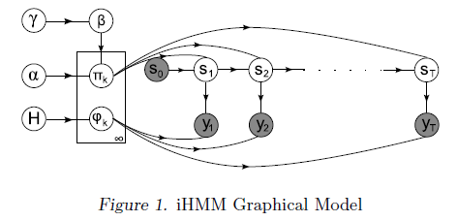
Infinite Hidden Markov Model (iHMM)
Known: y, F
Unknown: s, π, ϕ, K
Strategy: use BNP priors to deal with additional unknowns:

Slide 5
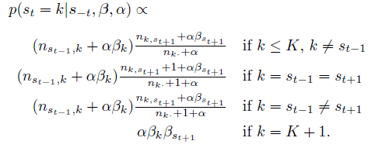
Gibbs Methods
Teh et al., 2006: marginalize out π, ϕ
Update prediction for each s_{t} individually
Computation of O(TK)
Non-conjugacy handled in standard Neal way
Drawback: potential slow mixing

Slide 6
Beam Sampler
Introduce auxiliary variable u
Conditioned on u, # possible trajectories finite
Use dynamic programming filtering algorithm
Avoid marginalizing out π, ϕ
Iteratively sample u, s, π, ϕ, β, α, γ

Slide 7
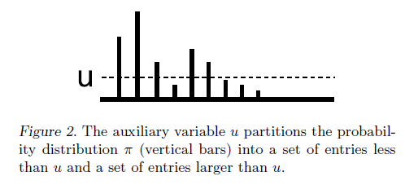
Auxiliary Variable u
Sample each u_{t} ~ Uniform(0, π_{st-1st})
u acts as a threshold on π
Only trajectories with π_{st-1st} ≥ u_{t} are possible

Slide 8
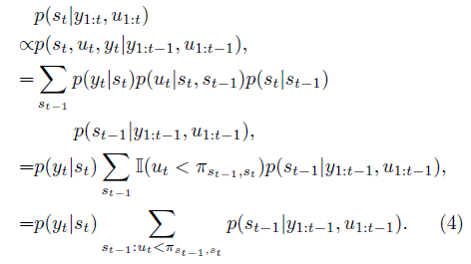
Forward-Backward Algorithm
Forwards: compute p(s_{t}|y_{1:t},u_{1:t)} from t = 1..T
Backward: compute p(s_{t}|s_{t+1},y_{1:T},u_{1:T}) and sample s_{t} from t = T..1

Slide 9
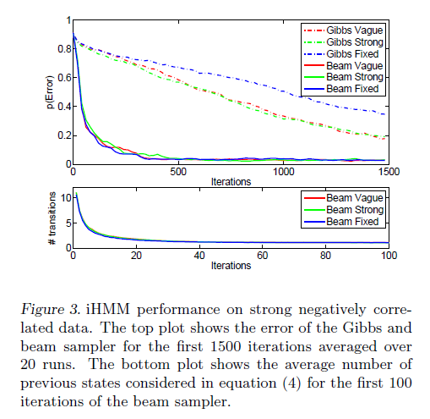
Non-Sticky Example

Slide 10
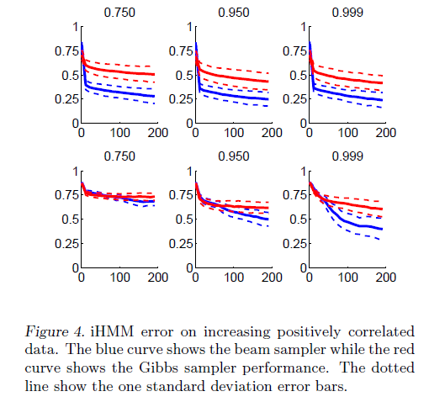
Sticky Example

Slide 11
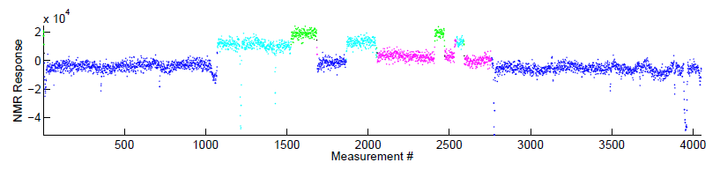
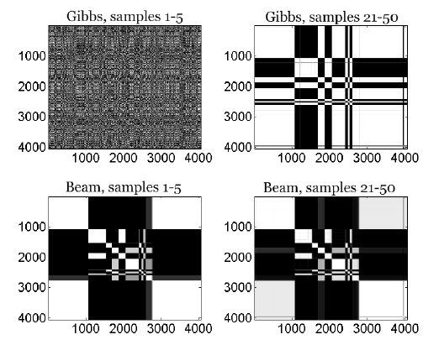
Example: Well Data

Slide 12
Issues/Conclusions
Beam sampler is elegant and fairly straight forward
Beam sampler allows for bigger steps in the MCMC state space than the Gibbs method
Computational cost similar to Gibbs method
Potential for poor mixing
Bookkeeping can be complicated

